Slide 1
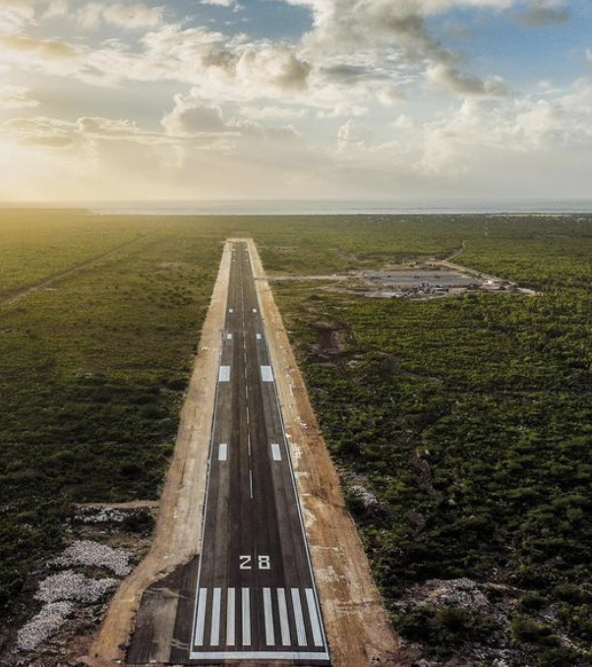
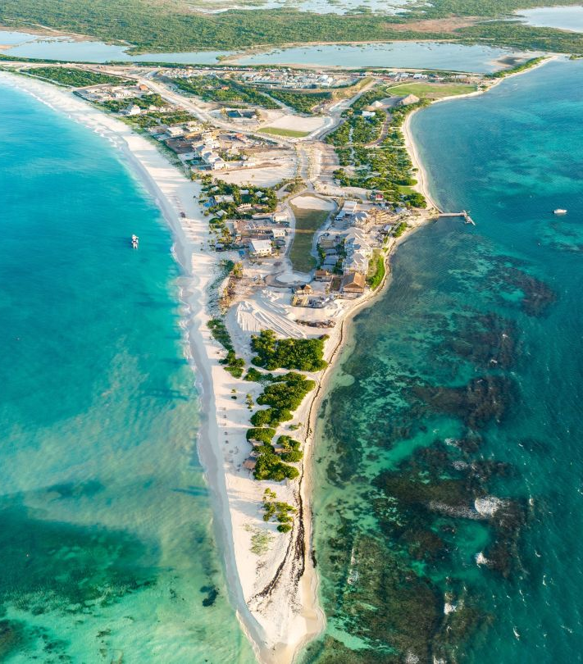
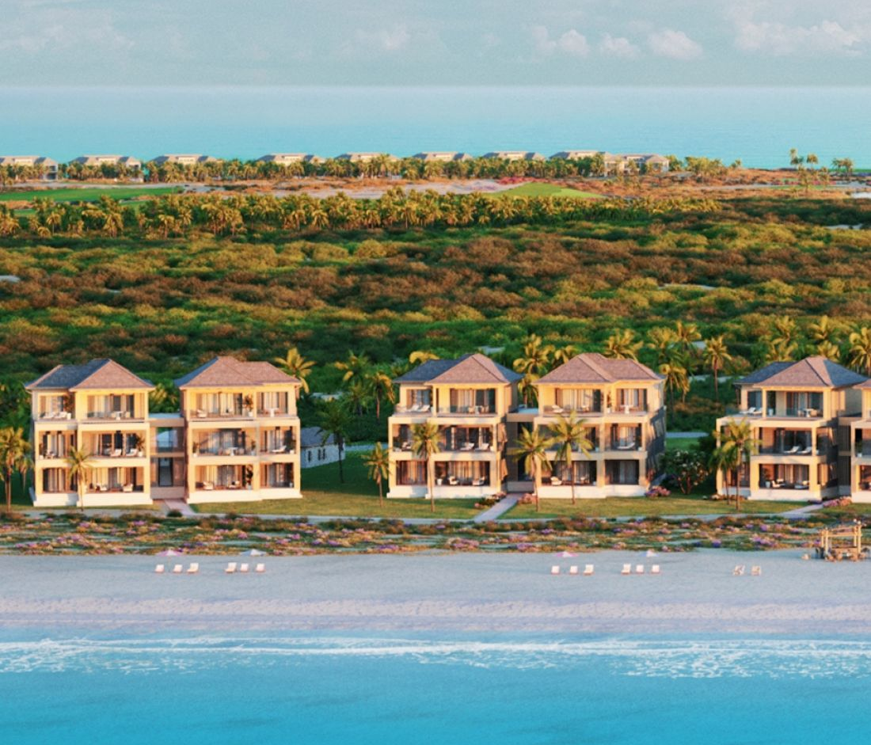
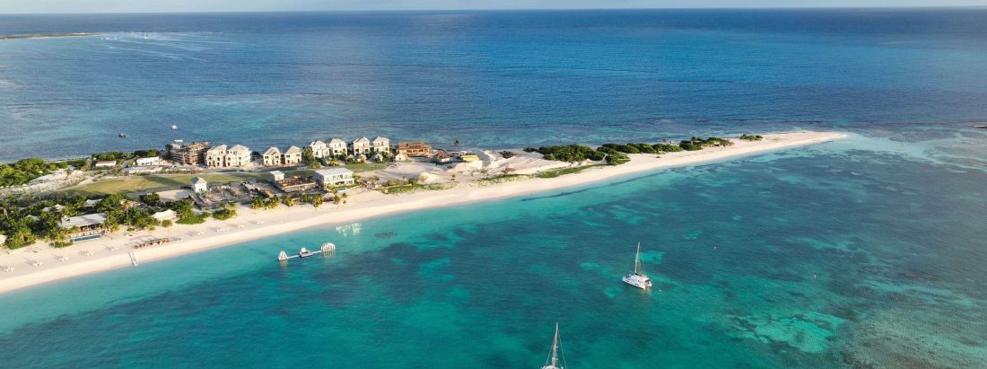
The Development
Barbuda Ocean Club
https://barbudaoceanclub.com/about

Slide 2
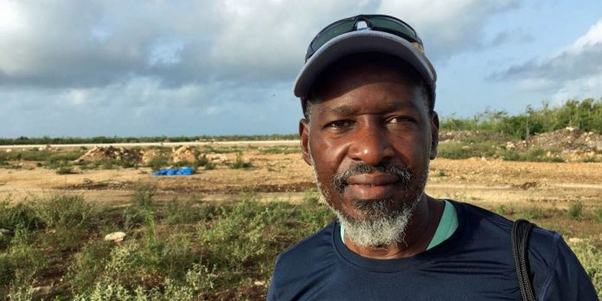

JOHN MUSSINGTON
savebarbuda.org

Slide 3
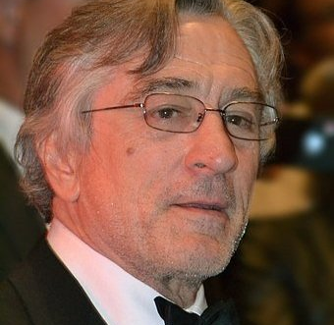
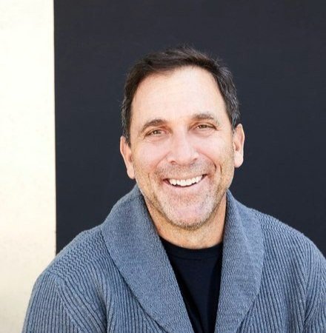
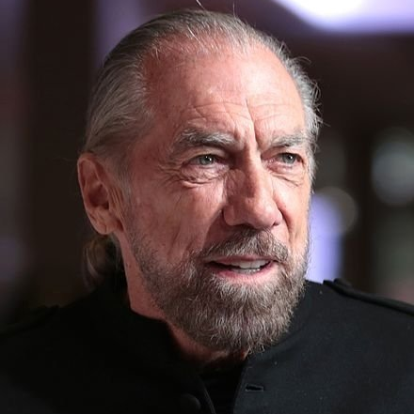
ROBERT DeNIRO MICHAEL MELDMAN JOHN PAUL DeJORIA
savebarbuda.org

Slide 4
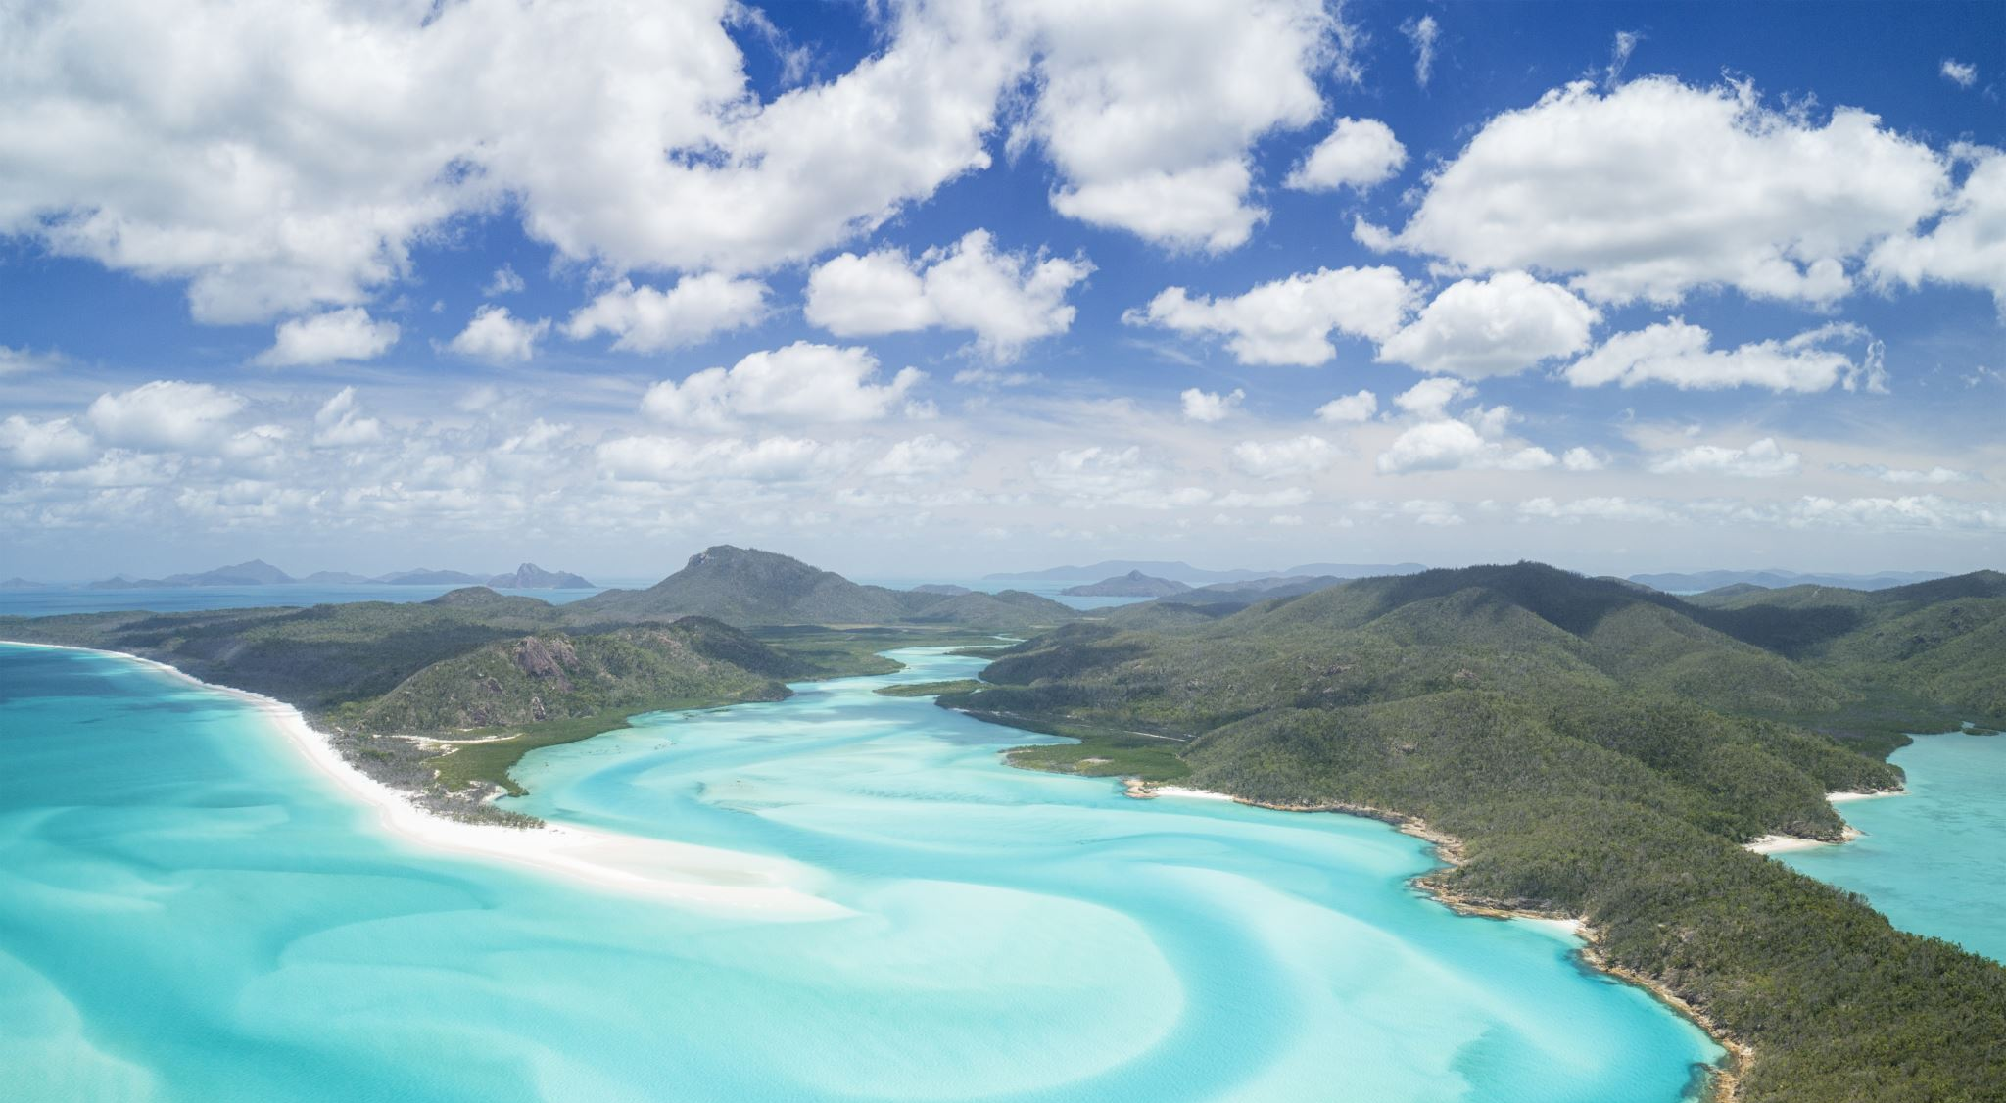
THE PROPOSAL
The development of Barbuda into a high-end tourist destination is supported by the government of Antigua and Barbuda, who say it’s essential to create jobs and for the economic future of the island. But others argue that it will fundamentally change the island’s ecology and unique way of life.

