Slide 1
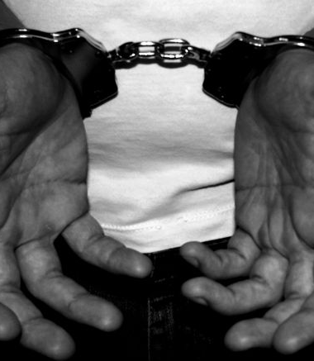
Gender, Race, Religion and Crime
Week 6 – Race and Crime
Jane
J.davies2@uwtsd.ac.uk 2025

Slide 2
Session Outline- Exploring the complex relationship between race and crime
Crime and Victimisation by Race
Racism
Hate Crime
Policing and Race
Hate Speech
Whiteness and Crime
Knife Crime
Racism in Football
Analysing Hate Speech online

Slide 3
Content Warning
Todays lecture will be discussing Racism in detail, and as such racial slurs will be discussed. Please engage in these discussions thoughtfully and respectfully.
Do not feel obliged to engage in these discussions if you do not want to.

Slide 4
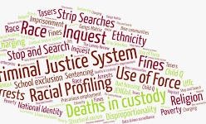

Slide 5
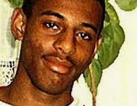
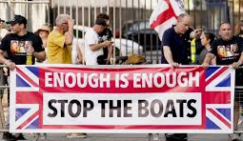
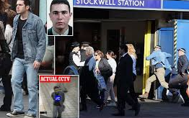

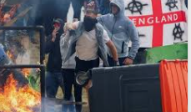
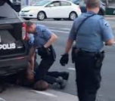
Race and Crime
Notes:
George Lloyd death USA
Chris Kaba in 2022 Met police Man shot dead in car by Met officer was not posing threat to life, jury told | UK news | The Guardian
Stephen Lawerence
Jean Charles Menezes Who was Jean Charles de Menezes? | Jean Charles de Menezes | The Guardian
Riots after the Portsmouth deaths
Small boats discussion

Slide 6
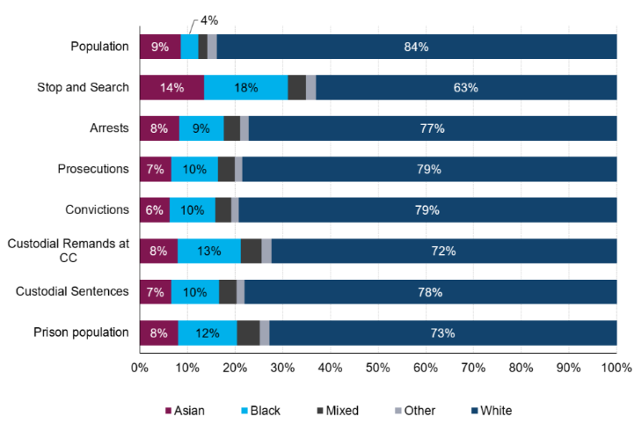
Crime Rates by Race 2022
Notes:
Statistics on Ethnicity and the Criminal Justice System, 2022 (HTML) - GOV.UK

Slide 7
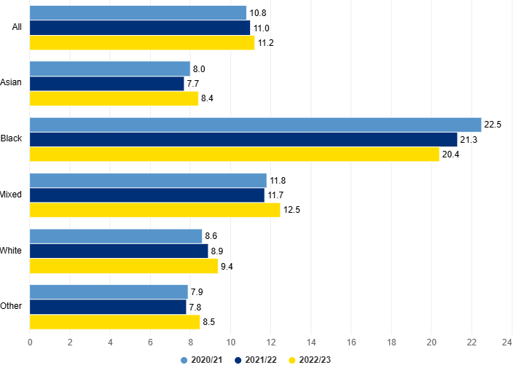
Notes:
Arrests - GOV.UK Ethnicity facts and figures

Slide 8
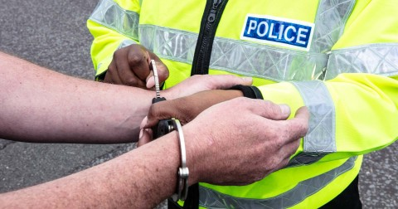
Arrests by Race
there were 668,979 arrests between April 2022 and March 2023 – up by almost 14,000 compared to the previous year
black people were 2.2 times as likely to be arrested as white people – there were 20.4 arrests for every 1,000 black people, and 9.4 arrests for every 1,000 white people
overall, men were 6 times as likely to be arrested as women – there were 19.4 arrests for every 1,000 men, and 3.3 arrests for every 1,000 women
black men were over 2.5 times as likely to be arrested as white men – there were 39.9 arrests for every 1,000 black men, and 15.4 arrests for every 1,000 white men
Notes:
Arrests - GOV.UK Ethnicity facts and figures

Slide 9
Discussion: Defining Racism
How do you define racism?
Can you define it easily?
Can you give a real life example that typifies what racism is?

Slide 10
Defining Racism
“Racism is a global hierarchy of superiority and inferiority along the line of the human that have been politically, culturally and economically produced and reproduced for centuries by the institutions of the “capitalist/western-centric/Christian-centric modern/colonial world-system”
The people classified above the line of the human are recognised socially in their humanity as human beings and, thus, enjoy access to rights (human rights, civil rights, women rights and/or labour rights), material resources, and social recognition to their subjectivities & identities.
The people below the line of the human are considered subhuman or non-human; that is, their humanity is questioned.
In the latter case, the extension of rights, material resources and the recognition of their subjectivities, identities, spiritualities and epistemologies are denied.”
Notes:
Grosfoguel, R. (2016) 'What is Racism?', Journal of World-Systems Research, 22(1), pp.9 - 15.
(Fanon 1967).

Slide 11
Defining Racism
the belief that different races possess distinct characteristics, abilities, or qualities, especially so as to distinguish them as inferior or superior to one another

Slide 12
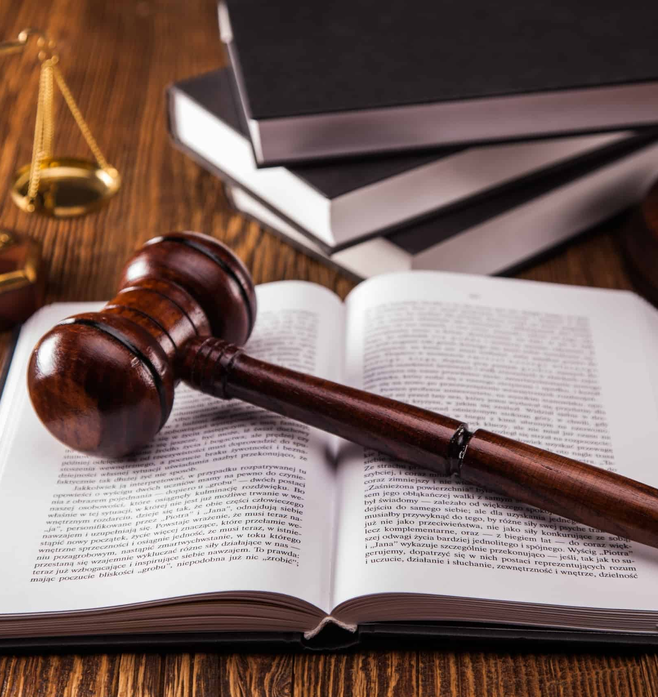
Defining Racism – UK Legislation
The Race Relations Act 1965 was the first piece of legislation in the UK to address the prohibition of racial discrimination and followed previously unsuccessful bills. The Act banned racial discrimination in public places and made the promotion of hatred on the grounds of ‘colour, race, or ethnic or national origins' an offence.
The Act received criticism at the time for being too weak, but is of historical importance as the legislation that instigated the drive towards greater equality in the UK
Notes:
Race Relations Act 1965, c73. Available at: https://www.parliament.uk/about/living-heritage/transformingsociety/private-lives/relationships/collections1/race-relations-act-1965/race-relations-act-1965/#:~:text=The%20Act%20banned%20racial%20discrimination,later%20on%208%20December%201965. (Accessed: 30/10/2022).

Slide 13

Can you define:
Race Discrimination
Hate Crime

Slide 14
Race Discrimination
A person (A) discriminates against another (B) if, because of a protected characteristic, A treats B less favourably than A treats or would treat others.
If the protected characteristic is race, less favourable treatment includes segregating B from others.
Equality Act 2010
Racism is when a person is treated worse, excluded, disadvantaged, harassed, bullied, humiliated or degraded because of their race or ethnicity
Collective failure to provide an inclusive and professional working environment to people because of their race or ethnicity
Notes:
Equality Act 2010, c.15 . Available at: https://www.legislation.gov.uk/ukpga/2010/15/part/2/chapter/2/crossheading/discrimination (Accessed: 30/10/2022).

Slide 15
Defining Hate Crime
The Public Order Act (1986) defines incitement to racial hatred:
  “A person who uses threatening, abusive or insulting words or behaviour, or displays any written material which is threatening, abusive or insulting, is guilty of an offence if- (a) he intends thereby to stir up racial hatred, or (b) having regard to all the circumstances racial hatred is likely to be stirred up thereby.”

Slide 16
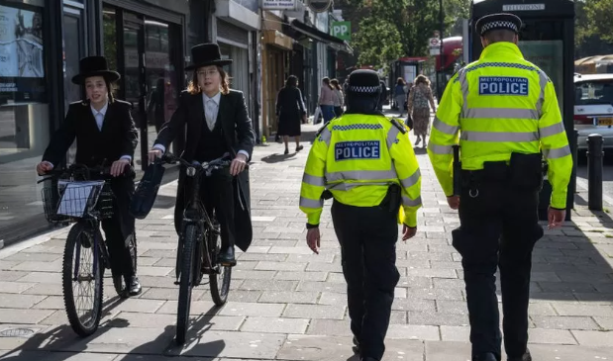
Hate Crimes Oct 2023
Met police report a significant increase of hate crime due to the antisemitic incidents since the Hamas attacks on Israel.
Between 1 and 18 October 218 antisemitic incidents recorded
The number of Islamophobic incidents were 101 during that time
There were 140,561 hate crimes recorded by the police in England and Wales in the year ending March 2024, a decrease of 5% compared with the year ending March 2023
religious hate crimes increased by 25%, from 8,370 to 10,484 March 2023 offences and was driven by a rise in offences against Jewish people

Slide 17
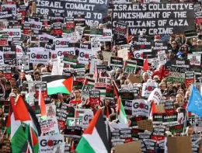
Hate Crime Law – Needs Updating
Met Police Commissioner Mark Rowley has said hate crime laws "probably need redrawing"
“Police role is to enforce to that line, Parliament's job is to draw that line - maybe some of the lines aren't in the right place.“
Pro- Palestinian march in London where 100,000 people gathered Oct 2023
To that group someone shouted - "jihad, jihad"
Met statement - the word jihad had "a number of meanings but we know the public will most commonly associate it with terrorism".
"However, recognising the way language like this will be interpreted by the public and the impact it will have.

Slide 18
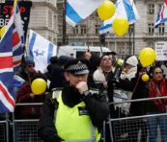
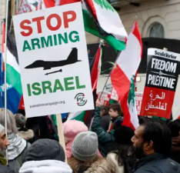
Pro- Palestinian march London January 2025
Several thousands attended
In total there were 65 arrests for breach of conditions:
5 for public order offences
2 for obstructing police
1 for support for a proscribed organisation
1 for inciting racial hatred
1 for common assault
1 for assault on an emergency worker
1 for sexual assault.

Slide 19
Defining Hate Speech
Hate speech is not a clear cut concept, with different definitions across countries, institutions, academics and social media companies.
Everyone who has a stake in understanding and combating racist hate speech has an interpretation and a set of priorities they insist upon when defining the parameters of its use
  Discussion: What is “hate speech” and what is “free speech”?

Slide 20
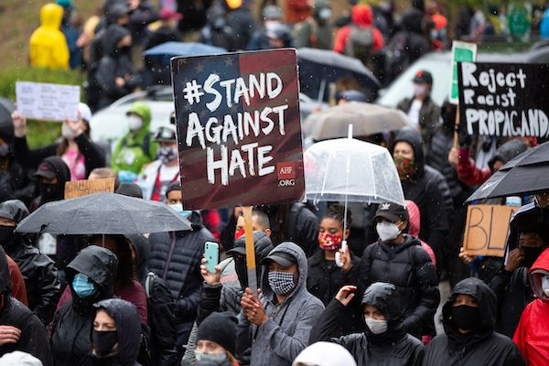
Defining Hate Speech
Council of Europe (1997):
  “the term ‘hate speech’ shall be understood as covering all forms of expression which spread, incite, promote or justify racial hatred, xenophobia, anti-Semitism or other forms of hatred based on intolerance, including: intolerance expressed by aggressive nationalism, discrimination and hostility against minorities, migrants and people of immigrant origin.”

Slide 21

Defining Hate Speech
X – Hateful Conduct Policy:
  “We are committed to combating abuse motivated by hatred, prejudice or intolerance, particularly abuse that seeks to silence the voices of those who have been historically marginalized. For this reason, we prohibit behaviour that targets individuals or groups with abuse based on their perceived membership in a protected category”.

Slide 22
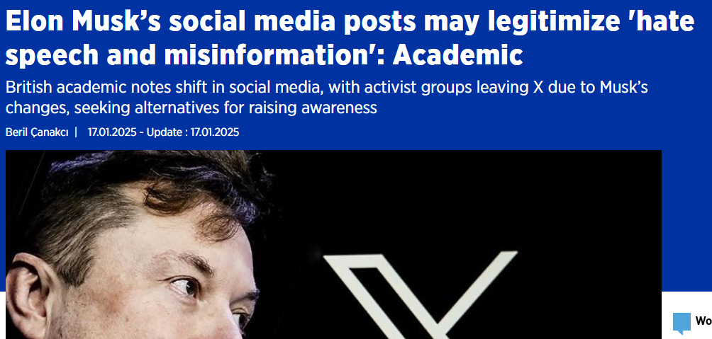
Musk and X
“The more these modes of speech are promoted, amplified, and given credibility by influential figures, the more the public may perceive these opinions as legitimate within political conversations,” James Dennis
Notes:
Elon Musk’s social media posts may legitimize 'hate speech and misinformation': Academic

Slide 23

Defining Hate Speech
Facebook – Community Standards:
  “We define hate speech as a direct attack on people based on what we call protected characteristics – race, ethnicity, national origin, religious affiliation, sexual orientation, caste, sex, gender, gender identity and serious disease or disability. We protect against attacks on the bases of age when age is paired with another protected characteristic, and also provide certain protections for immigration status. We define “attack” as violent or dehumanising speech, statements of inferiority, or calls for exclusion or segregation.

Slide 24
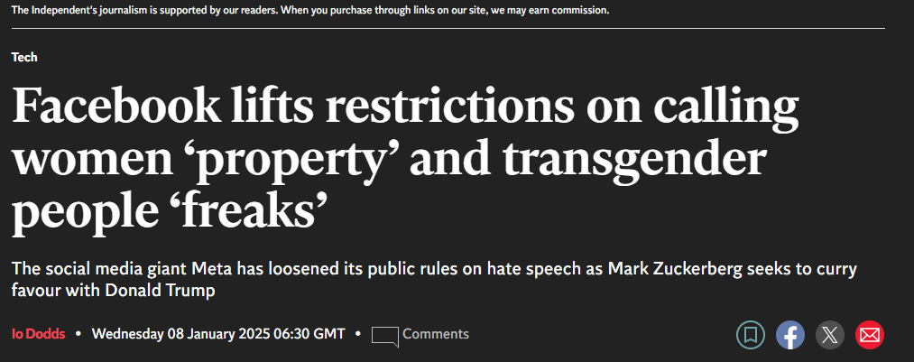
Facebook
Meta deleted numerous clauses banning specific derogatory statements about protected groups, while adding detailed exceptions for anti-trans speech.
Gone is the clause saying you cannot compare women to "household objects or property." Also removed is a prohibition on claiming that there is "no such thing" as a trans or gay person.

Slide 25
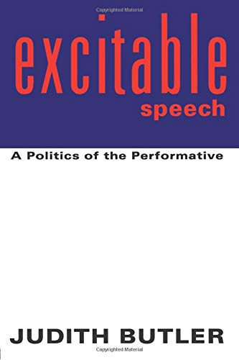
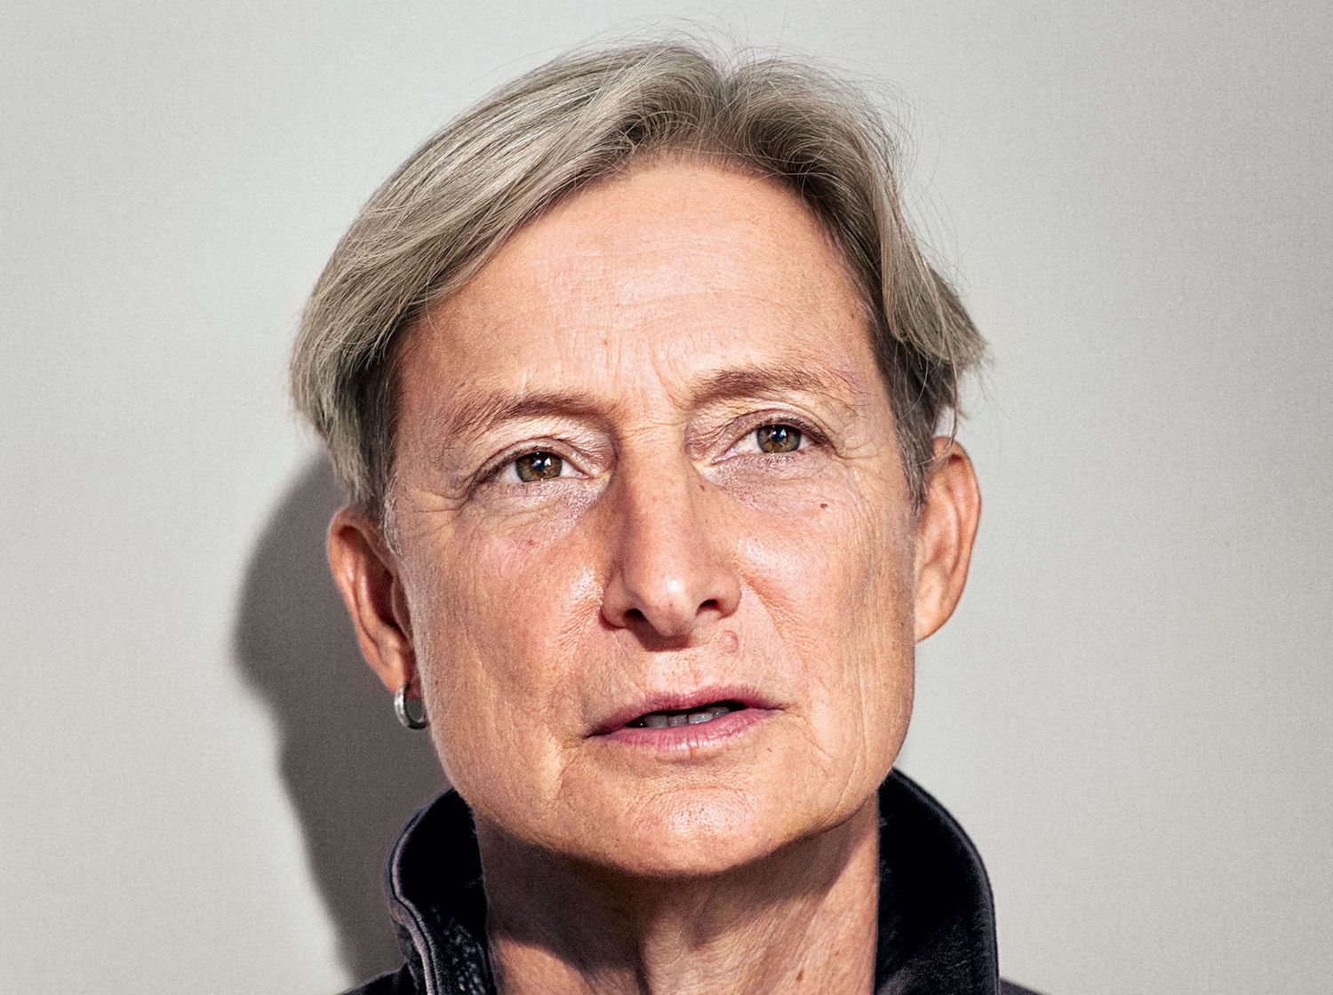
Speech as an “Attack”
Illocutionary Speech: A thing done by speech
  When you use hate speech, the speech may be theoretical, but the harm is real. By using dehumanising, threatening or offensive speech, you are doing real harm to the individual and the group
Notes:
Butler, J. (1997) Excitable Speech: A Politics of the Performative. New York: Routledge.

Slide 26
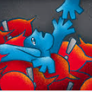
Turm and language of Hate
Animals, Aliens and people with bad genes
Trumps dehumanizing language used in rallies to describe immigrants
2024 presidential debate Trump referred to Haitian refugees in Springfield, Ohio, as ‘eating the pets of the people that live there’
January 20th, 2025, inaugural address, Trump spoke of “dangerous criminals, many from prisons and mental institutions, from all over the world” who have illegally entered the U.S.
Not unique – using hateful language to gain political advantage.
Makes an argument against certain group of people
Using hateful, polarizing language to gain a political advantage or make an argument against a group of people, like immigrants, is
Notes:
‘Aliens’ and ‘animals’ – language of hate used by Trump and others can be part of a violent design

Slide 27
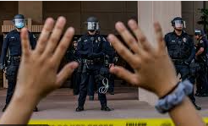
Policing Race

Slide 28
Stop & Search
Policing and Race
Police And Criminal Evidence Act 1984
Different Sections of PACE
Overall S & S police officers exercising their professional judgement and using the National Decision Model
The power enables officers to confirm suspicions about an individual without exercising their power of arrest.
Must have reasonable grounds that person has been involved in or about to be involved in criminal activity.
Has been criticised over the years on the ground of discriminative again ethnic minorities
2021 report - 35 years of S&S police still can’t explain why these powers are disproportionate.
Notes:
Disproportionate use of police powers – A spotlight on stop and search and the use of force - His Majesty’s Inspectorate of Constabulary and Fire & Rescue Services

Slide 29
Stop & Search
Stop & Search by Met police in July 2020 of Ricardo dos Santos and Bianca Williams car (baby inside)
Both were handcuffed and searched for weapons and drugs / Police Dogs and intelligence was collected = negative outcome but safeguarding report on child.
Racial stereotype rather than a crime
Over £50,000 raised for police officers
X comments:
Can anyone point me in the direction of one Black Police Officer dismissed by the Met Police for lying who has had this level of financial support?
“This fundraiser is sickening. Bad enough only two were sacked. Don’t tell me this isn’t about race…”
Others objected to the fundraiser:
“disgusting” to “take down the fundraiser”.
Notes:
Thousands raised for Met officers sacked over Bianca Williams and Ricardo Dos Santos stop and search | The Independent
Bianca Williams: video analysis shows how incident unfolded
251023-Bianca-Williams-Ricardo-Dos-Santos-investigation-report-final.pdf

Slide 30
The Macpherson Report 22 Yrs on -Stop and Search
Stop and search is an important police power and the Macpherson report’s conclusion that it has a useful role to play in the prevention and detection of crime still applies.
However, no evidence to this inquiry has adequately justified the scale of the disproportional use of S&S.
Especially the case for searches for the possession of drugs where evidence shows that Black people are less likely than White people to have used drugs in the last year, but are 2.4 times more likely to be stopped and searched for drug possession.
Reconise the importance of the police being able to take action against knife crime through stop and search but note that only 16% of ‘reasonable grounds’ searches in 2019/20 were conducted to find offensive weapons.
Report - troubling examples of stops and searches being conducted in a manner that was deeply alienating and uncomfortable. Given that the majority of people stopped and searched are not found to be committing any crime, stops should be initiated in a respectful and appropriate manner, with care taken to manage conflict and de-escalate encounters where necessary.

Slide 31
Stop and Search in Covid
Stop and search must always be used in a focused and targeted way. The Metropolitan Police increased their use of stop and search during the first national covid-19 lockdown to the highest levels seen in London for many years at a time when far fewer people were on the streets.
The result was that far more people who were not committing crimes were stopped and searched
The proportion of searches which found weapons or drugs dropped, but racial disparity widened.
The equivalent of 1 in 4 Black males between the ages of 15 and 24 in London who were not committing a crime were stopped and searched during a three-month period.
Notes:
UK Parliament (2021) The Macpherson Report: Twenty-two years on. London: Available at: https://publications.parliament.uk/pa/cm5802/cmselect/cmhaff/139/13903.htm#:~:text=The%20Macpherson%20report%20found%20that,both%20individual%20and%20institutional%20level. (Accessed: 30/10/2022).

Slide 32
Police Race Action Plan
Aimed at improving policing for Black people in England and Wales.
Developed by the National Police Chiefs' Council (NPCC) and the College of Policing
Effort to enhance trust and confidence in policing among Black communities.
Internal Culture and Inclusivity: Ensuring that the police force is representative and inclusive.
Use of Powers: Addressing the over-policing of Black communities.
Community Engagement: Building stronger relationships with Black communities.
Protection Against Victimisation: Ensuring Black people are not under-protected
The plan was developed in response to longstanding issues of racism and discrimination within policing, highlighted by events such as the murder of George Floyd and the subsequent global outcry
It aims to create an anti-racist police service that actively roots out bias and discrimination
Notes:
Police Race Action Plan: Improving policing for Black people

Slide 33
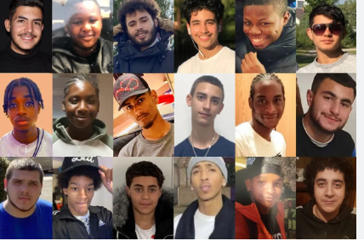
Knife Crime and Ethnicity 2021
Notes:
London’s 2023 murders examined: key figures in the UK capital’s homicides - AOAV

Slide 34

Knife Crime and Ethnicity
Data on knife crime in London only. In 2017 two thirds of knife crime offenders under 25 in London were black or minority ethnic, according to the Mayor of London’s Office for Policing and Crime.

Slide 35
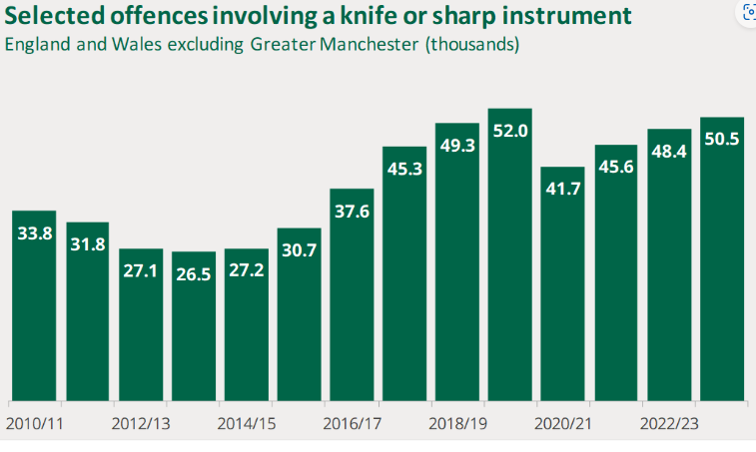
Knife Crime
Notes:
SN04304.pdf (parliament.uk)

Slide 36
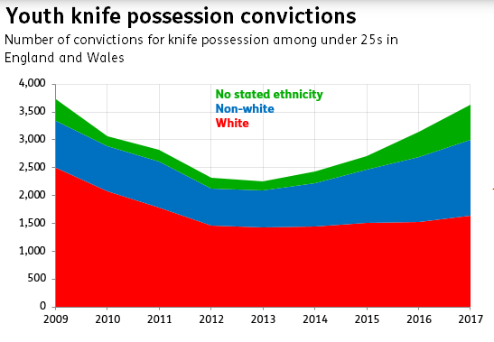
Notes:
Are a majority of youth knife offenders minority ethnic? – Full Fact

Slide 37
UK Knife Crime
Rebecca Wood 2010
Outside of London:
  “There were only seven [out of 43] cases nationally which involved non-White teenagers, as perpetrators or victims, being killed in ways which conform to the gang-gun-knife-teenager stereotype.”
In Greater London:
  The large majority of victims were Black or Asian, as were their attackers. (90 per cent of victims were Black or Asian, compared to 20 per cent outside Greater London. Twenty [out of 30] Black or Asian teenagers were killed by other Black or Asian people, thirteen of these by other Black or Asian teenagers.)
Notes:
Wood, R. (2010) 'UK: the reality behind the ‘knife crime’ debate', Race and Class, 52(2), pp. 97 - 103.

Slide 38
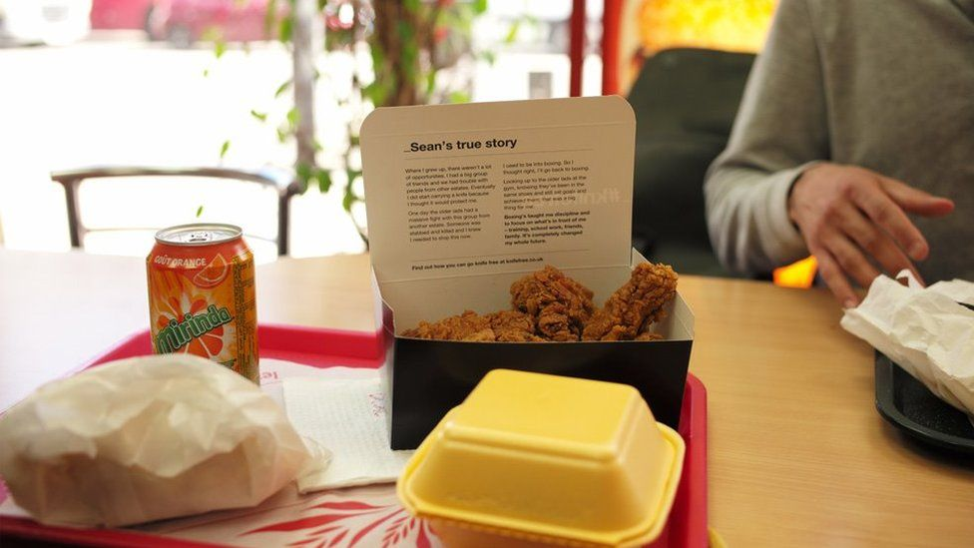
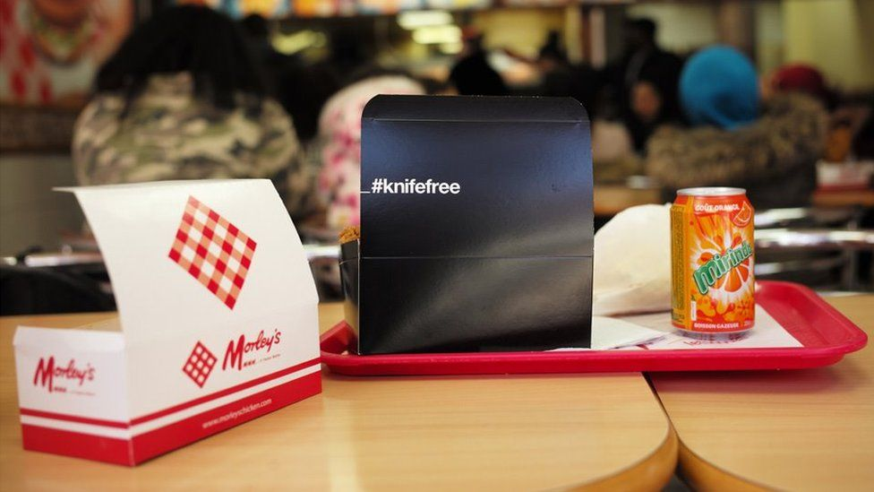
Government Response To UK Knife Crime
More than 321,000 chicken boxes that feature the Home Office #knifefree campaign in 2019
The insides of the boxes were printed with real life stories of young people who have chosen to pursue positive activities, such as boxing or music, instead of carrying a knife.
The then Policing Minister Kit Malthouse said:
  “These chicken boxes will bring home to thousands of young people the tragic consequences of carrying a knife and challenge the idea that it makes you safer.”
Notes:
Home Office (2019) Special #knifefree chicken boxes launched across the country. London: Available at: https://www.gov.uk/government/news/special-knifefree-chicken-boxes-launched-across-the-country (Accessed: 30/10/2022).

Slide 39
Discussion
Thinking back to theories of identity (Labelling, symbolic speech) what does a governmental response like this do to different groups of people?
How does government or the media portray perpetrators of knife crime?

Slide 40
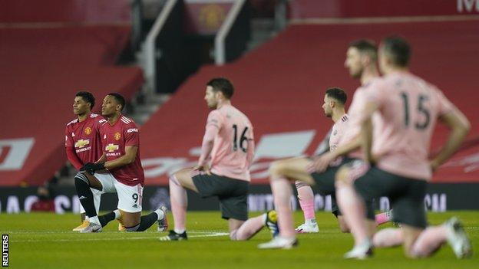
Racism Example - Football
Even though British football has undergone huge transformations since the 1990s (both on and off the field), 83 per cent of the participants stated that racism remains culturally embedded. Sixty-seven per cent of those who watched football between 1990 and 1999 witnessed or experienced racism during this period; 61 per cent between 2000 and 2009; and 50 per cent since 2010.
Notes:
Cleland, J. & Cashmore, E. (2016) 'Football fans’ views of racism in British football', International Review for the Sociology of Sport, 51(1), pp. 27 - 43.

Slide 41

Kick it Out
Kick It Out received a record 1,007 reports of discriminatory behaviour in the 2022-23 season
Reports of online abuse was 207 reports related to online forums and social media
reports related to sexism and misogyny – Aug 2022 Bristol City manager Lauren Smith says fan told her to stay ‘in the kitchen’
Düsseldorf player “women have no place in men’s football” made to referee a girls’ football and banned 3 games
Notes:
Bristol City manager Lauren Smith says fan told her to stay ‘in the kitchen’ | Bristol City Women | The Guardian

Slide 42

Racism Example - Football
This Tottenham Hotspur fan (white, male, age 30–39) condensed the views of many participants from across Britain who suggest that internalised dispositions and expressions regarding race spread from one white generation to the next and are embedded in the habitus and cultural practice of some white communities:
  Ignorance is passed down through the generations. Racism will always be rife unfortunately. The history of football clubs are embedded in local inner-cities and people who live in these areas have a ‘world is against us’ approach to life. Anyone who is not in that ‘community’ is seen as an ‘outsider’.

Slide 43

Euro 2020
UEFA Euro 2020 final at Wembley stadium
Marcus Rashford, Jadon Sancho and Bukayo Saka - All three players missed penalties in the 3-2 shootout loss and were targeted on social media after the game.

Slide 44
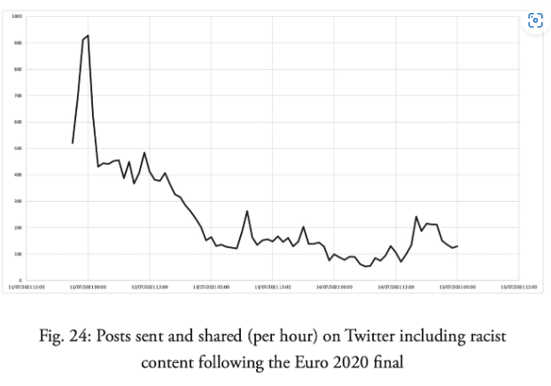
Notes:
nticipated a minority of England fans posting online hate speech directed at Italy’s players, but instead the events near the end of the game saw them turn on their own. Within minutes of the penalty misses the number of racist posts sent and shared on Twitter skyrocketed, peaking at over 920 between 11:00 p.m. and 12:00 a.m. just after the game. Rashford, Sancho and Saka were the prime targets

Slide 45
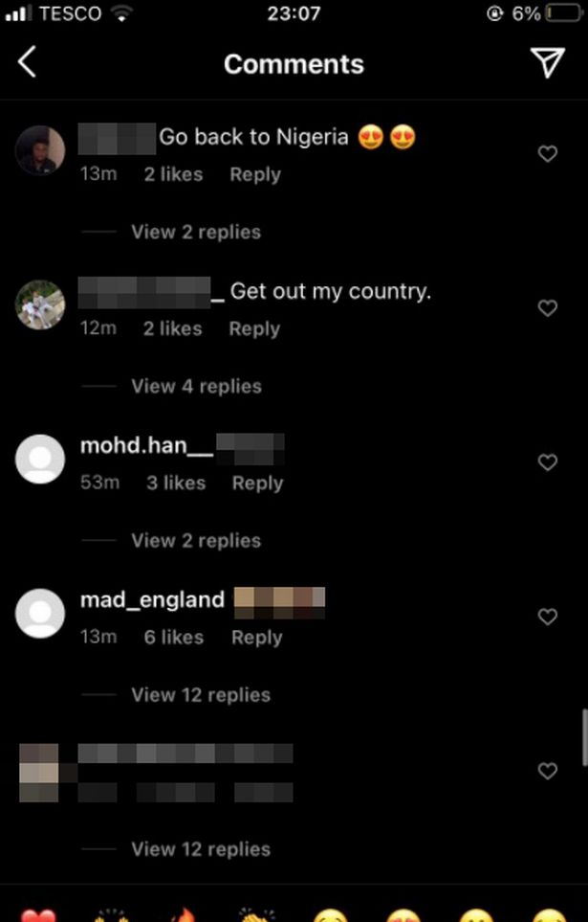
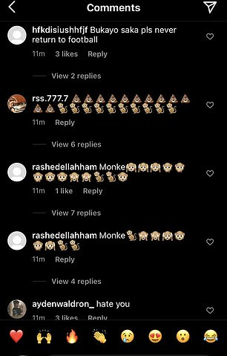
Euro 2020 Abuse
Marcus Rashford, Jadon Sancho and Bukayo Saka
livestreamed on Facebook racially abusing three England players after the Euro 2020
Targeted on Instagram and Twitter
How can we identify racism in the abuse sent to the football players following the Euro 2020 penalties?
What can we see happening in these tweets that relates to our understanding of race, ethnicity and nationality from before?
Notes:
EURO 2020:England players were targeted with 12,500 abusive messages during campaign | Daily Mail Online

Slide 46
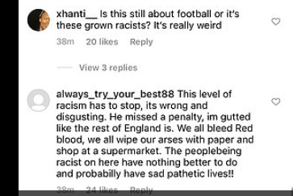
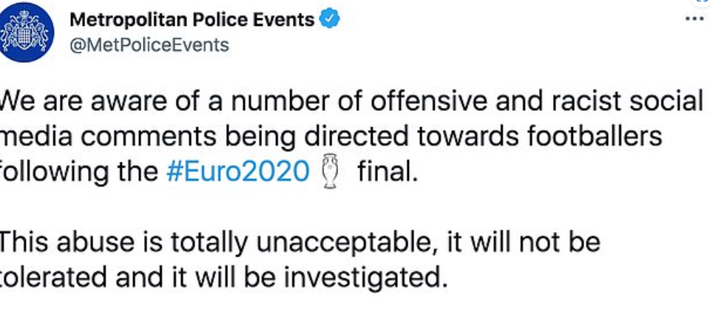
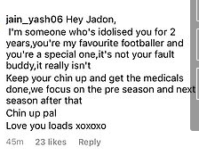
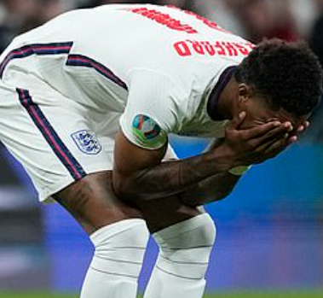

Slide 47

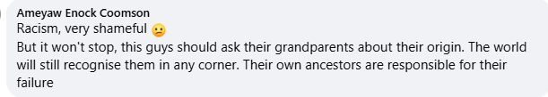

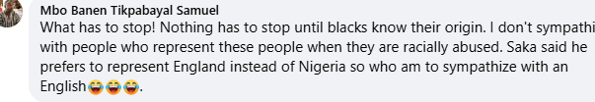

Goal Africa

Slide 48
Hate Speech Example
P1: I mean, I’m not racist but even you can’t deny it. Black people make everything scarier. Don’t even try to deny it.
P2: I mean, #asshats just make everything stupider. Don’t even try and deny it.
P3: maybe you’re just a pussy...
The Palestinians are like crocodiles; the more you give them meat, they want more
-Ehud Barak, the then Prime Minister of Israel, August 28, 2000.
Let’s Kill Jews, and let’s kill them for fun. #killjews
-Hamas Palestine, Twitter

Slide 49
Hate Speech Example
P1: [Video] 200 migrants try to break through Croatian border shouting “Allahu Akbar.” They also chanted, “No Croatia, Germany,” implying that their intended final destination was a more generous welfare state.
British Chinese received hate messages during COVID
  Eating bats /dogs
Through social media / personally
Immigration – ‘send them back’
  Taking our jobs/homes/doctors and schools
Notes:
UK Public Opinion toward Immigration: Overall Attitudes and Level of Concern - Migration Observatory - The Migration Observatory (ox.ac.uk)

Slide 50
Class Discussion
Analyse the following Twitter interactions with regards to the following questions:
  What makes these racist?
  What does the hate speaker do to create an identity for the other race?
  What does the hate speaker do to create an identity for themselves through their speech?
  What does the respondent counter speaker do to combat and re-make the identity of the hate speaker?

Slide 51
Any Questions?
About todays content?
About the assignment?
About anything else?

Slide 52
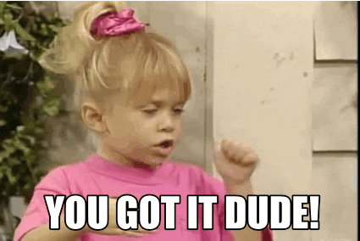
Week 6 Complete
Thanks for listening!
Today submit paper by 23:59 hrs
Next week Industry week – emailed about events on Monday and Thursday – please attend
See you 21st March
☺

Slide 53
References
Butler, J. (1997) Excitable Speech: A Politics of the Performative. New York: Routledge.
Cleland, J. & Cashmore, E. (2016) 'Football fans’ views of racism in British football', International Review for the Sociology of Sport, 51(1), pp. 27 - 43.
Equality Act 2010, c.15 . Available at: https://www.legislation.gov.uk/ukpga/2010/15/part/2/chapter/2/crossheading/discrimination (Accessed: 30/10/2022).
Grosfoguel, R. (2016) 'What is Racism?', Journal of World-Systems Research, 22(1), pp.9 - 15.
Home Office (2019) Special #knifefree chicken boxes launched across the country. London: Available at: https://www.gov.uk/government/news/special-knifefree-chicken-boxes-launched-across-the-country (Accessed: 30/10/2022).
Home Office (2021) Hate crime, England and Wales, 2020 to 2021. London: Available at: https://www.gov.uk/government/statistics/hate-crime-england-and-wales-2020-to-2021/hate-crime-england-and-wales-2020-to-2021 (Accessed: 30/10/2022).
Home Office (2022) Ethnicity Facts and Figures. London: Available at: https://www.ethnicity-facts-figures.service.gov.uk/crime-justice-and-the-law/policing/number-of-arrests/latest (Accessed: 30/10/2022).
Ministry of Justice (2021) Ethnicity and the Criminal Justice System, 2020. London. Available at: https://www.gov.uk/government/statistics/ethnicity-and-the-criminal-justice-system-statistics-2020/ethnicity-and-the-criminal-justice-system-2020 (Accessed: 30/10/2022).
Race Relations Act 1965, c73. Available at: https://www.parliament.uk/about/living-heritage/transformingsociety/private-lives/relationships/collections1/race-relations-act-1965/race-relations-act-1965/#:~:text=The%20Act%20banned%20racial%20discrimination,later%20on%208%20December%201965. (Accessed: 30/10/2022).
UK Parliament (2021) The Macpherson Report: Twenty-two years on. London: Available at: https://publications.parliament.uk/pa/cm5802/cmselect/cmhaff/139/13903.htm#:~:text=The%20Macpherson%20report%20found%20that,both%20individual%20and%20institutional%20level. (Accessed: 30/10/2022).
Webster, C. (2008) 'Marginalized white ethnicity, race and crime', Theoretical Criminology, 12(3), pp. 293 - 312.
Wood, R. (2010) 'UK: the reality behind the ‘knife crime’ debate', Race and Class, 52(2), pp. 97 - 103.

Slide 54
Discussion
What is being “done” by the lack of focus on white crime?
What is being “done” by the comparisons between white people of lower status and “black peoples work”

Slide 55
Whiteness and Crime
It is remarkable how white ethnicity and class retain their anonymity in discussions of ethnicity and crime—especially as self-report studies suggest that ‘whites’ disproportionately offend compared to other ethnic groups and obviously commit the vast bulk of crimes. After all, 85 per cent of offences involving children and young people were committed by those who classify their ethnicity as white, and 92 per cent of black young people and children are not subject to disposals in the youth justice system (House of Commons Home Affairs Committee, 2007).
In a sense these sorts of cultural, criminological and class issues make it all the more puzzling why white ethnicity has remained unaddressed in discussions of ethnicity, race and crime. The key problem seems to be a general difficulty in social science in conceiving whiteness or white ethnicity other than in terms of privilege, power and superiority over other ethnicities. Whiteness as an ethnicity appears as an empty signifier devoid of content or meaning except insofar as it racializes other ‘visible minorities’.
Webster, C. (2008) 'Marginalized white ethnicity, race and crime', Theoretical Criminology, 12(3), pp. 293 - 312.

Slide 56
Policing and Race: Stephen Lawrence and the Macpherson Report
“Stephen Lawrence was murdered on 22 April 1993 in an unprovoked racist knife attack in Eltham, South London. The Inquiry into his murder led by the late Sir William Macpherson uncovered major failings in the police investigation and in the way Stephen Lawrence’s family and Duwayne Brooks were treated.”
“Adults from Black and mixed ethnic backgrounds are less likely to have confidence in the police than adults from White or Asian backgrounds, and the confidence gap has widened over the last few years. 67% of White adults say they believe the police will treat them fairly compared to 56% of Black adults.”
Notes:
UK Parliament (2021) The Macpherson Report: Twenty-two years on. London: Available at: https://publications.parliament.uk/pa/cm5802/cmselect/cmhaff/139/13903.htm#:~:text=The%20Macpherson%20report%20found%20that,both%20individual%20and%20institutional%20level. (Accessed: 30/10/2022).

Slide 57
Whiteness and Crime
As in Britain, where relatively recently ‘Paddy-bashing’ was only ever a stone’s throw from ‘P*ki-bashing’, so in the United States, nativist folk wisdom held that ‘an Irishman was a “n****r”, inside out’ (Roediger, 2007: 133). Despite sharing neighbourhoods, poverty, criminalization and common experiences of racism with blacks, this denial of their ‘whiteness’ only resulted in their insisting all the more on their own whiteness and on white supremacy in opposition to blacks. The key was gaining better work, winning acceptance and political rights. ‘White n****rs’ were white workers in arduous, unskilled manual work or subservient positions, and in part Irish-American whiteness took shape attempting to sever any racial connections to blacks and ‘n****r work’, i.e. the burden of doing unskilled work (Roediger, 2007).
Webster, C. (2008) 'Marginalized white ethnicity, race and crime', Theoretical Criminology, 12(3), pp. 293 - 312.

