Slide 1
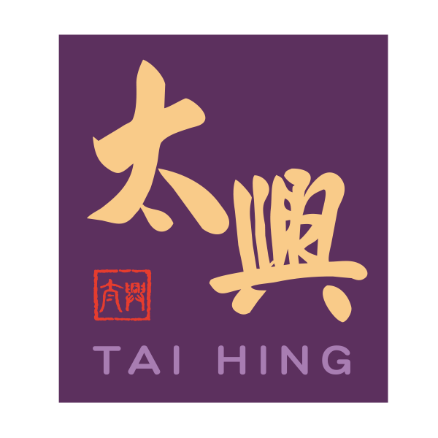

Tai Hing Organization Change
HKBM7015
Change and Stability
Student Name : Yin Ho Tong (Tommy)
Student ID : 2322644
Date of Submission : 13 April 2024
Lecturer : Dr. Joe Leung

Slide 2
Table of contents
01
02
03
04
05
06
Introduction
Background
Analyze the environment factor
Evaluation
Recommendation
Conclusion
07
Reference

Slide 3


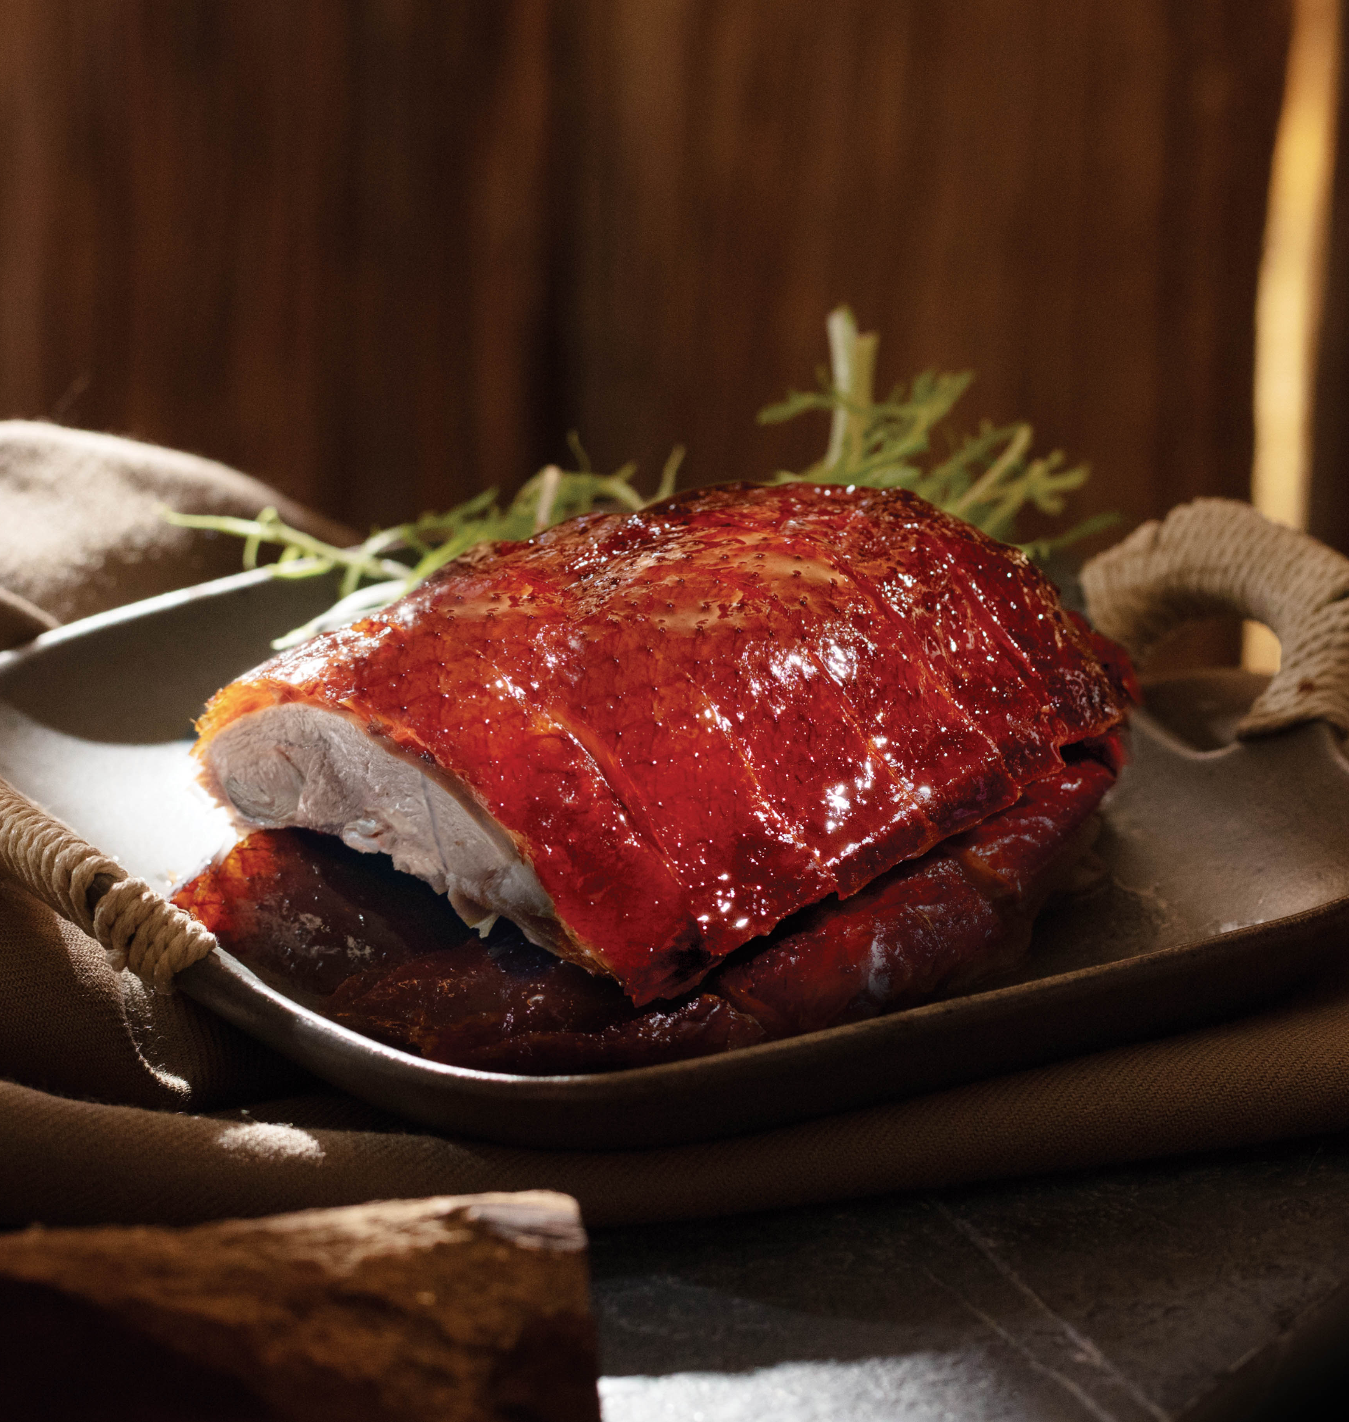
01
Introduction
Catering industry experienced challenge in 2022 due to the COVID-19 pandemic and related control measure, impacting the operation(Tai Hing, 2022)
Restaurant industry decrease in confidence by HongKongers shift towards “northbound consumption” by travel to China (Global Times, 2024)

Slide 4

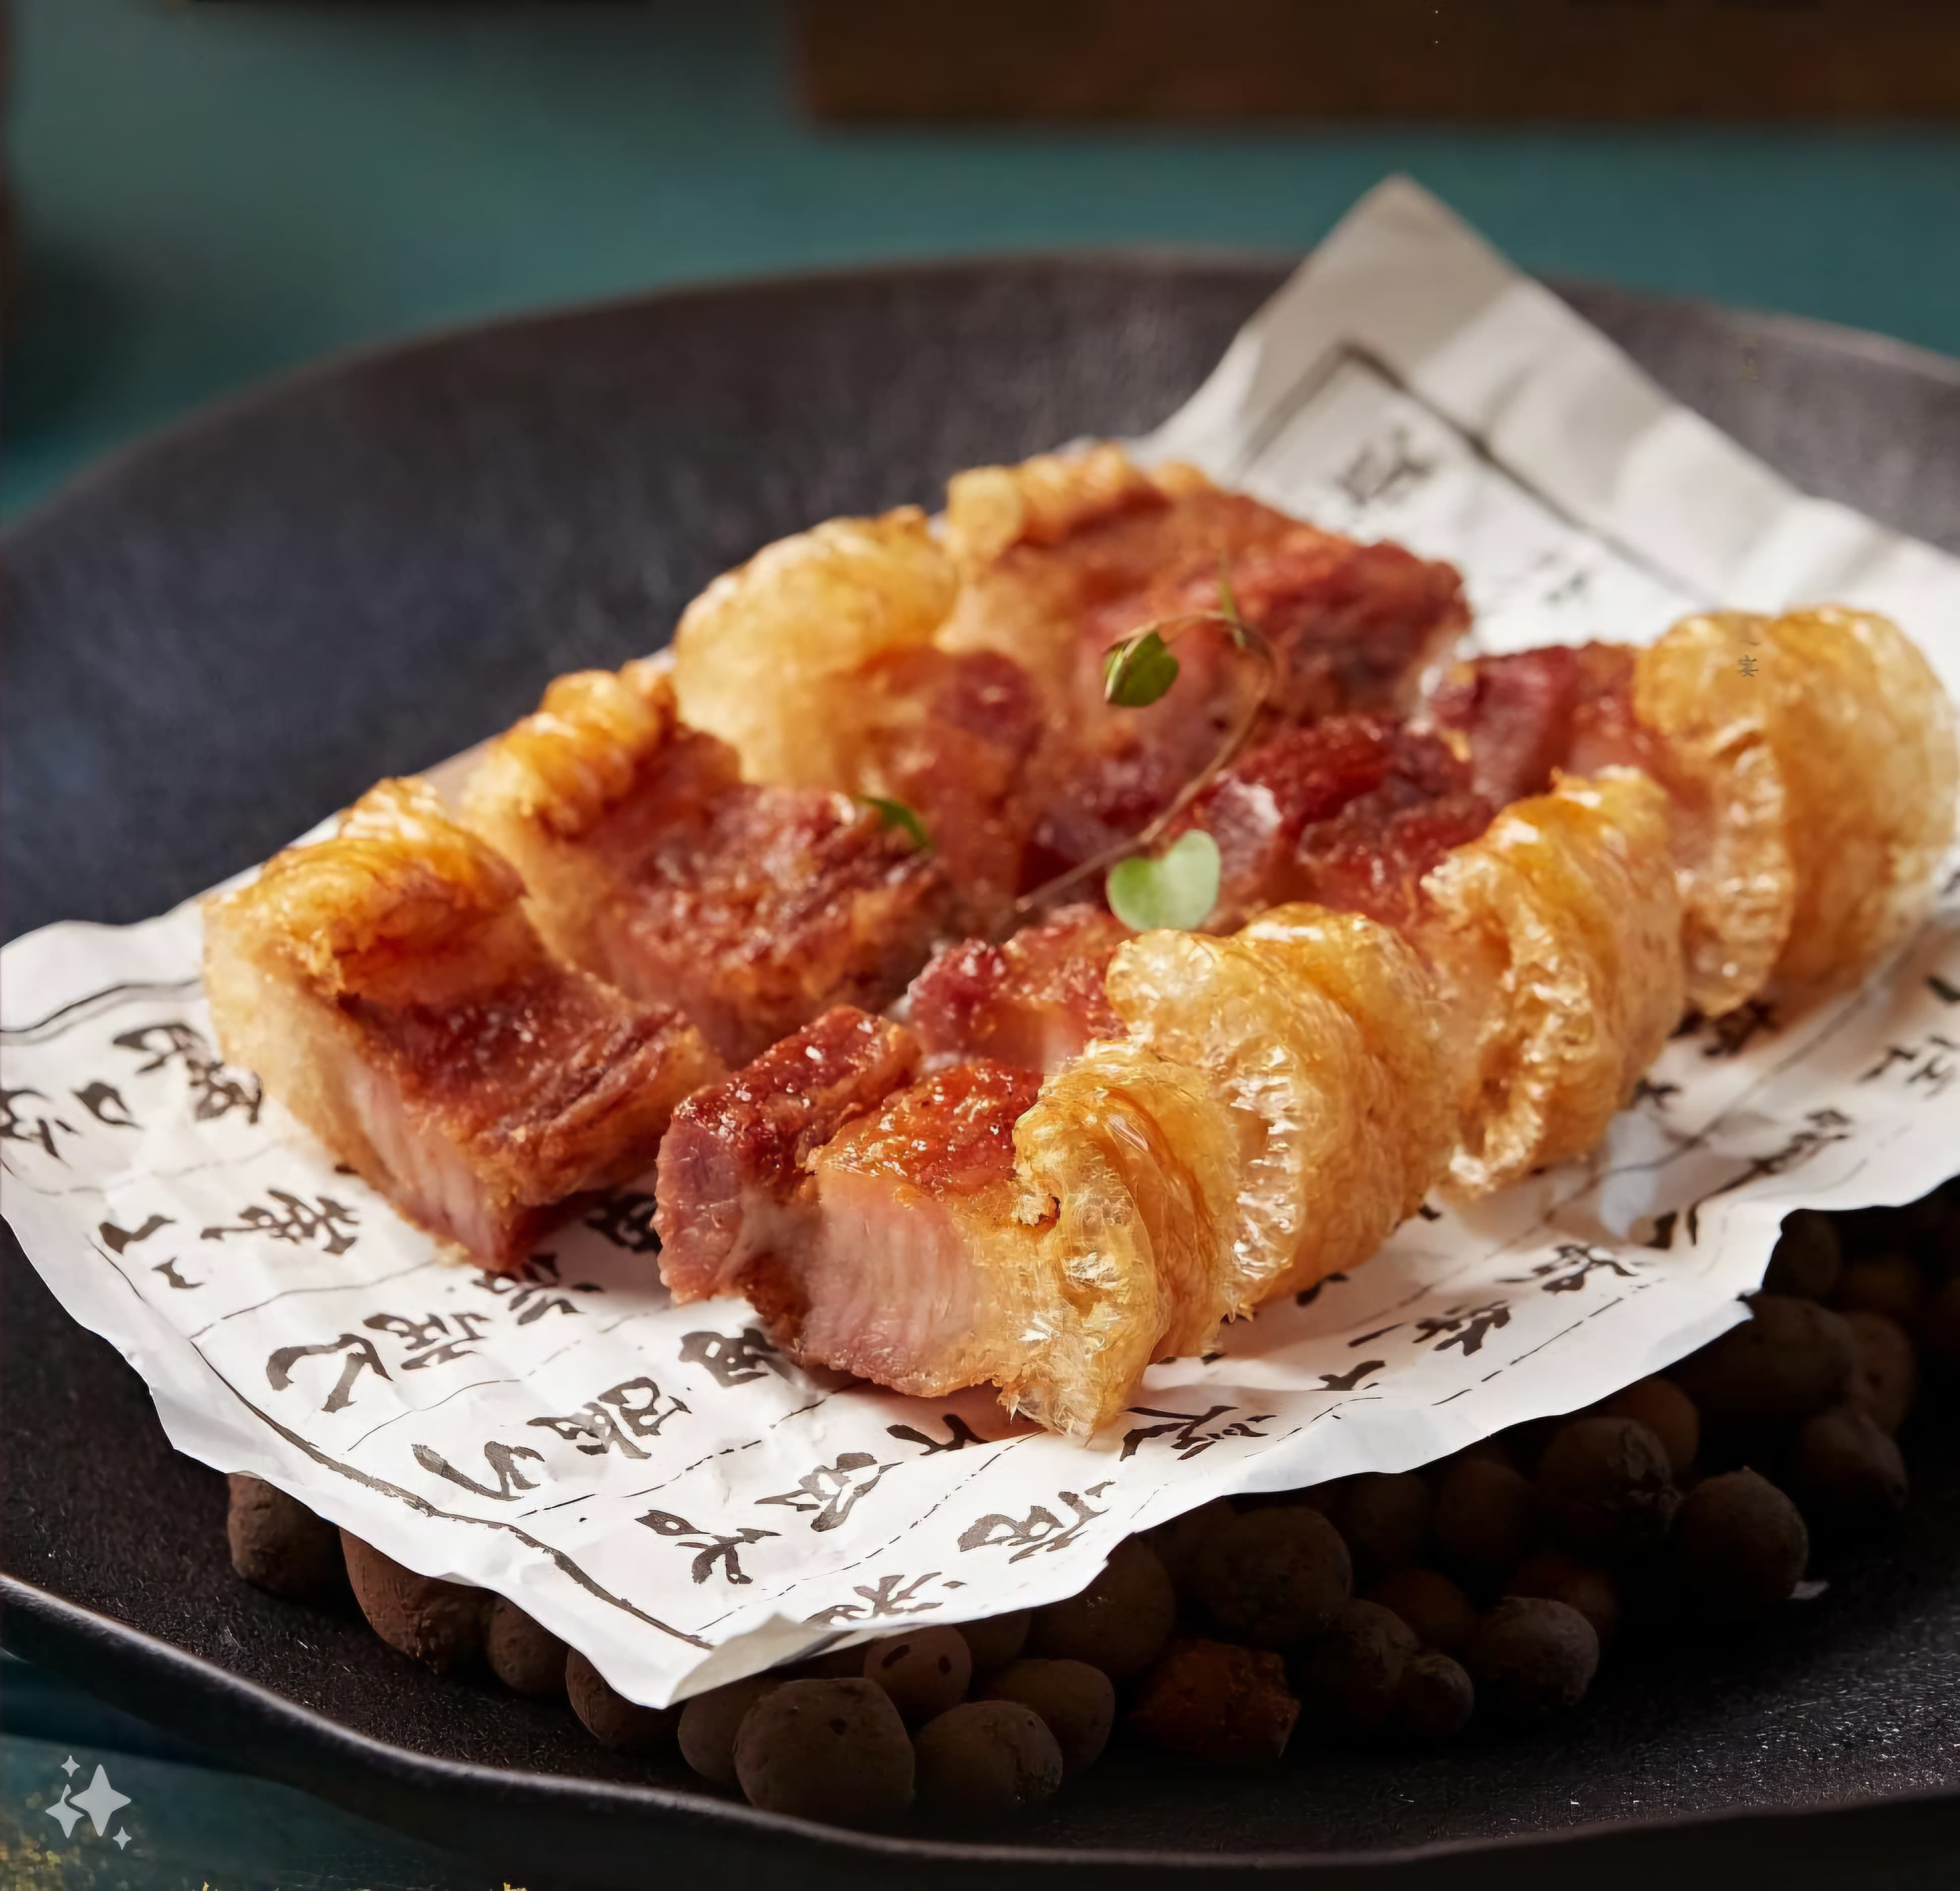

02
Background to
Tai Hing Group

Slide 5
Background to Tai Hing Group
Tai Hing Group Holding Limited - Overview
Founded in 1989 | Tai Hing Group has grown from a single restaurant to one of the largest multi-band casual dining restaurant operator in Hong Kong(Tai Hing,2023)
Listed at HKEX | Tai Hing Group (06811) public offering at HKEX in June 2019(ETnet, 2019)
Number of restaurant | Operates around 200 restaurants among Hong Kong, Macau and China
Number of staff | Hires around 7000 staffs in Hong Kong, Macau and China
Challenges of revenue decrease | Revenue decreased by approximately 15.7% to HK$2,675m (FY2021: HK$3173m) (Tai Hing, 2022)
Profit decrease | Profit keep on decreasing from 2019 to 2023, especially turn to loss in FY2022 due to Covid19. (Refer to Data set table 1)
Watch Tai Hing Group Background Video
VIDEO
https://www.youtube.com/watch?v=OBHpElfRhdg&t=80s

Slide 6
Tai Hing Group Financial Highlights from 2019 to 2023
(HK$ Millions) – Data set table 1
 | 2019 | 2020 | 2021 | 2022 | 2023
Revenue | 3,252,250 | 2,797,923 | 3,173,027 | 2,675,166 | 1,568,193
Profit | 51,772 | 47,148 | 43,360 | -110,799 | 33,896
Cost | 1,748,848 | 1,486,975 | 1,594,160 | 1,400,424 | 747,164
Shop | 355,190 | 437,904 | 452,807 | 435,856 | 242,368
Staff | 1,096,440 | 825,896 | 949,299 | 949,299 | 544,765
Other income* | 25,395 | 70,614* | 51,995 | 67,339* | 11,440
Source: Tai Hing Group Report https://www.taihing.com/?route=ir-report&lang=1
* Include Employment Support Scheme’s subsidy

Slide 7
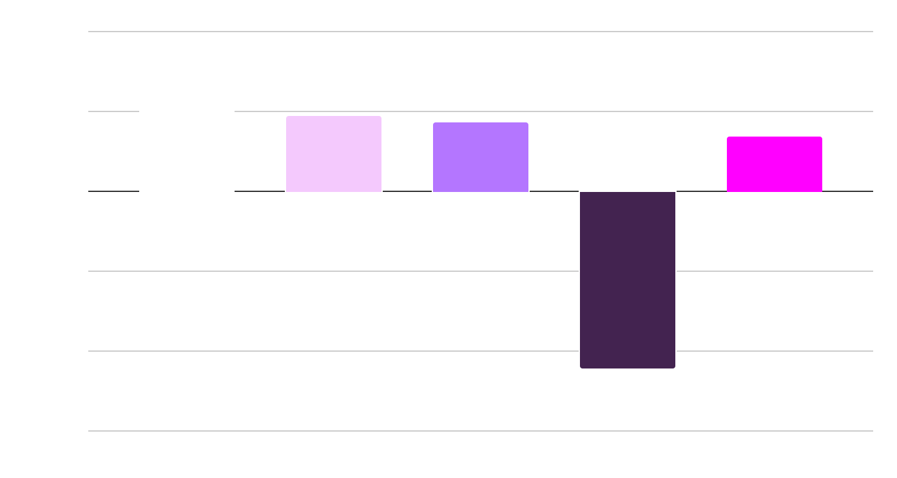
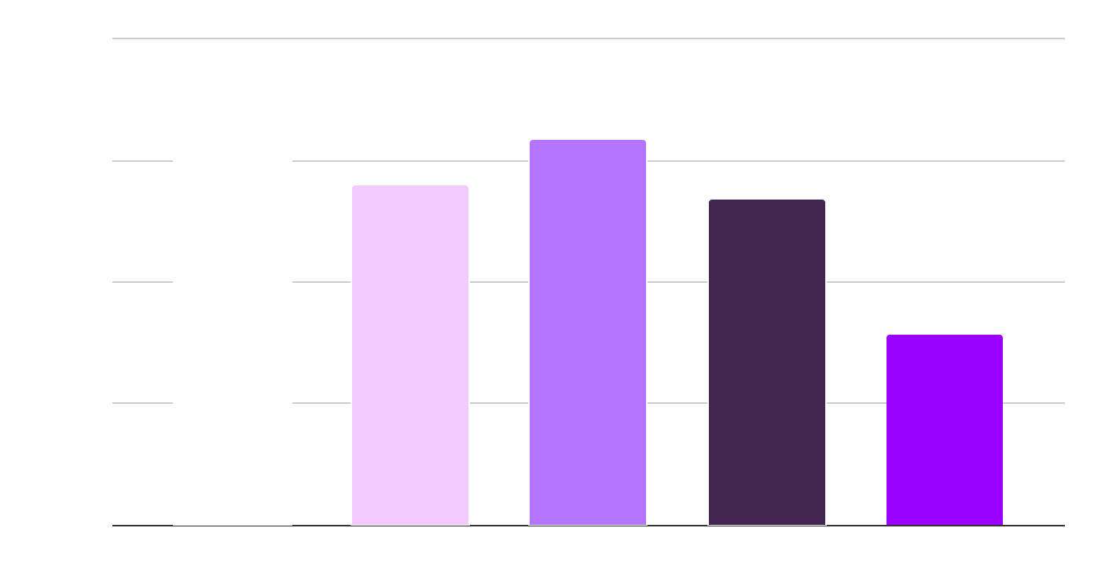
Revenue/ Profit from 2019-2023 (HK$ Million)
-Figure 1a & 1b
Revenue (HK$ Million)
Profit (HK$ Million)
Year
Year
2019
2020
2021
2022
2023
Revenue/profit drop by Covid19 by restrict no dine in but only accept take out order from tighten social distancing measures
Revenue/profit go up by ESS subsidy and Covid19 begin to ease
Revenue/profit drop by relax on social distancing measures, but HongKonger would lie to try restaurant not operate by HK business man
Revenue/profit drop due to customer behavior change
The best revenue and profit return (Tai Hing, 2019)
Source: Data set listed in table 1

Slide 8
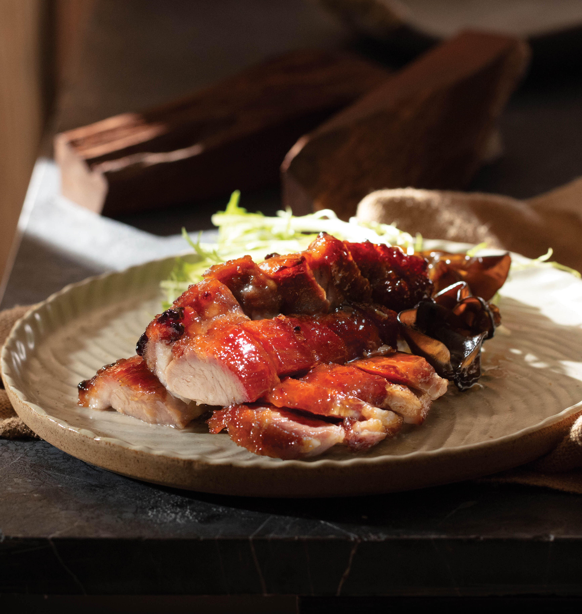
03
Analyse the Environment Factor that influence Change in Organisation

Slide 9
Analyse the Environment Factors that Influence Change in Tai Hing Group
Revenue/profit keep on dropping in five years from 2019 to 2023 (Refer to figure 1a and 1b)
There are 3 environment factors from general, task and internal that influence change in Tai Hing Group in order to meet the upcoming challenge in 2024
Task factor
General factor
Customer behavior change
Customer would like dine at home or flock to Shenzhen for dinner with better value(Danyl Lim,2024)
Economic Dimension
Hong Kong retail sales deteriorate which imply consumer consumption decrease (Focus Economics,2024)
Internal factor
Owners, board of directors culture
Tai Hing management believe on Automatic stir-fryer/central food factory to prepare/cook food, which make the food not delicious (HK01,2019)
Watch Auto Stir Fry Video
VIDEO
https://www.youtube.com/watch?v=a4i0SCL-03o&t=87s

Slide 10
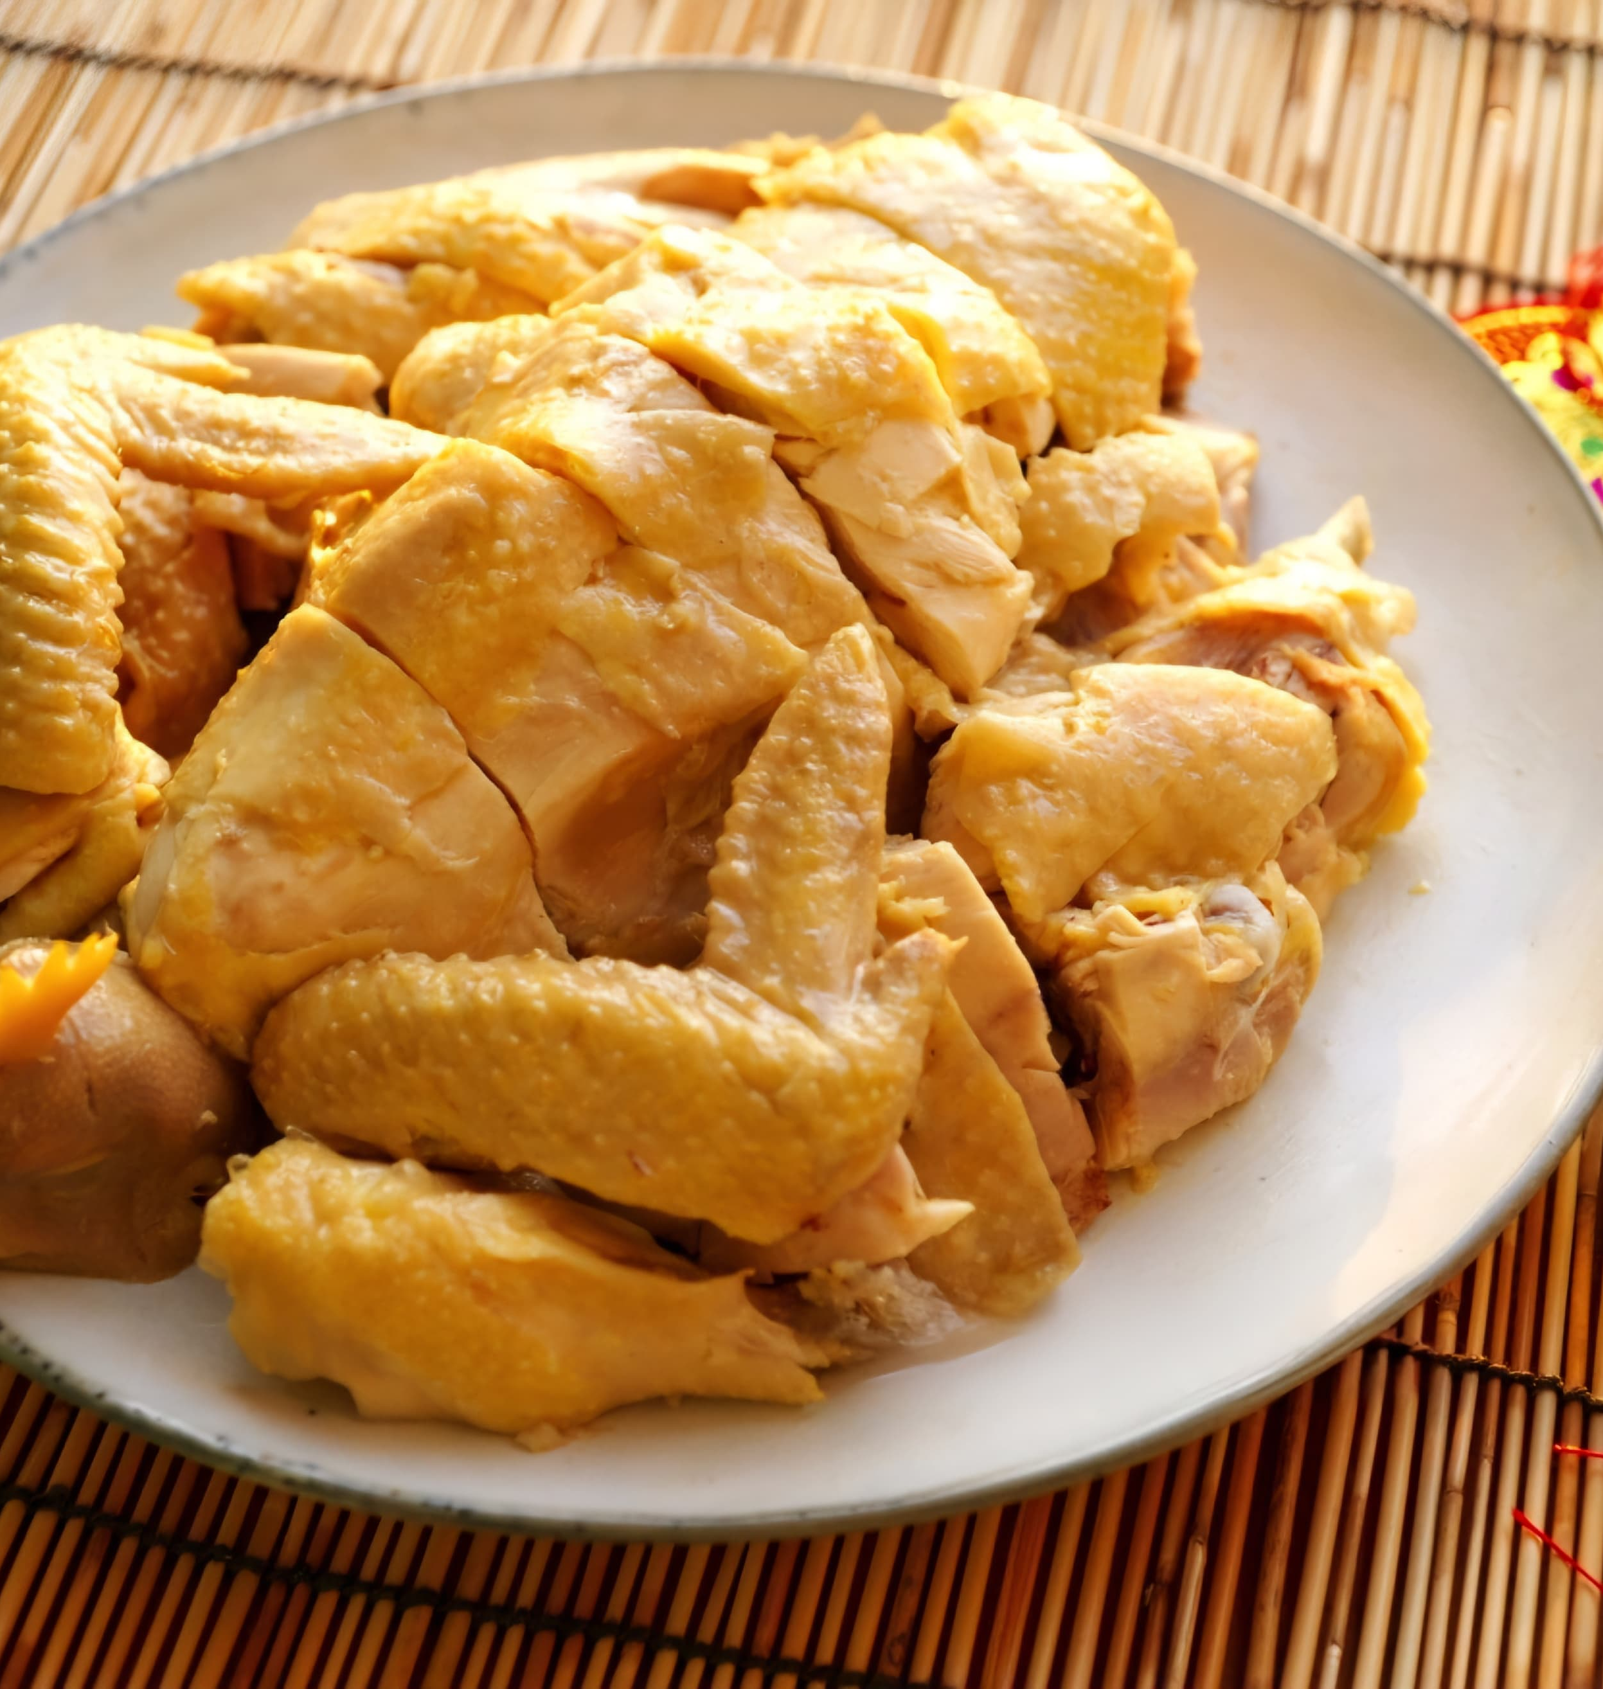
04
Evaluate Why
Tai Hing Group Change

Slide 11

Evaluate Why Tai Hing Group Change
Revenue/Profit continuous to drop from 2019-2023 (Refer to dataset table 1) and Covid19 effect
Active Inertia(Harvard Business Review,1999) for Tai Hing to believe the food quality by auto stir-fryer/ central food factory
Tai Hing Group is in progress of death spiral(David et al. 1995) by dropping revenue & profitability, losing market share by China catering competition
Reaction to internal and external challenge(Research
Gate,2017)

Slide 12
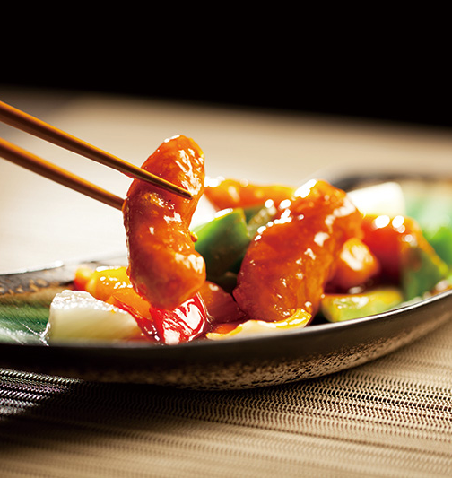
05
Recommend Change to
Tai Hing Group

Slide 13
Recommend Change
Tai Hing Group is recommend to implement following change:
1.Strategic Change to accomplish specific objectives such as reaching goals, gaining a competitive edge in the market, or adapting to new opportunities or challenges.
2.Remedial Change is recommend too as it is reactive measures taken when a problem arises and requires a prompt solution. Since these changes aim to resolve specific issue, they demand immediate attention
Environment factor need to change | Apply what type of Change | Type of Change
Task Factor Customer behavior change by preferring to dine at home or flock to Shenzhen for dinner by better value | Remedial Change | Addressing customer communication issues Establish Corporate Social Responsibility(Business News Daily, 2023) department to promote on HK traditional BBQ food and promote on HK food safety standard
General Factor Hong Kong retail sales deteriorate which imply consumer consumption decrease | Strategic Change | Restructuring Restructuring leads Tai Hing group to maximize the most profitable product such as BBQ food, in which provide more discount on BBQ food to attract consumer to consume on BBQ food
Internal Factor Restaurant food not delicious enough by management using auto stir-fryer/central food factory to cook/prepare food | Remedial Change | Providing more training for new hires cook In order to raise the food quality standard, Tai Hing management should provide more cooking training to their cook

Slide 14
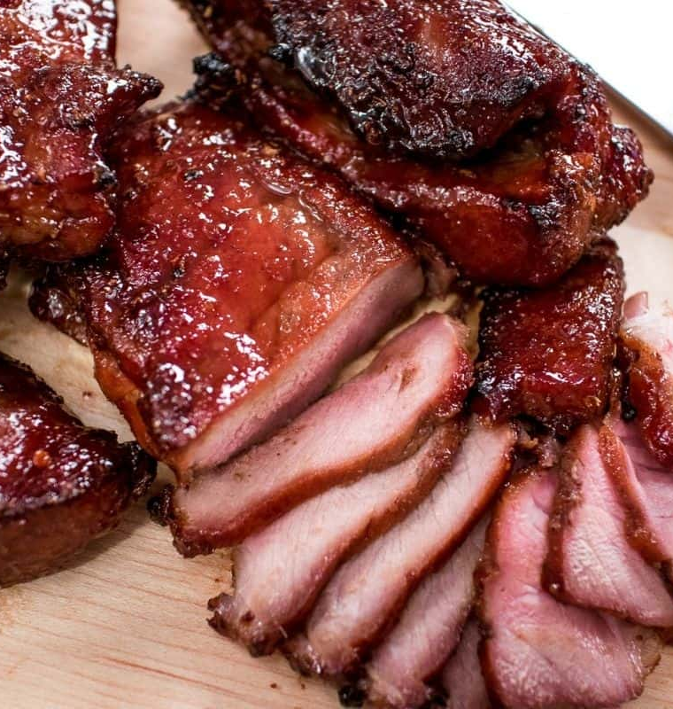
06
Conclusion /
Recommendation

Slide 15
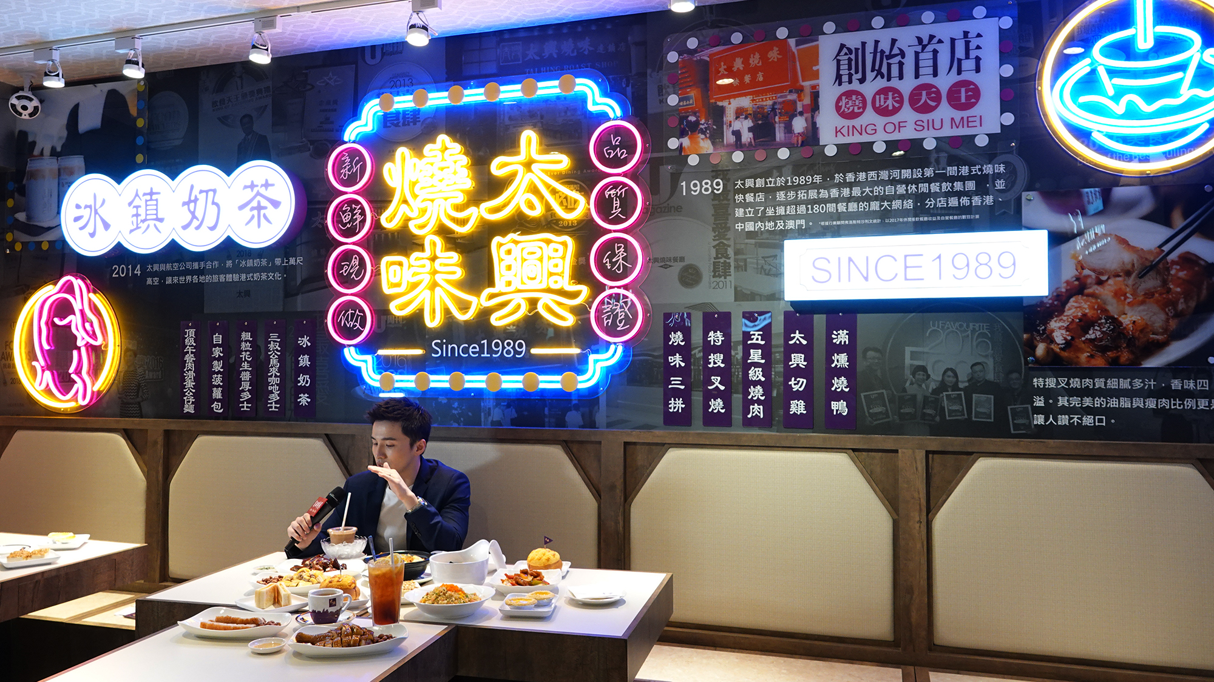
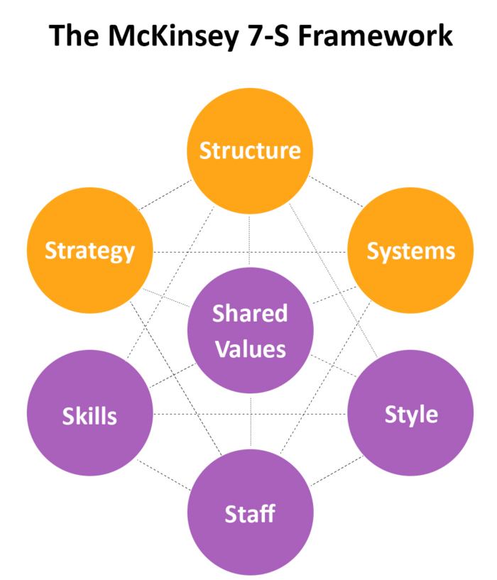
Conclusion/ Recommendation
McKinsey 7S Change Model(Investopedia, 2022)is required to
Tai Hing Group
1. Identify inconsistencies or gaps between various elements of organisation
2. Check alignment between elements by assisting shared values, soft elements and hard elements
3. Determine if shared values are consistent with structure, system, and strategy
4. Assess interdependence and alignment between soft and hard elements
5. Make necessary changes of adjustments to ensure alignment
6. Analyse whether elements function in alignment after change

Slide 16
07 Reference
Business News Daily(2023), What is Corporate Social Responsibility? Available at
https://www.businessnewsdaily.com/4679-corporate-social-responsibility.html
(Accessed: 13 April 2024)
Daryl Lim(2024), Hong Kongers flock to Shenzhen for value-for-money CNY reunion dinners. Available at
https://www.thinkchina.sg/hong-kongers-flock-shenzhen-value-money-cny-reunion-dinners
(Accessed: 13 April 2024)
David A. Nadler, Robert B. Shaw and A. Elise Walton(1995), Discontinuous change: Leading organizational transformation, Wiley.
Etnet(2019), Hong Kong Stock information. Available at
https://www.etnet.com.hk/www/eng/stocks/realtime/quote.php?code=06811
(Accessed: 13 April 2024)
Focus Economics(2024), Hong Kong Retail January 2024. Available at
https://www.focus-economics.com/countries/hong-kong/news/retail/retail-sales-deteriorate-in-january/
(Accessed: 13 April 2024)
Global Times(2024), HongKongers tripping north become new trend. Available at
https://www.globaltimes.cn/page/202401/1304865.shtml
(Accessed: 13 April 2024)
Harvard Business Review(1999), Why good companies go bad. Available at
https://hbr.org/1999/07/why-good-companies-go-bad
(Accessed: 13 April 2024)
HK01(2019), 【飲食熱話】太興用機器自動拋鑊炒河 網民：搞到食物冇靈魂. Available at
https://www.hk01.com/教煮/288642/飲食熱話-太興用機器自動拋鑊炒河-網民-搞到食物冇靈魂
(Accessed: 13, April 2024)

Slide 17
Investopedia(2022), How to use the Mckinsey 7-S model for strategic planning. Available at
https://www.investopedia.com/terms/m/mckinsey-7s-model.asp
(Accessed: 13 April 2024)
Research Gate(2017), The Science of Improvement: Responding to internal and external challenges. Available at
https://www.researchgate.net/publication/318735045_The_Science_of_Improvement_Responding_to_Internal_and_External_Challenges_in_a_Complex_School_Environment
(Accessed: 13 April 2024)
Tai Hing(2019), Tai Hing Financial Report. Available at
https://www.taihing.com/documents/global-en.pdf
(Accessed: 13 April 2024)
Tai Hing(2022), Tai Hing Financial Report. Available at
https://www.taihing.com/documents/global-en.pdf
(Accessed: 13 April 2024)
Tai Hing(2023), Tai Hing Financial Report. Available at
https://www.taihing.com/documents/global-en.pdf
(Accessed: 13 April 2024)
Tai Hing Group Video(2019), Tai Hing Group Background Video. Available at
https://www.youtube.com/watch?v=OBHpElfRhdg&t=80s
(Accessed: 13 April 2024)
Tai Hing Group Stir-Fryer(2020), Tai Hing Group anto stir-fry video. Available at
https://www.youtube.com/watch?v=a4i0SCL-03o&t=87s
(Accessed: 13 April 2024)

