Slide 1
Topic 2a – Inheritance

Slide 2
Inheritance Fundamentals
Inheritance is one of the cornerstones of object-oriented programming because it allows the creation of hierarchical classifications.
Using inheritance, you can create a general class that defines traits common to a set of related items.
This class can then be inherited by other, more specific classes, each adding those things that are unique to it.

Slide 3
Inheritance Fundamentals
A class that is inherited is called a superclass.
The class that does the inheriting is called a subclass.
Therefore, a subclass is a specialized version of a superclass.
It inherits all of the instance variables and methods defined by the superclass and adds its own, unique elements.

Slide 4
Inheritance Fundamentals
To inherit a class, you simply incorporate the definition of one class into another by using the extends keyword.
The following program creates a:
  superclass called A
  and a subclass called B.
The keyword extends is used to create a subclass of A.

Slide 5
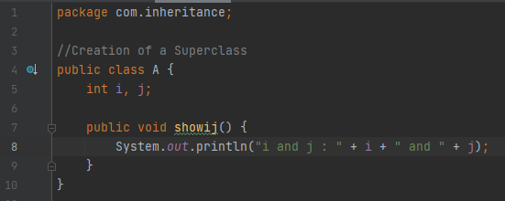
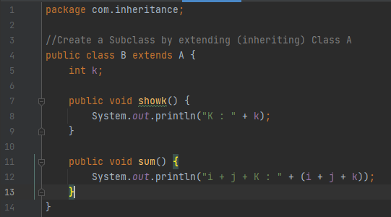

Slide 6
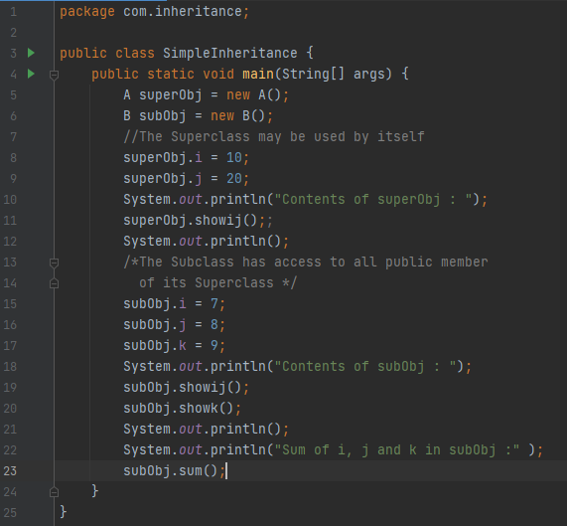

Slide 7
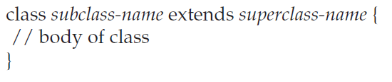
Inheritance Fundamentals
Even though A is a superclass for B, it is also a completely independent, stand-alone class.
Being a superclass for a subclass does not mean that the superclass cannot be used by itself.
Further, a subclass can be a superclass for another subclass.
The general form of a class declaration that inherits a superclass is shown here:

Slide 8
Member Access & Inheritance
Although a subclass includes all of the members of its superclass, it cannot access those members of the superclass that have been declared as private.

Slide 9
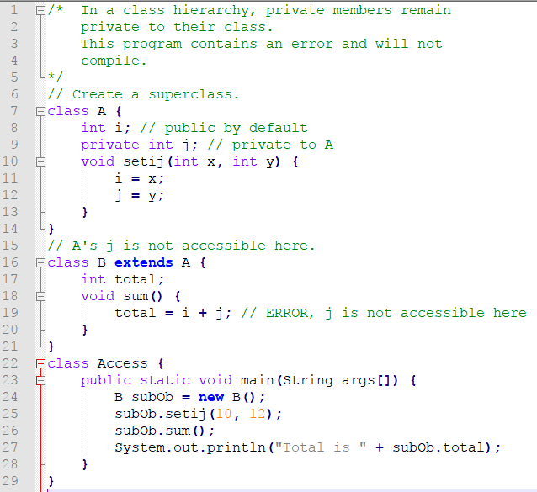

Slide 10
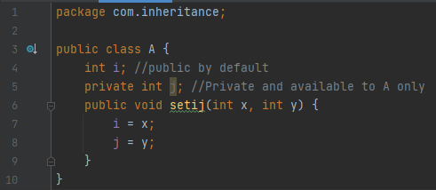
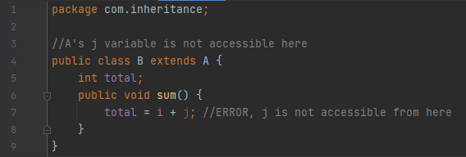

Slide 11
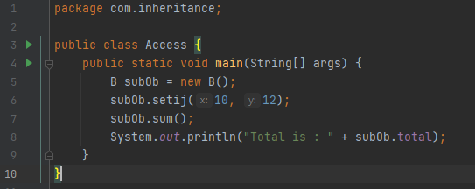
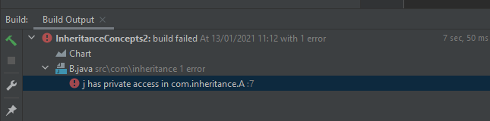


Slide 12
Member Access & Inheritance
This program will not compile because the reference to j inside the sum( ) method of B causes an access violation.
Since j is declared as private, it is only accessible by other members of its own class.
Subclasses have no access to it.

Slide 13
Box Class with Inheritance
The following code is a version of the Box class developed previously and extended to include a fourth component called weight.
Therefore, the new class will contain a box’s width, height, depth, and weight.
Note there are 4 Constructor methods for the Box class.

Slide 14
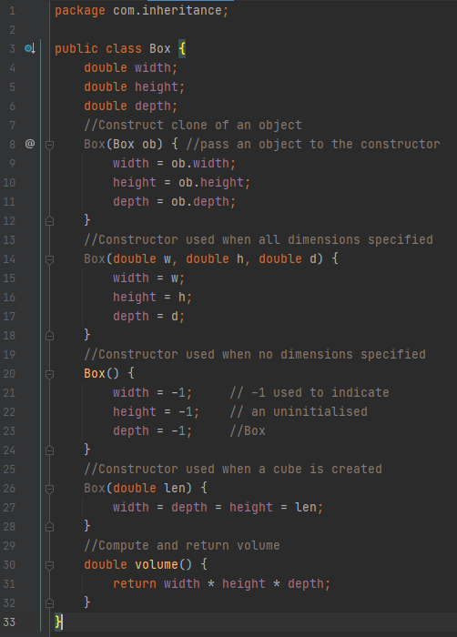

Slide 15
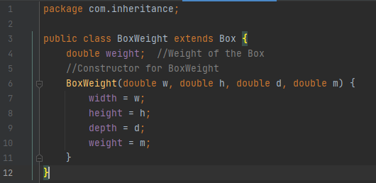

Slide 16
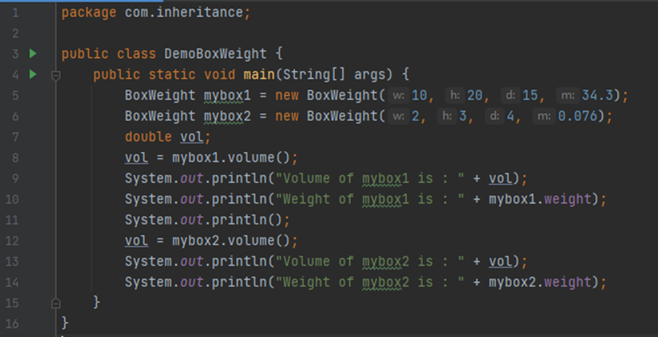
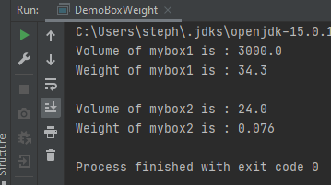

Slide 17
Box Class with Further Inheritance
A major advantage of inheritance is that once you have created a superclass that defines the attributes common to a set of objects, it can be used to create any number of more specific subclasses.
Each subclass can precisely tailor its own classification.
For example, the following class inherits Box and adds a color attribute:

Slide 18
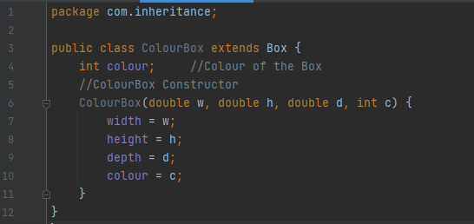
Box Class with Further Inheritance

Slide 19
Parent .. Child … Grand Child Inheritance

Slide 20
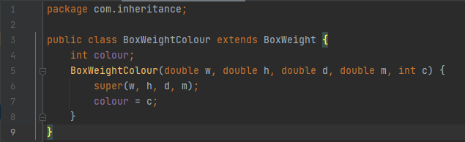
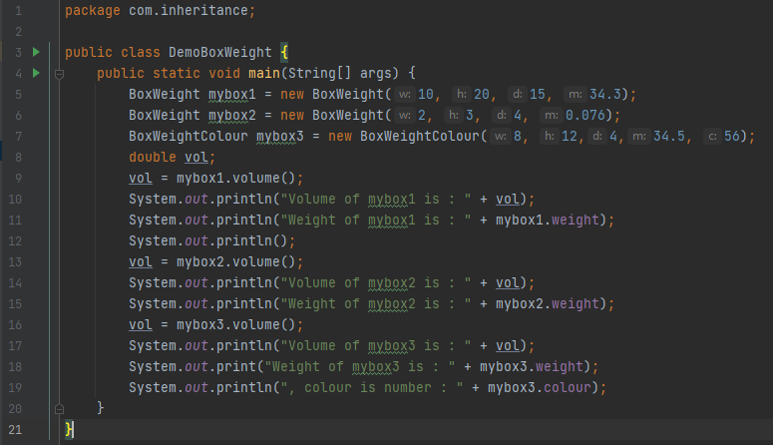

Slide 21
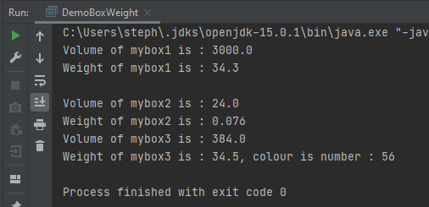
Sample Output

Slide 22
A Superclass Variable Can Reference a Subclass Object
A reference variable of a superclass can be assigned a reference to any subclass derived from that superclass.
For example, consider the following code snippet and determine why the last line of code that has been commented out would generates an error.

Slide 23
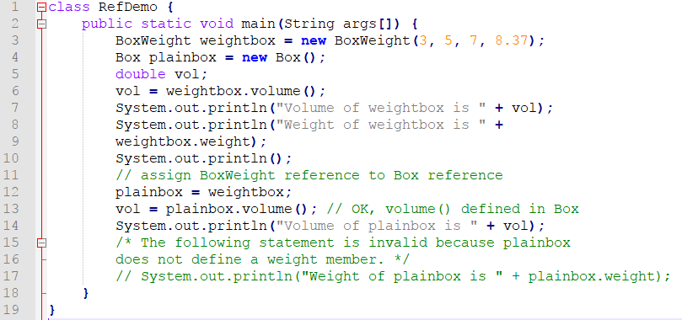

Slide 24
A Superclass Variable Can Reference a Subclass Object
Here, weightbox is a reference to BoxWeight objects, and plainbox is a reference to Box objects.
Since BoxWeight is a subclass of Box, it is permissible to assign plainbox a reference to the weightbox object.
When a reference to a subclass object is assigned to a superclass reference variable, you will have access only to those parts of the object defined by the superclass.

Slide 25
A Superclass Variable Can Reference a Subclass Object
This is why the last line of code in the preceding fragment is commented out.
It is not possible for a Box reference to access the weight field, because Box does not define one.

Slide 26
Using the super Keyword
In the preceding examples, classes derived from Box were not implemented as efficiently or as robustly as they could have been.
For example, the constructor for BoxWeight explicitly initializes the width, height, and depth fields of Box( ).
This duplicates code found in its superclass, which is inefficient.
It also implies that a subclass must be granted access to these members.

Slide 27
Using the super Keyword
There will be times when you will want to create a superclass that keeps the details of its implementation to itself (that is, that keeps its data members private).
In this case, there would be no way for a subclass to directly access or initialize these variables on its own.
Since encapsulation is a primary attribute of OOP, it is not surprising that Java provides a solution to this problem.

Slide 28
Using the super Keyword
Whenever a subclass needs to refer to its immediate superclass, it can do so by use of the keyword super.
super has two general forms.
  The first calls the superclass’ constructor.
  The second is used to access a member of the superclass that has been hidden by a member of a subclass.

Slide 29
Using super to Call Superclass Constructors
A subclass can call a constructor defined by its superclass by use of the following form of super:
  super(arg-list);
Here, arg-list specifies any arguments needed by the constructor in the superclass.
super( ) must always be the first statement executed inside a subclass’ constructor.

Slide 30
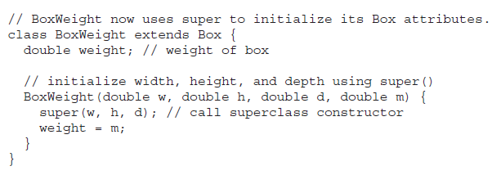
Using super to Call Superclass Constructors

Slide 31
Using super to Call Superclass Constructors
Here, BoxWeight( ) calls super( ) with the arguments w, h, and d.
This causes the Box( ) constructor to be called, which initializes width, height, and depth using these values.
BoxWeight no longer initializes these values itself.
It only needs to initialize the value unique to it:
  weight.
This leaves Box free to make these values private if desired.

Slide 32
Complete Implementation of the BoxWeight Project
The code that follows is a complete implementation of BoxWeight that provides constructors for the various ways that a box can be constructed.
In each case, super( ) is called using the appropriate arguments.
Notice that width, height, and depth have been made private within Box.

Slide 33
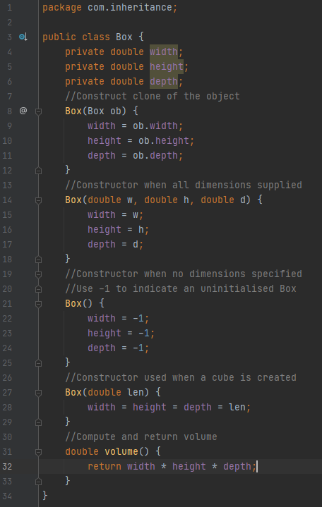

Slide 34
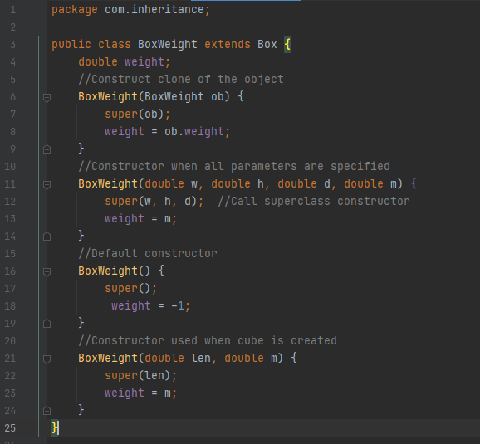

Slide 35
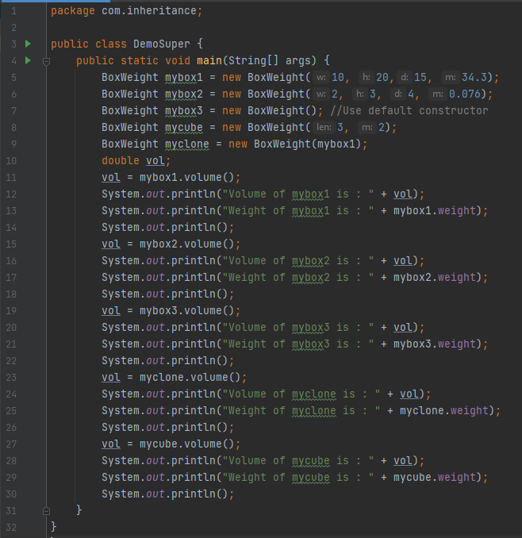

Slide 36
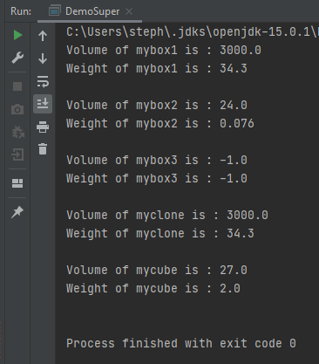
Sample Output

