Slide 1
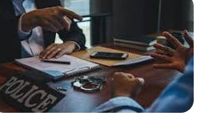
Conducting Investigations

Slide 2
PACE Codes of Practice
Provide guidelines on how investigative processes should be conducted
Definitions: CPIA 1996
-‘Criminal Investigator’
-‘Criminal Investigation’
-‘Material’
Code | General areas covered
A | Stop and Search
B | Search of premises
C | Detention, treatment, and questioning of suspects
D | ID of suspects
E | Audio-only recording of interviews
F | Audio-visual recording of interviews
G | Power of arrest
H | Detention, treatment, and questioning of terrorist suspects

Slide 3
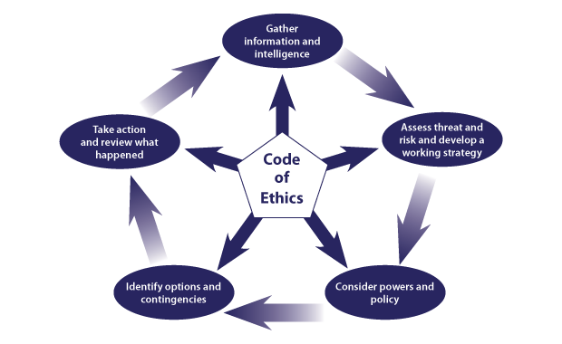
The National Decision Model (NDM)
JPLANE
Discretion
ABC Approach
Human Rights

Slide 4
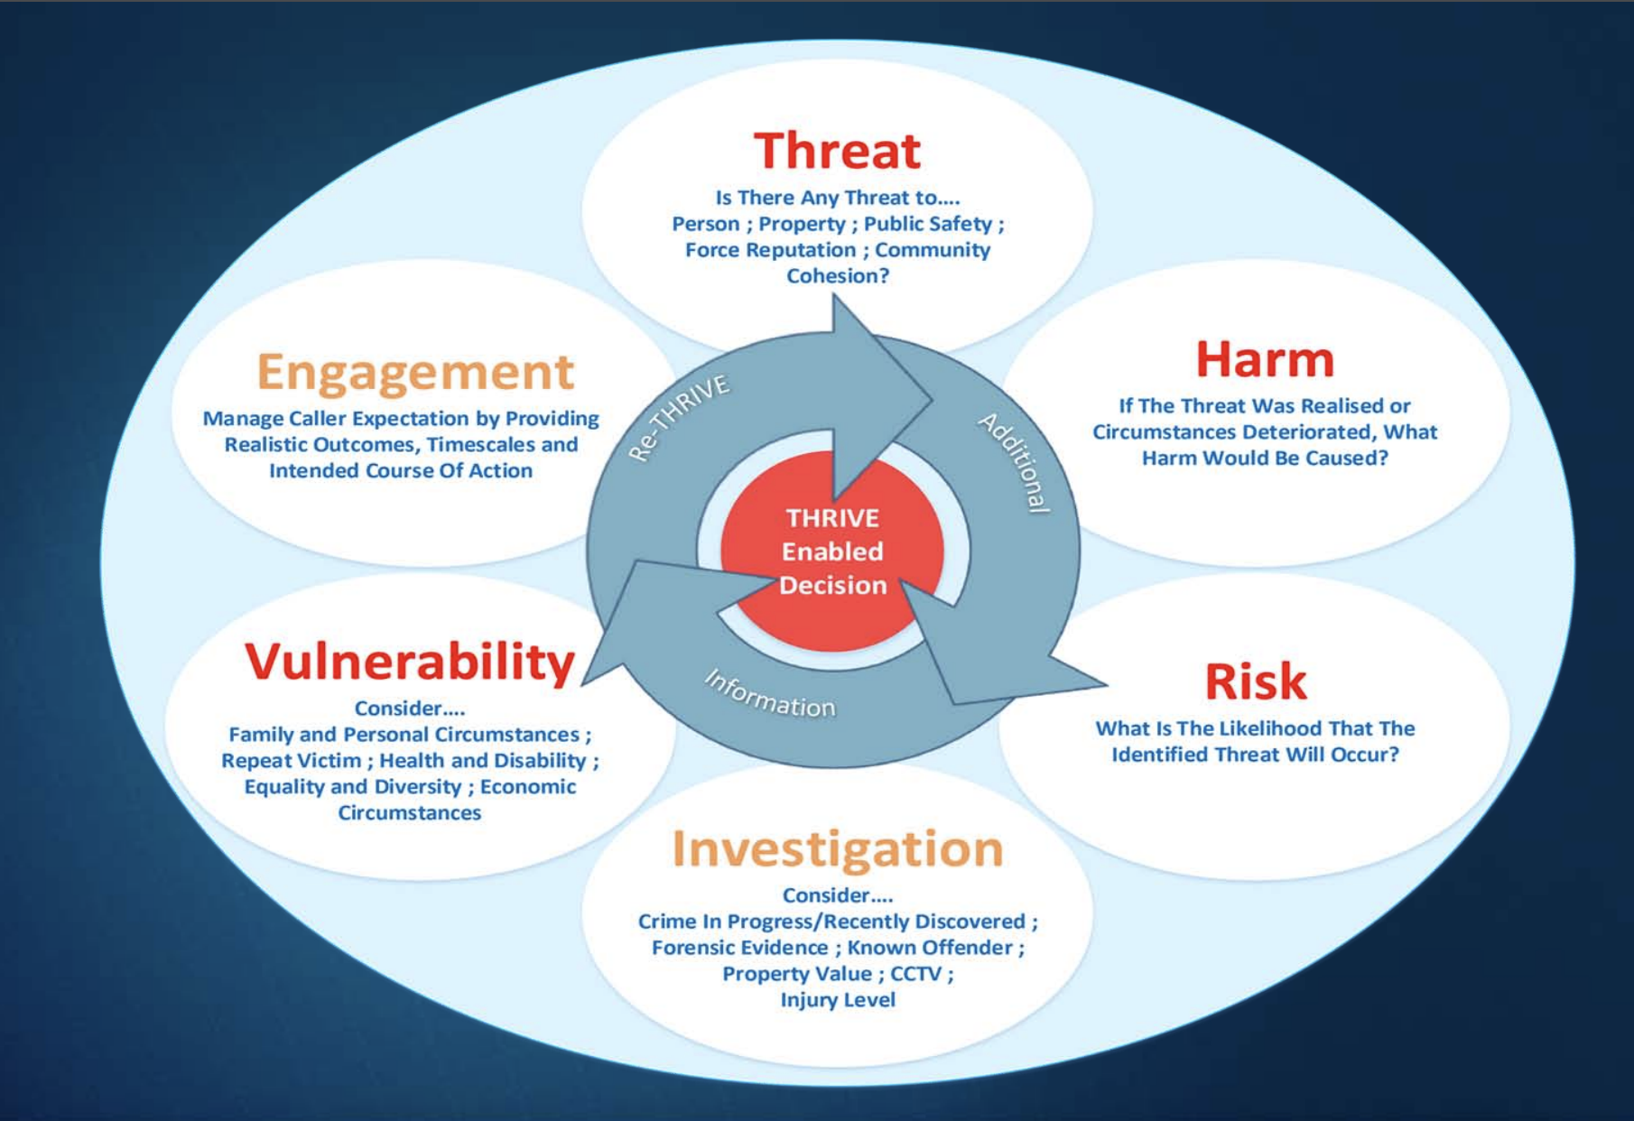

Slide 5
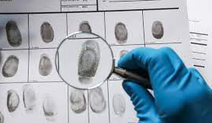
Forensics
Investigating a crime scene and forensic analysis using specialist procedures and techniques can provide evidence to:
Prove that a crime has been committed
Exclude a suspect from a scene
Link a suspect with a scene
Establish the identity of a victim, suspect or witness
Corroborate or disprove witness accounts
Interpret the scene in relation to movements within the scene and sequences of events
Link crime scene to crime scene and provide intelligence on crime patterns
(College of Policing, 2021)

Slide 6
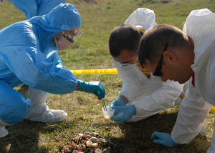
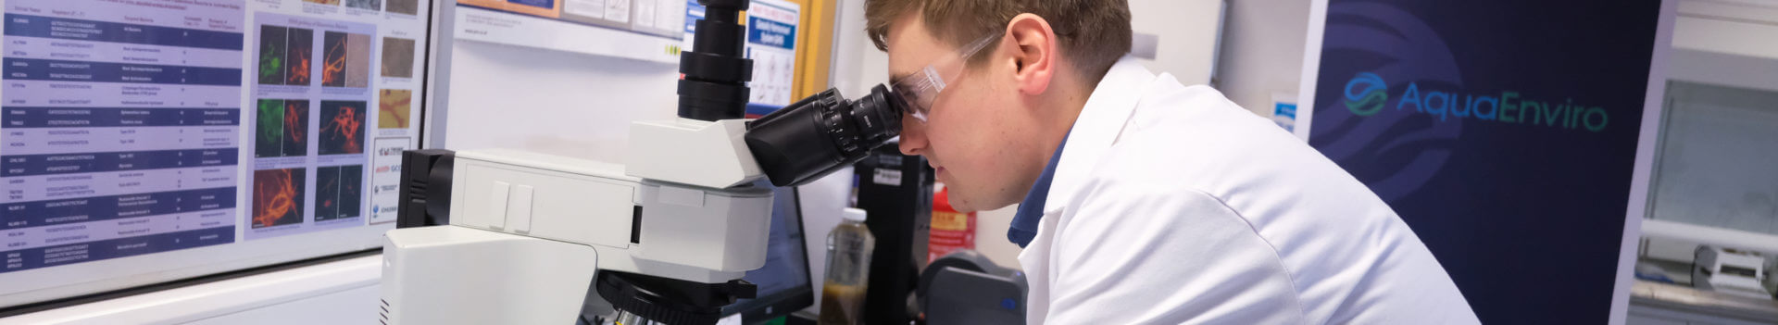
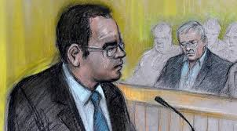
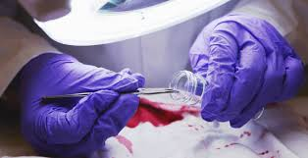
Forensic Science
Plays a crucial role in many criminal prosecutions, every piece of forensic evidence goes through three key stages between its recovery from the crime scene to the presentation of scientific findings at court.
The Recovery and
Continuity of Evidence
The Interpretation and evaluation of scientific evidence and the presentation of scientific results in court.
Analysis of the evidence recovered from crime scenes

Slide 7
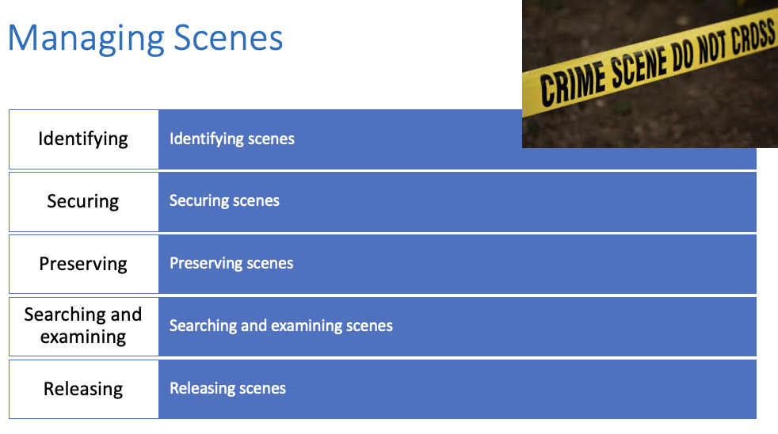
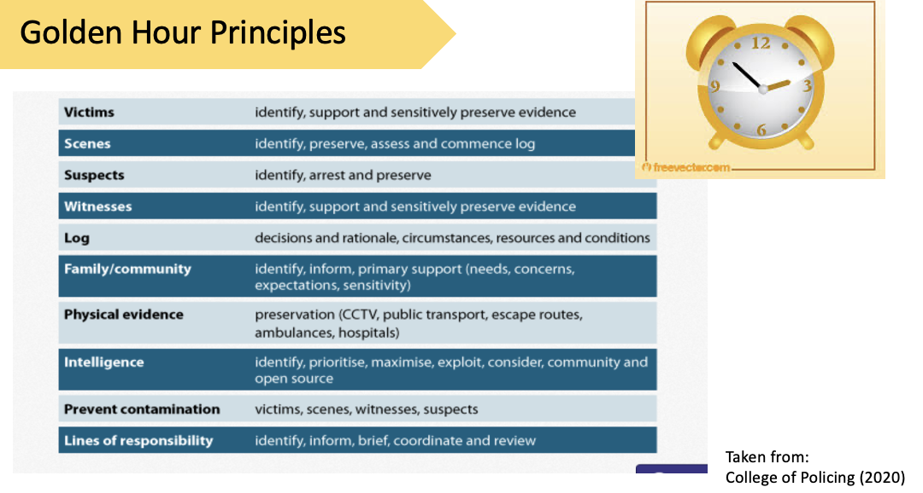
Forensic Recap
Sources of Forensic Evidence
(PIL Triangle)
Three main types of forensic Evidence
Role of a Crime Scene Investigator
The Golden Hour Principles
Chain of Evidence (W’s & H)
Scene Log / CAP
The 4 R’s

Slide 8
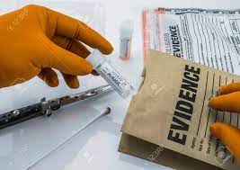
What can samples be used for?
Samples from a person can be used to:
Prove or disprove his/her involvement
Corroborate or refute statements
Show link between the offender, victim and the scene/location
Establish drug, toxin, or alcohol levels
Provide a reference sample for direct comparison or elimination or database

Slide 9
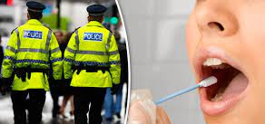
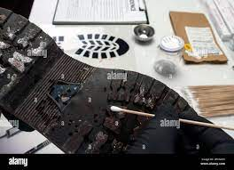
Purpose:
Taking Samples in Investigations
‘’The objective of taking samples from suspects, victims and crime scenes is to demonstrate a link between them…’’
‘’Forensic evidence has the potential to produce powerful forms of evidence…’’
‘’Typically, the sample is taken from one person or place then a corresponding sample should be recovered from elsewhere for comparison’’.
(Bryant and Bryant, 2021, p. 620)

Slide 10
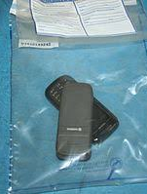
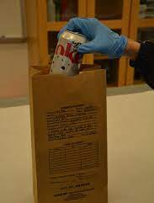
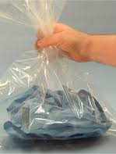
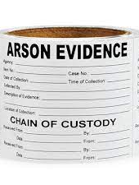
In which incidents will you need to seize and package potential evidence?

Slide 11
What samples should be taken?
 | Cheque or other fraud. Hate Mail | Burglary or other property crime | Sexual assault or rape | Theft from motor vehicle with damage caused | ABH and other assaults | Homicide victims and suspects
Blood and/or Urine for Toxicology
Clothing (inner)
Clothing (outer)
DNA
Fingerprints
Hair (combing)
Hair (pulled/cut)
Handwriting Sample
Photographs of injuries |  | When relevant | When relevant | When relevant | When relevant | Effectively mandatory
Sexual Offence Kit |  |  | Mandatory |  |  | Normally used
Shoes
(Blackstone’s, 2021)

Slide 12
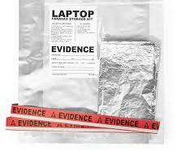
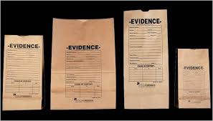
Seizure and Packaging Techniques
“Using the correct seizure procedures and methods for packaging prevents damage and contamination and is, effectively, a demonstration of care and skill that accompanied the seizure of the exhibits”.
(Bryant and Bryant, 2021, p. 627)
Examples of Packaging:
Paper bags
Polythene bags
Nylon Bags
Faraday bags
Boxes
Paper Folds
Plastic Tubes

Slide 13
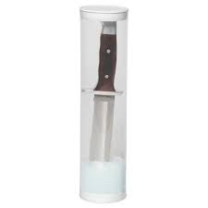
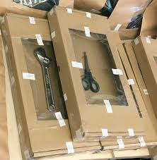
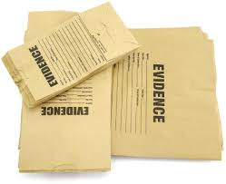
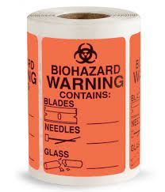
How to use packaging?
Paper bags should be folded over twice, and the joint should be sealed with two signature seals with officer's signature name and number.
Polythene bags a tamper bag should be used if available – methods for sealing plain polythene bags are more complex.
Nylon bags should be sealed by twisting into a ‘swan neck’ and the secured with tape or a cable tie. The nylon bag is then placed into a polythene bag swan neck and then sealed. The whole package should then be placed in a rigid container, signature sealed and labelled.
Boxes can be used for larger items but need to be made stable within the box using string or cable ties. All open edges must be sealed with tape and signature sealed. Smaller boxes can be sealed and then placed in polythene bags.
Paper folds required for safe collection and storage of dry materials such as powder, paint fragments and hair combings.
Blackstone’s (202)

Slide 14
Policing Perspective: Conducting Investigations
Information obtained from initial call
Information from police systems
Information from officer attending
Information provided by 1st witness
Info provided by victim (1st account)
Evidence collected at scene (exhibits)
Evidence from CSI in attendance
Suspect information & intelligence
Plan to locate & manage suspect
Complete crime report
Consider multi-agency approach
Consider future action- ie searches, interview, file prep

Slide 15
Role Play
Officer
You are to attend Mrs Jones’ house.
She has contacted the police in a very upset state, reporting that she thinks someone is inside her home and going through her personal belongings.
Deal with as you see fit, consider the NDM and your training.
Mrs Jones
You meet with the officer at the address, inform them that you think someone is in your home going through your belongings, when you and the officer go into the home, you see the door is ajar and there is no one there but unfortunately you can see that someone has been in and removed your laptop from the table and made a mess of things.

Slide 16
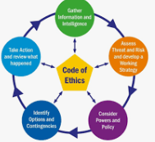
The marking guide
Critical application of the National Decision Model
Gather Info and Intel
Assess and develop a working strategy
Consider Police Powers and policies
Options and contingencies
Action and Review
The Code of Ethics

