Slide 1



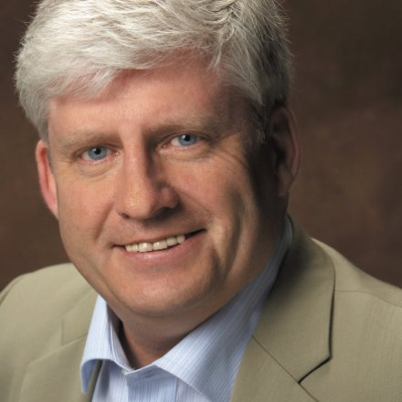





Mr Nigel T. Packer,
Consultant, Business for Business,
‘The use of LinkedIn to further your career’
http://www.linkedin.com/in/nigeltpacker
Monday 25 February 2013
4.30-5.30pm FT BA Business Final Year
6.00-7.00pm PT MBA/PT Professional courses and guests
Thursday 28 February 2013
11.00-1200am Public Services in 228
2.30-3.30pm FT MBA
All sessions apart from PS in Lecture Room GO1
High St Campus, SA1 1PW, Room ASG01, ground floor,
welcome!
Professional Associations at Swansea Business School:

