Slide 1
Introduction to the Law of Succession and Administration of Estates
Week 3 Intestate Succession

Slide 2
Intestacy…. we will be looking at:
Intestacy and partial intestacy
Inheritance and Trustee Powers Act 2014 (ITPA 2014)
The statutory rules (devolution on intestacy)
s47 statutory trusts
Statutory order
Entitlement of spouses/civil partners
Distribution where no surviving spouse or civil partner
Bona vacantia
Cohabitees

Slide 3
Where no will? - Intestacy
Personal representatvies = ADMINISTRATORS
Appointed by Court
Grant of letters of administration provide authority to act/administer
Persons entitled to apply = those entitled to inherit/have a beneficial interest under rules of intestacy
Strict order of priority (1. spouse, 2. children, 3. parents, 4. siblings, 5. grandparernts, 6. uncles/aunts…)
Categories are ‘cleared off’ if they can’t act or won’t act
If person has right to apply but doesn not wish to do so they can renounce
Maximum of 4 administrators, minimum of 2 if there are beneficiaries under 18 (minors)
Application made online by legal professionals

Slide 4
Intestacy and Partial Intestacy
Reluctance to write a will still prevalent in the UK | The Gazette
Statistics will vary but undoubtedly a high percentage of UK adults will die intestate – having made no will
Why?
Intestacy: when a person dies without a will
Partial intestacy: where there is a valid will but:
If Partial intestacy then the valid gifts and legacies must be paid in the normal way. Property not disposed of then distributed according to intestacy rules
Problem with partical intestacy? A family member could end up inheriting when that was not what T would wish
Fix? Provision in a will providing for residue to go to a named beneficiary and a substitution clause ( more later)

Slide 5
Inheritance and Trustee Powers Act 2014 (ITPA 2014)
ITPA 2014 introduced a number of changes to how intestate estate devolves esp. re spouse or civil partner
Pre October 2014 rules applying to intestacy –apply to deaths occurring prior to 1 October 2014
Section 46 of the AEA lists potential beneficiaries in hierarchical order
Section 46 is based on a presumed intention i.e that this is what the deceased would have wanted to happen to their assets

Slide 6
The statutory rules (devolution on intestacy)
When a P dies intestate, all assets become subject to a statutory trust ( s 33 Administration of Estates Act 1925 (‘AEA’)
Personal Representatives will hold all undisposed of estate ON TRUST with the power to sell
PRs wil pay funeral expenses and debts from any cash and proceeds of sale of other assets
PRs then pay any valid legacies if there is a partial intestacy
PRs then hold the remaining estate to be distributed under the strict order of entitlement in s 46 AEA 1925

Slide 7
s47 statutory trusts
Statutory Trust is defined in S47 AEA as including the class of relative to whom it applies TOGETHER WITH the issue ( children or direct descendants) or the relative in question if that relative has predeceased the intestate ( but see exception
This applies whether this the relative is a child or another class or relative e.g brother, sister, uncle, aunt……
‘Child’ – includes a child unborn at date of death but later born alive
If a child has predeceased the intestate ( ‘Int’) but had a child of their own ( the Int’s grandchild) that child (the grandchild) steps into the parent’s shoes and inherits along with any other living children of the Int
Any share is contingent on the child attaining 18 or marrying/civil p’ship earlier. So if a child survives the Int but dies before 18 or earlier marriage then that share devolves as if that child never existed.

Slide 8
s47 statutory trusts
There is an exception since February 2012 – under s 3 Estates of Deceased Persons ( Forfeiture Rule and Law of Succession Act 2011)
Exception: If the B dies after the Int without having attained a vested interest but leaves issue, then that issue will take the share under the statutory trust in the same way as if the B had predeceased the Int
For example,
B is 16 and has a child. Father of B dies intestate on 1st January 2024 and only relatives are B and B’s 19 year old brother. B’s share is contingent upon him reaching 18 ordinarily but if B dies on 31st January 2024 whilst 16 then, because B has a child, B’s share will pass to the child
If B did not have a child then when B died that share would devolve and B’s brother would inherit the lot!

Slide 9
Statutory Order
S46 of AEA governs the distribution of assets on an intestacy
Prior to distribution, the PR has to know how many relatives the Int had and who they are – needs family tree with ages, marital status, whether any children etc
First question : is there a living spouse or civil partner
If YES, what other relatives are there who are the Int’s children or their issue
If NO spouse/civil partner, what other relatives are there?
For basic order of priority see next slide

Slide 10
S46 AEA Basic order of priority
Spouse or Civil Partner
Issue ( deceased’s children and direct descendants) on the statutory trusts
Parents
Brothers and sisters of the whole blood on the statutory trusts
Brothers and sisters of the half blood on the statutory trusts
Grandparents
Uncles and aunts of the whole blood on the statutory trusts
Uncles and aunts of the half blook on the statutory trusts
The Crown ( i.e the state)

Slide 11
Entitlement of spouses/civil partners
If there is no issue, the spouse/civil partner inherits entire estate
This reflects assumption in law that most testators would want priority to be given to their spouse or civil partner
Divorced or judicially separated spouses and ex civil parnters ( where the partnership has been dissolved) are not entitled to a share in the estate
S 46 (2A) AEA 1925 states that the spouse must survive the Int by at least 28 days before they can inherit ( this 28 day rule only applies to spouses)
If there is a spouse then the only other family members who need to be considered are issue.
If there are issue of the Int then the spouse/cp may not take the entire estate – depends on size and nature of it.

Slide 12
Entitlement of spouses/civil partners
LUMP SUM
Spouse/Civil Partner is entitled to a statutory legacy of £322,000 (for deaths on or after July 2023) plus interest from date of death until payment
ITPA 2014 requires Lord Chancellor to reset the statutory legacy every 5 years
CHATTELS
Spouse/Civil partner receives all personal chattels ( personal possessions) other than:
RESIDUE
If estate has a value of over the statutory legacy i.e > £322,000 the spouse/cp will receive a ½ share of the residue ( the other ½ goes to the issue)
THE FAMILY HOME: If property is held as Joint Tenants then the spouse/cp takes the Int’s share by survivorship – so does not pass on intestacy anyway
If property was held as Tenants in Common or by Int alone then spouse will be anxious to ensure that family hom is transferred to them and s41 of AEA becomes relevant

Slide 13
S 41 AEA 1925
S 41 gives the PRs a general power to appropriate all types of asset, including houses to individual beneficiaries instead of their cash equivalent
PRs can therefore choose to appropriate the family home to the spous/cp but only it its value does not exceed the spouse/cp’s entitlement under the intestacy rules
If value of family home is greater than the spouse/cp’s entitlement, it may be possible for the spouse to require the PRs to appropriate the home to them under Sch 2 Intestates’ Estates Act 1952, as long as following conditions are met:
  The right must be exercised within 12 months of date of the grant
  Written notice must be given to the PRs
  The residue must include an interest in a ‘dwelling house’
  Spouse/cp must be resident in that dwelling house at the time of death
  Value of house must be taken at the date of appropriation ( not the date the deceased died). Re Collins [1975]
  If the value of the family home exceeds the share of the estate which is due to the spouse/cp they will be required to pay the difference from their own money
  Right does not apply in some circumstances and in those the consent of the court would be required…. See over

Slide 14
S 41 AEA 1925
Under Schedule 2 consent of the court would be required where an appropriation might diminish the value of the whole estate:
  The home forms part of a larger building, the rest of which is include din the residuary estate
  The home forms part of agricultural land that is included in the agricultural estate
  The home or part of it was used as a hotel or lodging house
  Part of the home was used for non-domestic purposes, eg where an antiques business was run from the home.
  *Remember also the 28 day survivorship requirement *

Slide 15
Distribution where no surviving spouse or civil partner
Apply the order in s46 AEA 1925 with the HIGHEST class of relative taking the lot
If there is ISSUE –issue inherits entire estate
If there is NO ISSUE, but parents – parents inherit the entire estate
No issue, no parents but brothers and sisters of the whole blood – brothers and sisters inherit ( or their issue if they have predeceased the Int)
No issue, no parents, no brother and sisters of the whole blood or their issue , but brothers and sisters of the half blood – the latter will inherit the entire estate on statutory trusts
No issue, no parents, no brother and sisters of the whole blood or their issue , no brothers and sisters of the half blood or their issue, but grandparents – the latter inherit the entire estate in equal shares
No issue, no parents, no brother and sisters of the whole blood or their issue, no brothers and sisters of the half blood or their issue, no grandparents, but uncles and aunts of the whole blood or their issue – aunts and uncles inherit in equal sares on the statutory trusts
No issue, no parents, no brother and sisters of the whole blood or their issue , no brothers and sisters of the half blood or their issue, no grandparents, no uncles and aunts of the whole blood or their issue, but aunts/uncles of the half blood– aunts and uncles of the half blood or their issue inherit in equal shares on the statutory trust
None of the above relatives? – the entire estate passes to the Crown ( unless Int died in Cornwall or in the Duchy of Lancaster in which case the estate passes to the Dukes of those places. Estate is described as BONA VACANTIA

Slide 16

Bona Vacantia
s46 AEA 1925 gives the Crown (or the Duke of Cornwall or Duchy of Lancaster) in these cases a discretion to make provision for the intestate’s dependants (whether related to the deceased or not) and for any other person for whom the intestate might reasonably have been expected to make provision.
Bona Vacantia Division (BVD) of the Treasury Solicitor’s department, acting on behalf of the Crown, administers the estates of people who die without known blood relatives and without leaving a will.
BVD publishes an updated list every working day of unclaimed estates which have been referred to it. An industry of specialists has developed in light of modern technology making the tracing of ancestors easier than before. If a genealogist manages to trace a relative who is entitled, the BVD will hand over the matter to enable the estate to be administered and the property distributed, with the genealogist taking a commission.

Slide 17
Cohabitees
Under current law, only spouse/cp can inherit on intestacy. If the surviving partner is a cohabitee they have no legal protection and will not inherit anything
If the cohabitation has lasted for at least two years, the surviving cohabitant has the right to apply to court for a financial award out of the estate – the court has discretion whether or not to grant an award
Law Commission recommended significant changes to the intestacy rules in its 2011 report Intestacy and Family Provision: Claims on Death. Many of the proposed changes were enacted in ITPA 2014. Part 8 of the report dealt with the rights of unmarried cohabitants under the intestacy rules and was not accepted by the government. The report included a draft Inheritance (Cohabitants) Bill which was introduced in the House of Lords but was not enacted.

Slide 18
Cohabitees
Part 8 of the Law Commission’s report highlighted the following points.
(1) Approximately 15 per cent of all couples are living as cohabitants and the percentage is expected to increase.
(2) Cohabitants are less likely to have made wills than married couples (though they do tend to be younger and younger people are generally less likely to have made wills).
(3) Although cohabitants can claim a share of the estate through I(PFD)A 1975, the requirement to go to court is onerous and causes unnecessary difficulties and legal costs when the underage children of the couple have to have separate representation as the defendants.
(4) Many unmarried couples are unaware that they do not have any rights under the intestacy rules against each other’s estates.

Slide 19
Cohabitees….contd.
(5) As with married couples, the finances of unmarried couples are often intertwined and interdependent.
(6) Other jurisdictions in Australia, Canada and New Zealand have been able to provide for cohabitants under intestacy without significant difficulties.
Choice and commitment? The report noted the arguments that all unmarried couples had the choice as to whether or not to get married or form a civil partnership. It also noted that they had the opportunity to make wills. Nonetheless, it argued that simply relying on choice could lead to injustice – both parties had to agree to a marriage or civil partnership and the reluctance of one party could be unfair on the other. Similarly, one party could not compel the other to make a will.

Slide 20
Cohabitees….contd.
In relation to commitment, similar arguments apply. The Law Commission did not accept the argument that the value of a public commitment to each other in a marriage or civil partnership ceremony had to be reinforced through the intestacy rules.
The Law Commission proposed in its draft Bill to give unmarried cohabitants who have lived together for five years or more the same rights on intestacy as a spouse or civil partner.
If the couple had had a child together, the period would be reduced to two years.
However, the current situation is that cohabitees are not included in the statutory order. If a cohabitee dies intestate a cohabitee that falls within the I(PFD)A1975 class of claimants will have the right to make a claim; however, that will be limited under the Act to provision for their maintenance.

Slide 21
Children
‘Child’ includes legitimate and ‘illegitimate’ as no distinction now made ( Family Law Reform Act 1987 s 18) +adopted children but NOT step-children
If D only leaves children ( no spouse) the estate is held on statutory trust ( s46 (1) (ii).
Child must be alive when D dies and if more than 1 child then estate goes to them all in equal shares
If a ‘child’ has died before D then any issue of that ‘child’ takes that share
If child alive at date of D’s death but dies afterwards and before reaching 18 then their share will either go to their issue or if no issue to their siblings
If that child was an only child then D is presumed to have died without issue if that only child dies before 18 – then next priority of intestacy is entitled
Trustees can use any interest accrued from the trust for maintenance of the child and also advance some of the capital if the Trustee considers this appropriate
For examples see extracts which follow from page 152 of Hedlund

Slide 22
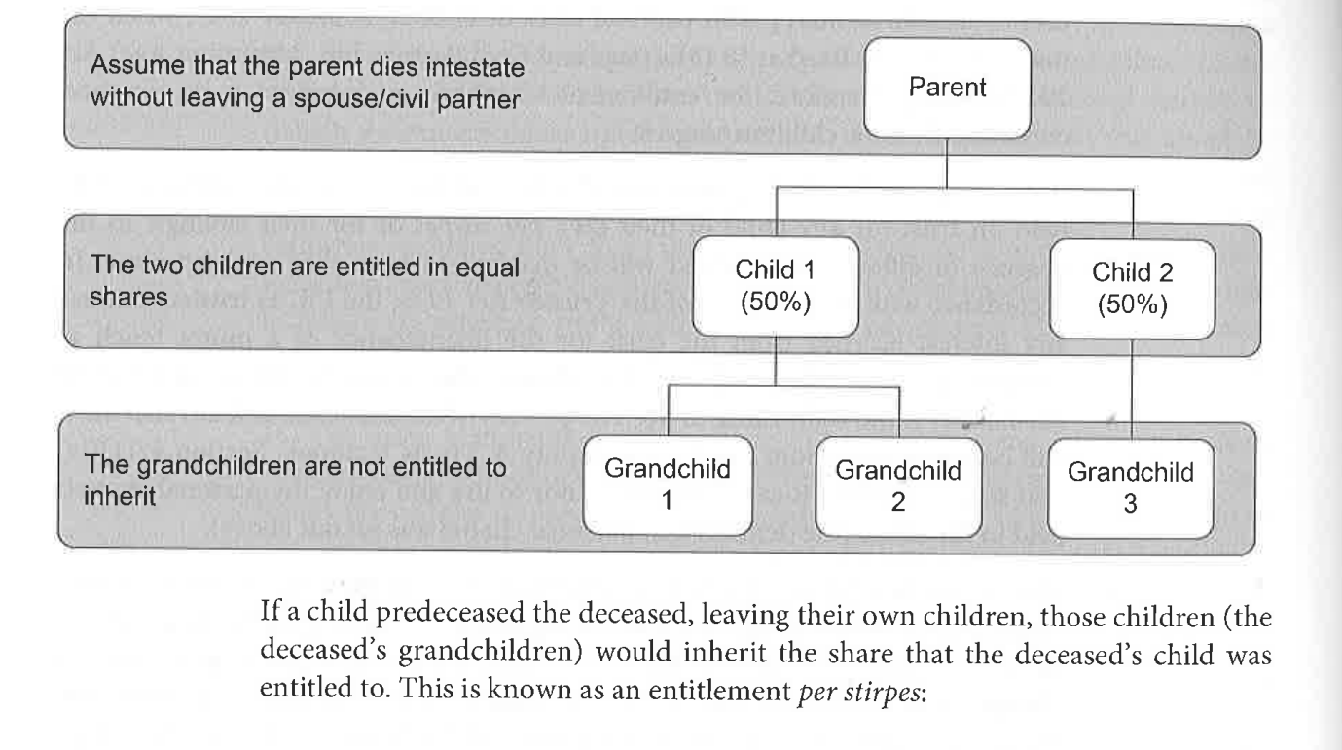

Slide 23
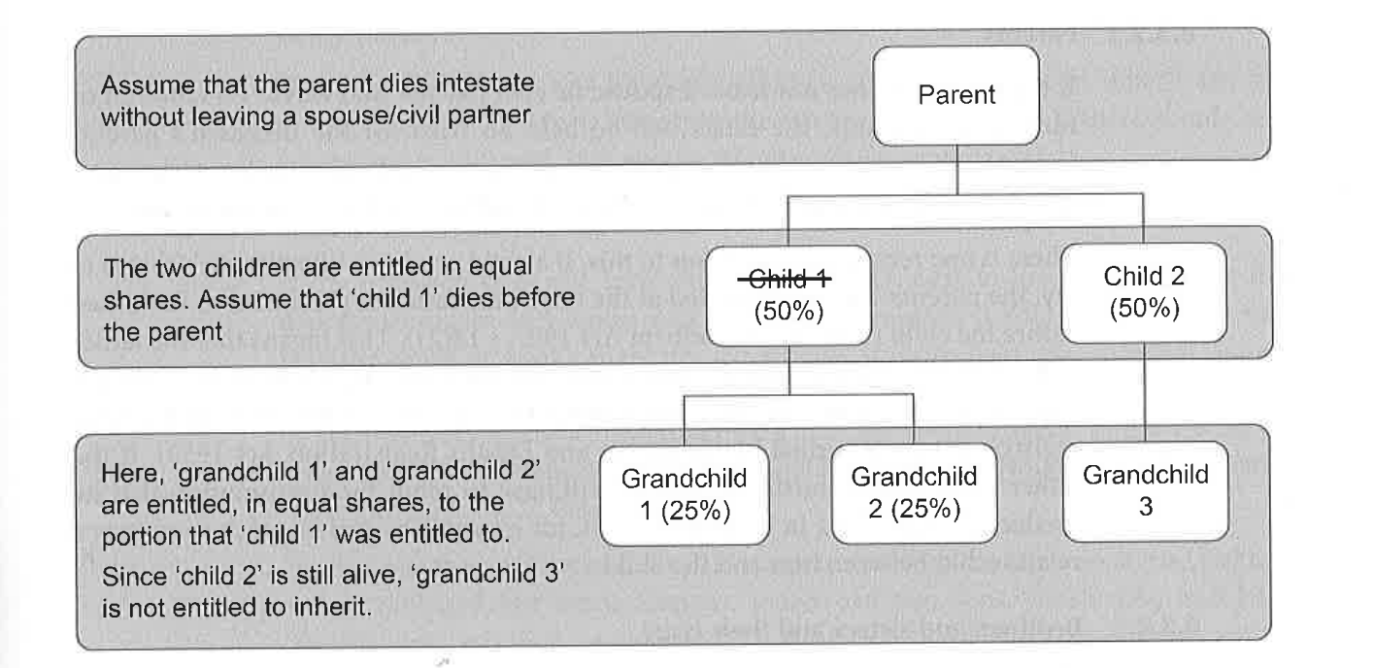

Slide 24
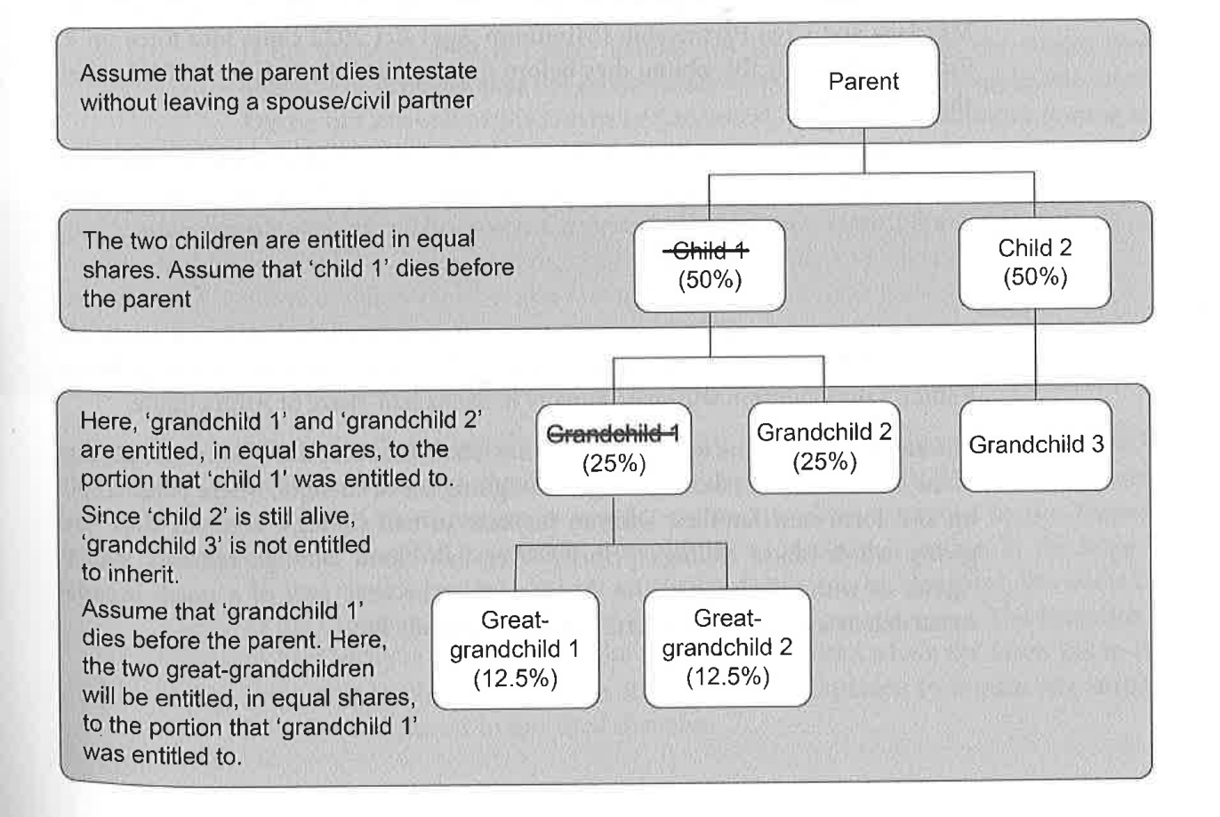

Slide 25
Workshop/Tasks
Select 3 members of your family ( at least one should be a distant relative)
Work out how their estate would devolve should that person die intestate ( you will need to create your own family tree to support your answer and can use Deidre’s family tree as an example)

