Slide 1

CAREERS SERVICE
HERE TO HELP YOU REALISE A CAREER

Slide 2

Learning objectives
CAREERS SERVICE
HERE TO HELP YOU REALISE A CAREER
Learn about the Careers Service
Understand the purpose of a CV
Learn about your options after leaving university

Slide 3
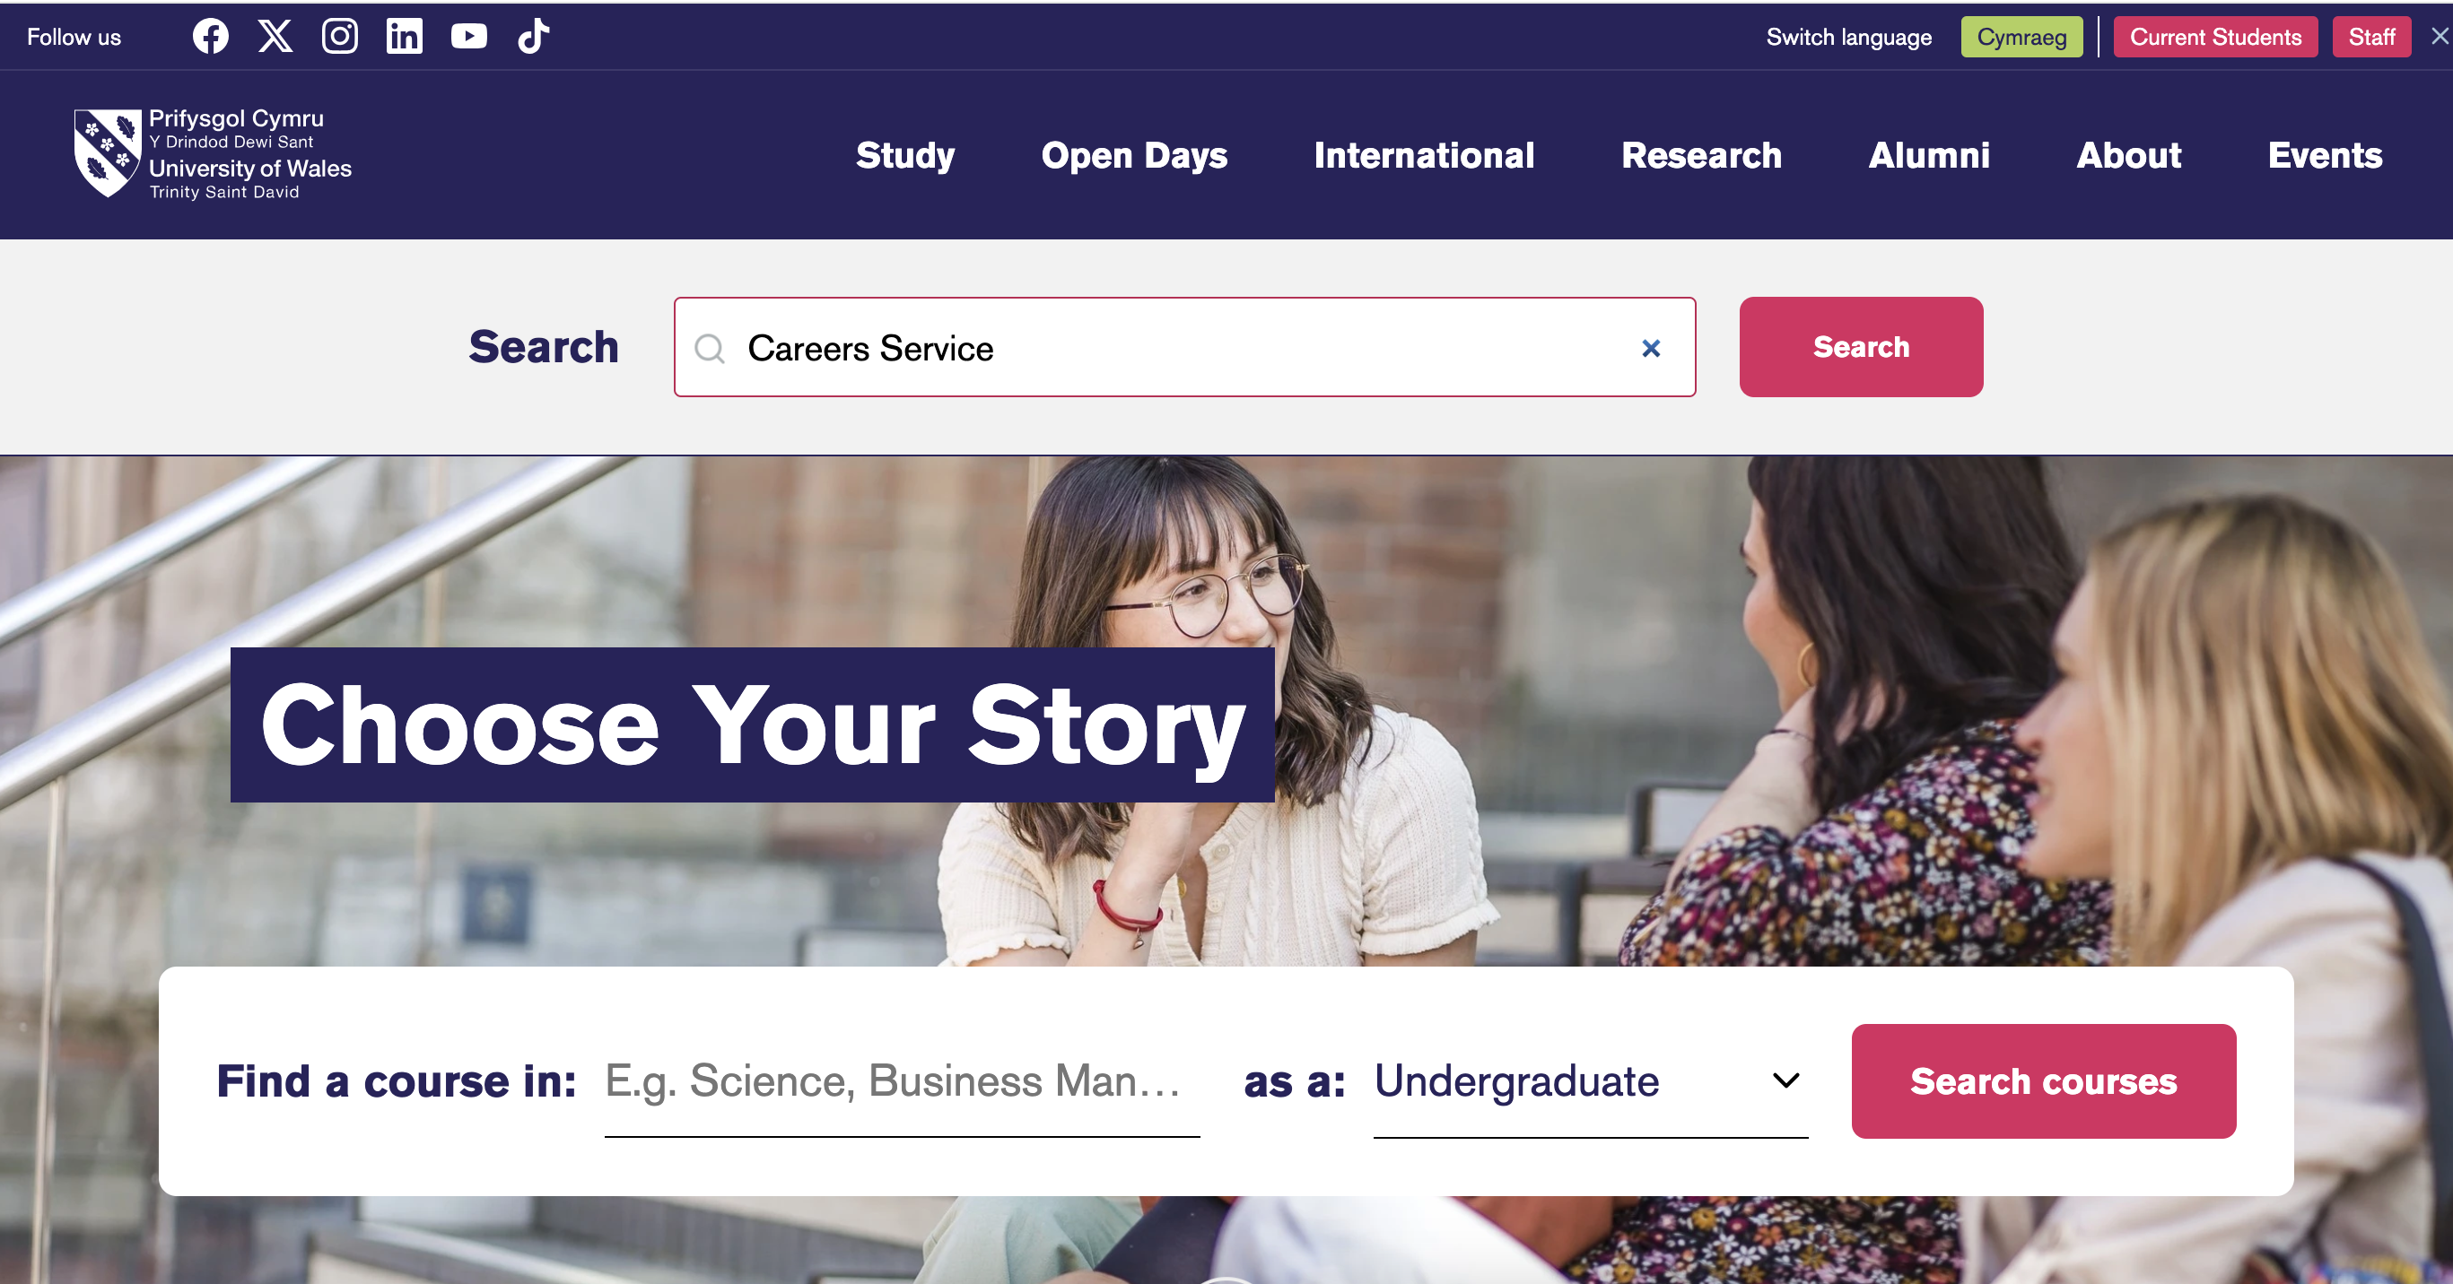

Slide 4
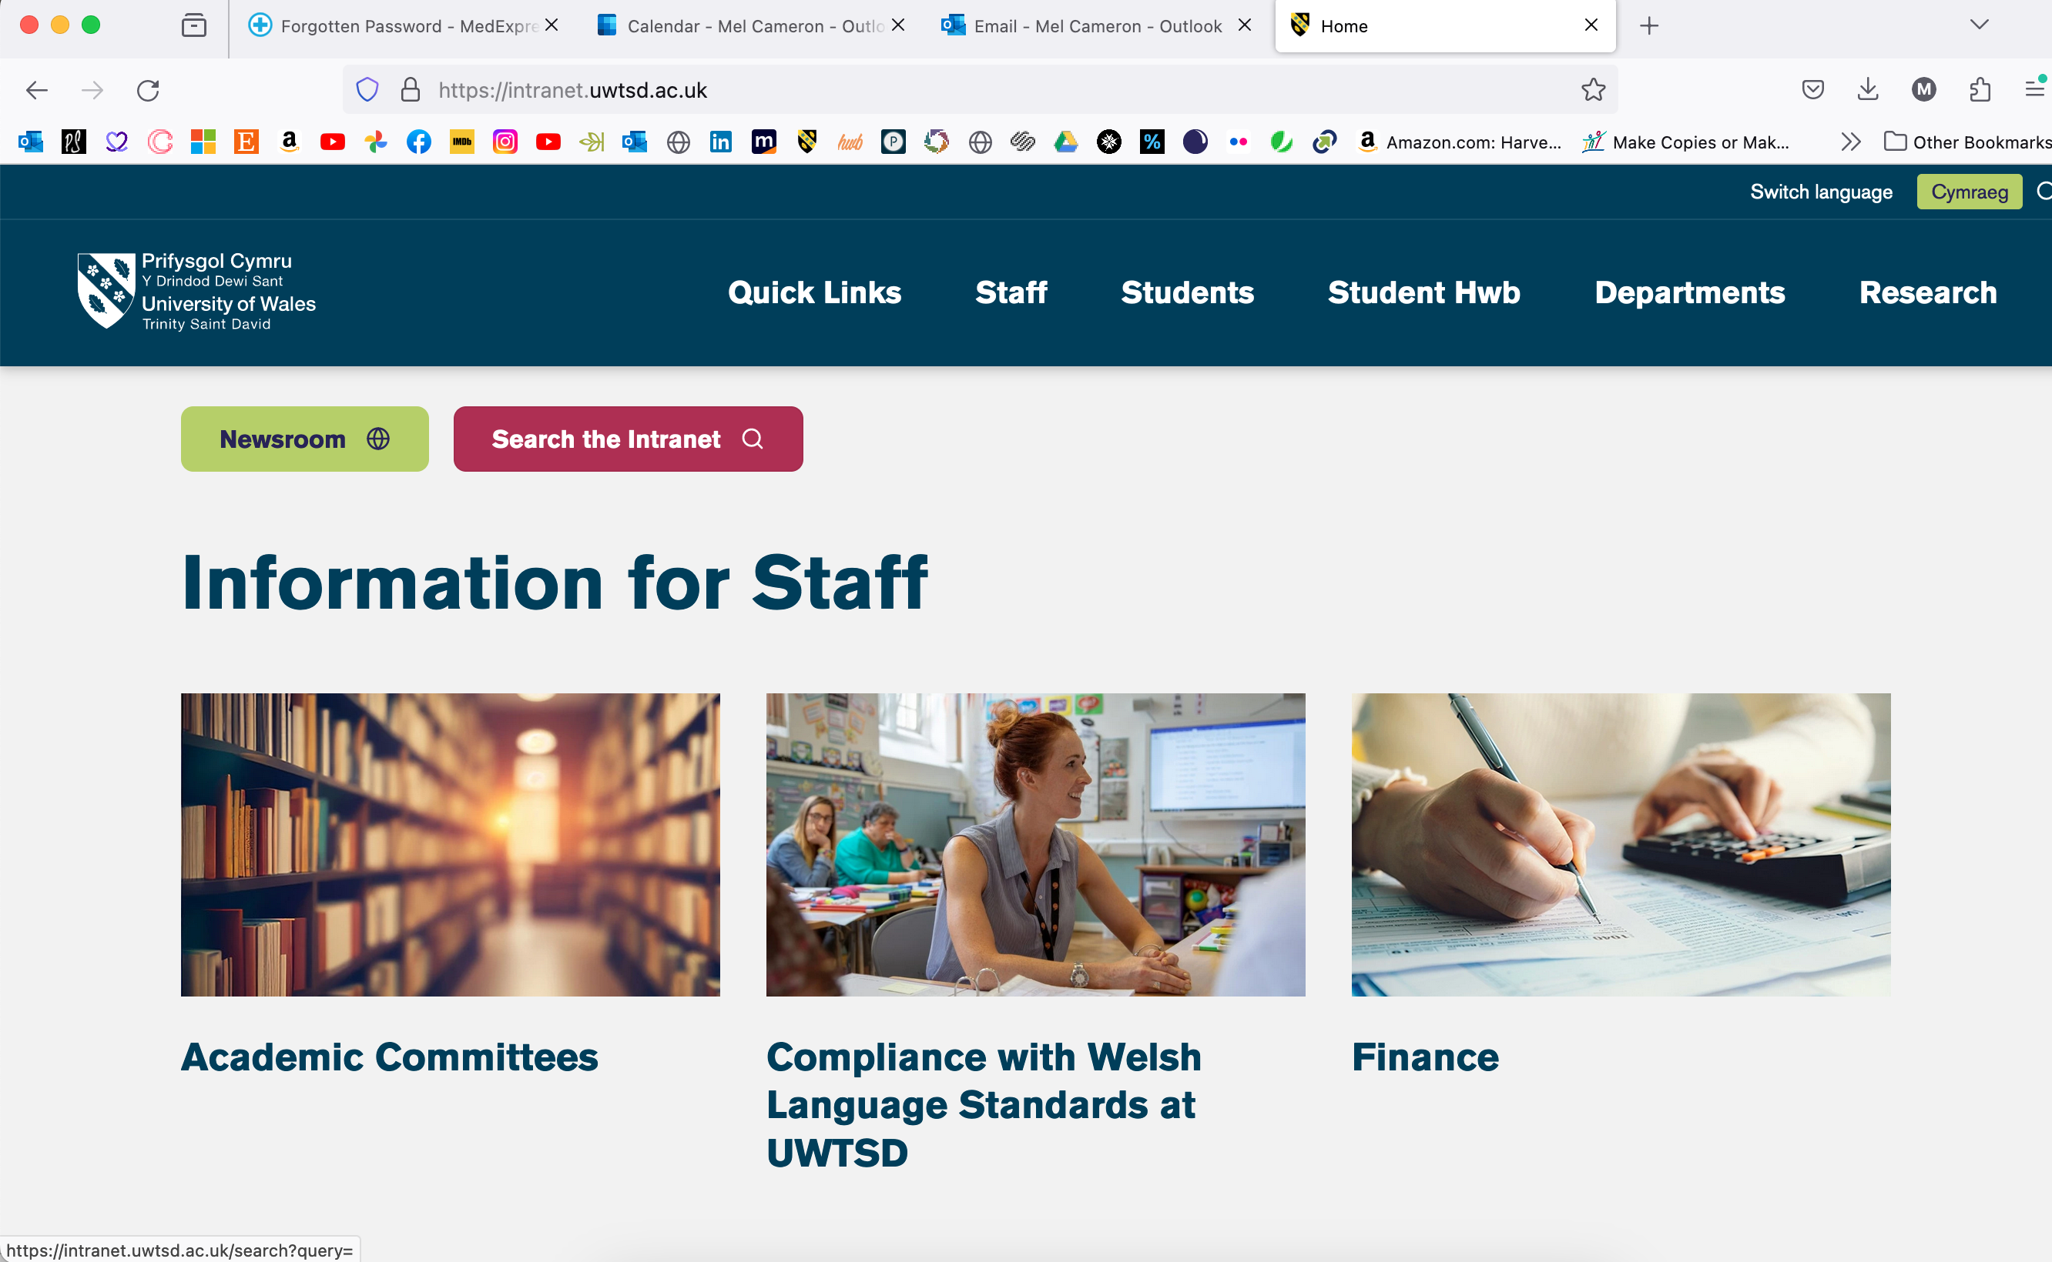

Slide 5
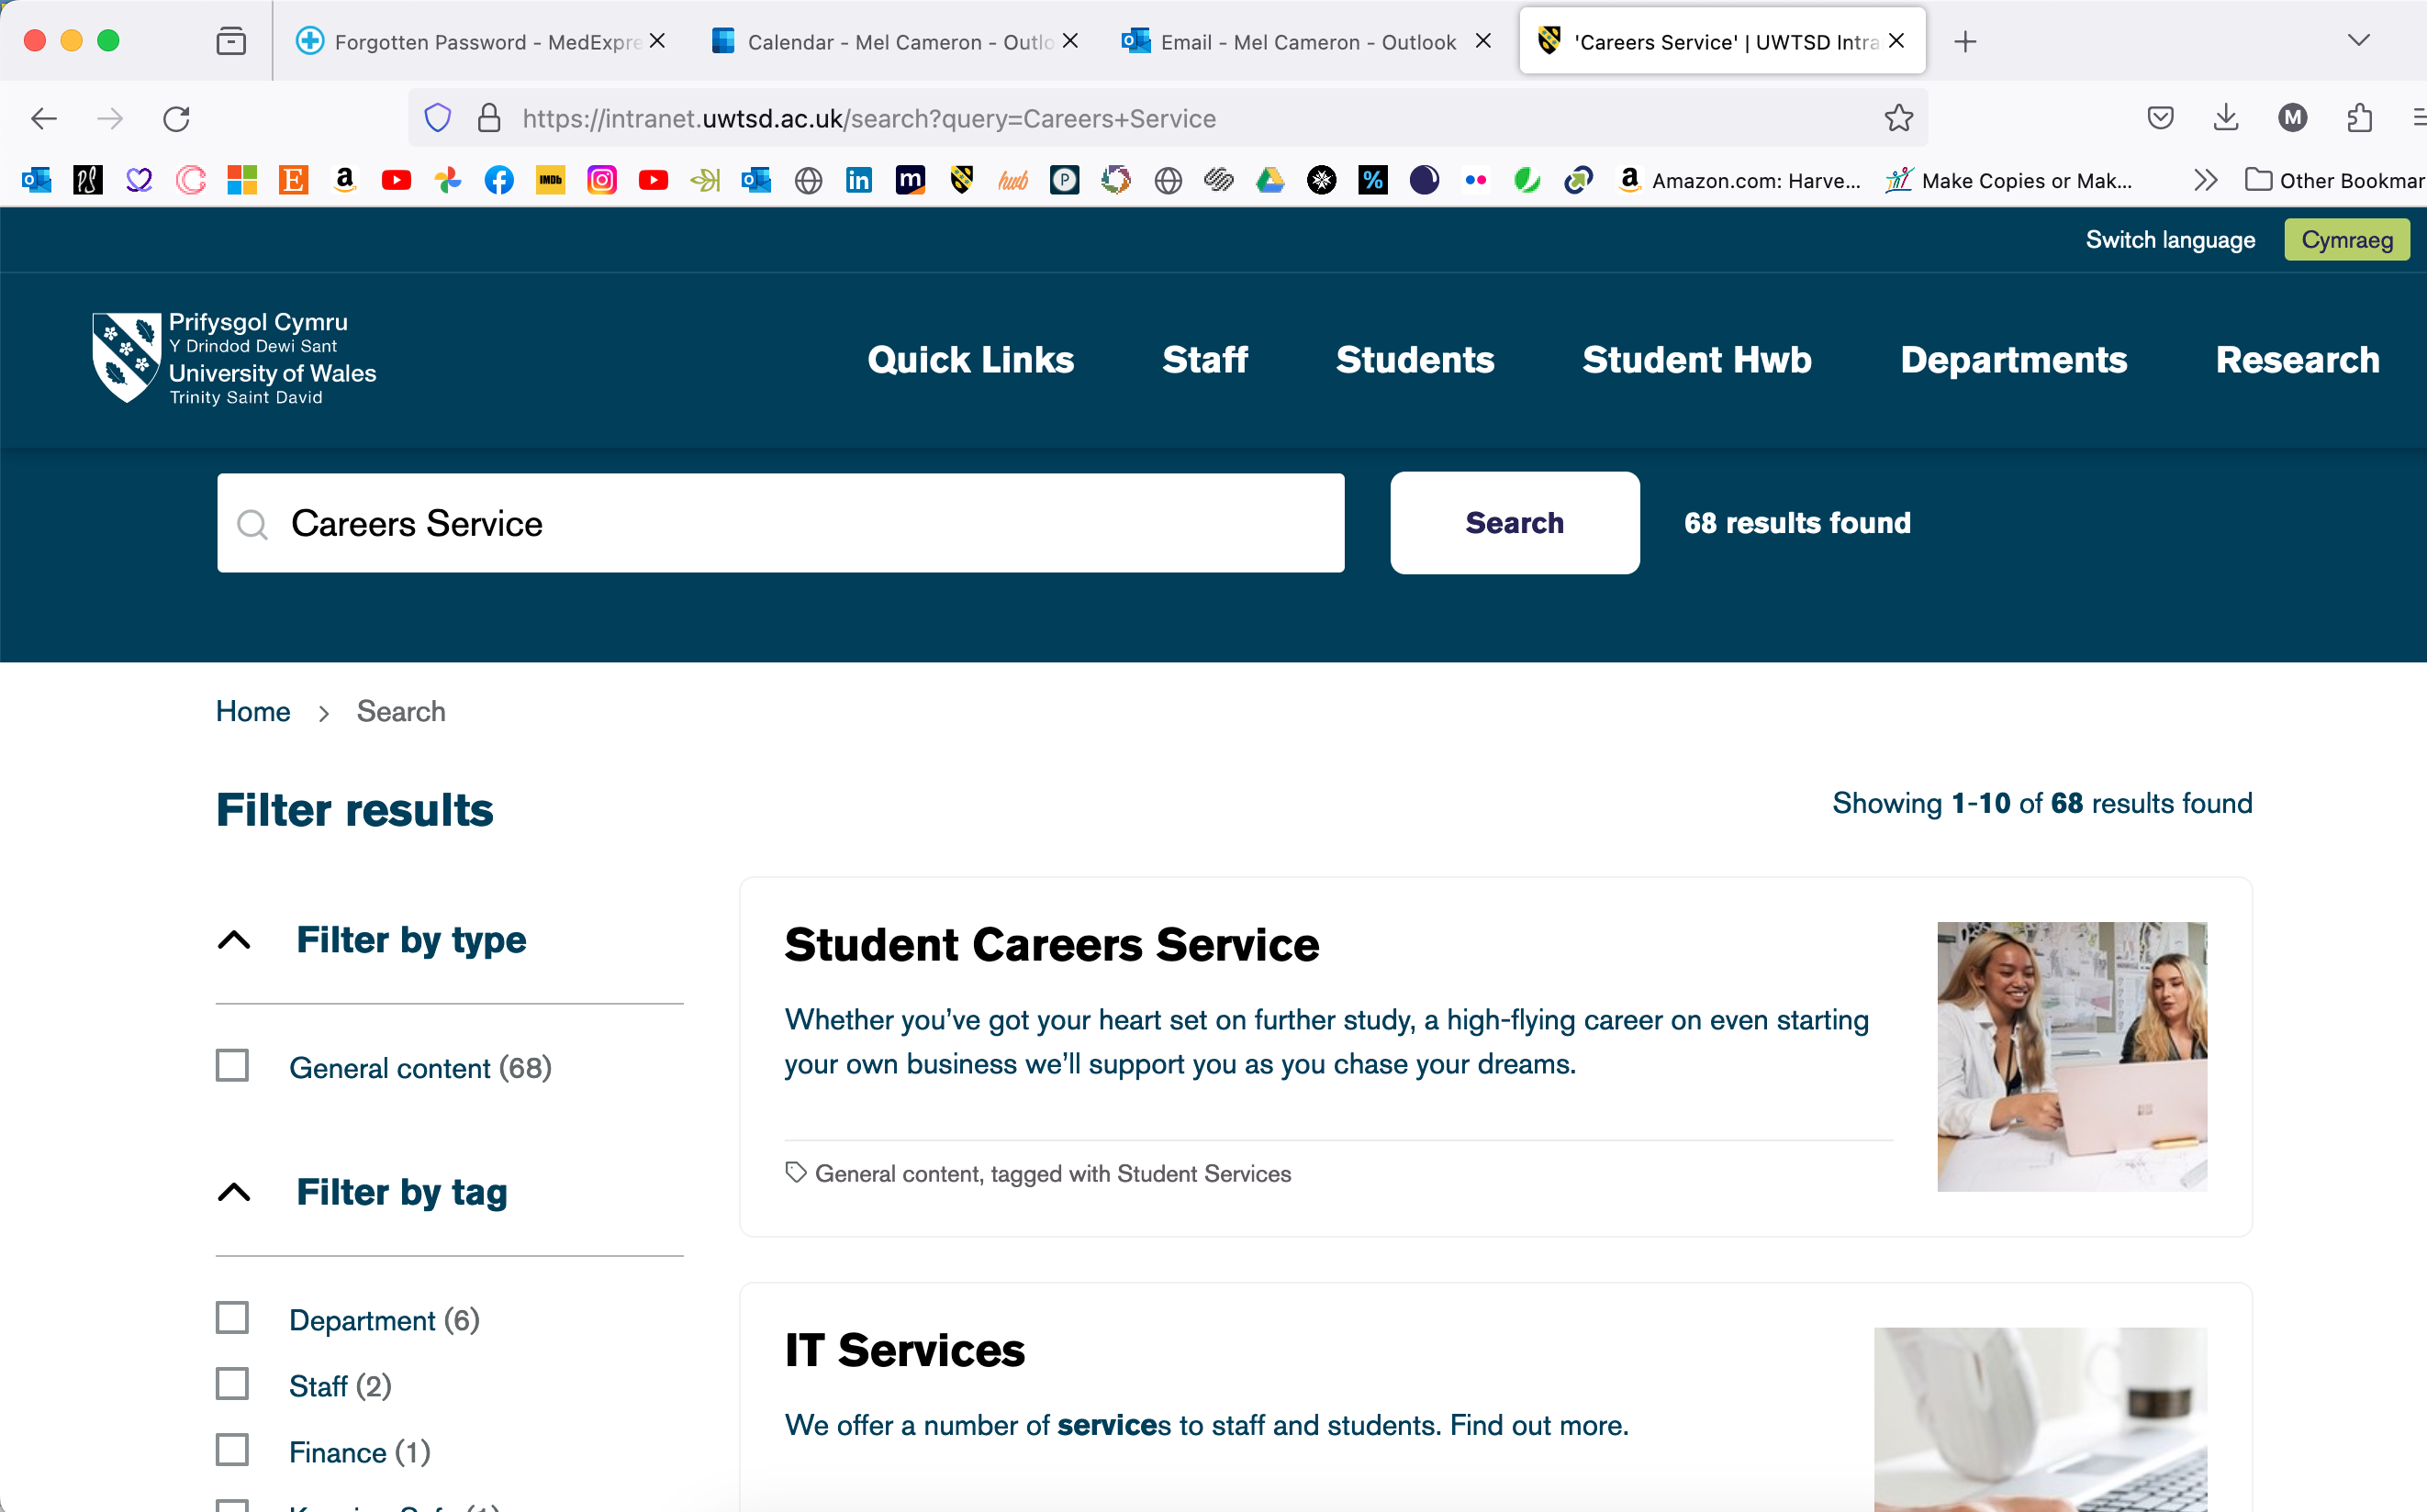

Slide 6
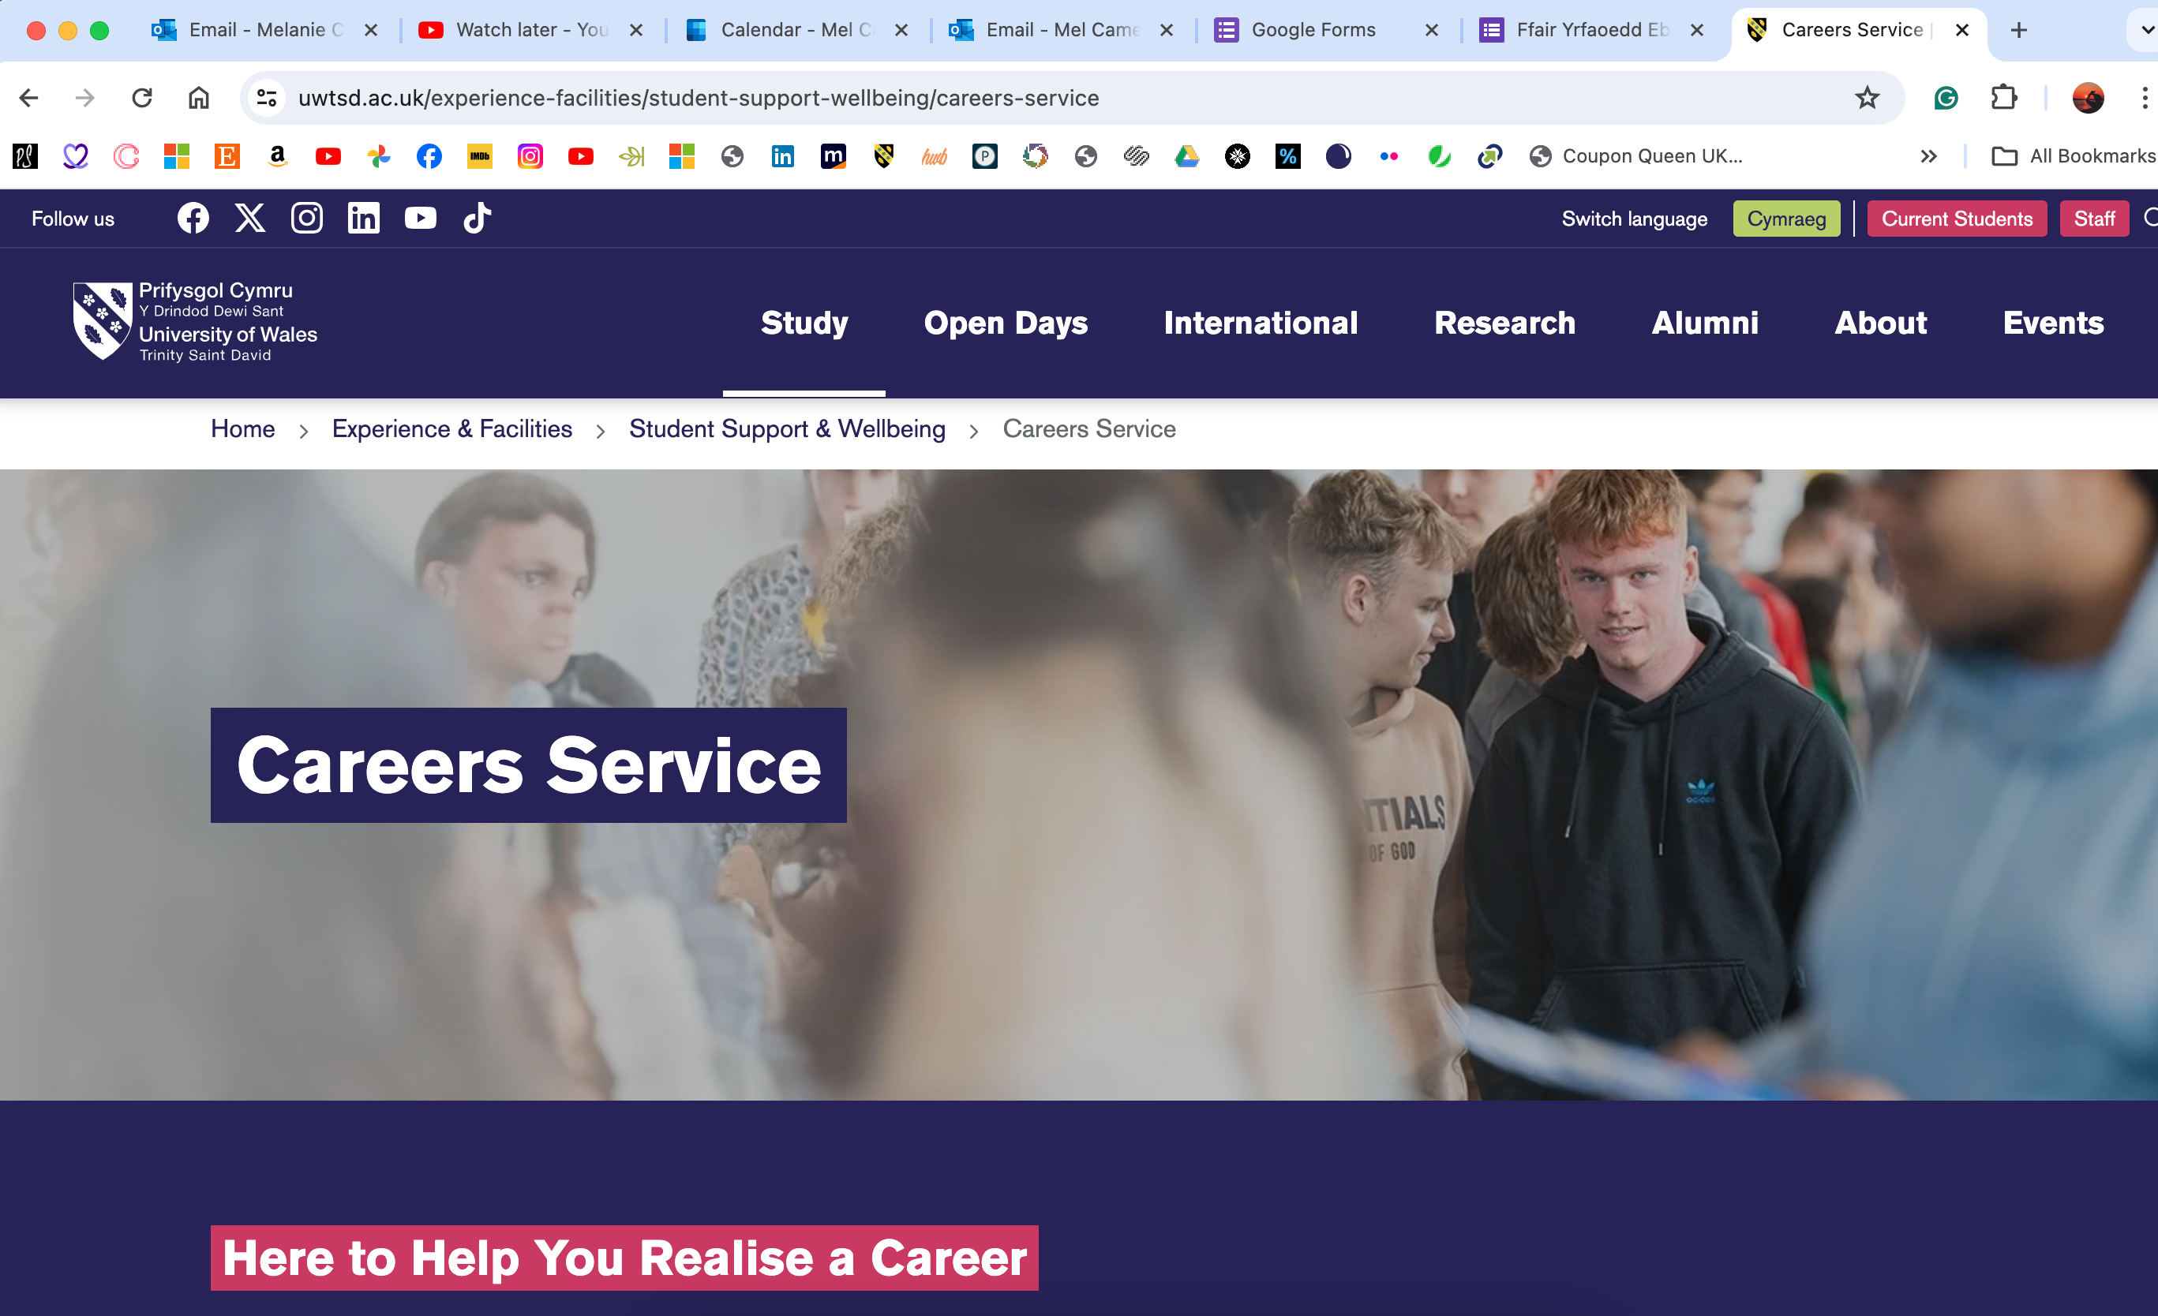

Slide 7
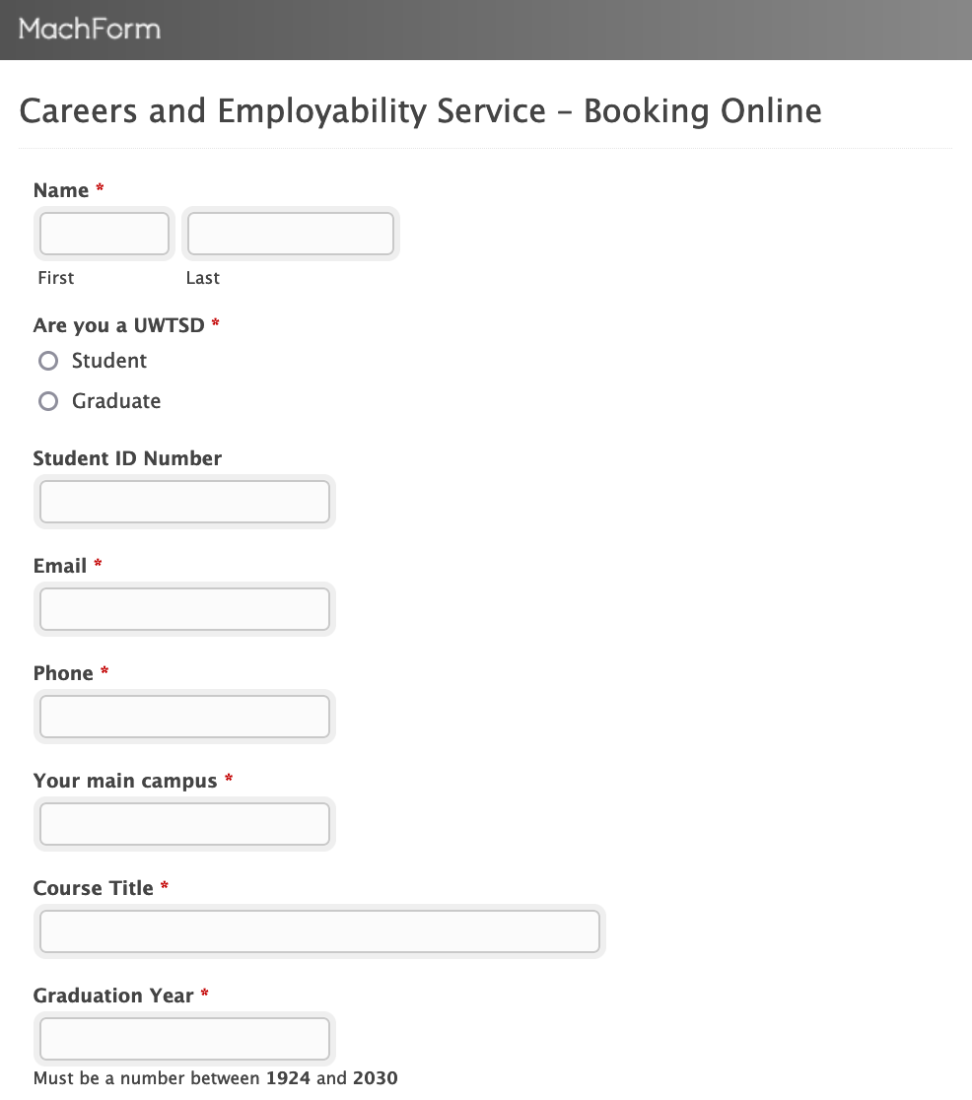
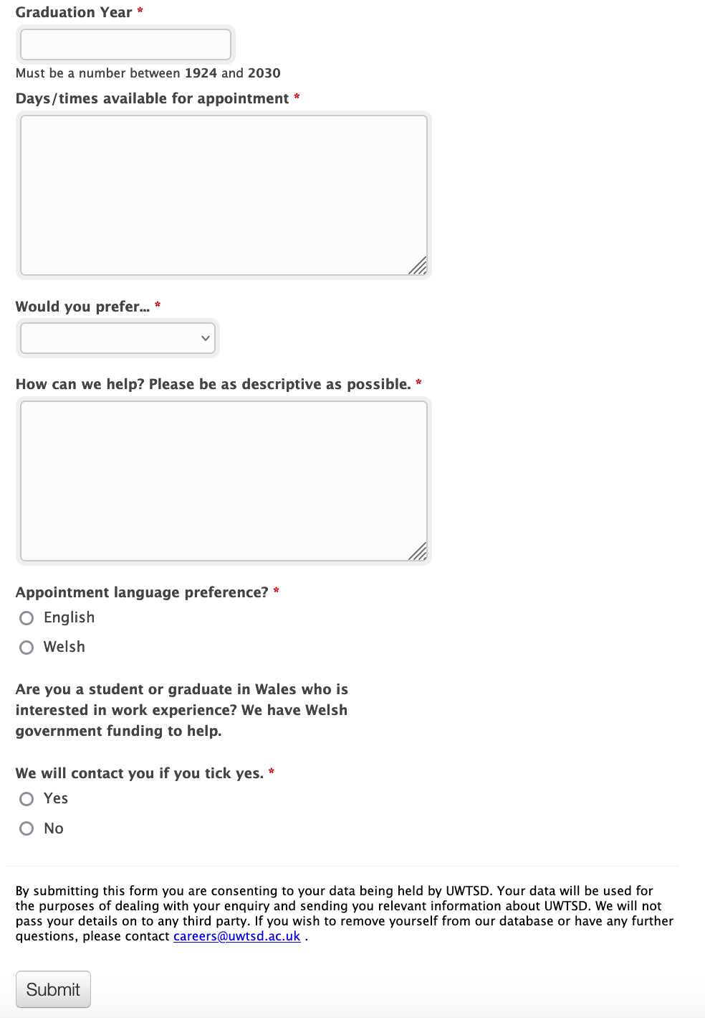
How to make an appointment…

Slide 8
How can we help?
CAREERS SERVICE
HERE TO HELP YOU REALISE A CAREER
CV’s, Applications, Cover letters, etc
Job searching tips
Interview practice
Gaining relevant work experience
Postgraduate study
Signposting to other resources
Support in looking for training/education
Exploring your options
Impartial advice and guidance
Advice with self-employment
Job fairs
Access to ‘MyCareer’

Slide 9
CAREERS SERVICE
HERE TO HELP YOU REALISE A CAREER

Slide 10
CAREERS SERVICE
HERE TO HELP YOU REALISE A CAREER
What is a CV?

Slide 11
CAREERS SERVICE
HERE TO HELP YOU REALISE A CAREER
What is a CV?
A CV (also known as a Curriculum Vitae, or résumé), is a written overview of your skills, education, and work experience.
They may be used for a variety of reasons, however, the most common of these is to send to prospective employers when looking for a new job.
A CV is an essential part of any job search, not to mention a great way to put all of your skills, experience, and qualifications in one place. In fact, a well written CV could be the difference between getting an interview and not being considered for the role.

Slide 12
CAREERS SERVICE
HERE TO HELP YOU REALISE A CAREER
Know yourself
• Skills and abilities
• Personal qualities
• Values
• Motivation
• Qualifications
• Interests

Slide 13
CAREERS SERVICE
HERE TO HELP YOU REALISE A CAREER
What’s important to you?
• Travel
• People
• Work/life balance
• Benefits
• Office based / Working from home
• Away from a desk….etc..

Slide 14
CAREERS SERVICE
HERE TO HELP YOU REALISE A CAREER
What skills have you gained?
• On your course
• During employment
• On placement / Internship
• Volunteering
• Qualifications / Certifications
• Courses /CPD
• Family responsibilities

Slide 15
CAREERS SERVICE
HERE TO HELP YOU REALISE A CAREER
What skills are graduate employers looking for?
• Decision making
• Planning
• Self-management
• Communication skills
• Team working
• Flexible & adaptable
• Able to use initiative
• Creative thinking
• Critical analysis
• Problem solving
• Motivated
• Enthusiastic
• Business & commercial awareness
…..and many more!

Slide 16
CAREERS SERVICE
HERE TO HELP YOU REALISE A CAREER
Examples of things that don’t belong on a CV…
      Address
      Age
      Photograph
      Referees
      Hard to read fonts
      Negativity

Slide 17
CV LAYOUT
EXAMPLE

Slide 18
CV LAYOUT
EXAMPLE

Slide 19
CAREERS SERVICE
HERE TO HELP YOU REALISE A CAREER
Here are a few important things to remember:
  CV Summary or Career Profile: This is a brief statement at the top of your resume. If you are looking to change direction or have many years of experience, create a powerful summary to highlight your accomplishments and skills. Show the employer, at a glance, why you're qualified for the job, what you're interested in, and where you want to go. Avoid repeating details that will be covered later; focus on the highlights.
  Keep It Concise: Your CV should be a maximum of two pages. Anything longer may not be read.
  Job Descriptions: Instead of listing all the tasks you performed in each job, write short, impactful paragraphs. This approach helps reduce page length and improves readability.
  References: Do not include referees' contact details on your CV. Employers will ask for this information if needed. Please be mindful of sharing personal data.

Slide 20
CAREERS SERVICE
HERE TO HELP YOU REALISE A CAREER
Skills and Qualifications: Highlight relevant qualifications and experience. Avoid including hobbies and passions unless they are directly relevant to the role or requested by the employer. Descriptive words like "ambitious," "conscientious," and "hardworking" should be demonstrated through your achievements and responsibilities rather than explicitly stated.
Master CV: Maintain a 'master' CV that you update throughout your career. This comprehensive document serves as a source of information for your current CV, which should be tailored for each job application to ensure relevance.
Modify Your CV: Customise your CV for every job you apply for to align it with the specific role and employer’s needs.

Slide 21
CAREERS SERVICE
HERE TO HELP YOU REALISE A CAREER
This section should include various additional skills and qualifications that might be relevant to the job. Consider including:
  Languages Spoken: List all the languages you speak fluently or conversationally.
  IT Proficiency: Mention any software programs or IT systems you are proficient in, such as Microsoft Office, Adobe Suite, or any industry-specific software.
  Driving Capability: Indicate whether you have a valid driver's license and any other relevant driving certifications.
  Additional Courses: Include any courses you have completed, such as First Aid, Health & Safety, CPR, or other relevant training, even if the certifications have expired.
  Relevant Qualifications: List any other qualifications that support your application, such as
  vocational training, professional certifications, or technical skills.

Slide 22
CAREERS SERVICE
HERE TO HELP YOU REALISE A CAREER
Some questions you might want to answer when writing about your work history…
How long did you work there?
What hours did you do?
Did you need to train to do the job?
What were your main responsibilities?
What did you learn?
Who do you work with?
If you worked with children, how old were they?

Slide 23
CAREERS SERVICE
HERE TO HELP YOU REALISE A CAREER
Useful resources

Slide 24
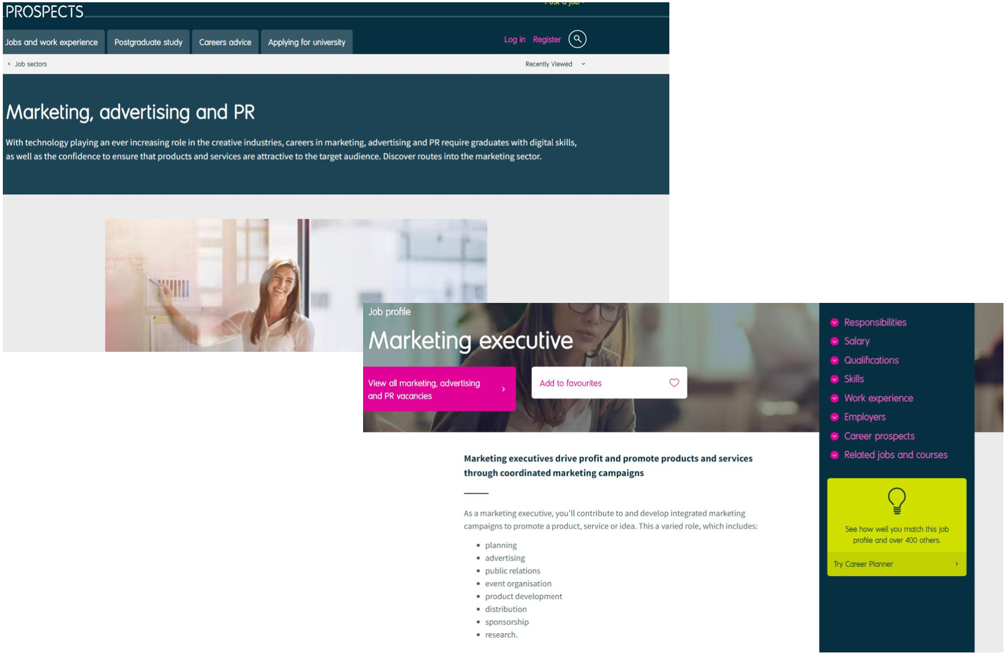
CAREERS SERVICE
HERE TO HELP YOU REALISE A CAREER
Prospects
Prospects are the experts in graduate careers. They help to guide students and graduates thoroughly researched information, advice, and opportunities.
They provide a market-leading portfolio of graduate career and postgraduate study recruitment options and work in close partnership with HE and further education (FE) professional bodies and the government.
You can research job sectors, further study, case studies, take career tests, get career advice and much more.

Slide 25
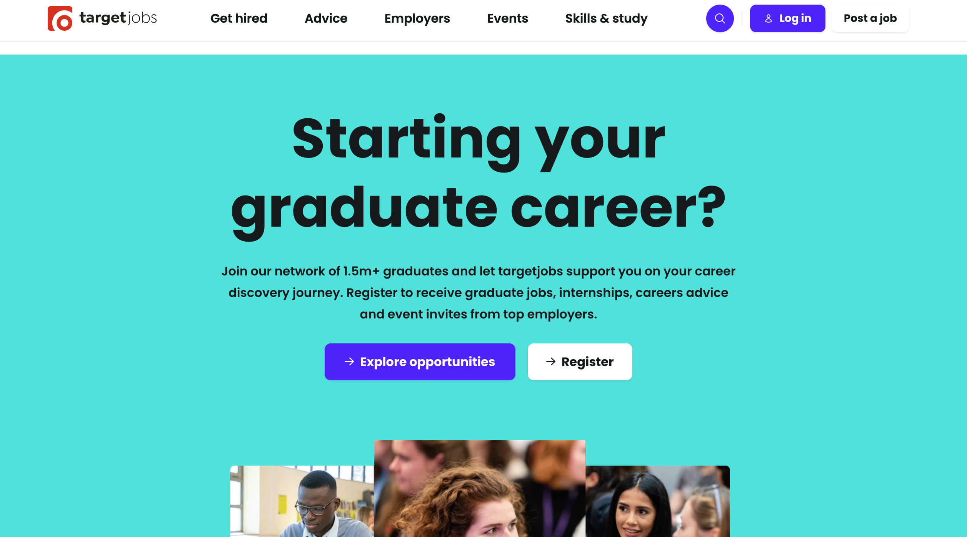
CAREERS SERVICE
HERE TO HELP YOU REALISE A CAREER
Target Jobs
targetjobs is the leading website for graduate recruitment in the UK. Combining great careers advice, sector experts, peer to peer reviews and over 3,000 internships and graduate job vacancies every year, over 1 million students trust targetjobs to help them in their career.
You can also do online learning, attend events and training as well as stay up to date with the latest labour market information, look for graduate jobs and plan your career path.

Slide 26
CAREERS SERVICE
HERE TO HELP YOU REALISE A CAREER
Self employment
If you’re considering self-employment get in touch with UWTSD Enterprise who can arrange a meeting with a mentor to talk through your ideas.
UWTSD Enterprise
www.uwtsd.ac.uk/for-business/enterprise/

Slide 27



CAREERS SERVICE
HERE TO HELP YOU REALISE A CAREER
There are several digital tools and technologies that can help you whilst studying at University. To access our list of recommended learning resources, you will need to log in to Moodle, our virtual learning environment.
Included is a range of resources, from ‘How-to’ guides on the Microsoft website, to courses within LinkedIn Learning. As a student, you have free access to LinkedIn Learning and access to all of the courses whilst you are a student..
digitalskills.uwtsd.ac.uk/students/

Slide 28
CAREERS SERVICE
HERE TO HELP YOU REALISE A CAREER
Resources
• MyCareer: www.uwtsd.ac.uk/careers/
• Prospects Luminate: www.luminate.prospects.ac.uk/
• Prospects: www.prospects.ac.uk
• Targetjobs: www.targetjobs.co.uk (Career Discovery)
Publications: Times top 100 / newspapers / trade Sector specific websites & professional associations Recruitment agencies.

Slide 29
Diolch!
Thank you!
CAREERS SERVICE
HERE TO HELP YOU REALISE A CAREER

Slide 30
Questions?
CAREERS SERVICE
HERE TO HELP YOU REALISE A CAREER

Slide 31
Contacting your Careers Service
HERE TO HELP YOU REALISE A CAREER
careers@uwtsd.ac.uk

Slide 32
CAREERS SERVICE
HERE TO HELP YOU REALISE A CAREER
Be proactive
You can be reactive or proactive in your job search. Best to incorporate both elements into your job search as some roles won’t be advertised:
• Speculative applications – identify and approach organisations you’re interested in
• Networking – start with family, friends and colleagues and build network through attending careers fairs … LinkedIn…
• Social media networking - Online networking – LinkedIn, Facebook, Twitter a good start

Slide 33
CAREERS SERVICE
HERE TO HELP YOU REALISE A CAREER
Researching the job market
• Do you know where in the UK you want to work?
• Do you want to work abroad or in your home country?
• What kind of employer do you want to work for?
• Private sector/public sector/not for profit
• Do you want to work for a large company or an SME?
• What about self-employment?
• A portfolio career? What skills would you need to succeed?

