Slide 1

Strategies for Effective Communication in a business setting
By Rebbeh Manneh (2026514), Louise Franklin (2025915) & Simone Cunningham (2028763)
Module Code: BMSW4002
Lecturer: Johnathan Wyatt

Slide 2
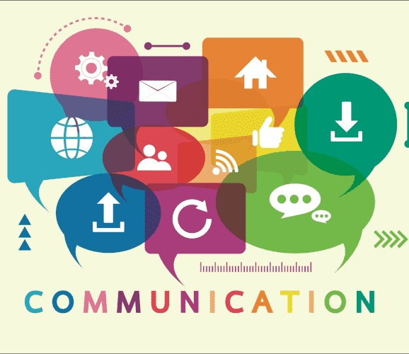
What is communication?
Communication can be described as the process/exchange of sending and receiving information, thoughts and ideas.
Methods of communication
Verbal communication – Any information, emotions and thoughts expressed by speech
Non-verbal communication – Gestures and proxemics, body language, emails, letters etc.
Communication allows people and organisations to connect, exchange thoughts and ideas, feelings and behaviours. Communication is a two-way process which enables mutual understanding.

Slide 3
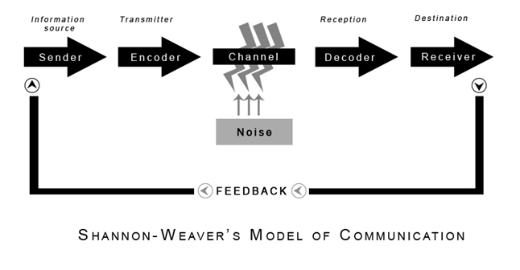
Theories relating to models of Communication
Communication theory studies the scientific process of sending and receiving information. There are many principles, methods, and components that can affect a message, and communication theory explains it all.
A number of communication models exist in which different elements and components are highlighted to illustrate assumptions and ideas by authors/scholars. Communication models are complex explanations with a guide for thoughts and exploration.
The Shannon-Weaver model was developed in 1949 it is one of the best known models of communication. The model presents communication as a process with six key concepts;
The Sender(information source)
Encoder(transmitter)
Channel(medium used)
Decoder(receiver)
Receiver(destination)
Noise
It was also the first model to introduce the concept of “Noise”.
Notes:
One way of analysing communication is to present it in a visual format, otherwise known as a communication model.
Read Slide
The Shannon- Weaver model was developed…….
The Shannon-Weaver model is a mathematical theory of communication in which each element of the communication process is interrelated.
Interrelated meaning they each have a effect on the other.
The sender acts asource

Slide 4
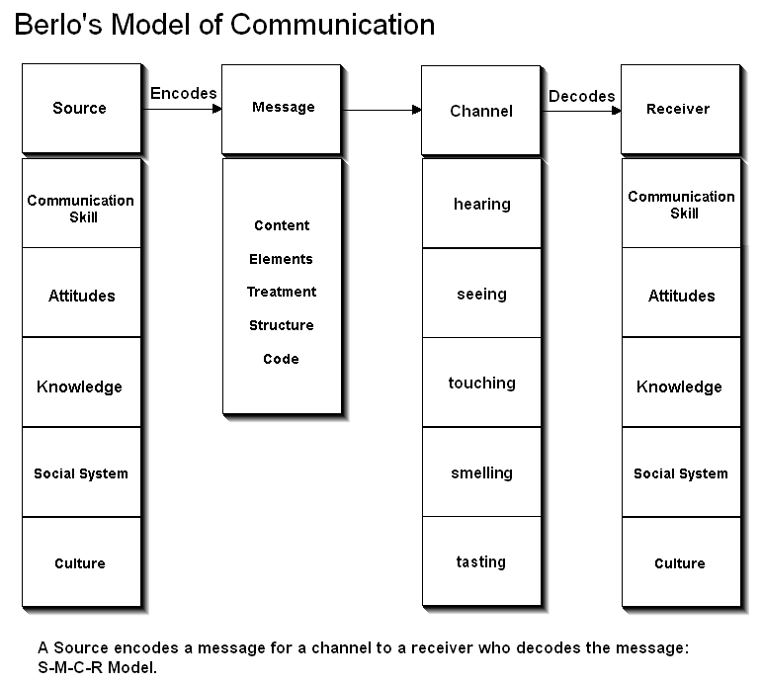
In 1960, David Berlo (SMCR) communication model was formulated to evolve the earlier communication model developed by Shannon & Weaver. This model is a development where he considered the different things that can affect each of the components.
Berlo’s model acknowledged that a message came from somewhere or rather someone who he refers to as the SOURCE who is the sender/ originator of the MESSAGE
The MESSAGE refers to the information that is being communicated, that MESSAGE then has to travel through a CHANNEL before it can get to the intended receiver or audience.
The CHANNEL refers to the route by which the message travels to the sender to the receive, once the message goes through the CHANNEL it is up to the RECEIVER to DECODE it
Berlo’s theory suggests that when the skills of the SENDER and RECEIVER complement each other communication will be more effective. He also presents the idea that communication is a personal and emotional connection between the sender and the receiver by means of:
Communication Skills – The Sender and Receivers ability to communicate effectively
Attitudes – The Sender and Receivers attitude at the time of communicating
Knowledge – The Sender and Receivers knowledge of the message being conveyed.
Social & Cultural – Environment and situation of the sender and receiver
Unlike Shannon-Weaver model there is no concept of feedback or noise.

Slide 5
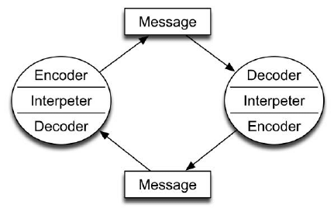
Schramm’s Interactive Model
Schramm’s Communication was proposed in 1954. Schramm’s Communication model focused more on the importance of interaction between the SENDER and the RECEIPENT. His model highlights that encoding and decoding are essential in effective communication.

Slide 7
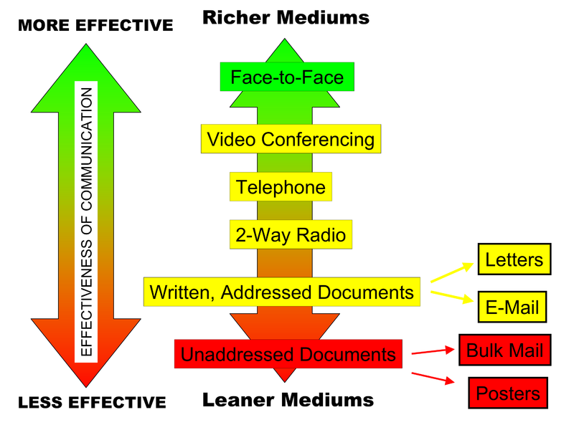
Channels of Communication
Channels of communication are mediums or medias that allow you to convey a message to its intended audience. For example, phone calls, texts, emails, video, radio, and social media are all channels of communication. In a company, these channels keep information flowing.
There are different types of business communications, including formal, informal, and unofficial. Communication can be rich or lean within these channels.
The richness of the information means how much of it can be transferred and how quickly it can be transmitted. Face-to-face communication offers the highest level of richness because information can be communicated immediately.

Slide 8
Oral Communications
There are many oral communication channels, including face-to-face, in-person presentations, mobile phone conferences, group presentations, telephone, video calls, conferences, speeches, and lectures. The utilisation of non-verbal communication and voice sound likewise gives importance to these channels, bringing about low contortion.
Written Communications
Emails, texts, memos, letters, documents, reports, newsletters, spreadsheets, and so on are all forms of written communication. These are among the leaner forms of business communication.
Electronic (Multimedia) Communications
Among this growing category of communication channels are broadcast television, web-based communications such as social media, interactive blogs, company web pages, and social networking sites such as Facebook and Twitter. Messages can be sent instantly and globally through electronic communications, allowing people to communicate face-to-face over long distances.
The importance of communication channel ​
​
A lack of communication among employees can result in employees not understanding what their employer expects of them, leaving them uninformed. This kind of lack of communication could affect the flow of information within a company.​
​
As well as losing focus on the big picture and losing company mind without an effective communication channel, employees tend to be less productive in the workplace and their decision making is impaired.

Slide 9
Channels that can be used to improve communication.
1.Face-to-face communication
Face-to-face communication offer the most effective way of interacting among teams because of the ability to read body language, facial expressions, and other nonverbal cues. It’s moreover the most excellent channel for long discussions.
As a result, face-to-face communication offers a highly effective means of conveying complicated or delicate messages or brainstorming with colleagues
2. Video conferencing
A video conferencing meeting holds the capacity to peruse facial expressions while expanding adaptability. You can have a huge gathering of individuals on a video meeting anyplace on the planet, assisting data with spreading rapidly.
3. Telephone calls
When you need immediate assistance and want to communicate a sense of urgency, phone calls are an excellent alternative. You still can hear the tone of voice on the phone, and there are no visuals needed to communicate your message.
4. Emails
Especially when sending messages down the chain of command, email is a very effective way to communicate formal announcements efficiently. In comparison to old-fashioned written communication methods, such as letters and memos, emails are a better option due to their security.

Slide 10
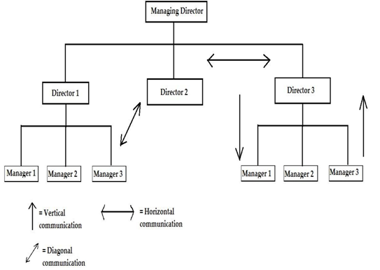
​
Communication types within organisations
•Vertical Communication - Communication vertically refers to the flow of information between upper and lower-level employees, which allows them to exercise greater control and improve coordination in the firm.
•Horizontal Communication - Horizontal communication occurs when employees on the same level within the organisation share information and ideas with one another.
•Diagonal Communication - A diagonal communication involves the use of several methods, including horizontally, upwardly, and downwardly.
​

Slide 11
The types of barriers that can prevent effective communication
The types of barriers to effective communication
Language
Noise
Visual impairment
Environment
Listening
filtering
Technological barriers

Slide 12
The types of barriers that can prevent effective communication
Barriers are problems or issues that occur when a message is in transmission and eithers stops or blocks the process.
The most common barriers to effective communication are language barriers, listening skills and information overload. Having a barriers between one another in an organisation could potentially be harmful, it runs the risk of misinterpretation and disorganisation throughout the organisation
1. Language Barriers
Language barriers such as jargon, cultural language can cause communication to not be effective. These barriers between patients and staff could cause anxiety and could prevent the patients receiving the correct care.
2. Listening Barrier
Listening effectively also known as active listening is very important for communication to be effective. Information needs to be retained correctly for you to be able to understand and give feedback on the information received. Being assertive and considerate to what is being relayed to you.
3. Physical Barriers
Workspace issues, Technology problems and noise are common physical barriers in an organization. When these problems occur communication could be disrupted i.e., misinterpretation of a message, and incorrect feedback given between hierarchies.
4. Attitude
Having the wrong attitude when communicating in any organisation could put blocks between communication from each section of the organisaton from the top of the hierarchy to the paiteiens. This could cause conflict and uncertainty.

Slide 13
5. Filtering
This communication barrier exists when one recipient does not want the message to be received correctly by the recipient that needs the correct information.
6. Physiological barriers
When a staff member or patient is ill this barrier could take effect .
Having these barriers not correctly finding a solution to correct the problems could sabotage your organisation . Improving these barriers could achieve your organisation to run smoothly and patient's would be happy to receive care.

Slide 14
The impact of communication on staff and patients
Communicating effectively can positively affect patients' experiences, reduce complaints, and improve nurses' feelings of self-confidence, professional status, job satisfaction, and career prospects.
Literature review also shows that, despite tragic outcomes caused by poor communication, effective communication can lead to the following advantages: increased information flow, increased efficiency, increased safety, increased morale among employees, increased engagement, and reduced turnover. Satisfaction of the patient and family increased.
By communicating and engaging with patients following discharge, providers can better prepare patients to transition from one health care setting to another.

Slide 15
References
AgilityPortal. Vertical, Horizontal & Diagonal Communication. Available at: https://agilityportal.io/blog/vertical-horizontal-diagonal-communication-a-complete-guide. (Accessed: 19 November 2021).
Jijo’s Skill Factory (2017). 10 Barriers to Effective Communication. YouTube. Available at:https://www.youtube.com/watch?v=f5Tao6KHV5w (Accessed: 15 Nov. 2021).
Lumen. Channels of Business Communication. Available at:https://courses.lumenlearning.com/wm-principlesofmanagement/chapter/channels-of-business-communication/. (Accessed: 14 November 2021).
Rahman (2015). BERLO’S SMCR MODEL OF COMMUNICATION. Available at: https://rahmanjmc.wordpress.com/2015/02/09/berlos-smcr-model-of-communication/ (Accessed 18 Nov. 2021).
Rayudu, c., (2009) Communication, Global Media, Mumbai. Available at: ProQuest Ebook Central. (Accessed: 18 Nov. 2021)
Wardle, C. and Derakhshan, H., (2018) Thinking about ‘information disorder’: formats of misinformation, disinformation, and mal-information. Ireton, Cherilyn; Posetti, Julie. Journalism, ‘fake news’ & disinformation. Paris: Unesco, pp.43-54.
Weebly. Communication Channels. Available at: https://mangementchallenge.weebly.com/communication-channels.html. (Accessed: 18 November 2021).
https://www.communicationtheory.org/wp-content/uploads/2011/06/shannon_weaver_model.jpg (Accessed: 18 November 2021).

Slide 16
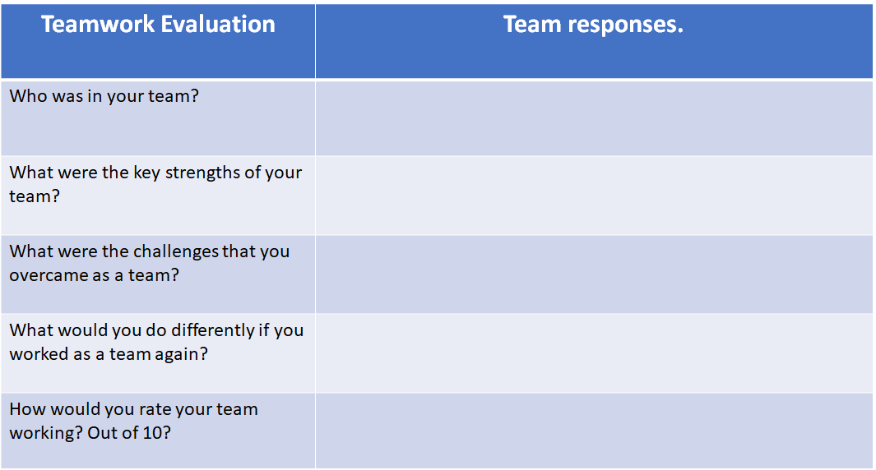
Team Evaluation Form
Rebbeh Manneh, Louise Catherine Franklin, Simone Jacqueline Cunningham
Our teams Key Strengths in my opinion were communication via different channels and consideration for each other.
As a team we overcame time restraints and communication barriers.
Take advantage of practicing our presentation.
I would have to give our team 9/10 for our efforts working together in our team.

