Slide 1
Enterprise Network Security (ACCA7032)
Name – Gautam Malaviya (2504384)
University Of Wales Trinity Saint David

Slide 2
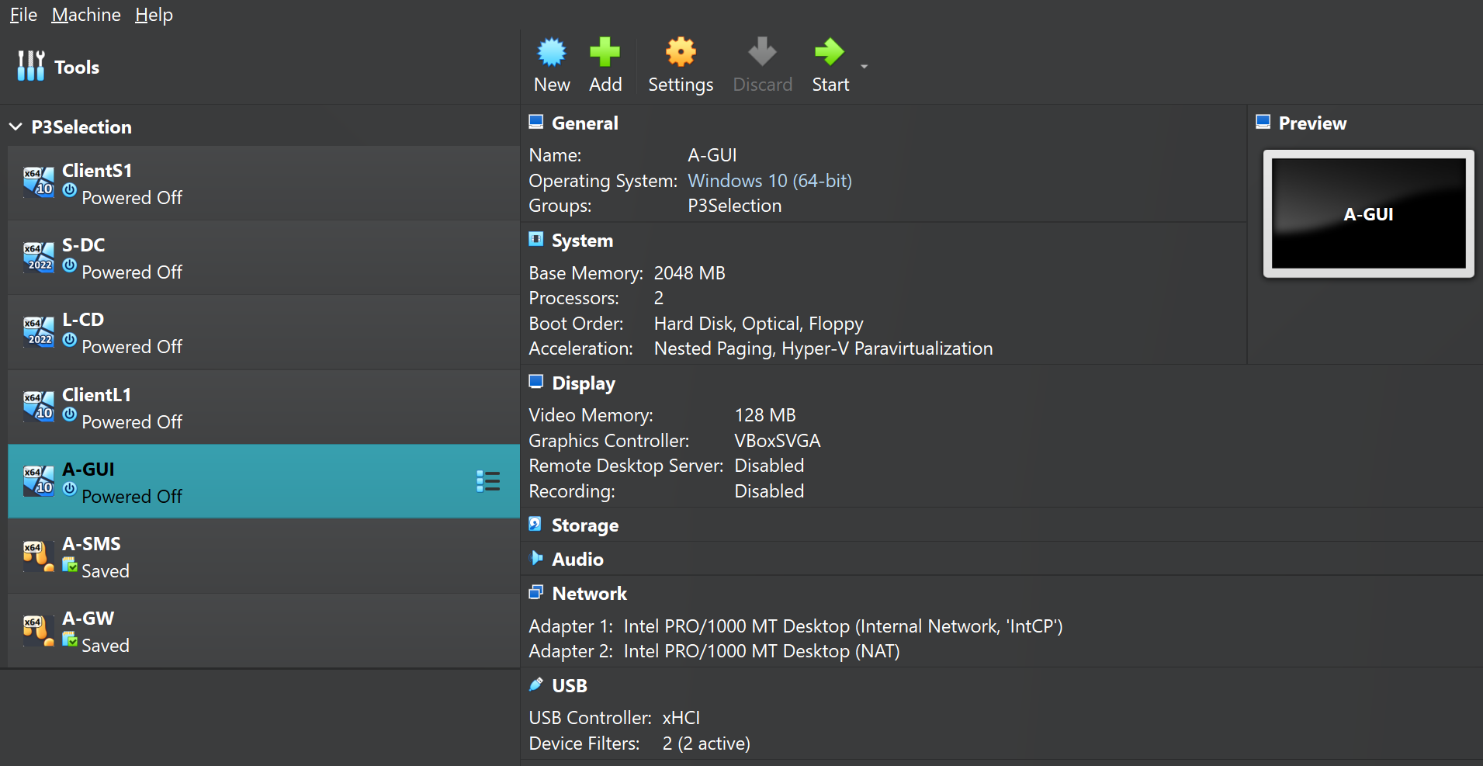
Virtual Lab Environment Setup
VirtualBox environment used to prepare the Check Point SmartConsole lab
What this screenshot shows
A-GUI — Windows 10 VM used as the SmartConsole administration client.
A-SMS — Security Management Server used to centrally manage policies and gateways.
A-GW — Security Gateway where firewall rules are enforced and traffic is inspected.
Network — A-GUI has an Internal Network adapter plus NAT for lab and external connectivity.
Lab design — Other client/server VMs are available for testing communication and security rules.
Purpose: create an isolated enterprise-style test environment before configuring licences, firewall policies, threat prevention and monitoring.

Slide 3
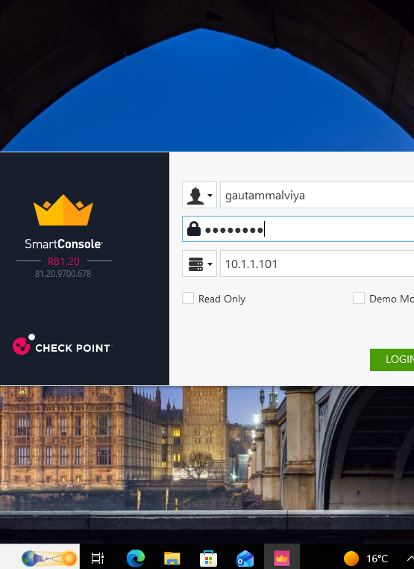
ENTERPRISE NETWORK SECURITY
Task 2- Check Point R81.20
Firewall Implementation
Practical lab presentation using SmartConsole, Security Management Server and Security Gateway
A-SMS • A-GW • A-GUI

Slide 4
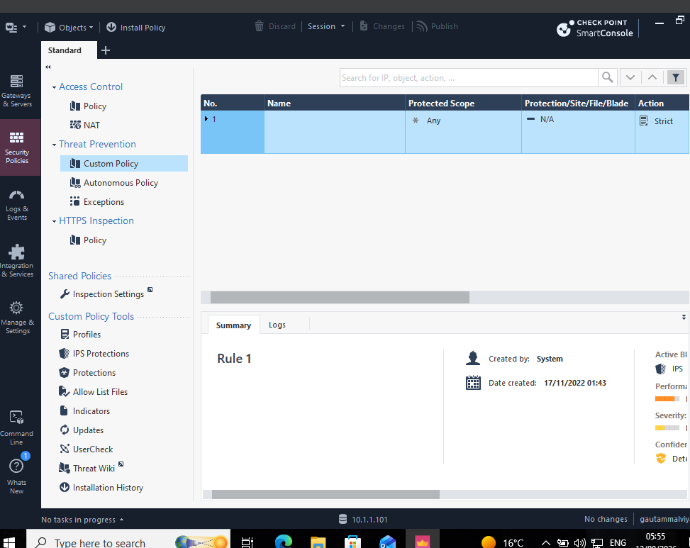
Project Overview
Enterprise firewall lab built and validated in a virtual environment
• Deploy a Check Point R81.20 management and gateway environment
• Use SmartConsole as the central interface for security administration
• Configure and validate access-control and threat-prevention functions
• Use logs to confirm accepted and dropped traffic
Goal: controlled, visible and auditable traffic

Slide 5
Lab Architecture & Components
Three-machine design used for management, enforcement and administration
A-SMS
A-GW
A-GUI
10.1.1.101
Management
10.1.1.1
Policy enforcement
10.1.1.201
Security Management Server
Security Gateway
SmartConsole Client
A-GUI connects to A-SMS for administration; A-SMS manages the A-GW, which enforces the security policy.

Slide 6
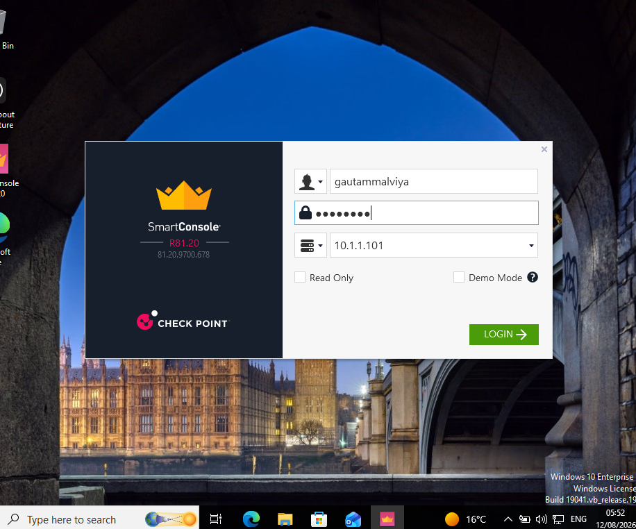
SmartConsole Access
Administrator connection to the Security Management Server
• SmartConsole R81.20 is used from A-GUI
• Management server address: 10.1.1.101
• Central location for gateway objects, policy, logs and monitoring
• Successful login confirms management connectivity
Management plane verified

Slide 7
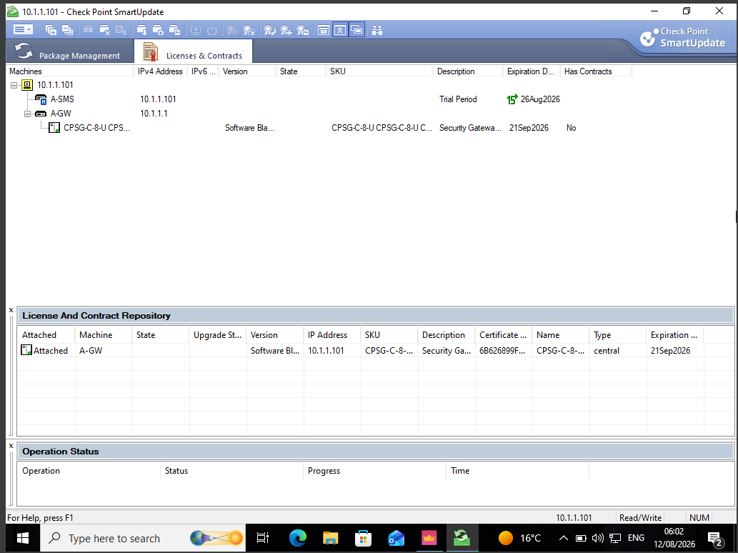
Licence & Contract Validation
SmartUpdate confirms the gateway licence is attached
• A-SMS and A-GW are visible in SmartUpdate
• Gateway licence is attached to A-GW
• Security Gateway licence expiry shown as 21 Sep 2026
• Management server trial period is also visible
A-GW licensed

Slide 8
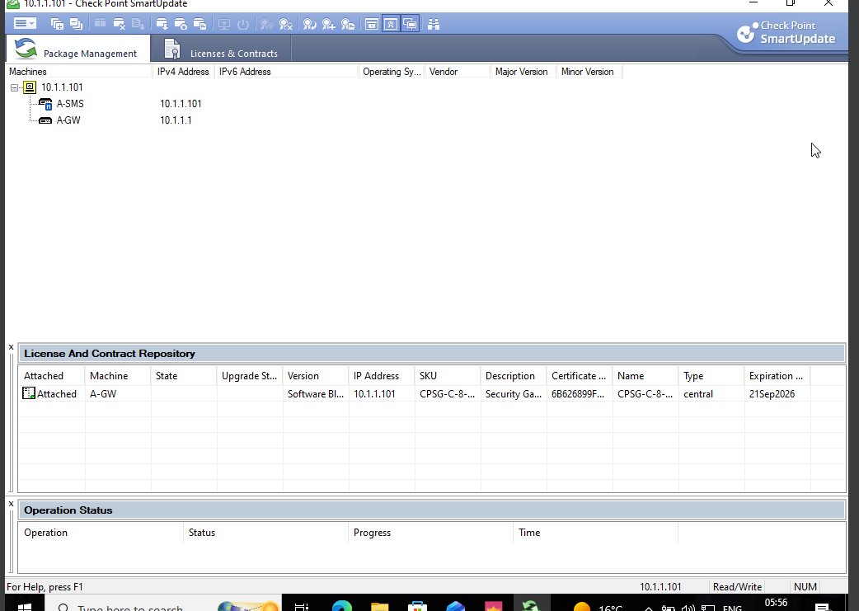
Package Management & Gateway Visibility
SmartUpdate recognises both management and gateway objects
• A-SMS: 10.1.1.101
• A-GW: 10.1.1.1
• Both machines are visible from the management server
• This validates the management relationship before policy work
Objects visible in SmartUpdate

Slide 9
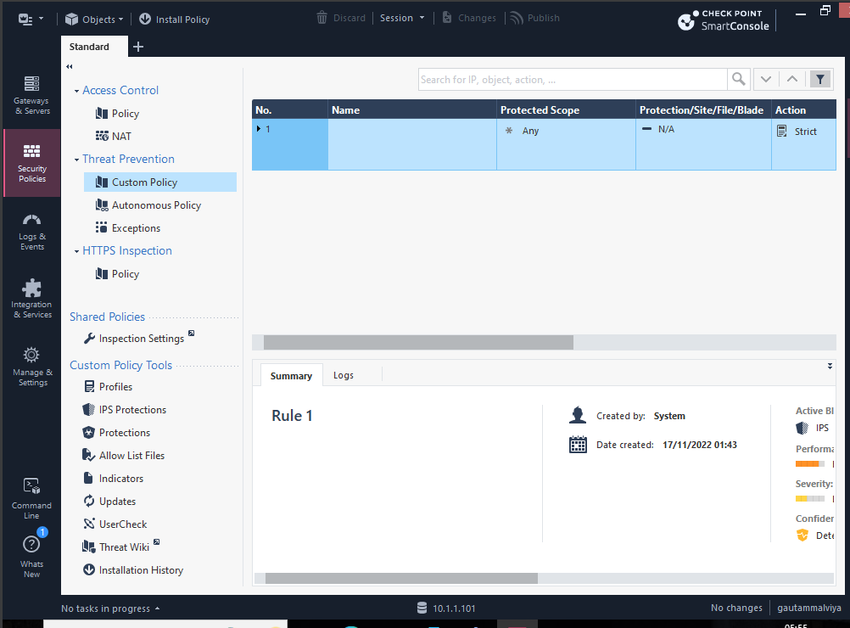
Threat Prevention Configuration
Custom Policy view in SmartConsole
• Threat Prevention provides an additional security layer beyond basic access control
• Custom Policy is available for defining protected scope and action
• The displayed rule uses a Strict action
• IPS is shown as an active blade in the policy summary
Layered protection

Slide 10
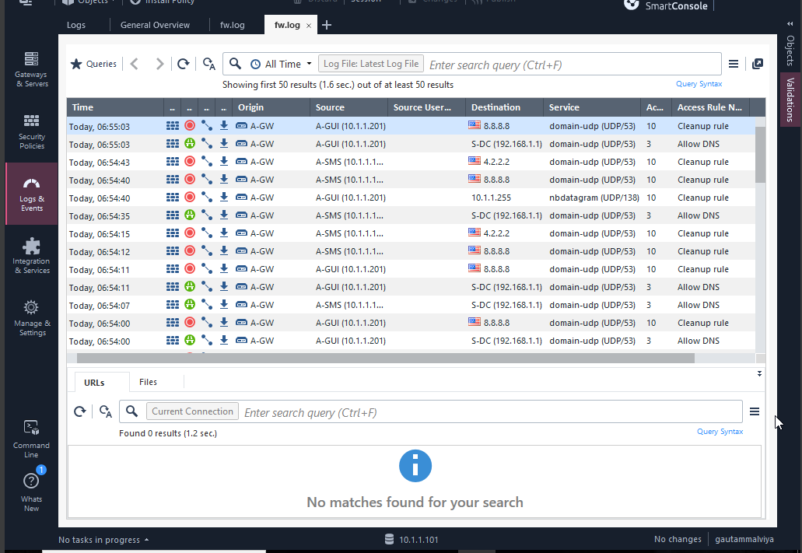
Logs & Policy Enforcement
Real-time evidence of allowed and dropped DNS traffic
• Origin is A-GW, confirming gateway enforcement
• DNS traffic to 5-DC (192.168.1.1) is accepted by “Allow DNS”
• DNS traffic to public addresses such as 8.8.8.8 and 4.2.2.2 is dropped by the cleanup rule
• Logs provide traceable evidence for verification and troubleshooting
Accept + Drop events visible

Slide 11
Security Controls Demonstrated
Key controls shown in the lab evidence
ACCESS CONTROL
Rules determine permitted and denied traffic
CLEANUP RULE
Unmatched traffic is denied by default
DNS CONTROL
Approved DNS path is allowed; other destinations are dropped
THREAT PREVENTION
Custom policy and IPS provide deeper inspection
LOGGING
SmartConsole records source, destination, service, rule and action

Slide 12
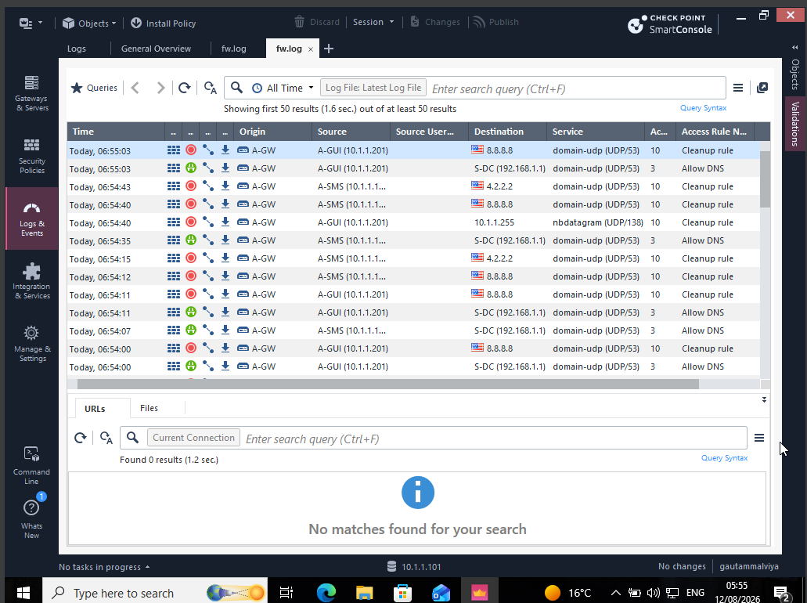
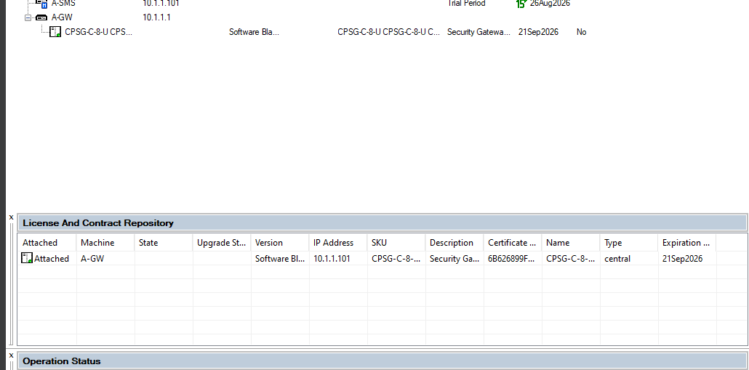
Results & Key Outcomes
• SmartConsole successfully connected to the A-SMS management server
• A-GW was recognised and its licence was attached in SmartUpdate
• Threat Prevention policy was available with IPS enabled
• Gateway logs showed both accepted and dropped traffic according to policy
• The cleanup rule demonstrated a deny-by-default approach for unmatched DNS traffic

Slide 13
Conclusion
What the implementation demonstrates
The lab demonstrates a centrally managed enterprise firewall workflow: configure the gateway, apply licensing, define layered security controls, and verify enforcement through SmartConsole logs.
CENTRAL
MANAGEMENT
POLICY
ENFORCEMENT
REAL-TIME
MONITORING
This provides a practical foundation for secure network administration and incident investigation.

Slide 14
References
• W. Stallings, Network Security Essentials, 6th ed., Pearson, 2017.
• Check Point Software Technologies, Check Point Security Management Documentation, 2024.
• NIST, Guide to Firewall and Policy Management, 2022.
Screen Recording 2026-08-12 055110.mp4

Slide 15
THANK YOU
Questions?
Presented by Gautam Malviya

