Slide 1
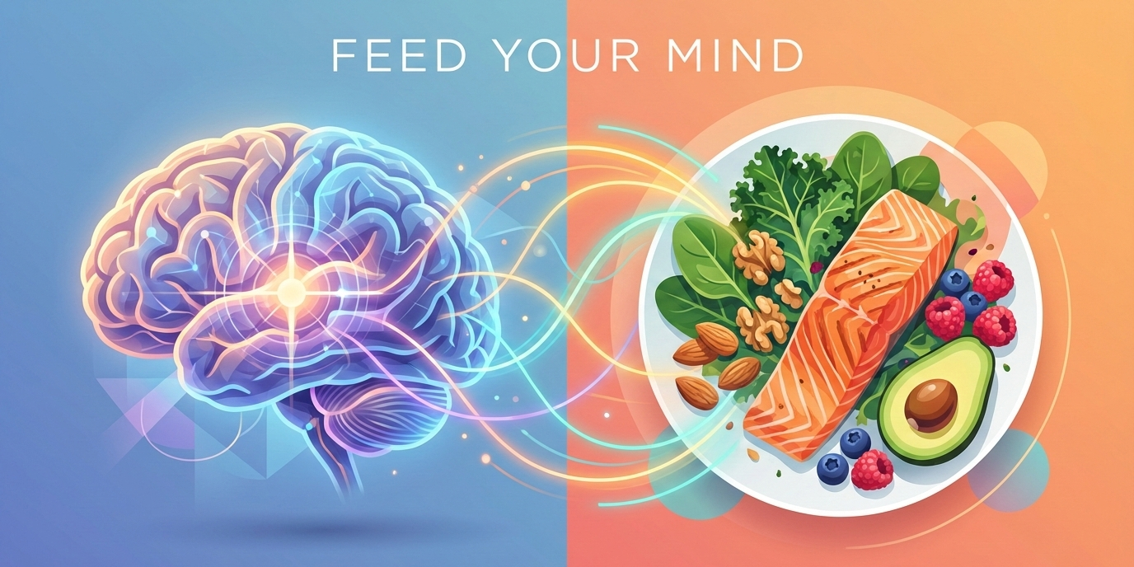

Nutrition for the Mind
The Influence of Nutrition on Neurotransmitters, Mental Health and ADHD
Kerin Roberts
Health, Nutrition and Lifestyle

Slide 2
Why Nutrition Matters for Brain Health
The brain requires nutrients to function effectively
Neurotransmitters are produced from nutrients found in food
Diet influences mood, cognition and behaviour
Poor nutrition may contribute to mental health difficulties
Reference:
Firth et al. (2020). Nutritional Psychiatry and the Brain. World Psychiatry.

Slide 3

Serotonin
Regulates mood
Supports sleep
Influences appetite
Contributes to emotional wellbeing
Key Nutrient: Tryptophan
Reference:
Jenkins et al. (2022). Neurotransmitters Regulation and Food Intake.

Slide 4
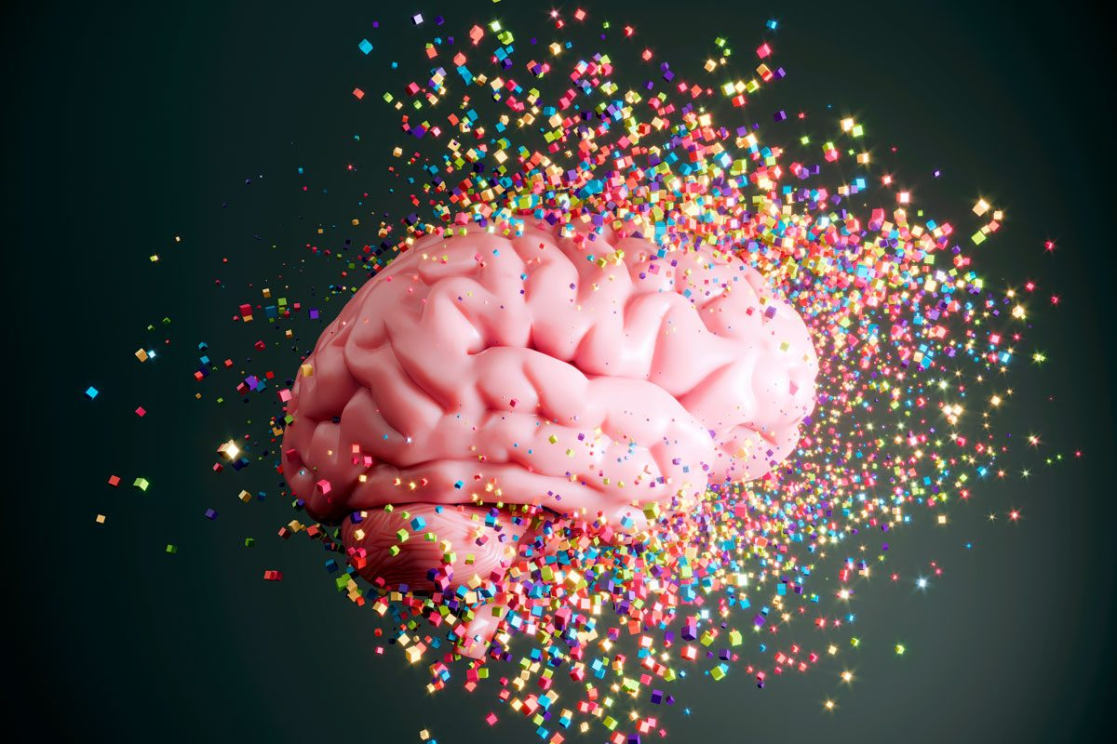
Dopamine
Motivation
Reward
Focus
Attention
Executive functioning
Reference:
Mahmoud et al. (2023). Nutrition and Neurotransmitter Function.

Slide 5
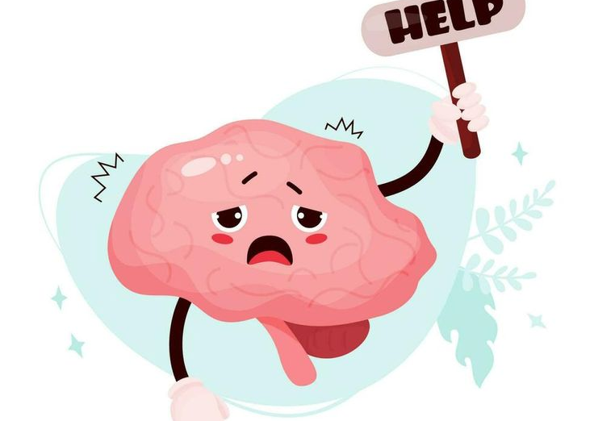
Cortisol (Stress Hormone)
Main stress hormone
Influences concentration
Affects memory
Impacts sleep quality
Reference:
Metabolites Journal (2024). Diet and Stress Regulation.

Slide 6
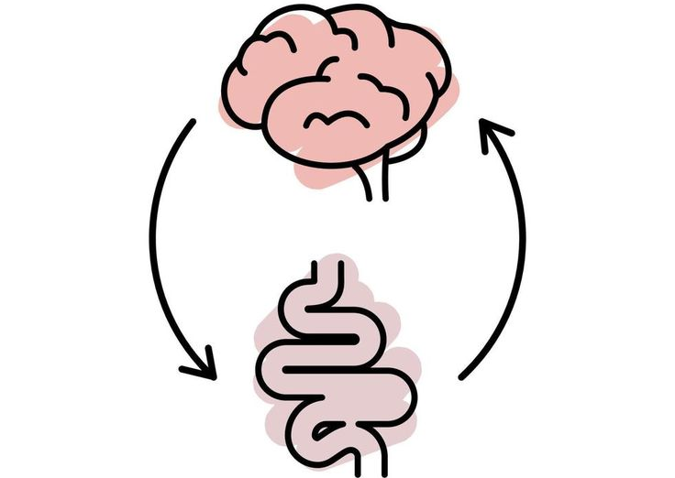
The Gut-Brain Axis
Gut microbiome communicates with the brain
Influences serotonin production
Impacts mood and cognition
Emerging area of neuroscience research
Reference:
Cryan et al. (2023). The Microbiota-Gut-Brain Axis.

Slide 7
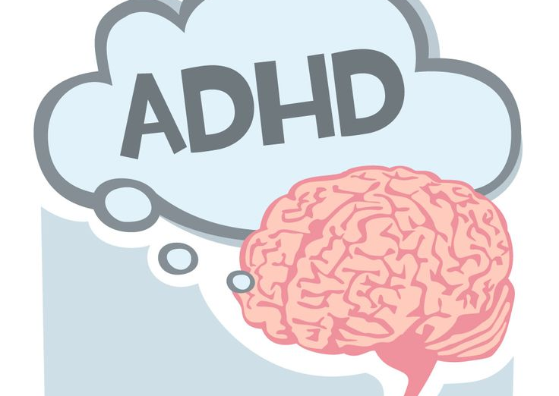
ADHD and Nutrition
Research links ADHD with:
Lower omega-3 levels
Iron deficiency
Zinc deficiency
Vitamin D deficiency
Altered gut microbiota
Reference:
Del-Ponte et al. (2023). Nutrition in the Management of ADHD.

Slide 8
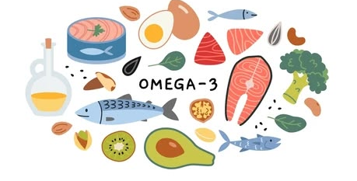
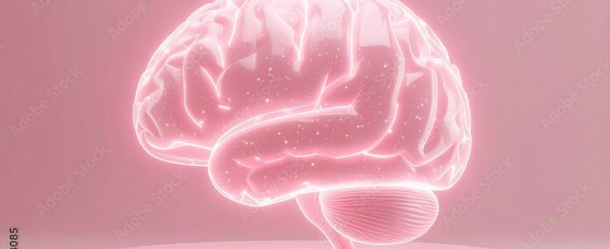
Omega-3 Fatty Acids and ADHD
Sources:
Salmon
Mackerel
Sardines
Chia seeds
Flaxseeds
Reference:
Chang et al. (2021). Omega-3 Polyunsaturated Fatty Acids in ADHD: A Meta-Analysis.

Slide 9
Critical Evaluation
Strengths:
Growing body of evidence
Biological mechanisms identified
Links between nutrition and brain function

Slide 10
Conclusion
Nutrition influences neurotransmitter production
Serotonin and dopamine rely on dietary nutrients
The gut-brain axis may affect mental health
Nutrition may help support ADHD management
Further research is required

Slide 11
Reference List
Chang, J.P.C. et al. (2021) Omega-3 Polyunsaturated Fatty Acids in Youths with ADHD: A Systematic Review and Meta-Analysis. Nutrients, 13(4), 1226.
Cryan, J.F. et al. (2023) The Microbiota-Gut-Brain Axis. Physiological Reviews.
Del-Ponte, B. et al. (2023) Nutrition in the Management of ADHD: A Review of Recent Research. Nutrients, 15(18).
Firth, J. et al. (2020) The Effects of Dietary Improvement on Symptoms of Depression and Anxiety.
World Psychiatry, 19(3), pp. 360-380.
Jenkins, T.A., Nguyen, J.C.D., Polglaze, K.E. and Bertrand, P.P. (2022) Influence of Tryptophan and Serotonin on Mood and Cognition. Nutrients.
National Institute for Health and Care Excellence (NICE) (2018, updated 2025). Attention Deficit Hyperactivity Disorder: Diagnosis and Management (NG87).

