Slide 1
Factors influencing Chinese students’ academic achievements
in UK: English language proficiency and culture integration
Student No: 2406839
Name： Jing Jing Zhu

Slide 2
Introduction /Background of the Research
Research Questions
Aim and Objective
Content
Critical Literature Review /Frame work
Research Design
Methodology –Research Tools
Ethical Process
Data Collection Process
Data Analysis Methods
Limitations and Conclusion

Slide 3
Introduction
Background of the study
Increasing number of Chinese students pursuing higher education in the UK has underscored the importance of understanding the challenges they face in achieving academic success.
Their performance in UK institutions is significantly influenced by two interrelated factors: English language proficiency and cultural integration.(Wong 2018)
Existing research often examines these factors in a wide range national of international students or some of them undertake the research without the Chinese international students, therefore this research will explores how linguistic competence and cultural adaptation collectively influence Chinese students’ academic achievements.
03

Slide 4
Research Questions
RQ1: What are the primary academic, social, and cultural challenges encountered by Chinese international students within the UK higher education system?
RQ2: What adaptive strategies do Chinese international students employ to navigate and overcome academic challenges in UK universities?
RQ3: How does the process of intercultural adaptation in the UK shape social culture, and academic transformations among Chinese international students?
03

Slide 5
Aim and Objectives
To contribute to ongoing debates on the factors influencing academic success among Chinese international students by closely examining the respective impact of English language proficiency and cultural adaptation.
Provide evidence-based recommendations to improve language support services, and develop strategies for cultural integration.
Highlight the specific academic, linguistic, and sociocultural challenges faced by Chinese students in UK higher education.
Promote equitable academic outcomes and more supportive teaching environment for Chinese students in the UK.
03

Slide 6
Critical Literature Reviews
Language Proficiency and Academic Performance
EPI Report (Ebel, 2024) found that many Chinese students excel in written English but struggle with spoken English, affecting their classroom participation and group work. The report suggests that test-based preparation (e.g., for IELTS) does not always build real-world communicative competence.
Jiang and Xiao (2024) highlighted that despite adequate IELTS scores, students often experience difficulties understanding lectures and participating in seminars, can lead to reduced academic confidence and engagement.
Guo (2024) points out that Chinese students often rely on familiar strategies to cope with language barriers—such as avoiding interactions or reverting to Chinese social media—which can further isolate them academically and socially.
03
Cultural Integration and Academic Performance
Spencer-Oatey and Xiong (2006) found that Chinese students often remain within ethnic peer groups due to language confidence issues and cultural distance, which limits intercultural engagement and academic collaboration.
Guo (2024) emphasizes that while digital platforms like WeChat provide social comfort and continuity, they also create "digital silos" that inhibit cultural immersion and language use in English-speaking environments.
Ward and Kennedy’s (2001) model of intercultural adaptation is applicable here: Chinese students often experience both psychological stress (e.g., homesickness, anxiety) and sociocultural challenges (e.g., making friends, understanding UK academic norms).

Slide 7
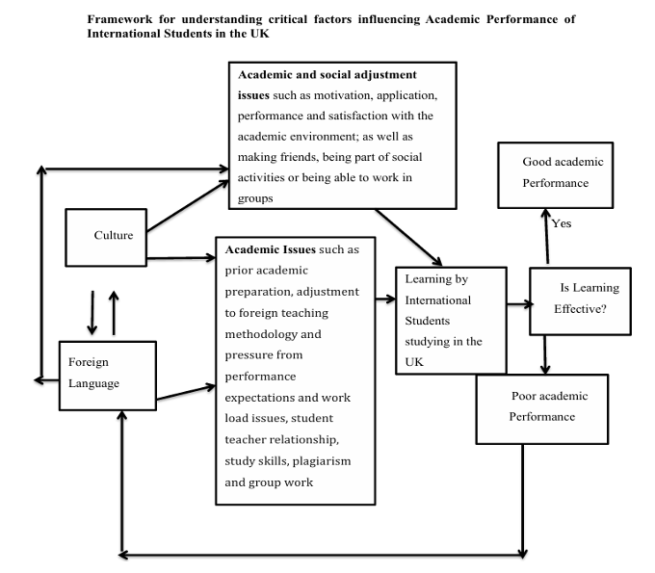
Critical Literature Reviews
03
Source: Ece and Inegbedion (2015) Frame work of factors influencing international students performs in the UK

Slide 8
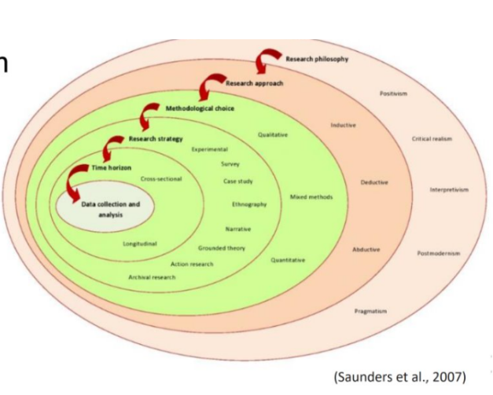
Research Design
Layer | Choice | Justification
Philosophy | Pragmatism | Allows combination of methods for real-world problem-solving
Approach | Abductive | Moves between theory and data; supports mixed methods
Methodological Choice | Mixed methods (quantitative + qualitative) | Gathers both measurable data and rich personal insights
Strategy | Survey + Case Study | Surveys for breadth, interviews for depth
Time Horizon | Cross-sectional | One-time snapshot of current experiences
Data Collection | Online questionnaire and semi-structured interviews | Accessible and appropriate for international student participants
Data Analysis | Statistics (quant) + Thematic analysis (qual) | Supports insight into both patterns and meanings
03
Research Design Table Based on Saunders' Research Onion

Slide 9
Research Methodology
Mixed Methods: Quantitative approaches – Online Questionnaires
Qualitative approaches --- Semi- Structured interview (Online)
Rationale of Methodology and Literature Supports
03
Mixed methods research involves using both qualitative and quantitative paradigms, either in separate phases or in combination, to provide a more comprehensive understanding of a research problem (Creswell, 2005).
Tashakkori and Teddlie (1998) emphasize that combining these methods can lead to a deeper and more complete analysis. Greene (2007) also highlights that mixed methods are particularly effective for investigating complex social issues and phenomena.
Several researchers have identified key advantages to using mixed methods (Newman & Benz, 1998; Martens, 2003).
First, different methods can serve different purposes within a single study.
Second, comparing qualitative and quantitative data can help produce more validated conclusions.
Third, qualitative data can be used to explain and contextualize quantitative findings. Fourth, integrating both types of data enhances the overall depth and richness of the research.

Slide 10
Research Tools
On-line Questionnaires
Advantages | Limitations
Cost-Effective
Minimal financial resources
No printing, postage, or transcription costs.
Time-Efficient
Data collection and analysis can be much faster.
Tools like Google Forms or Qualtrics
Wide Geographic Reach
Different regions or countries
(e.g., international students across the UK).
Convenient for Participants
Their own pace and preferred time.
Reduces pressure and social desirability bias
Anonymity
Honest and open responses
Automated Data Collection
Reducing human error in data entry.
Easily exportable for statistical analysis in SPSS
Sampling Bias
Excludes people without internet access or digital literacy.
May lead to a non-representative
Low Response Rates
low participation, especially if not incentivized.
Emails or links may be ignored or end up in spam folders.
Limited Control Over Respondents
Cannot ensure completes the questionnaire.
Risk of multiple submissions or inattentive responses.
Lack of Clarification
No opportunity to explain questions
Misinterpretation can affect the reliability of data.
Technical Issues
Website downtime, browser incompatibility, or device problems

Slide 11
Research Tools
Semi-Structured interview
Advantages | Limitations
Flexibility and Depth
Allows the interviewer to explore responses in more detail
Participants can express their views in their own words.
Guided but Open
Ensures key topics are covered.
Useful balance between both parties.
Clarification Possible
Interviewer can clarify questions
Reduces the risk of misinterpretation
Builds Rapport
Allows for a more personal and honest interactive
Useful in Exploring Complex Issues
Exploring beliefs, motivations, or cultural experiences.
Can uncover insights that structured methods might miss.
Time-Consuming
Data analysis is also more complex and time-consuming due to variability of qualitative data.
Interviewer Bias
The presence and behavior of the interviewer can influence participants’ responses.
Leading questions or tone can unintentionally shape answers.
Requires Skilled Interviewers
Interviewers need to be trained to listen actively, probe appropriately, and manage the flow of conversation without imposing their own views.
Data Management Challenges
Transcripts can be lengthy and difficult to code or categorize..

Slide 12
Ethical Process
Provide consent information
Ensure participants sign the consent form
Obtain ethical approval from UWTSD (research tools and consent form)
Anonymity and Confidentiality
Use codes or pseudonyms
Minimizing Harm during the Data collections especially interview
Data Protection and Storage
Comply with data protection laws Store data on secure platforms and back up encrypted copies. Set a clear timeline for data discards
Right to withdraw
Inform the participants the data of withdraw
Transparency and Integrity
Report findings honestly and acknowledge any limitations.
Disclose any conflicts of interest.
Inform findings to participants and acknowledge participants’ contributions.

Slide 13

Data Collection Process
03
Online Questionnaires
The questionnaires will undergo a pilot test with a small sample group to ensure clarity and reliability. To accommodate participants' language preferences, all questions will be available in both English and Chinese. The original questionnaires will be designed in English and sent to a professional translation company for accurate translation into Chinese.
Semi- Structured Interviews
Semi-structured interviews will be conducted with six Chinese international students who are currently studying at a UK university. The interviews will take place via Microsoft Teams, and questionnaires will be distributed to participants via email. Email addresses will be obtained from an IELTS training institution, where participants previously studied English in preparation for the IELTS examination before coming to the UK, as well as through the Chinese messaging app WeChat.

Slide 14
Data Analysis
Qualitative Data Semi-Structured interview | Quantitative Data Online-Questionnaire
Using thematic analysis, facilitated by the qualitative software NVivo.
systematic coding and categorization of recurring themes related to language proficiency and cultural integration. Following Braun and Clarke’s (2006) six-phase framework, the analysis will involve familiarization with the data, generating initial codes, searching for themes, reviewing themes, defining and naming themes, and producing the final report.
NVivo will assist in organizing the data and ensuring a transparent and rigorous analytical process.
Quantitative data gathered from the questionnaires will be analysed using SPSS.
The analysis will begin with descriptive statistics to summarize demographic data and general trends. Reliability analysis (Cronbach’s Alpha) will be conducted to assess the internal consistency of the questionnaire items.
Inferential statistical methods, including correlation and regression analysis, will be used to examine the relationships between English language proficiency, cultural integration, and academic performance

Slide 15
Limitations
Sample size is small
From a few university maybe not represent the entire population of the Chinese international students
Language and Cultural Barriers During Data Collection
Lack of Longitudinal Perspective
Measurement Challenges
03

Slide 16
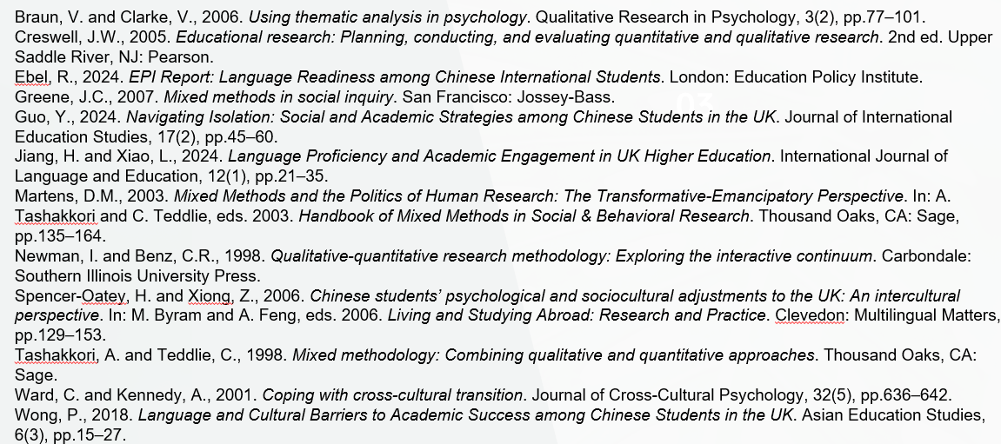
Reference
03

Slide 17
Thank you for your attention
Date:
2025/06/03

