Slide 1
Leadership and Authenticity
WAST Day 3
BMPF7021

Slide 2


Leadership and motivation

Slide 3
Human Resources approach
  Popular in the late 1950s through the 1960s
  Based on the work of Douglas McGregor (The Human Side of Enterprise, 1960), Rensis Likert (New Patterns of Management, 1961), and Chris Argyris (Personality and Organization, 1957)

Slide 4

Human Resources approach-
Douglas McGregor
  McGregor proposed that managers come in two types:
  Theory X managers who believe that workers are generally lazy and must be forced to be productive
  The Theory Y manager believes that staff want to better themselves, to develop new skills and gain knowledge.
  This, of course, was the example of the ‘one best way’ to lead

Slide 5
Comparison between Human Relations and Human Resources approach
  Human relations approach - Improve the worker-manager relationship. This will lead to a satisfied worker. A satisfied worker will be a more productive worker.
  Human resources approach - When managers treat their workers as valuable resources and help them improve their skills and knowledge, this helps the worker perform better. This in turn increases worker job satisfaction.

Slide 6
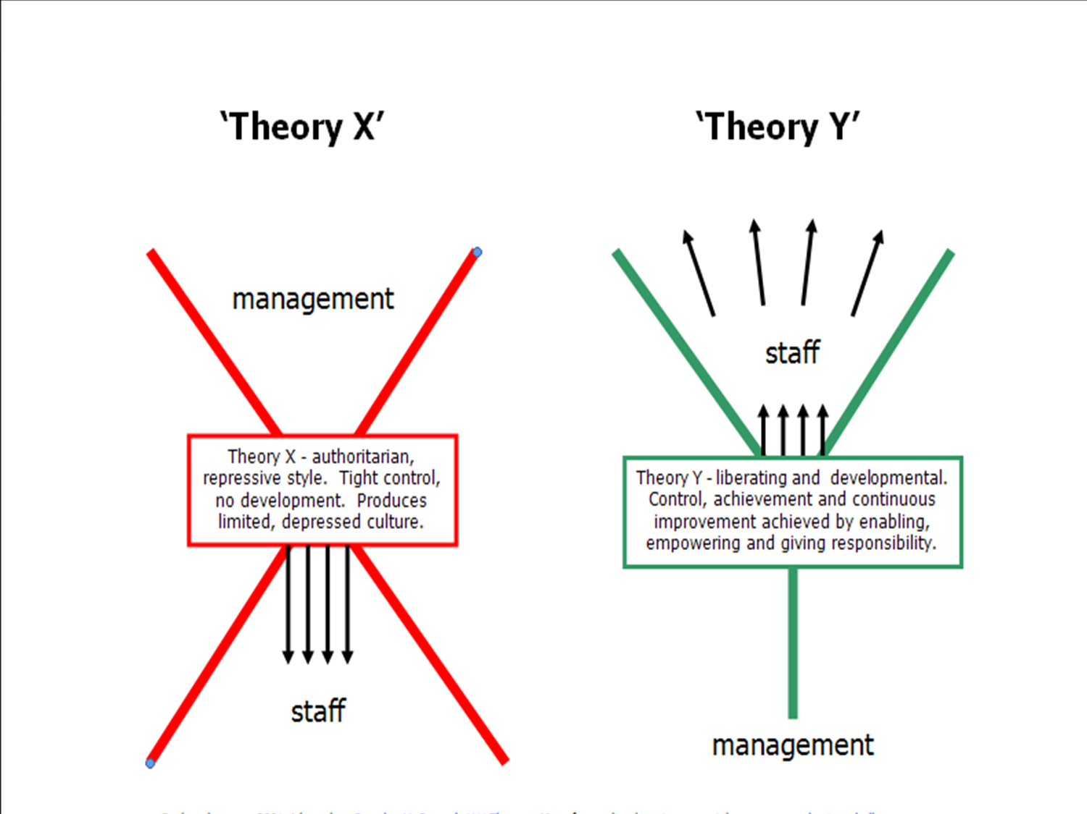
McGregor’s Theory X Theory Y (1960)

Slide 7
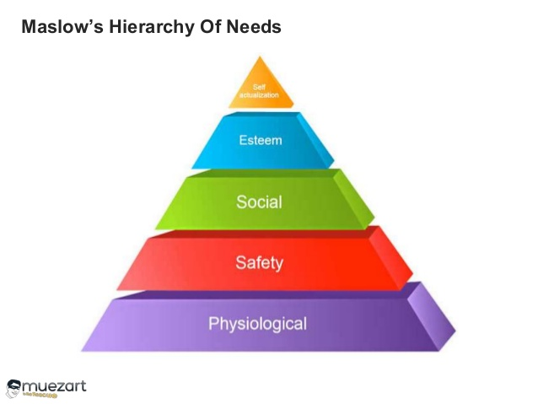
Maslow’s Hierarchy of Needs

Slide 8
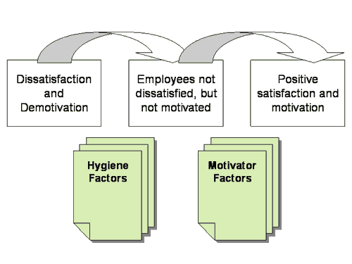
Herzberg’s 2 Factor Theory

Slide 9
Herzberg’s 2 Factor Theory
Hygiene Factors
Job Security
Working Conditions
Salary
Relationships with colleagues
Company Policy and Administration
Level and Quality of Supervision
Notes:
Sirota's Three-Factor Theory - The three factors, which together build enthusiasm, are as follows:
Equity/Fairness – People want to be treated fairly at work.
Achievement – People want to do important, useful work, and be recognized for this.
Camaraderie – People want to enjoy good relationships with their co-workers.
The equity factor is very similar to the hygiene factors described by Frederick Herzberg in his Motivation-Hygiene Theory

Slide 10
Herzberg’s 2 Factor Theory
Motivators
Sense of achievement
Recognition
Responsibility
Nature of the work
Personal growth and advancement
Notes:
Frederick Herzberg (1923-2000)
Frederick Herzber's Motivation-Hygiene theory was created to modify Abraham Maslow's Hierarchy of Needs theory. Herzberg decided that there were certain things that were satisfying and unsatisfying, Herzberg's research was based on the question "What do people want from their jobs?".
"The factors that lead to positive job attitudes do so beacause they satisfy the individuals need for self-actualization in his work ."(Herzberg, 1959)
They 5 strong determent's of
job Satisfaction were:
•achievement
•recognition
•work itself
•responsibility
•advancement
This showed that the satisfiers/motivators are centralized around the employees relationship with their job and the dissatisfiers/de-motivators happen to be the environment or what the job involves.

Slide 11


Case study
Critique the case study presented
Discuss and agree any pertinent aspects for WAST
Present your findings

Slide 12

McClelland
Notes:
David McClelland's theory of needs was built up showing that there are three types of motivating needs, the need for Power, Affiliation and Achievement.(McClelland, 1961)
Workers who have a need for "power" can be motivated to perform if they are given key positions or power positions. Workers who have a need for "affiliation" are motivated by social recognition as they like to have a good social group in the workplace. Finally workers who have a need for Achievement are motivated by the concept of success but also by the fear of failure.

Slide 13
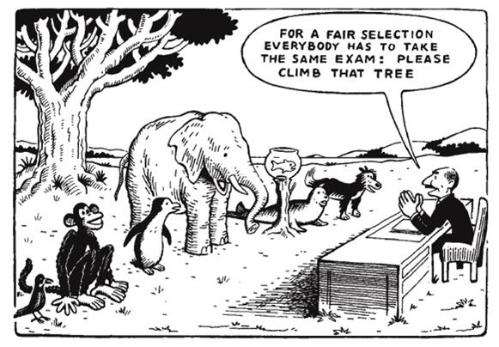
McClelland
n Ach. - Achievement motive
n Pow. – Power motive
n Aff. – Affiliative motive

Slide 14
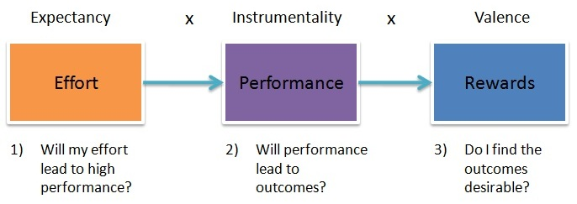
Vroom’s Expectancy Theory
Notes:
Expectancy is the belief that increased effort will lead to increased performance i.e. if I work harder then this will be better. This is affected by such things as:
1.Having the right resources available (e.g. raw materials, time)
2.Having the right skills to do the job
3.Having the necessary support to get the job done (e.g. supervisor support, or correct information on the job)
Instrumentality is the belief that if you perform well that a valued outcome will be received. The degree to which a first level outcome will lead to the second level outcome. i.e. if I do a good job, there is something in it for me. This is affected by such things as:
1.Clear understanding of the relationship between performance and outcomes – e.g. the rules of the reward 'game'
2.Trust in the people who will take the decisions on who gets what outcome
3.Transparency of the process that decides who gets what outcome
Valence is the importance that the individual places upon the expected outcome. For the valence to be positive, the person must prefer attaining the outcome to not attaining it. For example, if someone is mainly motivated by money, he or she might not value offers of additional time off.

Slide 15
Vroom’s Expectancy Theory
Vroom’s Expectancy Theory: He believes that people can be motivated if they believe that:
There is a positive correlation between efforts and performance
Favourable performance WILL result in a desirable reward
The reward will satisfy an important need
The desire to satisfy the need is strong enough to make the effort worthwhile.
Notes:
Victor Vroom
(1932-Present)
Victor Vroom's Expectancy theory showed that the sum of "valency x expectancy is motivation".(Vroom, 1964)
To explain this in simple terms expectancy theory says that an employee can be motivated to perform better when their is a belief that the better performance will lead to good performance appraisal and that this shall result into realization of personal goal in form of some reward. This leads us to the realisation that motivation causes an action which causes results which means there will be satisfaction in form of a reward.

Slide 16
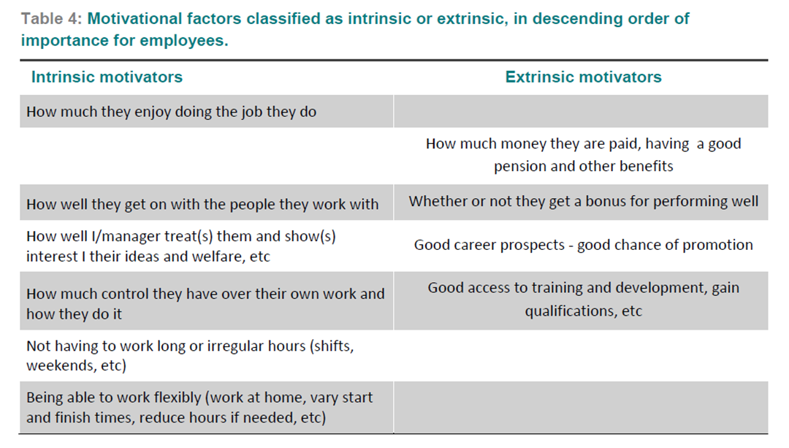
ILM Research: Intrinsic/extrinsic motivational factors

