Slide 1

Humanistic Counselling for Depression
Dr Beverly Cole

Slide 2
The aims of this lesson are to:
Foster collaboration, active learning, and practical application of concepts in relation to depression and therapy

Slide 3

Understanding Depression
Definition of Depression
Depressive disorder, or depression, is a common mental health condition that can happen to anyone. It is characterized by a low mood or loss of pleasure or interest in activities for long periods of time.
This is different from regular mood changes and feelings about everyday life. Depressive episodes last most of the day, nearly every day, for at least two weeks (WHO, 2024).
Depression

Slide 4
You have researched …
What depression is …
Theoretical Perspectives
Treatment Approaches
Psychopharmacological interventions
Impact of prescribed medication
Impact on the person
How (i) PersonCentred Therapy, (ii) Gestalt and (iii) EFT support individuals dealing with these issues

Slide 5

You have considered ….
Through therapy a client can, through taking responsibility for their choices and actions, experience a sense of empowerment which can lead to them towards identifying the root cause of their depression and understanding the impact of internal experiences and external circumstances.
By confronting painful experiences, a healthier, more compassionate relationship with a client’s ‘self’ can be formed which encourages healing and fulfilment.
While it is accepted that past experiences may contribute to depression, emphasising the present moment can encourage a client to focus on their current emotional experiences. This can be helpful in managing the overwhelming feelings of hopelessness that often sit alongside depression and in doing so can help a client take steps towards a more fulfilling life.

Slide 6
Humanistic Counselling for Depression
[foundational knowledge]
Person-centred
Gestalt
EFT
Existentialism

Slide 7

Let’s see how this information can be put to practical use!!!

Slide 8
Interactive Small Group work:
Reflect upon the principles around depression you have engaged with this week
Turn to the person next to you and share your thoughts and/or examples about these concepts.

Slide 9
Group Work: Applying knowledge to real-world scenarios
Break into four groups
Each Group: Drawing on knowledge obtained from your research/reading this week devise a scenario of a client who has presented with depression.
Swap scenarios with the group next to you and offer suggestions on how this client may be supported

Slide 10
Group Work: Applying knowledge to real-world scenarios
    Identify the core issue(s) in the case.
    Discuss how you would approach the client/presenting issues using humanistic therapy techniques for a 60 min session
    Elect one person to report back to the originating group
Devise a detailed scenario of a hypothetical client experiencing depression.
Your case should contain enough background for the other group to apply humanistic principles in a therapeutic context.
Swap

Slide 11


REPORT BACKS …
GROUP 1
GROUP 2
GROUP 1

Slide 12

Holding hopelessness: Discuss the following …

Slide 13
Holding hopelessness: Discuss the following …
There is an assumption that the experiences of hope and hopelessness exist as opposites and in inverse proportion – so that when hope is high, hopelessness is low, and vice versa.
An alternative understanding is to think of hope and hopelessness as coexisting experiences, and to allow for the possibility of strong hope and strong hopelessness existing side by side.

Slide 14
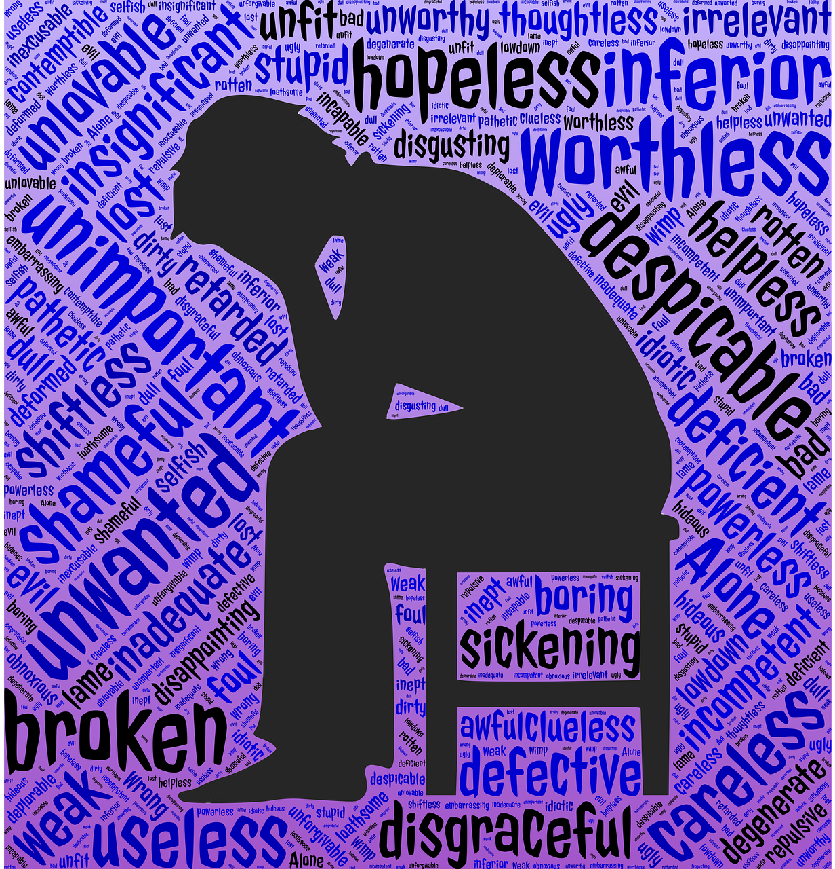
Identify, honour, and work with hopelessness.
This doesn't mean agreeing with or colluding with hopelessness but supporting a client in understanding it.

Slide 15

Time for reflection: Free Writing
Reflect upon:
What you have learnt about the role of humanistic therapy in treating depression
How you can incorporate these strategies in your future work with clients experiencing depression
Any potential limitations or challenges of using humanistic therapy with depressed clients.

Slide 16
Today, we have:
Fostered collaboration, active learning, and practical application of concepts in relation to depression and therapy

