Slide 1
MODULE NAME :Problem solving and decision making
MODULE CODE :LCLM4004
STUDENT NAME :P.Ivanova
STUDENT ID :2513373
LECTURER:prof..Loyd
Assignment 1: Presentation

Slide 2
OVERVIEW
Introduction :
Company background:
Problem:
PESTLE ANALYSIS: Green Haven Florists
Cause and effect analysis: Fishbone diagram
Conclusion
References

Slide 3
Introduction
- In last 12 months Green haven Florist has face 30% decries of in-store sales and online orders has increased slightly and they hasn’t compensated for lost foot traffic.
- Location on High Street from great location reduced activities due to closure nearby businesses.
- Costumers now prefer online shopping and general shifts and frequent discounts.
- They has difficulties to keep indate them site and to make fresh adverticement by social medias and for that impact Business Consultant.

Slide 4
Company background
Green Haven Florists
Founded in.High street Norwich.UK
Owners: Liam and Priya Patel
Sells Fresh flowers and bouquets
strong community ties: business thrived in personal touch and su
stainable ethos ,who resonate with conscious consumers.
Liam and Priya now face challenges of adapting their business mpdel to servive in a rapidly changing retail environment.

Slide 5
Problem: nature and scope
5W2H
Who: Liam and Priya Patel
Where:Green Haven Florist,Norwich
What:30% fall in Revenue
When:Over the last year
Why:Closure of surrounding business,increase in online sales.Customers prefer big shops.
How:Liam and Priya need to understand the issues.
How much:They have to modernise and complete.

Slide 6
PESTLE ANALYSIS: Green Haven Florists
Political : Trade Tariffs
Political factors include government policies, taxes, and regulations that may affect businesses. Government stability, tax policies, and trade regulations can influence how businesses operate and expand.
Ecconomical : Economic Growth
Economic factors refer to the overall economy such as inflation, interest rates, unemployment, and economic growth. These factors affect customer purchasing power and business profitability.
Social : consumer Behavior
Social factors relate to consumer lifestyles, population trends, culture, and attitudes. Businesses must understand customer preferences and adapt their products or services to meet changing social trends.

Slide 7
PESTLE ANALYSIS: Green Haven Florists
Technological : Innovation Trends
Technological factors include new technologies, automation, digital marketing, and e-commerce platforms. Technology can improve efficiency, reduce costs, and help businesses reach more customers.
Enviornment: Climate change
Environmental factors include climate change, sustainability, waste management, and environmental regulations. Businesses are increasingly expected to operate in an environmentally responsible way.
Legal: costumer protection Laws
Legal factors involve laws and regulations such as employment laws, consumer protection laws, health and safety regulations, and data protection. Businesses must follow these laws to avoid legal problems.

Slide 8
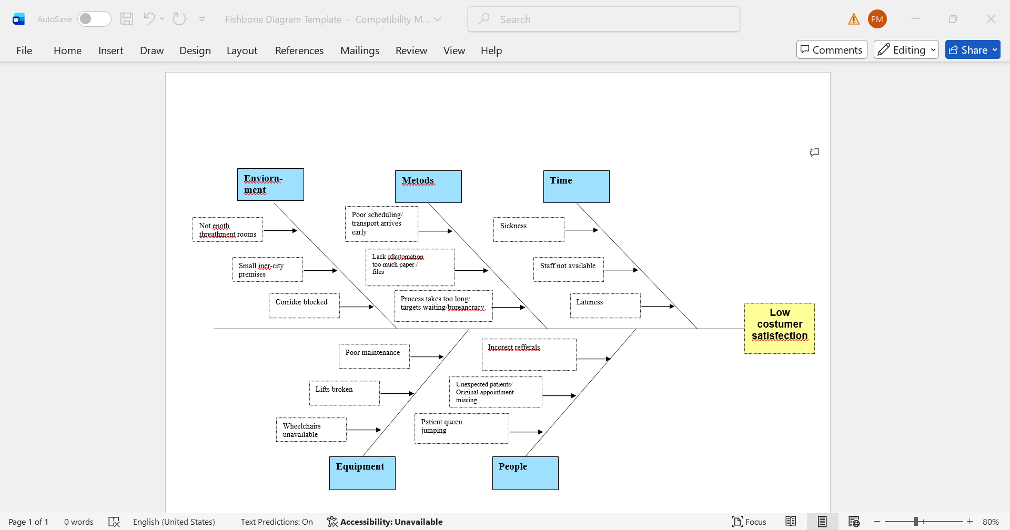
Cause and effect analysis: Fishbone diagram

Slide 9
Conclusion
1.Green Haven Florist is small family business with multiple problems over the years,company is create 2016 year,based in Norwich,Uk and last 12 months has face deadline of his financial problems,the boutick has struggle from morall and creative working comflicts ,because of life and business routine,because of that like a Business consultant bring them on flowers fair where find trendy young specialists,who to work for minimal paimont next two years- trendy boutique florist- influencer with fresh Instagram profile IT specialist with specialization in merchant dising .
2.Because of susteanable materials they has create major loses from 30%,who don’t has possible to cover,because of that create for them Revoltt credit with 3,5% interest and invest in Hana’s floral POS software brings order to the chaos by managing all them financial transactions in one place,and organice softuer supply for one month to learn them of specification of softuer product.
3. Create in Instagram floral curses every Friday evening with 20% interest and create accreditive sertificate after 10 dates curse in London Flower association with who they can pay advertice bills.
4. Set up a loyalty program to reward repeat customers and encourage more sales. The system also makes it easy to manage your social media presence and email marketing.
That my futursy for next two years for company is to reunite and to have 30% dividends in financial hub in them credit plan for Revolut.

Slide 10
References
1)BGMC(2024) Exploring the Fishbone Diagram: Types, Advantages, Drawbacks, and Revealing the Six M’s of Change Available at: https://bgmcgroup.com/exploring-the-fishbone-diagram-types-advantages-drawbacks-and-revealing-the-six-ms-of-change/ (Accessed: 28 October 2024)
2) Investopedia (2025) What Is a Market Economy, and How Does It Work? Available at: https://www.investopedia.com/terms/m/marketeconomy.asp (Accessed: 24 June 2025).
3) Tshabalala, N. (2025) What is a Stakeholder in Business? Available at:
4)https://www.bstudies.co.za/business-concepts/stakeholder-definition/ (Accessed: 24 June 2025).
https://www.hanafloristpos.com/blog/challenges-small-floral-business-owner-faces-and-solutions/
5)https://paywithatoa.co.uk/blog/open-a-floristry-business-in-the-uk/(Accussed:4 March 2024).

Slide 11

Questions

