Slide 1
BMSK4006:Managing Enterprise in the 21st Century
Business Plan
Title: Low Carb and Keto On the Go
Name of Students and ID number: Selina Akhtar 1713307
Rashida Sultana 1711170
Rukna Akhtar: 1713346
Momota Rahman 1714388
Lecturer Name: Olu Adegbite

Slide 2
Executive Summary
Low Carb and interest keto food
Food ready for on the go while will save time
Target all ages
Health benefits of low carb
Reasonably priced

Slide 3
BUSINESS/COMPANY OVERVIEW
Low carb and keto on the go
Healthy snacks = Healthy Lifestyle
Reducing carbs will help to lose weight
Provide ready meals with low carb and keto
Provide easy access to access the snacks such as on the go snacks from a service station
Make the healthy snacks a reasonable price

Slide 4
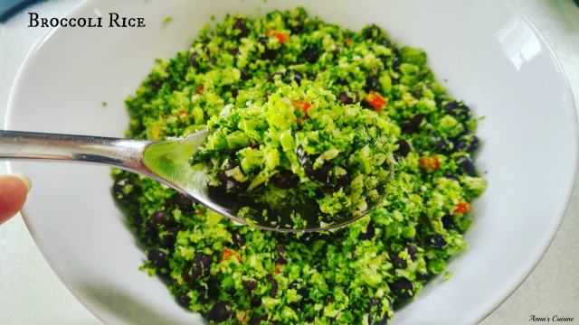
PRODUCTS AND SERVICES
Substituting carbohydrates to other alternatives including ketos.
Carb free, gluten free and vegan dishes
Encourage more vegetables in your daily life
Products will include: cauliflower rice, bread made out of almond flour and coconut flour and keto pasta.
All the products will be made to grab on the go, this will be the service we provide.
This Photo by Unknown Author is licensed under CC BY-NC

Slide 5
Target Market
We are looking to target all ages
Anyone who is looking for a healthy lifestyle
Looking for a quick healthy option to grab on the go
Somebody who is looking for carb free option
All products will be reasonably priced.

Slide 6
COMPETITORS
Competitors will be other fast food services.
Diet apps on phone
Service Stations
Local shops such as Spars
Free from foods

Slide 7
MARKETING AND SALES PLAN
We plan to put our products near other options free range sandwich deals
We plan to market it on social media
We will be marketing it into big supermarkets such as Tesco, Asda, Morrisons, Sainsburys and service station
We will be using organic ingredients and will highly promote this to the target market.
We will also do market research using questionnaires.

Slide 8
MANAGEMENT TEAM
We have 4 enterprenuars with equal share of 25%.
Momoto will be manager
Selina in charge of marketing and promotion
Rukna in charge of finance
Rashida in charge of Human Resources

Slide 9
FINANCIAL PLAN
Preferred amount of £25,000 per person X 4 = £100,000.00
Leasehold Price for meal prep premises, Birmingham: £40,000.00 for 3 years.
Left: £60,000.00
Rent: £89 per week, no business rates
Advert seen at rightbiz.co.uk ( Advert ID 236073 )
Appliances already available like commercial cookers, fridge, mixers and other food preparations items.
Will require sandwich packages, leaflets, logos, food labelling, bulk almond flour, bulk coconut flour, sea/pink salt, bulk free range eggs, bulk mozzarella/cheddar and other varieties. Bulk spices, herbs, bulk vegetables mainly cauliflowers, meat and fish products. Estimating to cost up to £40,000.00.
Leaving amount of £20,000.00 to use as required.
(£89.00 x 52 weeks = £4,628.00 x 3 years = £13,884.00)
£100,000.00 + £13,884.00 = £113,884.00 DIVIDE by 3 years = £37,961.34 per year DIVIDE by 52 weeks = £730.03 per week DIVIDE by 7 days = £104.29 per day.
Estimated amount per item/sandwich £2.30 x 200 per day = £460.00 x 1 week = £3,220.00 x 52 weeks = £167,440.00 x 3 years = £502,320.00
Estimated profit in 3 years = £388,436.00
Estimated profit per year £129,478.67

Slide 10
SWOT ANALYSIS
STRENGTHS Low carb products Using oraganic vegetables Fresh products | OPPORTUNITIES Health conscious customers Helping people to achieve goals Help obesity
WEAKNESSES Increasing fuel costs and wages Transporting costs | THREATS Other competitors Lack of fruit and vegetable on the market Price of products Timing of delivery

Slide 11
PESTLE ANALYSIS
Political factors are trends in the food market
Economical factors are the buying and selling of the local population. Inflation rates.
Social factors are consumer preferences of eating habits. Lifestyle trends and eating habits.
Technoligical factors- competitors with more access. Cost of wi-fi and card machines.
Legal factors will focus on company laws and investment regulations
Enviromental factors

Slide 12
QUESTIONS

