Slide 1


By Eden Hopkins
Notes:
Hello my name is Eden Hopkins. Today I will be presenting my review of Boomtown Festival. During this presentation I will be reviewing Boomtown 2019 which has been vitrual this year due to COVID-19. I will be reviewing the event by using a checklist that I have made to explain the feedback and satifaction levels.

Slide 2
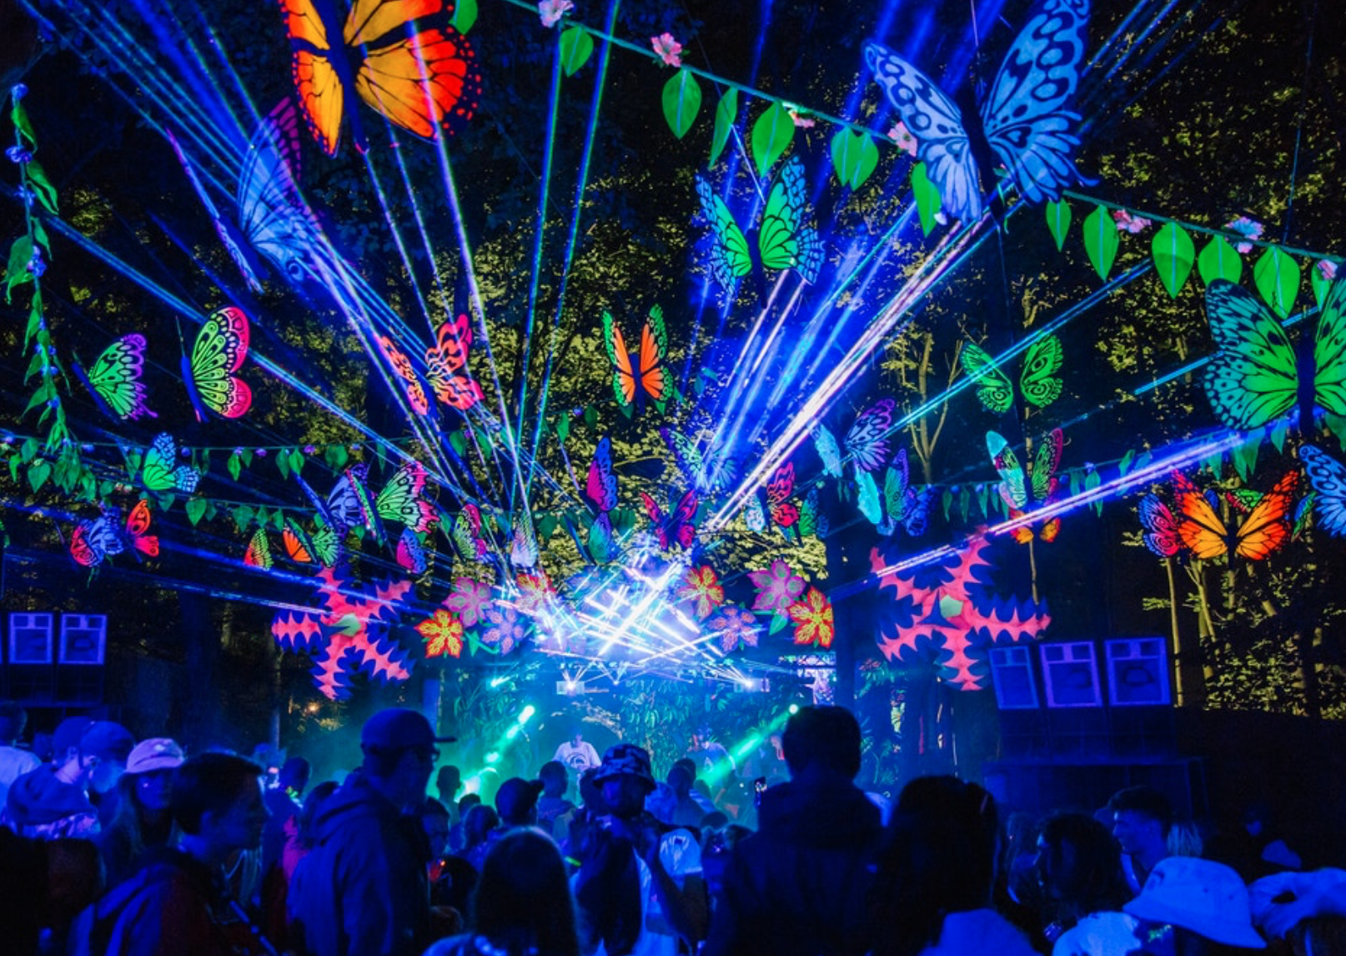
Boomtown
Boomtown Festival
Large Scale
Indepentent Festival
Respect, Connection, Creativity and Celebration
Notes:
Boomtown is a large scale festival. The defintion of the word Boomtown is a town that experiences a sudden growth in business and population. The desricption from Boomtown's own website is a living theatre that ignites imagination and inspires the emergence of a better world through respect, connection, creativity and celebration. Boomtown is a indepentent festival and is still ran by the same people who started it. They were able to bulid the event by having sponsers of course but mostly the festival is indepenent.

Slide 3
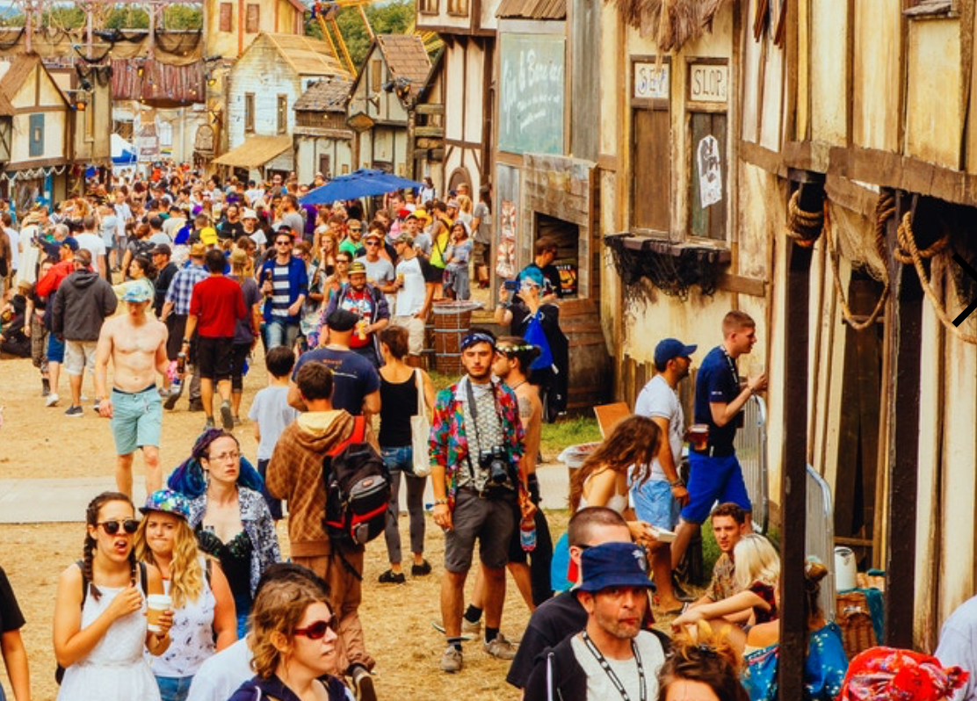
Festival Consumer
Notes:
The typical Boomtown consumer is someone who enjoys the arts as well as a music experience. Boomtown is well know to use theatre performance to engaged with the festival guest as they have a lot of actors in the different town to be able to show the festival guest a new experience and to make them feel more involved with the festival. Boomtown is well known for having different genres of music around the festival this means that the guest will be able to enjoy there own music tastes that may not be heard in other popluar festivals. Boomtown is able to give there guests an amazing experience by having different areas of the festival with towns and villages.

Slide 4
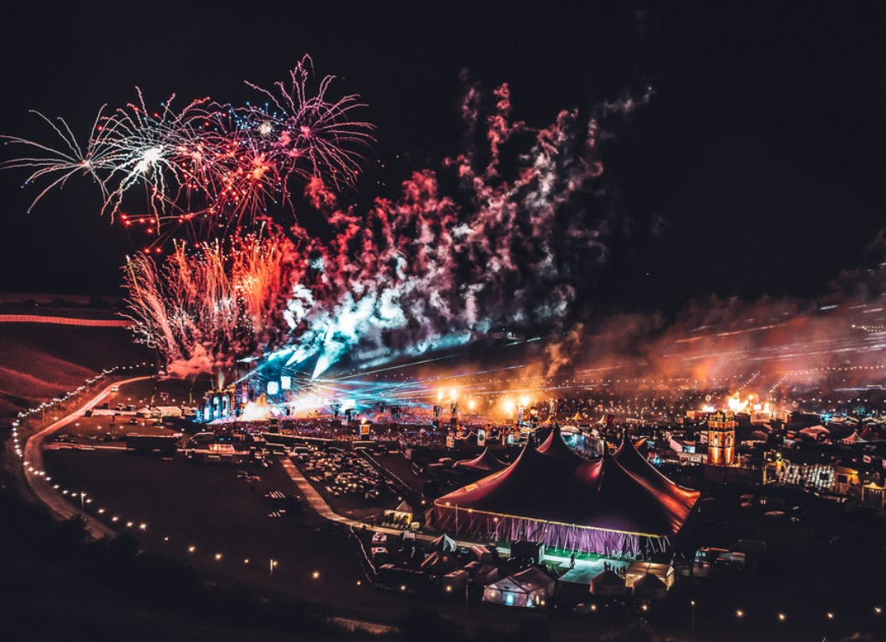
Customers Satifaction
Record Instagram
Feedback Questationaire
Crew Feedback
Notes:
The festival would be able to record how well the festival performed by relasing a suvery on all their social media porfile on how the guests experienced the festival and how the festival could be improved. To get guests more willing to fill out the suvery the festival could give a weekend ticket away or some merchnidase to a random particpated.

Slide 5
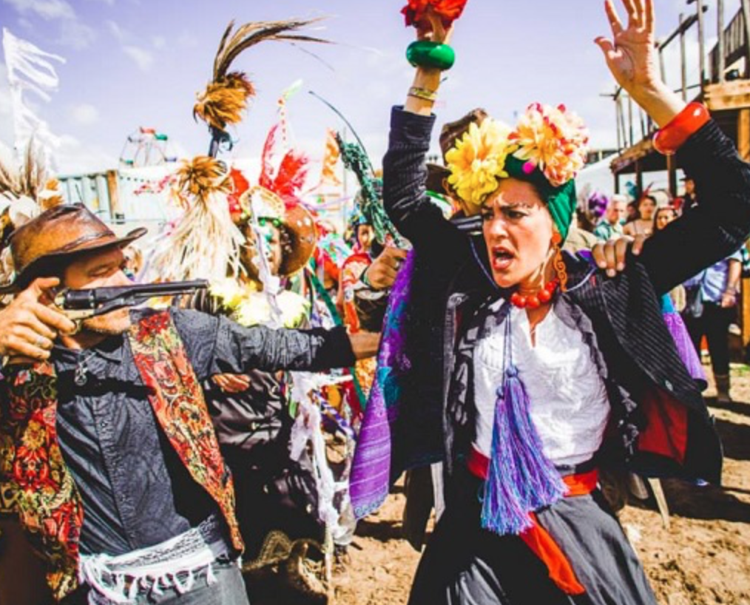
Consumer Satisfaction Engagement
Social Media
Guest Interaction
Safety
Notes:
To create consumer engagement using social media regrealy is a good way of creating engagement before the festival starts as it excites the guests and keeps them involved with the planning of the festival. To create consumer satisfaction creating a poistive enviroment is important as Boomtown has proven time again with tickets selling out within 2 hours. The postive enviroment of Boomtown is encouraged by the ethos and rules that people who attend like to stand by.

Slide 6

Checklist
https://uowtsd-my.sharepoint.com/personal/2017593_student_uwtsd_ac_uk/_layouts/15/doc.aspx?sourcedoc={02daaee8-3ab7-4de1-80f9-ddc232f517b5}&action=edit
Notes:
This is the checklist that I created to obtain information for how the festival worked with each element.

Slide 7
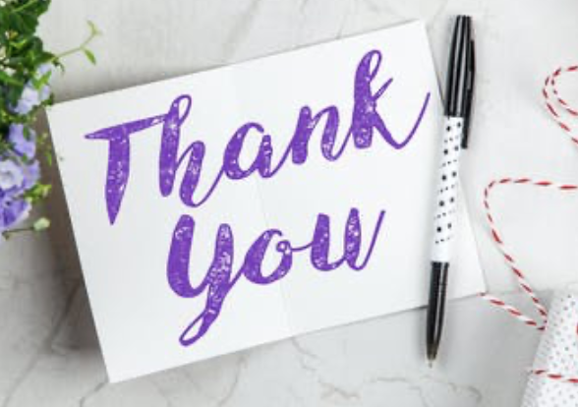
Notes:
Thank you for listening to my presentation

