Slide 1
The short and long term impacts of abuse on victims and the role of police- support service partnerships in effective safeguarding
Erin Davies
(2404320)
BMPL5015

Slide 2
introduction
Short and long term impacts of abuse
Role of police- support service partnerships
Importance of safeguarding

Slide 3
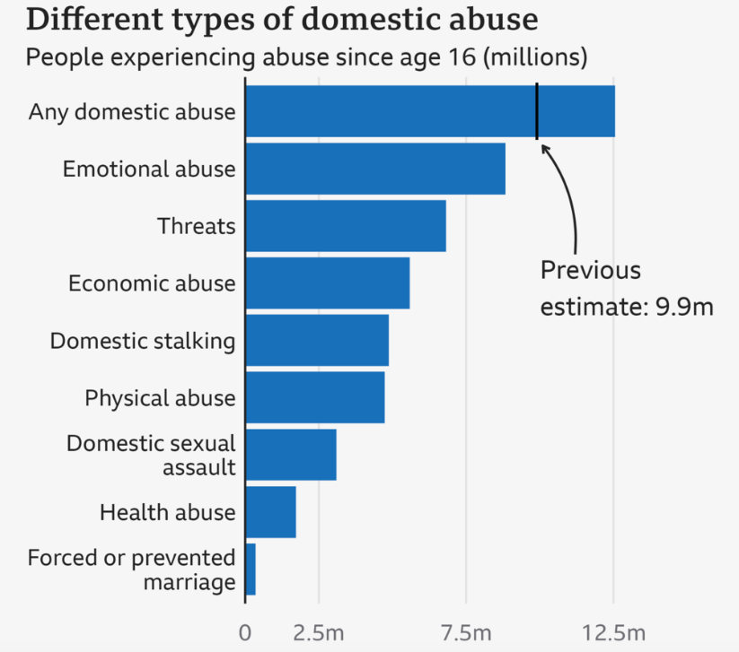
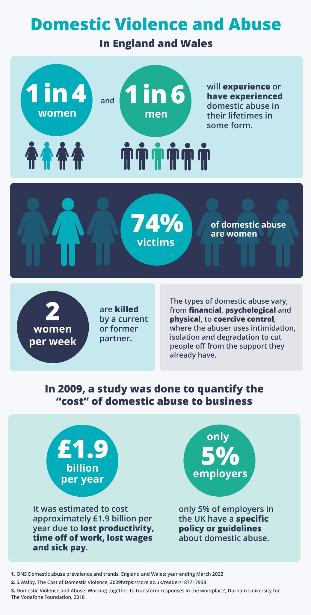
(Agerholm, 2025)
(Benson, 2023)

Slide 4
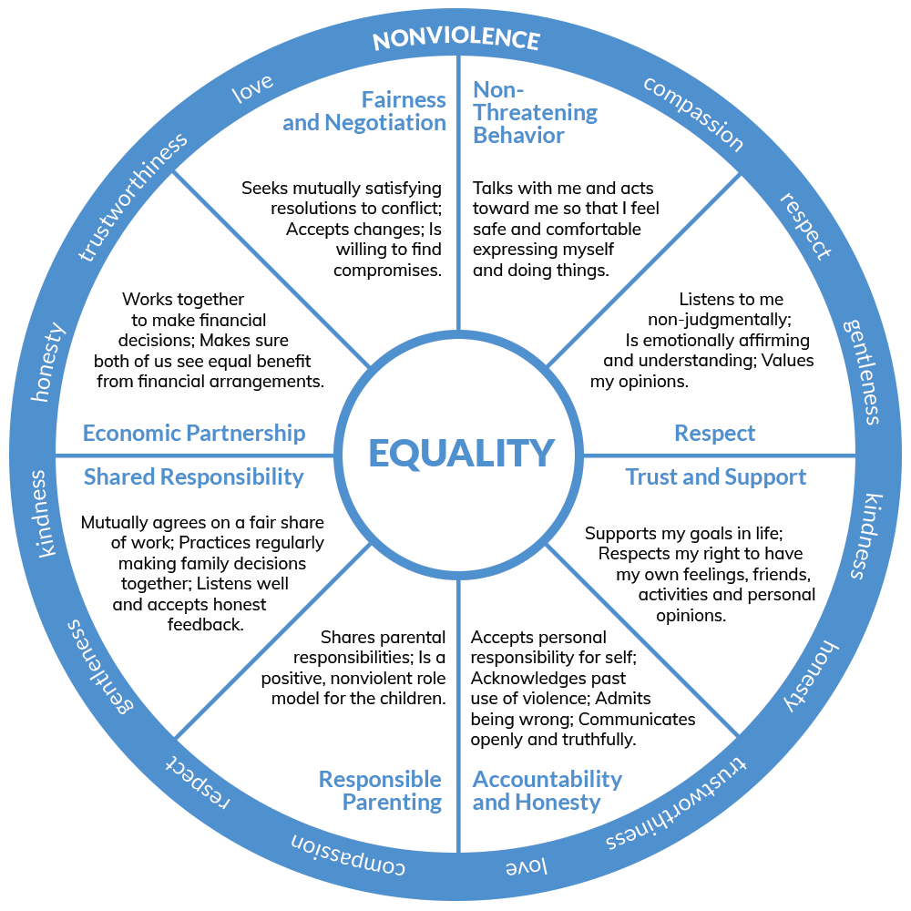
Key concepts
Victimisation
Trauma
Safeguarding
Multi-agency cooperation
Domestic Abuse Act 2021 : statutory definition of abuse
(Government Equalities Office and Department for Transport, 2022)
(MIND, 2023)
(Gov.UK,2021)
https://shelteringwings.org/2020/07/21/understanding-power-and-control/

Slide 5

Short term psychological impacts
Sleep disturbances
Anxiety & depression
Fear & shock
Flashbacks
(Lavie, P. 2001)
https://www.google.com/url?esrc=s&q=&rct=j&sa=U&url=https://www.shutterstock.com/search/mental-health-line-drawing&ved=2ahUKEwjRu-_t0_mRAxWAXEEAHdpCBqQQqoUBegQIERAB&usg=AOvVaw3NijftP3evHckq6b2yo4ne

Slide 6
Long term psychological impacts
PTSD
Depression
Drugs
Complex trauma
(Wallis, 2021)
(NHS, 2022)

Slide 7

Emotional/ social impacts
Shame
Distrust
Fear
Guilt
(NSPCC, 2025)
Isolation from close people
Financial control
Homelessness
Risk of re-victimization
(Freeva, 2024)
https://www.google.com/url?esrc=s&q=&rct=j&sa=U&url=https://www.shutterstock.com/search/separation-solitude&ved=2ahUKEwiYmO2f1PmRAxWlNvsDHelgMB8QqoUBegQIBBAB&usg=AOvVaw2QvH6aDEv4Qe-jvCJecNj1

Slide 8

Barriers to disclosure
https://www.google.com/url?esrc=s&q=&rct=j&sa=U&url=https://www.istockphoto.com/illustrations/closed-mouth-icon&ved=2ahUKEwjQwM-21PmRAxWFVUEAHWpdAKYQqoUBegQIChAB&usg=AOvVaw1mtzl-Bj7YQveS9mr_UoRj
Fear of the abuser
Worried they will not be believed
Threats can be involved
Language difficulties
Past negative experience can cause lack of trust in the police
(National Domestic Violence Hotline, 2024)

Slide 9

Police responsibilities
First responders
Risk assessment – DASH
Work with different organisations to help victims get the support they need
(HMICFRS, 2019)
(Safelifes, 2025)
https://www.google.com/url?esrc=s&q=&rct=j&sa=U&url=https://www.warwickshire.police.uk/area/your-area/warwickshire/nuneaton-bedworth-borough/nuneaton-central/about-us/our-priorities&ved=2ahUKEwjUivfY1PmRAxUAUqQEHR_IMJ0QqoUBegQIDhAB&usg=AOvVaw1i0e3XDJtKsNn01sA_JUW8

Slide 10
What do support services do?
Victim support
Domestic abuse services
Social care
Mental health services
Rape crisis
Why effective safeguarding matters?
(Victims Support, 2016)
(indirect, 2016)

Slide 11
Improving police- support service collaboration
Trauma informed training for police and frontline staff
Early referral to specialist support services
Regular meetings
Embedding IDVAs within police stations
Long term monitoring on high risk victims
(Home Office, 2022)
(SafeLives, 2019)

Slide 12
Harshita Brella- case study
Harshita Brella, aged 24, reported domestic abuse and coercive control by her husband.
Police arrested the perpetrator
Harshita experienced short and long term abuse
The abuse escalated over time and she was later found dead.
(Grant, 2024)

Slide 13
Conclusion
Abuse has severe long and short term impacts
Victims need trauma informed support
Collaboration is essential for safety and recovery

Slide 14
Refrence List
Agerholm, H. (2025). Millions more affected by domestic Abuse – new survey. BBC News. Available at: https://www.bbc.co.uk/news/articles/c991ymnpxzdo
Benson, A (2023). Policies that save lives: domestic abuse and the workplace. Social Value UK. Avialable at: https://socialvalueuk.org/policies-that-save-lives-domestic-abuse-and-the-workplace/
Freeva (2024). The impact of Domestic Abuse/ freeva. Available at: https://freeva.org.uk/how-might-domestic-abuse-be-impacting-your-loved-ones/#:~:text=Isolation%20and%20Broken%20Relationships,their%20relationships%20with%20loved%20ones.
Gov.UK. (2021). Domestic Abuse Act 2021. Legislation.gov.uk. Available at: https://www.legislation.gov.uk/ukpga/2021/17/contents
Government Equalities Office and Department for Transport (2022). Equality Act 2010- Explanotory Notes. Legislation.gov.uk. Available at: https://www.legislation.gov.uk/ukpga/2010/15/notes/division/3/2/2/15
Grant, J. (2024). Harshita Brella Murder: what we know so far. BBC News. Available at: https://www.bbc.co.uk/news/articles/c5ymv1p1j4vo
HMICFRS (2019). The police response to domestic abuse an update report. Available at: https://assets-hmicfrs.justiceinspectorates.gov.uk/uploads/the-police-response-to-domestic-abuse-an-update-report.pdf
Home Office (2022). Domestic Abuse statutory Guidance. Gov.uk. Available at: https://assets.publishing.service.gov.uk/media/62c6df068fa8f54e855dfe31/Domestic_Abuse_Act_2021_Statutory_Guidance.pdf
Lavie, P. (2001) ‘sleep disturbances in the wake of traumatic events’, new England Journal of Medicine, 345 (25), pp. 1825- 1832.
Michael Wallis (2021). The impact of domestic abuse on mental health- beyond PTSD. Somersetdomesticabuse.org.uk. Available at: https://somersetdomesticabuse.org.uk/the-impact-of-domestic-abuse-on-mental-health-beyond-ptsd/

Slide 15
MIND (2023). About Trauma. www.mind.org.uk. Available at: https://www.mind.org.uk/information-support/types-of-mental-health-problems/trauma/about-trauma/
National domestic violence hotline (2024). ‘why didn’t you say anything?’ The hotline. Available at: https://www.thehotline.org/resources/why-didnt-you-say-anything/
NHS (2022). Post- traumatic stress disorder. Nhs.uk. Available at: https://www.nhs.uk/mental-health/conditions/post-traumatic-stress-disorder-ptsd/overview/
Nidirect (2016). Support services for vicrims. Nidirect. Available at: https://www.nidirect.gov.uk/articles/support-services-victims
NSPCC (2025). Emotional abuse. NSPCC. Available at: https://www.nspcc.org.uk/keeping-children-safe/types-of-abuse/emotional-abuse/
SafeLives (2019) Safe and well: mental health and domestic abuse. Available at: https://safelives.org.uk/wp-content/uploads/Safe-and-well-Mental-health-and-domestic-abuse-spotlight-report.pdf
SafeLives (2025). Dash risk assessment resources for professionals. SafeLives. Available at: https://safelives.org.uk/resources-for-professionals/dash-resources/
Victim Support (2016). Victim Support. Victimsupport.org.uk. Available at: https://www.victimsupport.org.uk

Slide 16
I confirm that I have not used any AI tools in the research and creation of this assignment. I confirm that I have not presented any AI generated materials as my own work. I confirm I have copies of my drafts, notes and other resources I used, which I may be asked to provide in evidence.

