Slide 1
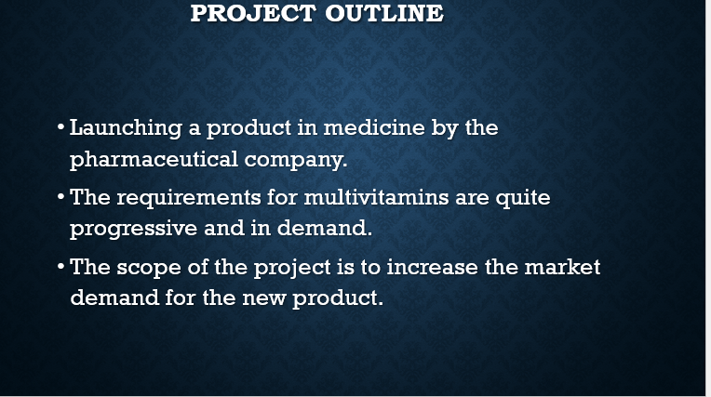
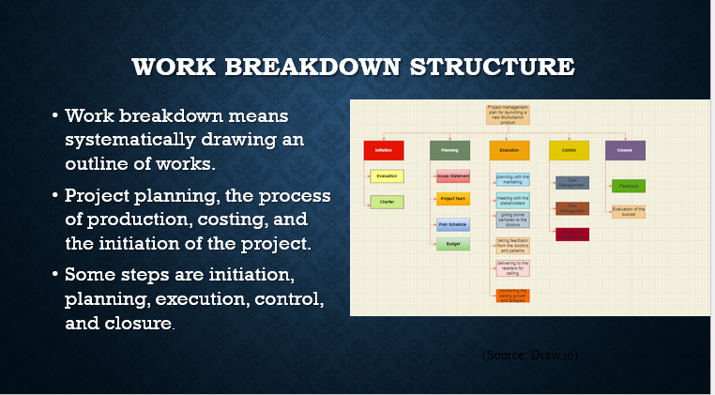
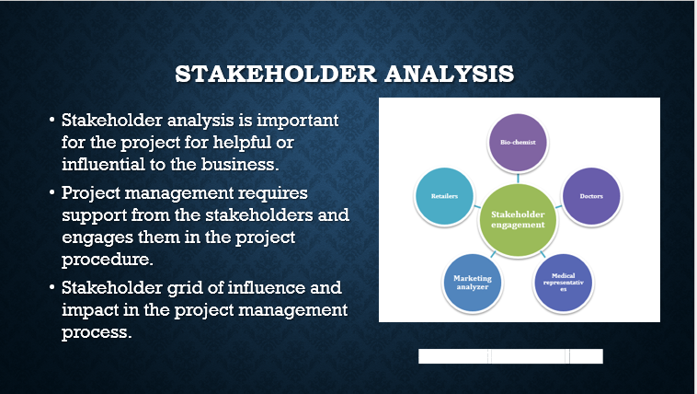

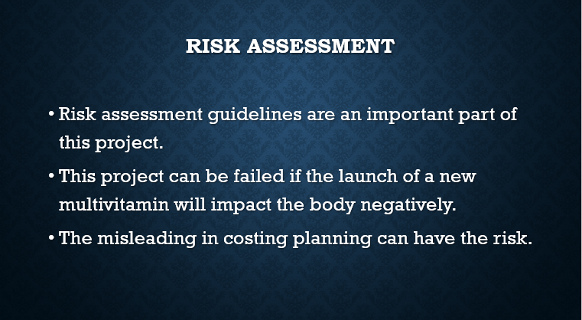
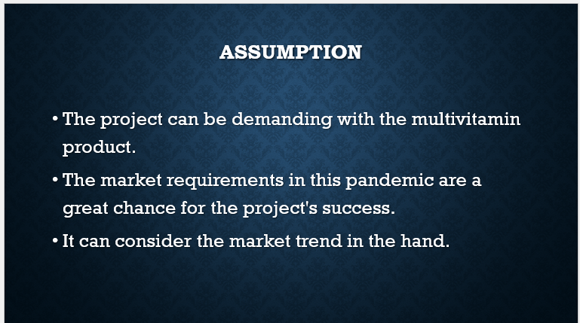
Student Name: Nelea Sargarovschi Student ID: 2021300 Lecturer Name: Sujeewa Herath Module Code: BMSW5104
PROJECT MANAGEMENT PLAN FOR LANCHING A NEW MULTIVITAMIN PRODUCT

