Slide 1
Study on the perspective of singing student aged 10 to 12 to Semi-Occluded Vocal Tract
(SOVT) exercises
BMPF7008 - Module 3 Presentation
MA in Professional Practice (Voice Pedagogy)
Voice Study Centre - University of Wales Trinity Saint David
Dani W. Dumadi
ID: 2246858

Slide 2
INTRODUCTION
Research Aim:
To enhance learning outcomes and effectiveness when working with young singing students
Research Objective:
To explore the experience of young singing students on SOVT exercises
Research Question:
“What is the perspective of private singing students aged 10 to 12 on SOVT exercises?”

Slide 3
PARTICIPANTS
Profile : 21 Singing students aged 10-12
Location : A music centre in South Jakarta
Procedures
Getting police records
Getting permission from music centre
Advertise at teachers whatsapp group and get direct parents contacts from our centre’s admin
Contacting parents and get their consent

Slide 4
INTRODUCTION
SOVT included:
Lip trill (Lip buzz)
Tongue trill (Rolled /r/)
Blowfish
Straw phonation
Water Resistance Therapy (SP in water)

Slide 5
METHODOLOGY
Underlying methodology:
Pragmatism
Research Method: Mixed-methods
Qualitative part: Thematic analysis
Quantitative part: Closed-ended interviews

Slide 6
FINDINGS
Familiarity to SOVT
Perceptions to each of SOVT
Favoritism Rank
Possibility of Independent practice outside lesson hours and the preference exercise for that
Pre- and post- session perception

Slide 7
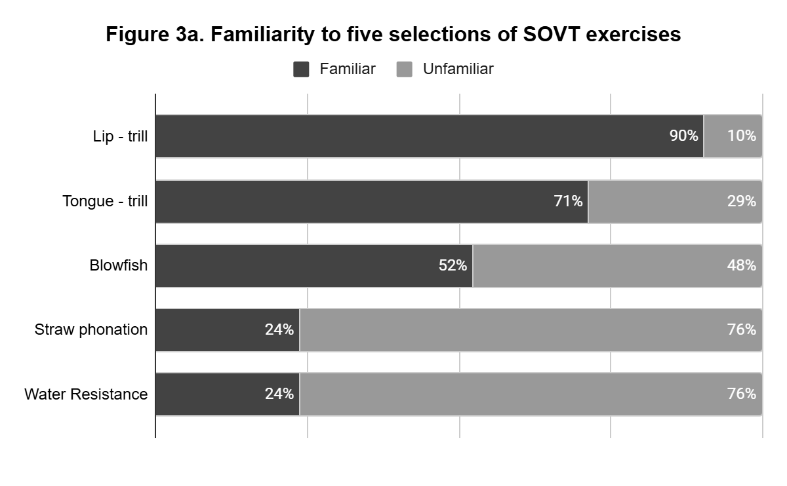
Familiarity to SOVT

Slide 8
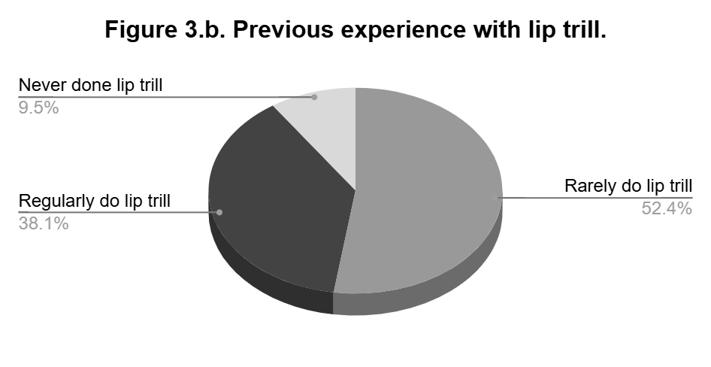

Slide 9
 | PERCEIVED PHYSICAL SENSATION
Type of feedback | Lip trill |  | Tongue trill |  | Blowfish |  | Straw phonation |  | Water Resistance Exercise
Positivie & | Ticklish | 15 times | Vibrating sensation | 6 times | Ticklish | 3 times | Vibrating sensation | 5 times | Vibrating sensation | 5 times
Neutral | Vibrating sensation | 5 times | Ticklish | 5 times | Vibrating sensation | 2 times | Ticklish | 3 times | Ticklish | 3 times
 | lips feels lighter | 2 times | shaky | 1 times | airy | 1 times | voice gets tiny | 2 times | comfortable | 4 times
 | buzzing | 1 times |  |  | lots of air in the mouth | 1 times | comfortable | 2 times | bubbles | 1 times
 |  |  |  |  | head posture tilting up | 1 times | buzzing | 1 times
 |  |  |  |  |  |  | airy | 1 times
 |  |  | no special sensations | 3 times | no special sensation | 10 times | no special sensation | 4 times | no special sensation | 6 times
 |  |  | normal | 2 times |  |  |  |  | normal | 1 times
Negative |  |  | uncomfortable | 2 times | keep loosing air | 2 times | keep loosing air | 1 times | uncomfortable | 1 times
 |  |  | slightly pain | 1 times | slightly pain | 2 times | mumbling | 1 times | Pain | 1 times
 |  |  |  |  | pitchy | 1 times | uncomfortable | 1 times | voice crack | 1 times

Slide 10
Type o feedback | PERCEIVED EFFORT REQUIRED
 | Lip trill |  | Tongue trill |  | Blowfish |  | Straw phonation |  | Water Resistance Exercise
Positive | easy | 3 times | moderate easiness | 4 times | easy | 2 times | easy | 2 times | easy | 3 times
 | moderate easiness | 1 times | easier than lip trill | 2 times | easier than lip trill | 2 times
 |  |  | easy | 2 times | easier than tongue trill | 2 times
 |  |  |  |  | moderate easiness | 2 times
Negative | difficult | 11 times | difficult | 7 times | harder than lip trill | 3 times | difficult | 6 times | challenging to hit the notes | 1 times
 | tiredness | 1 times | harder than lip trill | 7 times | harder than tongue trill | 2 times | need to get used to | 2 times
 | pitch going sharp | 1 times | hard to maintain the trills | 1 times | extra effort | 2 times | challenging to blow | 2 times
 |  |  | limited to those who can rolled their rrs | 1 times | challenging in the upper range | 1 times | challenging to hold the straw | 1 times
 |  |  | not used to it | 1 times | hard to breathe | 1 times | challenging to make consistent airflow | 1 times
 |  |  |  |  | tiredness | 1 times | challenging at first | 1 times
 |  |  |  |  | more push | 1 times | challenging to make sound | 1 times
 |  |  |  |  |  |  | challenging on the high notes | 1 times
 |  |  |  |  |  |  | challenging to breathe | 1 times
 |  |  |  |  |  |  | tiredness | 1 times

Slide 11
Type o feedback | EMOTIONAL RESPONSES
 | Lip trill |  | Tongue trill |  | Blowfish |  | Straw phonation |  | Water Resistance Exercise
Positive | fun | 3 times | interesting | 1 times | funny | 2 times | interesting | 3 times | fun | 9 times
 | interesting | 1 times | enjoyable | 1 times |  |  | Calm | 1 times | interesting | 4 times
 |  |  |  |  |  |  | funny | 1 times | I like this | 2 times
 |  |  |  |  |  |  |  |  | satisfying | 2 times
 |  |  |  |  |  |  |  |  | feels like playing | 1 times
 |  |  |  |  |  |  |  |  | gives childhood memories | 1 times
 |  |  |  |  |  |  |  |  | funny | 1 times
 |  |  |  |  |  |  |  |  | enjoyable | 1 times
 |  |  |  |  |  |  |  |  | unique | 1 times
 |  |  |  |  |  |  |  |  | useless | 1 times
Negative | loosing focus | 2 times | loosing focus | 2 times | I don't like this | 2 times | I don't like this | 2 times | weird | 1 times
 | confusing | 1 times | confusing | 1 times | useless | 1 times | confusing | 1 times
 | frustration | 1 times | useless | 1 times
 | useless | 1 times

Slide 12
SOVTs ranked based on favoritism
 | Lip trill | Tongue trill | Blowfish | Straw phonation | Water Resistance
Mean Rank | 2.76 | 3.52 | 3.38 | 3.19 | 2.14
Rank of Mean Rank | Second | Last | Fourth | Third | First
Mode | 2 | 5 | 4 | 3 | 1

Slide 13
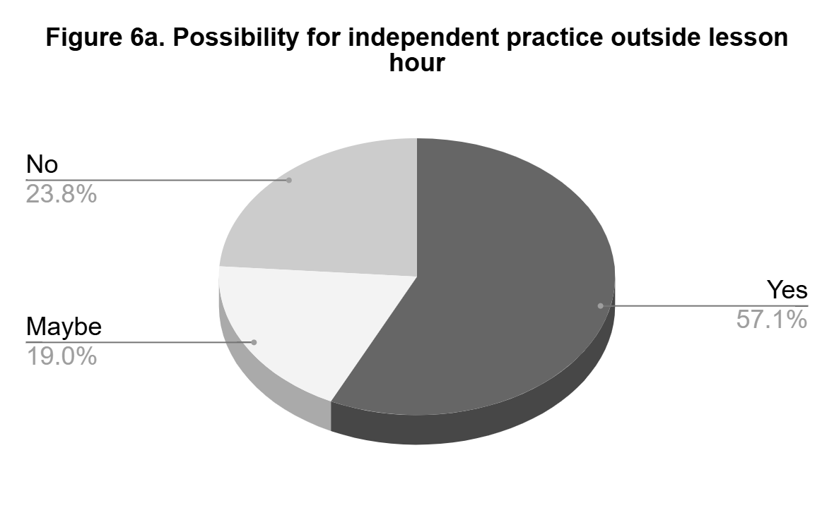
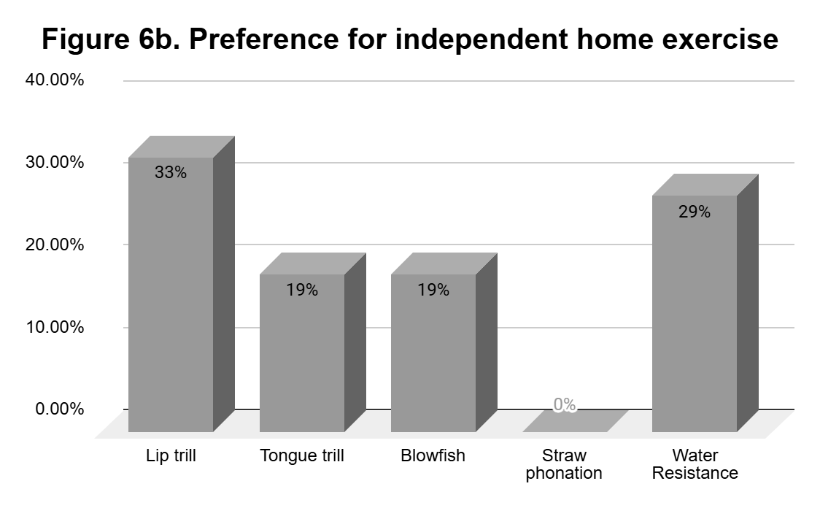

Slide 14
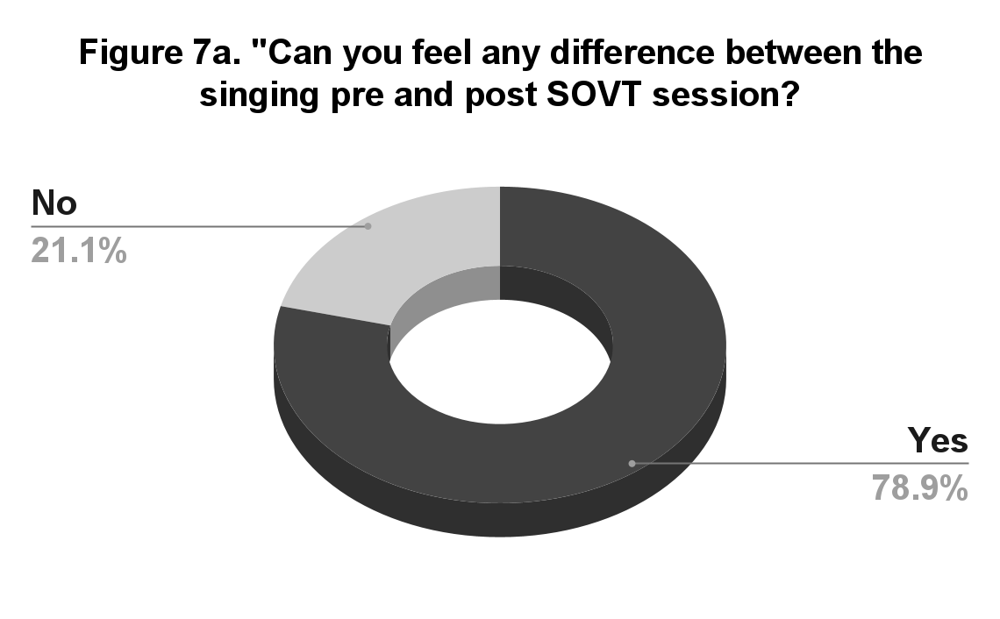
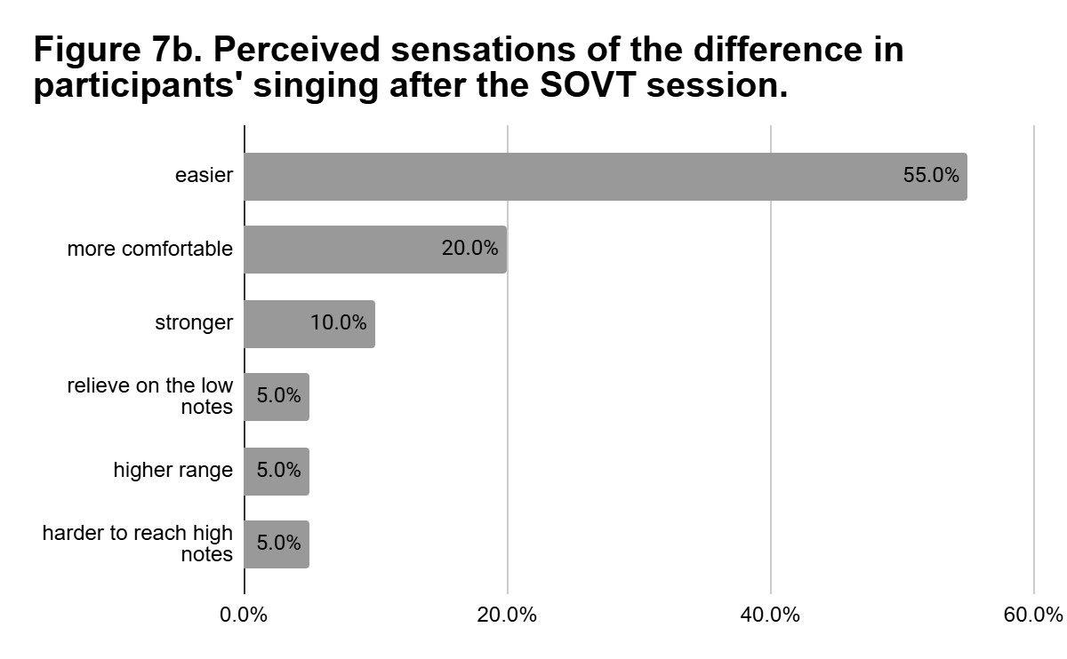
Pre and Post Session

Slide 15
CONCLUSION
Ability to feel and articulate physical changes → students self-reflection to build awareness
The importance of familiarity, practicality and emotional response factor when choosing exercises.
The use of exercises such as SOVT needs to be tailored to each students ability dan situations

Slide 16
LIMITATIONS & FUTURE RECOMMENDATIONS
Small number of participants
Self-reported vs physiological measurements devices
A longitudinal study to see how consistent training of SOVT exercises impacted young singers.

