Slide 1


Research method and Professional Development
ACFA7004: Assessment Report
Student Name: Deep Desai
Student ID: 2421862
Program: Msc Cybersecurity and Digital Forensics
Submission To: Dr.Suresh Shanmugasunadaram

Slide 2

Securing Data Sharing Using Blockchain Technology
A research proposal exploring decentralised, tamper-proof, and scalable data sharing architectures powered by blockchain — addressing critical gaps in security, privacy, and performance across healthcare, finance, and supply chain.
RESEARCH PROPOSAL
CYBERSECURITY
BLOCKCHAIN

Slide 3



Context & Background
The Problem
The Opportunity
Centralised data sharing models rely on cloud servers and third-party brokers — creating single points of failure, cyberattack exposure, and unauthorised access risks (Murala, Panda & Sahoo, 2023).
Blockchain offers decentralised, immutable, and cryptographically secured transaction registration — enabling trustless data exchange without a central authority (Ullah et al., 2022).
The Innovation
Smart contracts, Hyperledger Fabric, IoT, and AI integration are expanding blockchain's applicability to intelligent, decentralised data ecosystems (Hossain et al., 2024).

Slide 4


Research Problem
The Core Gap
Existing centralised systems fail to simultaneously offer trustless, tamper-proof, and scalable data sharing — especially in multi-stakeholder environments like healthcare and supply chains (Gousteris et al., 2023).
Blockchain's Own Limitations
Scalability constraints from consensus mechanisms
High energy consumption in public blockchains
Transaction delays and latency
Privacy vs. transparency trade-off
Non-optimised architectures undermining security and cost

Slide 5

Research Aim & Objectives
Design, test, and develop a secure, decentralised data sharing model using blockchain — addressing scalability, performance, and confidentiality gaps in existing systems.
01
02
03
Model existing systems
Investigate blockchain features
Design blockchain architecture
Identify security and performance limitations in current data sharing models.
Explore decentralisation, immutability, and smart contracts for secure sharing.
Create an effective and safe data sharing framework.
04
05
Develop & simulate
Measure & compare
Build the prototype using appropriate tools and platforms.
Evaluate security, latency, and scalability against existing methods.

Slide 6



Significance of the Research
Cybersecurity Impact
Provides an intermediary-free blockchain framework, reducing single-point-of-failure vulnerabilities and unauthorised data manipulation (Xi et al., 2022).
Technical Contribution
Advances blockchain knowledge by addressing scalability, latency, and privacy — with insights into smart contract design for automated access control (William et al., 2023).
Practical Application
Adoptable across healthcare (patient data), finance (fraud-free transactions), supply chain (transparent traceability), cloud storage, and IoT networks (Zhang et al., 2022).

Slide 7
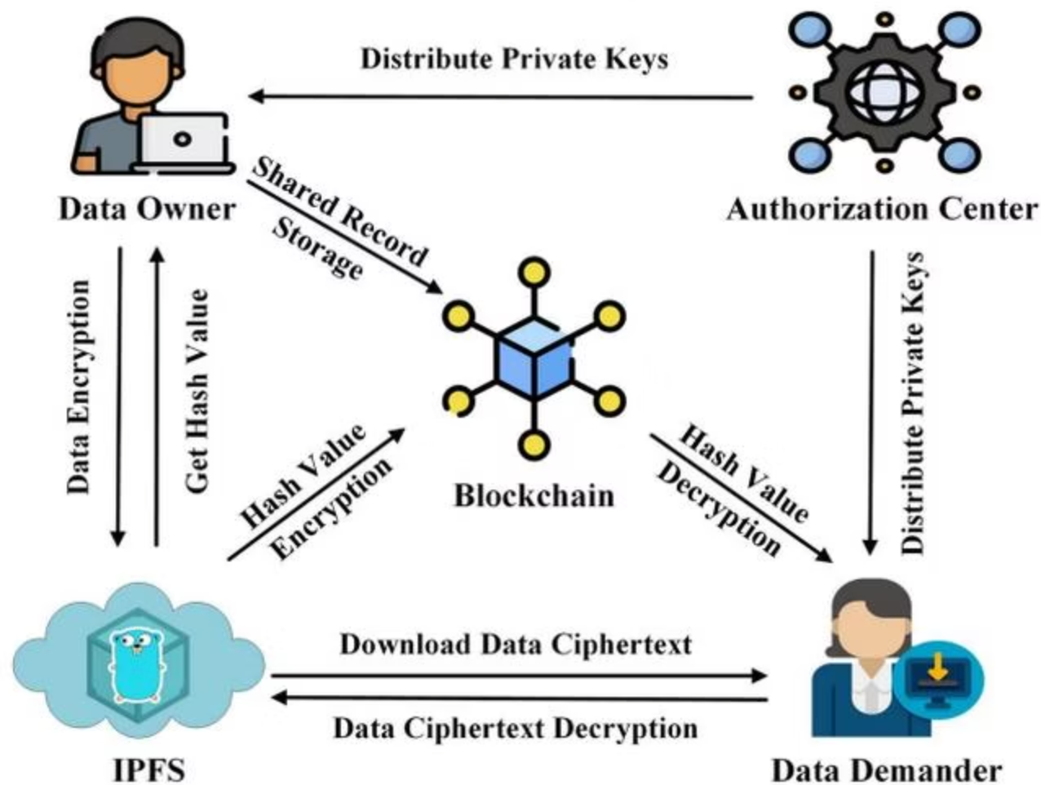


Conclusion and Technology
How It Works
Blockchain eliminates middlemen through peer-to-peer architecture. Transactions are stored in cryptographically linked blocks — making data impossible to tamper with and fully transparent (Mohammed et al., 2024).
Industry Applications
Healthcare: Secure patient data delivery with privacy and ownership
Supply Chain: Traceability, accountability, and fraud prevention
Finance: Enhanced transaction security and reduced operational risk
Smart contracts automate access control policies, ensuring only authorised individuals can access or modify data.

Slide 8
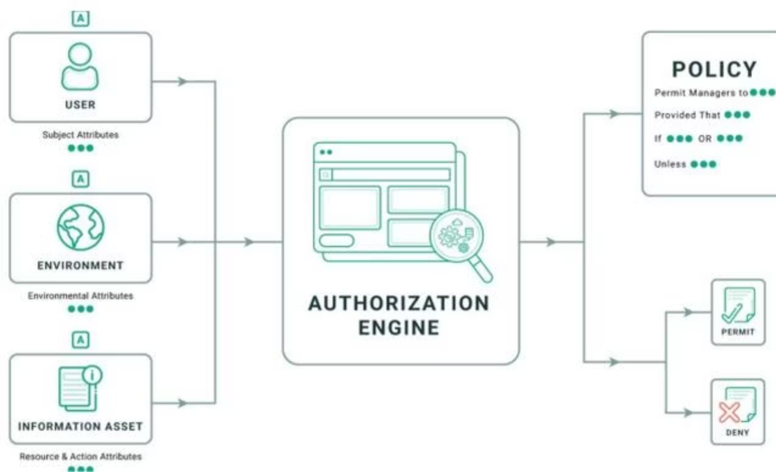


Privacy, Access Control & Scalability
Privacy & Access Control
Blockchain employs encryption, pseudonymisation, and smart contract-governed access. Zero-knowledge proofs and secure multi-party computation enable data verification without exposure (Kumar et al., 2023).
Role-based and attribute-based access models
Off-chain storage for large or sensitive materials
Hash-only metadata on-chain for efficiency
Scalability Challenges
Low transaction throughput, high latency, and energy-intensive Proof of Work consensus limit real-time
applications (Malik et al., 2023).
Sharding
Layer-2
Hybrid Models
Split networks for efficiency
Off-chain processing solutions
Balance public & private chains

Slide 9

Research Gaps & Theoretical Frameworks
Identified Research Gaps
Technical Foundations
Limited performance evaluation — few studies use quantitative or ML-based analysis
Theory over implementation — solutions tested in controlled/simulated conditions only
Scalability — current options struggle with large data volumes
Privacy tension — transparency conflicts with confidentiality in open blockchains
Distributed Ledger
Cryptography
Decentralised storage ensuring transparency
Hashing & public-key encryption for integrity
Consensus (PoW/PoS)
Platforms
Ethereum (DApps) & Hyperledger Fabric (enterprise)
Network agreement and transaction certification

Slide 10
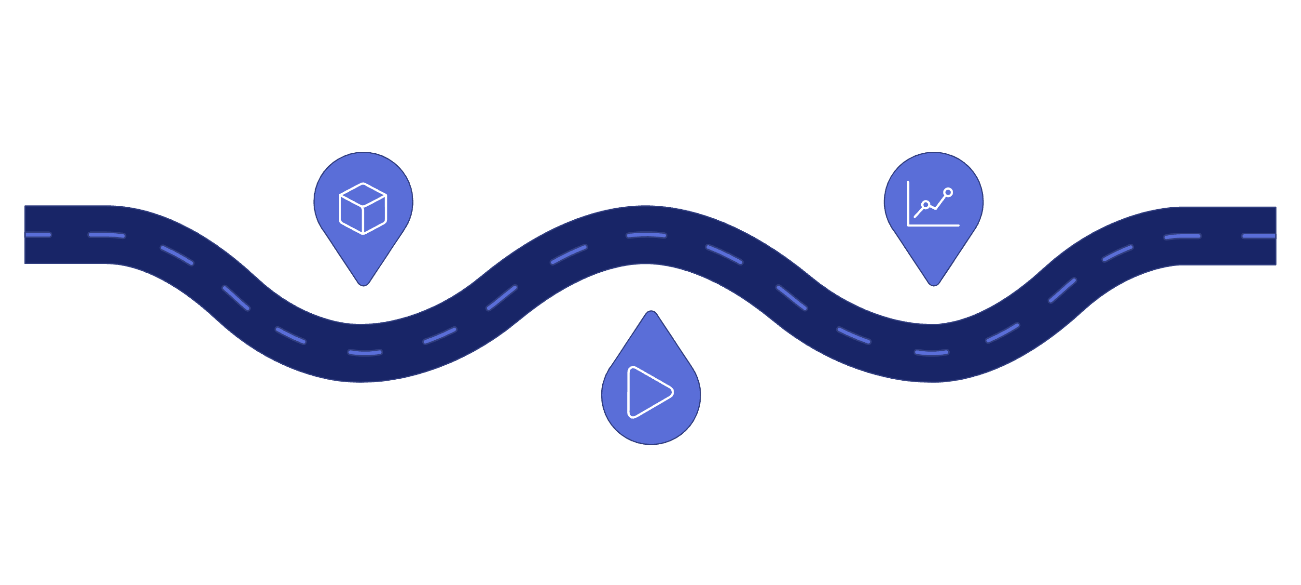

Research Design & Methodology
Design
Evaluate
Develop DSR blockchain artefact
Perform regression analysis
Simulate
Run simulations with synthetic data
The study employs Design Science Research (DSR) to systematically develop and test a blockchain artefact, validated through controlled simulation and quantitative regression modelling (Bathula et al., 2024).
Methods
Materials
Quantitative approach: latency, throughput, security efficiency
Python-based simulation with NumPy, Pandas, Scikit-learn
Linear and multiple regression models (R-squared, error rates)
Experimental variables: network size, transaction load, conditions
Synthetic and simulated transaction data
Hyperledger Fabric test environments or custom modules
Matplotlib/Seaborn for visualisation
Ethical compliance: anonymous data, research-only use

Slide 11

Expected Outcomes & Timeline
Expected Outcomes
Project Timeline
Higher data security, integrity, and transparency vs. centralized systems.
Resistance to tampering via cryptographic hashing and decentralized consensus.
Automated access control through smart contracts.
Regression models revealing dependencies between network size, transaction load, latency, and throughput.
Weeks 1–2
Topic finalisation, proposal refinement & literature review
Weeks 2–3
Research design, methodology & system architecture
Weeks 3–4
Prototype/simulation development & synthetic data generation
Week 4
Testing, regression analysis, results & final report

Slide 12


References
Murala, D.K., Panda, S.K. and Sahoo, S.K., 2023. Securing electronic health record system in cloud environment using blockchain technology. In Recent advances in blockchain technology: real-world applications (pp. 89-116). Cham: Springer International Publishing.
Ullah, Z., Raza, B., Shah, H., Khan, S. and Waheed, A., 2022. Towards blockchain-based secure storage and trusted data sharing scheme for IoT environment. IEEE access, 10, pp.36978-36994.
Sonkamble, R.G., Bongale, A.M., Phansalkar, S., Sharma, A. and Rajput, S., 2023. Secure data transmission of electronic health records using blockchain technology. Electronics, 12(4), p.1015.
Upadrista, V., Nazir, S. and Tianfield, H., 2023. Secure data sharing with blockchain for remote health monitoring applications: a review. Journal of Reliable Intelligent Environments, 9(3), pp.349-368.
Umran, S.M., Lu, S., Abduljabbar, Z.A. and Nyangaresi, V.O., 2023. Multi-chain blockchain based secure data-sharing framework for industrial IoTs smart devices in petroleum industry. Internet of Things, 24, p.100969.
Gousteris, S., Stamatiou, Y.C., Halkiopoulos, C., Antonopoulou, H. and Kostopoulos, N., 2023. Secure distributed cloud storage based on the blockchain technology and smart contracts. Emerging Science Journal, 7(2), pp.469-479.
William, P., Rai, A.K., Madan, P., Kumar, C.P., Shrivastava, A. and Rana, A., 2023, September. Analysis of Blockchain Technology to Protect Data Access Using Intelligent Contract Mechanism for 5G Networks. In 2023 6th International Conference on Contemporary Computing and Informatics (IC3I) (Vol. 6, pp. 1651-1657). IEEE.
Zhang, D., Wang, S., Zhang, Y., Zhang, Q. and Zhang, Y., 2022. A Secure and Privacy‐Preserving Medical Data Sharing via Consortium Blockchain. Security and Communication Networks, 2022(1), p.2759787.

