Slide 1
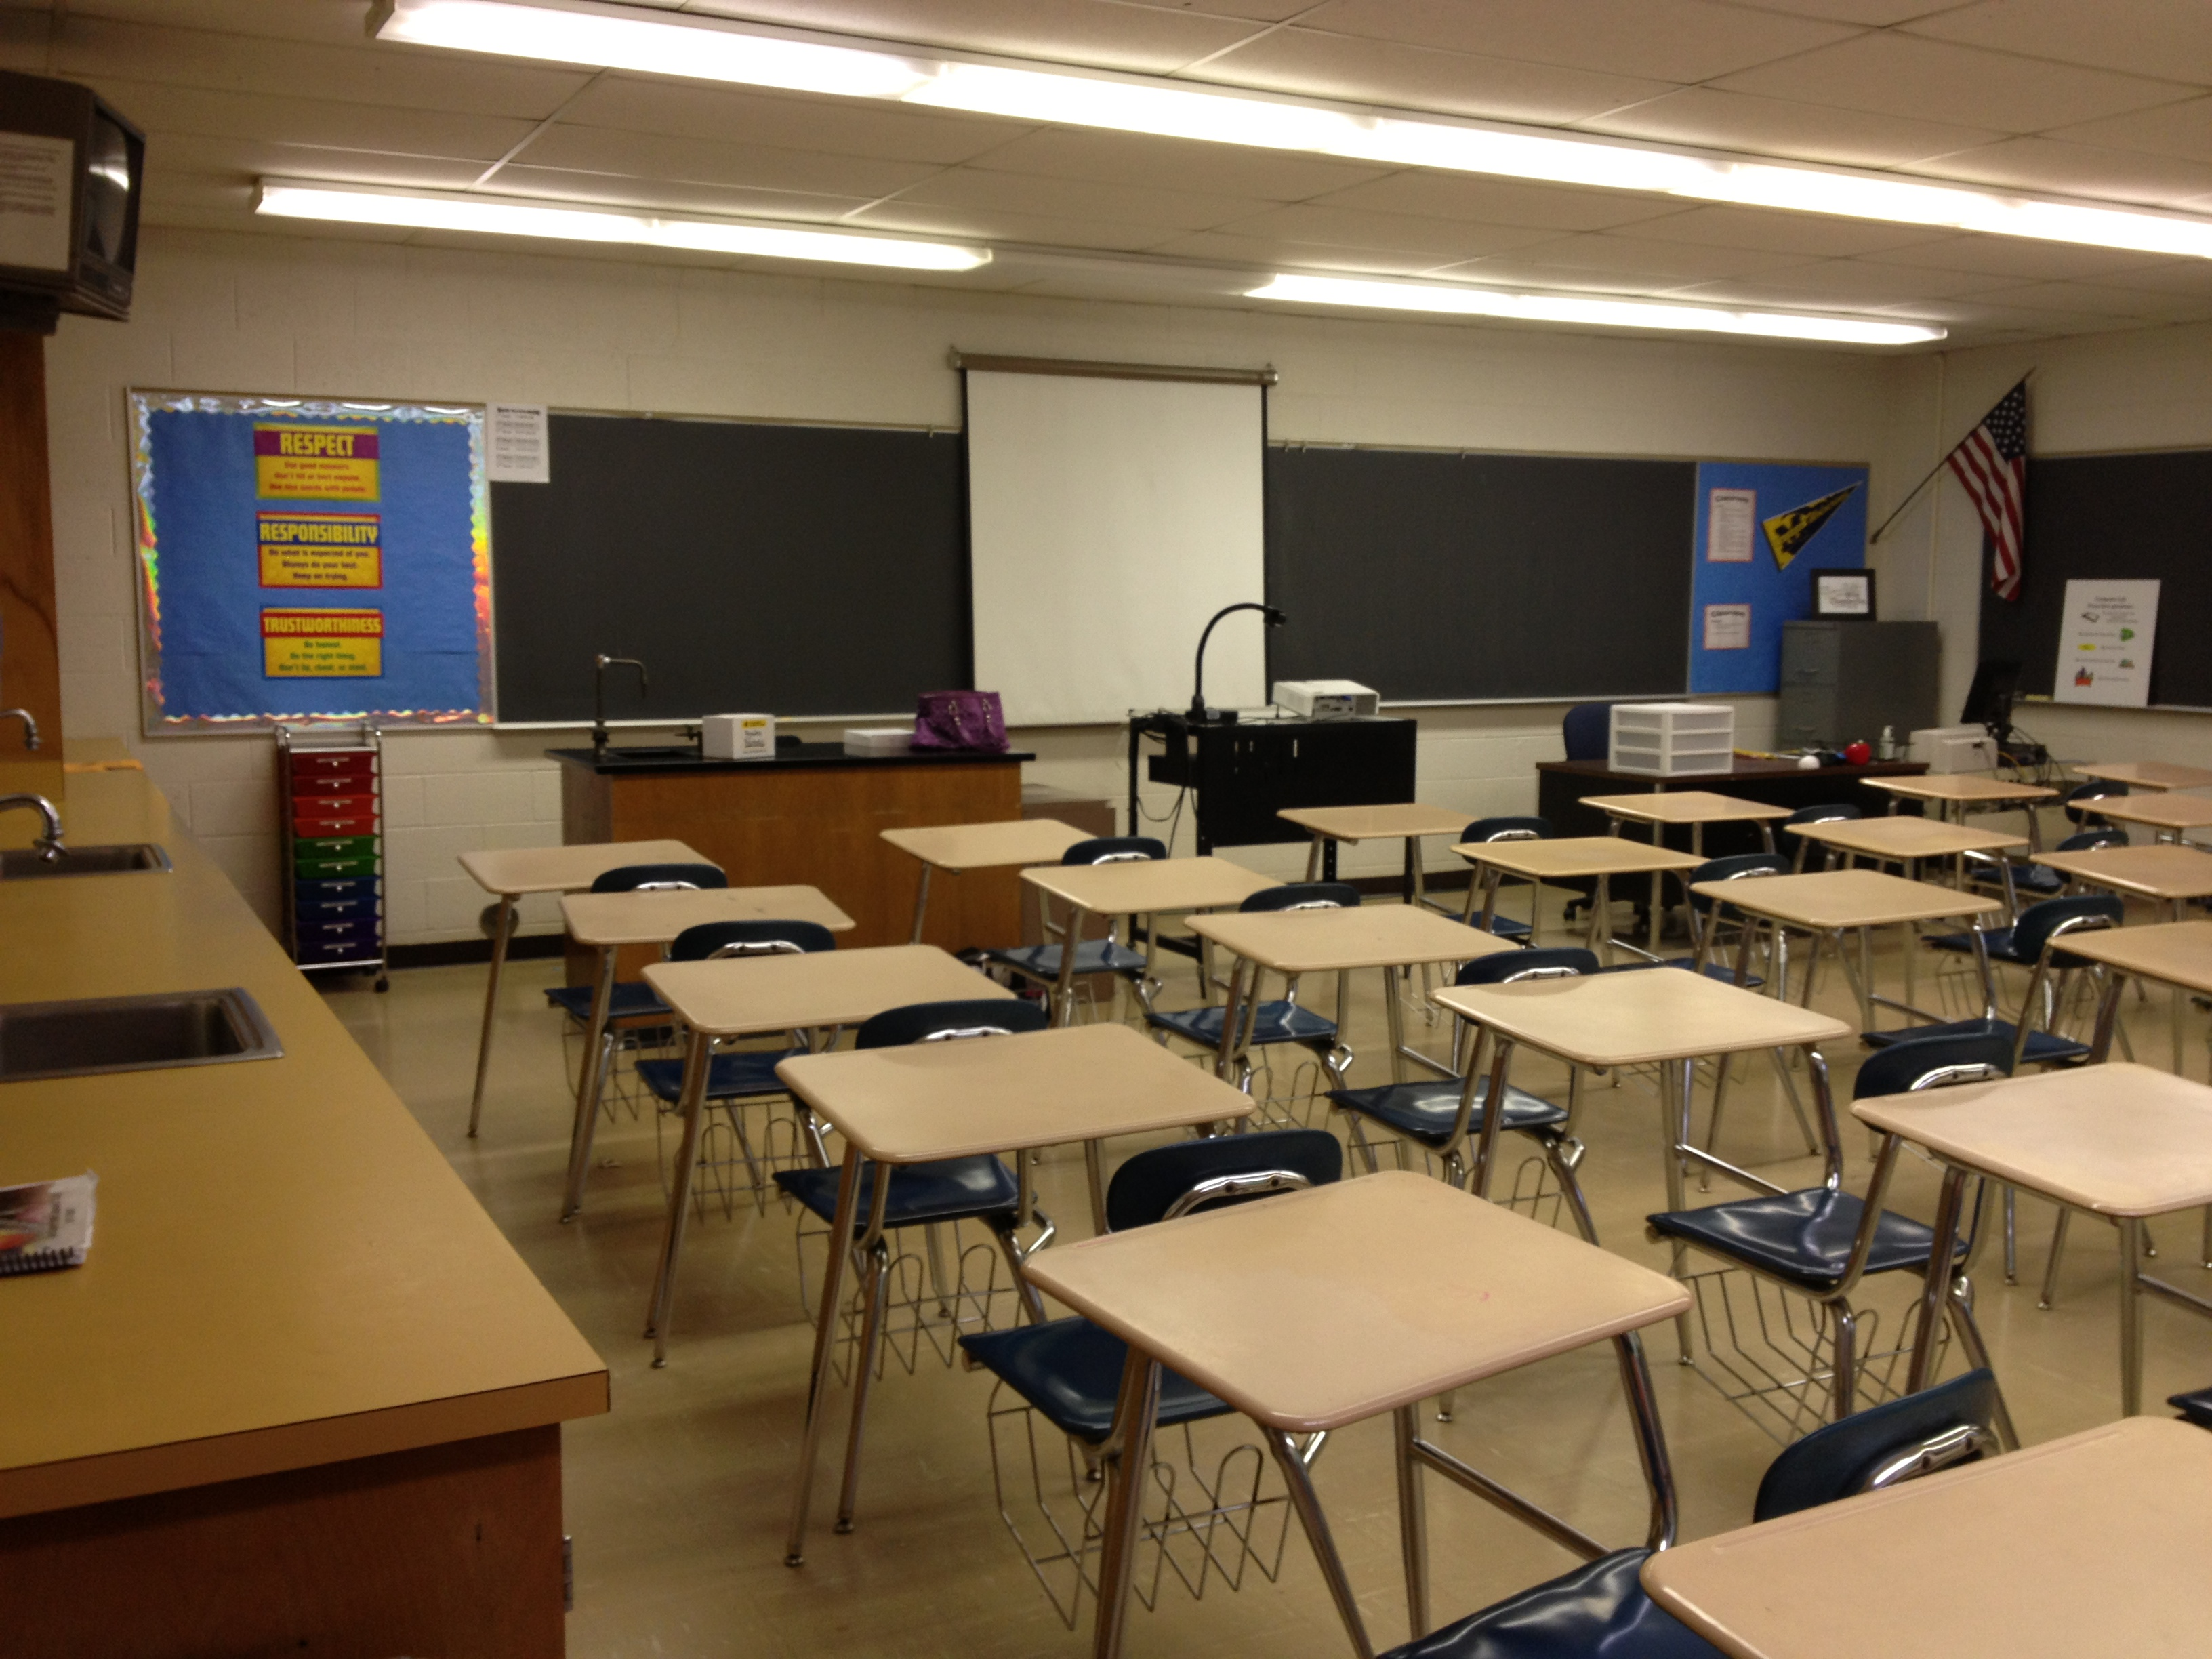



Principles of teaching and learning.
S
K
I
N
N
E
R
&
V
Y
G
O
T
S
K
Y
1
Title and contents
B.F. Skinner and behaviourism
Les Vygotsky and Social constructivism
2
3
1
Learning through play
Supporting behaviour
5
4
References
6
Scrapbook
By Aimee Frankland
(educate, 2013)

Slide 2
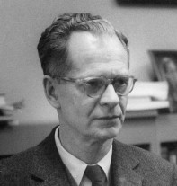

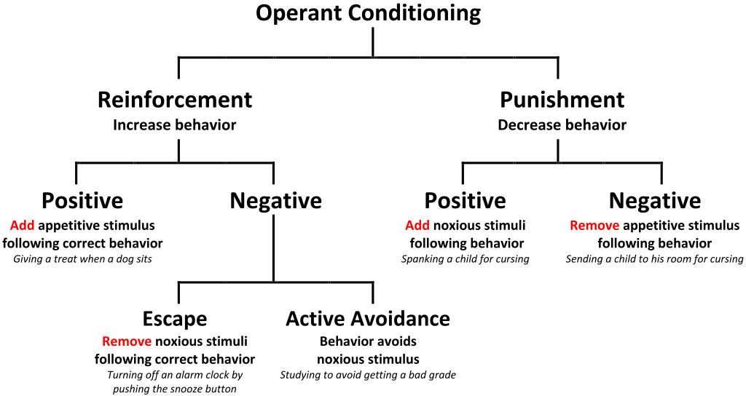



O
P
E
R
A
N
T
conditioning
(Wikimedia, n.d.)
Behaviourism
B. F. Skinner 1904 - 1990)
Who was B.F. Skinner?
Skinner was an American psychologist who is best known for his development of the operant conditioning chamber, otherwise known as the Skinner Box. This research helped form the understanding that consequences have an impact on behaviour in otherwise normal humans. (schools.com,s,2005)
Alliance against says that there is no evidence of long-term effectiveness and schools continue with restraints, conclusions and suspensions. (against, n.d.)
Skinners theories are used in my education setting on a daily basis and positive reinforcement seems to be making a big impact when working with children if used properly. Page 4 reinforces my evidence of this.
(discoverrs.co.uk, 2018)
This Photo by Unknown Author is licensed under CC BY-SA
vv

Slide 3
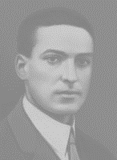
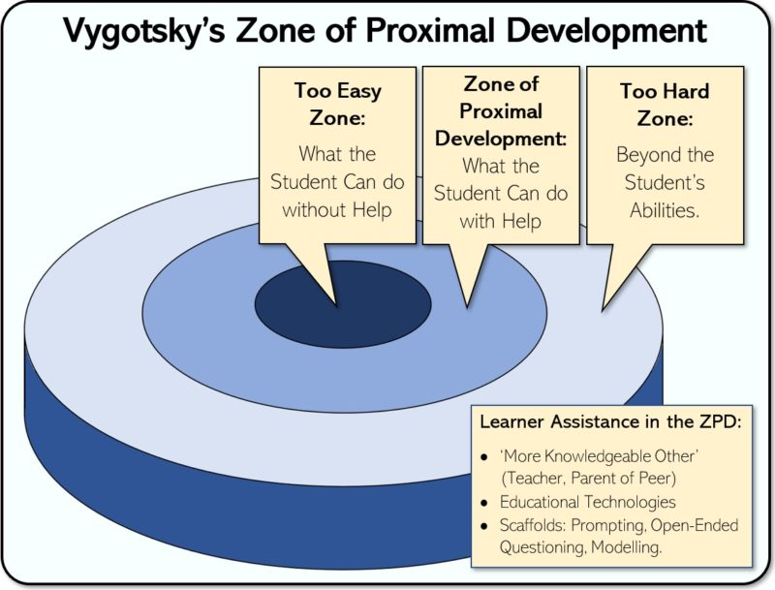




(Psychological, n.d.)
Social Constructionism
Lev Vygotsky 1896 – 1934
Who was Lev Vygotsky?
Vygotsky’s influence in the field of developmental psychology is all the more extraordinary given his relatively brief life, cut short by tuberculosis at the age of 37. (sci.com, 2020) Vygotsky believed in the (MKO) more knowledgeable other. The person with more knowledge on that particular subject the MKO is able to put a learning scaffolding in place in order to support the learner, as soon as the learner becomes more confident the MKO can assess and change or even take away the scaffolding when the child is ready to move on.
(professor.com, 2020)
The "zone" is the space between what children know and what they do not yet know.. accessing the missing information requires skills that a child does not yet have or cannot do by themselves, but which they can do with the help of a more experienced mentor. (mind, 2020) however One major criticism of Vygotsky's theories is how they divide out the ideas of language and thought. Some psychologists think that language and thought can change on similar pathways instead of individual tracks. (uk, 2020)
For example a child recognises a bottle and their pier can ask the child to find the bottle, the child is able to find that item even before he or she can speak that word.
UNCRC article 3 states that In all actions regarding children, whether undertaken by public or private organisations, courts of law, administrative authorities or legislative bodies, the interests of the child shall be a primary consideration therefor ZPD helps to formulate structure especially for the wellbeing for children's learning . (child, 1924)

Slide 4


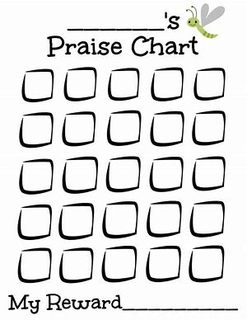


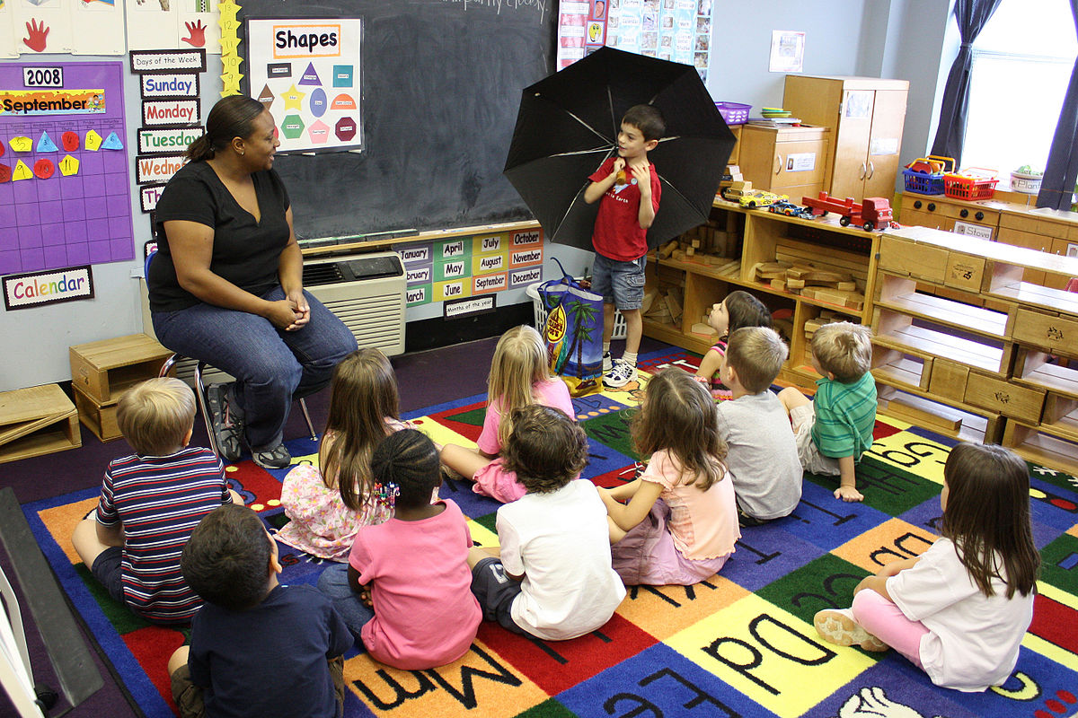


Supporting behaviour
Praise
Opportunity
Reward
This type of reward is associated with B.F.Skinners positive operant conditioning. Our praise chart reinforces the want to be better, to share, and to help others, when child reaches 5 boxes they get a prize, usually on a Friday, this gives an incentive for the children's behaviour to grow and develop through helping and seeing the changes they make in their environment .
(wikimedia.org, n.d.)
Telling a joyful story
There can be some negative outcomes as some children may become inpatient as it takes time to reach the end goal. however the praise chart can add another level of learning which is to be patient.
Telling a joyful story is a familiar part of our children's everyday experience’s enforcing positive reinforcements to support behaviour in a nurturing environment. Children can share stories of their achievements, for example child A was frustrated as child A could not put his/her coat on, through sheer perseverance child A was finally able to put their coat on by themselves. We then share this positive story with all of child A’s school friends, supporting positive reinforcement from something negative without using stickers and prizes in an all inclusive environment.

Slide 5


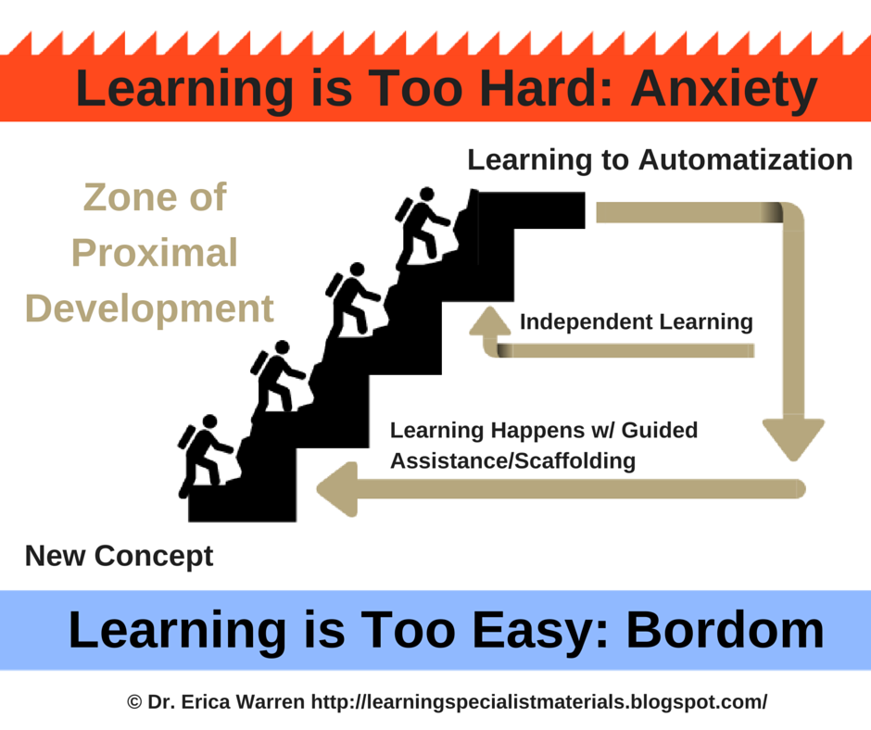

putting the correct scaffolding in place can bridge the gap between anxiety and boredom.
Learning through play
Experiential play, Learning through experiences.
(government, n.d.)
MKO TO GIVE SCAFFOLDING (ZPD)
Curriculum 2022
For the first time, Wales will have a curriculum that is grounded on four drives that articulate what we want for our younger public to be at 16: determined and accomplished; innovative and imaginative; ethical and informed and healthy and assertive. (minister, 2019)
for this to become a reality in our school is preparing our future classes to be a rich experiential learning environment using MKO’S and the ZPD method.
(Shutterstock, 2019)
(our.mviec.com, 2019)
In one of our experiential learning areas, we use Lego/Duplo (L/D ) as this covers all 7 areas of learning indoor and outdoor in the curriculum. (L/D) supports feelings of determination and accomplishment (L/D) also helps build social and emotional connections between piers, friends and family, we use (L/D) in intervention based activities, this gives us a platform in order to bridge the gap if a child needs extra support and scaffolding in order to support confidence and academic learning.
For example we can ask a child to build a Lego house and then the child can discuss who lives with them and who makes them happy, if there are difficulties at home we can get a better scope at how to support child and family. After assessing the child we are able to put the correct scaffolding in place to bridge the gap for a more happier child in an all inclusive environment. A child can struggle to learn if unhappy.

Slide 6
against, A., n.d. Alliance against seclusion and restraint. [Online]
Available at: https://endseclusion.org/research/the-problem-with-behaviorism/
[Accessed Monday November 2020].
child, U. n. c. o. t. r. o. t., 1924. United nations conventions of the rights of the child.
United nations conventions of the rights of the child, Volume Article 2.1, p. 4.
discoverrs.co.uk, f., 2018. First discoverers. [Online]
Available at: www.firstdiscoverers.co.uk/wp-content/uploads/2018/09/Child-Development-Theories-B-F-Skinner.jpg
[Accessed Monday November 2010].
educate, L. t., 2013. Love to educate. [Online]
Available at: https://love2educate.files.wordpress.com/2013/08/img_1215.jpg
[Accessed Monday November 2020].
government, W., n.d. Wlsh government. [Online]
Available at: https://gov.wales/
[Accessed Wednesday November 2022].
mind, V. w., 2020. Very well mind. [Online]
Available at: https://www.verywellmind.com/lev-vygotsky-biography-2795533
[Accessed Tuesday November 2020].
minister, K. W. F., 2019. Welsh government Wales. [Online]
Available at: https://gov.wales/written-statement-curriculum-wales-2022
[Accessed Wednesday November 2020].
our.mviec.com, 2019. our.mviec.com. [Online]
Available at: https://our.mviec.com/wp-content/uploads/2019/06/ZPD-Scaffolding.png
[Accessed Wednesday November 2020].
professor.com, H., 2020. Helpful professor.com. [Online]
Available at: https://helpfulprofessor.com/guided-practice/
[Accessed Tuesday November 2020].
Psychological, P. a., n.d. Philosophical and Psychological. [Online]
Available at: http://www.uky.edu/~eushe2/quotations/vygotsky.html
[Accessed Tuesday November 2020].
schools.com, s., 2005. Soft schools. [Online]
Available at: https://www.softschools.com/facts/scientists/b_f_skinner_facts/1036/
[Accessed Monday November 2020].
sci.com, T. o., 2020. Teacher of sci.com. [Online]
Available at: https://teacherofsci.com/vygotsky/
[Accessed Tuesday November 2020].
Shutterstock, 2019. researchoutreach.org. [Online]
Available at: https://researchoutreach.org/wp-content/uploads/2019/11/shutterstock_411586477.jpg
[Accessed Wednesday November 2020].
uk, e. h., 2020. e how uk. [Online]
Available at: https://www.ehow.co.uk/info_7988429_pros-vygotskys-theory-language-development.html
[Accessed Tuesday November 2020].
wikimedia.org, n.d. wikimwdia.org. [Online]
Available at: https://upload.wikimedia.org/wikipedia/commons/thumb/0/0e/Show_and_tell.jpg/1200px-Show_and_tell.jpg
[Accessed Tuesday November 2020].
Wikimedia, n.d. Wikimedia. [Online]
Available at: https://upload.wikimedia.org/wikipedia/commons/thumb/6/62/Operant_conditioning_diagram
[Accessed Monday November 2020].

