Slide 1



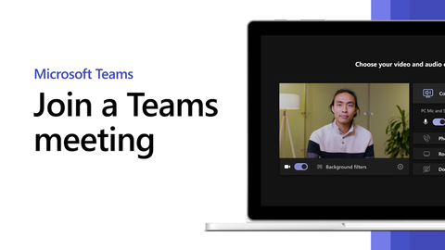
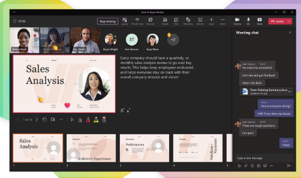
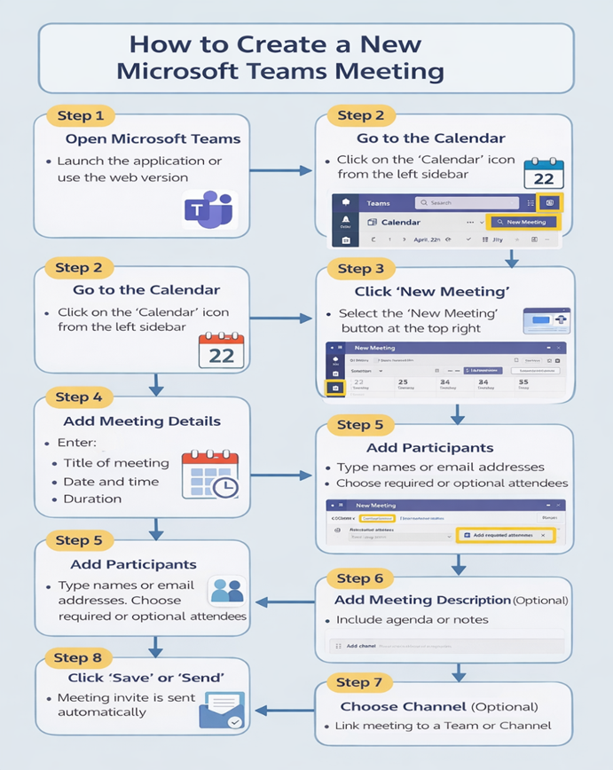
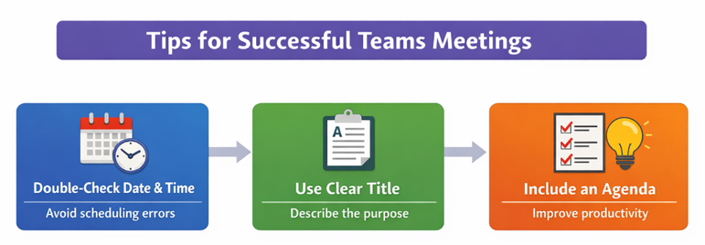
HOW TO CREATE A NEW TEAMS MEETING
ST NAME: IONUT VALENTIN CHIHAIA
ST ID: 2524760
GROUP: 3
MODULE CODE: LCLM4002
MODULE NAME: DIGITAL SKILLS
LECTURER NAME: REJWAN BIN SULAIMAN
Introduction
Microsoft Teams is an online collaboration tool allowing communicating with chat, video conferencing, and file sharing. It promotes work as a team across distance as employees can connect to work with others at other locations. Meetings are significant because they enable teams to network even when distanced, organise chores efficiently and exchange information on a real-time basis and keep orderliness and efficiency at the work place.
Requirements
It is required to have an active account of Microsoft Teams, a steady internet connexion, and Microsoft Teams calendar before you can create a Teams meeting. Furthermore, it is required to list the emails of the participants, which enables to invite individuals rapidly and disregard complications in the organisation of the order of actions and contacts (Siddique et al., 2022).
Step-by-Step Process
Step 1: Open Microsoft Teams
The Microsoft Teams application is accessible through a web-based tool or on your device where you can log into it through your account in a secure manner (Evans, 2022).
Step 2: Go to the Calendar
In the left-hand sidebar, there is an icon labelled Calendar that opens the field and displays any future meetings.
Step 3: Click ‘New Meeting’
On the upper-right side of the screen, one needs to choose the button of the new meeting and start the process of organising the new session.
Step 4: Add Meeting Details
Add crucial details such as the name of the meeting, choose date and time and specify the time of the meeting (Frey, and Bloch, 2023).
Step 5: Add Participants
Enter names or email address of the participants and set them as mandatory or voluntary participants.
Step 6: Add Meeting Description (Optional)
Provide other information like meeting agenda, goals, or notes to enable those participating in the meeting prepare in advance.
Step 7: Choose Channel (Optional)
Choose a Team or Channel, in case you desire the meeting to be linked to a certain group or project.
Step 8: Click ‘Save’ or ‘Send’
Press send and the meeting will be scheduled and invitations will be automatically sent to all the participants chosen.
Visual Elements
Best practices
The date and time of a Teams meeting should always be checked before an invite is sent, to ensure that there are no issues with scheduling or misunderstandings during the meeting. A descriptive meeting title in a clear way will ensure that the members of the meeting know what the meeting is all about. Briefly introducing the agenda assists participants to prepare beforehand, to keep discussions on track and enhanced productivity, as the meeting will become more organised, efficient, and purposeful (Keerio et al., 2022).
Conclusion
Teams meeting in Microsoft is an easy and effective process that facilitates the communication process at work. It enables teams to interact fast, arrange conversations, and work together without any problems. It assists in saving time by simplifying the scheduling process and decreasing intervals of time wastage in professional setting.
References
Evans, N., (2022). Microsoft Teams Supports Authentic Assessment of Learning. Journal of Teaching and Learning with Technology, 11, pp.37-50.
Frey, T.K. and Bloch, B.S., (2023). Using Microsoft Teams to facilitate asynchronous online focus groups. International Journal of Qualitative Methods, 22, p.16094069231211251.
Keerio, M.U., Bajwa, M.S.B., Mugheri, N.H., Memon, R.H., Bhayo, M.A. and Samo, K.A., (2022). Evaluating students’ perceptions of Microsoft Teams for online academics improvement. Pakistan Journal of Engineering and Technology, 5(1), pp.56-67.
Siddique, M.N., Wahid, A., Sarker, M.S.N. and Polash, J., (2022). Documenting team meetings in Microsoft Teams.

