Slide 1
Anthropology of Religion
Prof Bettina E. Schmidt

Slide 2
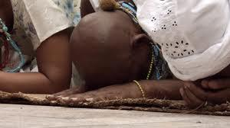
What is a ritual?

Slide 3
Term Ritual
Derives from Latin terms ritus and ritualis
And refers to a prescribed order of a liturgy and/or of the book that describes this order
In English interchangeable with ceremony and liturgy

Slide 4
Ritual is not a universal phenomenon but a specific way to organise the world
By studying ritual theories one can learn as much about the scholars and their system as about the human beings whose behaviour was studied (Bowie 2006: 138).

Slide 5
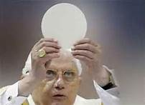
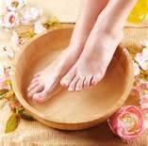
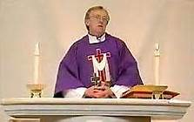
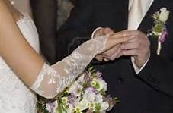
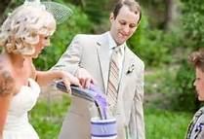
Christian rituals

Slide 6
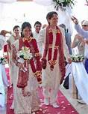
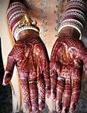
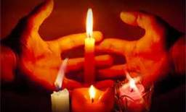
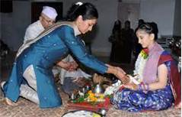
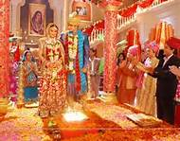
Asian rituals

Slide 7
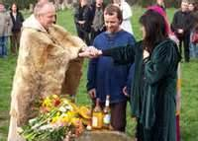
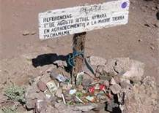
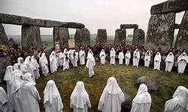
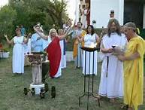
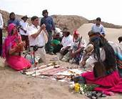
Pagan rituals in America and Europe

Slide 8
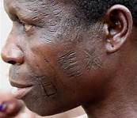
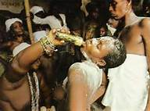
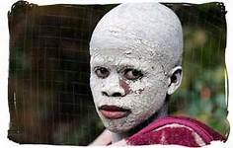
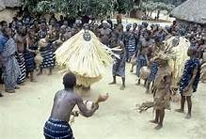
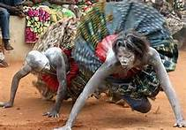
Rituals in Africa

Slide 9
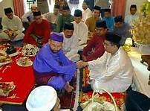
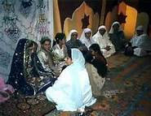
Gender divide in one ritual?

Slide 10
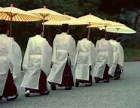
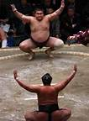
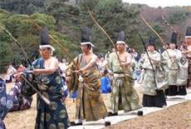
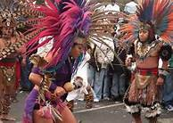
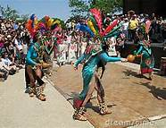
Secular rituals?

Slide 11
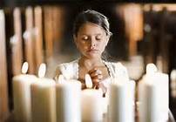
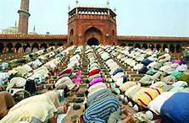
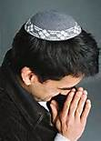
Ritual without movement?

Slide 12
Example: Jazz Funeral in New Orleans
Funeral Processions are an important ritual
They symbolize the transfer from the world of the living to the world of the dead
But how can we study them?

Slide 13
YouTube clip
New Orleans Jazz Funeral for tuba player Kerwin James

Slide 14
Questions?
What do we see (as outsiders)?
What do insiders see?
Who counts as an insider and who is an outsider?
What do different groups (e.g., African Americans / non-African Americans; those bereaved / those non bereaved; Americans / non-Americans; musicians / non-musicians) see in this video?
Notes:
Questions asked by Ron Grimes

Slide 15
Another YouTube clip
Jazz Funeral

Slide 16
Ritual
  ‘a performance, planned or improvised, that effects a transition from everyday life to an alternative context within which the everyday is transformed’ (Alexander 1997: 139, quoted in Bowie 2006: 140)
=> Rituals contain two basic elements: performance and transformance
Ritual is not a universal category
Function and meaning of a ritual is not self-defined

