Slide 1

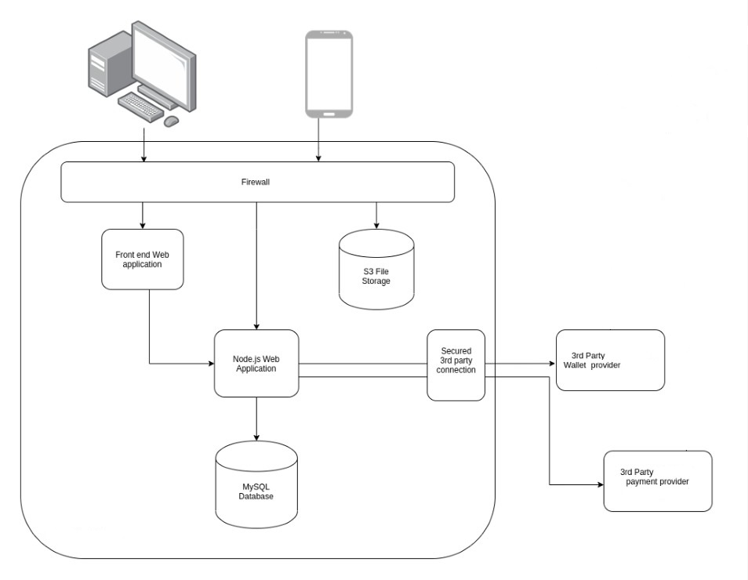

CharUty – The platform for transparent donations
Thomas Molner, BSc Cloud Computing, University of Wales Trinity Saint David
1804565@student.uwtsd.ac.uk
Introduction
In essence, CharUty is a donations platform. It differentiates from other platforms because it gives the individual clarity where their donation is going and how it will be spent.
Any charity featured on the CharUty platform must be transparent.
Another crucial feature of the platform is that it offers people the possibility of creating their own causes.
Aim
The aim of this project is the complete analysis to building a platform which would drive change in the charity sector, forcing a level of transparency and accountability rarely seen today. Using the most appropriate technologies, the vision for the platform is to create an immutable and transparent chain of good.
Materials and methods
The agile methodology is widely used today in software development- its aim is to deliver a product in stages and each stage of the build will be developed in rapid cycles.
This Agile methodology is easy to manage, and it is the best approach for my project because of its simplicity and demonstrated efficiency. It’s focused on continuous evolution and collaboration- feedback is vital as it will improve the work and make all people involved more productive.
Results
It is crucial to know the target public, so that the final version of the platform to reach as many people as possible. User stories have been therefore collected by offering a questionnaire to a selected number of people who have agreed to participate.
Following the user’s feedback, the build has been done taking into consideration several main points extracted from what people want. The user stories were transformed into system functional areas and specific functions.
This resulted in a platform that offers the following:
Simple navigation
Toggle between information and analytics
Share and edit your causes
See how well the causes are doing
Raise awareness and support
Easy access to wallet
Create meaningful causes
A little “LIKE” goes a long way
Clear call to action to “create a cause”
Conclusions
Charities will be able to treat the platform as an all-in-one management tool, as it provides them with the ability to view, control and administer communications and donations to and from their donation sources.
Users will be able to dictate where their donations should be spent and access the record to ensure their money is spent as intended.
They also have the possibility to create and share their own causes, as a qualitative user experience is the main focus of the platform.
Further information
Small steps can be taken to start building the transparency between donor and charity. In this project I have explored how to use blockchain technology to build a version of the product that should be seen as a learning tool to gain real users and provide a very clear product direction.
Acknowledgments
I would like to thank those who have supported me during these years of study and most important to Ms. Renuga Jayakumar and Dr. Terry Walcott for the support and valuable guidance provided.
Plan
Design
Develop
Test
Release
Feedback
Figure 1: Architecture of the application with 3rd Party Source: Author

