Slide 1


Community Sports Development
M5X02089
Mark
Napieralla

Slide 2
Community Sports Development
The aims of todays lecture:
To look at marketing and the relevance in the sports development world
To understand the importance of creating links and partnerships to deliver projects
Street Games- What does the organisation do?
Re visit planning for sports development
To look at the sports development planning template
To fully understand the assignment

Slide 3
A few definitions...
Marketing is the process by which companies create value for customers and build string customer relationships in order to capture value from customers in return with others.
Kotler & Armstrong(2014)
Marketing is the activity, set of institutions, and processes for creating, communicating, delivering, and exchanging offerings that have value for customers, clients, partners, and society at large.
American Marketing Association (2013)

Slide 4
CIM definitions (Chartered Institute of Marketing)
The strategic business function that creates value by stimulating, facilitating and fulfilling customer demand.
CIM (2007)
Marketing is the management process responsible for identifying, anticipating and satisfying customer requirements profitably CIM (2010)

Slide 5
Customer Orientation
Customer
needs
The single most important thing to remember about any enterprise is that there are no results inside its walls. The result of a business is a satisfied customer (Peter Drucker, 2003)
Potential
Market
Opportunities
Customer centred –market sensing and responding
Takes an outside-in perspective
Well-defined market, customer needs and integration of marketing activities
Creating lasting relationships based on customer value and satisfaction
Delivering better ‘value’ than your competitors
Marketing
Products
and services
Customers
Notes:
8

Slide 6
Marketing Task: Flip chart presentation – 1 person to present findings back to the group
Class to be split to 3 breakout groups:
https://www.youtube.com/watch?v=_O5S6O0Trqc
https://www.youtube.com/watch?v=wmnajdChTbA
https://www.youtube.com/watch?v=jsP0W7-tEOc
Consider 3 scenarios from the sports development world.
Scenario 1- children considering attending a half term sports camp.
Scenario 2 adults considering attending a GP Referral scheme.
Scenario 3- A group of girls 14 years+ considering attending an US Girls / This Girl Can session.
Present back on the following:
1- Who are your customers? What are their needs? Consider the different ages.
2- How can you reach this group of people / promote your session?
3- How can you create / build relationships with your customers?
4- What does good value and satisfaction look like?

Slide 7
In 2 groups- Work as a team to place a pen as far as you can away from the start line top side up.
Winning team is the team that can place the pen furthest from the line.
No body part can touch across the line

Slide 8
Partnership And Links
https://www.classtools.net/random-name-picker/
Forming partnerships and links can create bigger and better projects. In order for successful partnerships to work each partner must have something to gain from the agreement / organisation in place.
Individual Task- You are setting up a girls only (US Girls / This girl can session). Who could you link with?
How could they contribute?

Slide 9
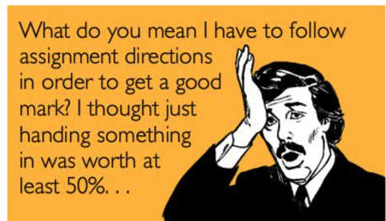
Aims- To understand fully what is required when writing this part of the assignment.

Slide 10
50%
Half of 65%
Students are required to devise an operational plan to increase sports participation in the area of Port Talbot. Students should use the Street Games template provided in order to plan 4 different sessions. Students should demonstrate an understanding of the key underlying issues in the national, regional and local sporting landscape and the external drivers that can be utilized to implement a successful development program.
Students will need to evidence that they can plan and set a suitable budget to each session utilising all of the funding available.

Slide 11
https://www.youtube.com/channel/UCJaNBMWae8BromCdtJ6Kk9w
Student resource- https://network.streetgames.org/student-zone

Slide 12
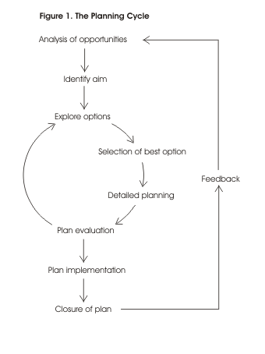

Slide 13
50 % of the task- 1000 words
Students are required to carry out a research task and highlight the current barriers to sports participation in deprived communities. Students should consider what the internal and external issues are affecting sports development organisations when planning to deliver sports development projects in deprived communities.

