Slide 1
Contemporary Themes In the Hotel and Hospitality Sector
Conference Presentation
Student Name: Cristina Veronica Vlasceanu
Student ID: 2125765
Lecturer name: Ernest Balutie Wavei

Slide 2
Table of Contents
Slide 1: Introduction
Slide 2: Literature Review
Slide 3: Method and Theme Impact Analysis
Slide 4: Conclusion
Slide 5: Recommendations
Slide 6: References

Slide 3

Introduction
Artificial Intelligence is considered as the simulation of human intelligence processes through computer systems and machines which includes self-correction, reasoning and learning (Shvaikovskaia, 2022).
Delta Hotels was founded by William Pattinson in 1962, headquarters in Toronto, Canada (Tracxn, 2025; Fandom, 2025).
Later, in 2015 its was acquired by Marriott in 2015 in an all-cash deal value of $135 million (Hotelmergers, 2025).
Notes:
Introduction
AI integration can provide virtual assistants, personalised evaluations and dynamic pricing which can improve guest satisfaction by streamlining the operations of hotels. Artificial intelligence revolutionises the tourism and hospitality industry by elevating operational efficiencies and customer experiences. As of 2024, Delta Hotels owned by Marriott International earned a revenue of $944 million in the third quarter and employed almost 174,000 individuals globally (PR Newswire, 2024).

Slide 4
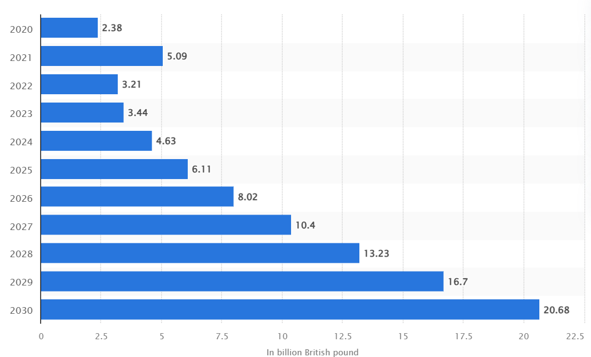
Literature Review
Concept of Artificial Intelligence
AI integration within hospitality industry includes personalised travel suggestions for recommendations, demand forecasting through predictive analytics and customer inquiries from chatbots (Kannan, 2024).
The AI market size is expected to reach $243.70 billion by 2025 with a CAGR of 27.67% and resulting in $826.70 billion by 2030 (Statista, 2025).
UK AI market size in 2024 valued at £4.63 billion which has been expected to reach to £20 billion within 2030 (Statista, 2024).
Notes:
Literature Review
The AI within the hospitality or tourism industry identifies the involvement of improving operational efficiency by automating tasks and enhancing customer services. It has been implied by the need of enhanced customer experiences by data analytics and operational efficiency. AI can help hotels and tourism businesses to streamline operations by reducing costs and providing personalised services for elevating customer loyalty, trust and satisfaction (Doborjeh et al., 2022). Moreover, AI technologies cover robotics, natural language processing and machine learning for simplifying human tasks.

Slide 5

Literature Review- continued
Technological factors and their impact on the tourism and hospitality industry
AI has been factor constantly revolutionising the industry through predictive analysis, virtual assistants and chatbots for optimising demand and price forecasts.
Cloud computing, Internet of Things has enabled accessibility by controlling and monitoring operations effectively (Matthew, Kazaure and Okafor, 2021).
Augmented and Virtual Reality plays a crucial role in providing immersive experiences of destinations.
Blockchain ensure safety in transactions by reducing the risks of fraudulent activities.
As of 2024, 15% of businesses adopted an AI technology while 2% piloting it and 10% plan to adopt (GOV.UK, 2025).
Notes:
Literature Review- continued
The technological factors have impacted the industry by providing costs reduction, customer satisfaction and competitiveness. It can help the industry to remain responsive and agile for meeting the travellers’ dynamic needs and preferences. Integration of AI within the mobile technologies plays a vital role in allowing users to book flights and accommodations in a destination through convenience and flexibility (Islam, Kumar and Konar, 2024). Technological advancements have transformed the hospitality and tourism industry in a profound manner by offering opportunities for enhancing operations, customer experiences and driving growth. Social media enables businesses to share user-generated contents for influencing travellers travel decisions.

Slide 6
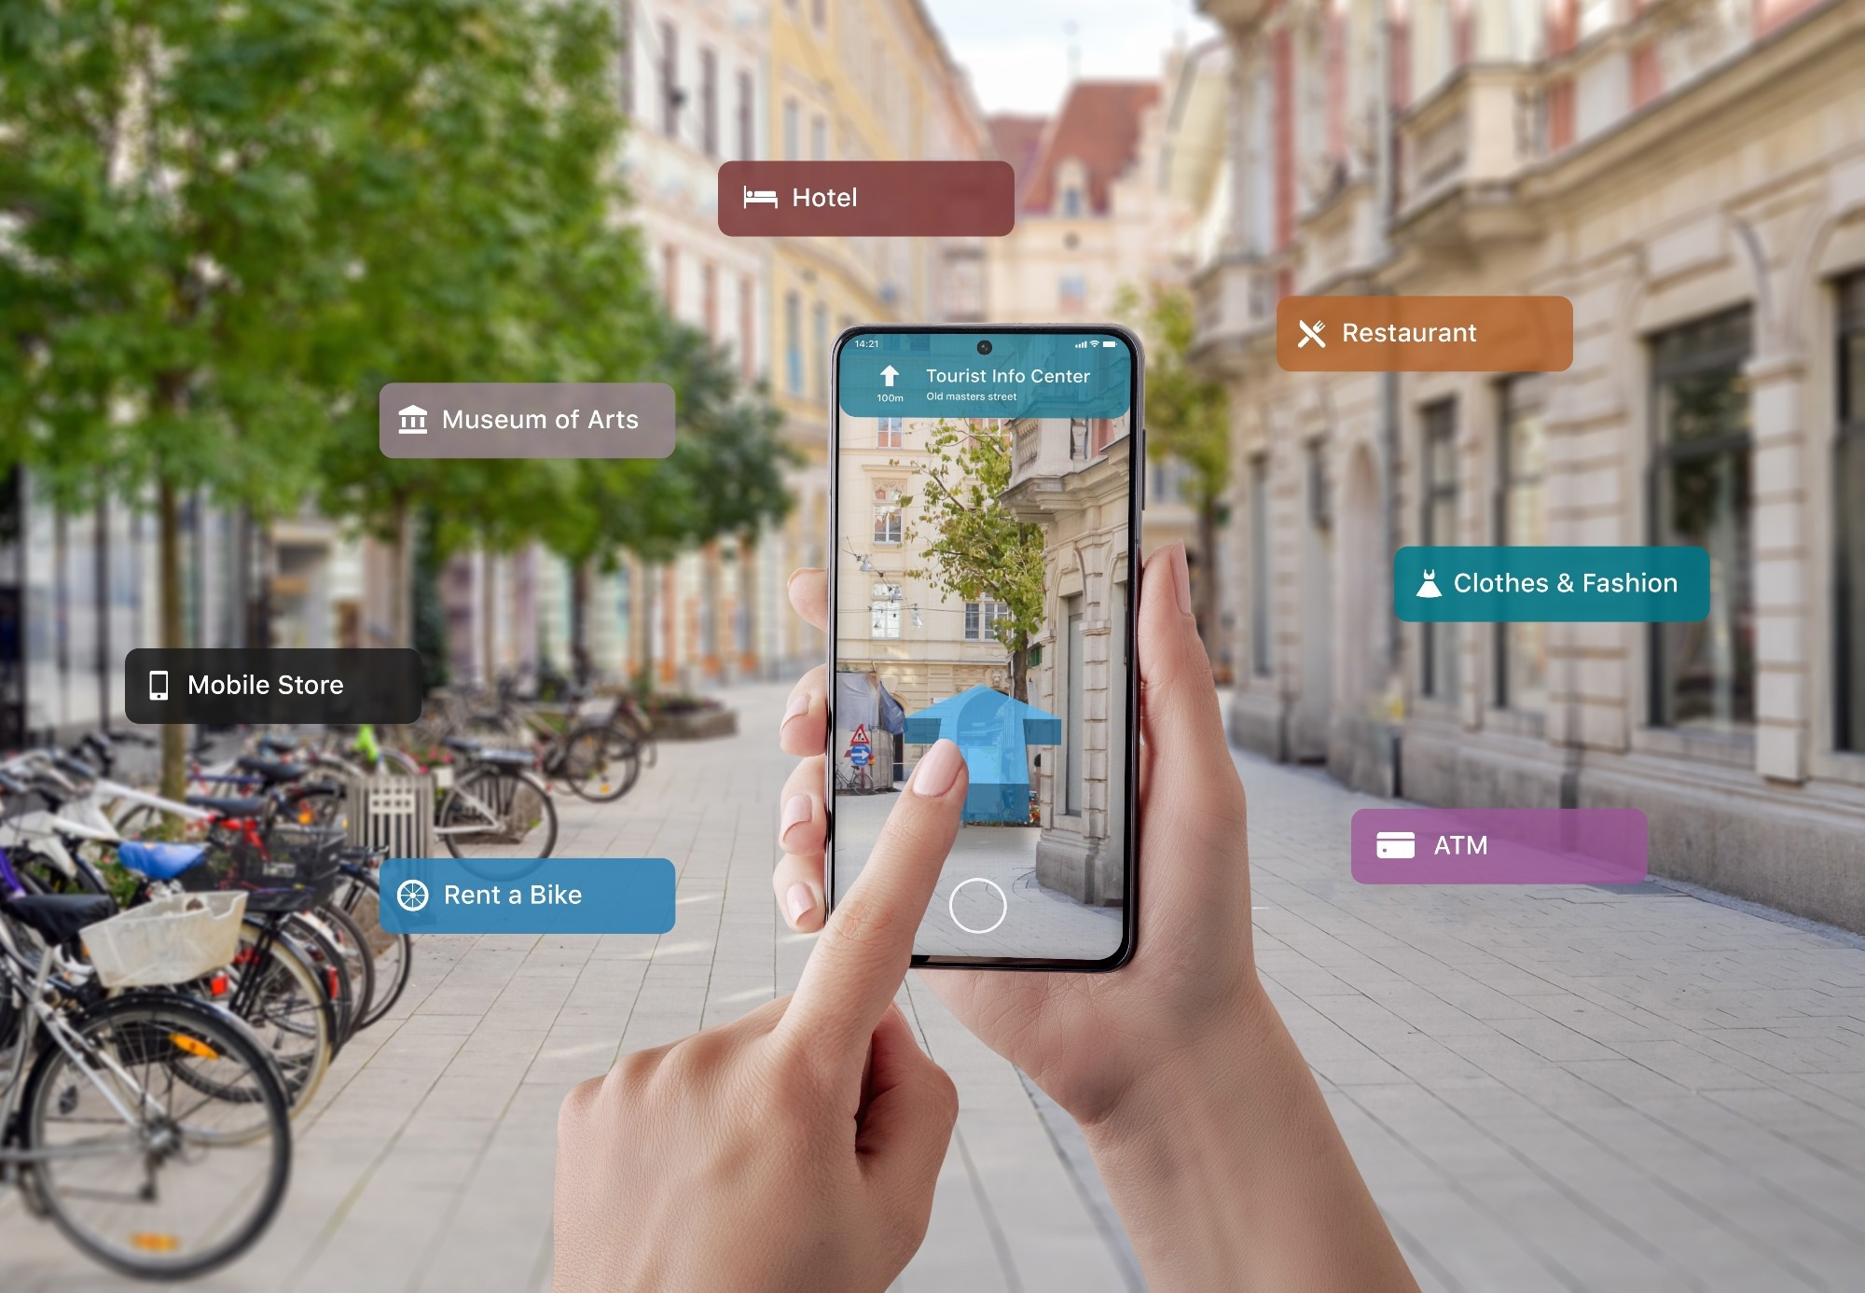
Literature Review- continued
Technological factors and their impact on the tourism and hospitality industry
AI has been factor constantly revolutionising the industry through predictive analysis, virtual assistants and chatbots for optimising demand and price forecasts.
Cloud computing, Internet of Things has enabled accessibility by controlling and monitoring operations effectively (Matthew, Kazaure and Okafor, 2021).
Augmented and Virtual Reality plays a crucial role in providing immersive experiences of destinations.
Blockchain ensure safety in transactions by reducing the risks of fraudulent activities.
As of 2024, 15% of businesses adopted an AI technology while 2% piloting it and 10% plan to adopt (GOV.UK, 2025).
Notes:
Literature Review- continued
The technological factors have impacted the industry by providing costs reduction, customer satisfaction and competitiveness. It can help the industry to remain responsive and agile for meeting the travellers’ dynamic needs and preferences. Integration of AI within the mobile technologies plays a vital role in allowing users to book flights and accommodations in a destination through convenience and flexibility (Islam, Kumar and Konar, 2024). Technological advancements have transformed the hospitality and tourism industry in a profound manner by offering opportunities for enhancing operations, customer experiences and driving growth. Social media enables businesses to share user-generated contents for influencing travellers travel decisions.

Slide 7
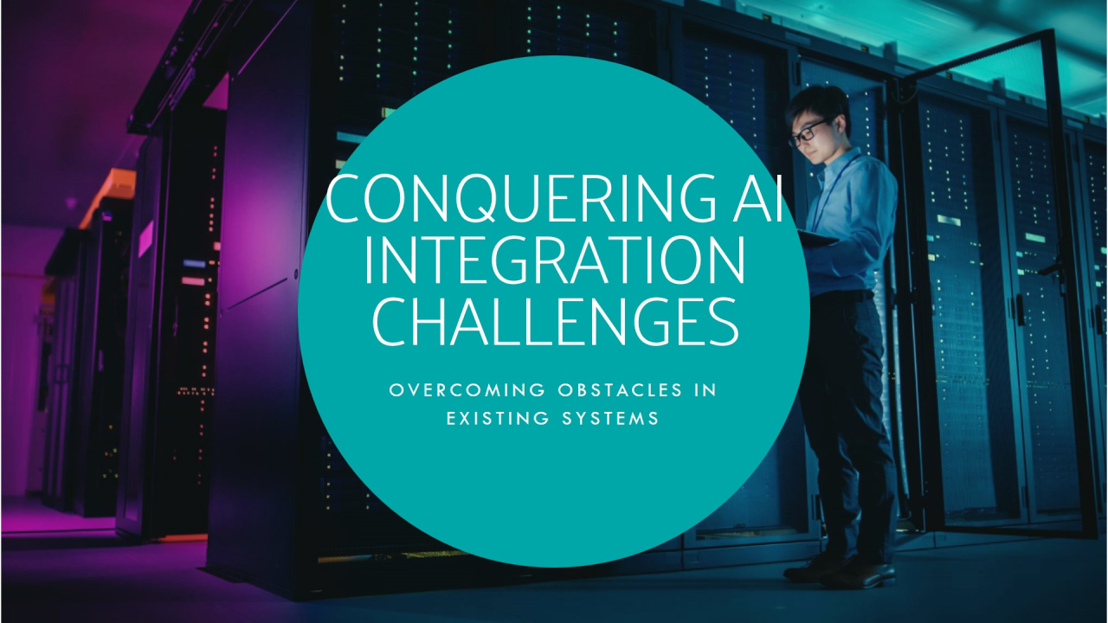
Literature Review- continued
Challenges of AI technologies
The major challenges for integrating AI within the hospitality or tourism industry delves into due to massive costs, integration complexities within existing system and staff training requirements (Bulchand-Gidumal et al., 2024).
Lack of technological infrastructure hinders the knowledge evaluation through reducing consistency and operational growth.
Notes:
Literature Review- continued
This inefficiency causes customers feel impersonal by posing a risk to the businesses. Challenges needs to be balanced with technology and human involvement. By integration of AI hoteliers can navigate the challenges with a personalised customer satisfaction. This complicates the implementation process and potentially disrupting the services of the hotels. Data privacy, security and legal concerns posed challenges in maintain legality of the business and are vital (Igbinenikaro and Adewusi, 2024).

Slide 8

Literature Review- continued
Recommendations to enhance technological advances
Tourism or hospitality businesses need to explore for options such as government funds and partnerships for alleviate the financial burden.
Develop comprehensive staff training to help enhance technical skills and improve adaptation by collaborating with education or training provider (Kim, 2024).
Updating of infrastructure with technology can bridge gaps between innovation within existing staff.
Notes:
Literature Review- continued
Addressing AI inefficiencies can help to personalise guest experiences and rectify it effectively. Moreover, implementing robust data protection measures regarding the challenges such as security and privacy of data can be rectified. Regular audits and consultations with legal experts can ensure practices with high standards (Latilo et al., 2024). Strategic planning, continuous evaluations, pilot testing and comprehensive training can provide specific effectiveness.

Slide 9
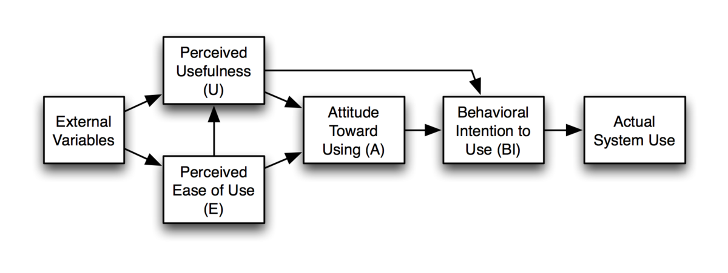
Literature Review- continued
Theoretical underpinnings
The TAM model evaluates the integration of AI within hospitality and tourism industry focuses on perceived usefulness and ease of use elements (Natasia, Wiranti and Parastika, 2022).
This determines with PU of AI it provides quality and efficiency while PEOU measures the ease of learning.
The Diffusion of Innovation theory identifies integration of AI within the hospitality industry by examining elements such as innovators, early adopters, early majority, late majority and laggards (Min, So and Jeong, 2021).
Notes:
Literature Review- continued
The model helps in identifying areas of improvements by enhancing guests’ experiences with operational efficiencies. Regarding employees, effective AI training programs can identify user-friendly interfaces through the model. Regarding the tourism businesses, AI can embrace new technologies for enhancing operations and services by setting early majority trends. This determines strategising targeting influencers for accelerating the diffusion to improve customer experiences.

Slide 10
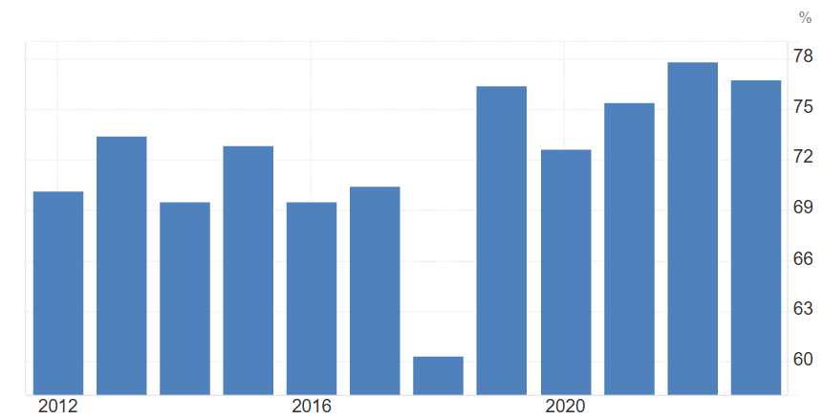
Method and Theme Impact Analysis
Data Collection Procedures and Tools and Analytical Techniques has been utilised for identifying the primary and secondary data with PESTLE analysis for AI integration with the hotel industry.
PESTLE Analysis
Political
Within the UK an investment of £14 billion has been provided for harnessing AI development for businesses (GOV.UK, 2025).
The political stability index within the UK values at 76.78% in 2023 which has been termed as a lower value (Trading Economics, 2025).
Moreover, it can effectively influence the hotel by allowing to acquire tools for enhancing operational efficiency.
Notes:
Method and Theme Impact Analysis
Political
It has aimed to deliver jobs establishment and excellent services for individuals. It determines a negative impact on the hotel and can disrupt operations due to sudden changes in laws.

Slide 11
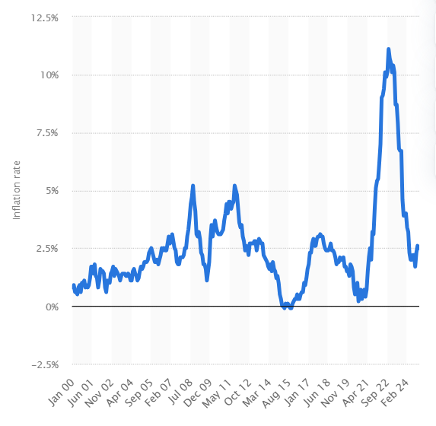
Method and Theme Impact Analysis-continued
Economic
As of 2024, UK has been recorded with an inflation of 2.5% which has indicated a downfall from the last month (Statista, 2024).
It can be a favourable factor for the Delta Hotels in enabling more investments for offering better services.
Social
75% of generation Z and 70% of millennials needs improvement in navigation and experiences through personalised shopping experiences (Mitchell, 2024).
Moreover, 66% of generation Z wants to be loyal to the company which satisfies the needs of the consumers.
This can elevate brand loyalty and provide personalised satisfaction to consumers.
Notes:
Method and Theme Impact Analysis-continued
Economic
As of 2025, within the UK, GDP growth rate has been estimated to grow by 1.48% (Statista, 2024). It can enable a positive effect for the organisation which can impact organisations increment with country’s revenue and can enable more customers evaluations.
Social
One-third of the consumers within the UK wants to spend more for receiving excellent services and this indicates utilisation of AI for enhancing high-quality service deliveries that can increase the profitability (Statista, 2025).

Slide 12
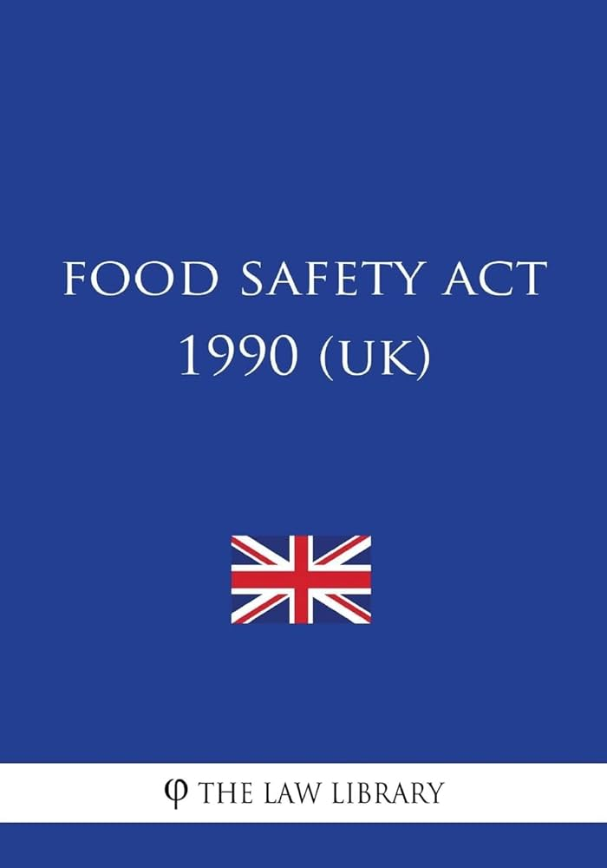
Method and Theme Impact Analysis-continued
Technological
UK ranked fifth in the Global Innovation Index as of 2024 while gained third position in Innovation Outputs (WIPO, 2024).
It implies this has been likely evaluate AI tools for improving the efficiency within hospitality industry.
Legal
The Food Safety Act 1990 governs the provision of food preparation, handling and storage within the hotels for consumers safety in the UK (Legislation, 2025a).
Environmental
The climate Change Act 2008 governs the organisations in case of gas emissions and climate change actions (Legislation, 2025b).
Notes:
Method and Theme Impact Analysis-continued
Technological
This determines UK has been home to 56.2 million social media users which is a total of 82.8% of the population (Statista, 2025). It can utilise this for promoting AI-powered services for influencing the buyer’s behaviour.
Legal
This determines the significance of implementing appropriate consumer safety measures regarding the food provision for the Delta Hotels.
Environmental
It highlighted that Delta Hotels need to specifically employ the law for effectively operating within the UK.
Environmental

Slide 13

Method and Theme Impact Analysis-continued
Impact and Industry response to the use of AI
Personalised services and recommendations have been implemented by hotel businesses for improving the guest experiences with high-quality services.
Virtual Assistants and Chatbots has been induced by leading hoteliers for delivering prompt, services and interactions to customers (Bilgihan and Ricci, 2024).
Enhancement of Operations through AI has been imputed by hoteliers for reducing resource wastage.
Notes:
Method and Theme Impact Analysis-continued
Impact and Industry response to the use of AI
AI has been significantly impacting the hospitality business which has been termed in both positive and negative effects. Regarding positive evaluations it has faced improved businesses infrastructure with appropriate technologies. While the negative facets have posed discrepancies regarding challenges in operations and service provisions.

Slide 14
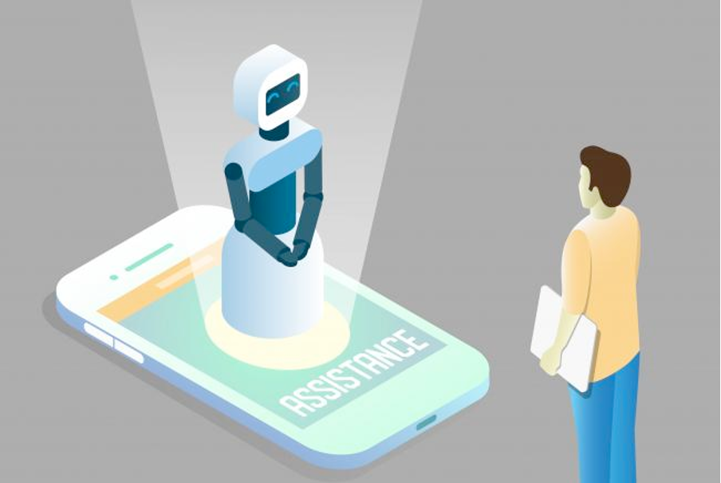
Conclusion
Concluding the key points it has been indicated that exploration of AI within the hospitality industry has unveiled potential benefits and challenges.
The myriads of AI enhances the customer experiences with evaluation of real-world data and analysis.
Notes:
Conclusion
The AI integration is quite a necessary task for the contemporary hoteliers as it helps in enabling effectiveness within revenue and positive feedback.

Slide 15

Conclusion- continued
This determines addressing challenges such as staff training, high costs and legal concerns.
Hoteliers need to be specific for proper integration of AI as a small discrepancy can turn down the whole business.
Notes:
Conclusion- continued
This can help it to evaluate effectiveness within the operations by improving the operational efficiency.

Slide 16
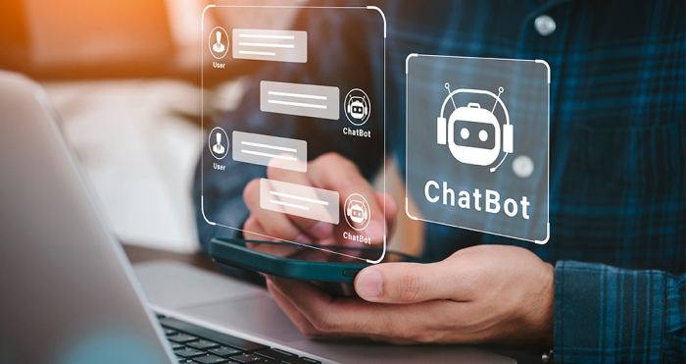
Recommendations
Implementing data security measures is recommended for the hotel to enable privacy concerns regarding the customer information (Anichiti et al., 2021).
Maintaining a bridge between AI and employee is quite effective for enhancing the operations and employee productivity.
Notes:
Recommendations
The hotel needs to evaluate effective data protection measures for enabling effectiveness within the AI integration evaluation with appropriate effectiveness. This can help it to attain effectiveness within the hospitality industry.

Slide 17

Recommendations- continued
Employee training is a necessity for reducing the resistance of adopting the AI within the employees.
Notes:
Recommendations- continued
Employee training is essential for reducing the resistance in adoption and bridging the distance between AI and employees.

Slide 18
References
Tracxn (2025) Delta Hotels and Resorts company profile. Available at: https://tracxn.com/d/companies/delta-hotels-and-resorts/__nW22M4vpiePwMeqHHgrd5dWlLKI7FxaoFGMHOcdyPYI (Accessed: 31 January 2025).
Fandom (2025) Staypedia Wiki- Delta Hotels. Available at: https://staypedia.fandom.com/wiki/Delta_Hotels (Accessed: 31 January 2025).
Hotelmergers (2024) M&A Case Study: Marriott International Acquires Delta Hotels and Resorts (2015). Available at: https://hotelmergers.com/ma-case-study-marriott-international-acquires-delta-hotels-and-resorts-2015/ (Accessed: 31 January 2025).
Shvaikovskaia, E. (2022) Artificial intelligence for innovative service design and guest experience: case: Hotels in Germany.
Eulerpool (2025) Marriott International Employees 2024 | US5719032022. Available at: https://eulerpool-com.webpkgcache.com/doc/-/s/eulerpool.com/en/stock/Marriott-International-Stock-US5719032022/Employees (Accessed: 31 January 2025).
Statista (2025) Artificial Intelligence – Worldwide. Available at: https://www.statista.com/outlook/tmo/artificial-intelligence/worldwide (Accessed: 31 January 2025).
Statista (2024) Size of the artificial intelligence (AI) market in the United Kingdom from 2020 to 2030. Available at: https://www.statista.com/forecasts/1461495/ai-market-size-uk#:~:text=Market%20size%20of%20AI%20in%20the%20UK%20from%202020%2D2030&text=The%20size%20of%20the%20AI,of%20the%20decade%20in%202030. (Accessed: 31 January 2025).
Kannan, R. (2024) Revolutionizing the Tourism Industry through Artificial Intelligence: A Comprehensive Review of AI Integration, Impact on Customer Experience, Operational Efficiency, and Future Trends. International Journal for Multidimensional Research Perspectives, 2(2), pp.01-14.
Matthew, U.O., Kazaure, J.S. and Okafor, N.U. (2021) Contemporary development in E-Learning education, cloud computing technology & internet of things. EAI Endorsed Transactions on Cloud Systems, 7(20), pp.e3-e3.
GOV.UK (2025) AI activity in UK businesses: Executive Summary. Available at: https://www.gov.uk/government/publications/ai-activity-in-uk-businesses/ai-activity-in-uk-businesses-executive-summary (Accessed: 31 January 2025).
Bulchand-Gidumal, J., William Secin, E., O’Connor, P. and Buhalis, D. (2024) Artificial intelligence’s impact on hospitality and tourism marketing: exploring key themes and addressing challenges. Current Issues in Tourism, 27(14), pp.2345-2362.
Kim, J. (2024) Leading teachers' perspective on teacher-AI collaboration in education. Education and Information Technologies, 29(7), pp.8693-8724.
Natasia, S.R., Wiranti, Y.T. and Parastika, A. (2022) Acceptance analysis of NUADU as e-learning platform using the Technology Acceptance Model (TAM) approach. Procedia Computer Science, 197, pp.512-520.
Min, S., So, K.K.F. and Jeong, M. (2021) Consumer adoption of the Uber mobile application: Insights from diffusion of innovation theory and technology acceptance model. In Future of tourism marketing (pp. 2-15). Routledge.
GOV.UK (2025) UK AI sector attracts £200 million a day in private investment. Available at: https://www.gov.uk/government/news/uk-ai-sector-attracts-200-million-a-day-in-private-investment-since-july#:~:text=More%20than%20%C2%A314%20billion%20pounds%20worth%20of%20investment%20into,the%20opportunities%20of%20artificial%20intelligence. (Accessed: 31 January 2025).
Trading Economics (2025) United Kingdom - Political Stability And Absence Of Violence/Terrorism: Percentile Rank, Upper Bound Of 90% Confidence Interval. Available at: https://tradingeconomics.com/united-kingdom/political-stability-and-absence-of-violence-terrorism-percentile-rank-upper-bound-of-90percent-confidence-interval-wb-data.html (Accessed: 31 January 2025).
Statista (2024) Inflation rate in the UK 2000-2024. Available at: https://www.statista.com/statistics/306648/inflation-rate-consumer-price-index-cpi-united-kingdom-uk/ (Accessed: 31 January 2025).
Statista (2024) Gross domestic product (GDP) growth rate in the United Kingdom 2029. Available at: https://www.statista.com/statistics/263613/gross-domestic-product-gdp-growth-rate-in-the-united-kingdom/ (Accessed: 31 January 2025).
Mitchell, S. (2024) Study shows personalisation key to consumer loyalty in UK. Available at: https://cmotech.uk/story/study-shows-personalisation-key-to-consumer-loyalty-in-uk#:~:text=According%20to%20the%20study%2C%2075,their%20individual%20needs%20and%20interests. (Accessed: 31 January 2025).
Statista (2025) Customers willing to pay more for getting excellent service in the UK 2020-2024. Available at: https://www.statista.com/statistics/1291591/customers-willing-to-pay-for-excellent-service-uk/ (Accessed: 31 January 2025).
Statista (2025) Active social media users in the United Kingdom (UK) 2024. Available at: https://www.statista.com/statistics/507405/uk-active-social-media-and-mobile-social-media-users/#:~:text=Active%20social%20media%20users%20in%20the%20United%20Kingdom%20(UK)%202024&text=Social%20media's%20influence%20in%20the,82.8%20percent%20of%20the%20population. (Accessed: 31 January 2025).
WIPO (2024) United Kingdom ranking in the Global Innovation Index 2024. Available at: https://www.wipo.int/gii-ranking/en/united-kingdom (Accessed: 31 January 2025).
Legislation (2025) Food Safety Act 1990. Available at: https://www.legislation.gov.uk/id/ukpga/1990/16 (Accessed: 31 January 2025).
Legislation (2025) Climate Change Act 2008. Available at: https://www.legislation.gov.uk/ukpga/2008/27/contents (Accessed: 31 January 2025).
Bilgihan, A. and Ricci, P. (2024) The new era of hotel marketing: integrating cutting-edge technologies with core marketing principles. Journal of Hospitality and Tourism Technology, 15(1), pp.123-137.
Anichiti, A., Dragolea, L.L., Tacu Hârșan, G.D., Haller, A.P. and Butnaru, G.I. (2021) Aspects regarding safety and security in hotels: Romanian experience. Information, 12(1), p.44.
Notes:
References
PR Newswire (2024) Marriott International Reports Third Quarter 2024 Results. Available at: https://www.prnewswire.com/news-releases/marriott-international-reports-third-quarter-2024-results-302294817.html (Accessed: 31 January 2025).
Doborjeh, Z., Hemmington, N., Doborjeh, M. and Kasabov, N. (2022) Artificial intelligence: a systematic review of methods and applications in hospitality and tourism. International Journal of Contemporary Hospitality Management, 34(3), pp.1154-1176.
Igbinenikaro, E. and Adewusi, A.O. (2024) Financial law: policy frameworks for regulating fintech innovations: ensuring consumer protection while fostering innovation. Finance & Accounting Research Journal, 6(4), pp.515-530.
Shvaikovskaia, E. (2022) Artificial intelligence for innovative service design and guest experience: case: Hotels in Germany.
Eulerpool (2025) Marriott International Employees 2024 | US5719032022. Available at: https://eulerpool-com.webpkgcache.com/doc/-/s/eulerpool.com/en/stock/Marriott-International-Stock-US5719032022/Employees (Accessed: 31 January 2025).
Islam, M.T., Kumar, J. and Konar, R. (2024) How Technology Is Revolutionizing the Bleisure Experiences of Tourists in Malaysia. In Bleisure Tourism and the Impact of Technology (pp. 168-189). IGI Global.
Latilo, A., Uzougbo, N.S., MC, U. and Oduro, P. (2024) Strategies for Corporate Compliance and Litigation avoidance in multinational enterprise. World Journal of Advanced Science and Technology, 6(01), pp.073-087.

Slide 19


