Slide 1
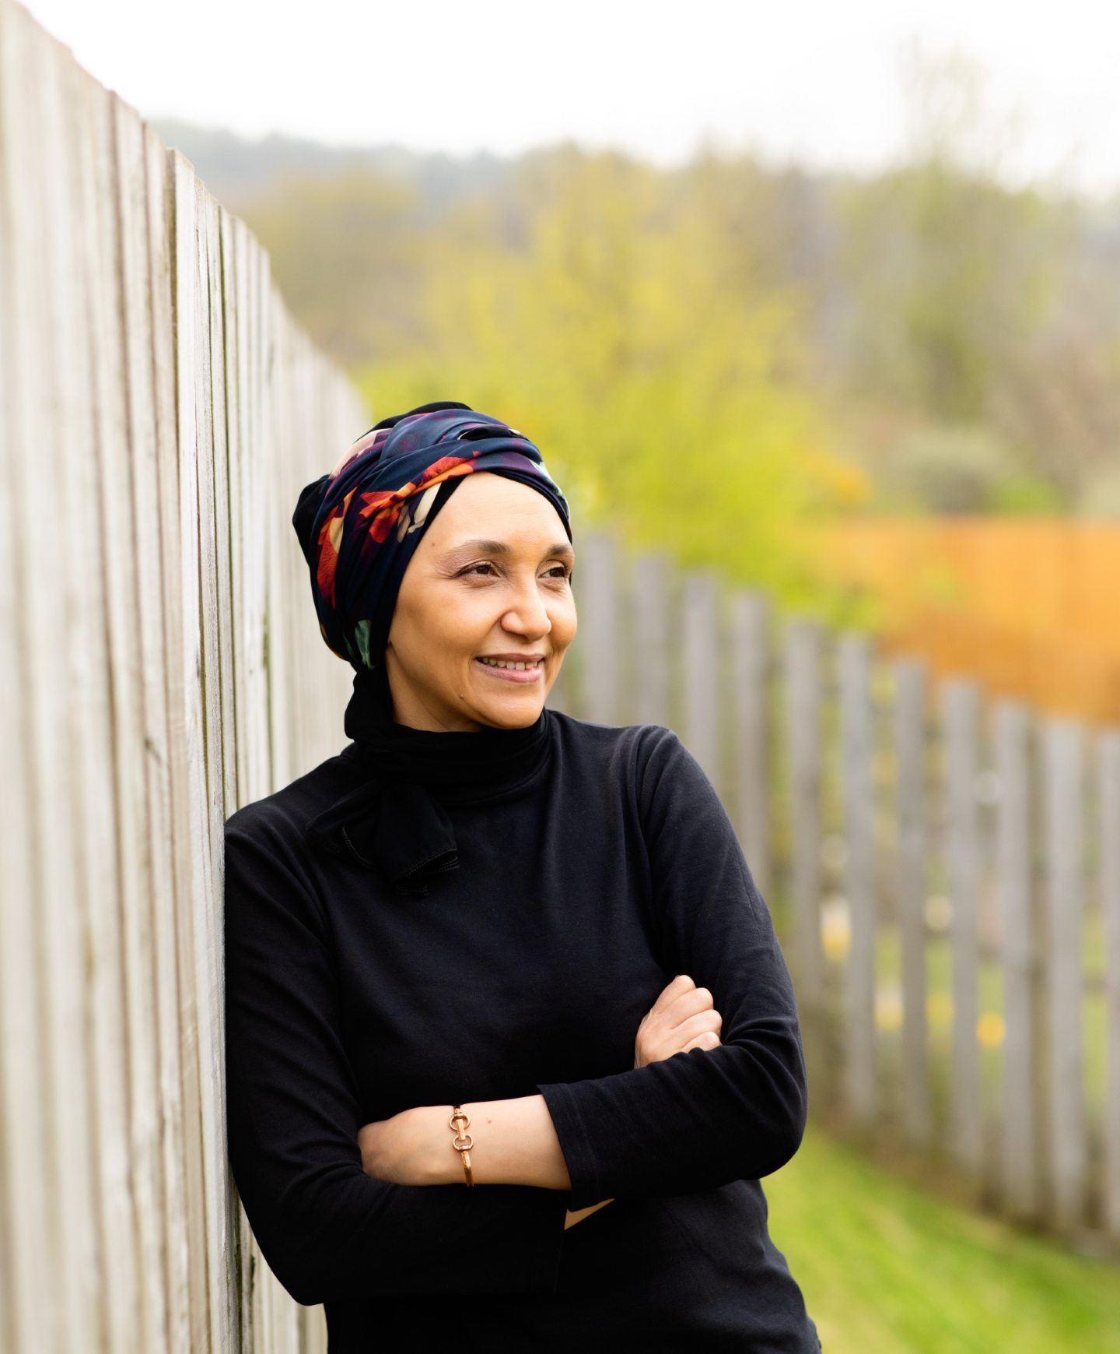
Leila Aboulela, Elsewhere, Home
Make it New, Week 4

Slide 2
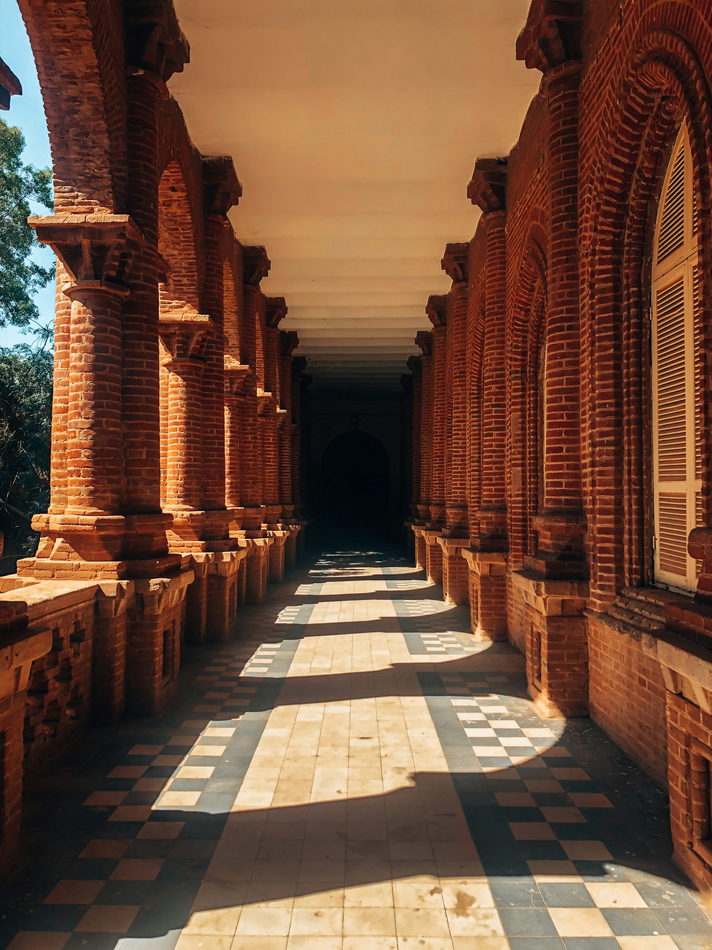
A few points of biography
Cairo-born (1964), of Sudanese-Egyptian parenthood; moved to Khartoum, Sudan, when very young
University-educated in Khartoum (economics – not literature)
Came to Scotland (Aberdeen) in 1990 – with small children in tow
A library-based writers’ group was crucial to her development as a writer of fiction

Slide 3
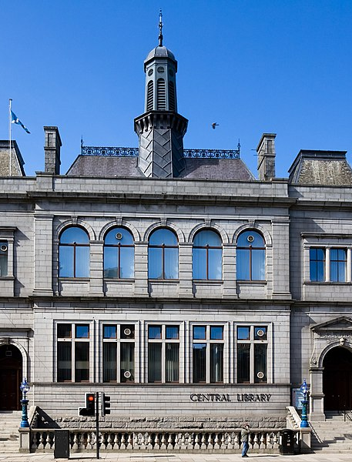
Writing in community
“Because I started writing in the 1990s, at a particularly exciting time for Scottish literature, I was certainly caught up in the buzz and optimism. The Central Library hosted nearly all the rising and established stars of the time – Kathleen Jamie, Robin Jenkins, Alan Spence, A L Kennedy – and I always attended.
(https://www.pressandjournal.co.uk/fp/lifestyle/6207405/aberdeen-inspired-leila-aboulela-global-writer/, 3 November 2023)

Slide 4
Connecting geographies
“Many of my novels and short stories are based in Scotland (notably Aberdeen) but of course Sudan figures heavily in my work as well.
“I am always trying to connect the two countries – Sudan and Scotland. In my latest novel River Spirit, I wrote about Charles Gordon (whose statue stands in Schoolhill) and the siege of Khartoum in the nineteenth century.
“The novel tells this turbulent history from the point of view of several Sudanese characters – a soldier, a slave girl, a mother- but there is also a Scottish artist and, through his eyes, we see Khartoum as it is increasingly threatened. I based his character on the Orientalist painter David Roberts who was born in Edinburgh.”
(https://www.pressandjournal.co.uk/fp/lifestyle/6207405/aberdeen-inspired-leila-aboulela-global-writer/, 3 November 2023)

Slide 5
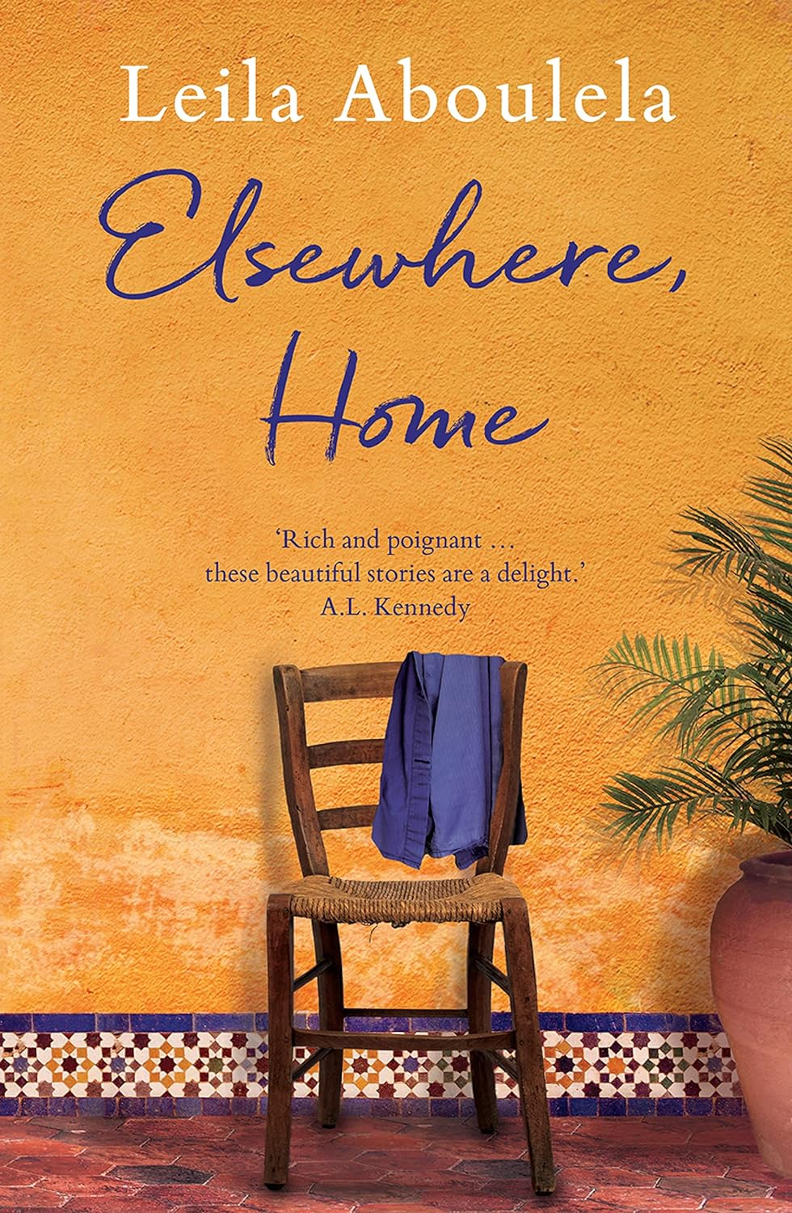
Elsewhere, Home (2018)
Effectively a ‘selected short stories’
Goes right back to her earliest short stories (‘Coloured Lights’; ‘The Ostrich’, 1997)
But also includes much more recent work ('The Circle Line' and 'Pages of Fruit' - first published in 2017)
Valuable text in understanding the developing sweep of her career, which includes…
Six novels (first in 1999) and two collections of short stories (2001, 2018)

Slide 6
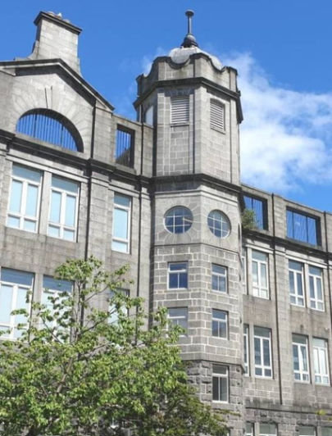
A little cultural context
“In his 2008 history of the relationship between Scotland and Islam, Bashir Maan states that '[b]y the close of the [twentieth] century, there were over 46,000 Muslims and 40 mosques in Scotland. The Muslim community had become a recognised part of Scottish society and Islam the second religion after Christianity’.”
Jessica Homberg-Schramm, "Negotiations of Scottish Muslim Identities in the Fiction of Suhayl Saadi and Leila Aboulela“, Scottish Literary Review, 13/1, spring-summer 2021, pp. 51+. Gale Literature Resource Center

Slide 7
Jessica Homberg-Schramm
“My analysis of [Suhayl] Saadi and Aboulela will demonstrate their visions of a progressive response to Scottish nationalism that, instead of regressively drawing on an essentialist nationalism, attempts to contribute to a post-national Scotland. While nationalism is not completely superseded, the development of a 'new', less essentialist, more pluralist and multi-ethnic Scottish nationalism means that national identity can lose importance (or can at least be complicated/complemented by) other narratives, such as gender, race, class or in this case faith. [Bashabi] Fraser underlines this by arguing that writers such as Saadi and Aboulela are substantially influenced by the duality of their national identities”

Slide 8
Jessica Homberg-Schramm (continued)
“Both writers’ approaches chime in with a trend in post-devolution Scottish literature to turn away from a concern with negotiating a stable national identity and instead emphasise cosmopolitan and post-national frameworks. The discussion of Muslim identity in Scotland only represents one facet of this new writing and contributes to fulfilling Berthold Schoene's hope that Scottish literature after devolution can transcend a narrow nationalist outlook and should ultimately ‘be allowed to go cosmopolitan rather than native’.”

Slide 9
A pause for space (and place)
…what we didn’t quite get to in our session on Winterson

Slide 10
Space/Place: Michel Foucault
‘The great obsession of the nineteenth century was, as we know, history: with its themes of development and of suspension, of crisis and cycle, themes of the ever-accumulating past, with its great preponderance of dead men and the menacing glaciation of the world. [...] The present epoch will perhaps be above all the epoch of space. We are in the epoch of simultaneity: we are in the epoch of juxtaposition, the epoch of the near and far, of the side-by-side, of the dispersed. We are at a moment, I believe, when our experience of the world is less that of a long life developing through time than that of a network that connects points and intersects with its own skein.’
Michel Foucault, ‘Of Other Spaces’ trans. by Jay Miskowiec, Diacritics , 16/1 (Spring, 1986), 22-7: 22. (Translation of the text on which Foucault based his 1967 lecture entitled ‘Des Espaces Autres’)

Slide 11
Space/Place: Robert T. Tally Jr.
‘If the metaphor of time as a smoothly flowing river and the evolutionary theory of history as progressively moving from barbarism towards civilization could not be maintained in the aftermath of concentration camps and atomic bombs, other real historical forces also helped shape the heightened attention to space in the postwar era. Certainly the massive movements of populations—exiles, émigrés, refugees, soldiers, administrators, entrepreneurs, and explorers—disclosed a hitherto unthinkable level of mobility in the world, and such movement emphasized geographical difference; that is, one’s place could not simply be taken for granted any longer.’
Robert T. Tally Jr., Spatiality (Abingdon: Routledge, 2013), p. 13

Slide 12
Space/Place: Yi-Fu Tuan
‘Place is a type of object. Places and objects define space, giving it a geometric personality. Neither the newborn infant nor the man who gains sight after a lifetime of blindness can immediately recognize a geometric shape such as a triangle. The triangle is at first “space,” a blurred image. Recognizing the triangle requires the prior identification of corners – that is, places. A neighborhood is at first a confusion of images to the new resident; it is blurred space “out there.” Learning to know the neighborhood requires the identification of significant localities, such as street corners and architectural landmarks, within the neighborhood space. Objects and places are centers of value. They attract or repel in finely shaded degrees. To attend to them even momentarily is to acknowledge their reality and value.’
Yi-Fu Tuan, Place and Space: The Perspective of Experience (Minneapolis: University of Minnesota Press, 1977), pp. 17-18

Slide 13
Space/Place: Doreen Massey (1)
‘The “character of an area” is no more the product of an internalized history than are the recent fortunes of its manufacturing industry. The global is in the local in the very process of the formation of the local. […] Thinking of places in this way implies that they are not so much bounded areas as open and porous networks of social relations. It implies that their “identities” are constructed through the specificity of their interaction with other places rather than by counterposition to them. It reinforces the idea, moreover, that those identities will be multiple (since the various social groups in a place will be differently located in relation to the overall complexity of social relations and since their reading of those relations and what they make of them will also be distinct). And this in turn implies that what is to be the dominant image of any place will be a matter of contestation and will change over time.’
Doreen Massey, Space, Place, and Gender (Minneapolis, MN: University of Minnesota Press, 1994), pp. 120-1

Slide 14
Space/Place: Doreen Massey (2)
‘[W]hat is special about place is not some romance of a pre-given collective identity or of the eternity of the hills. Rather, what is special about place is precisely that throwntogetherness, the unavoidable challenge of negotiating a here-and-now (itself drawing upon a history and a geography of thens and theres); and a negotiation which must take place within and between both human and nonhuman. […] This is the event of place.’
Doreen Massey, For Space (London: Sage, 2005), p. 140

Slide 15

a break about now
I’m guessing it’ll be time for…

Slide 16
Stories…
'Coloured Lights' and 'The Ostrich' - early stories
'Something Old, Something New' and 'Souvenirs’ – also early
'Farida's Eyes' (originally published 2012)
'The Circle Line' and 'Pages of Fruit’ – later stories (first published in 2017)

Slide 17
First discussion: ‘Coloured Lights’
Starter: pick a key paragraph – and we’ll discuss
Five to follow:
How would you characterise the story’s style?
What are its primary themes / concerns?
What characterises its approach to place/geographical relationships?
What does the story’s narrator encapsulate/dramatize?
How does the ending work?

Slide 18
Second discussion: ‘The Ostrich’
Starter (redux!): pick a key paragraph – and we’ll discuss
Four to follow:
What does the story’s narrator encapsulate/dramatize?
How would you characterise the depiction of marriage here?
What are the ‘centers of value’ (Yi-Fu Tuan) in London, in Khartoum?
Again, how does the ending work?

Slide 19
Third discussion: ‘Something old, something new’
Starter (redux!): pick a key paragraph – and we’ll discuss
Four to follow:
What characterises the story’s engagement with cross-cultural relationships?
In what ways does this story engage with Islamic female dress codes? (And by extension, the female body)
How does the story deal with the notion of conversion to Islam?
Once again, how does the ending work?

Slide 20
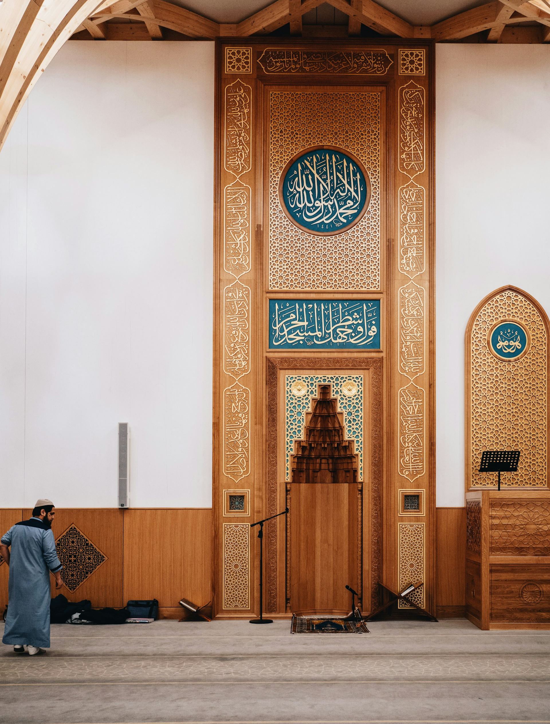
A writer of Islamic faith
“I want to show the psychology, the state of mind and the emotions of a person who has faith. I am interested in going deep, not just looking at 'Muslim' as a cultural or political identity but something close to the centre, something that transcends but doesn’t deny gender, nationality, class and race.” – Aboulela, https://literature.britishcouncil.org/writer/leila-aboulela
How is faith presented in the three stories we’ve looked at so far?

Slide 21
A comparison: ‘Pages of Fruit’
What’s changed since the earlier work? Can you identify anything? (Take some time to discuss…)
As a comment on the literary world, how does this present that cultural space?
Over pp. 196-7, what seems to constitute the notion of ‘belong[ing] in Britain’, for the (relatively conservative) narrator?
Again – what do you make of the ending…but take that a bit more broadly this time, from p. 212 onwards (“’I need a cigarette,’ you said”)

Slide 22

And if we have time…an exercise
Take one phrase from either ‘Souvenirs’ or ‘Farida’s Eyes’
Use the phrase as a jumping-off point to construct a brief story that engages with cultural difference in the way that Aboulela does – articulating its challenges and misunderstandings
“Like Minaret and The Translator, Coloured Lights deals with questions of cultural misunderstanding and mistranslation.” – James Proctor, https://literature.britishcouncil.org/writer/leila-aboulela
As we’ve done before: aim at 500 words; and think about Aboulela’s endings – you should try to imitate her concluding process of ‘curtailment’, as Proctor puts it.

