Slide 1
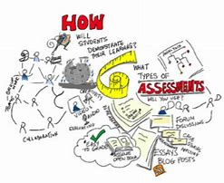
JESSICA AINSWORTH
ASSESSMENT COORDINATOR

Slide 2
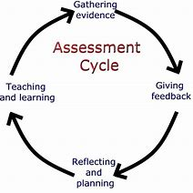
WHAT IS ASSSESSMENT
It is a term referred to;
“as a wide variety of methods or tools that educators utilize to evaluate, measure, and document the academic readiness, learning progress, skill acquisition, or educational needs of students” (Great Partnership, 2015).

Slide 3
ASSESSMENT OF LEARNING | ASSESSMENT FOR LEARNING
SUMMATIVE ASSESSMENT PURPOSE To find out what children can do, what they know and understand GOAL Evaluate student learning at the end of a topic/year Turned into a grade mark Comparison is made with performance of other students EXAMPLES; Tests Practical exercises Projects Exam | FORMATIVE ASSESSMENT PURPOSE To help children learn GOAL to monitor student learning to provide ongoing and useful feedback helps teacher to inform their teaching and children improve their learning – simplifies what is to be learnt & what their next steps are becomes an essential part of the process children can identify strength and weakness’ EXAMPLES; Learning objectives Questioning Peer assessment/Self-assessment Effective feedback
(Cambridge University, 2016)

Slide 4

POSTIVE FACTORS
IMPROVES LEARNER OUTCOME
IT’S A DAY-TO-DAY CLASSROOM PRACTICE
IMPROVES CONFIDENCE
IMPROVES INDEPENDENCE
IMPROVES CULTURE OF CLASSROOM
REMOVES THE END RESULT OF A TASK
CHILDREN NOT AFRAID TO MAKE MISTAKES
(Cambridge-community.org.uk, 2018)
PREVIOUS RESEARCH
BLACK AND WILLIAM (2001) ARGUE THAT CHILDREN CAN LEARN AT ALMOST DOUBLE THE RATE
HATTIE (2011) STATED THAT THE FEEDBACK STRATEGY HAS A PROFOUND EFFECT ON LEARNER ACHEIVEMENT
WHY CHOOSE ASSESSMENT FOR LEARNING?

Slide 5
HOW IS IT BENEFICIAL:
There is more emphasis on the learning rather than the end goal
Discussing intention helps focus teacher and child
Can be used in all subjects
Children have a say
Children actively involved
IMPLEMENTATION:
Needs to be done before activity/learning has begun on that topic
Identify what children will be learning
Explain the reason
Share/negotiate ideas
Present the idea in a language that is understood
Revisit the learning intention throughout
STRATEGY 1
SHARING LEARNING INTENTION
(council for the curriculum, examinations and Assessment, 2000)

Slide 6
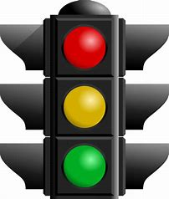
“PROGRESSION TRAFFIC LIGHT”
HOW IT WORKS FOR CHILDREN
RED – UH OH!
AMBER – HMMMMM…..
GREEN – EASY PEASY LEMON SQUEEZY
HOW IT WORKS FOR TEACHERS
Overview of understanding in the class
Checklist is done at beginning if topic – this helps teachers to structure planning
At end of topic – children re-evaluate their traffic lights and their understanding of the topic and learning outcome
Make a revision lesson

Slide 7
STRATEGY 2
QUESTIONING/DISCUSSION
HOW IS IT BENEFICIAL:
One of the most important techniques
Essential in a teaching repertoire
Improves a child’s thinking
Confidence and participation
IMPLEMENTATION:
Open and Closed questioning
Practice a pause
Technique – Pausing, Prompting and Seeking
(Pollard, 2014)

Slide 8
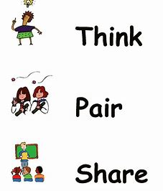
“THINK, PAIR AND SHARE”
HOW IT WORKS FOR CHILDREN
Teacher asks open ended questions
THINK: Children should be allocated time to think in direction of the question
PAIR: Children pair up and share ideas, discuss answers, clarify meaning and challenge
SHARE: Children then share ideas with the whole class or another pair
HOW IT WORKS FOR TEACHERS
Teachers can use with multiple activities
They are able to scaffold the learning to gain independent think
Support the children
Ideas can be displayed
Good observation technique

Slide 9
HOW IS IT BENEFICIAL:
Shapes an independent learner
A child can develop self-esteem
Improves understanding and can identify what makes quality work
Responsible for own and others work
Develop social skills
IMPLEMENTATION:
Carefully guide the process
Model/Discuss what’s good in work
Start with prompts and giving children questions to ask themselves
Encourage an atmosphere of mutual support
STRATEGY 3
PEER/SELF ASSESSMENT
(Black and William, 1998)
(Boud, 1995)

Slide 10

HOW IT WORKS FOR CHILDREN
Identify two positive things done well
Make a wish to improve
HOW IT WORKS FOR TEACHERS
Vital to this learning process
Observation tool
Active assessment tool
Model good assessment
Strengthen the pupils voice/reflection skills
Encourage children to use language used in marking criteria
Give children an active role
“TWO STARS AND A WISH”

Slide 11
STRATEGY 4
FORMATIVE FEEEDBACK
KEY ELEMENTS OF ASSESSMENT FOR LEARNING
Where are they now?
Where are they going?
How are they going to get there?
How is it beneficial:
Comment not just a grade
Rewarded with frequent praise
Motivated learners
Build self-esteem
Reinforce the positive
Encouraging right from wrong
(Hattie, 2011)

Slide 12


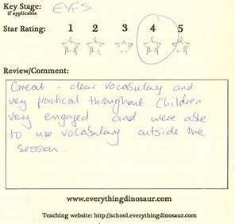
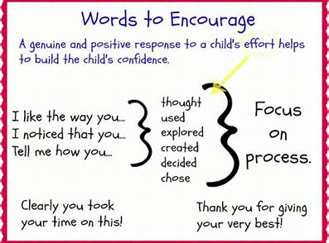
“WRITTEN & ORAL”

Slide 13
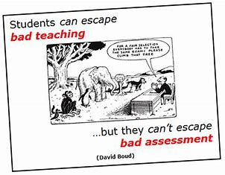

Slide 14

ANY QUESTIONS?

Slide 15
REFERENCES
Black, P., Williams, D. (1998). Assessment and Classroom Learning, Assessment in Education, pp 7-71.
Black, P., Williams, D. (2001). Inside the Black Box. Raising Standards Through Classroom Assessment Vol I. Nelson Publishing.
Boud, D. (1995) Enhancing Learning through Self- Assessment; Kogan Page; London.
Cambridge-Community.org.uk. (2018). Getting started with Assessment for learning. [online[ Available at: http://Cambridge.org.uk/professional-development/gswafl/index.html [Accessed 11 Feb. 2018]
Council for the curriculum, examinations and assessments,. (2000). Available at: http://ccea.org.uk/sites/default/files/docs/curriculum/assessment/assessment_for_learning/ks1_2_afl_guidanceb... [Accessed 12 Feb. 2018]
Hattie, J. (2011). Visible Learning. London: Routledge
Partnership, G. (2015). Assessment Definition. [online] The Glossary of Education Reform. Available at: https://www.edglossary.org/assessment/ [Accessed 10 Feb. 2018]
Pollard, A. (2014). Readings for Reflective Teaching in Schools. London: Bloomsbury.
University, C. (2016). Formative vs Summative Assessment - Eberly Center - Carnegie Mellon University. [online] Cmu.edu. Available at: https://www.cmu.edu/teaching/assessment/basics/formative-summative.html [Accessed 11 Feb. 2018].

