Slide 1
STUDENT NAME: ANCA MIHAELA MARIAN
STUDENT ID: 2130340
MODULE TUTOR: JINPING LI
MODULE: FOREIGN LANGUAGES AND CULTURAL AWARENESS BMIH5003
HOTEL EVENT ADVERTISEMENT

Slide 2

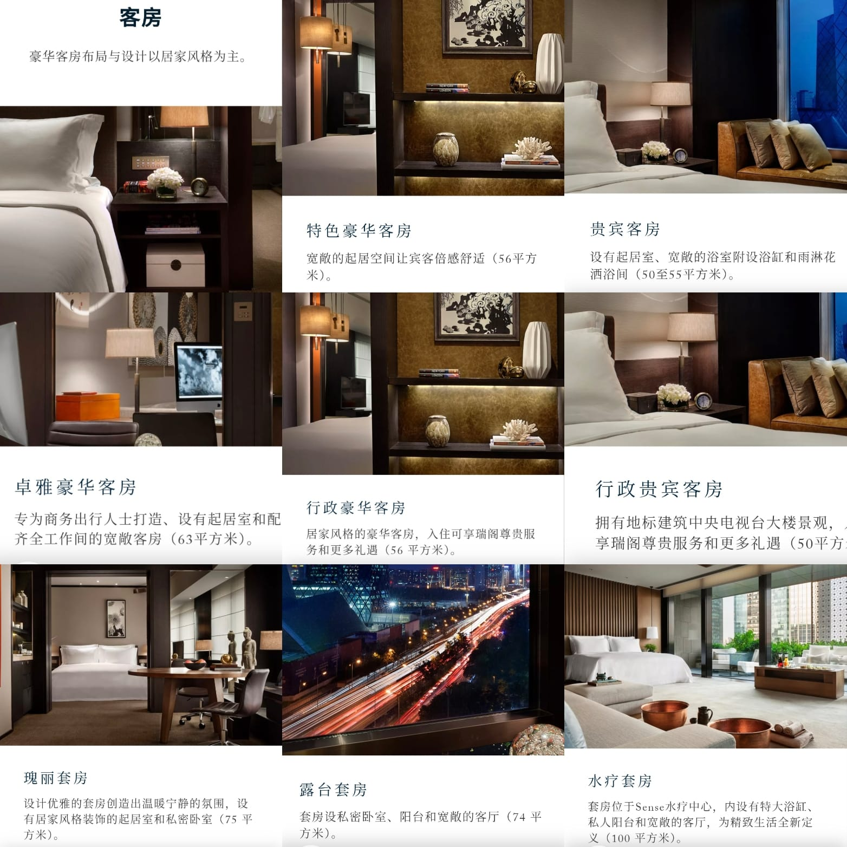
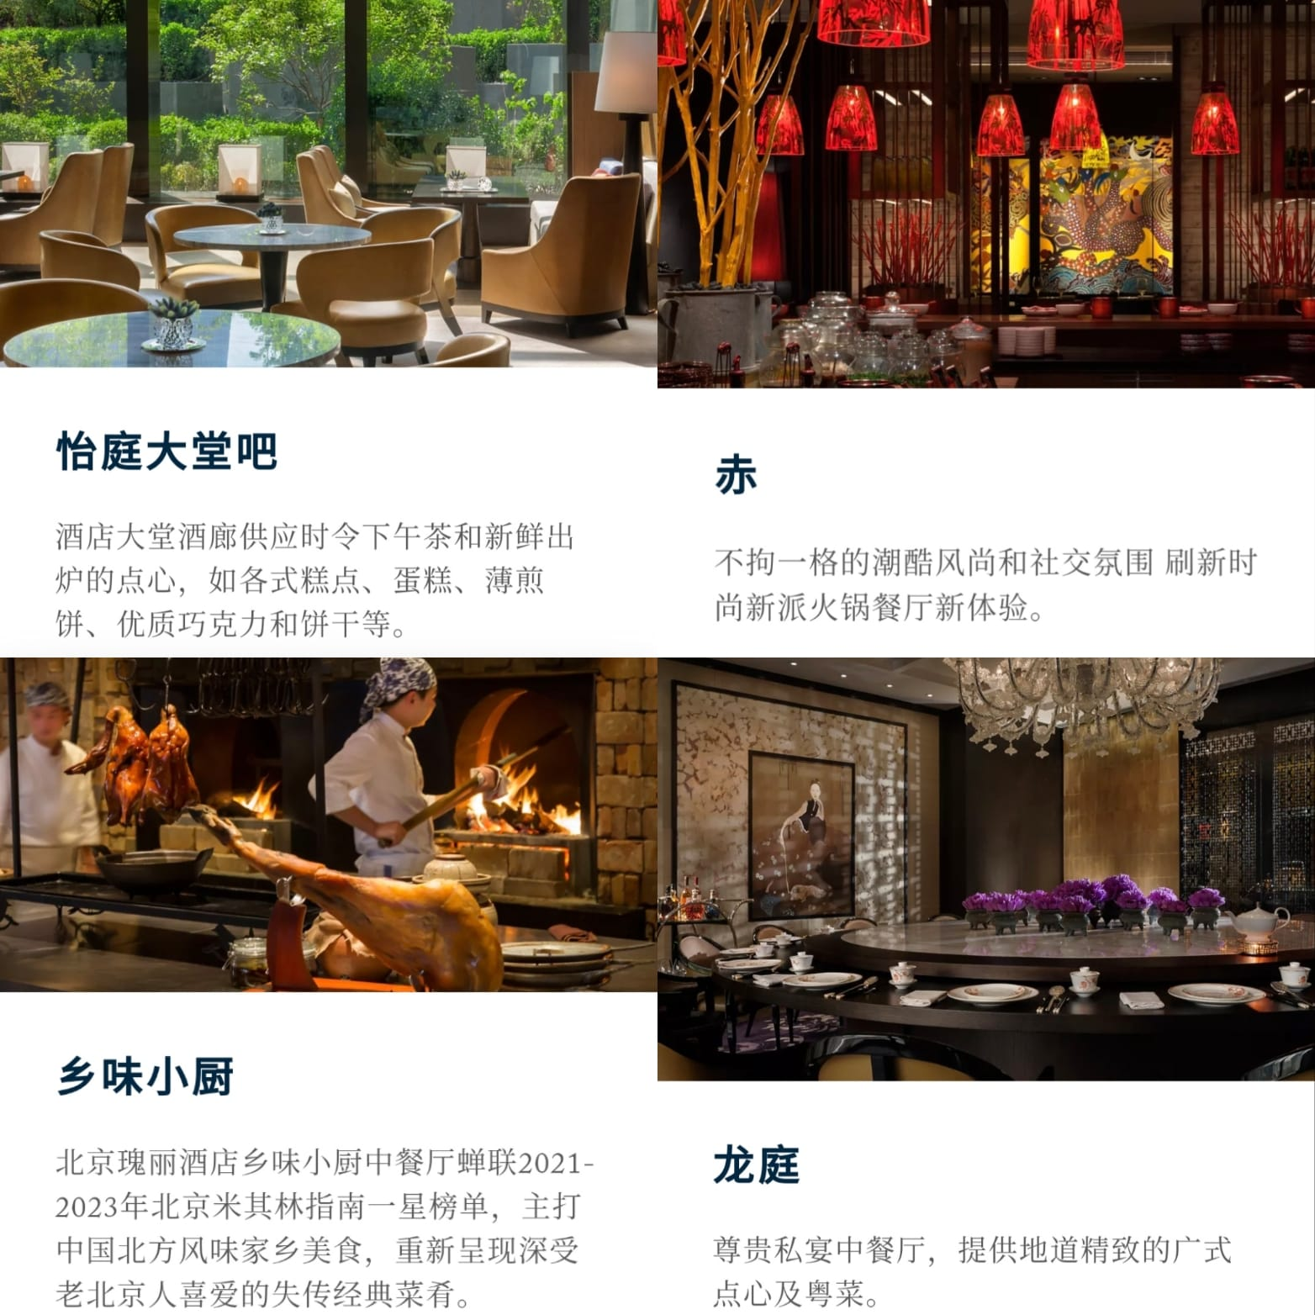
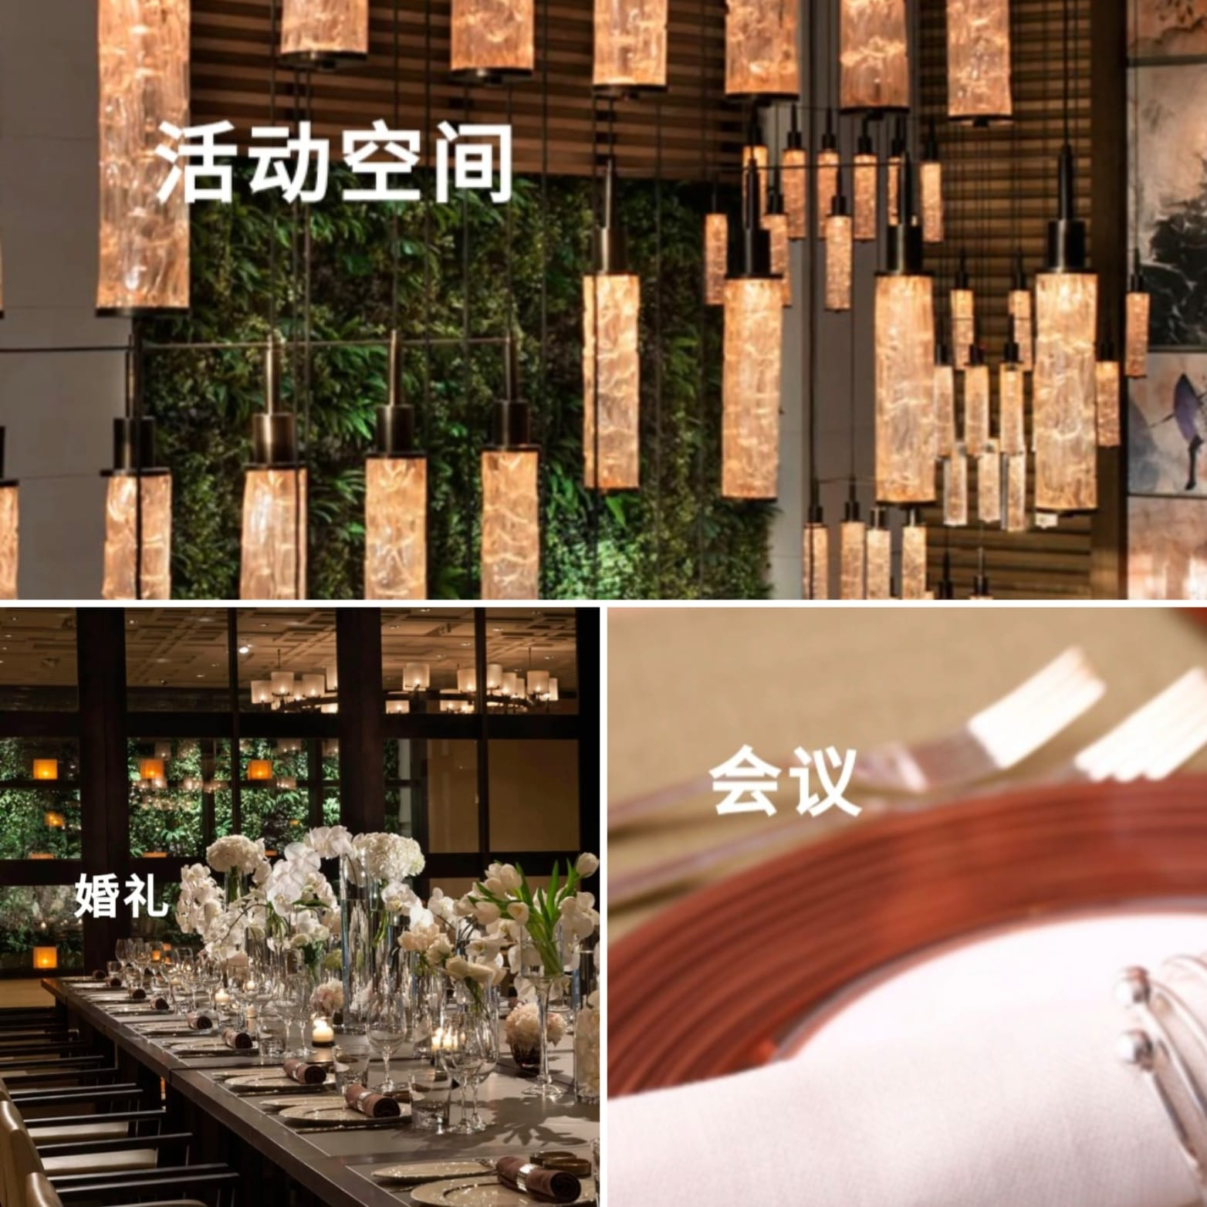
含食物的客房价格从1000元到2000元不等

