Slide 1
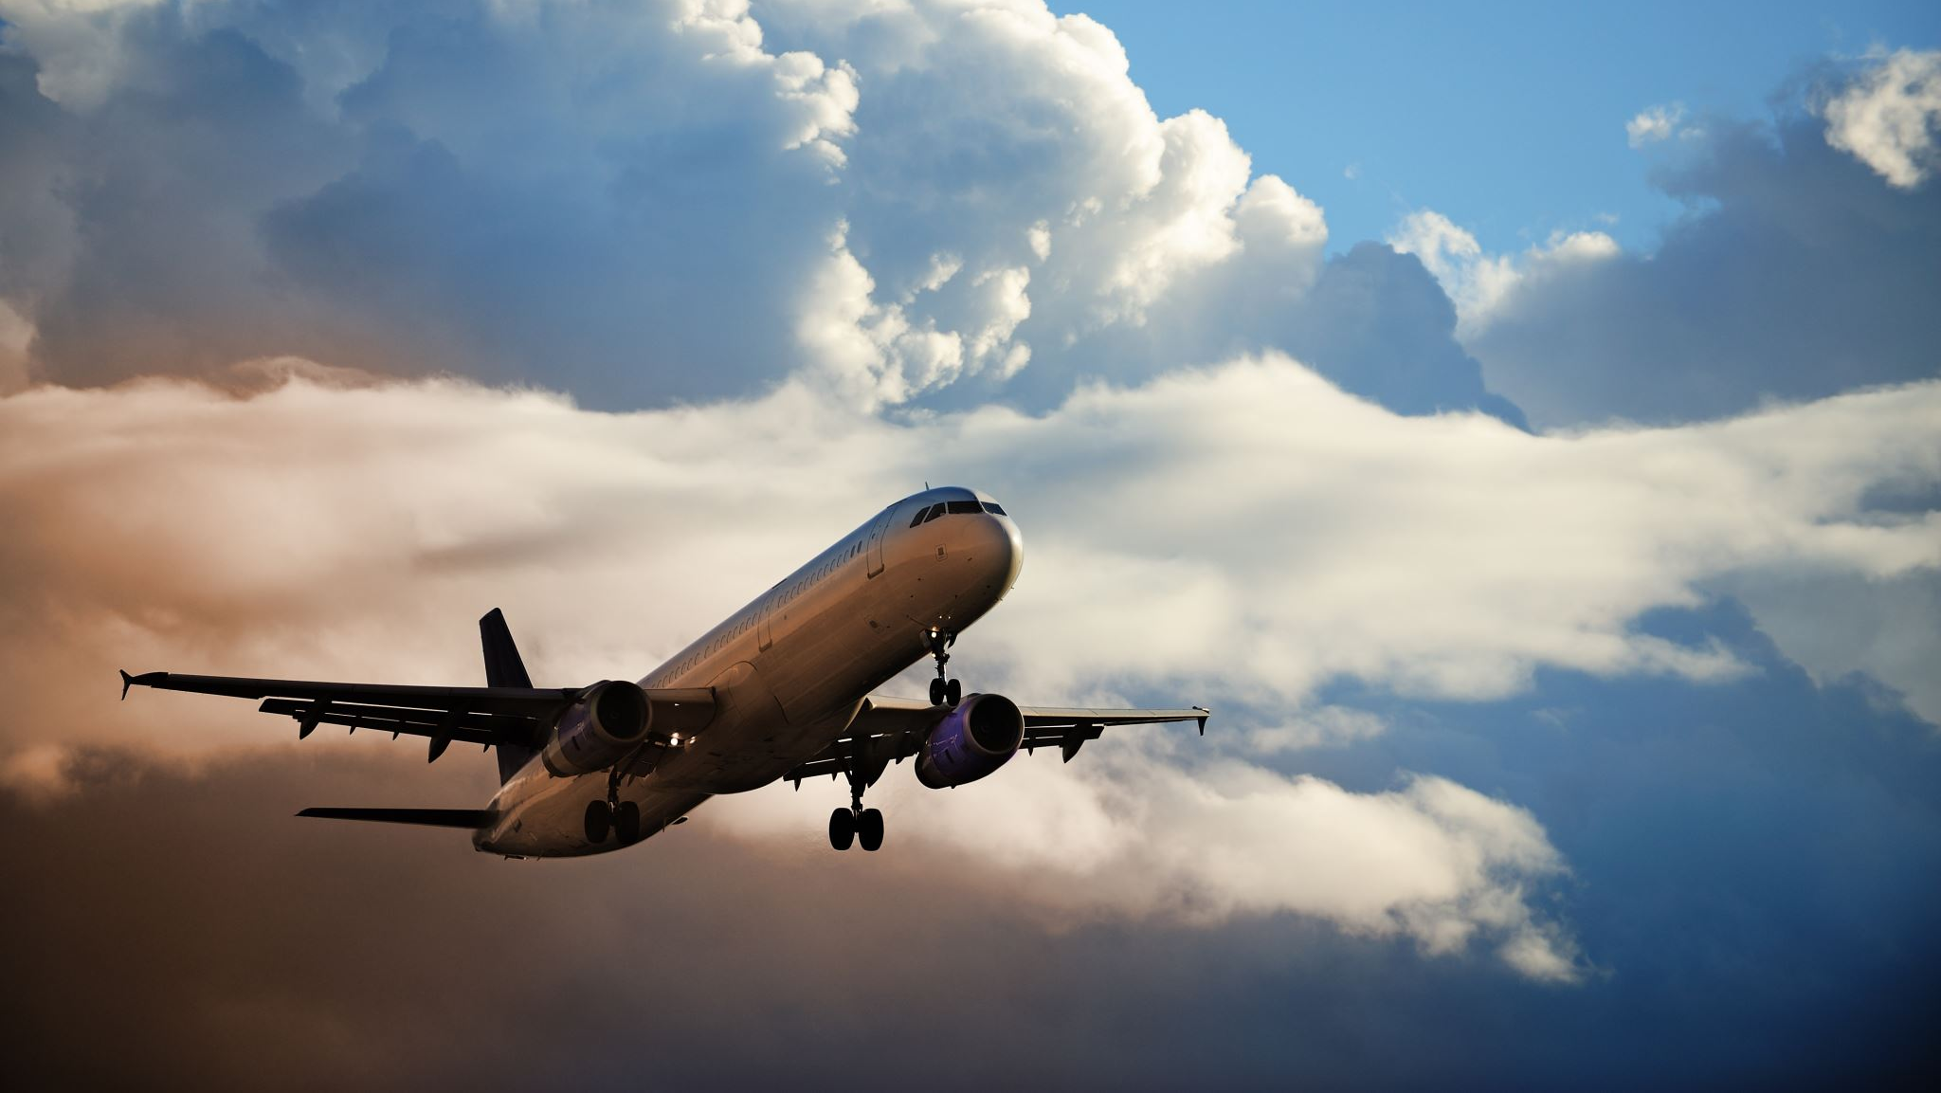
Culture Change – Ryan Air
By Chrysanthos Bikos
2210947
5th December 2023

Slide 2
Introduction
The presentation's goal is to offer suitable methods for assessing Ryan Air’s external environment and culture in order to decide on future strategy and plans for cultural change.
Despite controversies over its business practices, the airline maintained its market dominance through the 2010s, offering affordable travel options and continually expanding its extensive network of destinations across Europe and beyond.
It is evident that an effective organisational culture can draw in top talent. It can get you in front of the brightest people in your field and act as a retention tool for your finest workers (Indeed Editorial Team, 2021).

Slide 3
Models Of Culture
In an effort to explain organisational culture, a number of models and frameworks have been developed, including:
Edgar Schein Model: His most well-known work focuses on organisational culture and career development. His invention of the three levels of organisational culture, known as Schein's Model of Organisational Culture, was one of his key accomplishments.
Deal and Kennedy's Model: Deal and Kennedy, two organisational theorists, created the Corporate Culture Model. Their early 1980s concept focuses on how organisational culture effects performance and effectiveness.
Charles Handy's Model: pioneered several key ideas and concepts in organisational behaviour and management. One of his most noteworthy contributions is the "Four Cultures of Organisations" concept of organisational culture.

Slide 4
Charles Handy's model of organizational culture
Because of its simplicity and ease of comprehension, I have opted to adopt the Charles Handy Model for my Ryan Air presentation.
Organisational culture, as defined by Wong (2023), is the structures, norms, values, and attitudes that guide and shape employee behaviour inside a company.
It is understandable to a broad audience without requiring in-depth understanding of organisational theory since it divides organisational cultures into four categories.
Renowned philosopher Charles Handy, is an expert in organisational culture. Based on Charles Handy's approach, organisations adhere to four distinct sorts of cultures:

Slide 5
Charles Handy's model of organisational culture
Power Culture:
In a power culture, decisions are centralized, and power is concentrated in the hands of a few individuals or a central figure.
Ryanair expanded quickly in a short amount of time thanks to CEO Michael O’Leary’s tight and dynamic strategy and low-cost, low-price business model. Michael O’Leary controls and drives the organisation’s agenda.
Workers should anticipate being "bolloxed" and mistreated for errors while yet receiving substantial rewards for outstanding work.

Slide 6
How does Ryan Air fit within Charles Handy's model?
Role Culture:
Role cultures emphasize formalized structures, rules, and procedures.
Muchall (2023) claims that Michael Corcoran, the man responsible for creating Ryanair's sardonic social media brand, resigned from the airline due to his accusations of a poisonous workplace culture.
Ryanair employees are expected to work in isolation from one another for extended periods of time while being closely supervised by their supervisors.
The supervisors expect all employees to behave professionally, without sharing personal information or forming personal bonds.

Slide 7
How does Ryan Air fit within Charles Handy's model?
Task Culture:
Focus on getting tasks and projects accomplished, often through teamwork and flexibility.
After agreeing to recognise pilots' and cabin crew's trade unions in December—something CEO Michael O'Leary had previously stated he would sooner cut off his hands than accede to—Ryanair faced increased pressure from disgruntled employees (Davies, Farrell 2018).
Numerous cost-cutting initiatives have led to complaints from employees in online forums like Ryanair Don't Care and numerous media pieces denouncing the low-cost carrier's management style (Spritzer, 2023).

Slide 8
How does Ryan Air fit within Charles Handy's model?
Person Culture
This culture prioritises organisations that aim to improve the lives of its people while focusing on the person (Fraraccio, 2023).
“It’s not all work and no play though. Our teams can enjoy our games rooms and giant chess hall — just don’t let the boss catch you there between 8am and 6pm!” (Ryan Air, 2023). Their website features this direct quote that doesn't seem all that inspiring or upbeat.
Profits are the only metric used to determine success, and management of the business is thought to be difficult due to its high standards and paucity of incentives.

Slide 9
Code of Ethics – Ryan Air
What Is a Code of Ethics?
A code of ethics is a set of guidelines intended to support professionals in acting honourably and morally in business ( Hayes, 2023).
Ryan Air Code of Ethics (Ryan Air, 2013) is as follows:
“Employees and candidates will be judged on the basis of their behaviour and qualifications to perform their jobs, without regard to race, gender, religion, disability, age, marital status, sexual orientation, political beliefs or any other characteristic protected by applicable laws.”

Slide 10
Code of Ethics – Ryan Air
It's concerning that Ryan Air's ethics haven't altered or updated since 2013. It is generally accepted as best pactice to have planned reviews at least every two years to make sure the code addresses current concerns and operating procedures.
Poor treatment is now widespread and has long been documented at Ryanair.
Cabin personnel sign on and work for 10 or 12 hours a day but are only compensated for the time spent in the air.
Pilots must pay for their own uniforms, and other staff have been threatened with penalty if they do not'sell' enough things in-flight to enhance income (Manchester 1824, 2017).

Slide 11
Code of Ethics – Ryan Air
Which? has named Ryanair the worst airline for the sixth year in a row, claiming the Dublin-based carrier continues to overcharge passengers with hidden fees (Topham, 2019).
Workers at Ryanair rate the company's culture, pay, perks, work-life balance, management, and job security with three stars (Indeed, 2023). Here are some examples:
“Keep clear and we'll away from Ryanair”
“Toxic workplace”
Tiring, over worked 13hr+ days
Amazing Cabin Crewe staff, shame that they are not valued by their employer and not retained

Slide 12
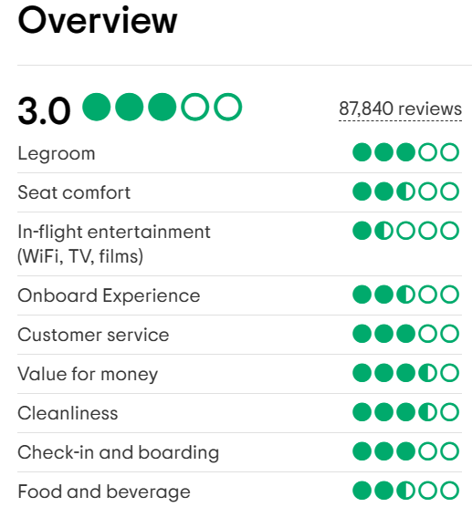
Code of Ethics – Ryan Air
As shown on TripAdvisor (2023), the customer experience score is 3.0, which is considered average!
Ryanair is often associated with providing value for money, primarily due to its low-cost business model.
Despite concerns with staff and customer service, the primary goal of customers is to obtain cheap tickets.

Slide 13
Code of Ethics – Ryan Air
To be very honest, I have had a hard time finding any ethically sound practises regarding Ryan Air employees.
Ryanair's primary focus is on profitability and efficiency, which are important facets of its business plan.
So are all Ryanair workers not happy?
No, not every employee at Ryanair is dissatisfied. A number of employees have expressed employment satisfaction, highlighting the advantages of flexible work hours and opportunities for travel (King, 2023).

Slide 14
Conclusion
In summary, it's difficult to say for sure if Ryanair employees are content. Some workers voice their displeasure with their working environment, yet others find fulfilment in their positions.
Ryanair must pay attention to employee complaints and work towards creating a fair and balanced work environment as it navigates these difficulties moving forward.
Ryan Air's loss of worker productivity and motivation will result in greater demoralisation and uncertainty within the organisation, as well as an increase in workforce turnover.
Hopefully, Ryanair will be able to adapt its culture to match its fist-clenched vow of "always getting better."

Slide 15
Reference List
Davies, R and Farrell, S. (2018)
Ryanair strike: unions accuse airline of breaching labour laws
Available at: https://www.theguardian.com/business/2018/aug/09/unions-accuse-ryanair-of-breaching-labour-law-after-crews-go-on-strike
Accessed: 24th November 2023
Fraraccio, M. (2023)
Management Theory of Charles Handy
Available at: https://www.business.com/articles/management-theory-of-charles-handy/
Accessed: 22rd November 2023
Hayes, A. (2023)
Code of Ethics: Understanding Its Types, Uses Through Examples
Available at: https://www.investopedia.com/terms/c/code-of-ethics.asp
Accessed: 22th November 2023
Indeed (2023)
Reviews
Available at: https://uk.indeed.com/cmp/Ryanair/reviews
Accessed: 25th November 2023
Indeed Editorial Team. (2021)
Available at: https://www.indeed.com/lead/build-great-organizational-culture
Accessed: 23rd November 2023

Slide 16
King, T. (2023)
Are Ryanair employees happy?
Available at: https://ticker.tv/news/are-ryanair-employees-happy/157010/
Accessed: 24th November
Manchester 1824. (2017)
What comes around goes around: Ryanair flight cancellations, corporate governance and (mis)management
Available at: https://www.alliancembs.manchester.ac.uk/news/what-comes-around-goes-around-ryanair-flight-cancellations-corporate-governance-and-mismanagement/
Accessed: 25th November 2023
Muchall, M. (2023)
Ryanair social media manager resigns over company culture
Available at: https://www.hrmagazine.co.uk/content/news/ryanair-social-media-manager-resigns-over-company-culture/
Accessed: 23rd November 2023
Ryan Air (2013)
Ryanair Holdings PLC, Code of Business Conduct & Ethics 2013
Available at: https://www.ryanair.com/doc/investor/2013/code_of_ethics_2013.pdf
Accessed: 24th November 2023
Ryan Air (2023)
Our People
Available at: https://corporate.ryanair.com/about-us/our-people/
Accessed: 22rd November

Slide 17
Spritzer, J. (2023)
RyanAir: An Investigation into Organisational Culture and Management Strategy
Available at: https://jakespritzer.wordpress.com/2017/02/03/ryanair/
Accessed: 23rd November 2023
Topham, G. (2019)
Ryanair ranked 'worst airline' for sixth year in a row
Available at: https://www.theguardian.com/business/2019/jan/05/strike-hit-ryanair-ranked-worst-airline-for-sixth-year-in-a-row
Accessed: 25th November 2023
Tripadvisor (2023)
Overview Customer Reviews
Available at: https://www.tripadvisor.co.uk/Airline_Review-d8729141-Reviews-Ryanair
Accessed: 30th November
Wong, K. (2023)
Organizational Culture: Definition, Importance, and Development
Available at: https://www.achievers.com/blog/organizational-culture-definition/
Accessed: 23rd November 2023

