Slide 1
Topic 3 – Interfaces

Slide 2
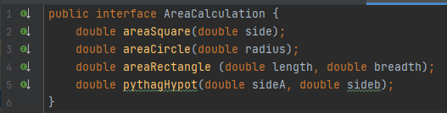

Slide 3
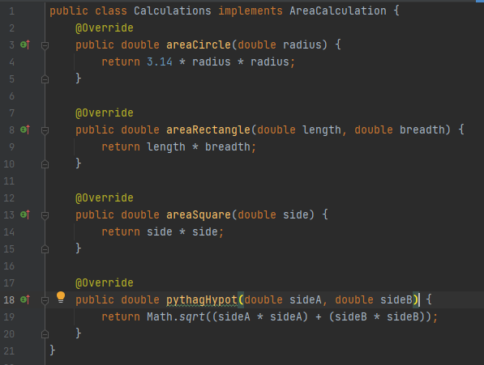

Slide 4
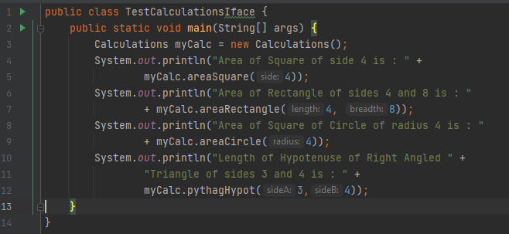

Slide 5
Abstraction Through Interfaces
Using the keyword interface, you can fully abstract a class’ interface from its implementation.
That is, using interface, you can specify what a class must do, but not how it does it.
Once it is defined, any number of classes can implement an interface.
Also, one class can implement any number of interfaces.

Slide 6
Abstraction Through Interfaces
To implement an interface, a class must create the complete set of methods defined by the interface.
However, each class is free to determine the details of its own implementation.
By providing the interface keyword, Java allows you to fully utilize the “one interface, multiple methods” aspect of polymorphism.

Slide 7
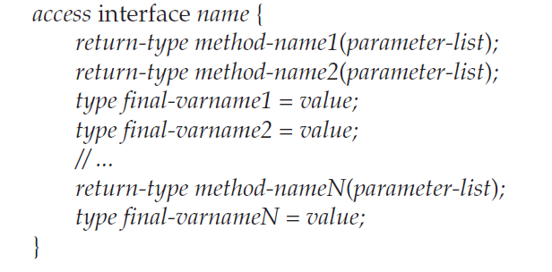
Interface Form
This is the general form of an interface:

Slide 8

Interface Definition
Here is an example of an interface definition. It declares a simple interface that contains one method called callback( ) that takes a single integer parameter.

Slide 9
Interface Form
When no access specifier is included, then default access results, and the interface is only available to other members of the package in which it is declared.
When it is declared as public, the interface can be used by any other code.

Slide 10

Implementing Interfaces
Once an interface has been defined, one or more classes can implement that interface.
To implement an interface, include the implements clause in a class definition, and then create the methods defined by the interface.
The general form of a class that includes the implements clause looks like this:

Slide 11
Implementing Interfaces
If a class implements more than one interface, the interfaces are separated with a comma.
The methods that implement an interface must be declared public.
Also, the type signature of the implementing method must match exactly the type signature specified in the interface definition.

Slide 12
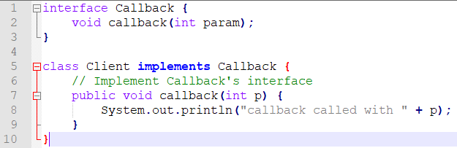
Implementing Interfaces

Slide 13
Implementing Interfaces
It is both permissible and common for classes that implement interfaces to define additional members of their own.
For example, the following version of Client implements callback( ) and adds the method nonIfaceMeth( ):

Slide 14
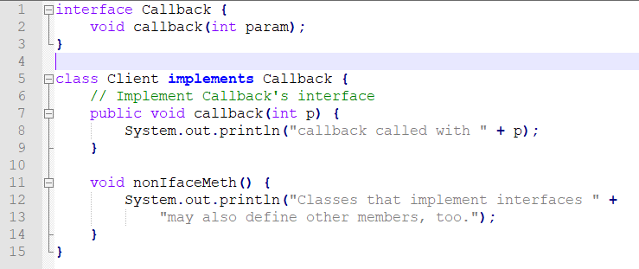
Implementing Interfaces

Slide 15
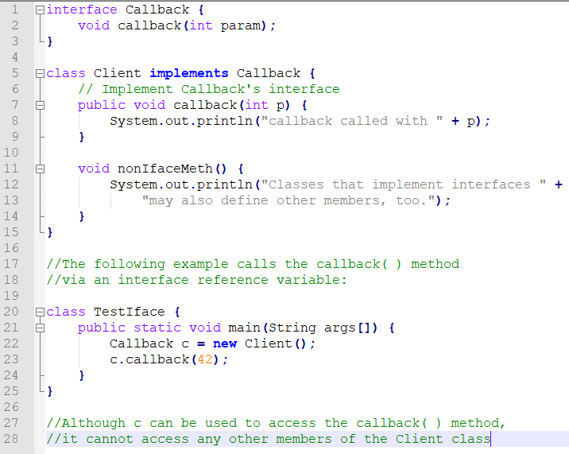

Slide 16
Implementing Interfaces
While the preceding example shows, mechanically, how an interface reference variable can access an implementation object, it does not demonstrate the polymorphic power of such a reference.
To sample this usage, first create the second implementation of Callback, shown on the next slide:

Slide 17
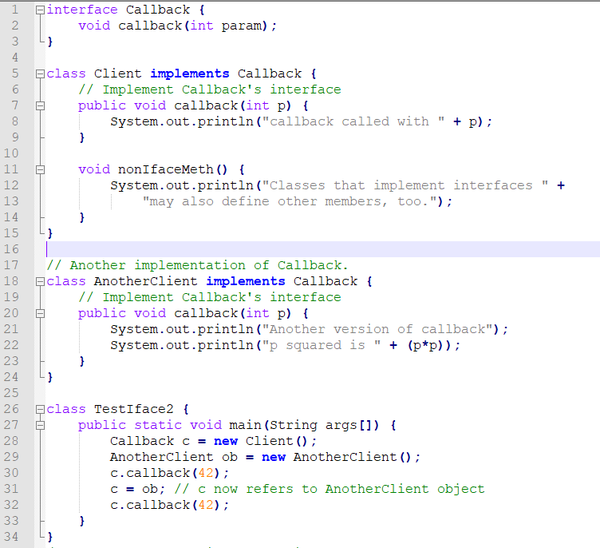

Slide 18
Implementing Interfaces
The output from this program is shown here:
  callback called with 42
  Another version of callback
  p squared is 1764
As you can see, the version of callback( ) that is called is determined by the type of object that c refers to at run time.

Slide 19
Nested Interfaces
An interface can be declared a member of a class or another interface.
Such an interface is called a member interface or a nested interface.
A nested interface can be declared as public,
private, or protected.
This differs from a top-level interface, which must either be declared as public or use the default access level.

Slide 20
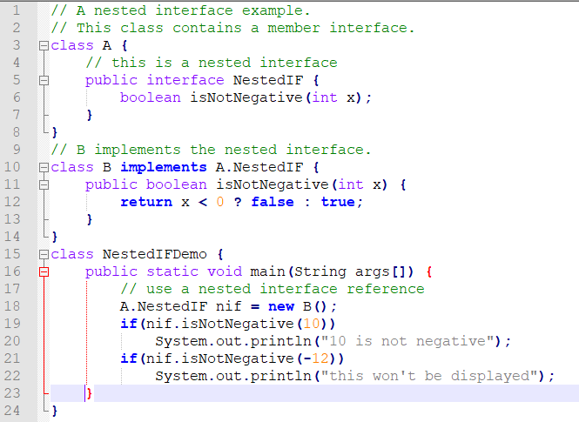

Slide 21
One Interface Two Implementations
The following program creates a class called FixedStack that implements a fixed-length version of an integer stack.
A second program creates a class called IntStack that creates a dynamic stack by use of the same interface definition.

Slide 22
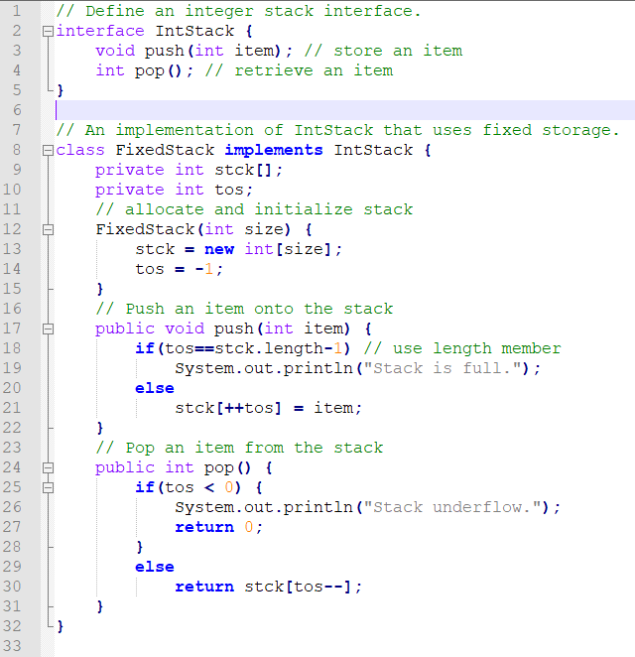

Slide 23
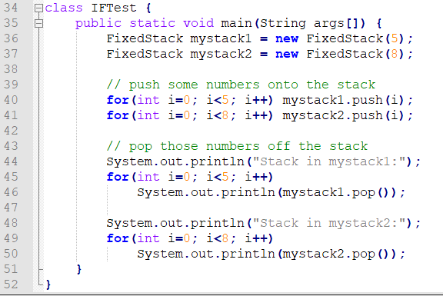

Slide 24
One Interface Two Implementations
Following is another implementation of IntStack that creates a dynamic stack by use of the same interface definition.
In this implementation, each stack is constructed with an initial length.
If this initial length is exceeded, then the stack is increased in size.
Each time more room is needed, the size of the stack is doubled.

Slide 25
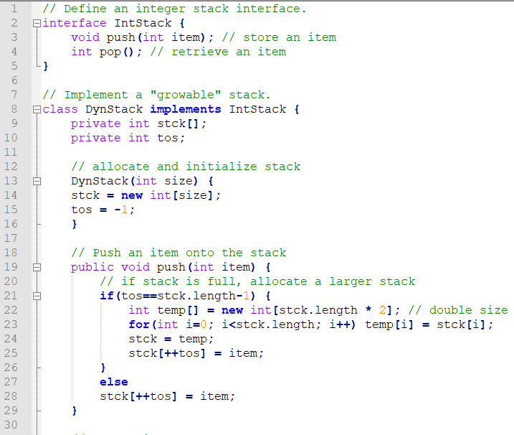

Slide 26
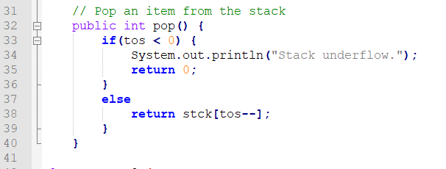

Slide 27
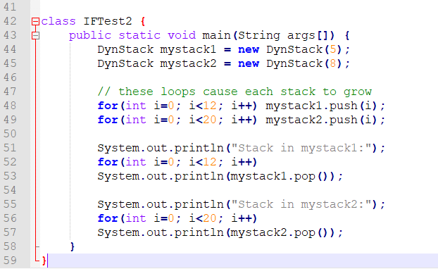

Slide 28
Variables in Interfaces
You can use interfaces to import shared constants into multiple classes by simply declaring an interface that contains variables that are initialized to the desired values.
It is as if that class were importing the constant fields into the class name space as final variables.
The next example uses this technique to implement an automated “decision maker”:

Slide 29
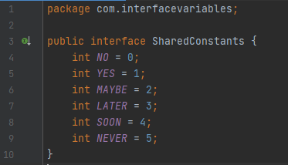

Slide 30
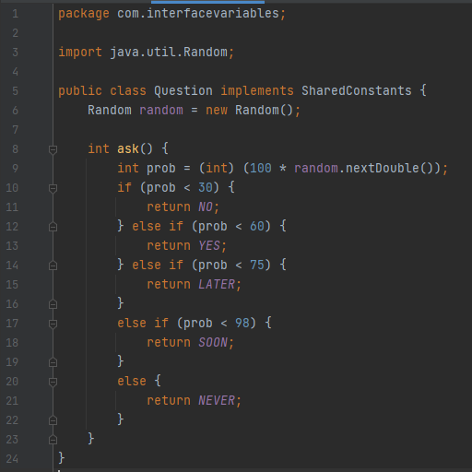

Slide 31
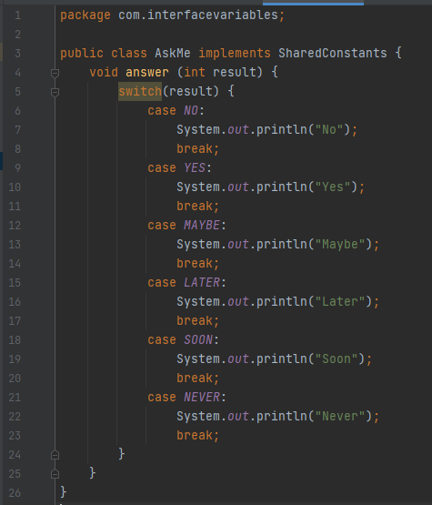

Slide 32
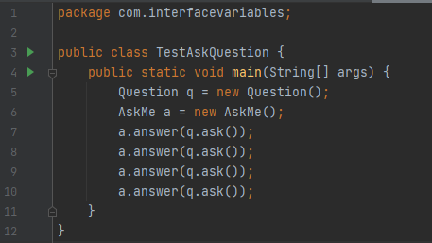

Slide 33
Extending Interfaces
One interface can inherit another by use of the keyword extends.
The syntax is the same as for inheriting classes.
When a class implements an interface that inherits another interface, it must provide implementations for all methods defined within the interface inheritance chain.

Slide 34
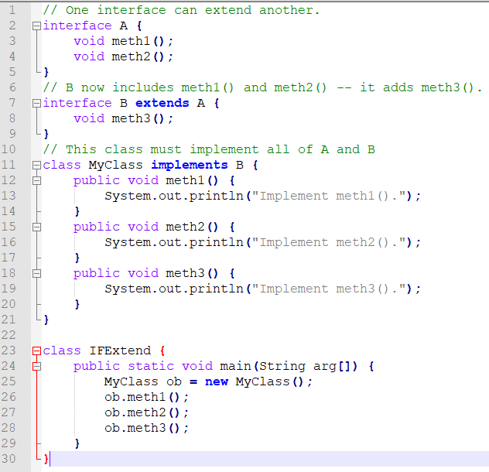

Slide 35
Interface v Abstract Class
Main difference is methods of a Java interface are implicitly abstract and cannot have implementations.
A Java abstract class can have instance methods that implements a default behaviour.
Variables declared in a Java interface is by default final. An abstract class may contain non-final variables

