Slide 1

HOW THE GP SERVICE HAS EVOLVED SINCE 1948
NAME: LARRY OSEI KOFI
STUDENT I.D: 2308809
LECTURER’S NAME: DR DIOLA BIJLHOUT
MODULE NAME(CODE): INTRODUCTION TO HEALTH AND SOCIAL CARE (LCHS4003)

Slide 2

Overview:
Introduction to general practice.
Foundation.
Beginning of developments towards General Practice.
Evolvement of General Practice.
Administrations of the current GP services and past services.
Conclusions
References.

Slide 3

Introduction to general practice:
A General Practitioner is a health personnel that provide people within the community the basic medical care to all forms of minor ailments and then transfer patients that needs severe medical attention to hospitals for proper healthcare treatments (NHS, 2015).

Slide 4
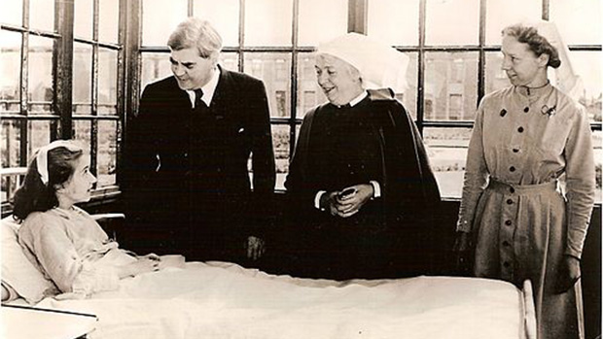
1948
Foundation:
The General Practitioner (GP) system established under the National Health service (NHS) act of 1946, Was implemented in the United Kingdom as a part of the National Health service (NHS) by the then health minister Aneurin Bevan and his colleagues in the post-world war II Labour government in, July 5, 1948 (Bower, 2018).

Slide 5
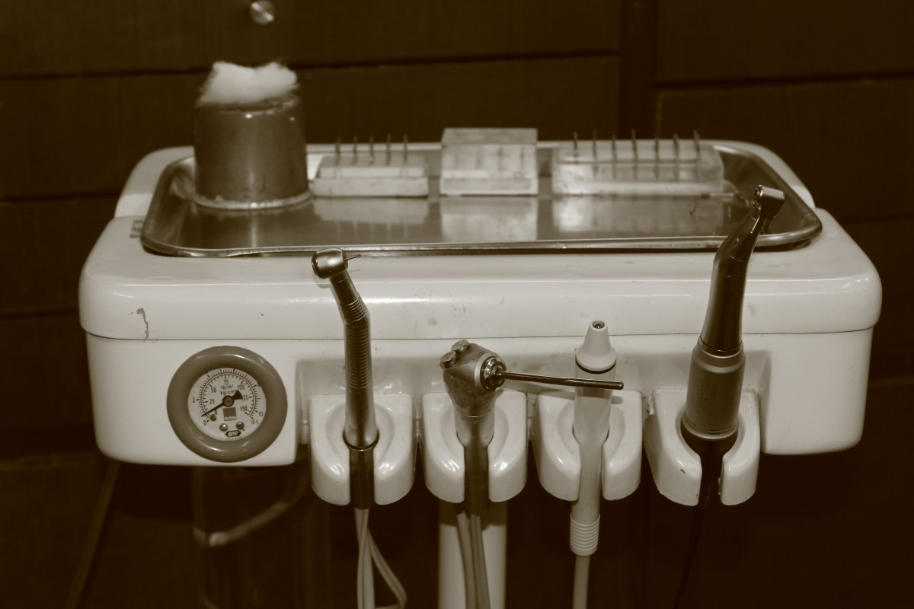
1950-1989
Beginning of developments towards General Practice:
The reports of Joseph Collings about the state of General Practice.
The institution of the Royal College of General Practitioners.
The family doctor charter.
Publishing of the Future General Practitioner: Learning and Teaching.
Use of computers.
Focus on quality.
(Irvine Loudon, Horder and Webster, 1998)

Slide 6

1990-2000s
Evolvement of General Practice:
Expansion on service.
New drugs and prescriptions.
Digitalisation.
Change in their operations.
A Period characterised by rapid development.
(Irvine Loudon, Horder and Webster, 1998)

Slide 7

Administrations of the modern GP services and past services:
MODERN GP SERVICES (BearingPoint, 2023) | PAST GP SERVICES
Strengthened digital connectivity. | Lack of computers and internet connectivity.
Extensive access to meet your GP. | Patient where able to book appoints through telegrams or in person (NHS England, 2018).
Effective workload services. | Less workload service.
Simplified triage and care navigating approach. | Lack of knowledge about tackling issues with different approaches.
Understanding of patients needs. | Lack education.

Slide 8

Conclusion:
In conclusion, General Practice has evolved over the years, and this is a clear information about how the developments in the service came about.
We have again acquired few knowledge about what it means to be a General Practitioner and how it was founded.
Also, the differences between the current GP service and the past GP service.

Slide 9

References:
BearingPoint (2023). Pioneering Modern General Practice. [online] www.bearingpoint.com. Available at: https://www.bearingpoint.com/en-gb/insights-events/insights/pioneering-modern-general-practice/ [Accessed 5 Mar. 2024].
Bower, E. (2018). The NHS at 70: General practice 1948 to 1967. [online] Gponline.com. Available at: https://www.gponline.com/nhs-70-general-practice-1948-1967/article/1485294.
Irvine Loudon, Horder, J. and Webster, C. (1998). General practice under the National Health Service 1948-1997. London ; New York: Clarendon Press.
NHS (2015). General Practitioner. [online] Health Careers. Available at: https://www.healthcareers.nhs.uk/explore-roles/doctors/roles-doctors/general-practitioner.
NHS England (2018). NHS England» the Changing Face of General Practice. [online] www.england.nhs.uk. Available at: https://www.england.nhs.uk/blog/the-changing-face-of-general-practice/.

