Slide 1
Group Project
Introducing to the modern workplace
Lecturer-Uju Ugochukwu
LCBB4003
Presentation worked by: Ana Maria Hasu
Alexandru Csaba Eros
Maria Ion

Slide 2
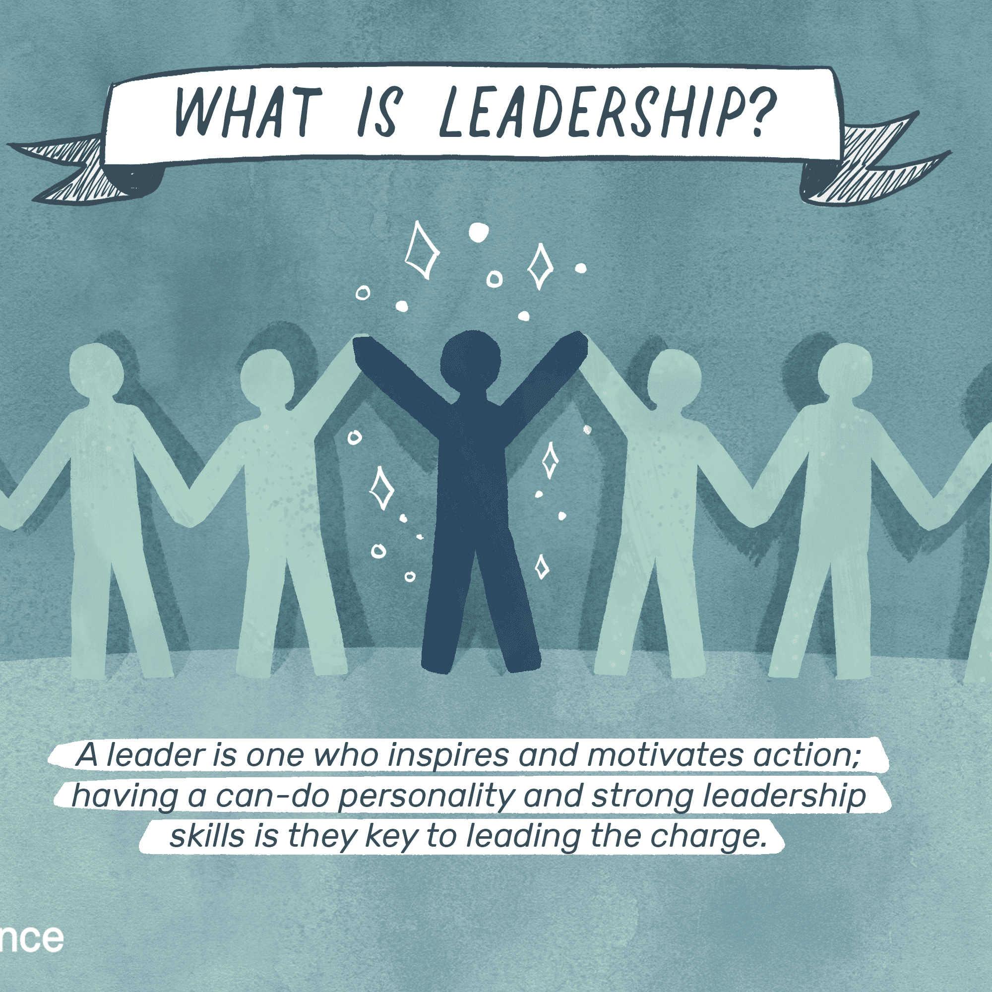
The fundamentals of being willing and equipped to influence others are captured by leadership.

Slide 3
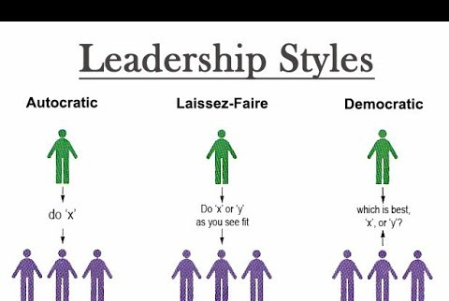
Leadership styles represent the classification of a person behaviour while leading a group

Slide 4
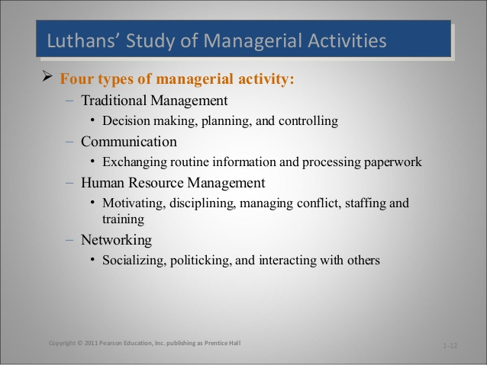
Luthans found four managerial activities and the time which effective managers usually spent on each activity

Slide 5
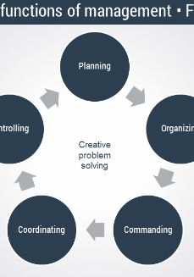
Henri Fayol's "14 Principles of Management" played an important part in modern philosophy of leadership. His practical list of values allowed administrators at the turn of the 20th century to plan and communicate productively with their workers. Fayol’s found six functions of management which go hand t hand with the principles.

Slide 6
Tesco Management
Through more than 2,200 locations, Tesco is the largest retailer. This is the third largest food store in the world, and is varied into finance, insurance and other industries. There are nearly 280,000 workers in the UK and over 460,000 globally. Tesco's biggest success storey is greater understanding, skills and employee loyalty.
The Tesco management developed a collaborative leadership model which is often called member leadership, which listens to the voices of the workers during decision-making processes
Tesco allows staff to provide rewards and incentives such as a wide range of other means of money making, securing their prospects and protecting their wellbeing with a paid holiday, a person's loyalty card given one year after work and a prize pension plan.

Slide 7

A good communication skill is one of the most important characteristics which a leader should have. Leaders need to be able to adapt on the basis of the community with which they interact. An significant component of a leaders list of talents and experiences is strong communication skills.

Slide 8
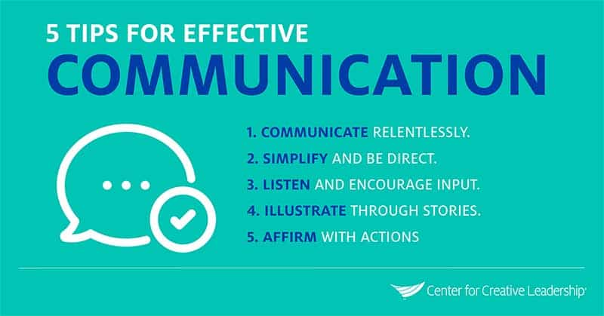
The willingness to listen is an essential element of communication. Communication is a strong characteristic for Tesco company and this helps a lot the leaders to success.

Slide 9
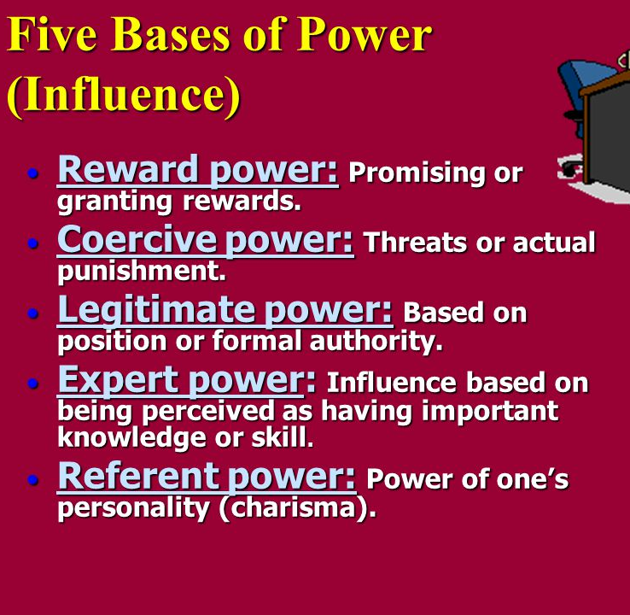
Leadership style:bases of power

Slide 10
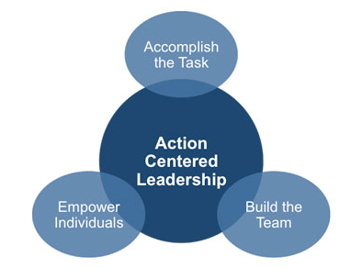
Action Centered Leadership
It highlights the key actions you have to take to effectively lead your team, rather than the type of leadership you prefer. Three areas are grouped into these actions:
Task: the actions you take to accomplish a goal.
Team: the group-level actions to facilitate successful collaboration and cohesion of groups.
Individual: acts that meet the particular needs of each team member

Slide 11
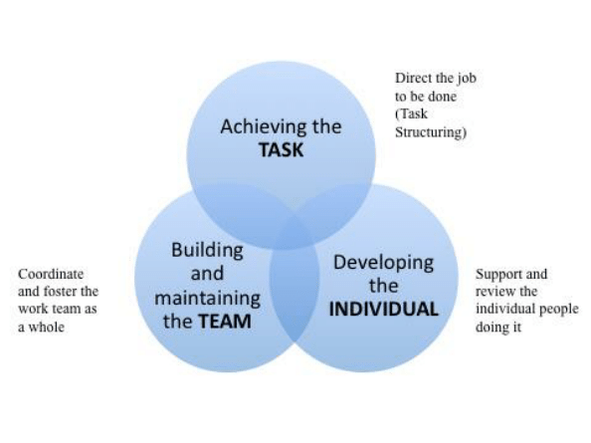
Action Centered Leadership in Practice
1.Develop Your Core Leadership Skills
2.Focus on the Three Key Areas of Responsibility
3.Adapt the Model to Your Situation

Slide 12
Either training is necessary for business development?
It is necessary for growth of Tesco to select right people, in the right place at the right time, and trained them according to the demand of time. What are the requirements for workforce planning?
New setup required new staff with perfect knowledge about customer profiles.
Different type of skilled employee required in-store and non-stores based posts.
Wide-ranging skilled employee performs better then less skilled employees.

Slide 13
Qualities required of people in leadership position
Honesty
Forward -looking
Competent
Inspiring
Intelligent

Slide 14

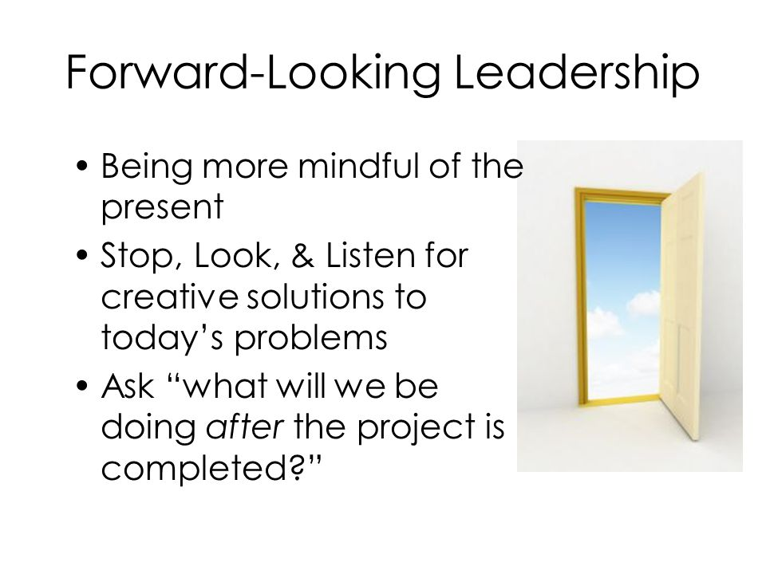

Leadership is forward looking

Slide 15

Tesco’s leadership Traits
the leaders have to discover various qualities, attributes, and characteristics for their functionality as the leaders.
Tesco follows different attributes in order to succeed:
Command
Group influences
Coolness
Judgment

Slide 16
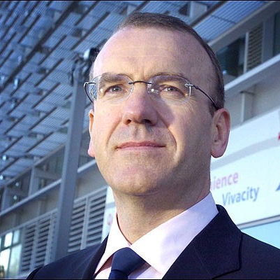
Transformational leadership at Tesco
Tesco Company is considered as the most successful company
The C.O.E Terry Leahy believes in a sample of things that the leaders should offer to their employees to sustain and make them effective. This includes:
interesting job to do
Respect
A friendly boss who helps

Slide 17


Business strategies of Tesco
The success of Tesco is attached to:
Powerful brand:
The company is customer cantered.
its prices are flexible and fit all the customers.

