Slide 1
LCBB4006
Academic Skills
Time Management

Slide 2
Aims of this session:
Define Time-Management
Understand the importance of effective time management to successful study
Introduce a range of time-management techniques
Setting SMART goals

Slide 3
Discuss
In pairs or small groups, write a definition of time-management and discuss why time-management is important.

Slide 4
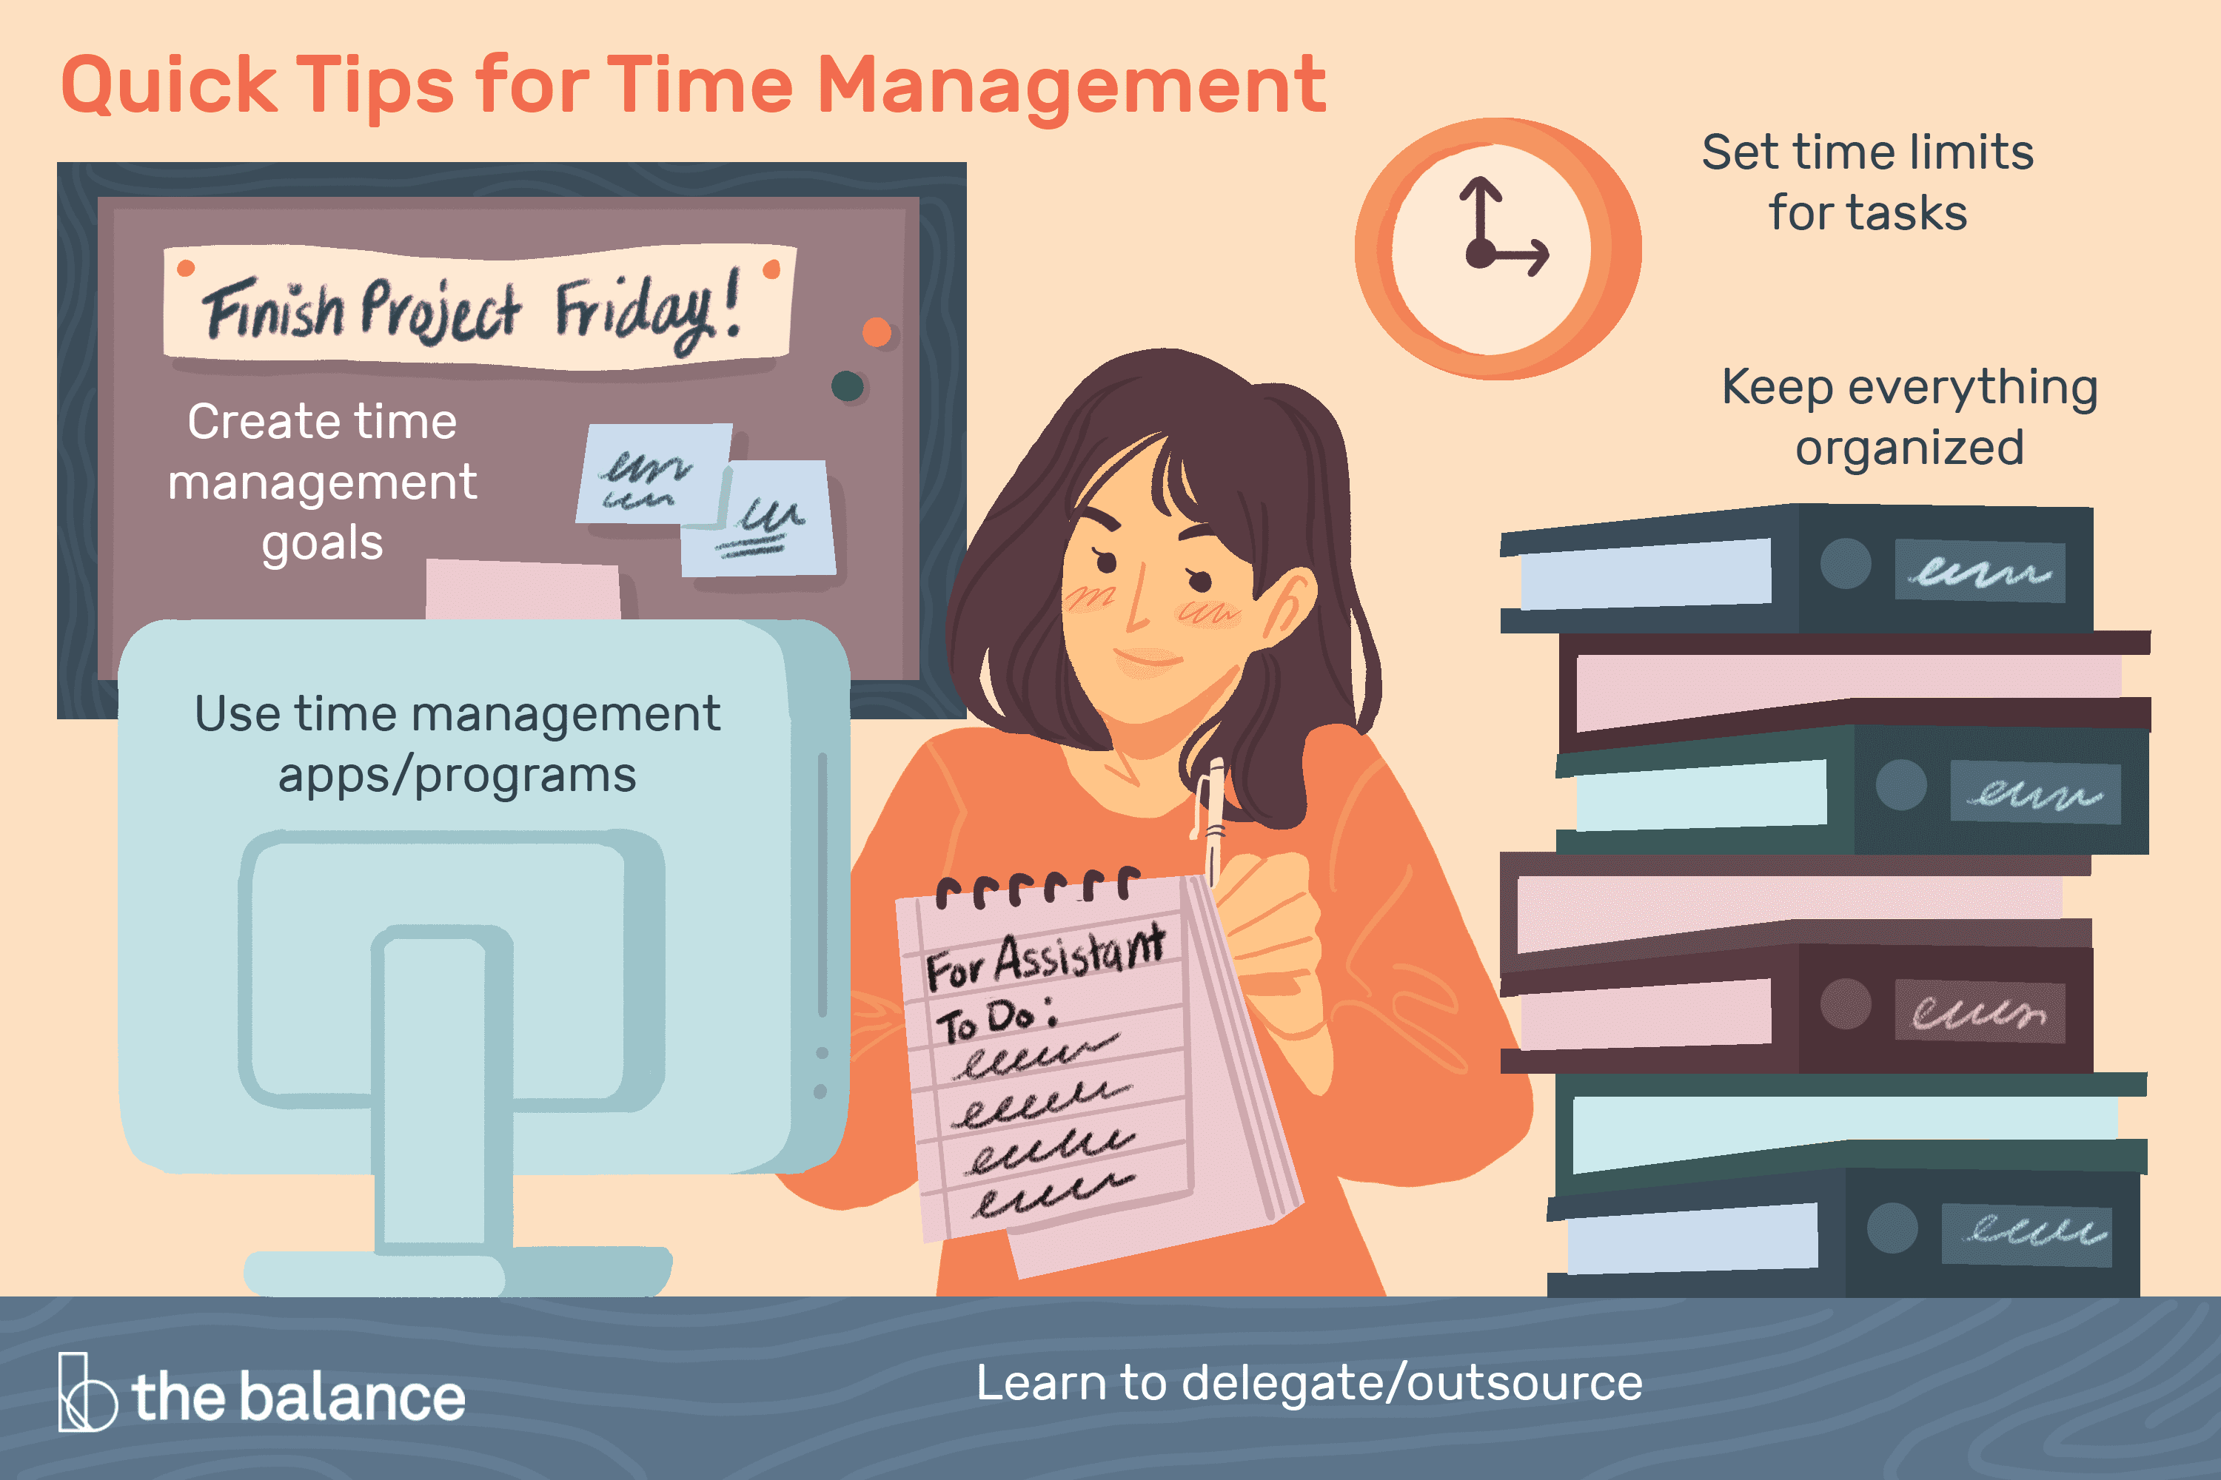
Time Management
Allocating time to study
Using that time effectively
Balancing the time requirements of different aspects of your life

Slide 5
Importance of time management
Time management increases your productivity and efficiency.
Time management can give you a sense of fulfilment.
Time management can decrease stress and anxiety.
Time management allows you to prioritise and complete activities to deadlines.
  (Cottrell, 2018)

Slide 6

Which activities take time?
Scheduled sessions
Study (1-3 hours for every hour spent in class)
Work
Family
Sleep (50-60 hours per week)
Eating
Commuting
Recreation
Other

Slide 7
Basic time management principles
You should direct your effort appropriately, that is, towards the things that are most important
You should direct your effort efficiently, that is, maximise what is achieved by the expenditure of time and energy
You should reduce time wastage
(Cameron, 2002)

Slide 8
Activity 1: Review your use of time
Do I use time efficiently?
How do I waste time?
What or who distracts me from study?
Do I need to plan out my time: for the year? The term? The week? The day? Each piece of work?
Do I waste time getting started?
Do I make the most of spare moments?
Do I find time passes and I don’t know what has happened?
For each question answer honestly and consider if you need /want to make improvements and what they might be.
(Cottrell, 2019)

Slide 9
Daily time management
List what you need to do within a certain time span
Prioritise all these activities (high, medium and low)
Estimate time requirements
Add in lunch and other ongoing activities
Allow time for planning and problem solving
Allow for delays and interruptions!
Draw up action logs or “trackers”
Review, replan etc. and manage this list

Slide 10
Organisation and time management
Being organised as a tool in effective time management
Diaries
Action logs – work plans/ trackers
Lists
Tidy workspace
Organised paperwork
Filing systems
What methods / tools do you use to organise your time?

Slide 11


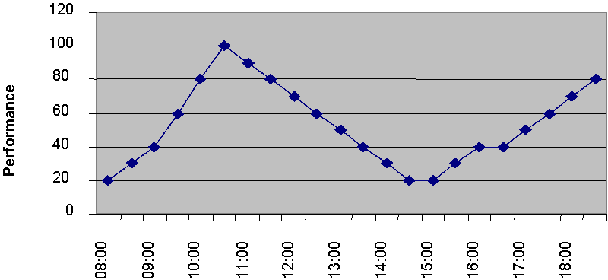
Your natural body clock
During the course of the day there are peak times for your performance.
During this time, high importance tasks.
You know what works best for you. Don‘t force yourself to work against your natural instincts

Slide 12
Tools
To-Do Lists
The Eisenhower Method/Matrix
Pomodoro Technique
SMART Goals

Slide 13

To-Do List
Image source: https://blog.hubspot.com/marketing/organize-to-do-list

Slide 14
To Do lists - Daily
Activity | Time Required | Priority | Time | Activity
 |  |  | 7:00 AM
 |  |  | 8:00 AM
 |  |  | 9:00 AM
 |  |  | 10:00 AM
 |  |  | 11:00 AM
 |  |  | 12:00 PM
 |  |  | 1:00 PM
 |  |  | 2:00 PM
 |  |  | 3:00 PM
 |  |  | 4:00 PM
 |  |  | 5:00 PM
 |  |  | 6:00 PM
 |  |  | 7:00 PM

Slide 15
To Do lists - Weekly
Monday |  | Tuesday |  | Wednesday |  | Thursday |  | Friday
Time | Activity | Time | Activity | Time | Activity | Time | Activity | Time | Activity
7:00 AM |  | 7:00 AM |  | 7:00 AM |  | 7:00 AM |  | 7:00 AM
8:00 AM |  | 8:00 AM |  | 8:00 AM |  | 8:00 AM |  | 8:00 AM
9:00 AM |  | 9:00 AM |  | 9:00 AM |  | 9:00 AM |  | 9:00 AM
10:00 AM |  | 10:00 AM |  | 10:00 AM |  | 10:00 AM |  | 10:00 AM
11:00 AM |  | 11:00 AM |  | 11:00 AM |  | 11:00 AM |  | 11:00 AM
12:00 PM |  | 12:00 PM |  | 12:00 PM |  | 12:00 PM |  | 12:00 PM
1:00 PM |  | 1:00 PM |  | 1:00 PM |  | 1:00 PM |  | 1:00 PM
2:00 PM |  | 2:00 PM |  | 2:00 PM |  | 2:00 PM |  | 2:00 PM
3:00 PM |  | 3:00 PM |  | 3:00 PM |  | 3:00 PM |  | 3:00 PM
4:00 PM |  | 4:00 PM |  | 4:00 PM |  | 4:00 PM |  | 4:00 PM
5:00 PM |  | 5:00 PM |  | 5:00 PM |  | 5:00 PM |  | 5:00 PM
6:00 PM |  | 6:00 PM |  | 6:00 PM |  | 6:00 PM |  | 6:00 PM
7:00 PM |  | 7:00 PM |  | 7:00 PM |  | 7:00 PM |  | 7:00 PM

Slide 16
Eisenhower Matrix
Watch this video ‘Setting Priorities with Eisenhower Matrix’
https://www.youtube.com/watch?v=49ao86ETaSo&ab_channel=ExpertAcademy (5 mins)
Discuss the importance of the Eisenhower Matrix

Slide 17
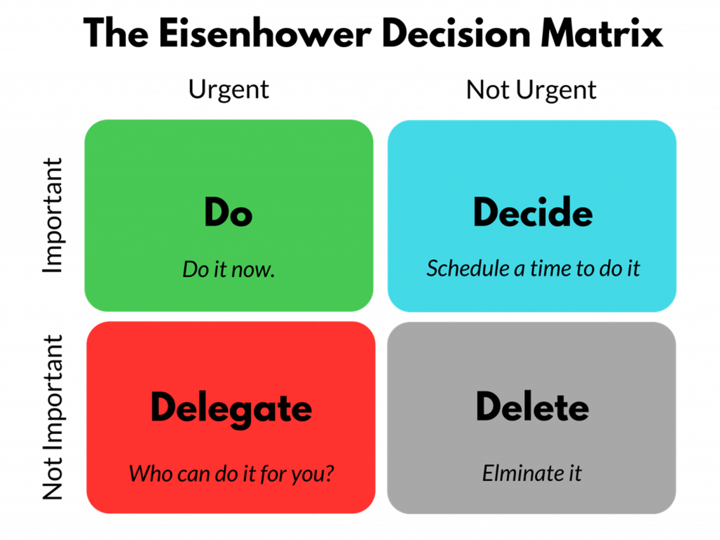

Slide 18
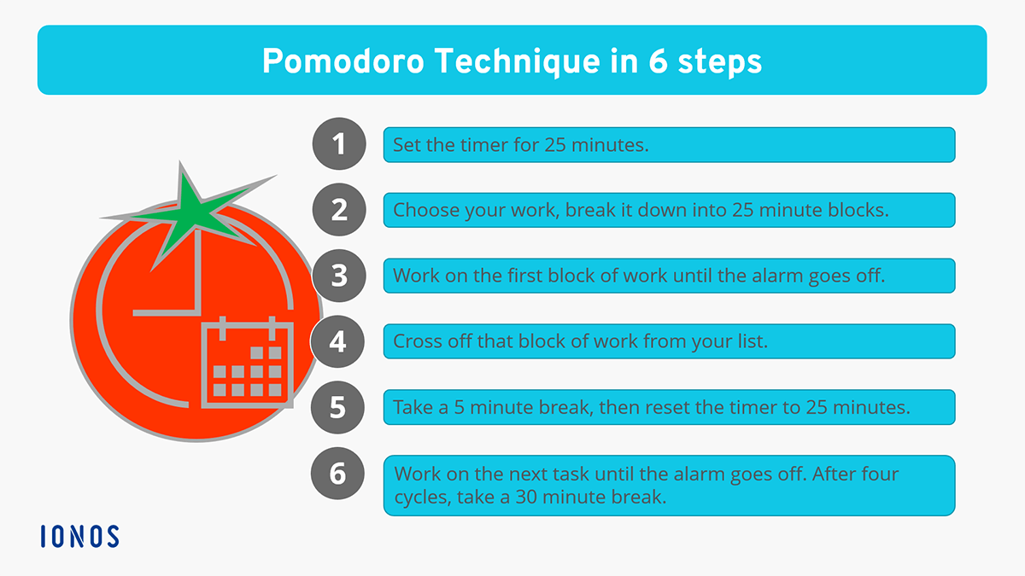
Pomodoro Technique

Slide 19
How to Set SMART Goals
Watch this video from MindTools:
https://www.youtube.com/watch?v=OXA6gfzFA24&ab_channel=MindToolsVideos (2:45)

Slide 20
Setting SMART Goals
S
Specific
M
Measurable
A
Achievable
R
Realistic
T
Time-Related

Slide 21
Activity 2: setting goals
Write down which goal you want to achieve:
within 1 month
within 1 year

Slide 22
Activity 3: Time management review
Think back over the past two days and make a list of how you spent your time
Add it up – how much time did you spend on each activity
Review your priorities
Review your use of time

Slide 23
Time management process: To-Do lists, Prioritisation and Reviewing Progress
1. List activities
Tasks, meetings, daily routines,things you did not do yesterday
2. Time required for each activity
Estimate if needed
3. Reserve time for interruptions
Remember the 70-30 rule, only plan 70% of your day
4. Set priorities – Eisenhower Method
What has to be done today? Sort out the important from the urgent
5. Monitor your results
Cross off your tasks as you do them (gives you a sense of success!), if you have not achieved your plan, assess why not and replan for the following day.

Slide 24
REFERENCES
Cameron, S. (2008) The Business Student's Handbook: Skills For Study And Employment. 4th edn. Harlow: Pearson Education.
Cottrell, S. (2019). The study skills handbook. 5th edn. London: Red Globe Press.

Slide 25
Useful sources
Entrepreneur Handbook (2019) ‘7 proven time management tips for busy managers’. https://entrepreneurhandbook.co.uk/7-proven-time-management-tips-for-busy-office-managers/
Mindtools (2019) ‘What Is Time Management?’ https://www.mindtools.com/pages/article/newHTE_00.htm
Zantal-Wiener, A. (2016). ‘How to Make the Most of Your To-Do List: 7 Styles to Try’. Available at: https://blog.hubspot.com/marketing/organize-to-do-list
and more on Moodle

