Slide 1

- to develop your understanding of how progression steps are used within the Expressive Arts AoLE
- to be able to use your knowledge of the Curriculum for Wales to devise art-based projects
Session aims:
Notes:
Task: Access Hwb Expressive Art AoLE
https://hwb.gov.wales/curriculum-for-wales/expressive-arts/statements-of-what-matters/
Set up Teams rooms with your peers. If possible, I recommend you group into the phase you will be teaching in. E.g.
Group 1: Foundation Phase
Group 2: Years 3 & 4
Group 3: Years 5 & 6

Slide 2
These are the headings for the statements of what matters within the Expressive Arts AoLE, The statements of what matters underpin all activity within the AoLE.
Exploring the expressive arts is essential to developing artistic skills and knowledge and it enables learners to become curious and creative individuals.
Responding and reflecting, both as artist and audience, is a fundamental part of learning in the expressive arts.
Creating combines skills and knowledge, drawing on the senses, inspiration and imagination.
Notes:
This task is to familiarize yourself with EA AoLE and the vocabulary used. Additionally, this should encourage understanding that as teachers there is a ‘creative process’ associated with the EA and components of each are required to provide a full & meaningful EA experience.
There is no ‘correct’ answer and this is an opportunity to discuss and become familiar with the statements. I would choose;
EXPLORING
RESPONDING & REFLECTING
CREATING
Task: 10 minutes in pairs/groups: Use the HWB area and the information below each of the what matters statements to think about what types of activities you might need to plan for an EA project. For example, research an artist, compare two artists whose work is similar but different, draw with a range of different materials etc

Slide 3
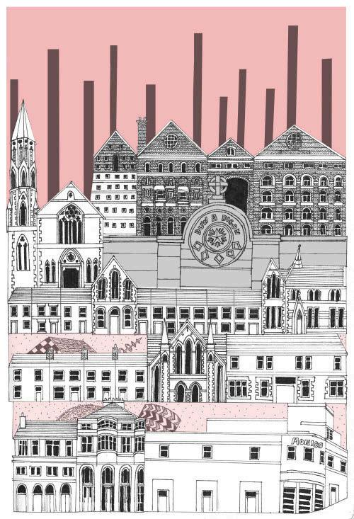
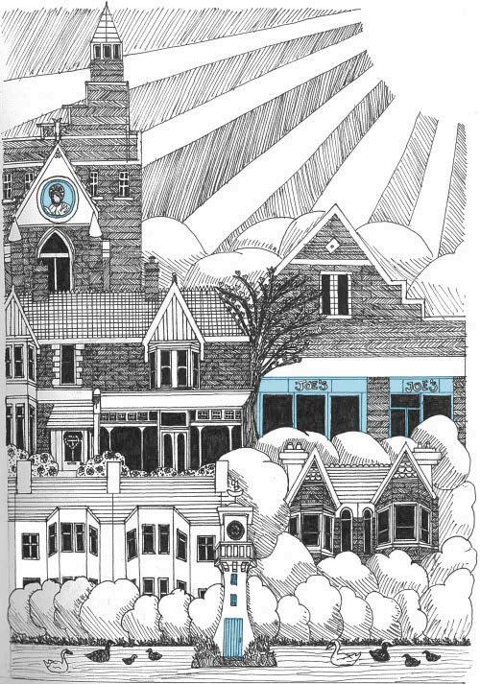
Year 6 Eisteddfod work inspired by Welsh illustrator Efa Lois
Efa Lois – Arlunydd | Illustrator
Notes:
Subject matter: city/townscape
Line, outlines subject matter
Blocks of pastel colour
Colour distributed evenly throughout the pictures
Pattern & detail within the buildings
Definite skyline
Advanced: Composition, sky makes up approximately 1/3 of the image of each

Slide 4
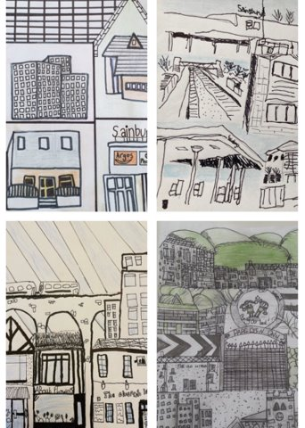
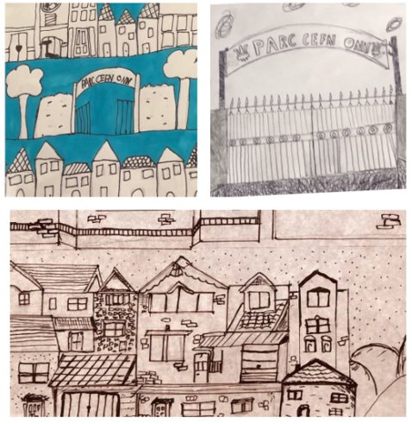
Notes:
These are artworks created by Year 6 learners following research into the work of Efa Lois. Can you pick out the visual techniques adopted? What are these? What about this strength of drawings? Are some more sophisticated than others?

Slide 5

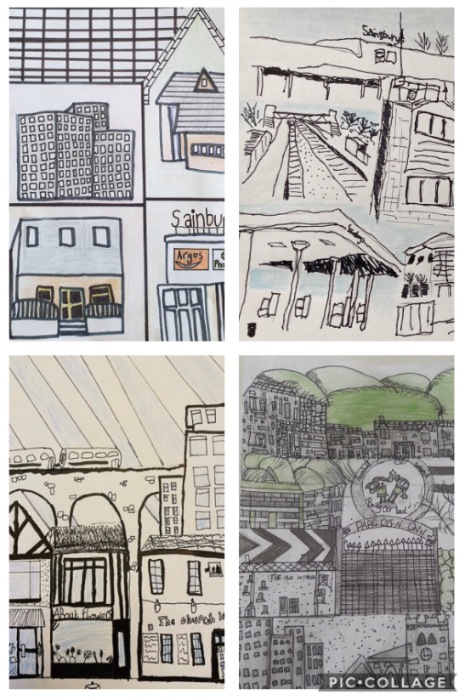
a.
Which artwork is most successful? Why?
b.
c.
Notes:
Task: Discuss 10 mins: Consider which artwork is most successful if learners have been studying Efa Lois? Why? Try to put them in order from top to bottom. They may wish to refer to the visual components identified in the previous slide. I would place them in the following order;
c: This learner has used the line, dispersed colour throughout the image and used the 1/3 of the image as sky/background (composition). Buildings chosen are drawn in a way that reflects local environment.
a: This learner has thoughtfully dispersed the one colour evenly throughout. The drawings are less detailed however some use of pattern ( I actually like this image most however as a work imitating artist techniques it wouldn’t be considered as successful)
b: The learner hasn’t connected the drawings but has imitated the use of line. The use of colour doesn’t show understanding of selecting just one colour.
Task: 15 minutes: Refer to the descriptions of learning including the progression steps. In groups or pairs, pick out which of the steps they have addressed in this task. Can they ‘place’ the works within one of the steps? What advice would they give each learner to ensure progress is made?

Slide 6
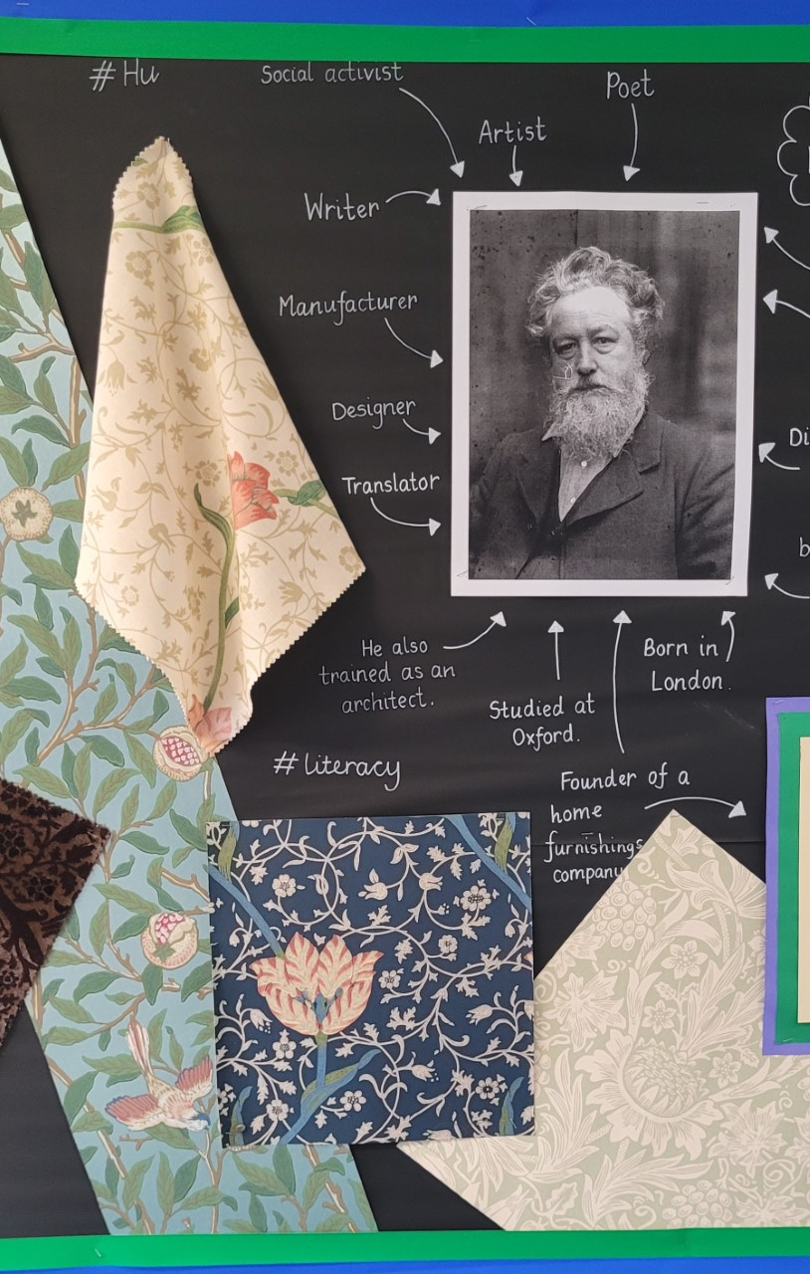
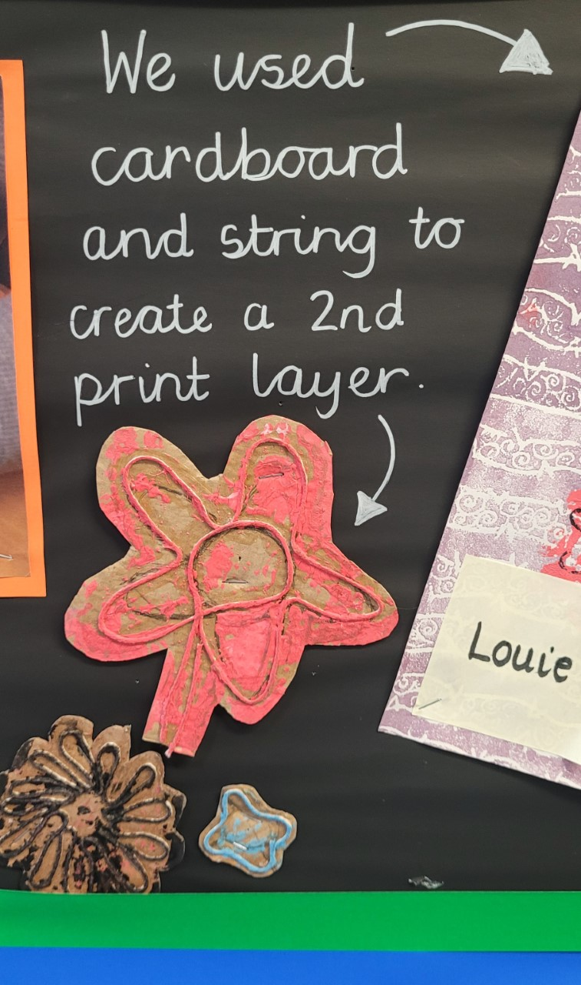
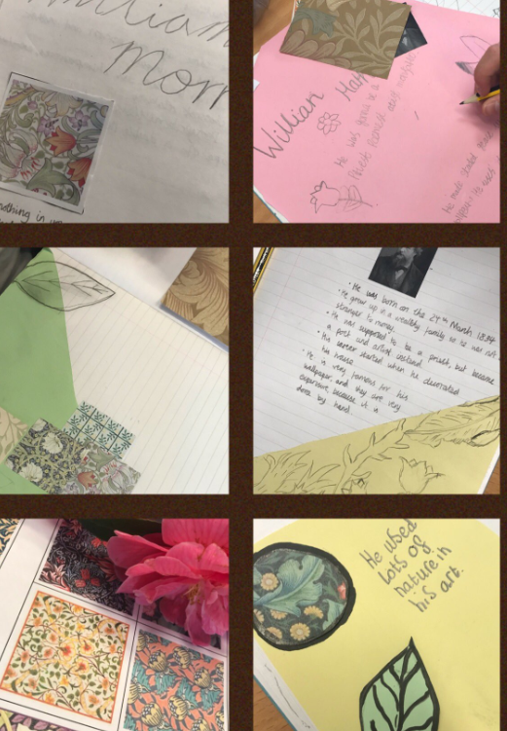
Notes:
Expressive Arts provision must not be tokenistic. It must include opportunities for progression. This is an art project into textile designer William Morris. During the project learners have;
- researched the artists (literacy)
made connections to his Welsh heritage
drawn from observation of organic form from their own environment (Cynefin)
used numeracy skills to create pattern (next slide)
explored printmaking techniques
had the opportunity to learn through exploration, trial and error of printmaking techniques, built resilience

Slide 7
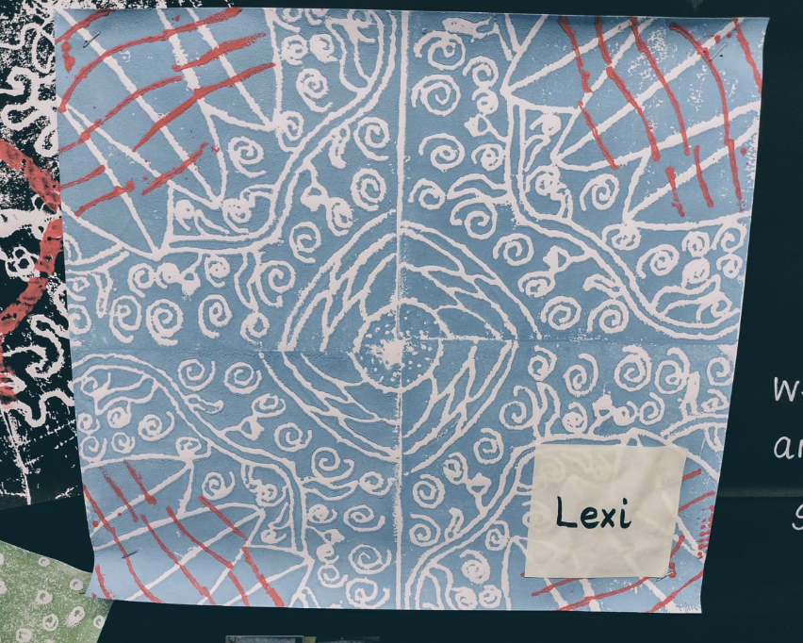
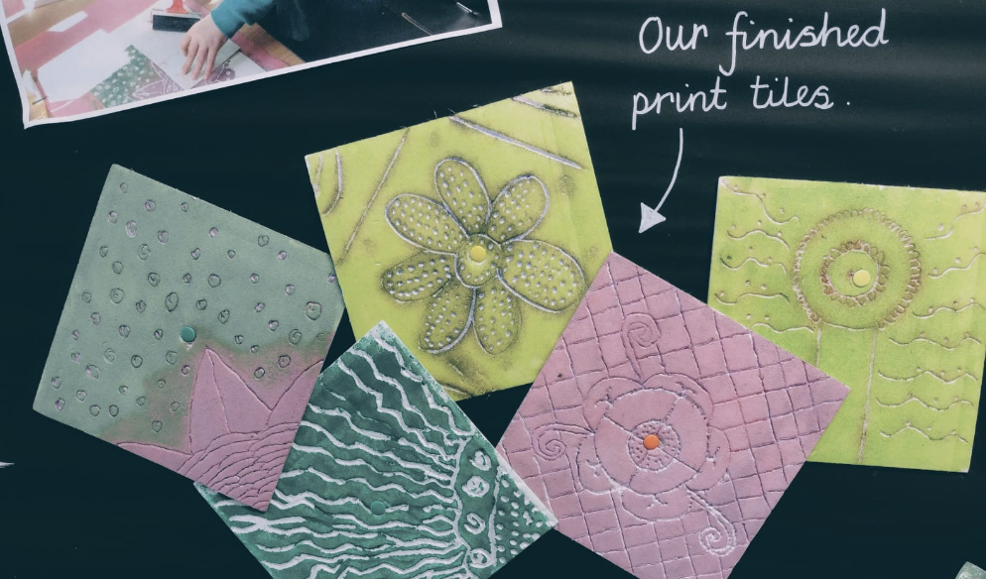

Slide 8
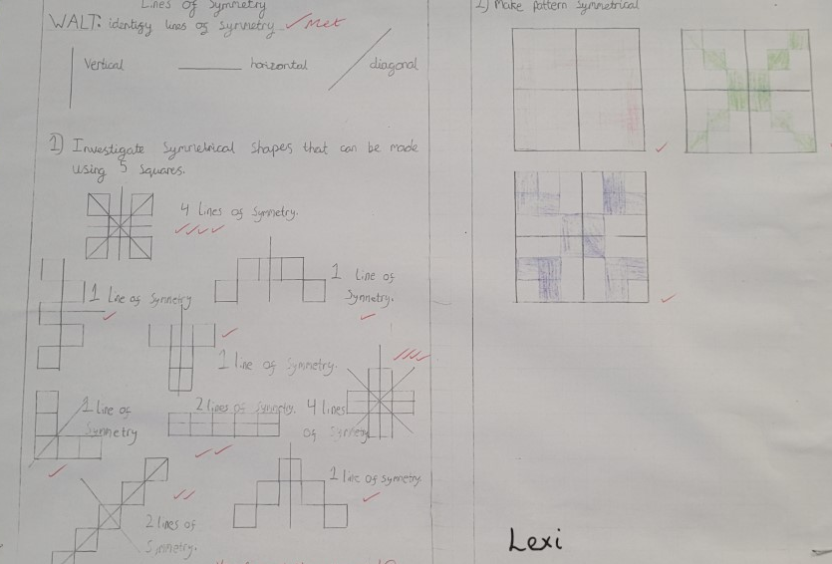
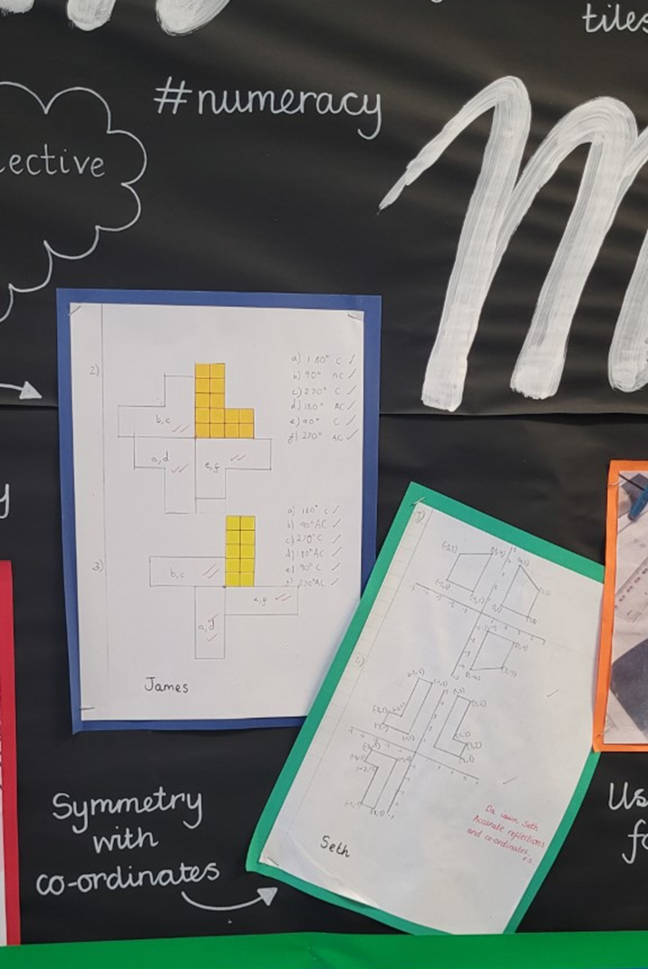
Numeracy
Notes:
Investigation of symmetry and co-ordinates to create pattern

Slide 9
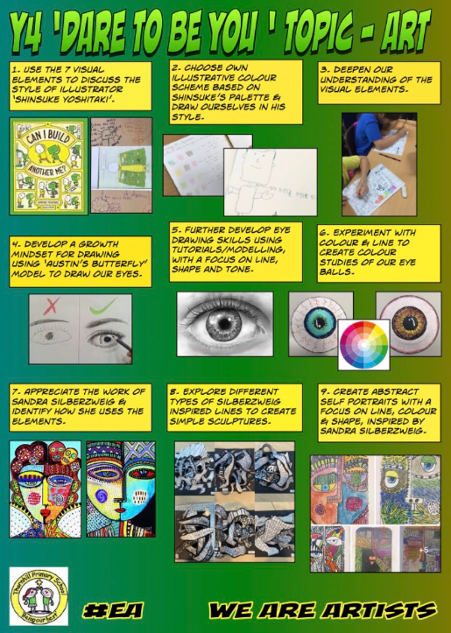
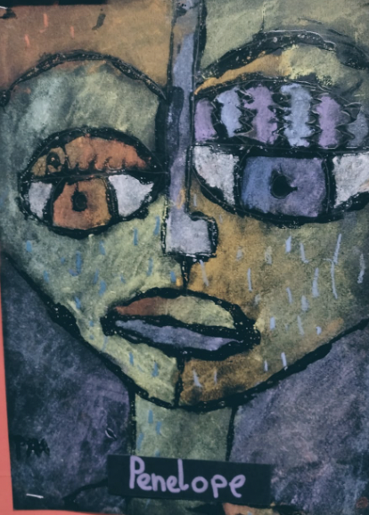
Notes:
Task: Use the what matters statements to identify the creative process and learning illustrated in this Year 4 project

Slide 10
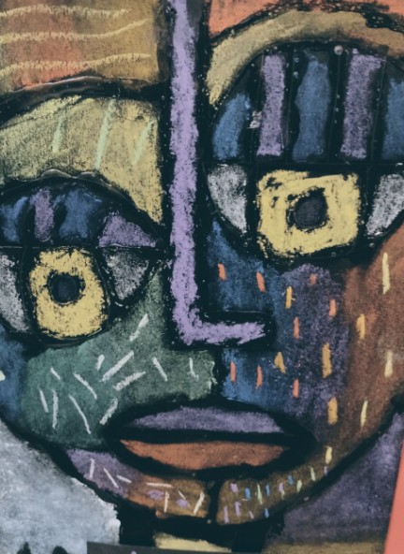
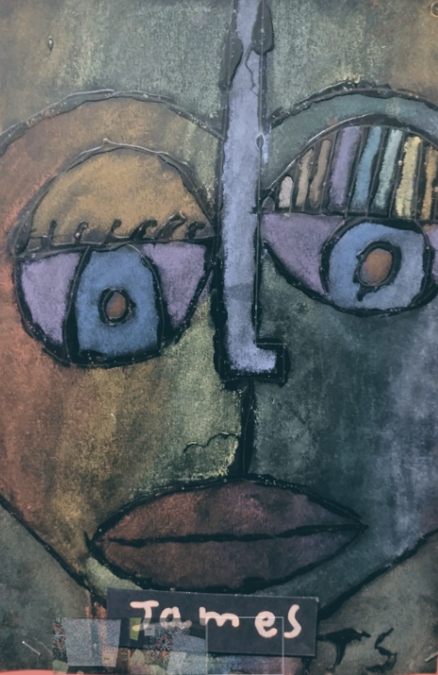
Notes:
Look at the progression steps. How would you advise each learner to make progression?

Slide 11
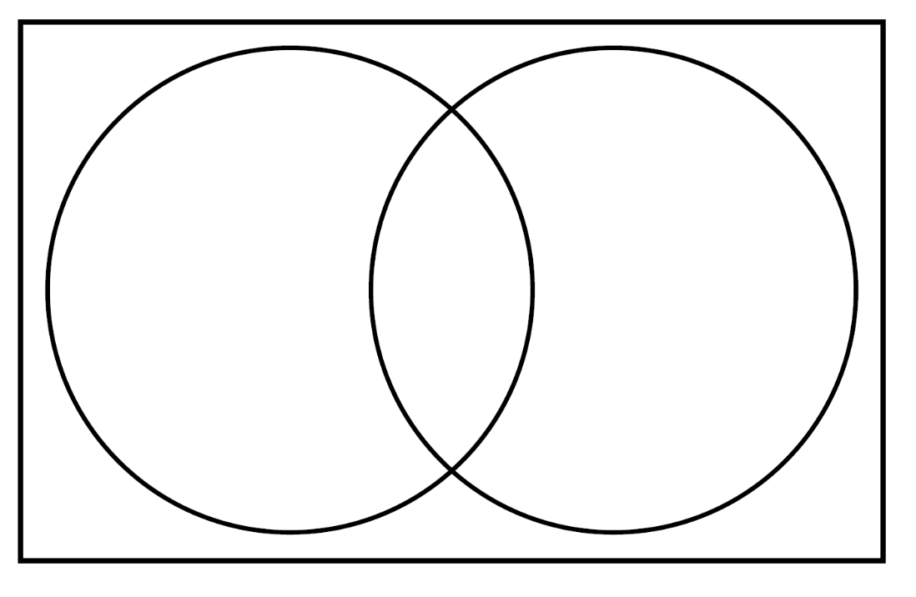
Planning an Art project
Stage 1: Research
The Red Dress Project
The Welsh Blanket
Both
Notes:
This is just ONE way of planning an Art project….there are many.
For this project, which we will continue with in our next session, we are going to start with two contextual starting points; The Red Dress project and Welsh blanket design https://reddressembroidery.com/ and https://www.celfadylunio.cymru/home/patterns/welsh-blankets/
Over the next hour you will find out as much as you can about the artworks and begin to consider how you might devise an innovative and phase appropriate task to use in your classroom.
Task: 30 mins In pairs/groups (it may be appropriate to pair/group up with someone who will be working in the same phase)
Research the starting points and populate the Venn diagram demonstrating individual facts and shared information. E.g. The Red Dress, has random pattern designs BOTH, have pattern, Welsh Blanket, has a repeated, often geometric, pattern.
Task 2: 30 minutes Group students dependent on their phase or FP/Yrs 3-4/Yrs 5-6. Devise a creative and engaging task that would suit the phase you are working in to research one of the artworks. Share a description of this on the Padlet provided (next slide).
E.g.
Hot seating
Write a ‘listicle’
Interview the artist as a news reporter

Slide 12
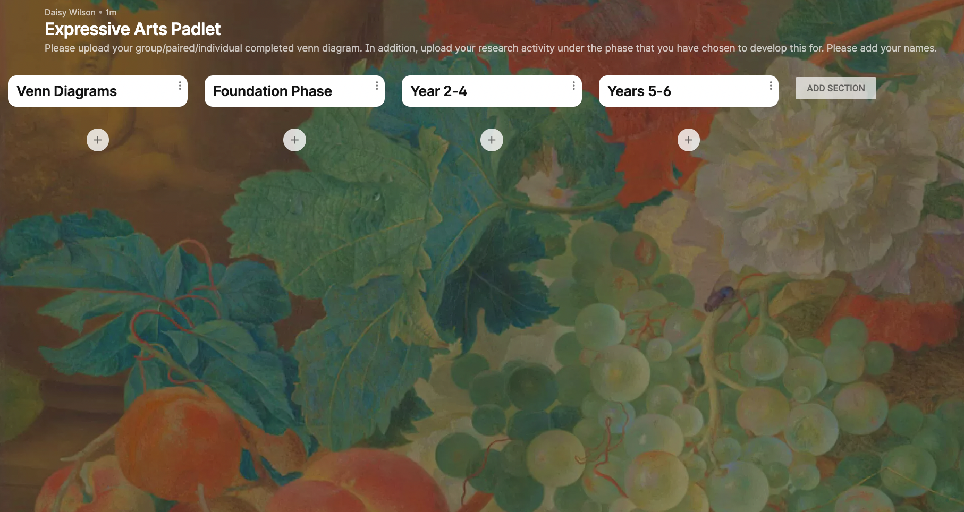

Please add a photograph/screen shot of your Venn Diagram here
QR Code for Padlet Access
DON’T FORGET TO ADD YOUR NAMES!
You will have chosen to devise an activity for one of these phases, please input a description beneath the appropriate phase

