Slide 1
Digital Skills and Research Methods
How do we use technology to collaborate at UWTSD?
Which digital tool is most commonly used for collaboration at UWTSD?

Slide 2
Introduction
The IT world is awash with technology buzz-words and abbreviations which have been associated with collaboration (enterprise content management, intelligence, knowledge management, enterprise application integration and business process management are just a few.
The term 'collaboration technology' is often used to describe various combinations of software and/or hardware
employed to help people collaborate.
This will include enterprise portals and intranet applications, generic workspace or project team applications, web and video conferencing and online meeting application, peer-to-peer file-sharing, and real-time instant messaging (IM), to name but few. (Wilkinson, 2005)

Slide 3
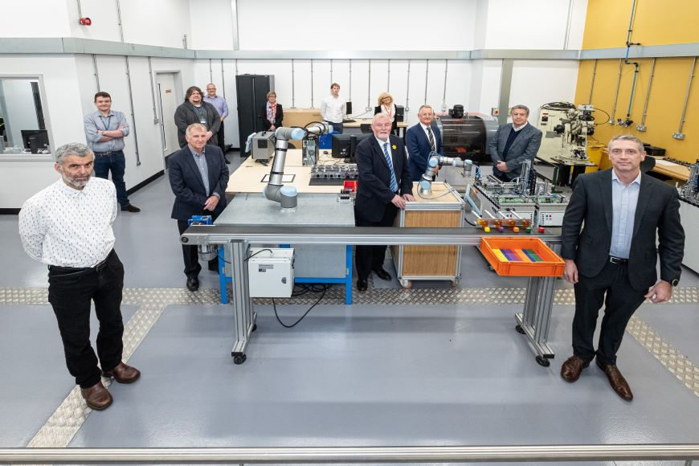
SMART Digital Accelerator project
Its aim is to provide expert support and advice for Welsh manufacturers using the skills and expertise of academia and industry to improve processes, engage talented employees across the company, driving new, profitable business models.
provides access to a diverse team of talented and experienced experts drawn from industry and academia
This project is just one of many offered by UWTSD that supports manufacturers in Wales. UWTSD also offers upskilling, and R&D via their EU funded MADE Cymru initiative, Degree Apprenticeships, and an Advanced Manufacturing Skills Academy.
(www.uwtsd.ac.uk, n.d.)

Slide 4
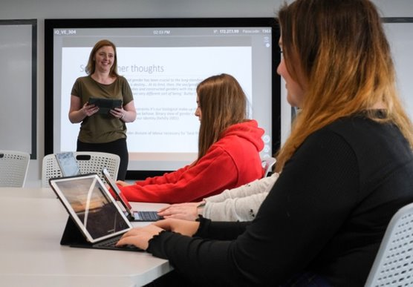
scalable Sony Vision Exchange solution to pioneer the next generation of active, collaborative learning through smart technology
The University’s vision for SA1 Swansea Waterfront is to create a neighborhood with academic activity at its core to attract companies to collocate with the University to exploit knowledge, develop skills, support existing companies and attract new investment into the region.
The partnership with Sony has expedited a move from traditional lecture theatres and auditoriums to a collaborative and interactive environment that is driving new levels of engagement and attainment.
The university of Wales Trinity Saint David is using a scalable Sony Vision Exchange Solution to pioneer the next generation of active, collaborative learning through smart technology
(www.uwtsd.ac.uk, n.d.)

Slide 5
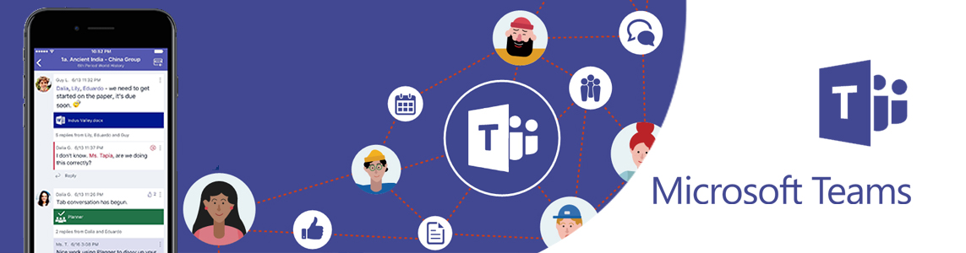
Microsoft Teams is a centralized hub for communication and collaboration within a team, department or student group allowing you to share content and access other apps.
Collaborate - Work with your team in real-time on a central hub to collaboratively edit documents and discuss ideas
Group Chat - Send instant messages to your Team
Online Virtual Meeting & Lectures - Host or join and collaborate with Virtual Meetings & Lectures
Share - Your screen, PowerPoint Presentation, running programs, interactive white board & more with other people
Audio Calls - Have High Quality Audio Calls with an individual or a group of colleagues
Assignments - Support and discuss an assignment with a student group
(www.uwtsd.ac.uk, n.d.)

Slide 6
Referencing
Wilkinson, P. (2005). Construction collaboration technologies : the extranet evolution. London Taylor & Francis.
www.uwtsd.ac.uk. (n.d.). Press Releases 2019 | University of Wales Trinity Saint David. [online] Available at: https://www.uwtsd.ac.uk/news/press-releases/press-2019/uwtsd-and-sony-pioneer-the-next-generation-of-active-collaborative-learning-through-smart-technology.html [Accessed 20 Mar. 2022].
www.uwtsd.ac.uk. (n.d.). Microsoft Teams - Collaboration | UWTSD. [online] Available at: https://www.uwtsd.ac.uk/whatsnew/microsoft-teams---collaboration/ [Accessed 20 Mar. 2022].
www.uwtsd.ac.uk. (n.d.). Press Releases 2021 | University of Wales Trinity Saint David. [online] Available at: https://www.uwtsd.ac.uk/news/press-releases/press-2021/uwtsd--welsh-government-collaboration-to-accelerate-digital-growth-in-industry.html [Accessed 20 Mar. 2022].

