Slide 1
Focus Groups Research
Dr Stuart Jones

Slide 2
Aims of the Lecture
To define a focus group.
To discuss when to use a focus group
Comparison of Focus Groups and Interviews.
Practical issues with focus groups.
Afternoon session – running a mini focus group.

Slide 3
What is a Focus Group
A focus group is a structured discussion used to obtain in-depth information from a group of people about a particular topic.
The purpose of a focus group is to collect information about people’s opinions, beliefs, attitudes, perceptions, not to come to consensus or make a decision.
Wilkson (2008)

Slide 4
What are Focus Groups?
Group discussions/ group interviews
Facilitated by researcher (often helped by another person)
Getting people to think about, discuss/debate an issue (or set of issues) – related to your research question
More than just a bunch of individuals responding to your questions
  Allows for interaction (new data, conflicting data)
  Allows participants to interpret each others’ responses
  Not just a series of separate conversations with you!!
The sum should be more than it’s individual parts!!!!

Slide 5
Examples of Studies Utilising a Focus Group.
Schulze, B., & Angermeyer, M. C. (2003). Subjective experiences of stigma. A focus group study of schizophrenic patients, their relatives and mental health professionals. Social science & medicine, 56(2), 299-312.
Reichstadt, J., Depp, C. A., Palinkas, L. A., & Jeste, D. V. (2007). Building blocks of successful aging: a focus group study of older adults' perceived contributors to successful aging. The American Journal of Geriatric Psychiatry, 15(3), 194-201.
Berland, A., Natvig, G. K., & Gundersen, D. (2008). Patient safety and job-related stress: a focus group study. Intensive and critical care nursing, 24(2), 90-97.

Slide 6
When to use Focus Groups.
Gather opinions, beliefs, attitudes, perceptions, behaviours and motivations about a topic.
Identify needs for a program or service.
Priliminary stages of questionnaire development.

Slide 7
When to use Focus Groups.
Test ideas, plans, programs, services, policies before introduction. E.g. to test an existing program in the local cultural context.
Get feedback on a program, service, policy after introduction.
Clarify information gained from individual interviews or written surveys (quantitative study – quantify; numbers).

Slide 8
Why/when might you use them?
MAIN REASON – when you want to generate discussion/debate about your research question/ area of research
  You do not think that individual responses will yield the kinds of data you want
When you think that individuals may not be able to provide adequate responses on your research question
  Haven’t thought about the issues
  The issue requires discussions
  Might be normal/ everyday/ taken for granted issues
When people may not feel ‘safe’ talking in individual interviews
  Young people?
  Groups that may work on basis of collective discourse
Notes:
Group meanings and how people arrive at them are what many researchers are most interested in in using focus groups today. How do people decide their opinion, do they maintain it in the face of opposition from a group, do the more dominant people influence the thinking of the quieter group members??
Most texts rarely advise using focus groups as your sole method of data collection unless you are doing a needs assessment and even then you have the issue of representativeness of the groups to grapple with. They work best when combined with other methods such as surveys, interviews etc.

Slide 9
Why/when might you use them?
Other reasons are the same as all qualitative methods
  Lack of research in area
  Wanting to develop theory
  Wanting to develop a quantitative stage of study
  Etc, etc
REMEMBER – this is not a group counselling session – there is always a possibility of a ‘research relationship’ to stray into a ‘therapeutic relationship’ – but even more so in focus groups
Notes:
Group meanings and how people arrive at them are what many researchers are most interested in in using focus groups today. How do people decide their opinion, do they maintain it in the face of opposition from a group, do the more dominant people influence the thinking of the quieter group members??
Most texts rarely advise using focus groups as your sole method of data collection unless you are doing a needs assessment and even then you have the issue of representativeness of the groups to grapple with. They work best when combined with other methods such as surveys, interviews etc.

Slide 10
Focus Groups vs Interviews
Strengths
Potential Weaknesses
Group interaction: building on each others answers.
New topics might emerge
Facilitator lacks skills.
More logistical effort.
Complex data-analysis.
No individual answers.
Participants feel uncomfortable voicing their true opinions in a group

Slide 11
Focus Groups vs Quantitative Data (Surveys)
Strengths
Potential Weaknesses
In-depth information.
Group interaction: building on each others answers.
New topics might emerge.
Facilitator lacks skills/is biased.
Participants feel uncomfortable voicing their true opinions in a group.
More logistical effort.
Findings are not generalizable.
Time consuming.
Expensive (financial and human resources).
Complex data-analysis.
Cannot determine causal effects.

Slide 12
Question Generation for Focus Groups.
Good questions:
  Short.
  Use everyday language of the target group (avoid: jargon [e.g. protocol], abbreviations, acronyms).
  Open-ended (no fixed answers).
  Invitation to discussion: often begin with “how”, “what”, or “why”.
  Developed or translated in the language of the FGD.
  Try to avoid questions that might trigger a conflict between the facilitator and the participants.

Slide 13

Question Generation for Focus Groups.
Questions can involve activities: making a list, using rating scales, drawing pictures, sorting pictures.
Avoid leading participants towards a particular answer.

Slide 14
Data Management
Data = recordings (transcripts), (transcripts of) focus group notes, notes of debriefing with facilitator/note taker. [If needed, translate data to language of analysis.]
Analyse each FG immediately (after a week the information is ‘gone’).
Write down the main points of each FGD.
Note useful quotes.

Slide 15
How to Analyse Focus Groups.
Analyse question by question.
Look for themes.
  Clustering the themes as for interviews.
Look for group consensus or dissenting views.
Compare data from all groups.
Capture any key similarities in groups or notable differences.
You can analyse the data using the techniques discussed in lecture 1.
  E.g. Discourse Analysis, Grounded Theory, IPA etc.

Slide 16
Research Ethics Surrounding Focus Groups.

Slide 17
Ethics
Can sometimes be more challenging to gain ethical approval compared to individual interviews.
Opinion of others could be considered offensive / challenging.
So sensitive topic areas are particularly challenging.
Clear information would need to be given (and consented to) from each participant regarding the nature of focus group and the anonymity / confidentiality.

Slide 18
Research ethics
ALL research needs to consider and respond to the following ethical principles:
  Research Merit and Integrity
  Respect
  Beneficence
  Justice
However, when thinking about using focus groups, we have some additional ethical issues to consider

Slide 19
Research ethics
Data control – if 1 person wants their data to be removed, how does one do this within the context of a discussion - and make it amenable to analysis?
Confidentiality and anonymity – a variety of things may be talked about within the group, how do you make sure none of that goes outside the group?
Power – there may be distinct power dynamics – how do you make sure each person has an equitable voice?

Slide 20
Practicalities of a Focus Group

Slide 21
Practicalities
Setting it up
Deciding on composition and size
Running focus group
Transcribing
Potential pitfalls

Slide 22
Setting it up
Adequate physical facilities
  Big enough room
  ‘friendly’ atmosphere
  Child-care facilities?
  Disabled access?
  Car parking or public transport routes?
Relevant recording equipment
  Good quality audio recorder – to pick up a variety of voices at different distances from microphones
  Make sure you have pre-tested it and know how it works
Refreshments
Incentives?
  Okay – consistent and in-line with what you’re asking them to do

Slide 23
Deciding on composition and size
Heterogenous vs homogenous?
Heterogeneous
  diversity of perspectives on central research question
Homogeneous
  May be good for sensitive issues – Kitzinger’s work on HIV
  shared experiences – good for bouncing off each other and a sense of ‘safety’
  May be good for marginalised groups – for whom individuals may feel ‘powerless’ within a heterogeneous group
What’s a good sized group?
  Ideal size is 6 to 10 participants
  Not enough discussion vs alienation of some people or too rowdy
  Over-recruit!!! – invariably get last-minute cancellations

Slide 24
Running focus group
Role of facilitator (YOU) - success depends heavily on skills of the facilitator
  keeping discussion going
  keeping discussion within the research framework
  making sure people have a say – fairness and respect
  trying to involve ‘quiet’ participants
  trying to make ‘ethnographic’ notes on the non-verbals (HARD – so maybe take an observer along too)

Slide 25
Transcribing
Takes MUCH longer than transcribing individual interviews
Help the transcriber – ask people to go around room and either say their name or pick a pseudonym
Level of voice is really important – ask people to speak up
Also – ‘civility’ rules – ask people (wherever possible) not to talk over one another – if this happens it’s not transcribe-able – so ask to repeat maybe?

Slide 26
Some Potential Pitfalls
Dominance by one person
Going off topic
Writing up – sometimes it’s hard to see that there was more than 1 person in the room at the time!!!! – analysis and writing is on the basis of group discourse, not individual discourse
Notes:
Example from Focus group on proposed co-ordinated care trial in area of Palliative care.
Issues:
Highly emotional subject in the first place
Recruitment via an intermediary
Person came who was very recently bereaved in difficult circumstances
Group were supportive
Offered opportunity to leave the setting and followed up by appropriate people later.
Silence: may be a sign of problematic recruiting/power relationships. draw people out, pick up a previous point, know when to finish.
Focus groups should not cause harm to those who participate- if it’s really dodgy and you don’t feel confident, use interviews or surveys instead.

Slide 27
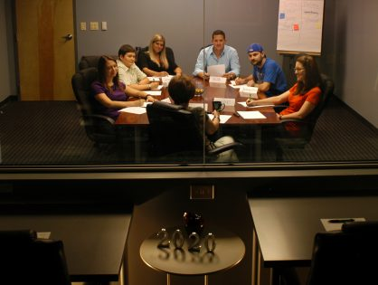
Starting the Focus Group…..
Welcome the group, introduce facilitator and note keeper.
Overview of the purpose and format of the Focus Group (incl. recording of the session).
Informed consent.
Ground rules.
Participants introductions.

Slide 28
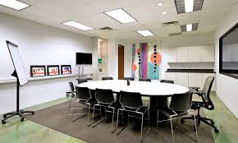
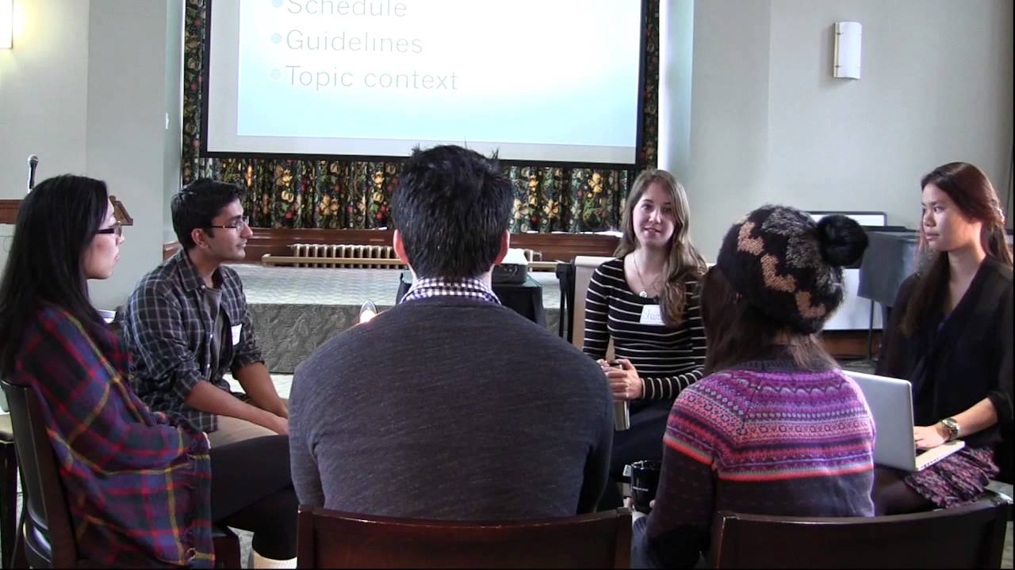
Focus Group Set Up

Slide 29
Typical Ground Rules.
Only one person speaks at a time.
Give everyone an equal chance to participate in the discussion.
Respect the opinions of others; don’t put down or criticise others’ comments.
Respect the privacy of others in the group by not repeating what is discussed outside of the focus group.
Explanation of the recording, anonymity etc.

Slide 30
Opening Statement…. Example
Good morning. Thank you all for taking the time to be with us today. My name is …, and I am … [position, affiliation]. My role is to facilitate this group discussion. My assistant’s name is … and he/she will be in charge of taking notes and making observations (if you have an assistant). The purpose of this group discussion is to talk about …

Slide 31
Opening Statement…. Example.
We / I will ask you some questions, which will take about 2 hours, and please tell us / me what you think is important. We / I want everyone to feel free to say exactly what he or she thinks, no matter what this may be. [Introduce ground rules.] Everything you say here will be kept confidential and anonymous, so none will ever know what you personally said (only what the overall combined responses are).

Slide 32
Opening Statement….. Example
In order to capture all that is said we / I will record this session. Does everybody agree with their participation in this Focus Group? [get oral or written informed consent] Questions? Before we begin this session, I would like to quickly go around the group and give each person a moment to introduce him or herself. [Icebreaker/Introductory question] Tell us how you learned to do the contact investigation interview?

Slide 33
Ice-Breaker.
Ice-breaker/Introductory question:
This should be non-threatening and easy to answer, so that everyone answers. It emphasises what is shared, gets participants thinking about topic, and makes people feel comfortable which encourages conversation.
As noted can use pictures or a small written task and explain the results.

Slide 34
Key Questions
Focus of the study.
Approximately 5 key questions
Allow time to explore issues (new questions may arise).
Time: 60 – 90 minutes

Slide 35
Closure – Wrapping up.
Discussion is summarized by the facilitator / note keeper, and participants clarify and confirm the information.
Any remaining questions from participants are answered.
Participants are thanked and next steps are indicated (dataanalysis, reporting).

Slide 36
Tips for Successful Facilitation
Encourage discussion:
  Maintain a warm and friendly attitude.
  Establish eye contact with participants (if culturally appropriate).
  Do not judge participants responses (verbally, body language).
  If a participant gives a vague answer: probe, e.g. “Could you say a little more about that?” or “Would you give me an example of what you mean?”

Slide 37

Tips for successful facilitation.
Keep the group focused:
  If the group is getting too far off the topic, remind the group of the original question by summarizing the responses and then repeating the question.
  If the group is finding the question difficult to answer, rephrase the question.

Slide 38
Tips for successful facilitation.
Keep individual participants from dominating the conversation:
  Try avoiding eye contact with dominant participants.
  Remind the group that everyone’s opinion is important.
  Acknowledge the response of the dominant participants and redirect the discussion by asking other participants for their opinions.
  Some researchers have written that they were required to ‘freeze’ a participant for a set amount of time, whereafter the person is free to talk again.

Slide 39
Tips for successful facilitation
Encourage shy participants to contribute.
  Making eye contact with quieter participants.
  Gently ask quieter participants for their opinions during pauses in the conversation by addressing them by name.
Be aware of group pressure:
  Probe for alternate views from the group, e.g. “That is an interesting viewpoint. Let’s also explore some alternatives.”
Monitor time closely.

Slide 40
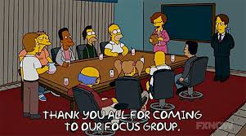
Responding to comments
Do not indicate agreement: “I agree”, “That’s great”, “Fine”.
Restrict head nodding.
Use short verbal responses: “Yes”, “OK”, “Uhhuh”.

Slide 41
Maintaining the Flow and Questions.
Pause:
  5 second pause.
  Don’t rush into questions.
Probes:
  To obtain further information or clarification.
  To encourage differing viewpoints.
Be prepared to answer or postpone answering.
  Frequently asked question: “Can we get a copy of the report?” (So know the answer, and do not give a promise that you can not keep.)

Slide 42
The Researcher / Facilitator
Crucial to the success of a focus group.
Skills include:
  Background knowledge of topic.
  Sensitive/respect for participants’ opinions.
  Can interpret verbal and non-verbal responses.
  Good listener, can manage lively group discussion.

Slide 43
The Facilitator / Researcher – Skills to Consider
Facilitators (and note takers).
  Needs to have an very good understanding of the topic area in advance.
  Basics of FGD methodology.
  Exercises / Icebreakers.
  Familiarize with facilitation guide.
  Conduct actual focus groups.
Refresh skills from time to time.
Feedback (revise questions/facilitator guide).
After action review after each FGDs.

Slide 44
The Venue of the Focus Group.
Needs to accommodate up to 14 people (maximum).(participants, facilitator, note keeper).
Neutral, comfortable, safe.
Distraction free (e.g. telephones, traffic).
Easily accessible, easy to find.
Tables and chairs not fixed: participants face each other (circle/U-shape). Re-arrange the venue if needed.
Examples: health facility, classroom.

Slide 45
Checklist for a Focus Group
Venue set up, refreshments available.
List of participants, name tags (identifiers).
Recording equipment set up (spare batteries).
Flip chart set up, markers (if needed).
Notepad for note taker, pencils.
Facilitator guide.
Watch/clock/phone.
Afterwards: label notes, recording materials.

Slide 46
Summary
Focus groups can be very good for generating discussion/debate about your research questions
Main Adv – “more than the sum of its parts” – the added value that comes from debate/discussion
Potential pitfalls – power, voice and group speak
Need skillful moderator to minimise these
If thinking about using focus groups – make an informed choice based on your RESEARCH QUESTION, rather than because they seem to be fashionable in research!!!

Slide 47
Task…..
Afternoon session.
Prepare and plan a mini focus group session.
Three questions.
  1) A discussion on compulsory PE in Secondary Education
  2) A discussion on the age of voting in elections.
  3) A discussion on impact of social media on mental health.

Slide 48
Task
This is only a mini focus group – so I would like to see you all have a go at being the facilitator. Stay in the same group, but work on the questions individually.
Vary the questions….

Slide 49
Groups to be confirmed based on attendance.

