Slide 1
  BMPF 7058: Leading Service Improvement
  Candidate No: 1812509
  Sustainability of OBS Cymru
  (Obstetric Bleeding Strategy for Wales)
DR CERYS SCARR, WELSH CLINICAL LEADERSHIP TRAINING FELLOW
Notes:
Hello My name is Dr Cerys Scarr and for the last year I’ve been a welsh clinical leadership training fellow with OBS Cymru – the obstetric bleeding strategy for Wales aiming to improve care for women experiencing excessive bleeding after childbirth also known as postpartum haemorrhage (PPH)
Today I’m going to outline some of the work and learning I’ve had through this fantastic project focussing on sustainability of the patient impact. I want to start by saying that all of the activities I have been involved in have been in conjunction with a wider project team and I’ve very grateful to have had their support through the year.

Slide 2
Bleeding after childbirth is common
50,000 women/yr bleed more than 1 litre
5000 women/yr bleed more than 2.5 litres
Significant impact on the woman, baby and family
Notes:
So why is this important?
Bleeding after childbirth is a common problem with over 50000 women in the UK bleeding over 1000ml every year
Over 5000 women in the UK each year bleed more than 2500ml which is half of their blood volume and at which point complications markedly increase.
Around 350 women have a hysterectomy to stop excessive bleeding which removes their ability to have any more children
and 350 women go to critical care separating them from their baby which may lead to delayed bonding, difficulty breastfeeding and delayed recovery with some experiencing PTSD. This has a huge impact and is increasing with significant variation in care. This is without the 6 women each year that die as a result of obstetric bleeding where in 70% an improvement in care would have changed this devastating outcome.
The majority of women bleed because the uterus does not contract after delivery or due to tissue trauma related to cs and vaginal birth. In some patients bleeding may be exacerbated by failure of the clotting system

Slide 3

OBS CYMRU
Obstetric Bleeding Strategy for Wales
2.5L Bleed
Blood Transfusions
Critical Care
Hysterectomy
Reduce inappropriate variation
Care for those with the greatest need first
Reduce Harm
Outcomes that matter
to patients
Welsh Government (2018) A Healthier Wales: Our Plan for Health and Social Care
Notes:
OBS Cymru – the obstetric bleeding strategy for Wales was developed in response to these challenges faced and a standardised care package devised following an extensive period of research in Cardiff.
The overall project aims and patient impact was to reduce the incidence of >2.5L pph, reduce blood product transfusions, reduce critical care admissions and reduce hysterectomy rates.
These patient impact aims have a wider impact fitting into the principles of prudent healthcare in having an evidence based package of care to reduce inappropriate variation, doing only want is needed and reducing harm by minimizing blood product transfusions and surgical interventions, being on the front foot and caring for those with the greatest need first and considering outcomes important to women like intensive care admissions which involve separation from their baby.

Slide 4

OBS Cymru Intervention
Risk Assessment
Measurement of Blood Loss
Early multiprofessional team at bedside
Point of care testing
Notes:
OBS Cymru is a complex clinical intervention, devised by a multiprofessional team, incorporating evidence-based best practice in management of a woman experiencing postpartum haemorrhage. The intervention consists of four components:
Risk assessment for haemorrhage
Cumulative, objective measurement of the blood loss at every birth to identify those who require targeted therapy rather than estimating
Multidisciplinary team presence at the mother’s bedside with management guided by measured blood loss and clinical assessment
bedside testing of blood clotting and haemoglobin to inform blood product replacement through an evidence based algorithm and a point of care testing device on each LW
Through an extensive implementation phase led by previous fellows and the national team, the OBS Cymru intervention has now been adopted by all 12 obstetric units in Wales with support from local champion teams. The project was registered locally with each health board’s clinical governance department and a national data sharing agreement covering implementation and sustainability.
Project funding was via an Efficiency Through Technology grant (Welsh Government), 1000 Lives Improvement and Werfen (industry partner). This funding and formal support from all Welsh health boards ended on 31st March 2019

Slide 5
Initial Aim
Analyse and present data to help better understand the uptake of the OBS Cymru intervention
Notes:
So initially my aim was to analyse and present data to help better understand uptake of the intervention and inform spread beyond Wales

Slide 6
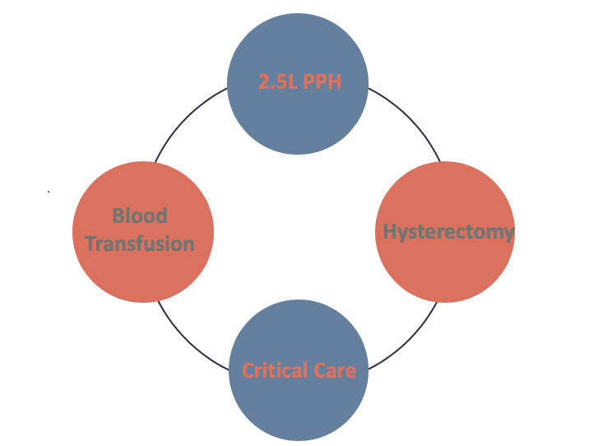
Initial Outcomes
Reduced variation between units
Improved Clinical outcomes
Patient reported outcomes
.
Notes:
As I started to analyse the outcomes it became apparent that the clinical outcomes of the project were encouraging significantly showing reduced variation between units and improving incidences of >2.5L postpartum haemorrhage, blood product transfusion and intensive care admission. Importantly the patient reported outcomes through patient surveys was positive with descriptions of feeling safe and having been impressed by the team working seen during the emergency

Slide 7
Aim
Sustainability
‘when new ways of working and improved outcomes become the norm’
To ensure sustainability of the OBS Cymru approach to management of obstetric bleeding in Wales
QI Hub Scotland (2014) Spread & Sustainability of Quality Improvement in Healthcare
Notes:
With such key benefits being seen it became even more important to ensure that these new ways of working became embedded into routine clincial practice particularly given the project funding end date of April 2019 ensuring continued positive patient impact.

Slide 8


“Cerys needs to work within a loose framework and will function best if given the freedom to roam”
“Cerys will probably be more useful in the setting up and initial stages of projects”
BELBIN TEAM ROLE REPORT 2019
Notes:
This stage of the project came at around the same time as we were undertaking a number of leadership diagnostics and for me these have been invaluable in really starting to understand myself better
Firstly my Belbin team type showed very strong preferences for being a plant and resource investigator which in itself was very useful to reflect on knowing that I was involved in leading a project in its sustainability phase rather than initial set up
Cerys needs to work within a loose framework and will function best when given the freedom to roam, explore and develop new schemes and ventures
Fortunately, the team I was working with were incredibly trusting of my abilities and really supported me in developing the sustainability plan as almost an entirely new set up project so appealing to my natural enthusiasm for new ideas innovation and exploring solutions

Slide 9
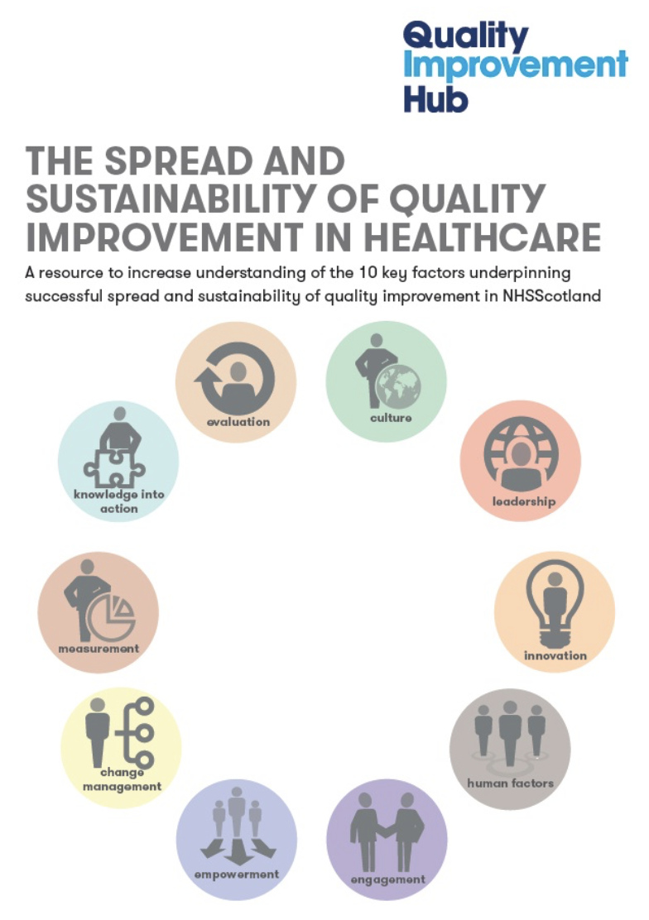
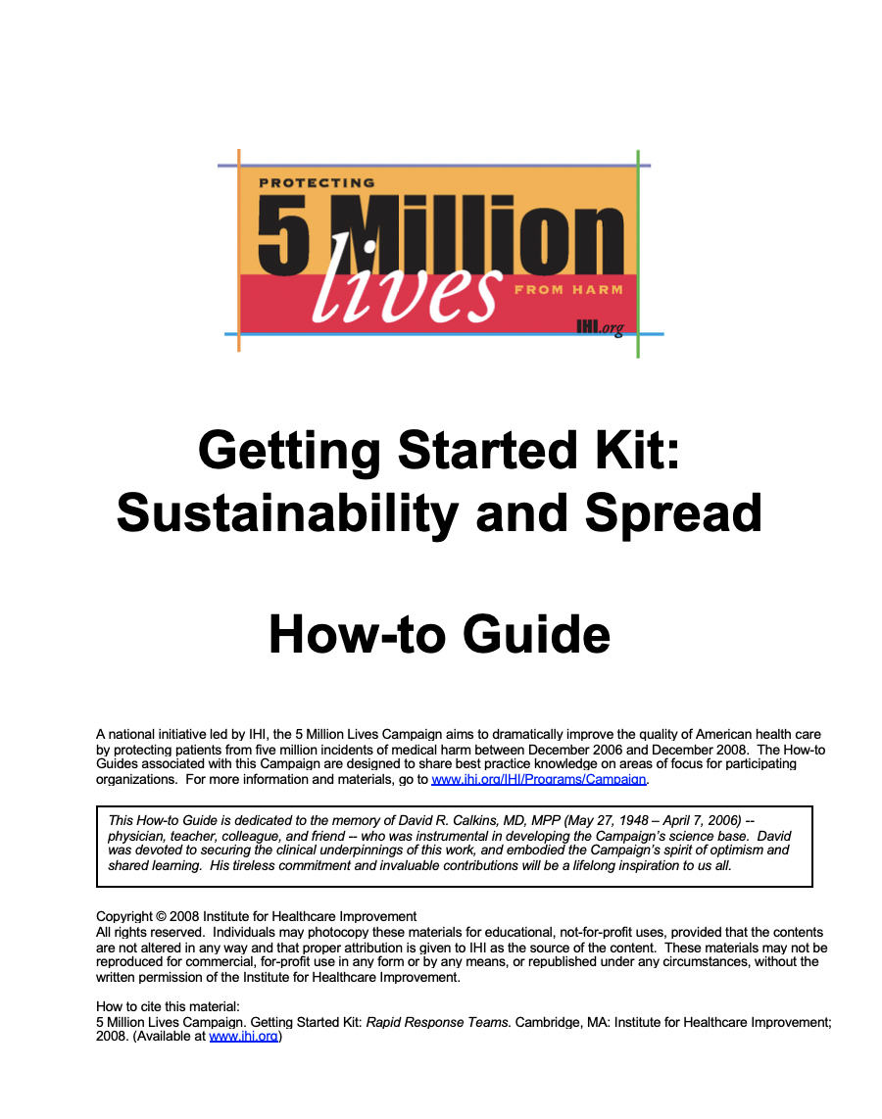
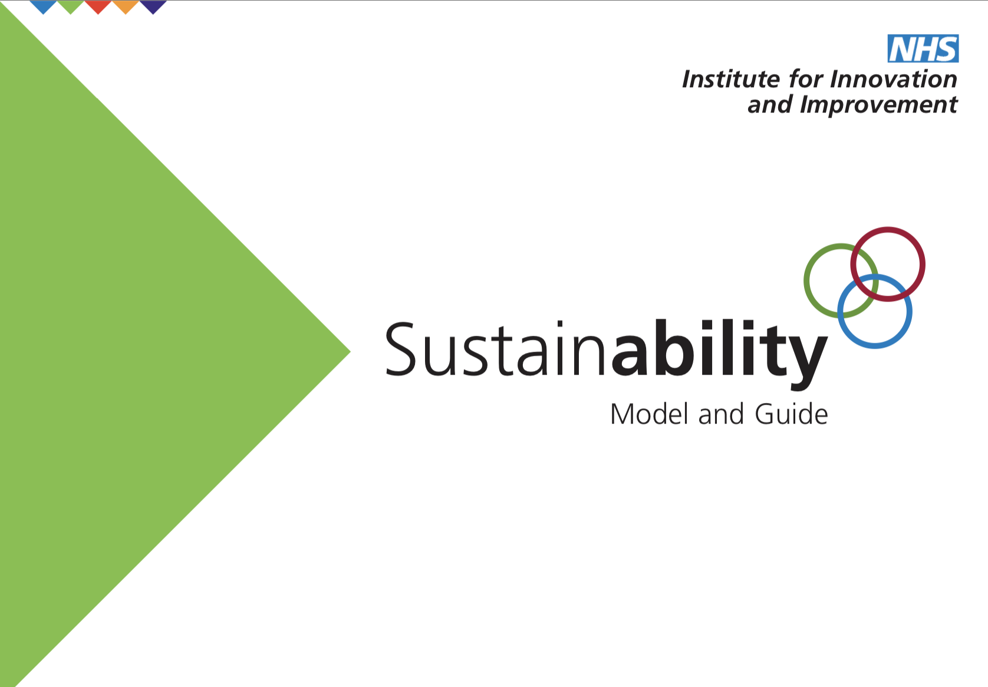
Sustainability Models
NHS Institute for Innovation and Improvement (2010) NHS Sustainability Model.
Institute of Healthcare Improvement (2006) How to Guide: Sustainability & Spread
QI Hub Scotland (2014) Spread & Sustainability of Quality Improvement in Healthcare.
Notes:
In typical resource investigator style I researched sustainability models to ensure that the OBS Cymru project had the best chance of becoming securely embedded in clinical practice and adaptive to local needs - most of which described key themes that sustainable projects had but were invariably vague and held little in the way of analysing and reflecting on our own project and where these themes could be worked on and developed until I found the NHS Improvement Model and Guide
Using the diagnostic tool has been invaluable. The tool outlines evidence-based factors key to sustaining change and highlights areas that require attention through team self-assessment. I have completed self-assessment of these factors which broadly fit into 3 themes: staff (purple), process (green) and organisation (blue) factors (figure 1).
. My self-assessment portal diagram highlights factors which have greatest potential for improvement gains

Slide 10
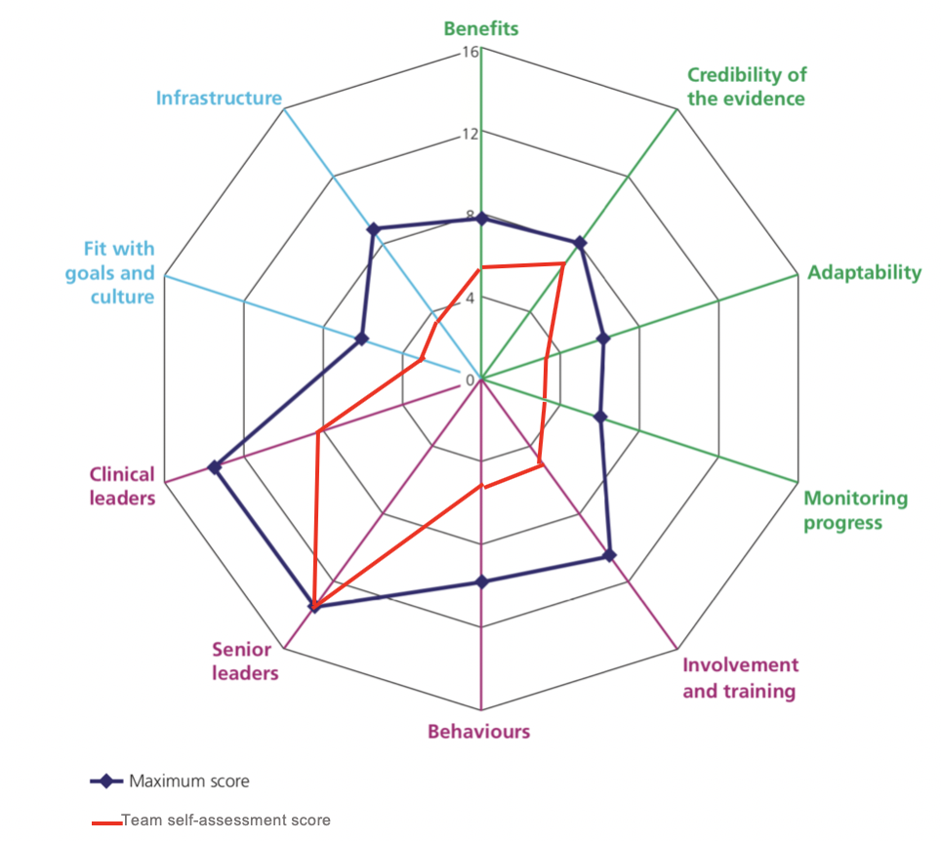
Infrastructure
Involvement & Training
Monitoring Progress
NHS Institute for Innovation and Improvement (2010) NHS Sustainability Model
Notes:
So this tool generates a portal diagram which gives you the maximum score (navy) and the team self-assessment in red in each of the key areas of Staff (purple) Process (green) and Organisation (blue) and not only tells you the score but also the areas that when worked on have the greatest potential for improvement gains. For us this was in infrastructure, involvement and training and monitoring progress. We have also been working on other themes but for today's presentation I will focus on these three.

Slide 11
DELIVERABLES
Involvement & Training
Monitoring Progress
Infrastructure
Cost-effectiveness plan
Use this for business case for the bedside technology
Integrate training package into PROMPT Wales materials
Involvement of local teams in national event
Develop data strategy for performance indicators
Notes:
I looked at these three areas and with regards to infrastructure thought the key priorities were to deliver a cost-effectiveness plan and use this to generate a business case for the technological innovation
For involvement and training working with the newly commissioned PROMPT Wales multiprofessional obstetric emergencies team to embed OBS Cymru into their materials and organise a national event to link local teams
Finally ensuring that any ongoing progress in PPH could be monitored with a data strategy for the performance indicators including the rates of PPH, and adverse outcomes

Slide 12
SUCCESS
Point of care testing technology on each obstetric unit
OBS Cymru training embedded in PROMPT Wales
National strategy for continued process and outcome data collection
Notes:
Through this project proposal I have outlined how I planned to approach sustainability of OBS Cymru beyond April 2019. But what would standing on the top of the mountain look like?
Monitoring success will be through both process and outcome measures. Process measures will include presence of a point of care testing device on each obstetric unit with an associated cost-effectiveness plan outlining funding, presence of OBS Cymru training in the PROMPT Wales programme. Outcome measures will be those of the OBS Cymru project including incidence of >2.5L haemorrhage, intensive care admissions, blood product transfusions and hysterectomy rate. If these outcome measures display sustained or continued improvement then these initial sustainability interventions will be considered effective in ensuring the approach is embedded. The focus will then be directed to spread of this improvement outside Wales.

Slide 13

CEDA
Infrastructure
Business Case
Cost-effectiveness plan
Use this for business case for the bedside technology
Personal
ISFP
Notes:
The greatest challenge facing the project was funding to retain the technology essential to continue point of care testing so one of the first activities I got involved in was the generation of a cost-effectiveness analysis with CEDAR - a department of Cardiff University to inform the business case for this technology
Alongside this I was having a number of conversations with stakeholders from welsh government to the heads of midwifery, point of care testing managers, and the industry partner Werfen to determine the future funding of the project and whether this would be via an all wales procurement strategy or on an individual health board basis.
As I was developing this cost effectiveness plan It became apparent that there was no central funding route available so working with local teams I was able to develop the business case at individual health board level for retaining the technology using the cost-effectiveness model developed with CEDAR. This really challenged my personal skills as an ISFP on the Myers-Briggs personality type I’m curious and like new challenges like learning about understanding a complex intervention but I prefer to identify steps myself and have some defined plan of action and having varying specifications based on national or local funding made it difficult for me to focus my energies. I had to work hard personally to cope with the flexible nature of this and once as a project team we had more defined rationale it became much easier for me to work with both the team at CEDAR and support individual units with their business case.
This business case was successful and the development of the cost-effectiveness model invaluable to ensuring that the technology is now in place in each obstetric unit in Wales but it also provided me with more development opportunities for how I approach a flexible adaptive situation. After this was completed I was also able to achieve an all wales health circular from the CNO to ensure that OBS Cymru standards continue to be adhered to and an expectation that health boards continue to support full implementation

Slide 14
Involvement & Training
PROMPT
Wales
Personal
Integrate training package into PROMPT Wales materials
Involvement of local teams in national event
National event
Notes:
Training on the OBS Cymru approach had occurred through the health board’s regular skills and drills sessions, facilitated by OBS Cymru champion midwives.
However obstetric emergencies training has now been standardised through the commissioning of PROMPT (Practical Obstetric Multi-Professional Training) Wales.
Postpartum haemorrhage management is included in this training but in a different format to that encouraged by OBS Cymru. Over the year I have worked with PROMPT Wales national team to adapt their materials and develop new training materials.
The relationship hasn’t always been easy with both parties feeling protective over the ethos of their projects and compromise being difficult to achieve. This was particularly evident during the production of a training video which I scripted, filmed and edited with the PROMPT team in the first month of my post but then needed significant revisions when a new Welsh team was appointed leading to a variety of modifications that have meant the video has only just been launched following extensive negotiation and compromise.
Personally I found this very challenging and I have learnt a lot about myself in the process. I've learnt that I really care about having people get along and find it hard to discuss what upsets me in an attempt to maintain harmonious relationships. I need to have time to reflect and write down ideas rather than speak out at the time. I have worked on this with my coach and project team learning to accept that I can't make every person happy every time and to develop strategies to recognise when to agree to disagree in the interests of developing a more productive relationship. This has led to the training material being embedded into the ongoing package and a much better working relationship
The national event that was organised brought local teams together with their own POCT, finance and blood bank managers to work on how they were locally going to sustain the project impact.

Slide 15
Monitoring Progress
Maternity Vision
Database
Develop data strategy for performance indicators
Personal
Notes:
The final area of the sustainability plan has been how to monitor ongoing progress and maintain oversight of the process and outcome measures than have defined the project. This is the area that is still ongoing and will be developed alongside the new strategic vision for maternity services in Wales which I was fortunate to become involved in the writing of as a result of trying to embed PPH data indicators. This work and the response to the independent review of maternity services in Cwm Taf is being developed by the new maternity network and I going to continue this work beyond August to not only look at PPH indicators but other maternity data to ensure that moving forward we have robust data that is accessible to local teams and valuable to sharing good practice and benchmarking of services. This has been personally informed by the work I have also been doing with NHS England NHS Improvement to spread the OBS Cymru approach into their QI learning sets for trusts and the way in which they collect and share data nationally

Slide 16
“Success seems to be connected with action. Successful people keep moving. They make mistakes, but they don’t quit.”
CORDON HILTON
Notes:
This is sort of how I feel about the year – its been successful on a number of levels and I’ve active and moving between so many different aspects of the project. What I’ve shared today is just a small portion of the activities I’ve been involved in both through OBS Cymru and all of the other opportunities I’ve had this year.
Most importantly I’ve learnt so much about myself through the mistakes I’ve made along the way I have reflected on and will change how I approach challenges in the future. I feel like I might be standing on the top of this first peak at the moment – enthused and positive about my journey this year but also aware of the bigger peak looming which will be translating this into the real world and completing my clinical training

Slide 17
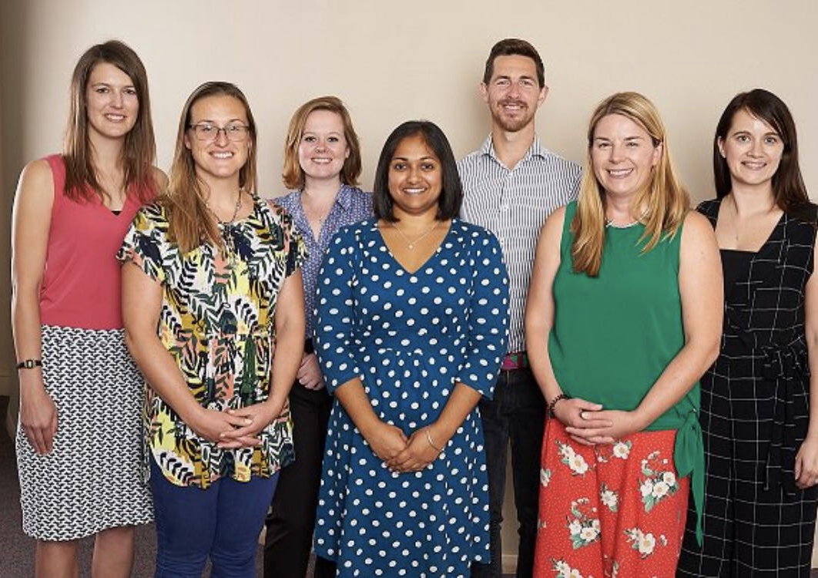
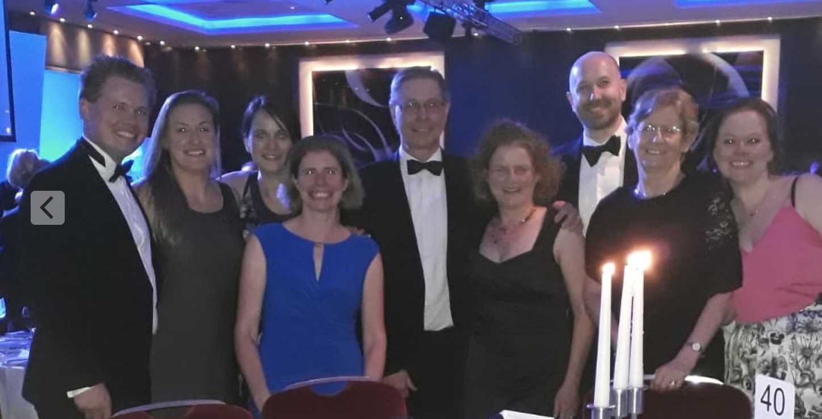
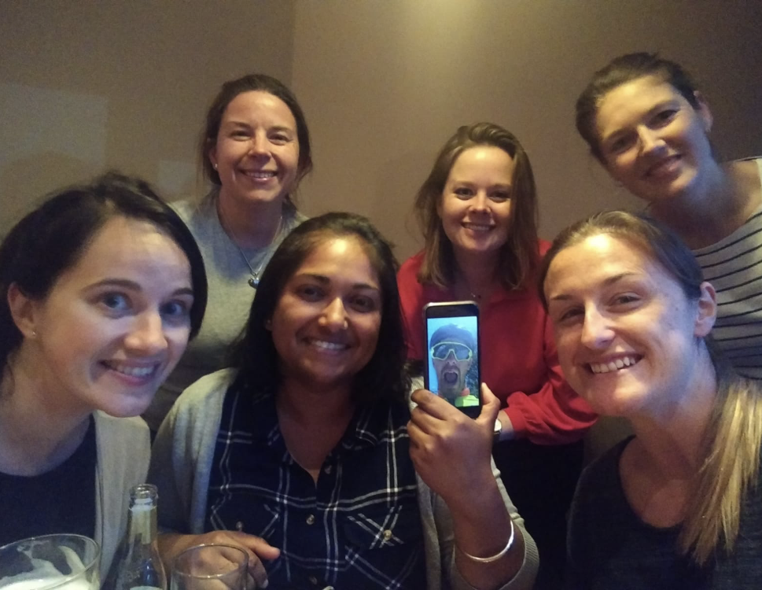
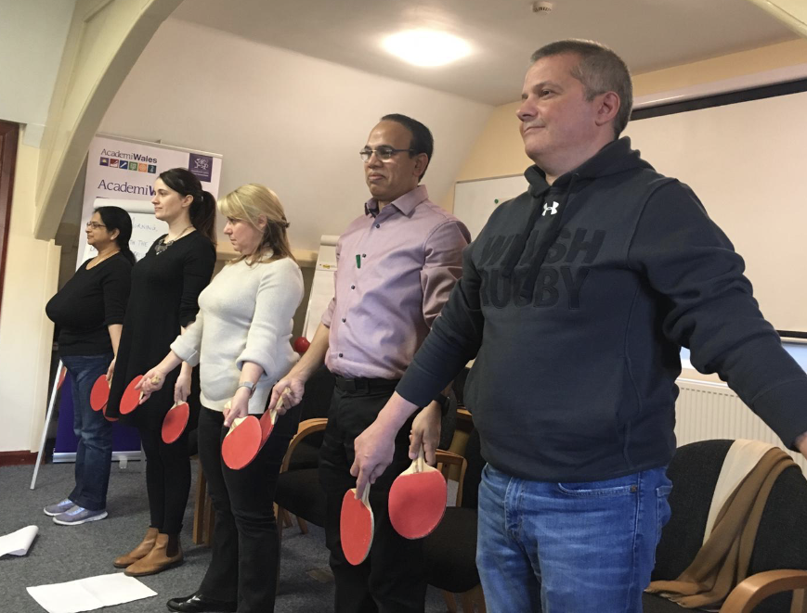
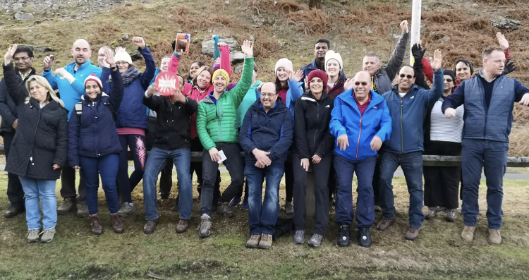
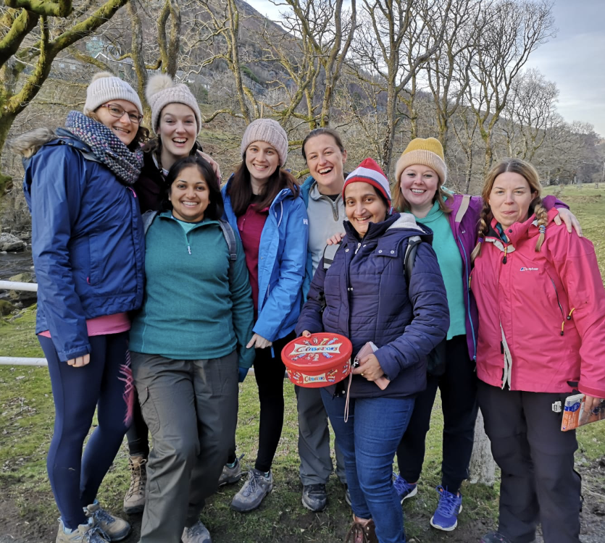
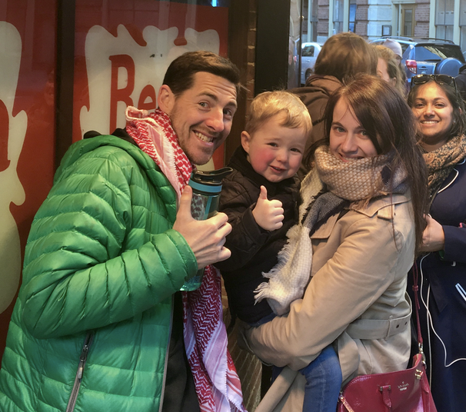
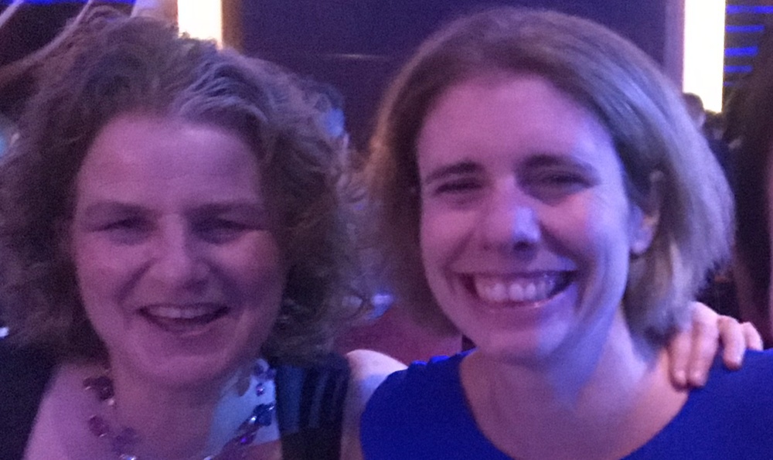
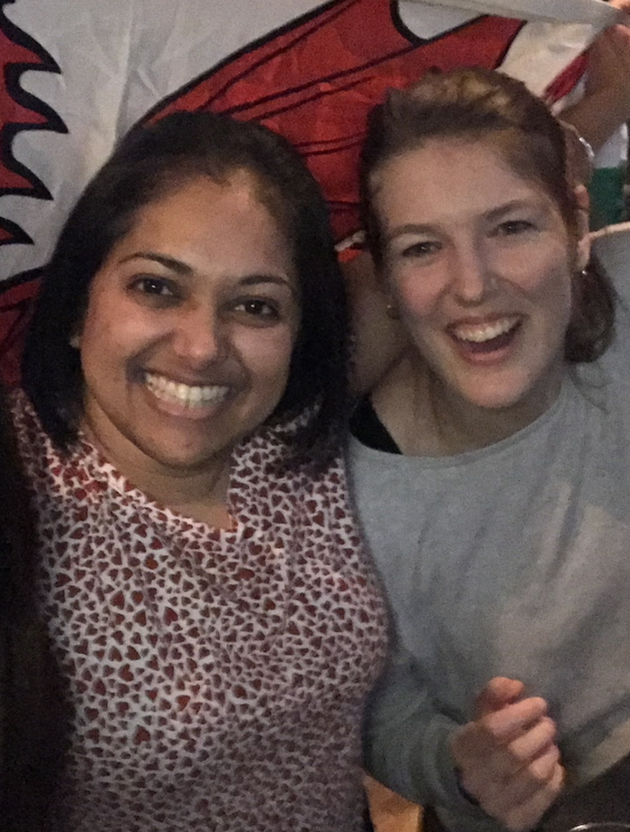
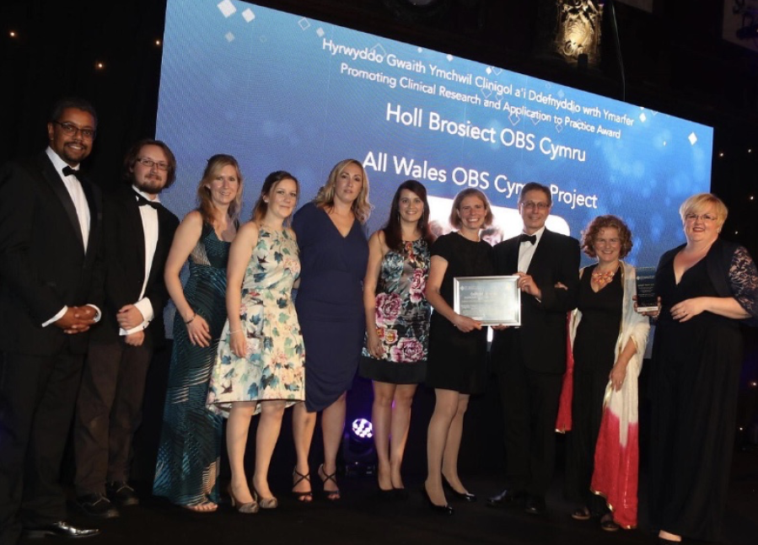
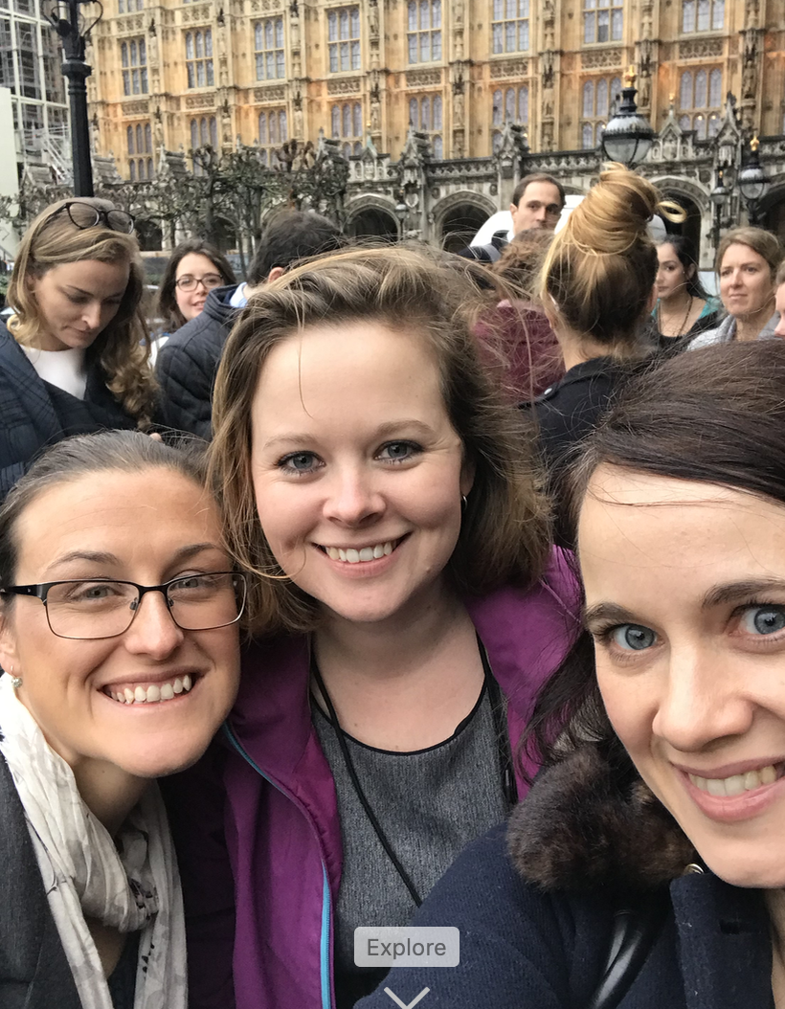
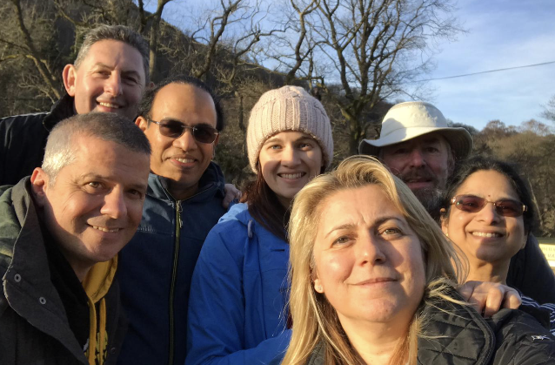
Mummy, What are you on?
GEORGE SCARR 2019
Notes:
At one point in the year my three year old said this to me and I’m not entirely sure what the answer is but I do know that whatever it is that kept me going through this amazing challenging year it was shared from these incredible people so a huge thank you. I've been privileged to have found a group of the most talented and inspirational junior doctors who have provided so much support (and just enough challenge) and I'll always be grateful that I chose to do this project in this brilliant fellowship.
Special thanks to the OBS Cymru project team and particularly my supervisors Dr Sarah Bell & Professor Rachel Collis for embracing having an obstetric trainee in their midst and fantastic leaders in their own right and incredibly supportive mentors

Slide 18
References
Institute of Healthcare Improvement (2006) How to Guide: Sustainability & Spread
NHS Institute for Innovation and Improvement (2010) NHS Sustainability Model
Quality Improvement Hub Scotland (2014)Spread & Sustainability of Quality Improvement in Healthcare
Welsh Government (2018) A Healthier Wales: Our Plan for Health & Social Care

Slide 19
Any Questions?

Slide 20
Fellows Meetings
Academi Wales
Shadowing
Maternity Vision
Conferences
QI skills
Education & RCOG curriculum
OBS Cymru Project Work
Research & Informed consent
Elan Valley
Notes:
So this is just a brief overview of all of the things I’ve been involved in since starting the fellowship,
As a group of fellows we’ve had the opportunity to attend a number of conferences and arranged meetings with clinical leaders including Clare Marx, new GMC chair, Sally Lewis & Rebecca Richards to discuss value based healthcare and a number of individuals in 1000 lives and public health wales, putting into context some of the key policies and strategies which were also outlined through Academi Wales and shadowing in welsh government/health board.
Through my own specialty I have been working with the obstetric NSAG to develop some of the key principles of the new maternity vision for Wales and also through the RCOG curriculum advisory group and editing online journal.
One of the most valuable experiences has been in finding a really great coach through the academi wales coaching network who has really helped with developing a future career plan and highlighting areas for personal development.
Variety of activities – O&G, Maternity vision strategy, engagement of obstetricians in vision/maternity network, RCOG curriculum development & eportfolio & StratOG,./
Shadowing, MDs, CMO, DCMO, CD
Fellows meetings – Sally Lewis, Rebecca Richards, John Boulton, PHW, Clare Marx, Giri Shankar, Westminster, Michael West,
Conferences – Induction in London, FMLM Birmingham and Cardiff
Academi Wales
Coaching
Consent work
Advanced QI study day
Developing QI skills in champion midwives
NHS Wales Health Hack
GMC UKAF, focus groups,

