Slide 1


Course: BSc Health and Social Care.
Module: Community Care and Development (BMHP6022)
Student Name: Ogo-oluwa Mafimisebi
Student ID: 1914926
Lecturer: Laila Surani
Assignment Title: Infant Mortality Presentation, Assessment1
Date: 25th November 2022.

Slide 2

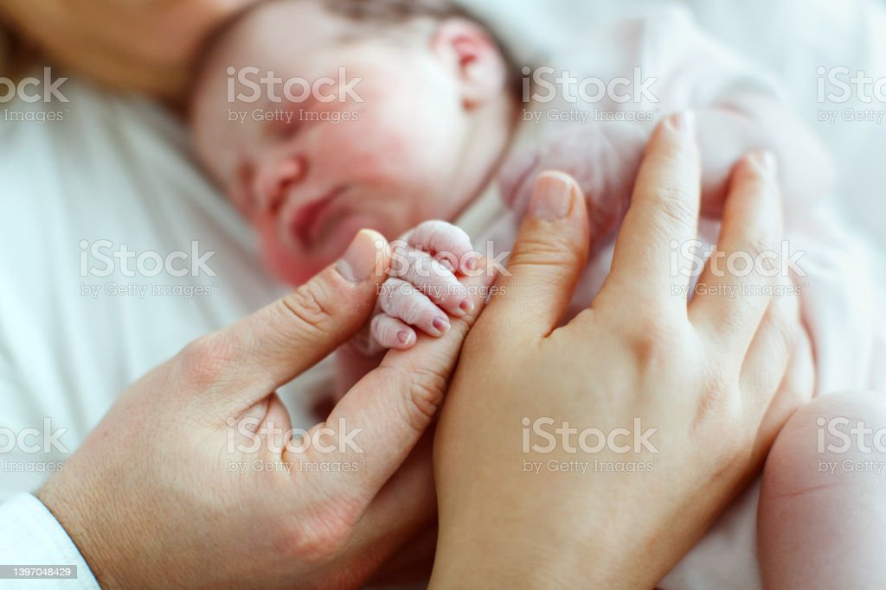
Understanding the infant mortality rate in Southwark Borough will be the aim of my presentation.
“Infant mortality is the death of an infant before his or her first birthday. The infant mortality rate is the number of newborn deaths per 1,000 live births”.
(Source: CDC, 2022)
Infant mortality in Southwark has also witnessed an improvement, going from 7 fatalities per 1000 live births from 2003 to 2005 to 4 deaths per 1000 live births from 2013 to 2015.
From 2015 to 2016, the infant mortality rate rose from 3.7 to 3.8 per 1,000 live births, according to the Office of National Statistics.
(newsshopper.co.uk, 2018)
(Source: uk.images.search.yahoo.com)
(Source: www.istockphoto.com)

Slide 3

DEMOGRAPHIC CHARACTERISTIC
Just over 314,200 people reside in Southwark, and we are substantially younger than the London or national average.
Southwark is a diverse borough with residents from many cultures. Over 120 languages are spoken, and 11% of households don't speak English.
54% of Southwark's population is white, 25% black, 11% Asian, and 10% other. (Southwark.gov.uk, 2018)
Religion Percentage, 52.54 % Christian, 8.52 % Muslim, 26.74 % No Religion, 8.54 % Religion Not Stated, 1.35 % Buddhism, 1.27 % Hindu, 0.35 % Jewish, 0.23 % Sikh, and 0.47 % Other. (Vinsights.co.uk, 2022)
(Shutterstock.com, 2022)

Slide 4
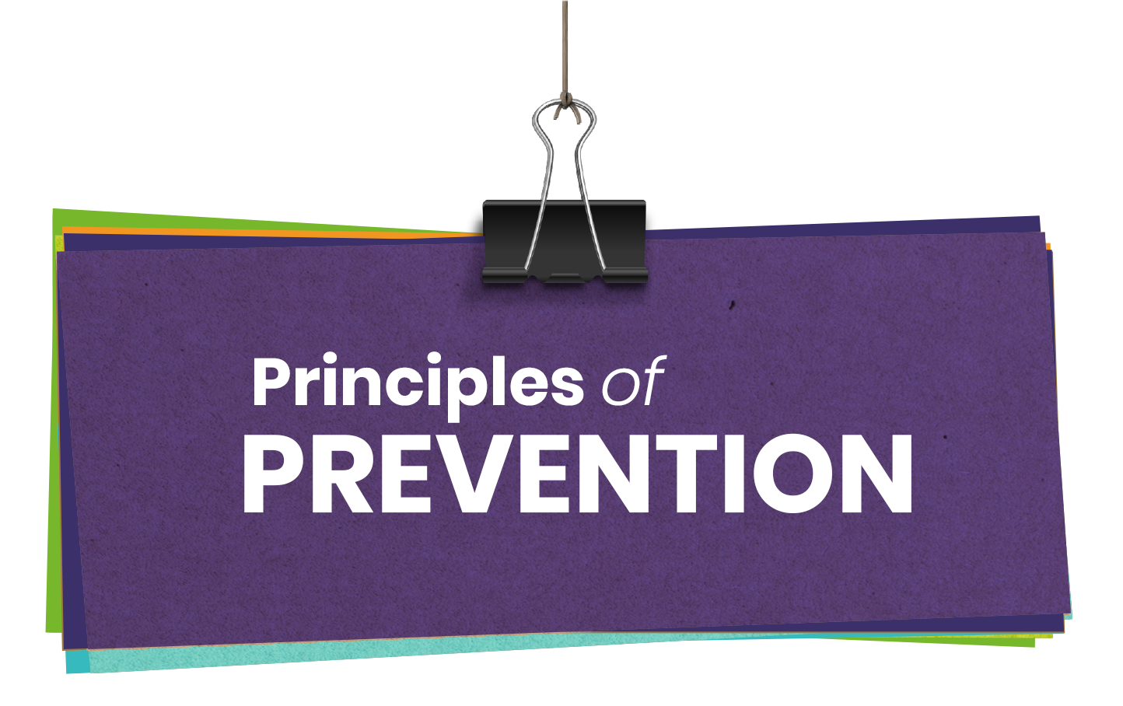
The Principle that supports infant mortality in the community.
Managing delivery complications, neonatal care, and childhood illnesses in the community: A pilot home-based newborn care initiative that included sepsis management, low-birthweight infant support, primary prevention, health education, and TBA training decreased newborn and infant mortality rates.
Home visit: Pre- and postnatal home visits by Community health workers to counsel moms, give newborn care, and arrange referrals may lead to early detection of problems and appropriate referrals. (Lassi, S. et al., 2016)
(Uk.image, nd)

Slide 5

WHO ARE THE STAKEHOLDER?
The health and wellbeing board recognizes that enhancing health and decreasing health inequities is complicated and needs numerous interventions by many organizations.
King’s Fund
Adult Social Care
HNS Southeast London Clinical Commissioning Group
Southwark Public Health
General Practitioner (GP)
Local Authority
All Adult Women living in the community
School Teachers
(Southwark.gov.uk, 2020)

Slide 6

How Digital Campaigns Can Help Reduce Infant Mortality.
A digital campaign on newborn death rates can reach citizens who require health information. All digital efforts are supposed to create awareness, but we're striving to impact community members' lives by ensuring they have access to critical information.
Email is the best digital tool for reaching large audiences.
A recent analysis indicated that a higher mortality rate is "totally or virtually entirely" due to less advantaged populations. Over 90% of people own a cell phone, therefore texting could be an effective way to reach those without email.
Monthly digital newsletters or blog posts might raise awareness of the issue. (Granicus.com, nd)
(Uk.image, nd)

Slide 7
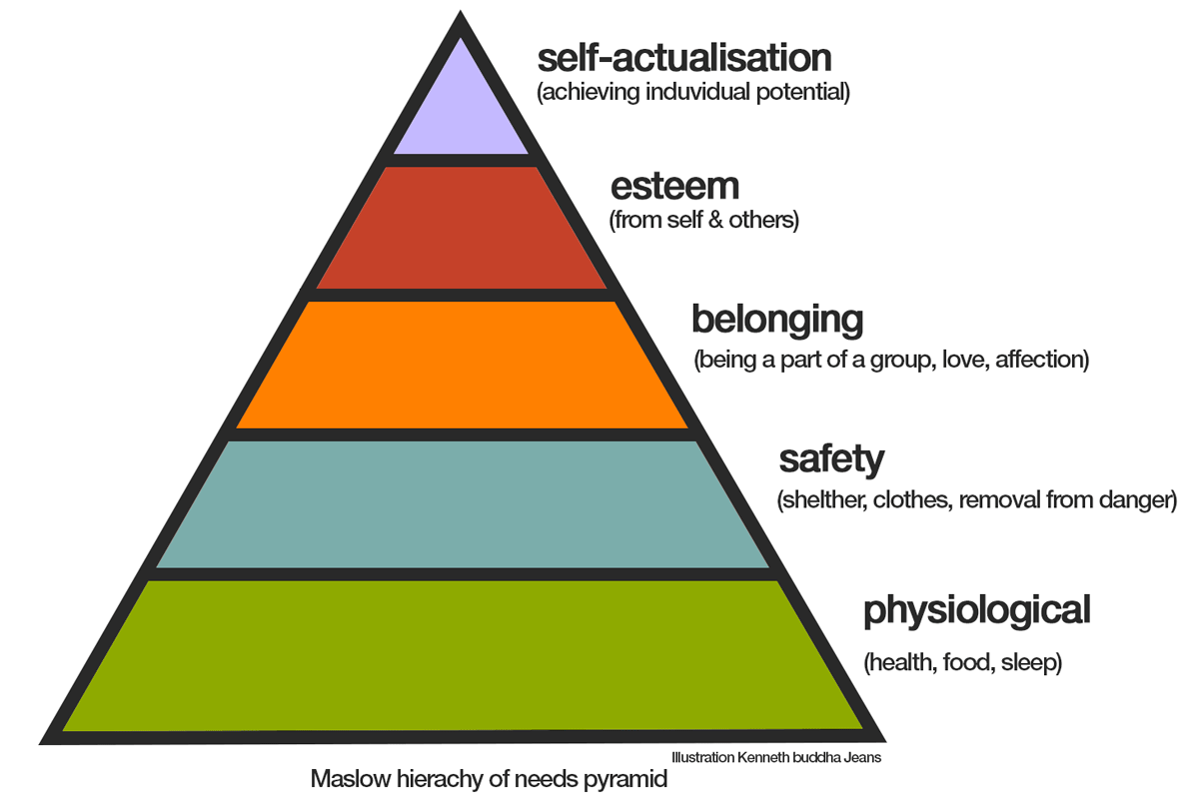
Maslow’s Hierarchy of Needs
infancy and Toddlerhood Period
Physiological needs: During this time, physiology is crucial. A baby's nutrient intake must keep up with its growth.
Safety Needs: Infants and toddlers need support with this. Curiosity can lead to danger. Parents "baby-proof" their homes to meet this demand.
Belonging and Love Needs: Infants and toddlers develop quickly. They form attachments and are comforted (or disturbed) by others' presence. A mother's voice or scent can comfort a youngster. A father's hug can comfort and delight a youngster. (Weebly.com, nd)
(quotesgram.com, nd)

Slide 8

Legislation and Policy.
Malnutrition and inadequate cleanliness may increase newborn mortality.
The Education (Provision of Meals) Act 1906 allowed local authorities the right to give free school meals due to children's poor nutrition and health. (The Health Foundation, 2022)
Renewed investment and resources should support the Healthy Child Program modification.
The program shall provide universal preventative services for 0–2-year-olds.
A health visitor must see every child at least five times.
The Program should be revised using the 5th edition of 'Health for All Children (2019)
(RCPCH, 2020)
JJJJCPCHRCPCH, 2020)
(Uk.image, nd)

Slide 9
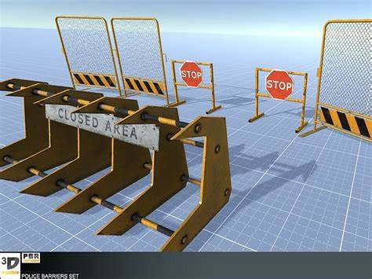
Obstacles and Barrier
Funding: Programs for home visits require consistent funding and backing from physicians and other healthcare professionals. (Temple, P. et al., 2008 p 371-384)
Communication: •BME women who don't speak English or are recent migrants may not grasp suggestions.
•Many 'promising' techniques need further research and testing before being deployed or evaluated in the NH 'promising' techniques need further research and testing before being deployed or evaluated in the NHS.
•Many 'promising' techniques need further r(ese(and testing before being deployed or in N or evaluated in the NHS.ME migrants, may not fully or adequately understand information and advice provided ME women, who lack English as their first language or are recent migrants, may not fully or adequately under information and advice provided
Many 'promising' techniques need further research and testing before being deployed or evaluated in the NHS.
Complexity: The intricacy of the system hinders BME women's early presentation for ongoing prenatal care.
(NPEU, 2022)
(Uk.image, nd)

Slide 10

My recommendation will be.
Prenatal care and routine prenatal checkups should be prioritised to ensure the unborn child's smooth delivery.
It will be better for all women to start taking folic acid as this can reduce the risk of birth abnormalities.
Because it reduces the risk of infant mortality, breastfeeding should be supplied to the kid for six months after birth. Providing the child with healthy diet aids in maintaining his well-being.
(Vedantu.com, 2022)
(Uk.image, nd)

Slide 11

To sum up this PowerPoint presentation on infant mortality in the Southwark borough, I can say that the deaths of infants before the age of one year or before their first birthday have demonstrated the significance of healthy births and the need for the Southwark Council to support these births and ensure that the necessary steps are taken before, during, and after pregnancy.
(Uk.image, nd)

Slide 12

References.
CDC- Centers for Disease Control, (2022) Infant Mortality (Online). Available at:
https://www.cdc.gov/reproductivehealth/maternalinfanthealth/infantmortality.htm
(Accessed: 15th November 2022)
(2) Granicus, (no date) Digital Campaigns can Help Reduce Infant Mortality (Online).
Available at: https://www.Granicus.com/blog/digital-campaigns-can-help-reduce-infant-mortality-rates/
(Accessed: 23rd November 2022)
(3) Lassi, S. et al., (2016) Community Base Care to Improve Maternal Newborn (Online).
Available at: https://www.ncbi.nlm.nih.gov/books/NBK361898/ (Accessed 22nd November 2022)
(4) Newsshopper, (2018) Statistics Southwark Infant Mortality (Online). Available at:
https://www.newsshopper.co.uk (Accessed: 15th November 2022)
(5) RCPCH, (2020) Infant Mortality (Online). Available at:
https://www.stateofchildhealth.rcpch.ac.uk/evidence/mortality/infant-mortality
(Accessed: 23rd November 2022)
(6) Southwark, (2018) Southwark Joint Strategic Needs Assessment (Online). Available at:
https://www.southwark.gov.uk/health-and-wellbeing/public-health/health-and-webeing-in-southwark-jsna
(Accessed: 13th November 2022)
(7) Southwark, (2020) Southwark Health and Wellbeing (Online). Available at: https://www.southwark.gov.uk/jsna
(Accessed 23rd November 2022).
(Uk.image, nd)

Slide 13
References:
(8) Temple, P. et al., (2008) Limited Access to Care and Home Healthcare (Online). Available at:
https://www.journals.lww.com/clinicalobgyn/Abstract/2008/06000/Limited_Access_to_Care_and_Home_Healthcare.20.aspx (Accessed: 22nd November 2022)
(9) NPEU, (2022) Inequality in Infant Mortality Work programmed (Online). Available at:
https://www.npeu.ox.ac.uk/research/projects/25-bme-barriers-antenatal-care
(Accessed: 23rd November 2022)
(10) Vedantu, (2022) Infant Mortality Rate (Online). Available at:
https://www.vedantu.com/biology/infant-mortality-rate (Accessed: 23rd November 2022)
(11) Vinsights, (2022) Southwark: Borough Level Demographic Composition Covering The Last Two Census (Online). Available at: https://www.vinsights.co.uk/CensusBorough/Southwark (Accessed: 17th November 2022)
(12) Weebly, (no date) Maslow’s Hierarchy of Needs (Online). Available at:
https://www.hierarchybymaslow.weebly.com/infancy-and-toddlerhood.html (Accessed: 21st November 2022)
(13) The Health Foundation, (2022) Legislation to Tackle The Rise in Infant Mortality (Online). Available at: https://www.navigator.health.org.uk/theme/legislation-tackle-rise-infant-mortality (Accessed: 17th November 2022)
(Uk.image, nd)

