Slide 1

MBA Marketing management
BMMB7012
The Marketing Environment
Gwyneth jones
April 2024

Slide 2

The Marketing environment
The Marketing Environment consists of external forces which affect an organisation’s capability to operate effectively in providing products and services to its chosen markets.
It can be classified into:
The macro-environment (external environment)
The micro-environment (immediate external environment)

Slide 3
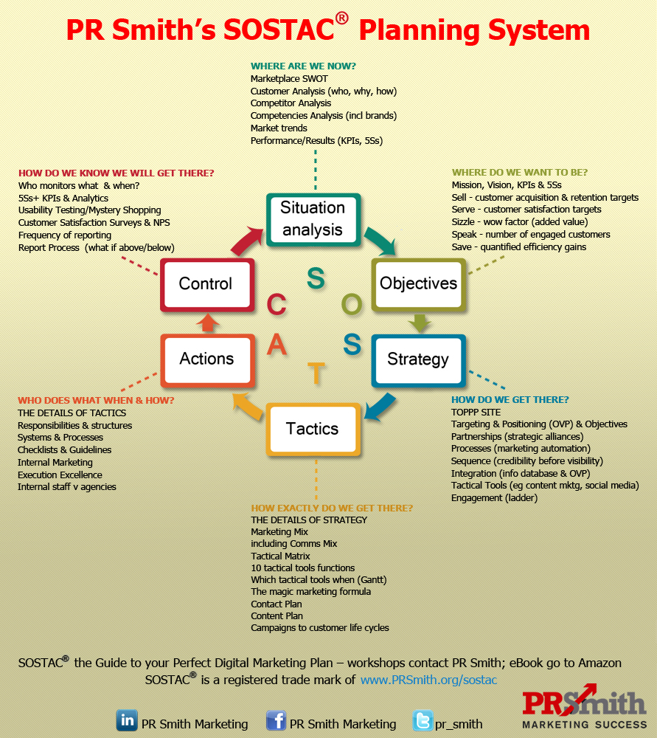
Marketing planning process
Largely linear: follow steps in order to make well-informed decisions
Understand core strategy and strategic plan to ensure branding is aligned
Situation analysis is key to recognising changing market conditions and customer preferences
Flexibility required to adapt

Slide 4
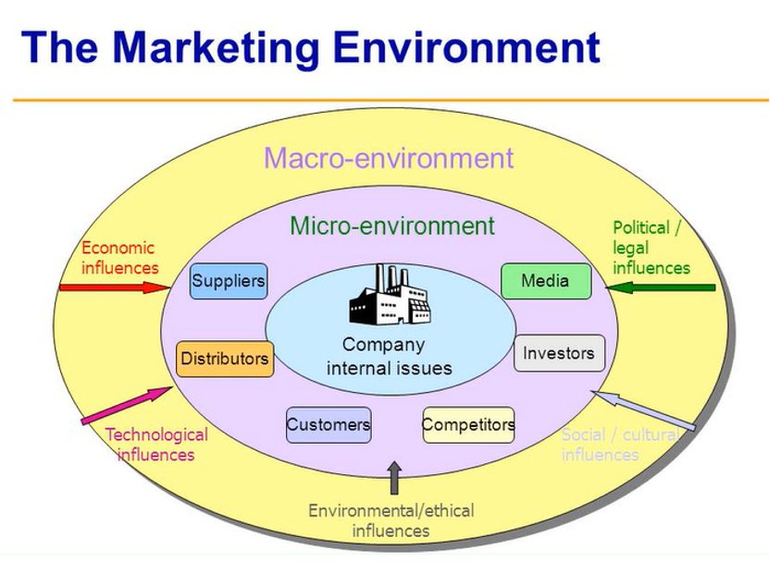
The macro, micro and internal marketing environment
The Business Environment consists of several layers, with the organisation in the centre

Slide 5
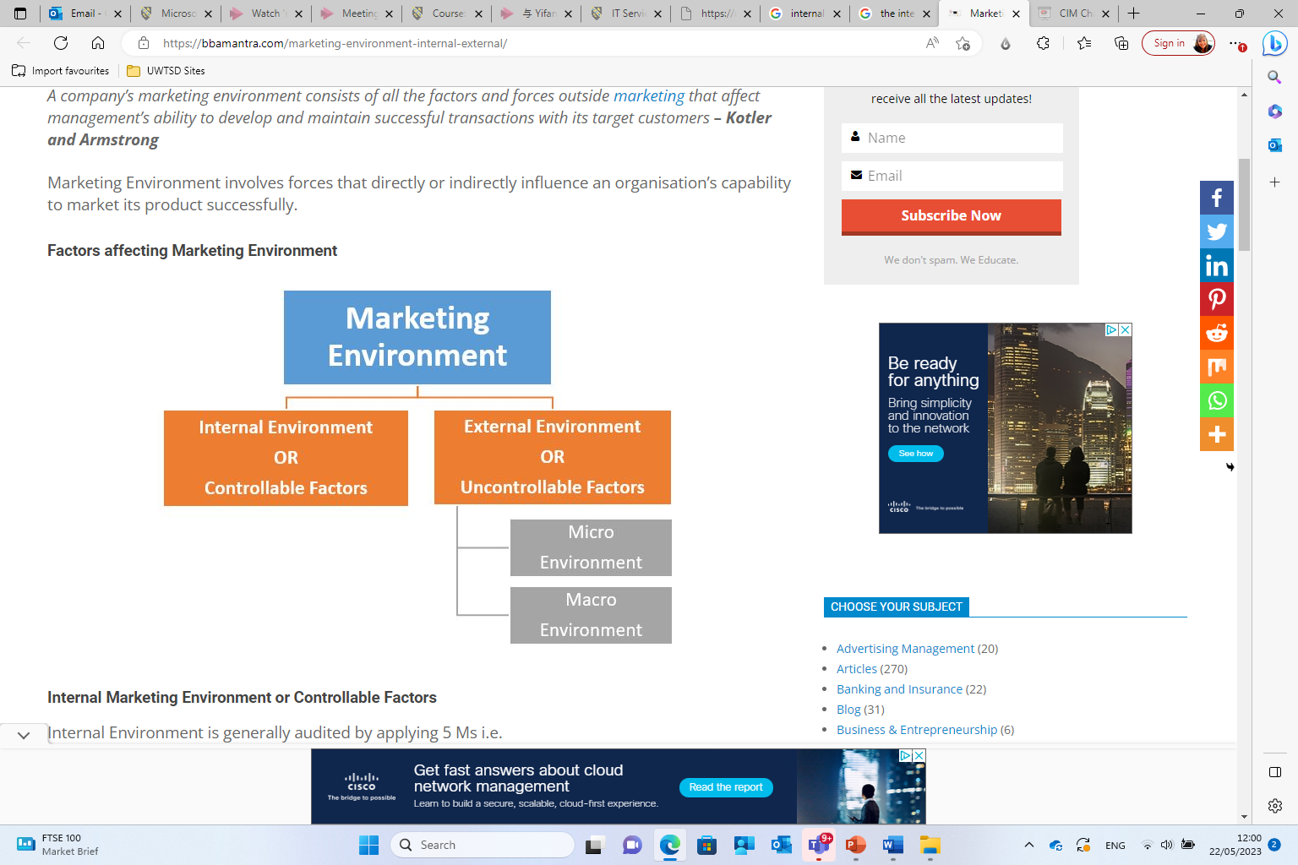
The macro, micro and internal marketing environment
The Business Environment can be evaluated externally and internally.

Slide 6
Environmental scanning
Analysing the External Environment
Environmental scanning in marketing is defined as a comprehensive review of the external environment
The purpose is to uncover factors that influence future decisions
Environment
Fit
Fit
Strategy
Organisation
Fit

Slide 7
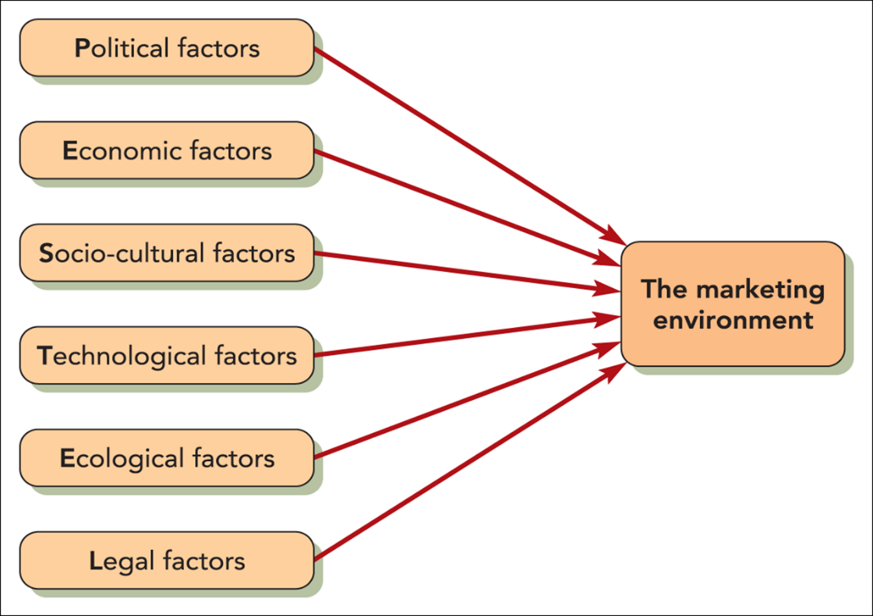
Analysing the macro environment with Pestel
Influence Organisation’s Environment
PESTEL OR PESTLE is a strategic framework
Also known as STEP or STEEPLE,
Guides analysis of macro-environment (external)
Changes in the external environment play a big part in determining marketing planning and shaping strategy
These factors do not include market forces such as the effect of increasingly more intensive competition. (Blythe & Megicks (2020)

Slide 8


Pestle: political factors
Political factors include:
Government policies
Taxation changes
Foreign trade regulations
Political risk in foreign markets
Changes in trade blocks (e.g. BREXIT)
Exposure to civil society organisations
(e.g. lobbyists, campaign groups, social media)

Slide 9
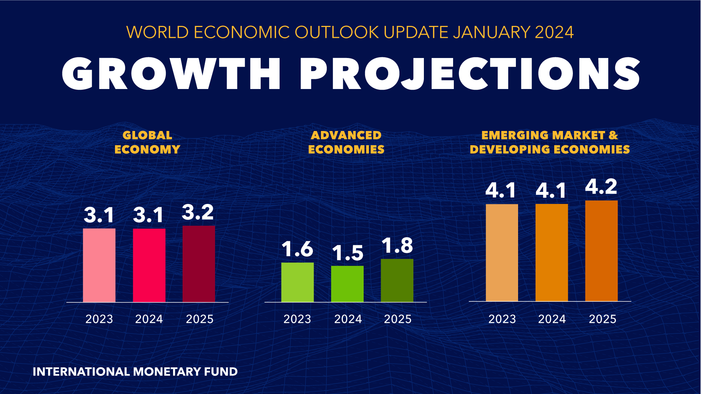
Pestle: Economic factors
The general state of both national and international economies can have a profound effect on an individual organisation’s prosperity
Three major economic influences on the organisation’s environment of companies:
  Economic growth and unemployment
  Interest and exchange rates
  Taxation and inflation

Slide 10
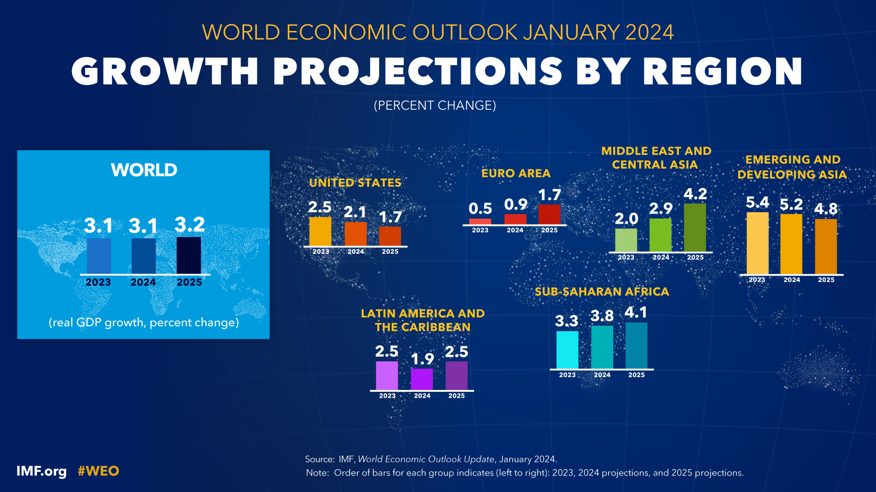

Slide 11
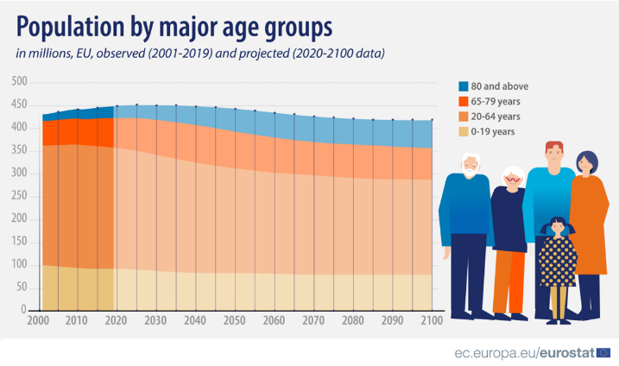

Pestle: Socio-cultural factors
To understand your market, you have to understand socio-cultural trends
Including factors such as:
  seasonal shifts in demand based on cultural peculiarities or
  age of a population
  income level
  health concerns

Slide 12

More on cultural factors
Culture is the combination of values, beliefs, and attitudes that is possessed by a national group or sub-group
Rapid movement of global population has meant that ethnically based subcultures have sprung up in most developed countries
This has created potentially lucrative niche markets for products and services

Slide 13

Technological factors
Technological innovations are of growing concern
Can be highly disruptive and lead to big increases in profit margins
Automation is a cornerstone of technological considerations
  Artificial Intelligence
  Car-assembling robots
  Self-service scanners in supermarkets
  Online shopping
Not all innovations are guaranteed to be beneficial!

Slide 14
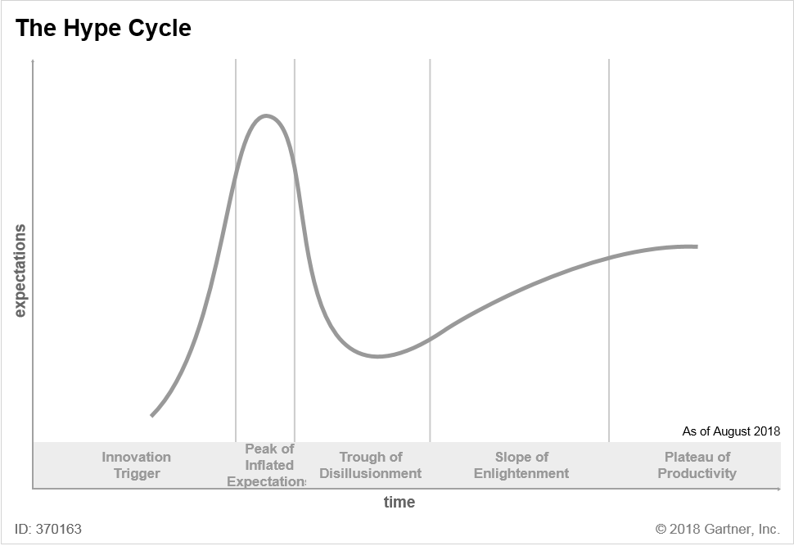
Gartner’s Hype Cycle
Used to evaluate emerging technologies
Gartner Hype Cycle Research Methodology | Gartner
Understanding Gartner’s Hype Cycles
4 Exciting New Trends in the Gartner Emerging Technologies Hype Cycle
Hype
Hype Cycles help you:
Separate
Separate hype from the real drivers of a technology’s commercial promise
Reduce
Reduce the risk of your technology investment decisions
Compare
Compare your understanding of a technology’s business value with the objectivity of experienced IT analysts

Slide 15
How Do hype cycles work?
Each Hype Cycle drills down into the five key phases of a technology’s life cycle.
Innovation Trigger: A potential technology breakthrough kicks things off. Early proof-of-concept stories and media interest trigger significant publicity. Often no usable products exist and commercial viability is unproven.
Peak of Inflated Expectations: Early publicity produces a number of success stories — often accompanied by scores of failures. Some companies take action; many do not.
Trough of Disillusionment: Interest wanes as experiments and implementations fail to deliver. Producers of the technology shake out or fail. Investments continue only if the surviving providers improve their products to the satisfaction of early adopters.
Slope of Enlightenment: More instances of how the technology can benefit the enterprise start to crystallise and become more widely understood. Second- and third-generation products appear from technology providers. More enterprises fund pilots; conservative companies remain cautious.
Plateau of Productivity: Mainstream adoption starts to take off. Criteria for assessing provider viability are more clearly defined. The technology’s broad market applicability and relevance are clearly paying off.

Slide 16


Slide 17

Ecological factors
Climate change
Pollution
Conservation of scarce resources
Recyclable and non-wasteful packaging
Use of environmentally friendly ingredients
Animal testing of new products
Use of environmentally friendly ingredients
Corporate Social Responsibility (CSR)
Marketing ethics
Consumer movement

Slide 18
Ecological factors
Which company would you consider as an ethical company – and why?
Corporate Social Responsibility (CSR)
CSR is a management concept
Companies integrate social and environmental concerns in their business operations and interactions with their stakeholders
To what degree do you feel your purchasing decisions are influenced by ethical / social and/or environmental factors?

Slide 19

Legal factors
Health and safety
Equal opportunities
Access to resources
Consumer rights
Standards policies
Etc.

Slide 20
Using the PESTEL framework
Apply selectively – identify specific factors which impact on the industry, market and organisation in question.
Identify factors which are important currently but also consider which will become more important in the next few years.
Use data to support the points and analyse trends using up-to-date information.
Identify opportunities and threats – the main point of the exercise.

Slide 21
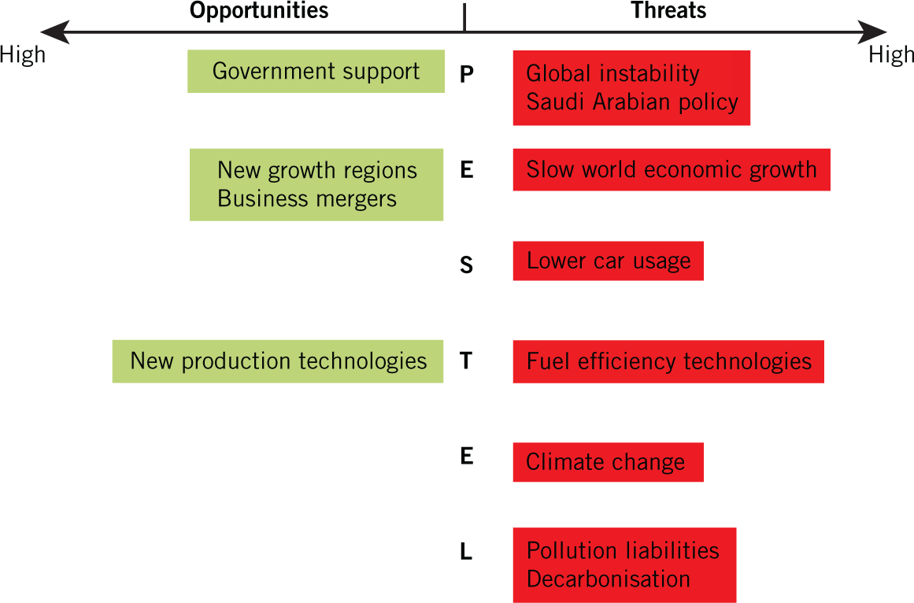
PESTEL example
This is an example of PESTEL for the oil industry

Slide 22

Pestel analysis – using amazon as an example
Two Teachers
https://youtu.be/F0KQ-h6v3-s

Slide 23
The micro environment
Micro-environment refers to the environment which is in direct contact with company and affects the routine activities of business straight away.
It is a collection of forces or factors that are close to the organization and can influence the performance as well as the day-to-day activities of the firm.
The Business Environment consists of several layers, with the organisation in the centre

Slide 24
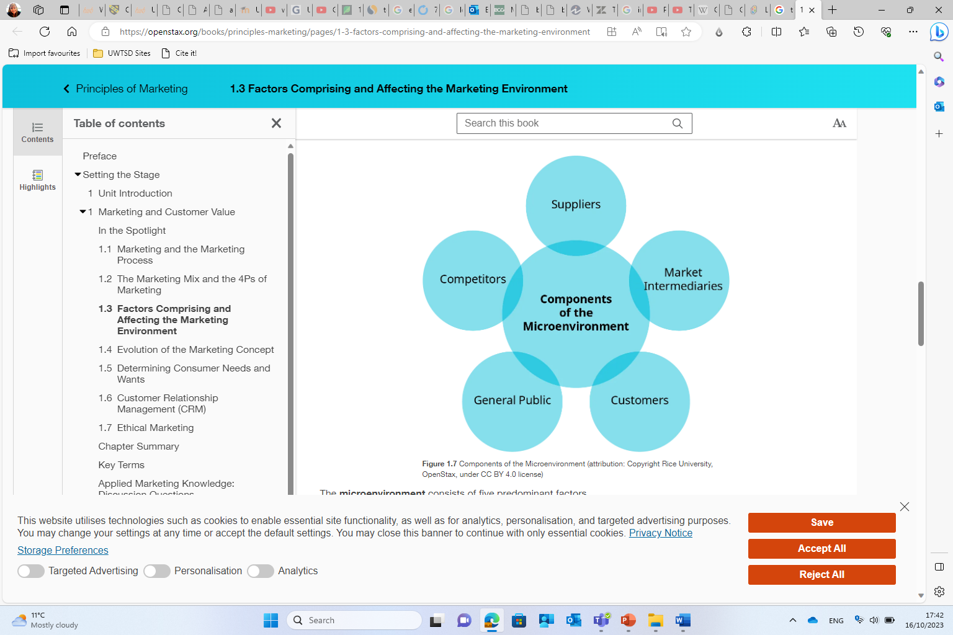
The micro environment
Components of the Micro Environment

Slide 25
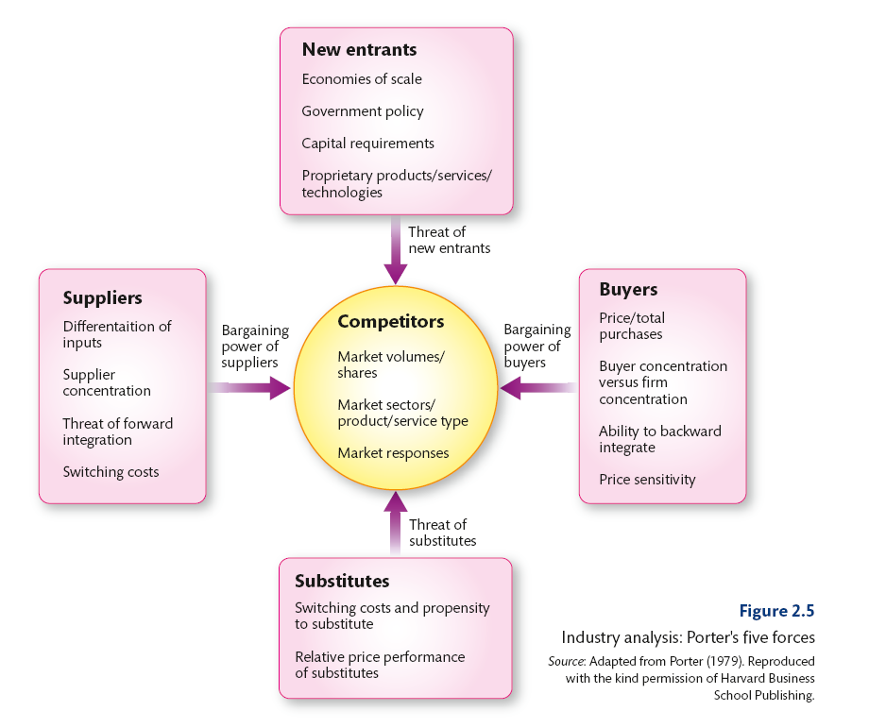
Porter’s five forces
Developed by Michael Porter of Harvard University
Identifies the attractiveness of industries – which industries/markets to enter or leave.
Identifies strategies to influence the impact of the forces, for example, building barriers to entry by becoming more vertically integrated.
The forces may have a different impact on different organisations e.g. large firms can deal with barriers to entry more easily than small firms.

Slide 26

The Five Competitive Forces That Shape Strategy
Interview with Michael E. Porter, Professor, Harvard University
https://youtu.be/mYF2_FBCvXw
Porter's 5 Forces EXPLAINED | B2U | Business To You - YouTube

Slide 27
Competitors / rivalry
Rivalry between existing competitors
Competitive rivals are organisations with similar products and services aimed at the same customer group and are direct competitors in the same industry/market (distinct from substitutes).
The degree of rivalry depends on things like:
    Competitor concentration (rivalry = high if concentration is high or balanced in strength)
    Industry growth rate (rivalry = high if growth rate is low)
    High fixed costs (e.g. costs that stay the same, no matter how many products are being made)
    High exit barriers (e.g. very specialised assets, which may be difficult to sell or relocate, closure costs)
    Differentiation

Slide 28
New entrants
The threat of entry
Barriers to entry are the factors that need to be overcome by new entrants if they are to compete. The threat of entry is low when the barriers to entry are high and vice versa.
The main barriers to entry include:
  Required experience
  Access to supply and distribution channels
  Differentiation and market penetration costs
  Legislation or government restrictions (e.g. licensing)
  Retention of advantages

Slide 29
substitutes
The threat of substitutes
Substitutes are products or services that offer a similar benefit to an industry’s products or services, but have a different nature i.e. they are from outside the industry.
Customers will switch to alternatives (and thus the threat increases) if:
The price/performance ratio of the substitute is superior (e.g. aluminium is more expensive than steel but it is more cost efficient for car parts)
The substitute benefits from an innovation that improves customer satisfaction (e.g. high speed trains can be quicker than airlines from city centre to city centre on short haul routes).
Extra-industry effects. Substitutes come from outside the industry which forces managers to look outside their own industry to consider more distant threats and constraints.

Slide 30
suppliers
The bargaining power of suppliers
Suppliers are those who supply what organisations need to produce the product or service. Powerful suppliers can reduce an organisation’s profits.
Supplier power is likely to be high, for example, when:
  The suppliers are concentrated (few of them)
  Suppliers provide a specialist or rare input
  Switching costs are high (it is disruptive or expensive to change suppliers)
  Suppliers can integrate forwards (e.g. low-cost airlines have cut out the use of travel agents)

Slide 31
buyers
The bargaining power of buyers
Buyers are the organisation’s immediate customers, not necessarily the ultimate consumers.
If buyers are powerful, then they can demand cheap prices or product/service improvements to reduce profits.
Buyer power is likely to be high, for example, when:
    Buyers are concentrated (few of them)
    Buyers have low switching costs (it not disruptive or expensive to change their providers)
    Buyers can supply their own inputs (backward vertical integration, e.g. through the acquisition of a business operating earlier in the supply chain – e.g. a retailer acquiering a wholesaler)

Slide 32
Porter’s five forces analysis – example: UK supermarkets
Two Teachers
https://youtu.be/30oFuYiYOp0

Slide 33
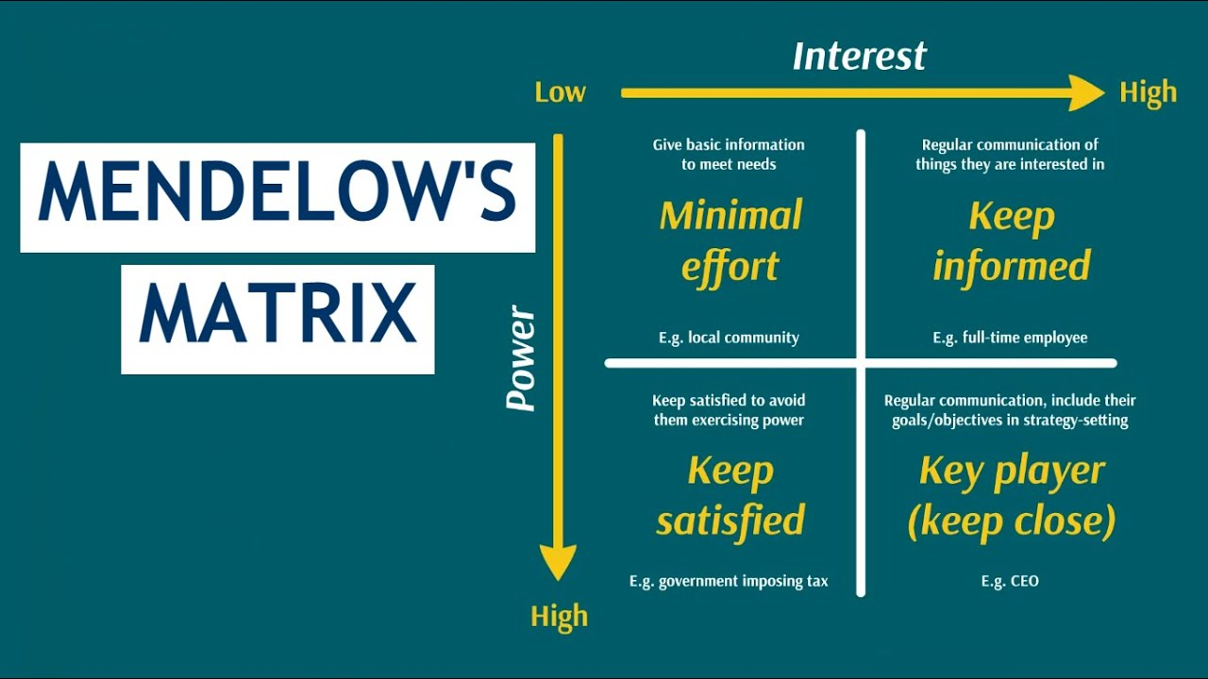
MendElow Matrix –
A strategic planning tool used to understand and prioritize different stakeholder interests when planning marketing strategies

Slide 34
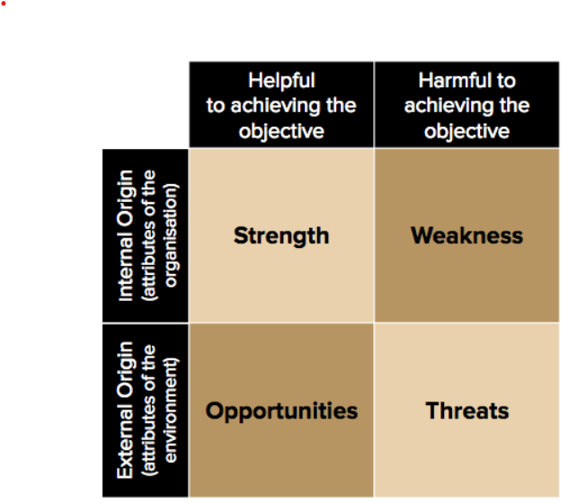
Opportunities and threats
The critical issue in undertaking macro-environmental analysis (e.g. PESTEL) and industry analysis (e.g. Porter’s Five Forces) is the implications that are drawn from this understanding in guiding strategic decisions and choices.
Identifying opportunities and threats is extremely valuable when thinking about strategic choices.
Opportunities and threats form one half of the SWOT analysis that shapes strategy.

Slide 35
marketing audit
Analysing the Internal Environment
Element | Examples
Physical resources | List of fixed assets e.g. machinery, buildings and equipment and their age, condition, financial value
Human resources | Staff, their motivation, commitment, capabilities etc.
Financial resources | Sources of money e.g. equity or loan, funding sources
Intangibles | Brands, patents, reputation and relationships (e.g. with customers)
Marketing Audit is the analysis of the internal environment
It includes physical / human / financial resources, as well as intangibles

Slide 36
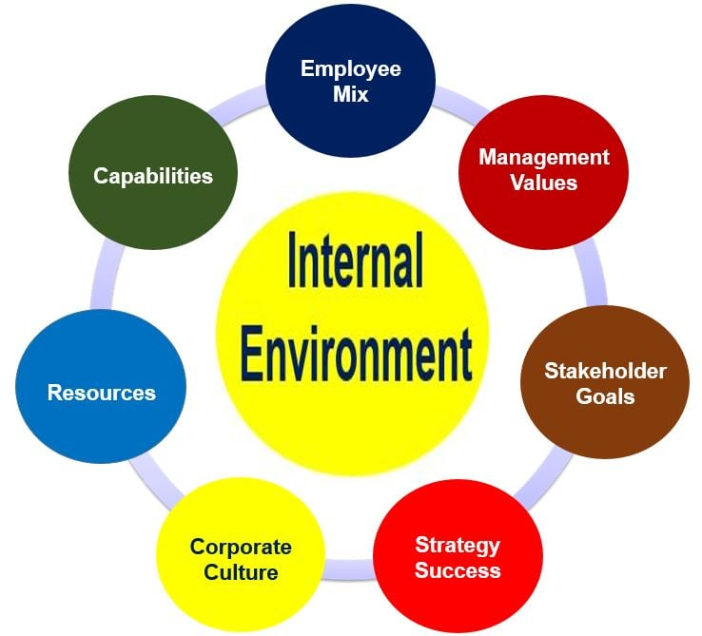
The internal marketing environment
Factors inside the company that are unique to the organisation.
Analysis of the internal environment is critical in the development of marketing strategy to ensure that the firm’s strategy is based upon its situation, resources and goals.

Slide 37
Swot analysis
STRENGTHS & WEAKNESSES: (Internal)
  What are we best / worst at?
  Specific skills / training
  Financial resources
  Partnerships
  Intellectual property
  Etc.
OPPORTUNITIES & THREATS: (External)
  Market changes to exploit or to defend against
  Competitors weaknesses / strengths
  Technology developments
  New markets
  Etc.

Slide 38
SWOT Analysis – example questions to ask yourself
Strengths | What does your company do particularly well? Do you have a strong brand? Large market share? High quality? Low prices? Strong supplier relations? Loyal customers?
Weaknesses | What are your failings? Are you slow to react to change? Cumbersome management structure? Poor supplier relations? High production costs? Poor customer satisfaction?
Opportunities | What are the opportunities in the market? How can your strengths be used to exploit these? Which weaknesses should you address to do so more efficiently?
Threats | What are the main threats facing your company? How can you use your strengths to address them? Which strengths should you build on to secure and build on your position? Which weaknesses pose the greatest hazard?

Slide 39

Going Beyond a SWOT Analysis

Slide 40
TOWS Analysis
A TOWS analysis takes a SWOT analysis one step further to help you take action with your findings.
The TOWS acronym uses the same elements as SWOT, but in reverse order. It combines internal and external forces to come up with productive ideas of how to best use the information.
The main purpose of a TOWS is to reduce threats, take advantage of opportunities, exploit strengths, and remove weaknesses.

Slide 41
What is the difference between TOWS and SWOT?
Although TOWS uses the same elements as a SWOT analysis, it is more of an action tool rather than an analysis one. TOWS is best used as an addition to the analytical SWOT tool to help you decide what to do with your findings.
Why is it important?
TOWS helps bridge the gap between research and forward thinking strategic directions.
It can very quickly define key focal points for actions.
It covers all bases by taking into account positive and negative influences.

Slide 42
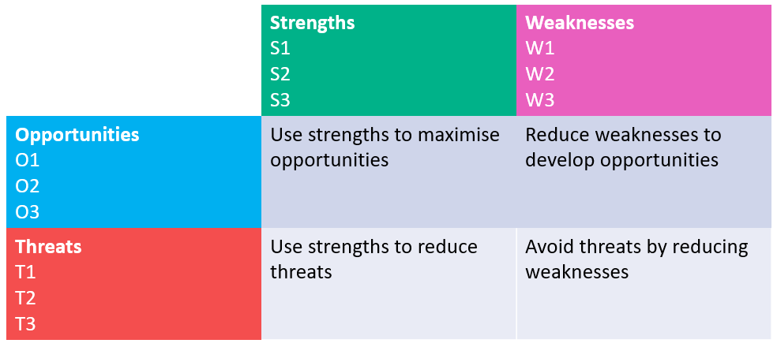
How does TOWS Analysis Work?
Your SWOT analysis will give you a list of Strengths, Weaknesses, Opportunities, and Threats. Number these as S1, S2, W1, W2, and so on. This will make it easier to identify them later.

Slide 43
Measure the elements against each other to consider potential strategies
Strengths & Opportunities: Use strengths to maximise opportunities
Strengths & Threats: Use strengths to reduce threats
Weaknesses & Opportunities: Reduce weaknesses to develop opportunities
Weaknesses & Threats: Avoid threats by reducing weaknesses

Slide 44
How to Use TOWS
TOWS can expand your SWOT analysis to discover some really useful potential strategies for the future.
See examples on the next slides

Slide 45
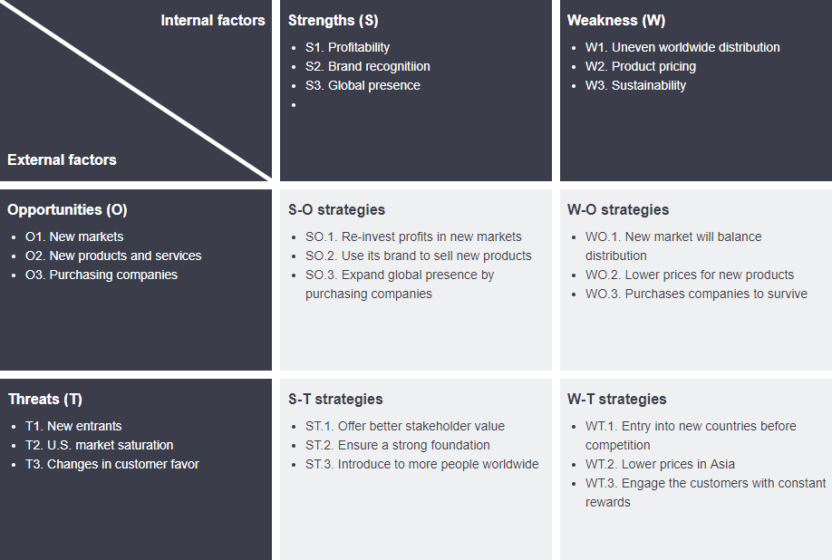

Slide 46
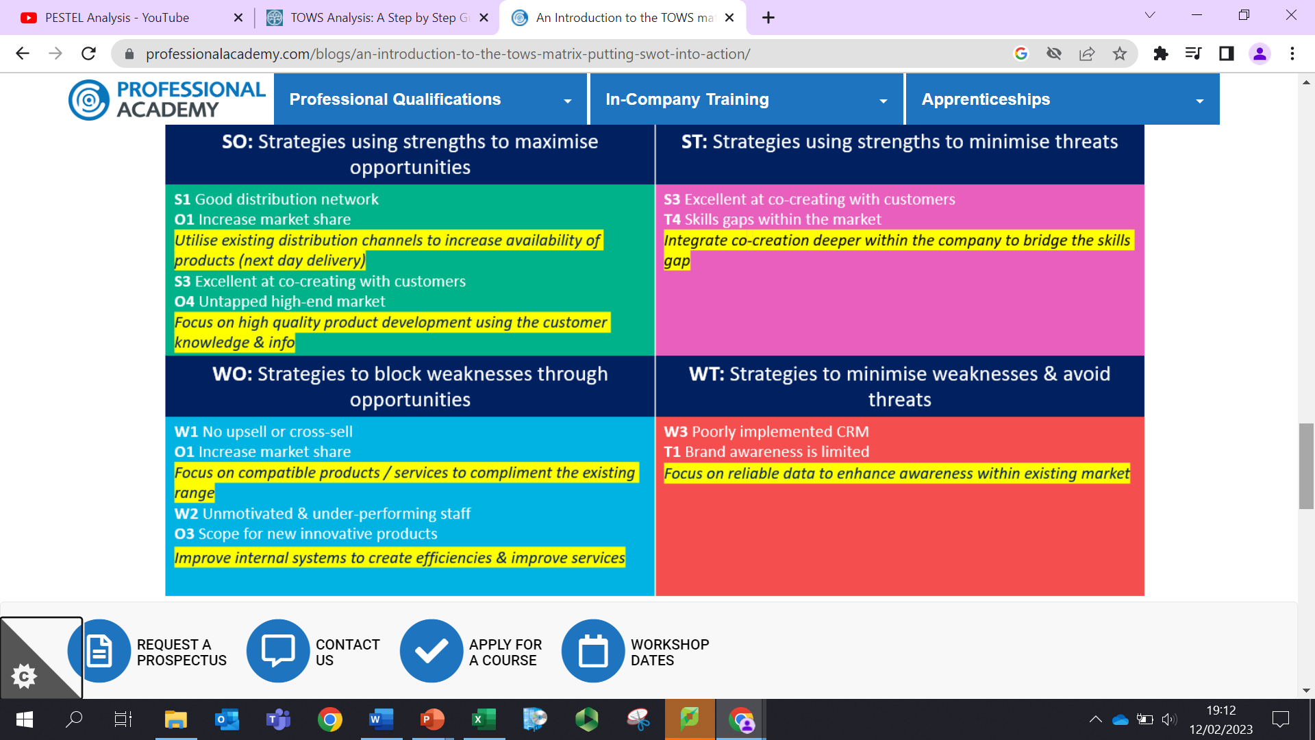

Slide 47
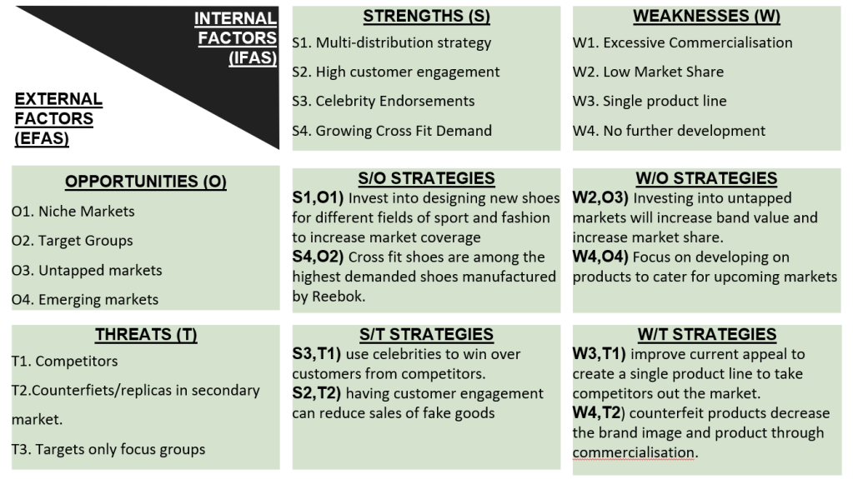
Example TOWS - Reebok

