Slide 1

BIOMETRIC REGISTRATION SYSTEM

Slide 2
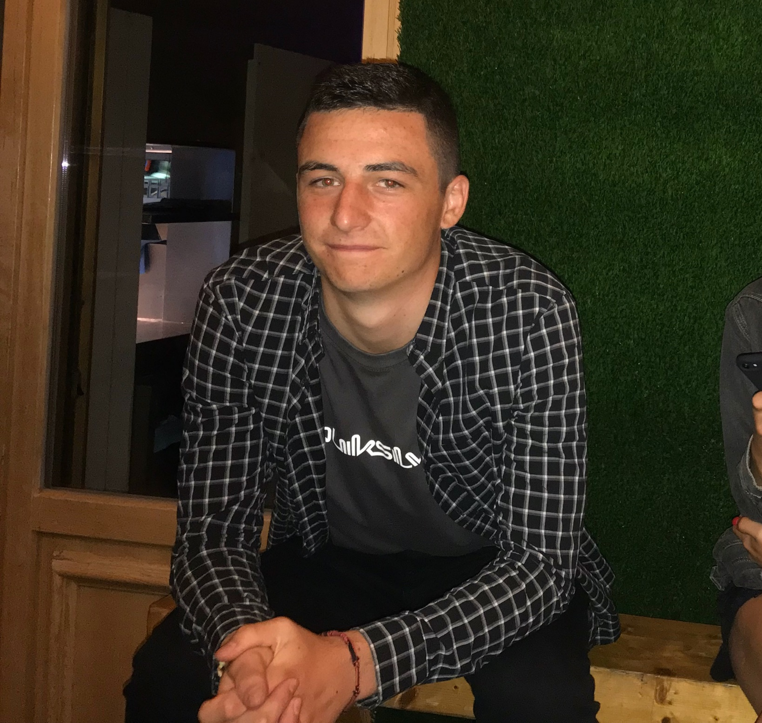
TEAM
Name:
Course:
Role:
Cieran Hughes
Applied Computing
Project Manager

Slide 3
Contents
Introduction Slide 4
Resource Planning Slide 5
Business Slide 8
Conclusion Slide 10
References Slide 11

Slide 4
Introduction
In the presentation we will be informing you of our product that we will be developing over the coming months
We will talk about the market
The planning and production of the product
Information on our business and objectives
Team Working
Cieran Hughes

Slide 5
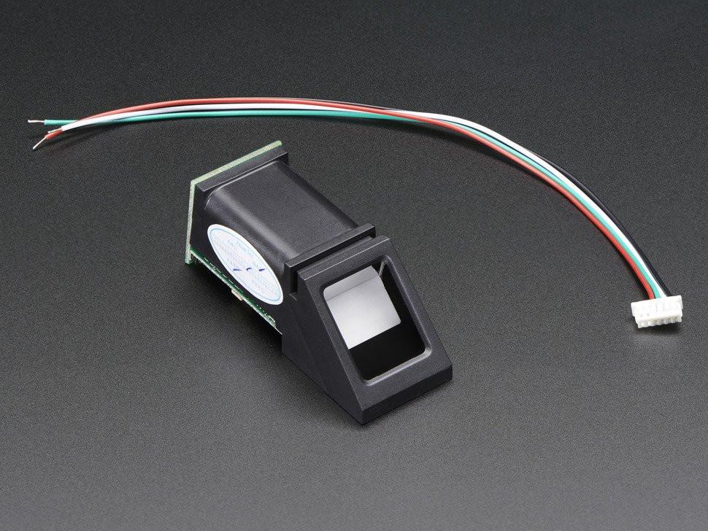
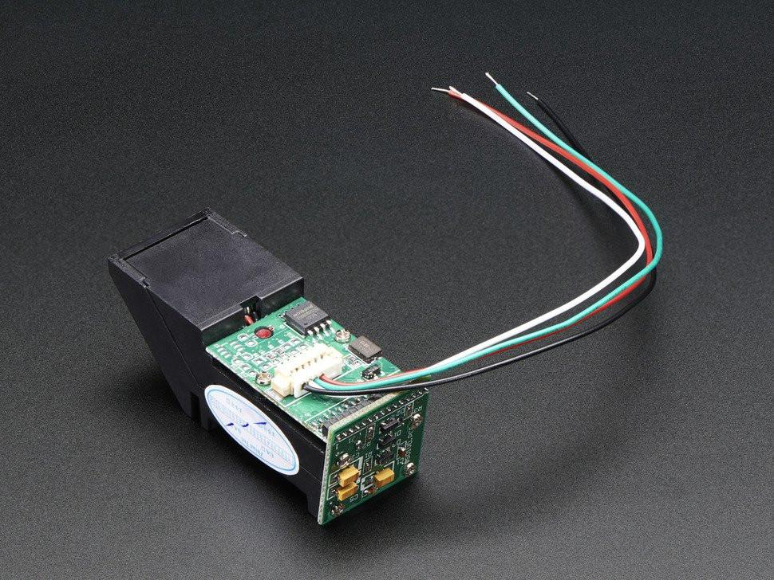
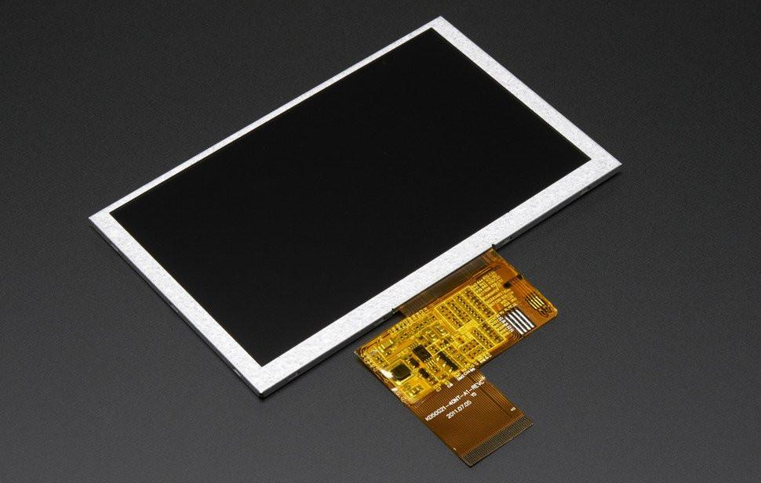
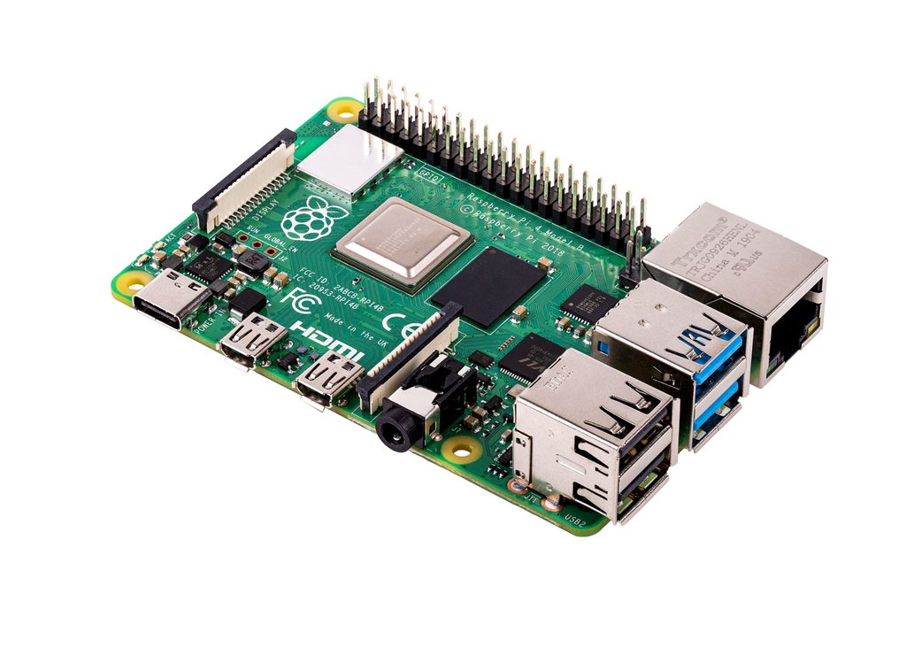
Resource Planning
Hardware
  Fingerprint scanner
  RaspberryPi for host the website and running the SQL server
  Mini Screen to show status after using the scanner
[4]
[1]
[2]
[3]
Cieran Hughes

Slide 6





Resource Planning
Software
  Integrated Development Environments (IDEs)
  Microsoft Office 365 suite
  Linux
[5]
Cieran Hughes

Slide 7
Resource Planning
People
  Students to test the system as it is being developed
  Lectures to give input on how they picture the system working
  Registration Team
Cieran Hughes

Slide 8
Business
Tech Start-up
We decided on the name Biometric Registration System (BRS)
The logo, as seen shows the main colours that will be used throughout the house style of the company Green, Orange and Red.
The legal classification of BRS is a Limited Partnership. This will give the owners a limited liability.
Our Mission Statement:
[6]
“Making Registration Easy”
Cieran Hughes

Slide 9
Business
Objectives
  Develop a fingerprint recognition system for students to sign into lectures
  Create a web interface that will show all the attendance for lectures, stats and trends
  Allow the lecturer to append student data and time of entry. e.g. if the student failed to use the fingerprint reader
  The system recognises late students
Cieran Hughes

Slide 10
Conclusion
I hope this presentation informed you all of our resources that will be used thought out the project
The business we will strive to become.
Cieran Hughes

Slide 11
References
[1] – Image Finger Print Sensor: https://thepihut.com/products/adafruit-fingerprint-sensor?variant=27740485969&currency=GBP&gclid=Cj0KCQiAno_uBRC1ARIsAB496IWmgTlMjfkMRE0HARldKIxZm42cJ9H9oi5rInqHfypaSK6L3_mhBJwaAhhhEALw_wcB
[2] – Image Display: https://thepihut.com/products/adafruit-5-0-40-pin-800x480-tft-display-without-touchscreen?variant=27739549969&currency=GBP&gclid=CjwKCAiArJjvBRACEiwA-Wiqq1lDqOh8hgYl9cfy6qj1EYiMhC-0I3cE0BHL2w6j0xXZ_3YCUai_1RoC46UQAvD_BwE
[3] – Image Raspberry pi 4: https://thepihut.com/products/raspberry-pi-4-model-b
[4] – Image Finger Print Sensor: https://thepihut.com/products/adafruit-fingerprint-sensor?variant=27740485969&currency=GBP&gclid=Cj0KCQiAno_uBRC1ARIsAB496IWmgTlMjfkMRE0HARldKIxZm42cJ9H9oi5rInqHfypaSK6L3_mhBJwaAhhhEALw_wcB
[5] – IDEs: https://searchsoftwarequality.techtarget.com/definition/integrated-development-environment
[6] – Limited Liability: https://www.gov.uk/guidance/set-up-and-run-a-limited-liability-partnership-llp
Cieran Hughes

Slide 12
The End
ANY QUESTIONS?

