Slide 1
BMPE 5005
Pedagogeg Chwarae ym myd Addysg
Pedagogy of Play in Education
Darlith / Lecture 5
13/10/2020
Heddwen Davies
Heddwen.davies@uwtsd.ac.uk
Notes:
During the lecture last Tuesday – you were encouraged to keep notes inorder to help you gain a better understanding of some educational theorists. As a result you now may have a summary of these people. To support you and to help you a little with this – lets recap on these firstly today.

Slide 2
Module Learning Outcome Assessment Part 1/A :
LO1 Evaluate the contribution of constructivist theory and educational ideologies to early years education and the underlying principles and philosophy of the Foundation Phase and/or Successful Futures in Wales.

Slide 3
Recap lecture 1 – Behaviourism
Educational Theorists that have influenced the Foundation Phase
Learning is conditioned with learnt responses. Controlled approach. Teacher is the ‘giver’ of all knowledge and the learner is passive ‘recipient’ of knowledge and understanding based on the reinforcement principle. The learning and behaviour is shaped through positive reinforcement or negative reinforcement.
B.F. Skinner / Pavlov
Notes:
Positive indicates the application of a stimulus;
negative indicates the withholding of a stimulus
The problem with a behaviourist approach is that it initiates learning based on external consequences rather than internal desire to learn.

Slide 4
Recap lecture 1 – Constructivism
Educational Theorists that have influenced the Foundation Phase
Key theorists: Bruner, Piaget, Montessori.
Learning is a result of the child’s exploration of and interaction with the environment but importantly that learning is the result of internal processes rather than external stimuli.
Montessori thought children should have open access from indoor to outdoor areas for ball games and to sit under trees for shade.
Reminder to watch video clip …

Slide 5
LEVEL UP
(25mins video)
Maria Montessori
http://www.tes.co.uk/teaching-resource/Teachers-TV- The-Montessori-Method-6084496/

Slide 6
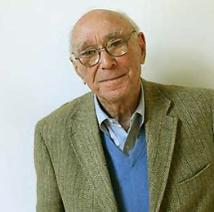
Recap lecture 1 – Constructivism
Educational Theorists
Piaget (1896 – 1980) believed that children can be active participants in their own learning. Children can construct their learning by interacting with their environment. Children can also make connections between new experiences with previous experiences.
Bruner (1915 – 2016) has since proposed the idea of a ‘spiral curriculum’, where a topic can be re-introduced at a more complex level as thinking skills develop
Furthermore, he stressed the importance of
adult intervention to support or ‘scaffold’ learning
and enable a child to make progress
Notes:
PIAGET : Schema – pattern of thought and the relationship between them
There is assimilation when a child responds to a new event in a way that is consistent with an existing schema
BRUNER : He believed that learning is initiated and enhanced by a ‘more knowledgeable other’ through scaffolding e.g. guiding, prompting, discussing, questioning and providing stimulus materials
Piaget = Interest in epistemology – aspect of philosophy concerned with knowledge.

Slide 7
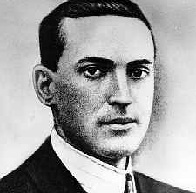
Recap lecture 1 – Social Constructivism
Educational Theorists
Vygostsky (1896 – 1934) said that the gap between what children can achieve unaided and what they can achieve with support and guidance he called the ‘Zone of Proximal Development’
believed that children could achieve higher levels of understanding by communicating and socialising with adults or more knowledgeable peers. All cognitive functions originate in social interaction.
He believed that language/speech and play were important factors that helped children to learn. By playing with others children made meaning of the world which further supported their learning / cognitive functions.
Vygostsky further emphasised the role of the practitioner in matching learning activities to the child’s level of development.
Notes:
Vygotsky 1896 0 1934 – social constructivism – philosophy was that all cognitive functions originate in social interaction and are then internalised on an individual level.
The child will not be able to take the next step in their development unless they are supported in the ZPD
This support is sometimes known as scaffolding (see also Bruner) and is seen as the main role of adults/teachers.

Slide 8
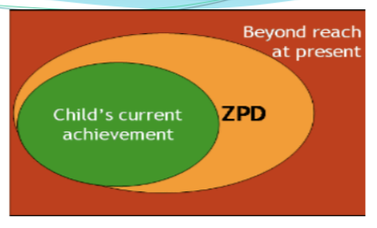
Notes:
The gap between what a child can do on their own and what a child can do with support
The child will not be able to take the next step in their development unless they are supported in the ZPD
This support is sometimes known as scaffolding (see also Bruner) and is seen as the main role of adults/teachers.
What might this ‘scaffolding’ be in your context for very young children? Tying laces? Making knots? Kicking and stopping a ball
Sometimes ZPD this was achieved through play – as play facilitates – supports many different attributes – character / motivation / confidence – role play / self-espression

Slide 9
Y Cyfnod Sylfaen
The Foundation Phase
Cafodd ei ddylanwadu gan nifer o ddamcanieithwyr addysgiadol
Cafodd ei ddylanwadu gan ddulliau rhyngwladol.
Cwricwlwm ar gyfer plant 3 i 7mlwydd oed
annogir plant i ddysgu trwy ddilyn dulliau amrywiol e.e. chwarae a bod tu allan.
Influenced by educational theorists
Influenced by approaches from around the world.
Curriculum for children 3 to 7 years old
learning is encouraged through various methods e.g. play & the outdoors
Notes:
So we now know that the Foundation Phase was created by including influences from around the world. Also – some very well known and respected educational theorists were considered. Within the delivery of this curriculum – behaviourism, constructivism and social constructivism theories are used.

Slide 10
Pam chwarae?
Froebel – rhoi statws i chwarae.
Piaget ‘Chwarae yw gwaith plant.’
Vygotsky –ma’r plentyn yn fwy medrus yn ystod ei chwarae’..
Isaacs ‘dyma sut gwna’r plentyn wneud synnwyr o’r byd.’
Bruce (2001:96) ‘gwna greu cysylltiadau yn yr ymennydd fel bod y byd yn gwneud synnwyr.’
Chwarae fel ymarfer, chware er mwyn dysgu.
Notes:
Darllennwch yn ehangach er mwyn bwydo’ch aseiniad.
Read further in order to support your assignment.

Slide 11
Why Play?
Froebel – gave status to play
Piaget ‘Play is children’s work’. Enables discovery.
Vygotsky – ‘a head and shoulders above himself during play’.
Isaacs ‘children understand the world through play’
Bruce, (2001) ’play creates neuronal networks so that the world makes sense.’

Slide 12
Chwech Maes Dysgu
Seven Areas Of Learning
Personal & Social Development, Well-being and Cultural Diversity Area of Learning
Language, Literacy & Communication Skills
Knowledge & Understanding of the World
Physical Development
Creative Development
Mathematical Development
Welsh Language Development
Notes:
No subjects – areas of learning
Taught holistically – with others i.e. physical & oral / creative development & personal & social etc
Each area of learning is given Range and skills / ystod a sgiliau
The curriculum is a continuum – continwwm yw’r cwricwlwm
We now know from our lecture on Friday that the research that Nalda and now Amanda made showed that children didn’t develop the physical movements that was once assumed that this physical curriculum would provide – yes possibly the locomotor movement were shown to be satisfactory however their ability to manipulate objects was poor. So here lies the argument that you may include in your essays. i.e. it’s expected that you will write positively about the creation and the being of the foundation phase – however evidence has proven that there needs to be further adjustments and considerations to the delivery of this curriculum.

Slide 13
Amcanion / Aims :
To develop an understanding of how the Foundation Phase is taught
To develop an understanding of what is meant by ‘play pedagogy’
Develop an appreciation of the value of play in early education.
Consider how play pedagogy is incorporated within the Foundation Phase to enhance learning.
Gain a better understanding of how children learn.
Datblygu dealltwriaeth sut mae’r Cyfnod Sylfaen yn gweithio mewn ysgolion.
Datblygu dealltwriaeth beth ydy ‘pedagogeg chwarae’
Datblygu gwerthfawrogiad o werth chwarae yn addysg blynyddoedd cynnar.
Dylanwad pedagogeg chwarae i gyfoethogi dysgu yn y Cyfnod Sylfaen.
Ennill gwell dealltwriaeth o sut mae plant yn dysgu.
Notes:
The F Phase – a play based curriculum :
The Foundation phase advocates a holistic child-centered approach. Well-being underpins the Foundation Phase, the learning being through ‘first hand experiential activities with the serious business of play providing the vehicle’ (DCELLS, 2008a:4).

Slide 14
Cynllunio yn y Cyfnod Sylfaen
Foundation Phase Planning

Slide 15
Focused activity - adult led
(1) Vocabulary specific to learning
(2) Skills – technique
(3) Modeling - method

Slide 16
Focused Task
Yn eich maes o arbenigedd pa fath o offer bydd angen i chi i ddangos i blant bach sut i ddefnyddio?
Pa eirfa bydd yn cydfynd gyda hyn?
In your field of interest what type of equipment would you need to show young children how to use?
What vocabulary would accompany them?

Slide 17
Focused activity - adult led
Enhanced Provision – adult observation
(1) Vocabulary specific to learning
(2) Skills – technique
(3) Modeling - method
Specific equipment introduced to areas

Slide 18
Cynllunio yn y Cyfnod Sylfaen
Continuous Provision – independent challenges/learning
Planning in the Foundation Phase
Visit areas to engage in playful learning opportunities

Slide 19
Focused activity - adult led
Enhanced Provision – adult observation
Continuous Provision – independent challenges/learning
(1) Vocabulary specific to learning
(2) Skills – technique
(3) Modeling - method
Specific equipment introduced to areas
Indoor / Outdoor
Visit areas to engage in playful learning opportunities

Slide 20
Rights of the Child
Article 31 of the United Nations ‘recognises the right of the child to rest and leisure, to engage in play and recreational activities appropriate to the age of the child’ (UN, 1989: article 31).

Slide 21
Video

Slide 22
Break out rooms …
Amser i ystyried : sut mae chwarae wedi dylanwadu ar ein bywydau?
Opportunity to consider : how has play influenced our lives?
Task 30mins
3 questions to discuss
Write summary
Place in ‘Files’
Gweithgaredd 30munud
3 cwestiwn i drafod
Ysgrifennu crynodeb
Gosod yn ‘Files’

Slide 23
Break out room task
20 mins discussion : Scenario : When you were between 3 and 8 yrs old
(1) what types of games do you remember playing?
(2) did your play involve... (i)rules? (ii)specific area / space used? (iii)children you played with same or varied? type of equipment?
(3)what type of movements did these games involve? e.e. running?
Then you have 10mins as a group to write up one word document collating all your responses.
Place the document in the section that says 'Files' (in between 'Posts' and 'Notes’.
Thank you.
Therefore, after 30mins - come back to the main group.

Slide 24
Defining play
The context or situation and the emotions of the player are all important in defining whether an activity is play or not, giving the example that ‘sometimes running is play, and sometimes it is not. Play is a state of mind rather than an activity’. Brown (2009, p.60)
Notes:
play involves an attitude of a natural willingness :
Genuine interest and ownership by the child.
Open
Play is not controlled by an adult
The outcome is not made by an adult
Bruce, T (2001) ‘Learning Through Play’ 12 features of play.

Slide 25
The power of play
Children are often deeply involved in their play and experience a state of flow and higher levels of motivation through peak experience
(Maslow, 1987).

Slide 26
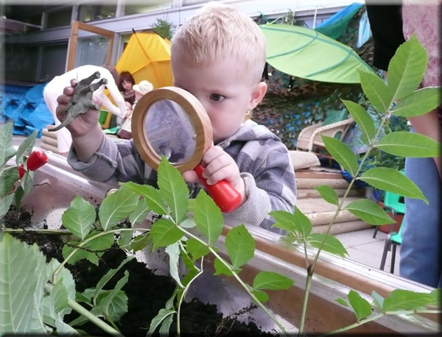
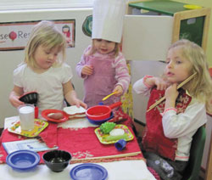
Notes:
Yn ol Jameson a Kidd 1974. ‘Play is as essential to the mortal existence of a young child as is food and shelter.’

Slide 27
Play Pedagogy
‘sociable and cooperative endeavours expose children to other children’s perspectives and they become experts for one another, scaffolding their own and peers’ learning experiences’ (Broadhead, 2006:202).
Vygotsky (1967) argued play’s importance in creating its own zone of proximal development

Slide 28
Is play always good?
Notes:
Sutton-Smith (1997) questions the rhetoric surrounding play as a discourse of play as fun that fails to acknowledge any play that is not fun, or dark play, highlighting that there is little or no mention of children for whom play is not fun, or happy. The notion that play reproduces experiences from real life surely means that some children must be experiencing rejection, discomfort and alienation (Sutton-Smith, 1997).

Slide 29
Inclusion of Play Pedagogy in the Foundation Phase
Broadhead (2006:2) suggests that the more cooperative children’s play is, the more they are likely to connect with other children and understand their knowledge along with a ‘deeply fulfilling emotional engagement with the world around them.’
Notes:
This is particularly relevant to a play-based curriculum such as the Foundation Phase, as it could be argued that any play that takes place in the school setting cannot be ‘pure play’ but would be on a continuum of play and playfulness (Howard et al., 2002; Pellegrini, 1991).

Slide 30
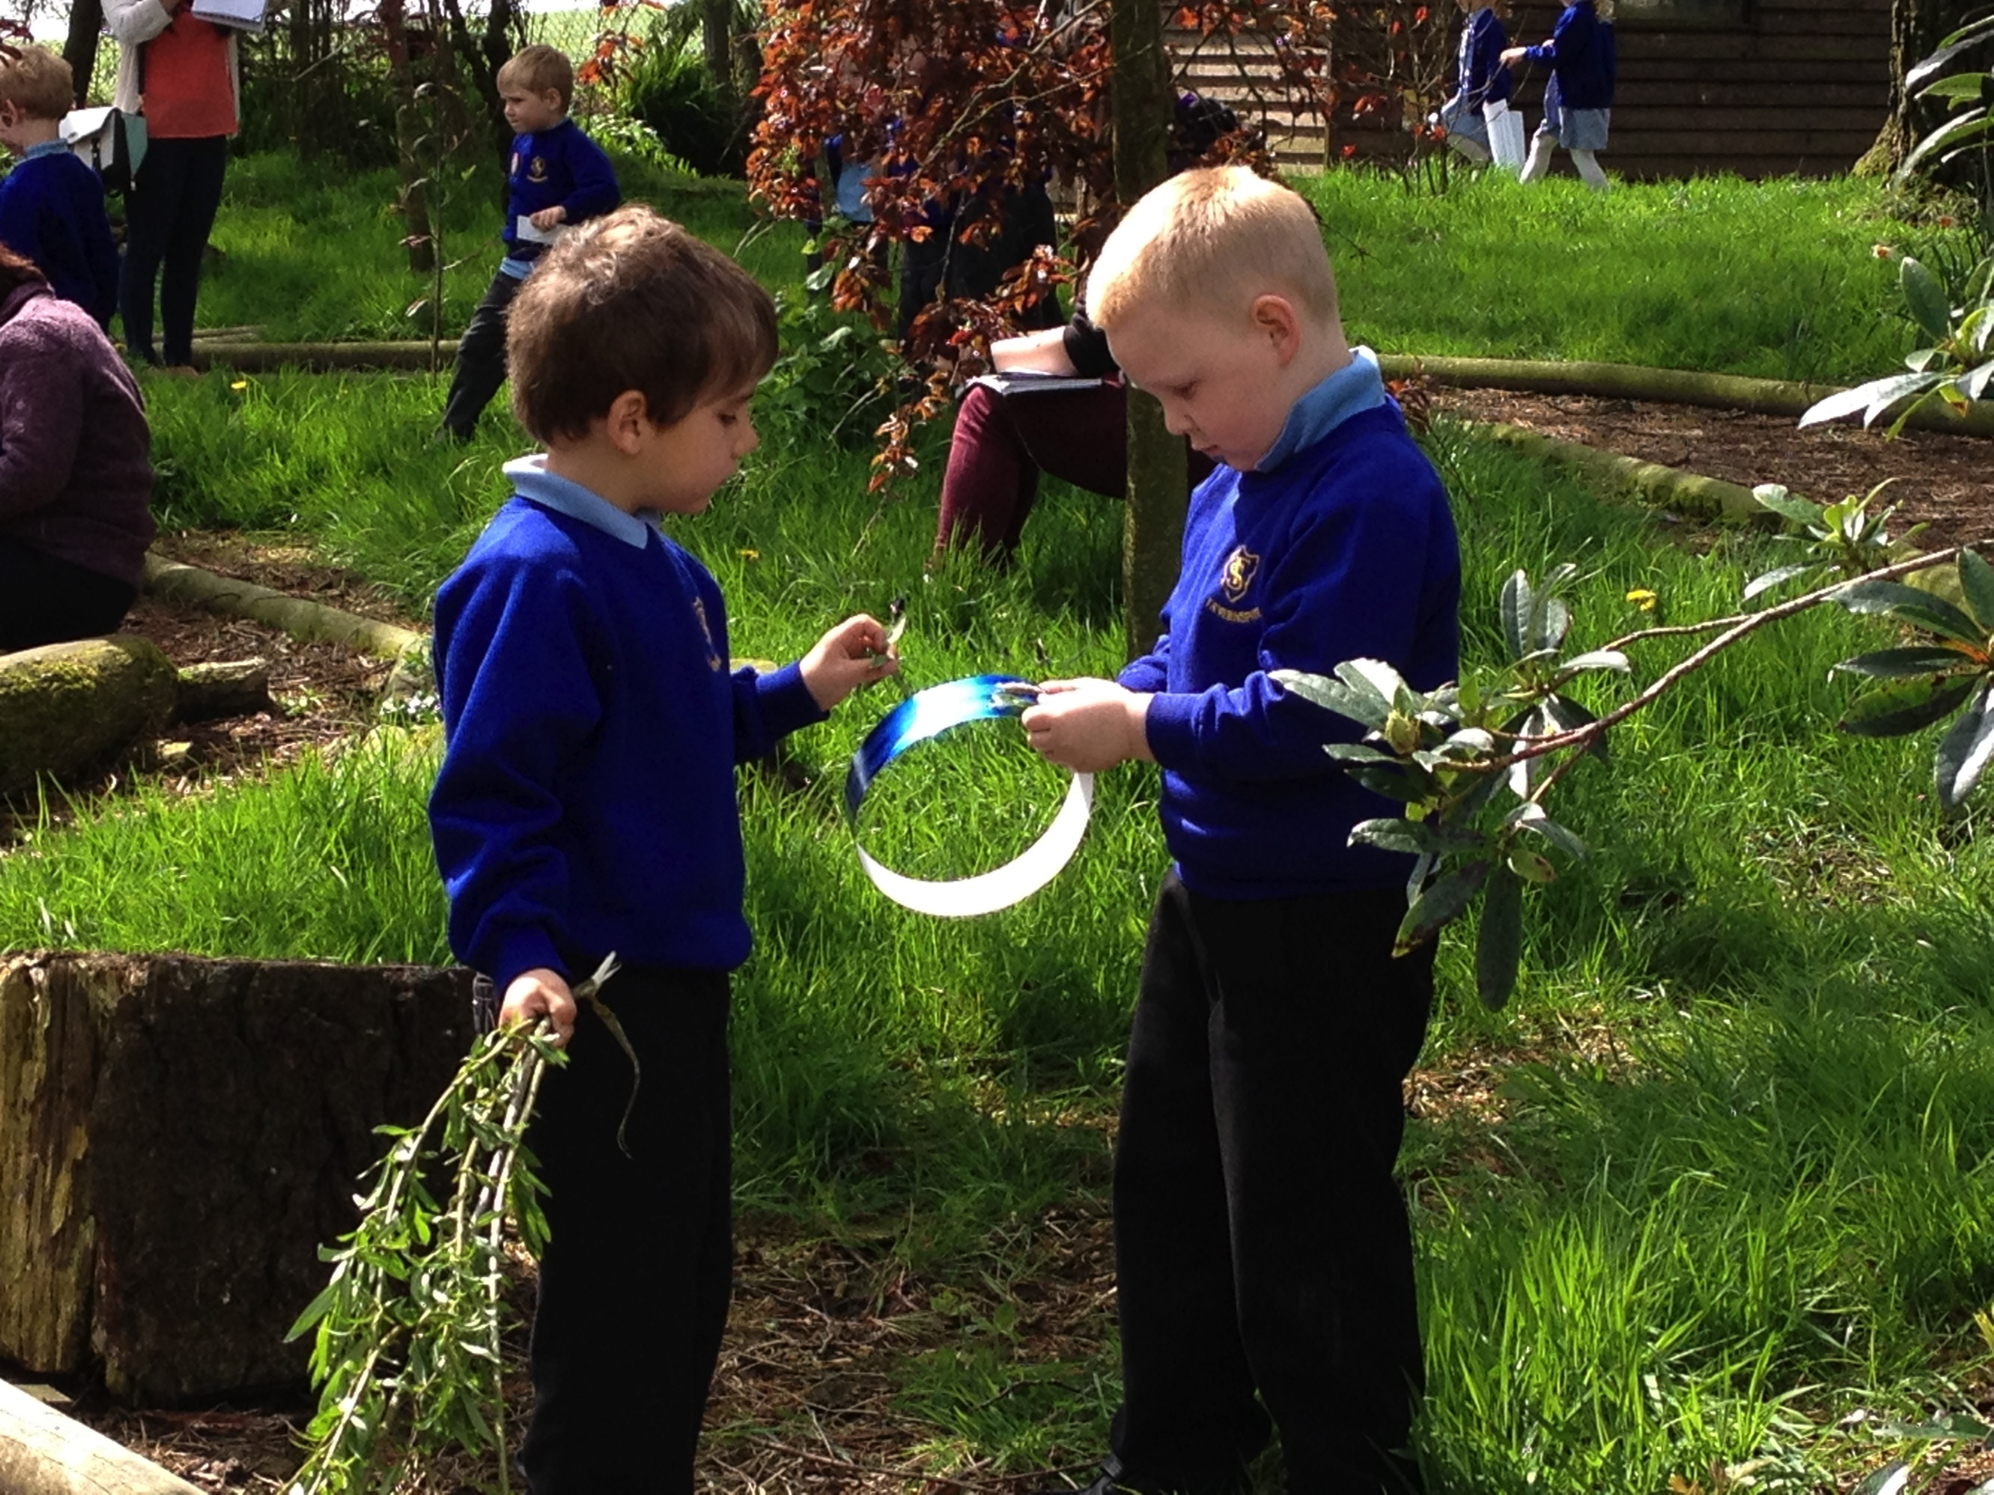
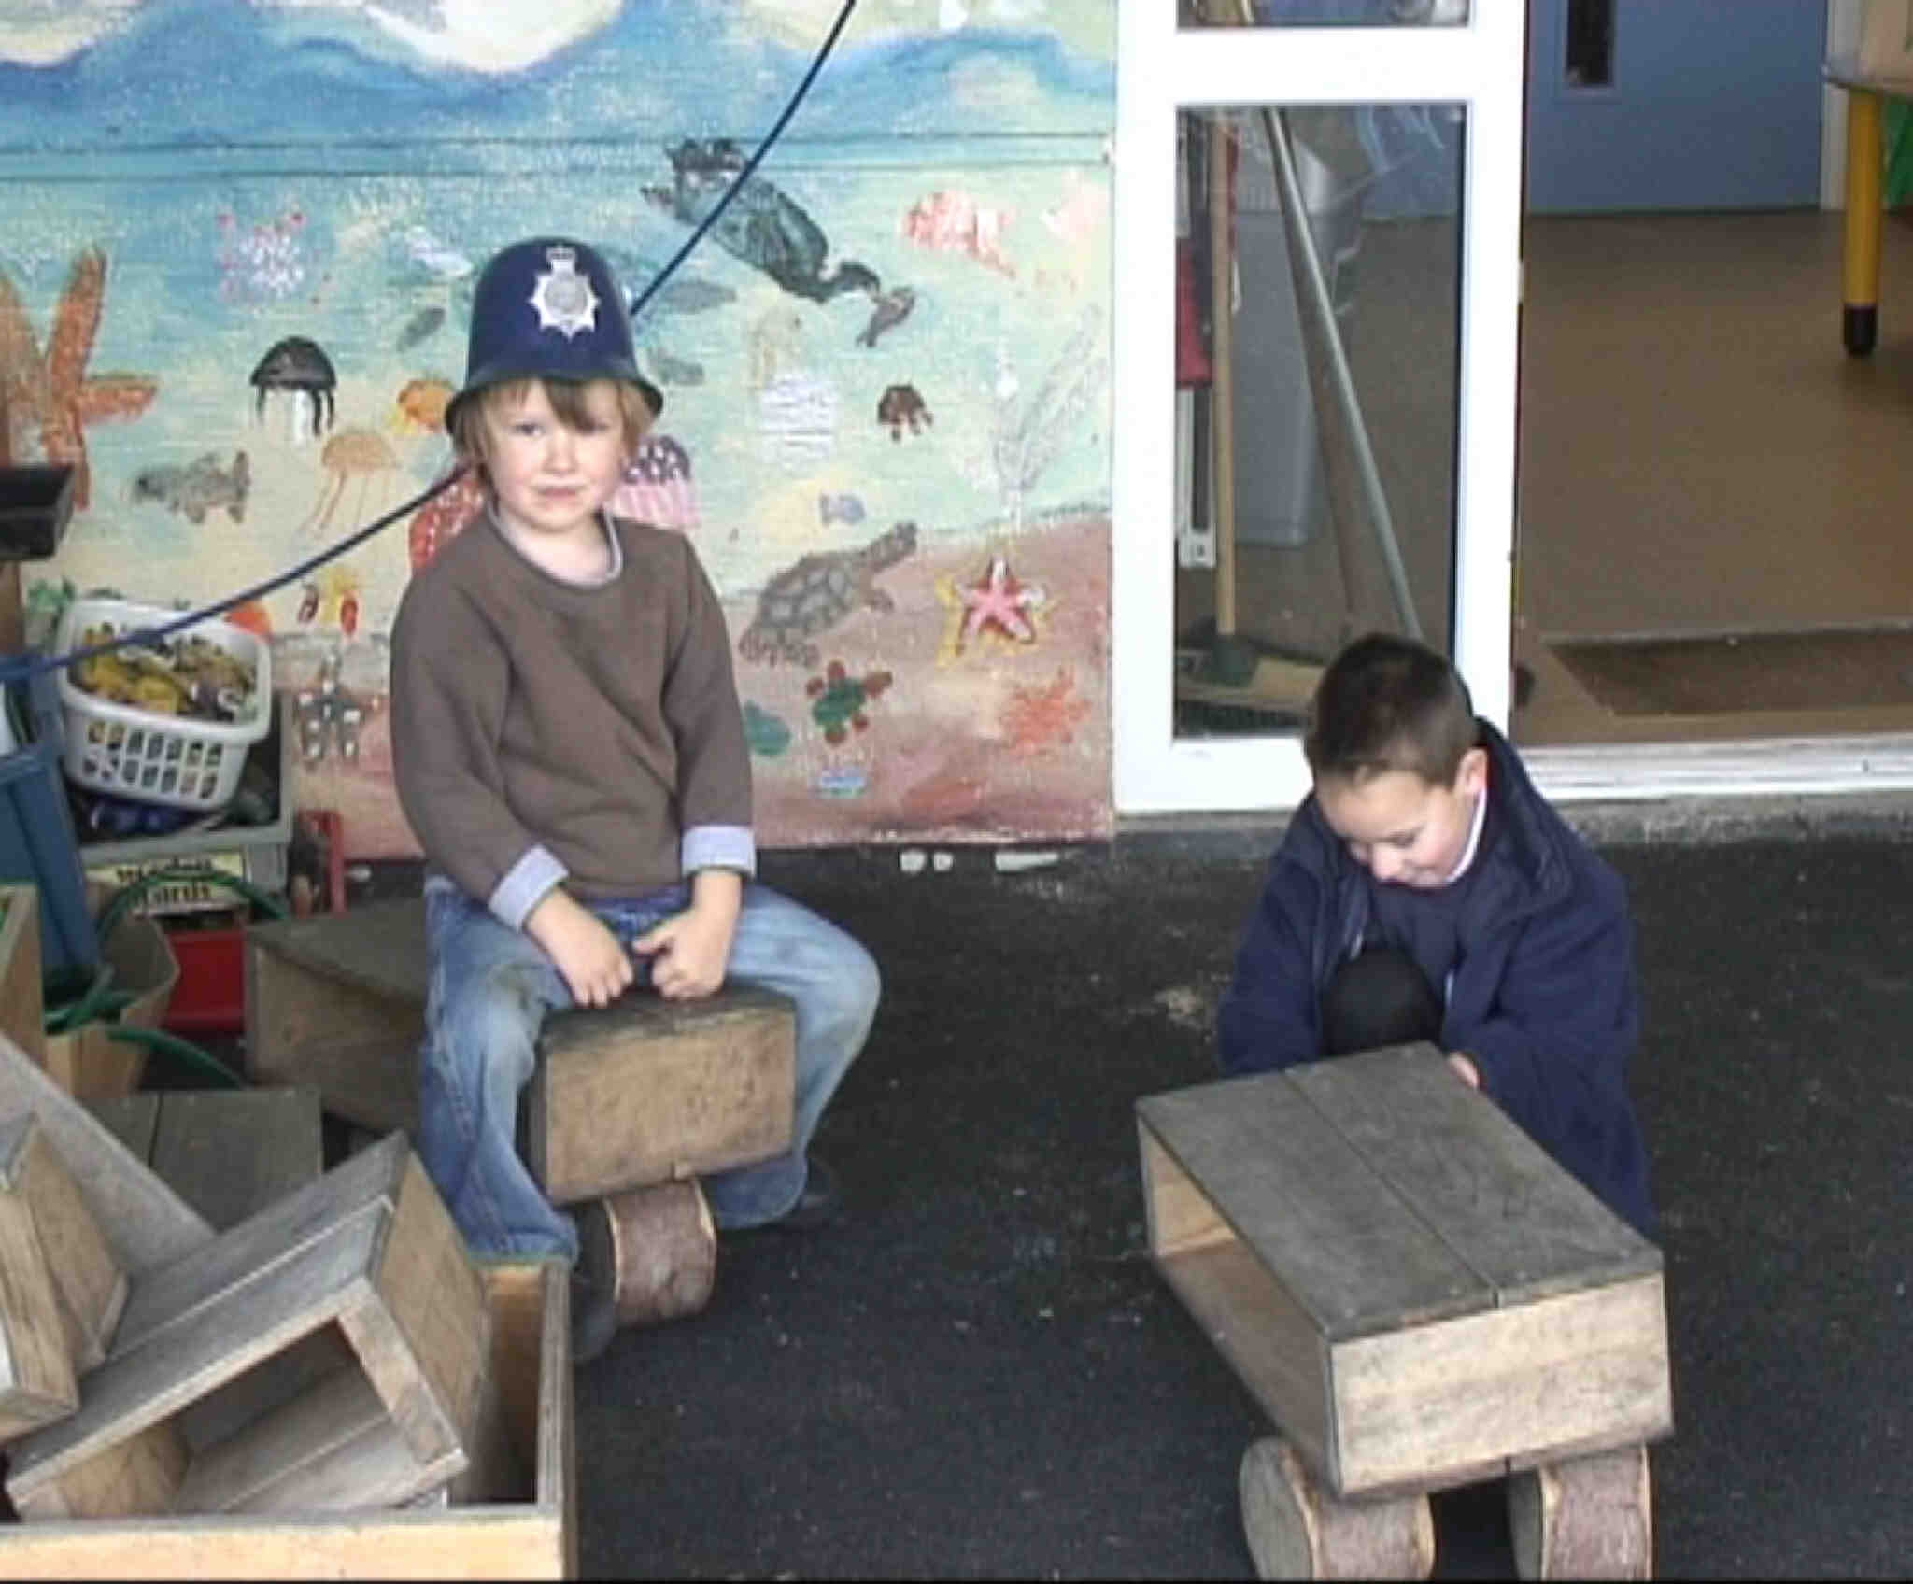
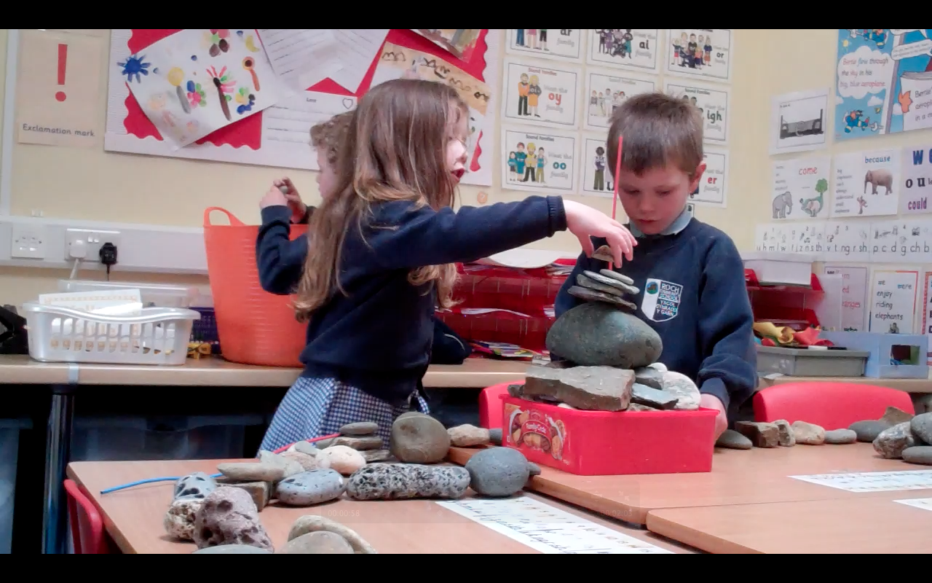
Notes:
Through play children socialize – speak – share experiences – cooperate with other children and adults – share knowledge – share enjoyment - solve problems – create script – copy what they experience / see and play then makes sense of this – engage in fantasy worlds develop imagination creating a new world

Slide 31
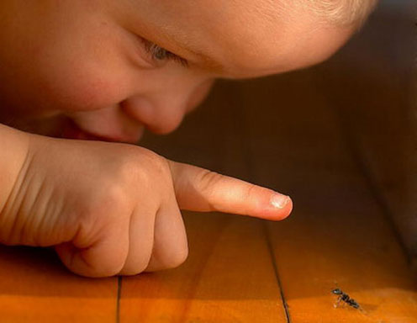
Inquisitiveness is the cure for boredom. There is no cure for inquisitiveness.
Anonymous
Notes:
Mae chwarae’n rhan allweddol o ddull ac athroniaeth y Cyfnod Sylfaen
Mae wedi’i ddatblygu ar dystiolaeth ac ymchwil gadarn
Ceir amrywiad o ran ‘gwerth’ chwarae-e.e. o ymchwil, rhieni, cyd-weithwyr…
‘Children opperate at their highest level during play’
Vygotsky (1978)
Play is a central feature of the Foundation Phase philosophy
It has been developed on research
There is a wide understanding of the ‘value’ of play-e.e. research, parents, co-workers…

Slide 32
Focused activity - adult led
Enhanced Provision – adult observation
Continuous Provision – independent challenges/learning
Personal & Social Development, Well-being and Cultural Diversity Area of Learning
Language, Literacy & Communication Skills
Knowledge & Understanding of the World
Physical Development
Creative Development
Mathematical Development
Welsh Language Development
Indoor / Outdoor
Notes:
Within the NC document it is noted that ‘the F Phase advocates a holistic child-centered approach. Well-being underpins the Foundation Phase, the learning being through ‘first hand experiential activities with the serious business of play providing the vehicle’ (DCELLS, 2008a:4).

Slide 33
Benefits of Learning Outdoors e.g. Froebel (1782 – 1852) believed …
In the benefits in encouraging a strong connection between man, nature and all living things.
Children should learn about nature through outdoor play and gardening activities.
Notes:
& Montissory : her outdoor garden consisted of an area for ball games and trees for shade
she thought children should have open access from indoor to outdoor areas
she believed in structured materials rather than a purely “natural” environment

Slide 34
Value of Play Outdoor
Fjortoft (2000) explored the learning effects from playing in a natural environment on motor development. Grahn et al., (1997, cited in Fjortoft, 2000 and Mygind, 2007) found that children playing in an outdoor environment which included natural environments had better physical fitness, motor skills and coordination, concentration abilities and less absence due to illness than children in an urban environment.

Slide 35
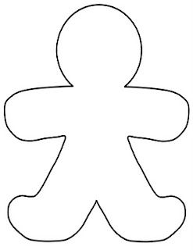
Sut mae chwarae’n dylanwadu ar blentyn yn fewnol ac allanol?
How does play effect a child iternally (emotionally) & externally (physically)?
Notes:
Nodwch rhain o amgylch a thu fewn yr amlinelliad.
Write these within and around the outline.

Slide 36
Play and Physical literacy
Play ‘facilitates the establishment of many of the other attributes that are characteristic of a physically literate individual, including motivation, confidence, environmental and interpersonal engagement, self-knowledge and self-expression.’ Maude (2010:111)
Notes:
Mae plant angen datblygu euc yrff eu meddyliau a’u personoliaethau ac mae chwarae yn cynnig cyfleoedd I hyn I ddigwydd. Mae’n cryfhau’r corff ac yn herio’r meddwl. Mae’n datblygu’r personoliaeth a chaffael hyfedredd cymdeithasol.

Slide 37
Video

Slide 38
Re-visit your break out room …
& can you decide what are the key features of play?
Write what you think is a definition of play.
Task 15mins
Discuss & share opinions
Write definition &
Place in ‘Files’
Gweithgaredd 15munud
Trafod a rhannu barn
Ysgrifennu dyfyniad o chwarae
Gosod yn ‘Files’
Notes:
Write what you think is a definition of play. Can we decide what we think are key features of play?

Slide 39
Rhestr Cyfeirnodi / Reference List
Broadhead, P. (2006) Developing an Understanding of Young Children’s learning. British Educational Research Journal. Vol.32, No.2. pp.191-207
Brown, S. (2009) How it shapes the Brain, Opens the Imagination and Invigorates the Soul. London. Penguin Group.
Bruce, T. (2001) Learning Through Play – Babies, Toddlers and the Foundation Years. London. Hodder & Stoughton
DECLLS (2008) Physical Development. Cardiff. Welsh Government.
Maslow, A. (1987) Motivation and personality. New York. Harper and Row.
Maude, P. (2010) Physical Literacy and the Young Child. Oxford. Taylor & Francis Group.
The United Nations Convention of the Rights of the Child (UNCRC) (1989) Rights of the Child - article 31. Available : https://www.unicef.org.uk/what-we-do/un-convention-child-rights/ Accessed 11/
10/2020
Notes:
Abraham Maslow’s hierarchy of needs – proposed in a paper in “Psychological Review” his in 1943 “A theory of Human Motivation” . Five tier model – hierarchy of human needs. There I little scientific basis to the theory.

Slide 40
Paratoi ar gyfer dy Gwener
Prep for Friday
Ymarferol
Dillad addas
Cot glaw – rhag ofn!
Potel dwr personol.
Llyfryn SKIP
Cwdyn o ddail
Pot iogwrt
Practical
Dress appropriately
& rain coat – just in case!
Bring own water bottles
Bring SKIP booklet
Bring bag of leaves
Bring yogurt pot

Slide 41
Q&A …
Beth yw eich cwestiynau? …
What are your questions? …

