Slide 1
PIC16F887
Features

Slide 2
PIC16F887 Features
Device Overview
Memory
Peripherals
Device Pins
Internal Arrangement
Interrupts
In-Circuit Serial Programming
Timers
Capture Compare PWM modules
Enhanced Universal Asynchronous Receiver Transmitter
Master Synchronous Serial Port Module
A/D Converter module
Comparators
Summary

Slide 3
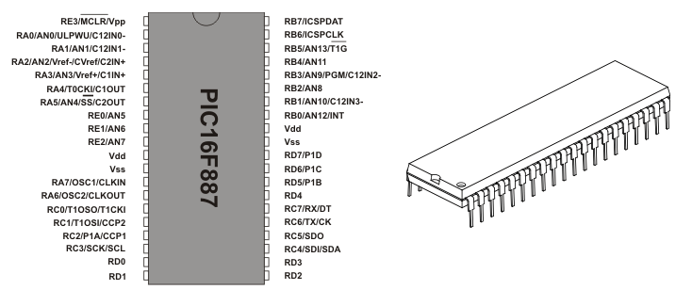
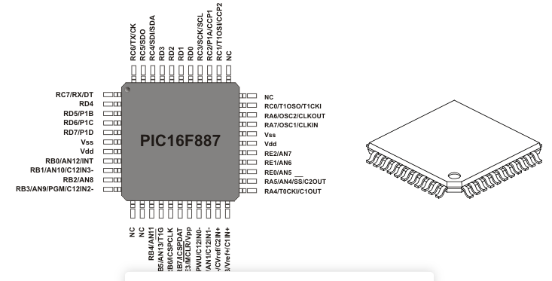
PIC16F887

Slide 4
Device Overview
RISC architecture
  Only 35 instructions to learn
  All single-cycle instructions except branch (pipelined architecture)
Operating Frequency 0-20 MHz
Precision Internal Oscillator – 31 kHz to 8 MHz software selectable
Wide supply voltage 2.0 V – 5.5 V
Low current consumption (220 µA @ 2.0 V, 4 MHz down to 50 nA standby)
35 Input/output pins
  High current source/sink for LED drive
  Programmable internal pull-up resistors
  Interrupt on Change pin

Slide 5
Device Overview - Memory
8k ROM in Flash technology – can be reprogrammed up to 100,000 times
In-Circuit Serial Programming – can be reprogrammed in target device
256 bytes EEPROM
368 bytes RAM memory

Slide 6
Deice Overview – Peripherals
A/D Convertor
  14 Channels @ 10 bit resolution
3 independent timers / counters
Watch-dog timer
Analogue Comparator module with:
  2x analogue comparators
  Fixed voltage reference (0.6V)
  Programmable on-chip voltage reference

Slide 7
Device Overview - Peripherals
PWM output steering control
Enhanced USART module
  Supports RS-485, RS-232, and LIN2.0
  Auto-Baud detect
Master Synchronous Serial Port (MSSP)
  Supports SPI and I2C mode

Slide 8
Device Pins
Most pins are multi-functional
  e.g. Pin 5 - RA3/AN3/Vref+/C1IN+ could be….
    RA3 – Port A third digital input/output
    AN3 – Third analogue input
    Vref+ - Positive voltage reference
    C1IN+ - Comparator C1 positive input
Reduces pin count without reducing functionality
Pin functions cannot be used simultaneously but can be changed at any time in software

Slide 9
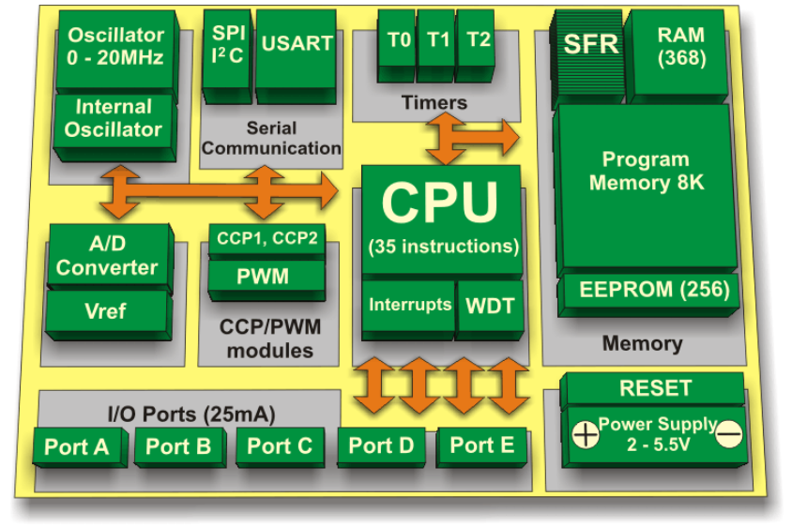
Internal Arrangement

Slide 10
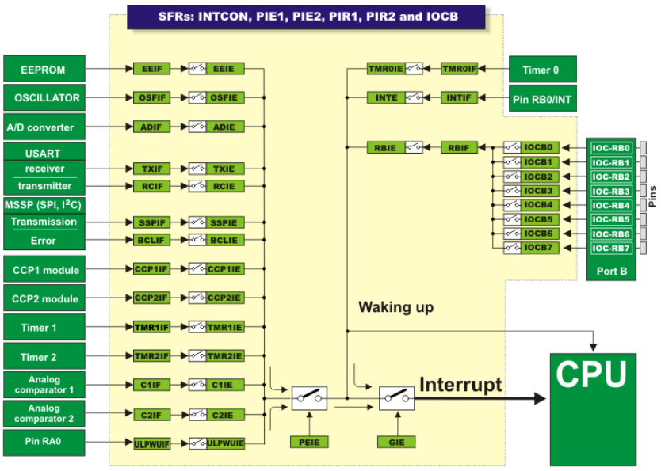
Interrupts
Wide range of interrupt sources available
Interrupt force program counter to jump to interrupt vector (usually 0x04)
Software must test where interrupt came from and act on it accordingly

Slide 11
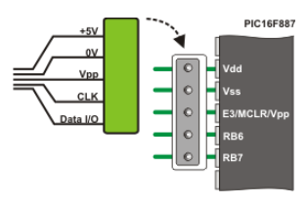
In-circuit Serial Programming
Not complicated at all – just a 5-pin connector
  +5V, GND, Vpp, CLK, Data
Only stipulation is programming voltages cannot be interfered with by application circuit
Can be isolated using jumpers / resistors / switch etc.

Slide 12
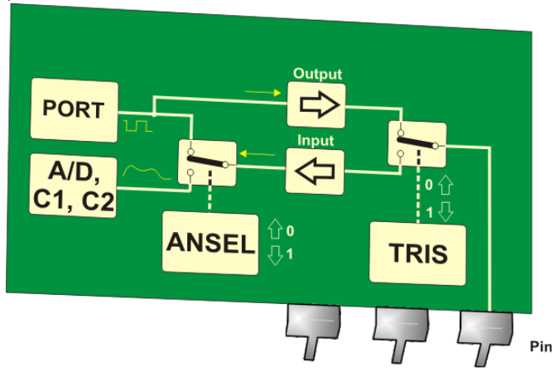
Using Pins
To be able to use a pin for specific function – registers must be set accordingly
  TRIS – TRI-State selects if pin is an input (1) or an output (0)
  ANSEL – ANalogue SELect – Selects if a pin is analogue (1) or digital (0)
One ANSEL register per port
One TRIS register per port

Slide 13
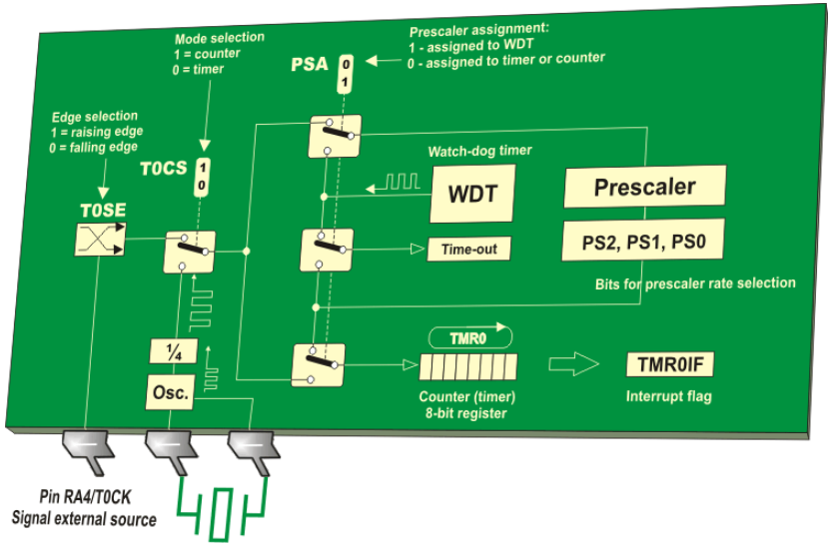
Timers – TMR0
Timer TMR0 has lots of uses
generating arbitrary duration pulses
time measurement
counting external pulses
TMR0 has:
8-bit timer/counter
8-bit pre-scaler (shared with WDT)
Programmable internal/external source
Programmable external clock edge selection
Interrupt on overflow

Slide 14
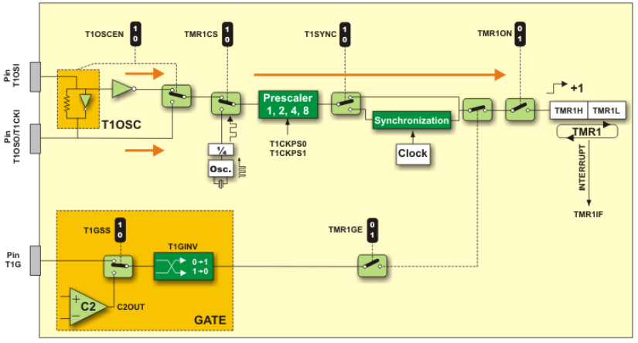
Timers – TMR1
TMR1 is a 16-bit timer/counter
  Two 8-bit registers (TMR1L and TMR1H) – both have R/W access
  Can count-up to 65,535 pulses before overflowing
  Interrupt on overflow

Slide 15
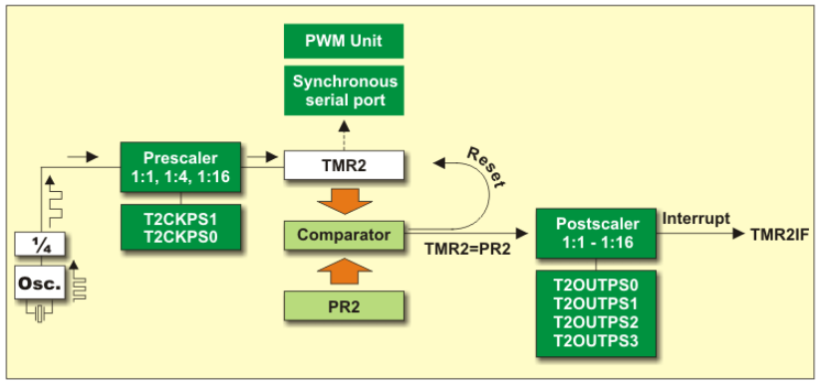
Timers – TMR2
Timer TMR2 is an 8-bit timer with very specific operation:
Pulses from quartz oscillator pass through pre-scaler
Output of pre-scaler increments TMR2 register starting at 0x00
Value of TMR2 compared with PR2 and used to clear TMR2
TMR2 and PR2 have R/W access

Slide 16
CCP Modules (Capture Compare PWM)
Two of these modules on PIC16F887 – CCP1 and CCP2
CCP1 has more features than CCP2
Allows user to time and control events – uses TMR1 register
Uses a 16-bit register CCPR1 consisting of CCPR1L and CCPR1H

Slide 17
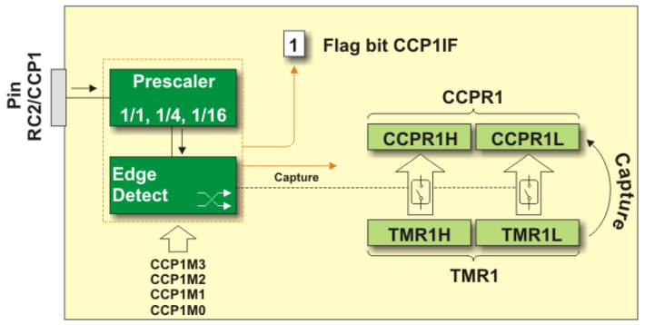
CCP Modules (Capture Compare PWM)
Capture mode allows duration of events to be measured
  Value of TMR1 copied to CCPR1 on an external event and interrupt is triggered
  e.g. every 4th rising edge of RC2/CCP1 pin (pin must be set to be an input)

Slide 18
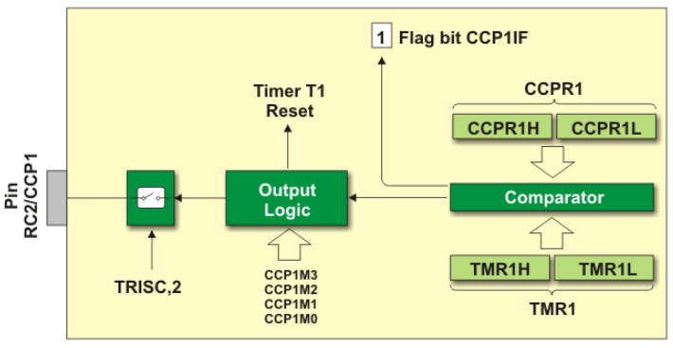
CCP Modules (Capture Compare PWM)
Compare mode compares values in two registers (CCPR1 and TMR1)
  Allows users to trigger an external event when a predetermined amount of time has passed

Slide 19
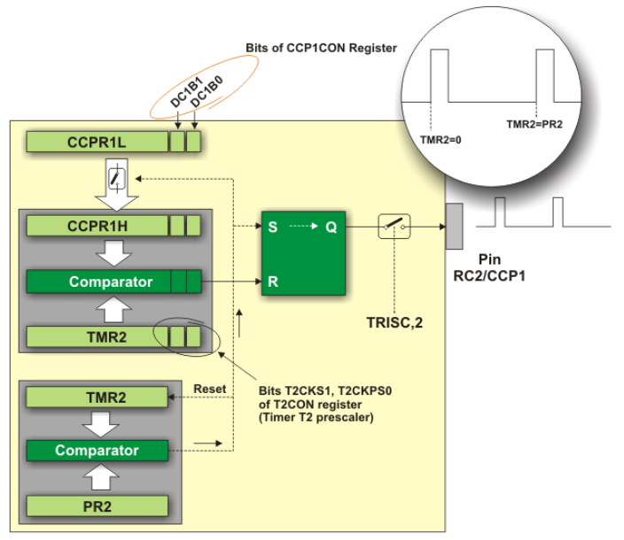
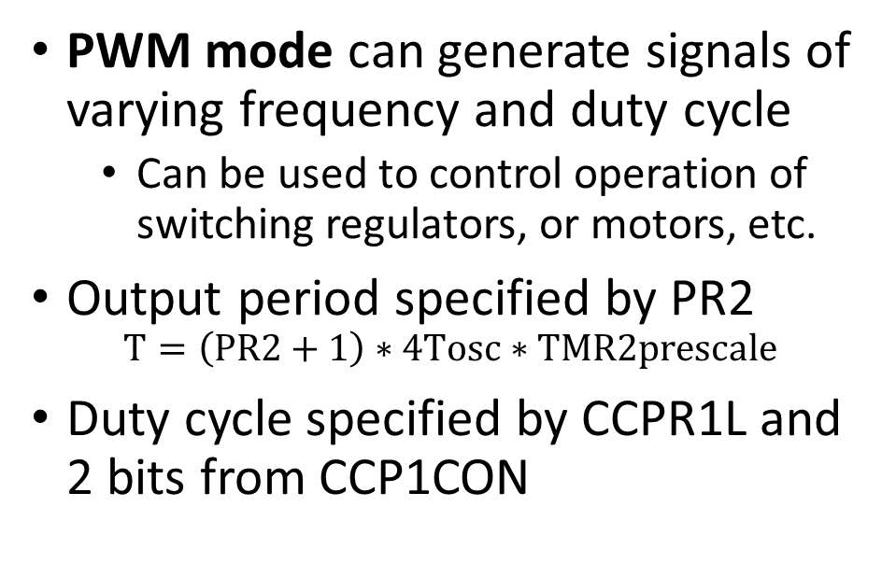
CCP Modules (Capture Compare PWM)
PWM mode can generate signals of varying frequency and duty cycle
  Can be used to control operation of switching regulators, or motors, etc.
Output period specified by PR2
$$T=\left(PR2+1\right)∗4Tosc∗TMR2prescale$$
Duty cycle specified by CCPR1L and 2 bits from CCP1CON

Slide 20
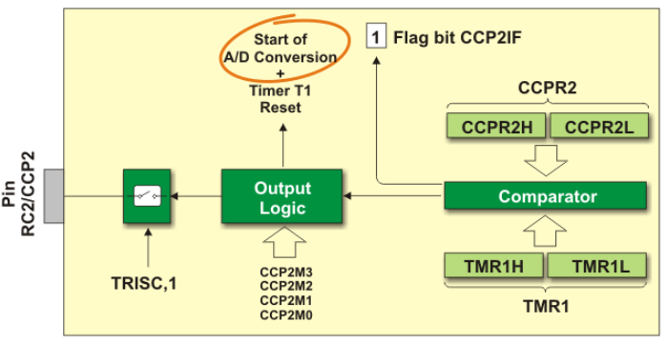
CCP2 Module
Very similar to CCP1
Can also be used to trigger A/D Conversion – useful for creating regularly sampled data

Slide 21
EUSART – Enhanced Universal Synchronous Asynchronous Receiver Transmitter
Serial communications peripheral. It contains clock generators, shift registers and data buffers needed to serialise and de-serialise data independently of device program operation.
Peripheral features:
  Full-duplex asynchronous transmit and receive
  Programmable 8- or 9-bit character length
  Address detection in 9-bit mode
  Input buffer overrun error detection
  Half-duplex communication in synchronous mode (master or slave)

Slide 22

EUSART – Asynchronous mode
Transmits and receives data using a standard non-return-to-zero (NRZ) encoding
Briefly, each data is transferred in the following way:
  In idle state, data line has high logic level (1);
  Each data transmission starts with START bit which is always a zero (0);
  Each data is 8- or 9-bit wide (LSB bit is first transferred); and
  Each data transmission ends with STOP bit which always has logic level which is always a one (1).

Slide 23
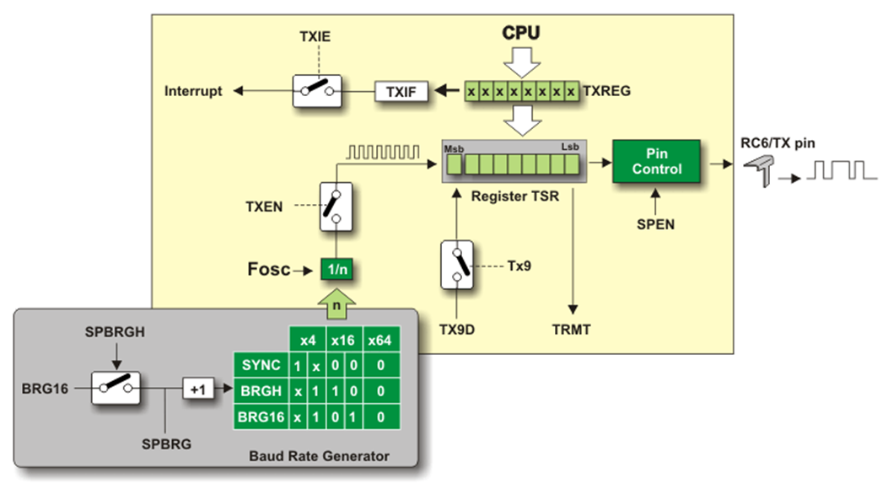
EUSART – Asynchronous Transmitter
Byte to send loaded into from TXREG (Transmitter Register) to TSR (Transmit Shift Register)
Data is pushed from TSR bit by bit to pin including start (0) and stop (1) bits
Data Rate controlled by Baud Rate Generator

Slide 24
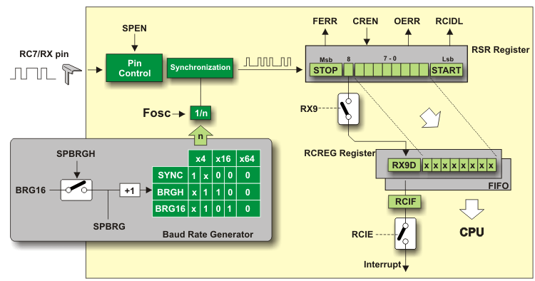
EUSART – Asynchronous Receiver
Data automatically transferred to RCREG (if empty)
Flag bit RCIF is set, and interrupt generated
Flag is only cleared by software i.e. by reading RCREG register (two-character FIFO memory)
If the stop bit is zero, a receive error flag will be set

Slide 25
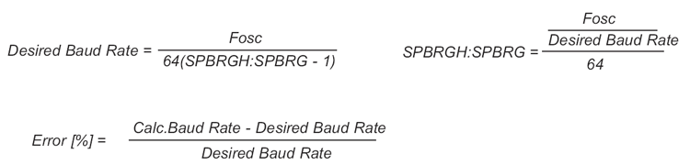
EUSART – Baud rate generator
A local timer BRG is used to synchronise transmission and reception of data
Controlled by two registers SPBRGH and SPBRG
Actual baud rate depends on oscillator frequency

Slide 26
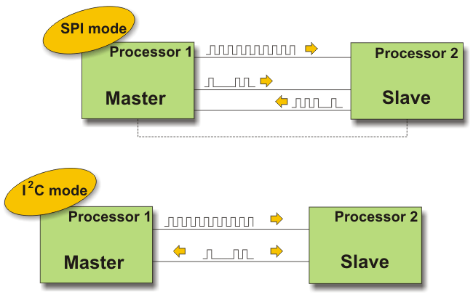
Master Synchronous Serial Port Module (MSSP)
Allows high speed communication between PIC and other peripherals such as LCD displays, A/D converters, Serial EPROMS, etc.
Can operate in either:
  SPI mode (Serial Peripheral Interface)
  I²C (Inter-Integrated Circuit)

Slide 27
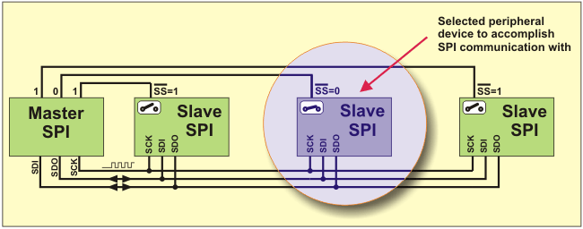
MSSP in SPI Mode
The SPI mode allows 8 bits of data to be transmitted and received simultaneously using at least 3 input/output lines
  SDO - Serial Data Out – transmit line
  SDI - Serial Data In – receive line
  SCK - Serial Clock – synchronization line
  SS – Slave Select – device selection line

Slide 28
MSSP in SPI Mode
When operating in SPI mode, MSSP module uses in total of 4 registers
  SSPSTAT status register
  SSPCON control register
  SSPBUF buffer register – temporarily holds data written to SSPRS
  SSPRS shift register (not directly readable or writable)
SSPRS is directly connected to PIC IO pins and used for data transmission in serial format

Slide 29
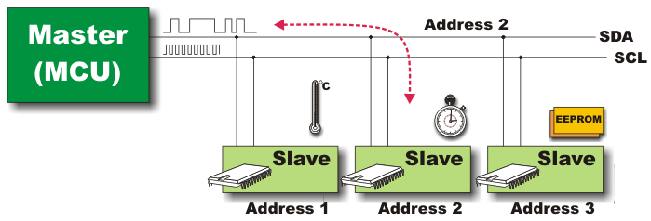
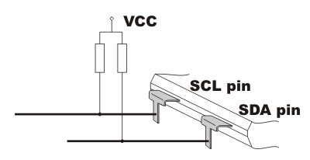
MSSP in I2C Mode
I2C mode is especially suited when the PIC should exchange data with multiple peripherals
Uses only 2 wires SDA (Serial Data) and SCL (Serial Clock)
Enables up to 122 different components to be connected simultaneously
Clock is used to synchronise data transfer and always generated by the master
Each device has its own address which is transmitted in the first byte along with the direction of data flow
Pull-up resistors must be used on SCL and SDA lines
Transmissions follow this pattern:
Start - Address - Acknowledge - Data - Acknowledge .... Data - Acknowledge - Stop

Slide 30
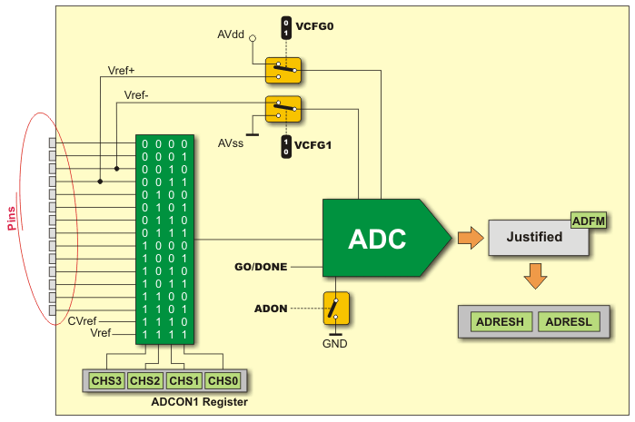
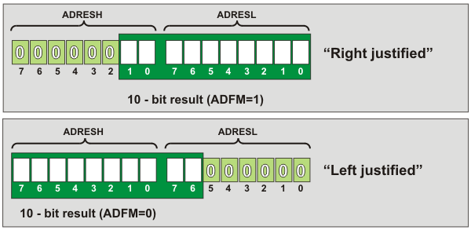
A/D Converter
PIC16F887 has 14 analogue inputs, but 1 A/D converter
Channel is selected by multiplexer
Result is either left or right justified in ADRESH & ADRESL registers

Slide 31
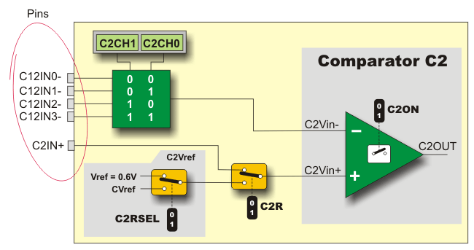
Comparators
Comparator output changes of state generate an interrupt
Can be used to detect changes in analogue voltage as a signal crosses a threshold

Slide 32
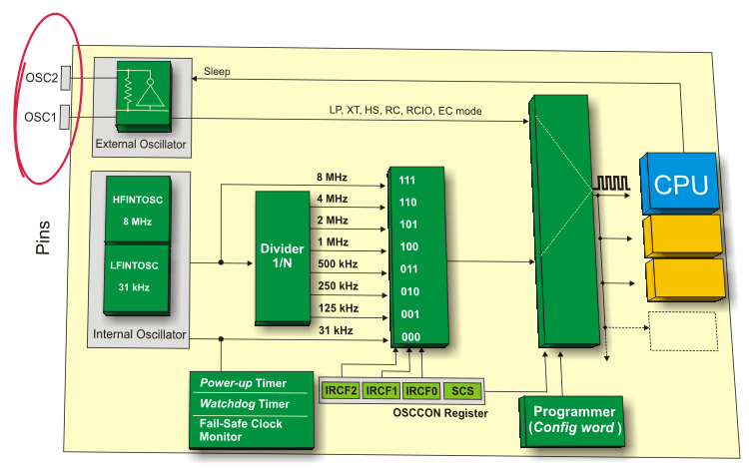
Oscillators
2 Built-in oscillators & external oscillator option
Programmable frequency divider
Can be put to sleep by software to save power

Slide 33
Summary
PIC16F887
Communications
EUSART – RS232
SPI
I2C
Oscillator Options
XT
RC
Int
Analogue Interfaces
ADC / Comparators
Timers
Counters
Frequency Measurement

