Slide 1

My Foundation Journey
Paul Goodfield

Slide 2
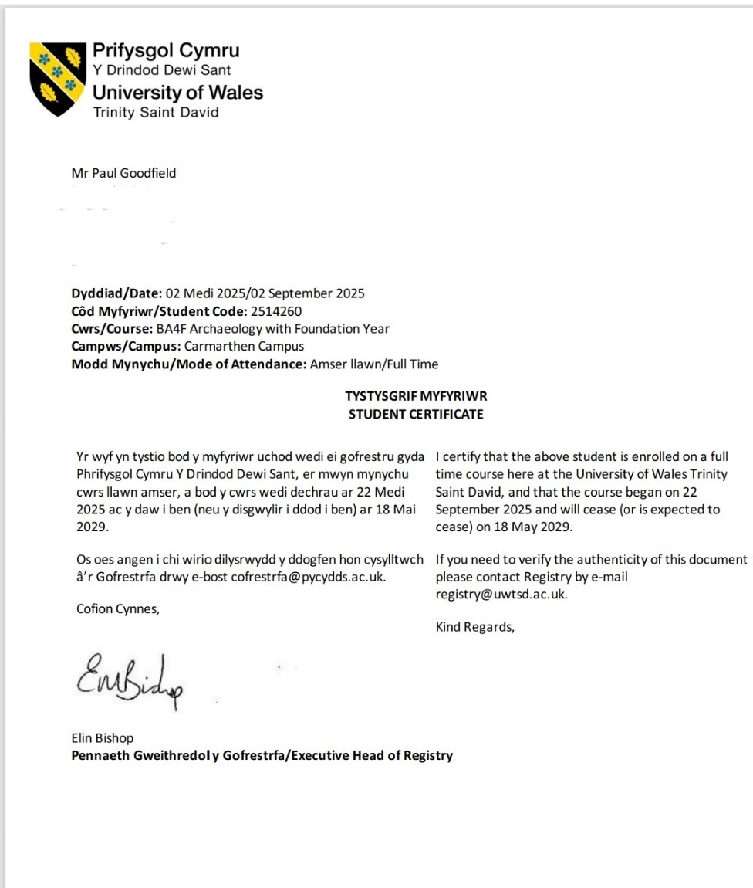
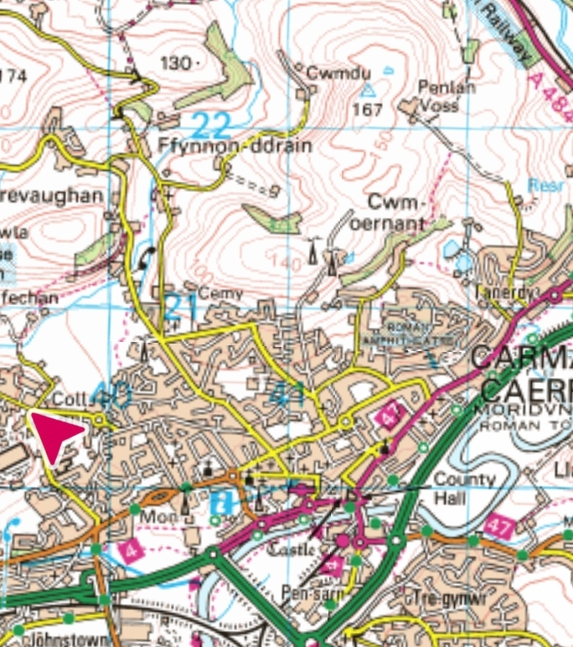
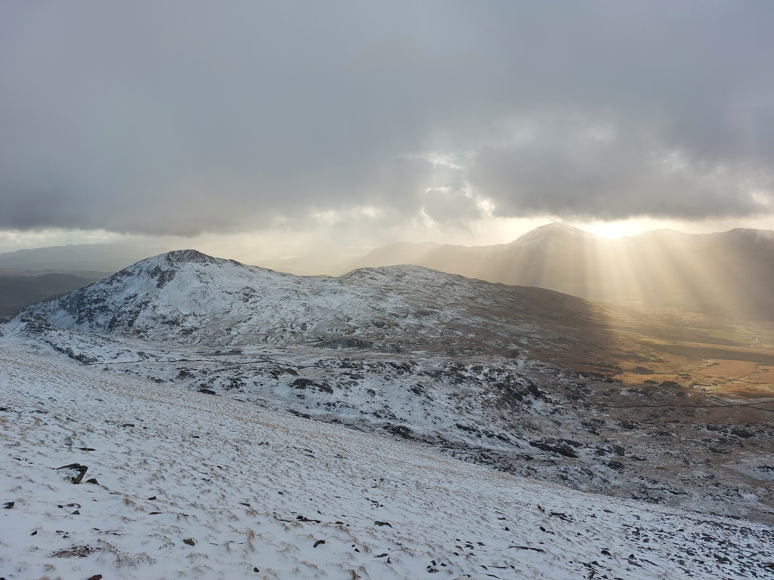
Presentation agenda
‘Stepping into the unknown’ – how it felt.
‘Overcoming the first hurdles’ – how I hit my stride.
‘Navigating the challenges’ – how I used tools and tips to make the passage smoother.
‘Steady progress’ – how learning, feedback and reflection help me push forward.
Seeing the summit – the next steps as the path becomes visible.
Notes:
Discuss how you will be using climbing a mountain as a metaphor for your journey and make passing comment about photos as symbols of your journey.

Slide 3
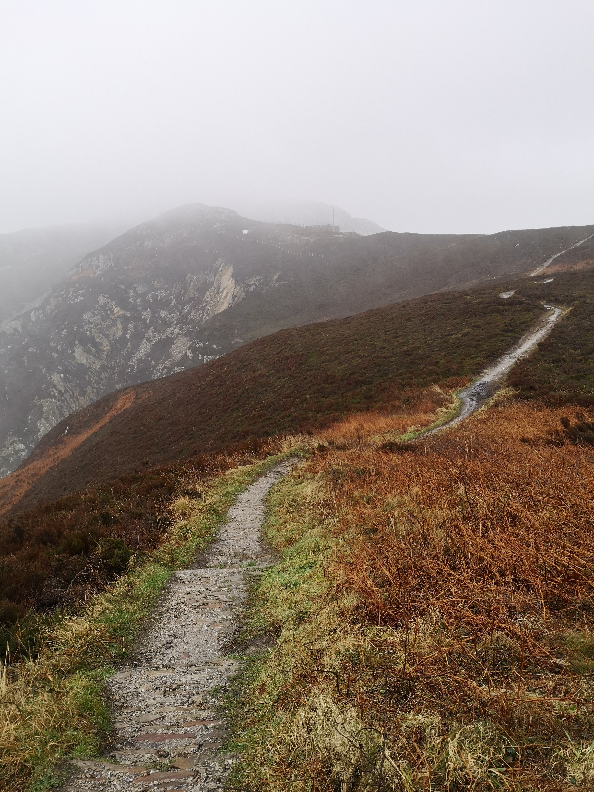
Stepping into the Unknown
“You step into the road, and if you don’t keep your feet, there is no knowing where you might be swept off to.” — J.R.R.Tolkien, The Lord of the Rings.
Feelings:
Imposter syndrome?
Too old & fish out of water?
How would I cope as a carer?
Would my health hold out?
Notes:
This reflective slide is to highlight how the start of the journey felt - was I as prepared as I could have been? What were emotions on the first day? Paraphrase the words of Professor Evans, UWTSD Vice chancellor, at welcome meeting on first day – “you only get one first day at University so grasp it with both hands” and how I used this to overcome nerves and apply not just to first day but every day and helped overcome these doubts.

Slide 4
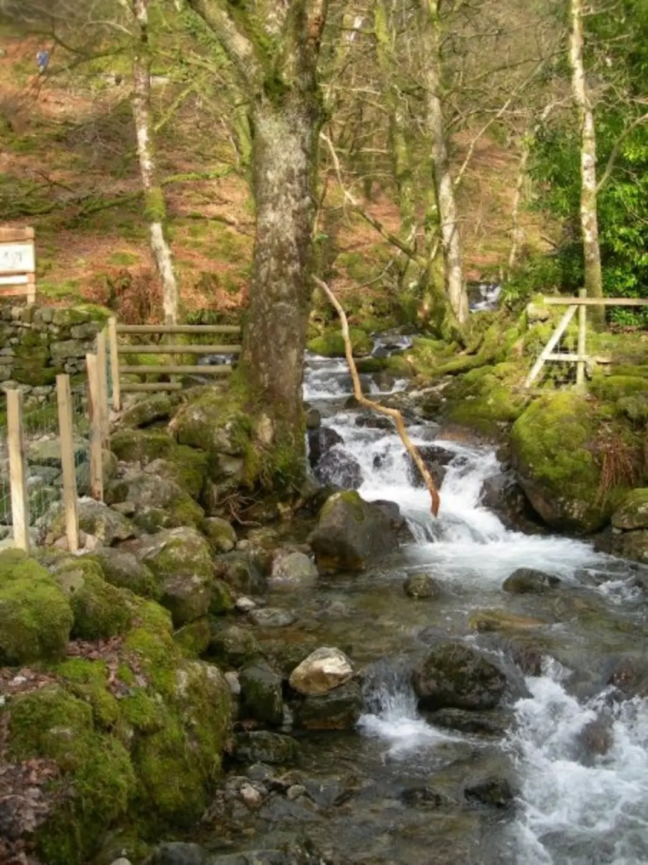
Overcoming the first hurdles
Non course related:
Universal Credit – Money Support to the rescue.
Technology challenges – delays and new software.
Course related:
Poor administration – last minute cancellations.
Changing of module lecturers and reading list.
Lack of tutor 1-2-1 meetings that were promised.
Notes:
Describe how confusing information regarding Universal Credit meant that on 1st October all monies stopped, even disability element for my wife and how I nearly quit as didn’t think I could afford it. How Delyth in Money Support was able to allay my fears and took that stress away by owning the problem as much as possible. Also impact of laptop arriving after start of course and Tech training was ongoing throughout the course which meant I wasn’t able to fully utilise my software in the early days.

Slide 5
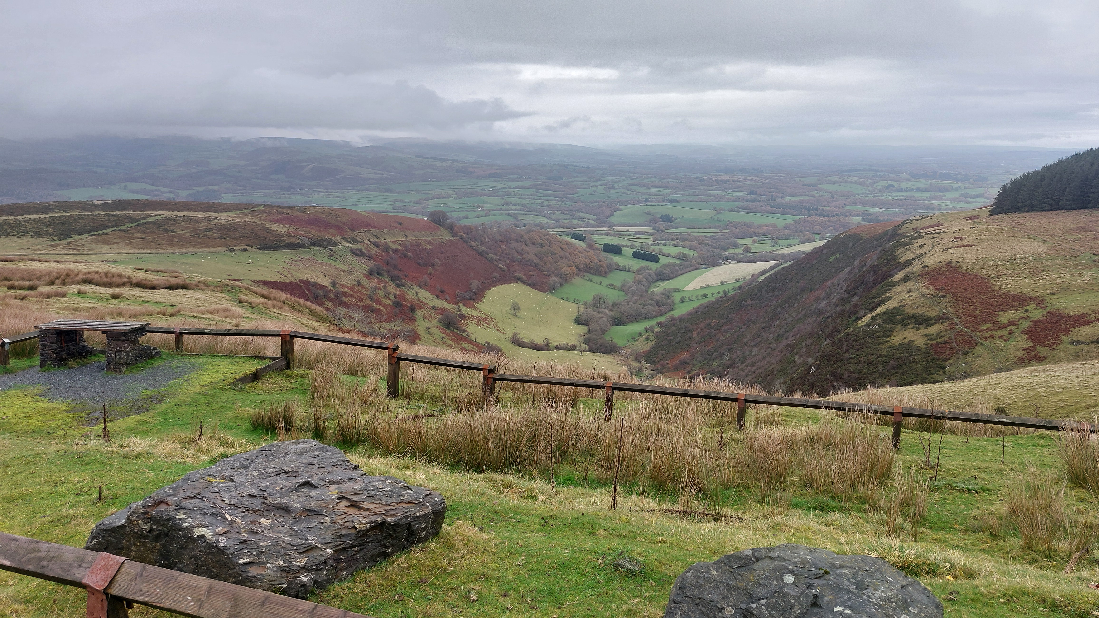
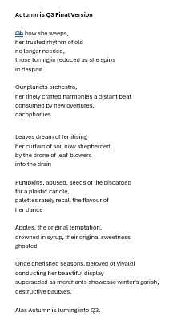

Navigating the challenges
Academic writing – how to become concise.
Critical thinking – how dare I?
Essay structure – Xicheng’s pyramid.
Time management – Rhian’s time management, planning & note taking.
Library support – Suzanne’s AI & Margery Kempe help.
Notes:
Describe how I have improved my writing skills because of restricted by word counts, which helped focus on conciseness, particularly during first assignment (Reflective essay 450 words on why joined University). Regarding critical thinking share how you had a feeling of ‘how can I challenge an academic who may have spent a lifetime researching something and I spent just a few weeks on’. Explain how I overcame this by speaking with Rhian and realising I came to understand how it is the process of spending time questioning and seeing if their views match mine, sometimes it is just having a different angle and not just accepting things at face value . Relay stories of how Suzanne in thew library who saw I was reading Margery Kempe shared information about a professor at Swansea Uni who had recreated a recipe from the original manuscript and when doing AI assignment how she recommended a new book about using AI in academia.

Slide 6
Steady progress
Continuous learning – AT training & LinkedIn Learning
Feedback – Turnitin & 1-2-1 sessions with tutors
Reflection – setting aside time to evaluate progress
Treating it like a job – disciplined learning
Notes:
Gwennan’s advice about using LinkedIn learning to improve my Excel and Word skills when I was struggling during TTD graveyard study assignment. Share how treating my day in Uni like a job helped me stay focused and disciplined. Talk about how you feel how University was much calmer than anticipated and how valuable the time in lectures is, especially with small numbers, how expectation was that it I would feel lost in the crowd in lectures. Also mention how you found team working hard in TTD - reflecting on this it was frustration at myself as my communication skills were poor. Finally comment on how you have been practising Welsh when visiting Yr Egin and it has made your more confident in using it.

Slide 7
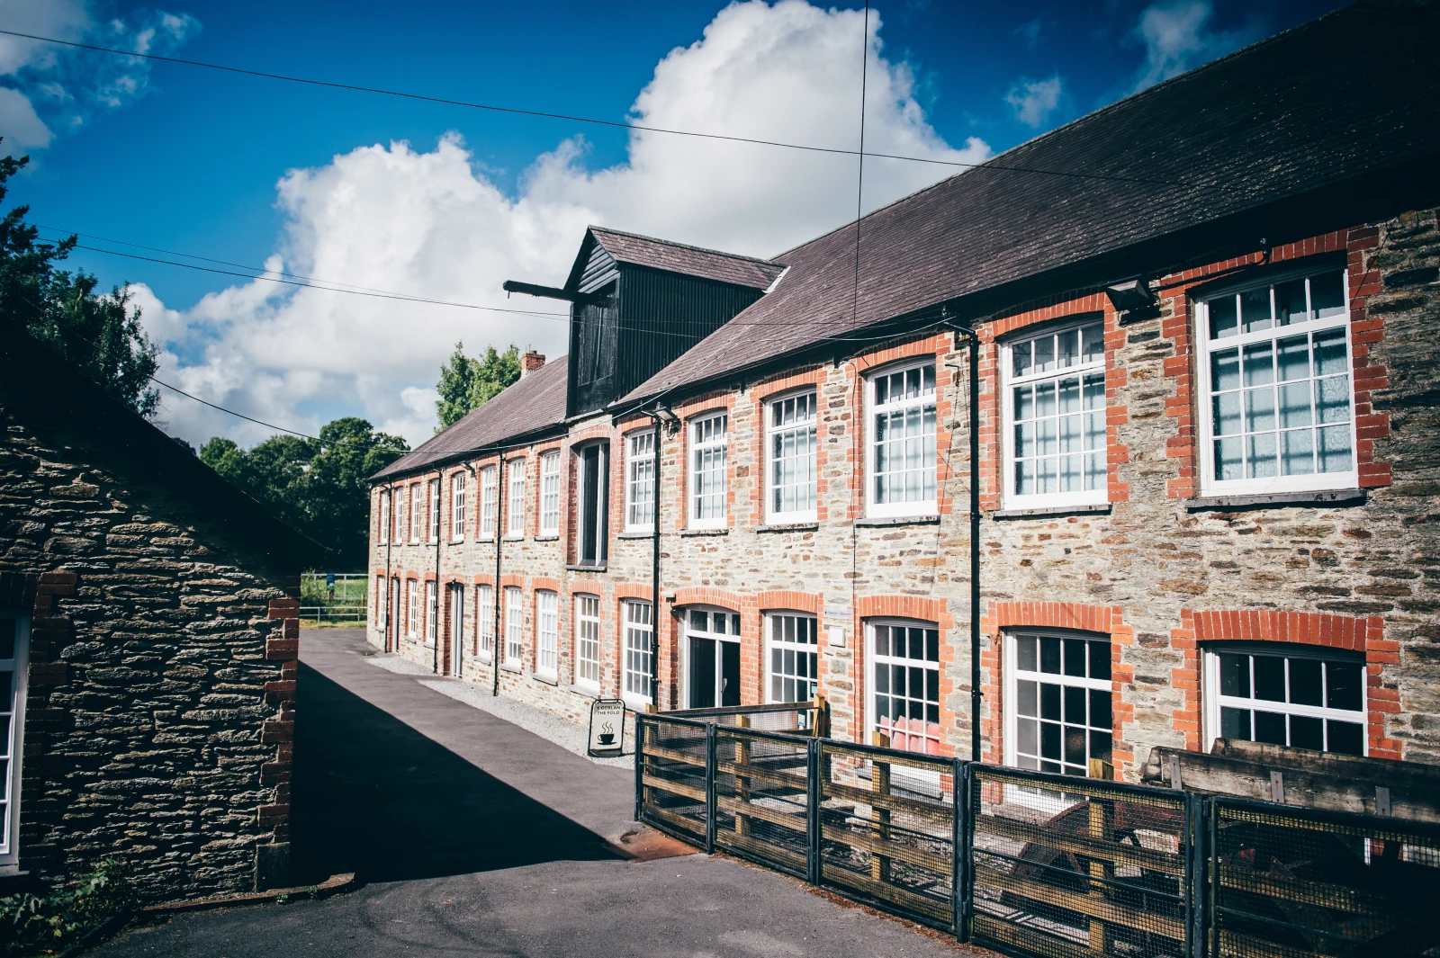
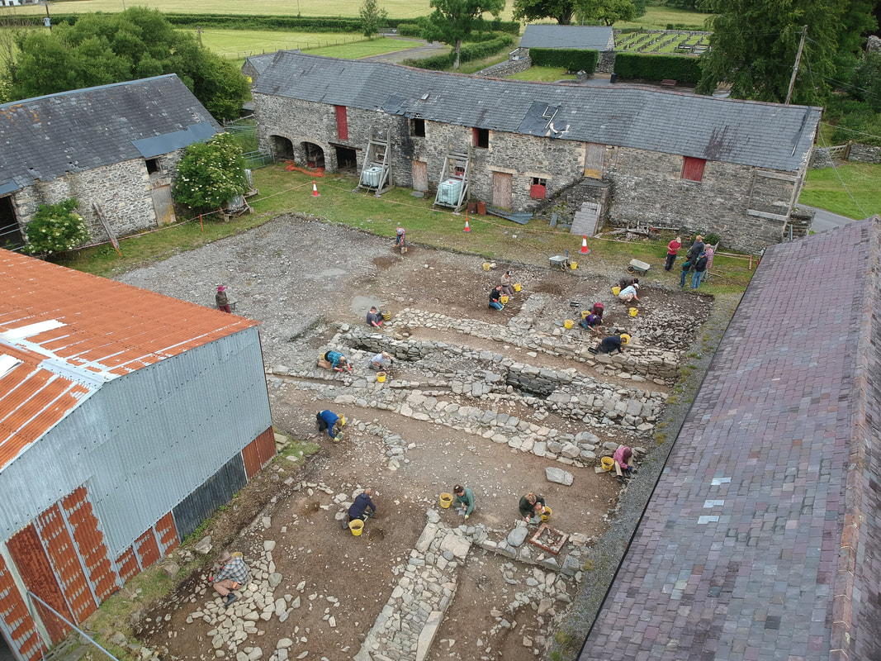
Seeing the summit - next steps
Work placements –
Llanerchaeron House (TBC)
National Wool Museum (July 26)
Archaeology dig –
Strata Florida (June 26)
2026 – 2029
Changing to a split degree - Archaeology & History at UWTSD Carmarthen.
“I think I’m quite ready for another adventure’ – Bilbo Baggins, The Lord of the Rings” – J.R.R. Tolkien
Notes:
Discuss how you met with Tristan and Rhian to discuss next year and attended lectures on Philosophy and Archaeology to get a taste of these courses.

Slide 8
Images & Quotes Used
Slide 1
Slide 2
Top right OS Map of Carmarthen –Contains Ordnance Survey Data, Crown Copyright 2026.
Bottom Own image, ‘View of Yr Wyddfa (Snowdon) from Rhyd Ddu path’.
Slide 3
Slide 4
Slide 5 –
Slide 6 -
Slide 7
Bottom right Strata Florida Archaeology Field School https://www.strataflorida.org.uk/archaeology-field-school.html
Left hand side Own image UWTSD Carmarthen Library.
Top left Own image of ‘Admission letter from UWTSD’.
Top right National Wool Museum main building - https://museum.wales/wool/about/
Left hand side Own image ‘Holyhead mountain’
Left hand side Own image of Waterfall near the bottom of Cadair Idris, Eryri (Snowdonia)
Quote by Bilbo Baggins, Tolkien, J. R. R., 1995. The Lord of the Rings. Reprinted. London: Harper Collins.
Quote by Bilbo Baggins - Tolkien, J. R. R., 1995. The Lord of the Rings. Reprinted edition. London: Harper Collins.
Top Own image of ‘View from Mynydd Epynt, Cambrian mountains’, taken as part of Introduction to Humanities presentation
Bottom left Own image of ‘Autumn is Q3’ poem for Understanding Literature assignment
Bottom right Own image of ‘Graveyard study report’ from Talking to the Dead assignment

