Slide 1
HPHI 4901
John Keegan - What is War?

Slide 2
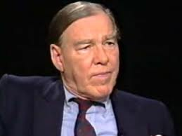
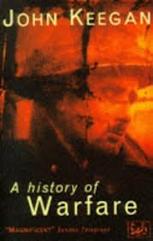
JOHN KEEGAN

Slide 3
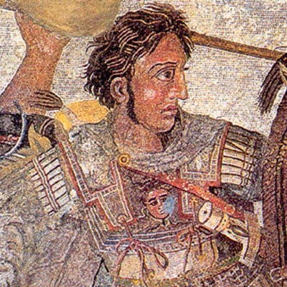
WHAT IS WAR?
As old as ‘Man’ – almost!
It ‘reaches the most secret places of the human heart’ (Keegan,p.3)
It is about – pride, emotion, instinct
It reflects the ‘savage’ in all of us

Slide 4
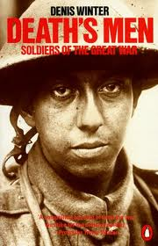
WAR AND CULTURE
War is a product of our cultural identity, because we:
a. Recognise and accept a potentiality to go to war, while we:
b. Recognise it as an aberration – a deviation from the norm.
c. it means compromise, as its manifestation is deprecated but its use legitimised as a practical necessity

Slide 5
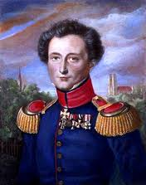
‘ON WAR’
Central to Keegan’s study of war is the theories of Carl von Clausewitz (1780-1831).
Prussian Officer and Military Theorist
Author of ‘On War’ (Vom Kriege) published posthumously in 1832

Slide 6
CLAUSEWITZ’S ‘WAR’
Distinguished between the ‘lawful bearer of arms’ (the disciplined and subordinate soldier) and the ‘brigand’
Sought a ‘typology’ or convention to warfare – war of sieges, battles, strategy, and with parameters (a definitive start and end)
war without beginning or end is deemed unlawful

Slide 7
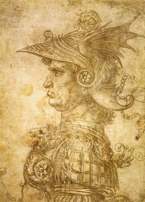
CLAUSEWITZ’S ‘WAR’
Professional soldier evolved out of 15th century ‘hired mercenaries’ (in Italy: Condottieri) to protect rule of Kings and landed interests from ‘hired mercenaries’!
Self perpetuating problem led to the need for permanent armies

Slide 8
NEW ARMIES
Charles VII of France (1440s) – created permanent (uniformed) companies of paid mercenaries to protect his interests from other mercenaries
Improvements in firearms and gunpowder technology witnessed the primacy of infantry companies over cavalry
Advent of mobile batteries undermined castle fortifications and rival powers - e.g to Charles VIII of France

Slide 9
REGIMENT!
From the 16th century onwards the concept of the permanent Regiment developed throughout Europe
Regiments became institutionalised on a national basis, each linked to a specific town or city, recruiting locally, officered by the aristocracy, with local training schools
Many epitomised the philosophy of the European Enlightenment, viewed as ‘instruments of social virtue’ (Keegan, p.15)

Slide 10
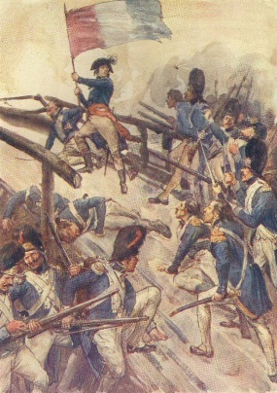
REVOLUTION
1789 – The motives of the French regiments changed
‘Liberty, Equality, Fraternity’ – Frenchmen fought as Citizens and a duty to bear arms
New Dynamic – to defend the revolution at home and to spread revolution abroad, and in 1806 that meant Prussia and beyond!

Slide 11
‘REAL’ AND ‘TRUE’ WAR
According to Keegan, in ‘What is War’, Clausewitz saw ‘True’ War distinguished from ‘Real’ War by the concept of the ‘Regiment’ and the aims of the professional soldier
The ideals of ‘courage’, ‘honour’, ‘duty’ in turn emanating from the philosophical ideals of the Enlightenment
The dynamic of the French Revolution meant a dilemma for Clausewitz

Slide 12
DILEMMA
The need to possess a Prussian Army to match the fervour and perceived unbeatable quality of the French Revolutionary Armies, without political revolution. Or:
‘How might one have popular warfare without a popular state?’ (Keegan, p.17)
Aim: ‘to elevate the regimental officer’s values …to the status of a political creed’ (Keegan, p.18).

Slide 13
CLAUSEWITZ’S THEORIES
NATURE OF WAR – ‘THE TRINITY’:
a. Hate, violence, enmity
b. Free-will; chance, probabilities, freedom to react, the ‘fog of war’
c. subordination and reason – socio-political underpinning of war requiring reasoned analysis

Slide 14
CLAUSEWITZ’S THEORIES
War is ‘the continuation of politics by other means’
Act of force on the enemy, to impose your will
Stress on: instruction, planning, training, strategy on a philosophical and dialectical basis
Empiricist outlook – his own experiences, other writers, Napoleon!
Significance of economic and technological variants

Slide 15
CLAUSEWITZ’S THEORIES
Significance of socio-political background of troops and commanders
The full involvement of the State apparatus
Superiority of defence strategies over attack
The ‘fog of war’ - reacting to uncertainties

Slide 16
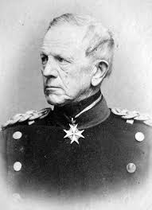
HERMUTH VON MOLKE (1800-91)

Slide 17
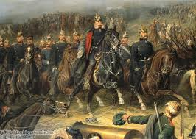
AUSTRO-PRUSSIAN WAR 1866

Slide 18
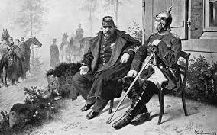
FRANCO-PRUSSIAN WAR 1870-71

Slide 19
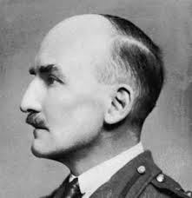
J.F.C. FULLER 1878-1966

Slide 20
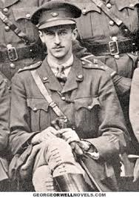
B.H. LIDDELL-HART 1895-1970

Slide 21
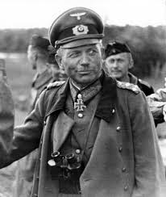
HEINZ GUDERIAN 1888-1954

Slide 22
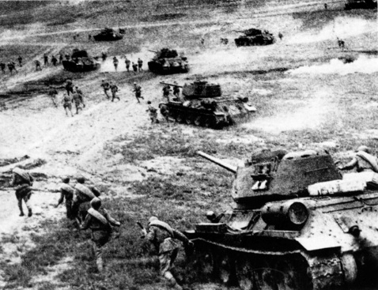
DEEP OPERATIONS

Slide 23
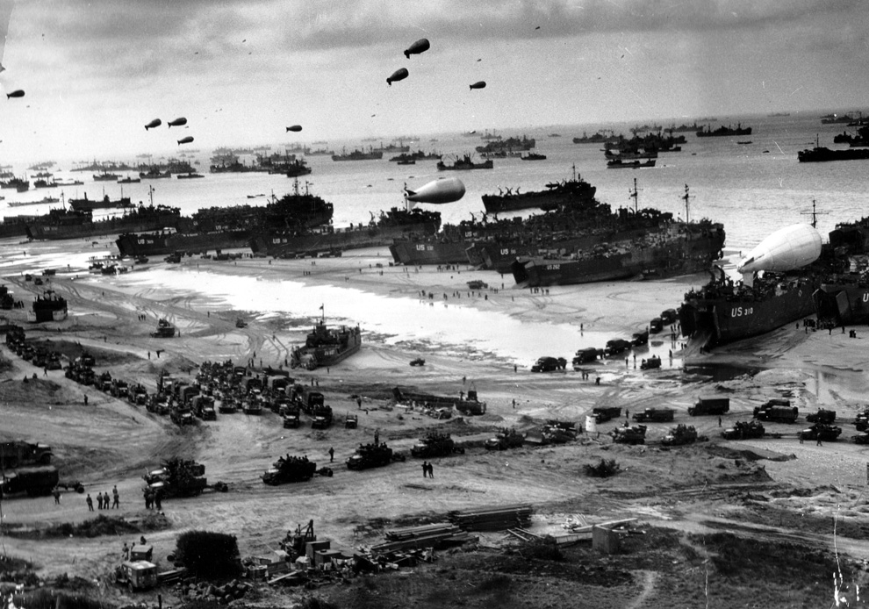
Logistics

Slide 24
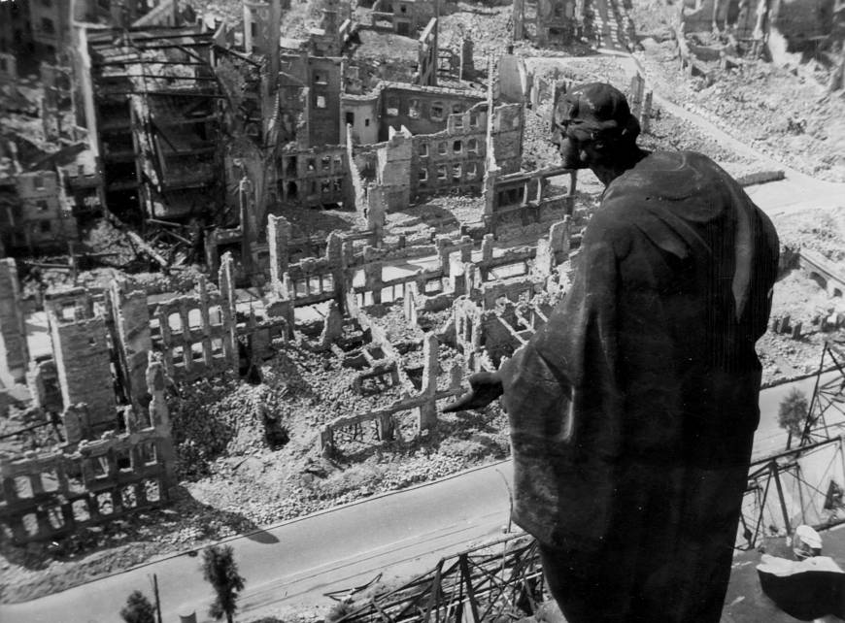
AERIAL BOMBING

Slide 25

DRESDEN

Slide 26
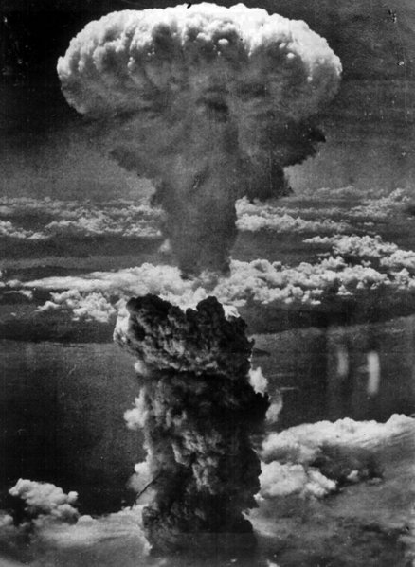
ATOM BOMB

Slide 27
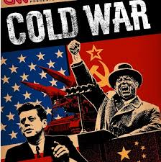
The Cold War

Slide 28
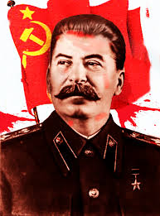
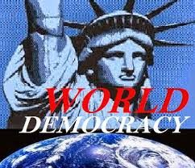
The Cold War – Two Blocs

Slide 29
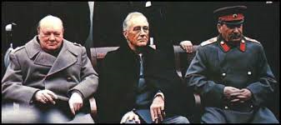
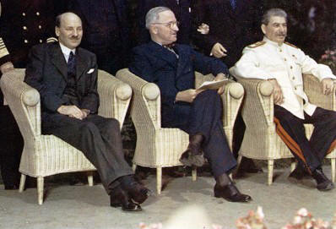
YALTA AND POTSDAM

Slide 30
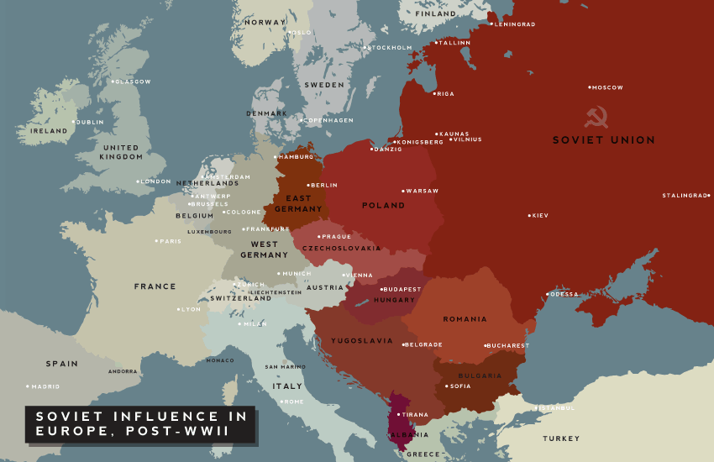
POST-WAR EUROPE

Slide 31
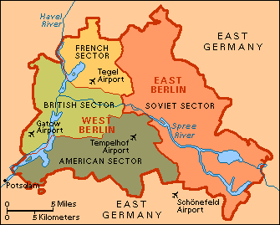
BERLIN

Slide 32
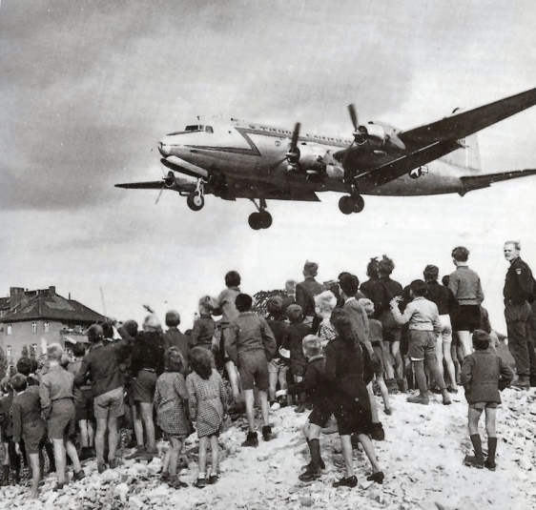
BERLIN AIRLIFT

Slide 33
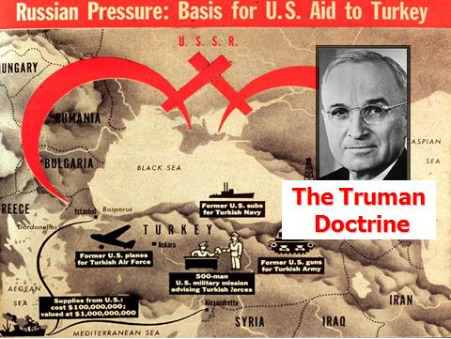
‘TRUMAN’DOCTRINE

