Slide 1
INTRODUCTION TO PHYSIOLOGY
(BMHP5003)
RESPIRATORY SYSTEM

Slide 2
OBJECTIVES OF THE LESSON
By the end of the lesson, students should be able to:
Outline the structure of the lungs
Describe the gaseous exchange pathway
Describe the mechanism of gaseous exchange in the thoracic cavity
Explain the relationship between the respiratory and the cardiovascular systems

Slide 3
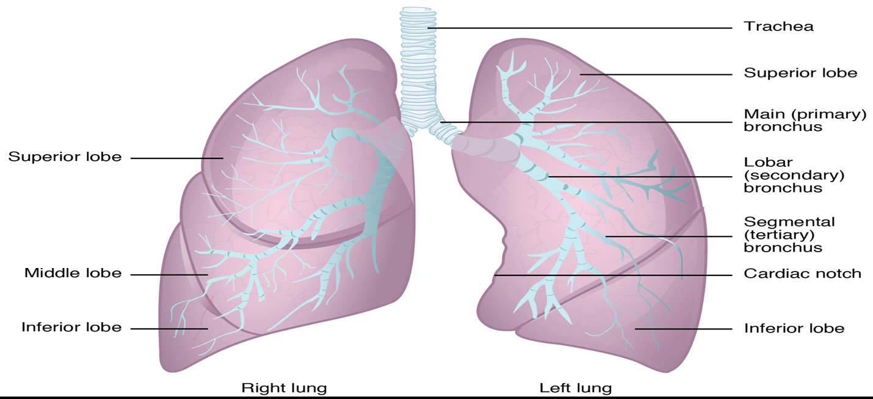
GROSS ANATOMY OF THE LUNGS
https://opentextbc.ca/anatomyandphysiology/

Slide 4
Task 1 – Condense this paragraph, keeping the most important parts to describe the respiratory system.
The main job of the respiratory system is to give oxygen to the blood in order for the blood to deliver oxygen to all parts of the body. The respiratory system does this through the process of breathing. When we breathe, we inhale oxygen (O2) and exhale carbon dioxide (CO2).
This exchange of gases is the respiratory system's way of getting rid of carbon dioxide from the blood and giving new oxygen to the blood.

Slide 5
Structure of the Lungs
The lungs are pyramid-shaped, paired organs that are connected to the trachea by the right and left bronchi.
On the lower surface, the lungs are bordered by the diaphragm.
The diaphragm is the flat, dome-shaped muscle located at the base of the lungs and thoracic cavity.
The right lung is shorter and wider than the left lung. and the left lung occupies a smaller volume than the right.
The cardiac notch is an indentation on the surface of the left lung, and it allows space for the heart.

Slide 6
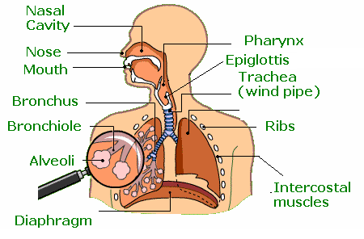
Main Structures

Slide 7
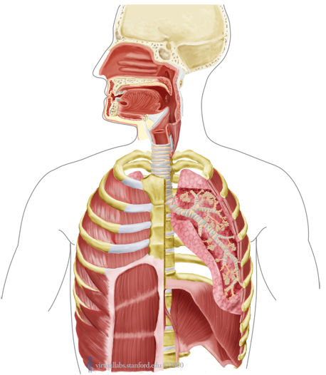
The passage of oxygen…..
Air is breathed in through the nose or mouth into the
nasal cavity.

Slide 8
Air then passes the pharynx or larynx otherwise know as the voice box, this is found in the throat.

Slide 9
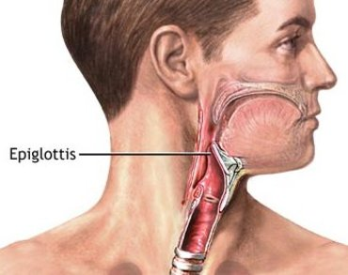
Air then passes the epiglottis, which is a flap of elastic cartilage covered. There are taste buds on the epiglottis, this helps stop food coming back up!

Slide 10
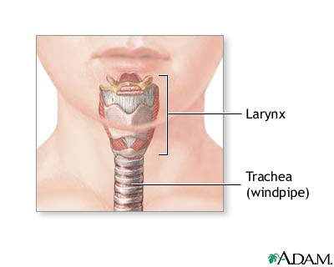
The air then passes down the trachea also know as the windpipe. (this is like the trunk of a tree)
This is a flexible tube held open by rings of cartilage.

Slide 11
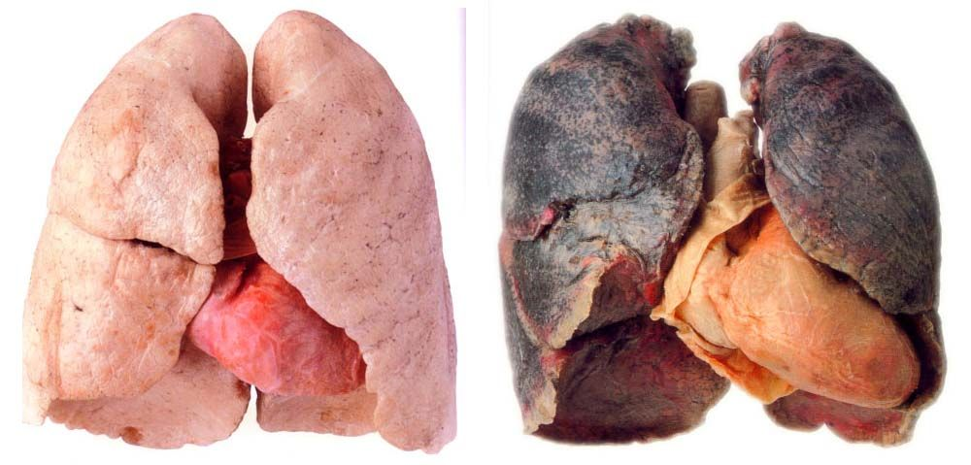
Once the windpipe reaches the lungs it splits in two. Air then passes down into the two thick tubes called the bronchi. (like the branches of a tree)

Slide 12
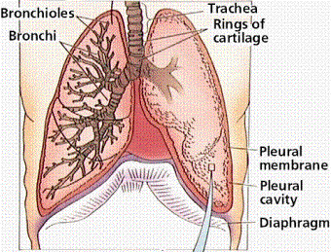
The air then goes into the smaller divisions called bronchioles (like twigs on a tree)

Slide 13
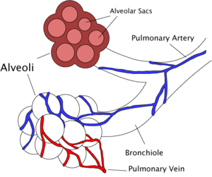
Connected to the end of bronchioles (the twigs of a tree) are tiny air sacs called Alveoli, they have thin walls so air can pass through them into the blood stream. They look like a bunch of grapes (these are like the leaves on a tree).
Mouth – lungs – blood- heart – blood - body

Slide 14
Tiny capillaries surround the alveoli and help in the gaseous exchange as you can see there are red ones (oxygenated) and blue ones (deoxygenated)
This is where the cardiovascular and respiratory system link together
There are over 600 million air sacks like these in your alveoli

Slide 15
The diaphragm is a sheet of muscle below the lungs.
As you inhale your diaphragm contracts and your chest cavity gets bigger to receive in oxygen, as you exhale you diaphragm relaxes and your chest cavity gets smaller forcing out the carbon dioxide out.

Slide 16
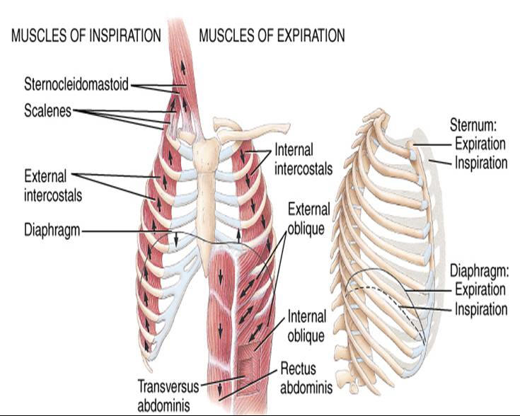
Intercostal muscles are a group of muscles that run between the ribs, and help form and move the chest wall.
The intercostal muscles are mainly involved in the mechanical aspect of breathing.

Slide 17
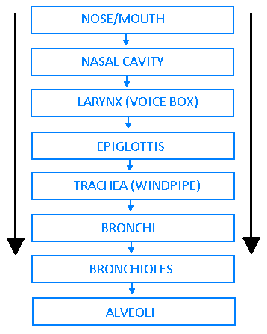
The passage of oxygen

Slide 18
LUNGS

Slide 19
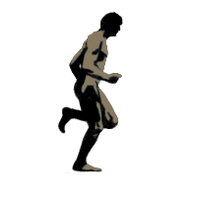
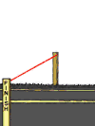
Function
The respiratory system is responsible for transporting oxygen from the air we breathe into our body.
We need the oxygen to produce energy for our organs and muscles to work (We need this to live!)

Slide 20
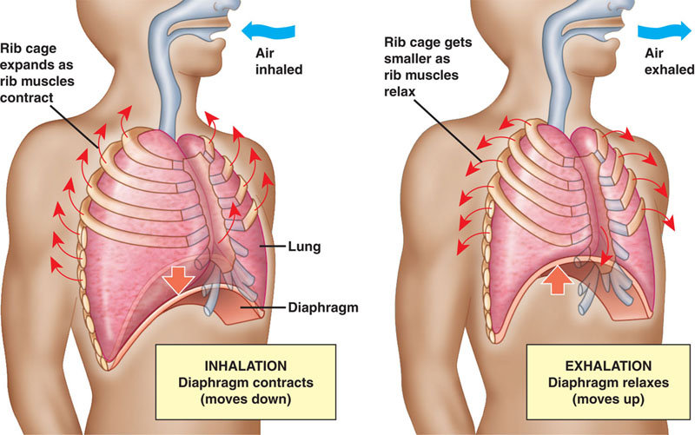
Mechanics of breathing

Slide 21
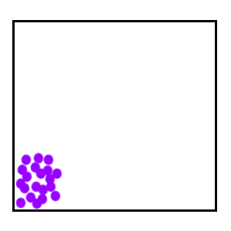
So what is Gaseous Exchange
Gaseous exchange is the process of oxygen and carbon dioxide moving between the lungs and the blood stream
Diffusion occurs when molecules move from an area of high concentration to and area of low concentration
http://www.bbc.co.uk/schools/gcsebitesize/science/add_aqa/cells/cells3.shtml
Gaseous exchange ^
When we breathe in, our lungs and alveoli fill with oxygen which need to be passed into the BLOOD for our muscles.
At this point carbon dioxide (deoxygenated blood) is switched with the oxygen in the alveoli as shown in the link above.
Diffusion →

Slide 22
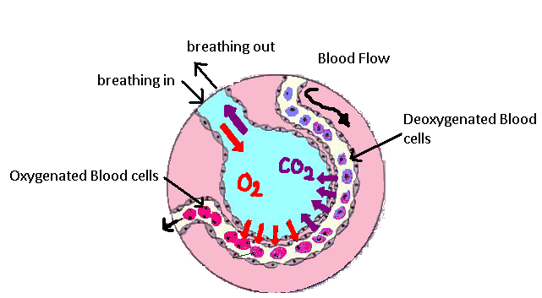
Synergy with Cardiovascular System
The cardiovascular system and respiratory system work together to supply the body with oxygen.
The respiratory system takes in oxygen from the air we breathe and begins gaseous exchange where oxygen and carbon dioxide are exchanged from the blood stream
Once it has entered the blood stream it then goes through the heart and is pumped all around the body to be used
When used, the blood cells become deoxygenated (CO2 rich) which is then pumped back up to the lungs to be exchanged for oxygen

Slide 23
DISCUSSION
Discuss the different pulmonary diseases and possible lifestyle interventions to reduce the risk of each of the conditions

Slide 24
VIDEO ON PULMONARY DISEASES
https://www.youtube.com/watch?v=-oHlcuS7AeU

