Slide 1
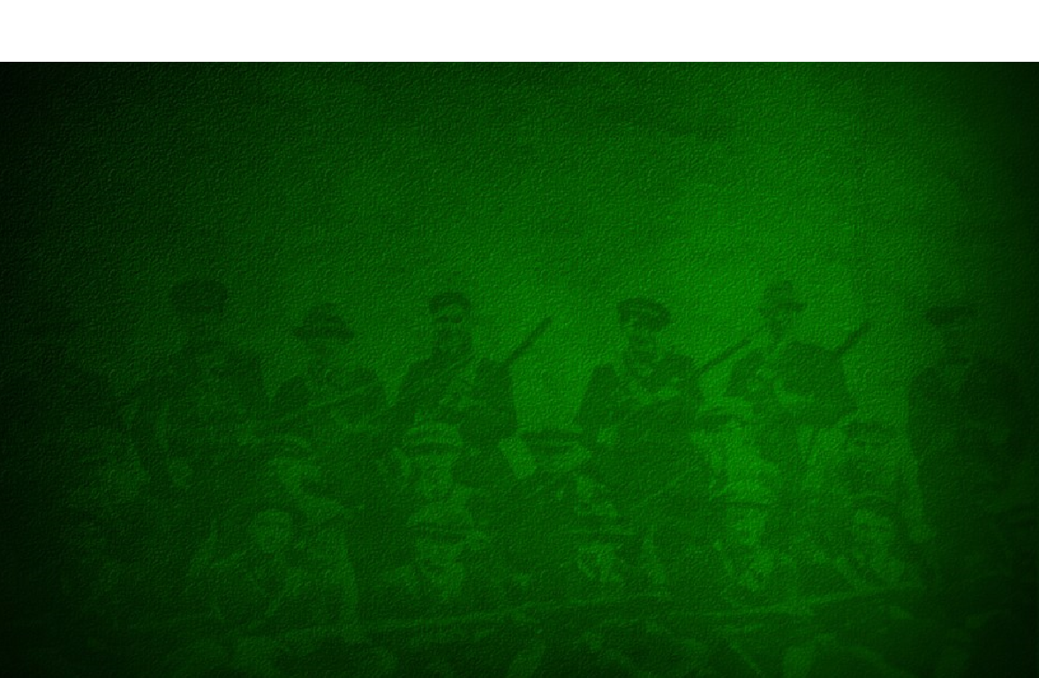
Hero or Sell-out?
Irish and British Opinions on Michael Collins during the Irish War of Independence, Irish Civil War and later periods.
HPHI6017
Declan Lennon
1703779
BA Modern Historical Studies

Slide 2
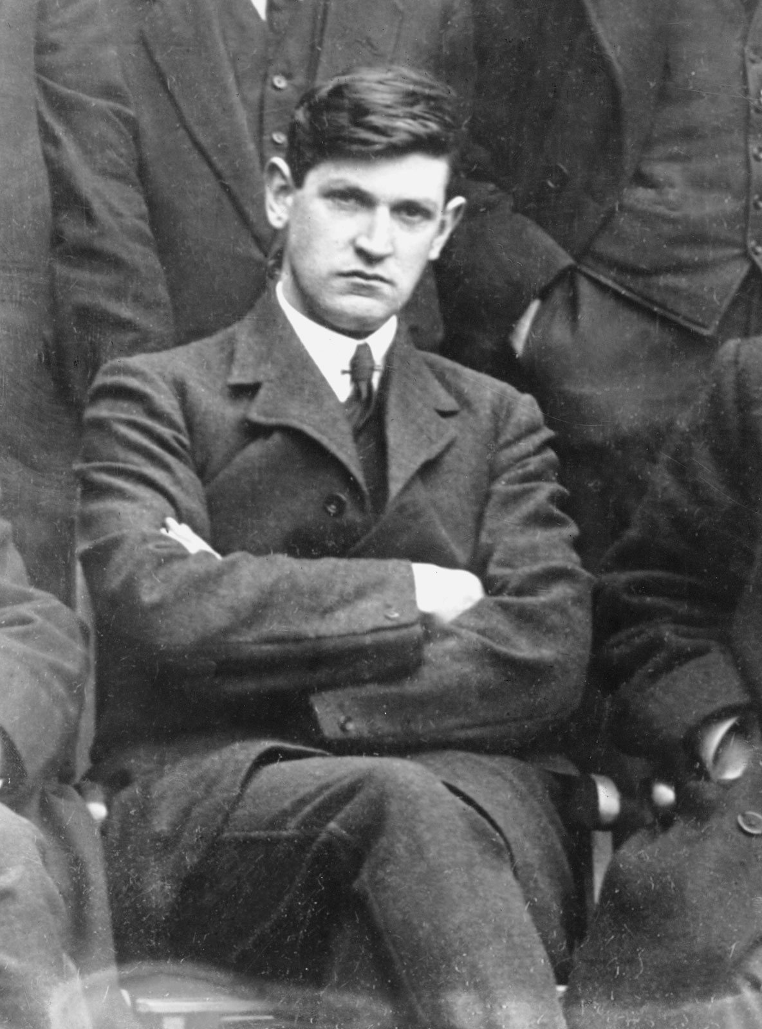
Aims & Objectives
To discover whether opinions from a British and Irish viewpoint on Michael Collins changed over the course of events in Ireland during the early 20th Century.
Fig. 1

Slide 3
Research Questions
What opinions were held regarding Collins during his life and career prior to the signing of the Anglo-Irish Treaty?
What opinions were held regarding Collins following the signing of the Anglo-Irish Treaty and immediately following his death?
Have contemporary opinions on Michael Collins altered in the modern era?

Slide 4
Why?
Work has been carried out regarding Collins’ military tactics and biography.
However, no work has been carried out in discussing whether Collins was deemed to be making the correct decision in signing the Anglo-Irish Treaty. No work has been carried out in seeing if opinions on signing the treaty have altered over the last 79 years.

Slide 5
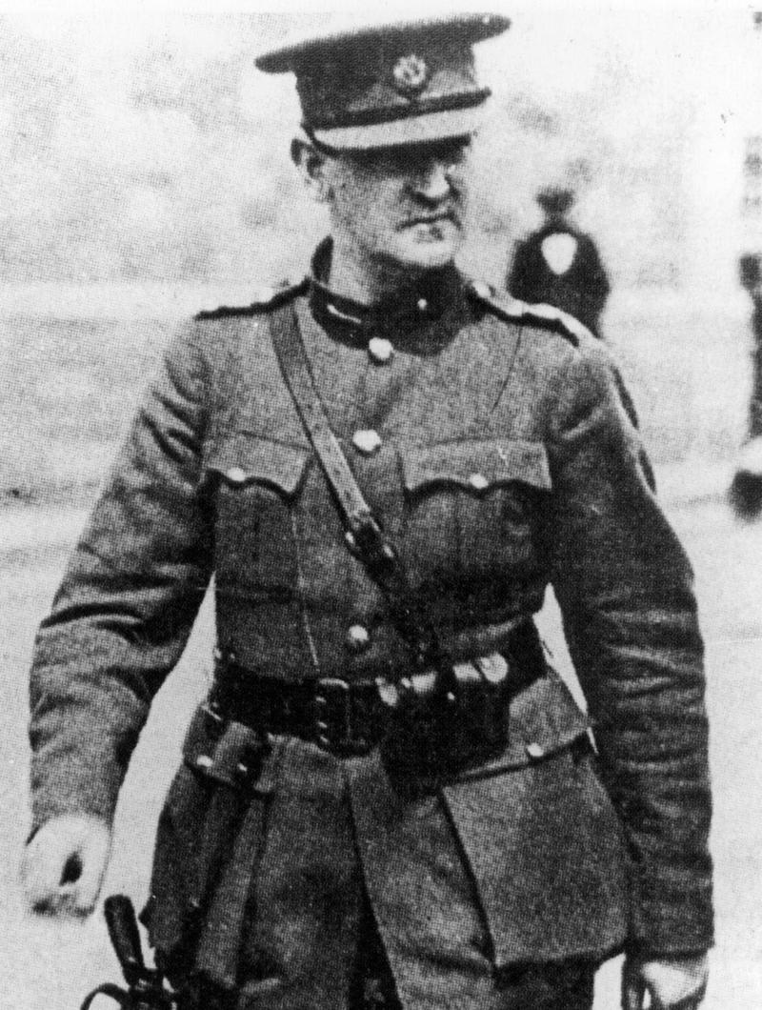
Beginning Research
Views on Michael Collins in media
  British Newspapers
  Irish Newspapers
  Documentaries
Fig. 2

Slide 6
Focussing Research
Viewing the content of Media and whether it held a particular nationalist agenda
  British Newspapers holding anti IRA/Republican views
  Divided opinions in Irish Newspapers depending on Loyalist/Republican allegiances
Focusing on individuals and their opinions on Collins and discussing if their opinions also fit into particular agendas
  Eamon De Valera, Winston Churchill, Arthur Griffiths.

Slide 7
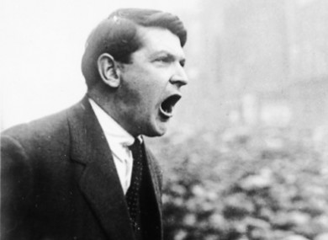
Sources
  Period Newspapers
  First Hand Accounts of Individuals
  Biographies
    Winston Churchill
    Eamon De Valera
    Michael Collins
  Documentaries
    Ireland: A Television History
    The Story of Ireland
  Diaries of Participants in Civil War and War of Independence
  Letters between individuals at the time.
Fig. 3

Slide 8
Findings so Far
During War of Independence
  Regarded by many politicians and civilians a hero who was beating the great power of the British.
Following treaty signing and during Civil war
  Division of opinion some felt he had sold out the Irish dream of an independent Ireland, some had felt he had brought peace to Ireland.
Following Collins’ death
  Despite differences in political policies mutual respect from British politicians for Collins
  Loyalist Irish Politicians felt that despite Collins negotiating the signing of the treaty being the incorrect decision he would be regarded in history books as hero.

Slide 9
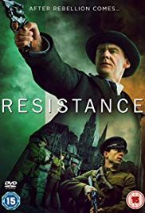
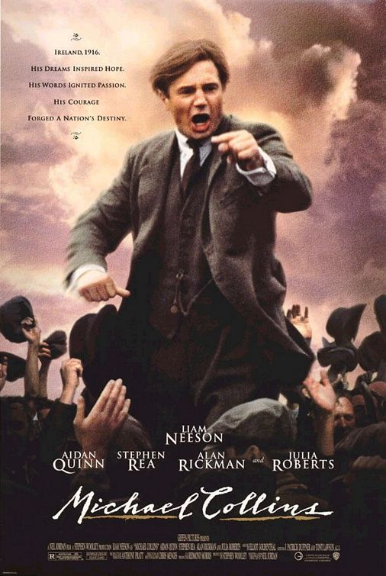
Popular Culture
Have the depictions of Collins in popular culture affected the opinions of Michael Collins in the modern era?
Fig. 4
Fig. 5

Slide 10
Conclusion
Research is suggesting that the expected outcomes are proving to be correct.
During war of independence Michael Collins was regarded as and influential member of the IRA and Sinn Fein
His belief that the fight for Irish freedom needed to be militarily fought rather than politically was mostly proving popular with the Irish public and politicians.
His military tactics and actions against the British during the War of Independence lifted Collins to Hero Status
Following the signing of the Anglo-IrishTreaty and Collins’ death politics surrounding Collins becomes increasingly complicated and divided.

Slide 11
References
BBC, Ireland: A Television History, 1981 https://www.youtube.com/watch?v=oCkxwROWYAQ&list=PL-NlJbmY3woh0SDUIy2ION2-DWyoz8oxY&index=9&t=0s [Accessed 15 October 2019].
Britishnewspaperarchive.co.uk, 2019 https://www.britishnewspaperarchive.co.uk [Accessed 15 October 2019].
Collins, Michael, The Path to Freedom (Cardiff, Welsh Academic Press, 1996).
Coogan, Tim Pat, De Valera: Long Fellow, Long Shadow (London, Arrow Books, 1995).
Coogan, Tim Pat, Michael Collins (London, Arrow Books, 2015).
English, Richard, Armed Struggle: The History of the IRA (Oxford, Pan Macmillan, 2004).
Furneaux Smith, Eleanor, Life’s a circus (New York, Doubleday, 1940).
Gilbert, Martin, Churchill: A Life (London, Heinemann, 1991).
Hart, Peter, British Intelligence in Ireland: 1920-21 (Cork, Cork University Press, 2003).
Hopkinson, Michael, The Irish War of Independence (Dublin, Gill & Macmillan Ltd, 2004).
Independent, ‘No wonder Michael was never caught: all the women wanted to hide him…’, independent.ie, 10 December 2011 https://www.independent.ie/lifestyle/no-wonder-michael-was-never-caught-all-the-women-wanted-to-hide-him-26801323.html [Accessed 1 February 2020].
Michael Collins, dir. By Neil Jordan (Warner Bros, 1996) [on DVD].
Moloney, Ed, A Secret History of the IRA (London, Penguin Press, 2002).
O’Connor, Ulick, Michael Collins and the Troubles (Edinburgh, Mainstream Publishing, 2007).
Rebellion, RTE One, 3 January 2016.
Resistance, RTE One, 6 January 2019.
RTE Archives, 2019 http://rte.ie/archives/ [Accessed 14 October 2019].
The National Archives, 2019 https://www.nationalarchives.gov.uk [Accessed 14 October 2019].
UCD Digital Library, 2019 http://digital.ucd.ie [Accessed 14 October 2019].
‘What If…Michael Collins had survived the war’, What If…, RTE Radio 1, 4 March 2007 http://www.timpatcoogan.com/media/what_if_michael_collins_had_survived_the_civil_war.htm [Accessed 15 October 2019].

Slide 12
List of Figures
Figure 1 – Editors, ‘Michael Collins’, Encyclopaedia Britannica, 9 January 2020 https://www.britannica.com/biography/Michael-Collins-Irish-statesman [Accessed 1 February 2020].
Figure 2 – Irish Times, ‘Memorial to Michael Collins unveiled on anniversary’, irishtimes.com, 22 August 2013 https://www.irishtimes.com/culture/heritage/memorial-to-michael-collins-unveiled-on-anniversary-1.1502160 [Accessed 31 January 2020].
Figure 3 – Hennessy, Michelle, ‘Michael Collins would not be happy with suggestions Ireland follow Britain out of EU’, thejournal.ie, 8 July 2017 https://www.thejournal.ie/michael-collins-brexit-3485219-Jul2017/ [Accessed 2 February 2020].
Figure 4 - Internet Movie Database, ‘Resistance’, IMDb.com https://www.imdb.com/title/tt9555104/ [Accessed 2 February 2020].
Figure 5 – IMP Awards, ‘Michael Collins (1996)’, impawards.com, 8 January 2003 http://www.impawards.com/1996/michael_collins.html [Accessed 4 February 2020].

