Slide 1
Welcome to
Developing Innovation and
Creativity for Business Advantage
(BMSWK6102)
Week 1 - Lecture 1

Slide 2

Introduction
Starting with ……
Get to know each other
BMSW 6102

Slide 3
Introduction
Learning Outcomes:
Critically reflect on the innovation concept;
Recognise, analyse and apply creative thinking at the individual, team, organisational and industry level;
Critically explore and differentiate between different models of innovation;
Critically assess characteristics of organisational knowledge and organisational knowing.
(UWTSD Module Descriptor, 2019)

Slide 4
Weekly Schedule
Week 1 | Introduction
Week 2 | Concepts & techniques of innovation & creativity
Week 3 | The process of innovation management and models
Week 4 | Innovation and product development
Week 5 | Digital revolution
Week 6 | Assignment preparation workshop
Week 7 | Disruptive innovations and innovation matrix
Week 8 | Innovation and growth open vs closed innovation
Week 9 | Workshop
Week 10 | Interview

Slide 5
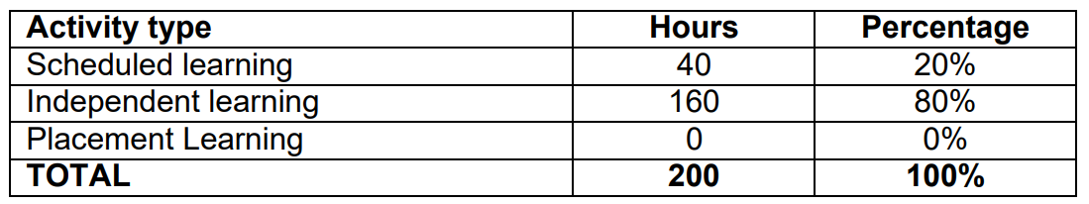
Learning and Teaching Strategy
The study time for the module is divided as follows:
Source: UWTSD Module Descriptor

Slide 6
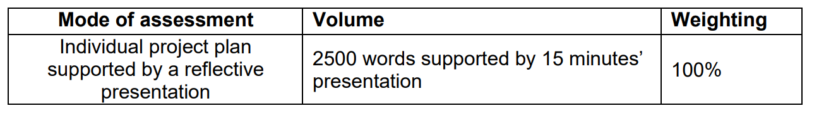
Module Assessments
Assessment Component
Source: UWTSD Module Descriptor

Slide 7
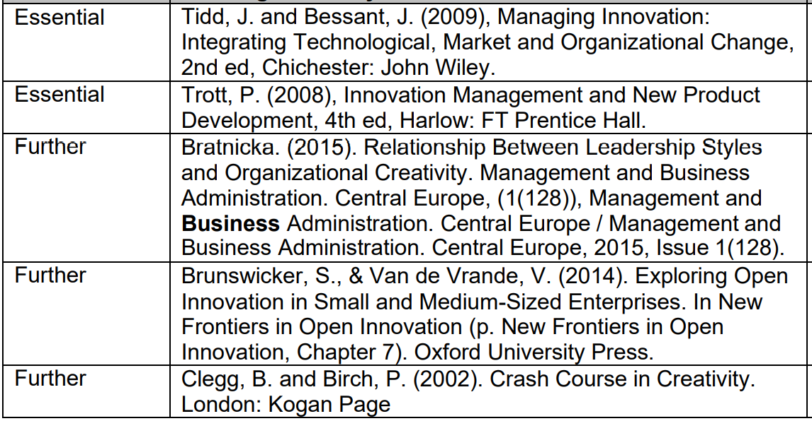
Reading List

Slide 8
Today’s Objective(s)
At the end of this session you will be able to:
Explain what this module is all about;
Define & understand what innovation is;
Assess the different types of innovation and the application within an organisation;
Analyse the drivers and sources of innovation;
New Conditions for Innovation
Understand relevant (Stage-Gate) model
Illustrate the conditions that promote and hinder innovation in the workplace

Slide 9
1. What is Innovation?
Innovation is the process and outcome of creating something new, which is also of value.
Innovation involves the whole process from opportunity identification, ideation or invention to development, prototyping, production marketing and sales, while entrepreneurship only needs to involve commercialisation (Schumpeter).

Slide 10
1. What is Innovation? (Contd...)
Schumpeter argued that innovation comes about through new combinations made by an entrepreneur, resulting in
  a new product,
  a new process,
  opening of new market,
  new way of organising the business
  new sources of supply.

Slide 11
2. Dimensions of Innovation
There are several types of innovation
  Process, product/service, strategy,
which can vary in degree of newness:
  Incremental to radical,
and impact:
  continuous to discontinuous

Slide 12
3. Drivers of Innovation
  Financial pressures to reduce costs, increase efficiency, do more with less, etc
  Increased competition
  Shorter product life cycles
  Value migration
  Stricter regulation
  Industry & community needs for sustainable development

Slide 13
3. Drivers of Innovation (Contd...)
  Increased demand for accountability
  Demographic, social and maket changes
  Rising customer expectations regarding service & quality
  Changing economy
  Exceeding in the competition in these technologies

Slide 14
4. Radical Business Innovation
Market place is hostile to incumbents, who now needs to conduct radical business innovation:
Radically reconceiving products and services, not just developing new products and services
Redefining market space
Redrawing industry boundaries.

Slide 15
Sources of Innovation
REGULATION: triggered or enabled by changes in legislation opening up new directions. Also entrepreneurs can take advantage of new legal restrictions.
DISRUPTIVE TECHNOLOGY: triggered or enabled by developments in technologies which can disrupt current markets.
RECOMBINANT INNOVATION: triggered or enabled by transferring an idea from one market or usage and apply it into another.
LEAD USERS: triggered or enabled by the demands of early, sophisticated users who contribute ideas. Their requirements are ahead of the general market of other users.

Slide 16
Sources of Innovation (Contd...)
OPEN / USER-LED INNOVATION: triggered or enabled by key or strategic users that create ideas – and often prototypes – for innovations rather than acting as consumers of other people’s ideas.
OPEN COLLECTIVE INNOVATION: triggered or enabled by co-creation amongst a wide range of users enabled by the internet and similar communication technologies.
BENCHMARKING: triggered or enabled by learning from other companies by systematic comparing products, services or processes with those from competing companies

Slide 17
New Developments in Innovation Raises New Issues and Problems
Greater emphasis on commercializing scientific discoveries, particularly in IT and the bio-sciences
Speed and potential value of scientific progress leads to emphasis on solid and well-designed portfolios of research projects
Universites as active drivers of innovation: Academic entrepreneurship and the entrepreneurial university
University-industry partnerships
Increased search for radical innovation and top-line growth.

Slide 18
Stage-Gate Model
Concept - Idea Generation
Considered against strategic fit, market need and decide which are worth exploring further.
Feasibility - Proof of Concept/Principle
Project to go into development based on market acceptability, achievability of technical requirements, risk/reward criteria, and the availability of resources
Development - Development, Prototyping and Testing
Progress to market based on the prototype, an assessment of the competitive response, and deliverable strategies on sourcing, marketing and pricing/ margins.
Implementation - Marketing and Launch
Notes:
Most businesses innovate without necessarily realising that they are doing it. Like all business processes, it is best carried out in a reasonably systematic fashion.
• The process starts with an idea and ends with successful and profitable sales. It is easiest to describe in a linear fashion, but in practice many activities often take place together, or in a different order, and may
require recycling. In general, the front end is more chaotic and the back end more defined.
• The “Stagegate”™ model breaks activity down into discrete linear units. Progression only occurs after satisfying certain criteria, designed to ensure that the investment is minimised in the early stages and if
necessary the project abandoned sooner rather than later. In this way a portfolio of projects in an “innovation pipeline” (sometimes called the innovation funnel because many initial ideas are refined down to only a
few market entry projects), can be created, with their progress matched to suit the available funding, resources and desired entry time into the market place. (Diagram D). ™ Robert Cooper
Typical stages in the pipeline are Concept, Feasibility, Development and Implementation. Between each stage are notional gates where the idea/project is assessed against selected criteria to determine whether to
progress it.

Slide 19
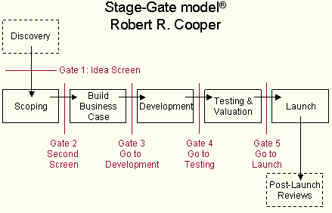
Stage-Gate Model Cooper, R.G. (2011)
Notes:
Each gate consists of cross functional activities which inputs the decision to move onto the next stage or not

Slide 20
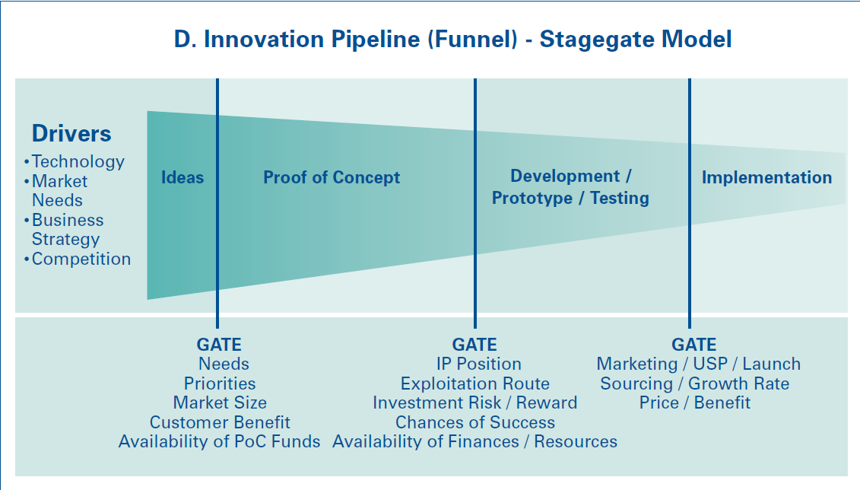
Innovation Pipeline (Funnel) Stage-Gate Model

Slide 21
Idea Screening
A good idea is not enough:
  it needs some degree of fit with the organization in terms of resources, capabilities, finances, structure and values.
  It must also fit with the external environment – the market, the needs of customers, relevant regulations and other relevant stakeholders.
Ideas need screening to ensure resources, finance, people structure, market demand and policies are existent

Slide 22
Idea Screening (Contd...)
Out of 100 or more ideas, may be 1 or 2 opportunities.
Superior business ideas have 4 anchors:
They create / add significant value to a customer;
They do so by solving a significant problem, or meeting a significant want or need, for which someone is willing to pay a premium.
They therefore have a robust market, profit margin, and moneymaking characteristics.
They are a good fit with the founder(s) and management team at the time and in the marketplace with a risk/reward balance.

Slide 23
Idea Screening: Offices of Innovation (Contd...)
They tend to be established in order to stimulate innovative ideas and are created in large organisations. They are sometimes known as discovery or innovation networks
An Office of Innovation usually comprises a decentralized network of innovation facilitators who seek out and attract other employees to offer ideas for innovations.

Slide 24
Idea Screening:
Patents and Suggestion Schemes (Contd...)
Patents / Intellectual Property Rights
Used to protect innovative ideas so that there is no commercial loss for the innovator.
Used to 'ward off' competitors
Suggestion Schemes & Customer Involvement
Means of tapping employers' ideas
Customer involvement and feedback
Incentive schemes

Slide 25
Key Features of Innovative Organisations
Flatter in structure and make use of multi-disciplinary workforce / project teams;
Faster and more flexible in terms of its responsiveness to business and change;
Constantly looking for incremental improvement;
Actively developing partnerships with customers, suppliers and competitors;
Advocates of parallel product development;
Patience with failure;
Keen to promote systems of incentives;
Advocates of R&D investment

Slide 26
Class Activity (30 minutes)
Identify the sources of innovation in your organisation (an organisation you work at or own) or in any organisation of your choice.

Slide 27
Class Discussion (30 minutes)
Discuss your findings with the rest of the class.

Slide 28
Class Discussion (30 minutes)
Disruptive Innovation:
Watch this video:
https://hbr.org/2015/12/what-is-disruptive-innovation

