Slide 1

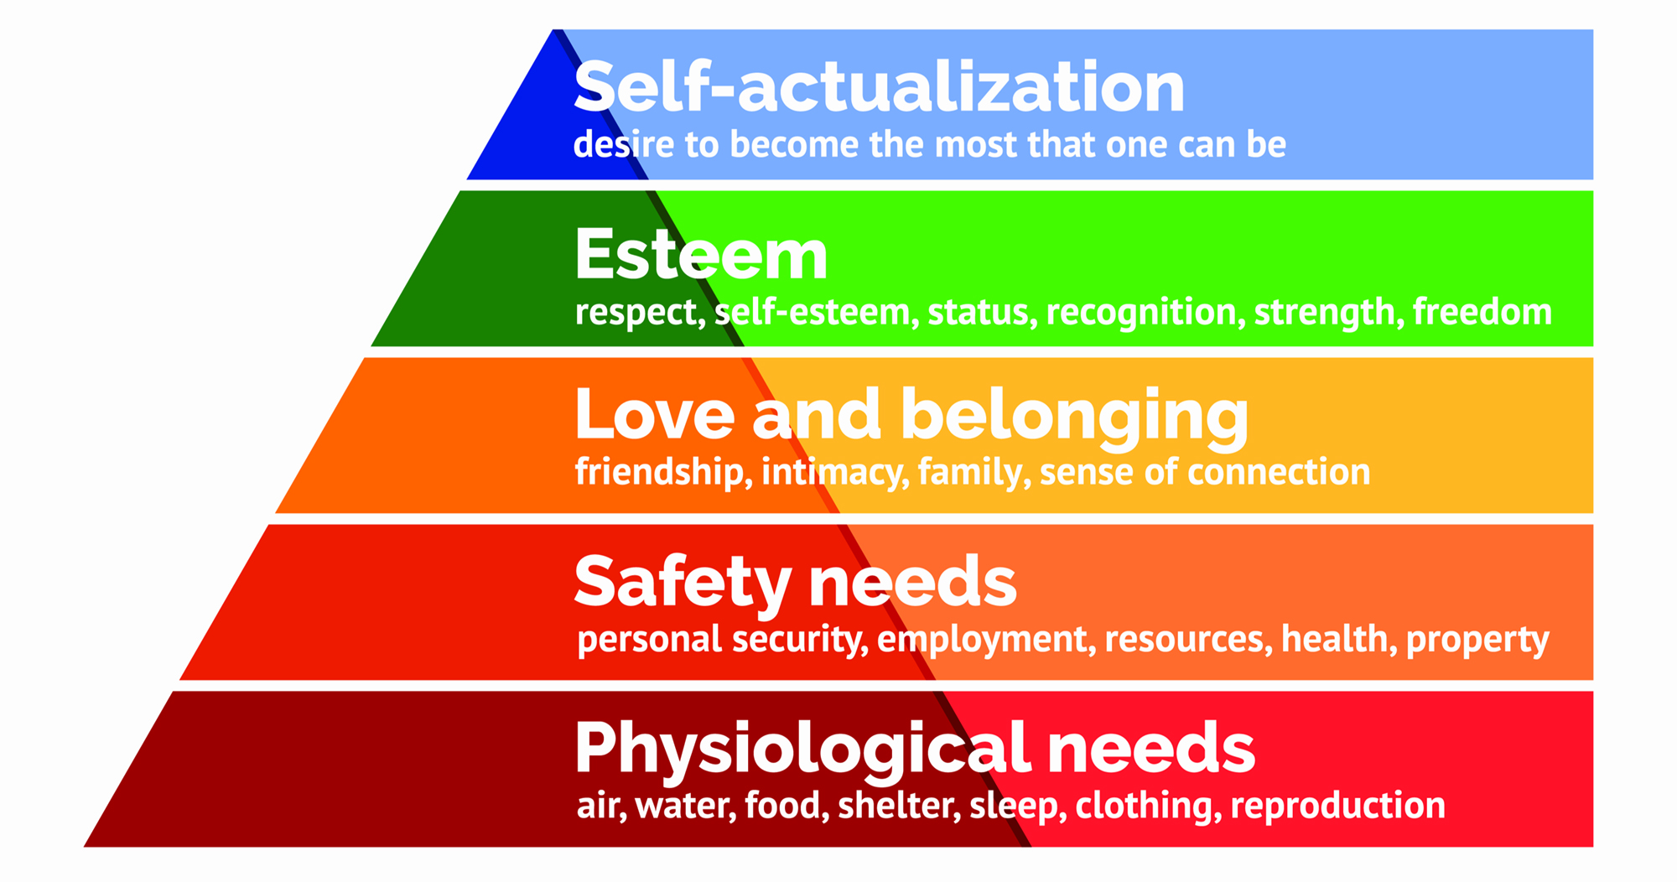
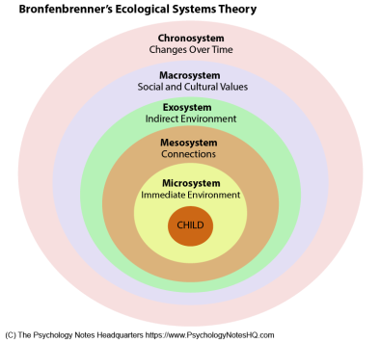
Types of Bullying
ST P
Cyber bullying
Verbal bullying
BULLYING
Physical bullying
A, B, C’S of bullying
Awareness- Be aware of the signs of bullying and how to support.
Bullying- Know the different types, the causes and the policies.
Consider- the best approach to support the individual(s) following policy guidelines.
“56% of young people said they have seen others be bullied online and 42% have felt unsafe online. Cyber bullying can happen 24 hours a day, 7 days a week and it can go viral very fast. “(Family Lives, 2017)
“Research from University of Warwick and Duke Medical Centre suggests that the long term impact of bullying may even be worse than that of child abuse “(Anti Bullying Alliance, 2017)
“70.6% of students report having witnessed
bullying in their school and over 71% say
bullying is a problem”(Loveless.B, 2017)
Help lines
Bullying UK :0808 800 22
22
Child line: 0800 1111
Bully Busters : 0800 169 6928
(McLoed, 2020)
(Evans,2020)

Slide 2
References
Anti Bullying Alliance . (2017). The Impact of Bullying . Available: https://www.anti-bullyingalliance.org.uk/tools-information/all-about-bullying/prevalence-and-impact/impact-bullying?gclid=EAIaIQobChMIwJvP7bWg7gIVF-ztCh0t7QKbEAAYAiAAEgLQ__D_BwE. Last accessed 15/1/2021.
Anti Bullying Policy (2015) – Setting A , location omitted to protect schools anonymity.
Evans.G. (2020). Bronfenbrenner's Ecological Systems Theory. Available: https://www.simplypsychology.org/Bronfenbrenner.html. Last accessed 15/1/2021.
Family Lives . (2017). What is Cyber Bullying?. Available: https://www.bullying.co.uk/cyberbullying/what-is-cyberbullying/. Last accessed 15/1/2021.
First Discoverers. (2020). Child Development Theories: Urie Bronfenbrenner. Available: https://www.firstdiscoverers.co.uk/child-development-theories-urie-bronfenbrenner/. Last accessed 15/1/2021.
Jennifer.D (2008). New Perspectives on Bullying . Berkshire: Open University Press. ..
Loveless.B. (2017). Bullying Epidemic: Facts, Statistics and Prevention. Available: https://www.educationcorner.com/bullying-facts-statistics-and-prevention.html. Last accessed 15/1/2021.
Mcloed.S. (2020). Maslow's Hierarchy of needs. Available: https://www.simplypsychology.org/maslow.html. Last accessed 15/1/2021.
National Centre Against Bullying . (2015). Types of Bullying . Available: https://www.ncab.org.au/bullying-advice/bullying-for-parents/types-of-bullying/. Last accessed 15/1/2021.
NSPCC. (2015). Bullying and cyber bullying. Available: https://www.nspcc.org.uk/what-is-child-abuse/types-of-abuse/bullying-and-cyberbullying/?gclsrc=aw.ds&&gclid=EAIaIQobChMI57-yucuh7gIVuWDmCh2PpgQIEAAYBCAAEgI7t_D_BwE&gclsrc=aw.ds. Last accessed 15/1/2021.
Save the children . (2011). The convention on the rights of the child. Available: https://www.savethechildren.org.uk/what-we-do/childrens-rights/united-nations-convention-of-the-rights-of-the-child. Last accessed 15/1/2021.
Welsh Government . (2019). Challenging bullying: rights, respect, equality. Available: https://gov.wales/sites/default/files/publications/2019-11/rights-respect-equality-guide-for-children.pdf. Last accessed 15/1/2021.

